Slide 1
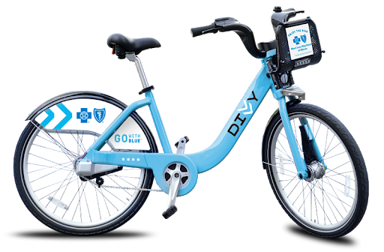




PROJECT TWO
PLANNING YOUR DIVVY TRIP
A WEBSITE FOR NAVIGATING CHICAGO BY DIVVY BICYCLE

Slide 2
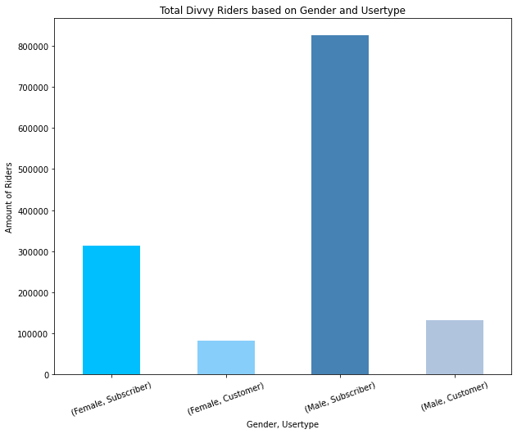
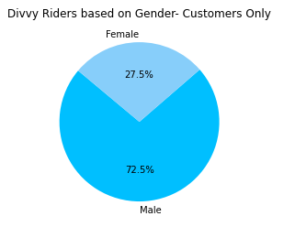
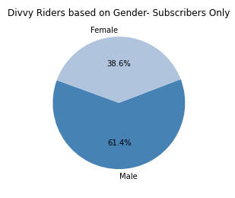
SUBSCRIPTIONS VS. CUSTOMER: GENDER
61%
MISADVENTURES IN DATA
23.1%
9.7%
6.1%

Slide 3
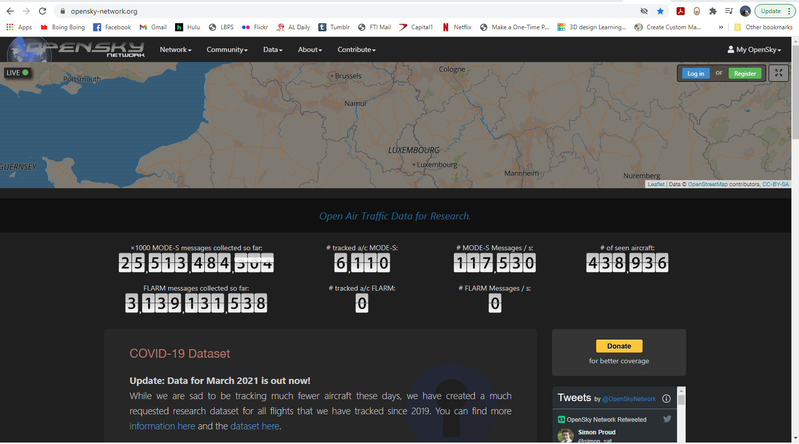
OPENSKY.ORG

Slide 4
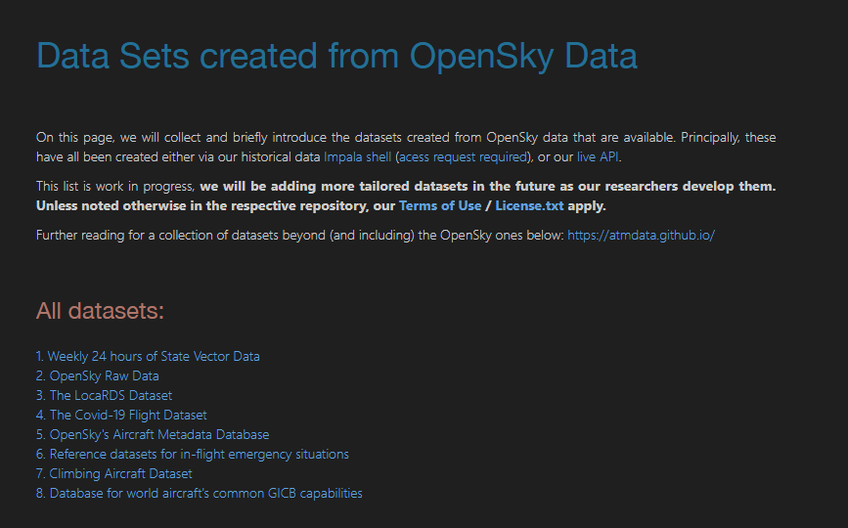
OPENSKY.ORG

Slide 5
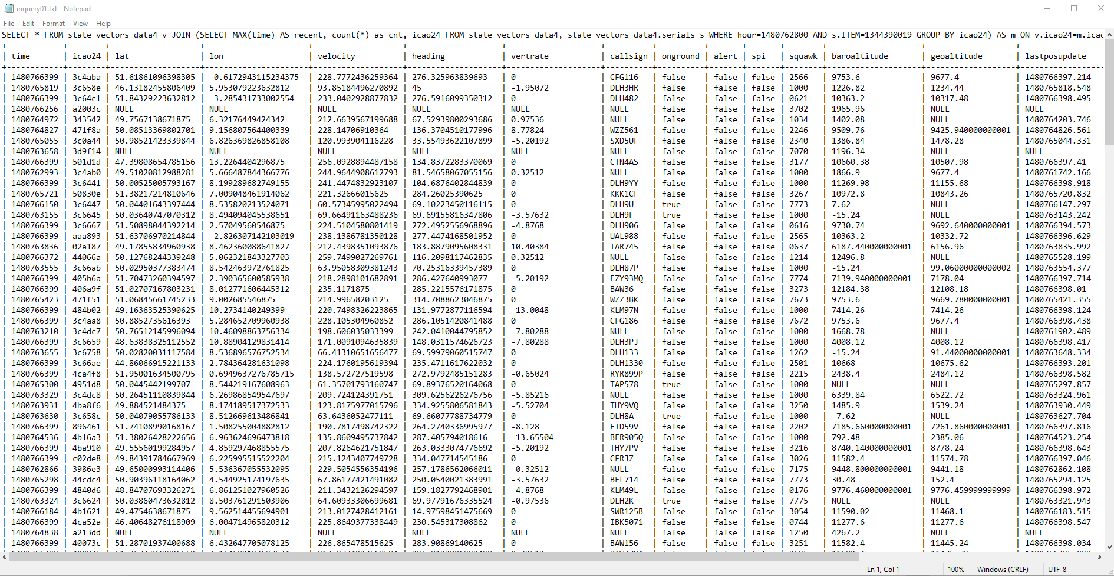
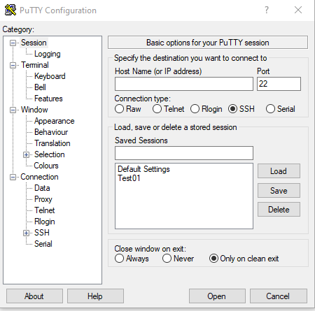
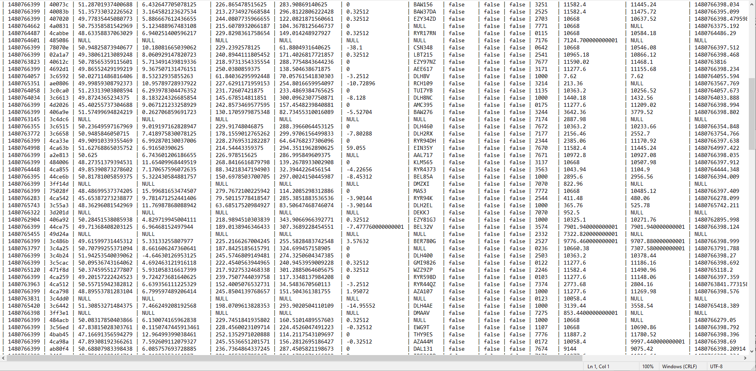
PuTTY QUERIES

Slide 6
PURPOSE OF OUR SITE

Slide 7
SUBSCRIPTIONS VS. CUSTOMER: GENDER
61%
PLANNING YOUR DIVVY TRIP
23.1%
9.7%
6.1%

Slide 8
THE SITE
1. BUILT A WEBSITE TO LOCATE AVAILABLE BIKES using live json api data available
2. marker cluster group visualization layers
3. Multiple layers showing electric and CLASSIC bikes
4. Popular bike routes visualized
5. Features Chicago landmarks
6. Searchable table using live data

Slide 9
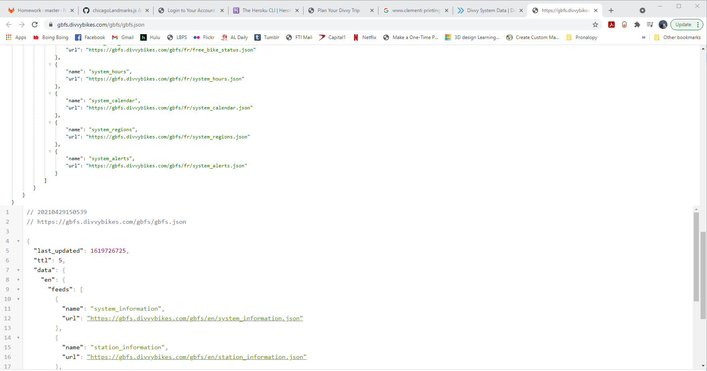
DATA SOURCE: GBFS.DIVVYBIKES.COM

Slide 10
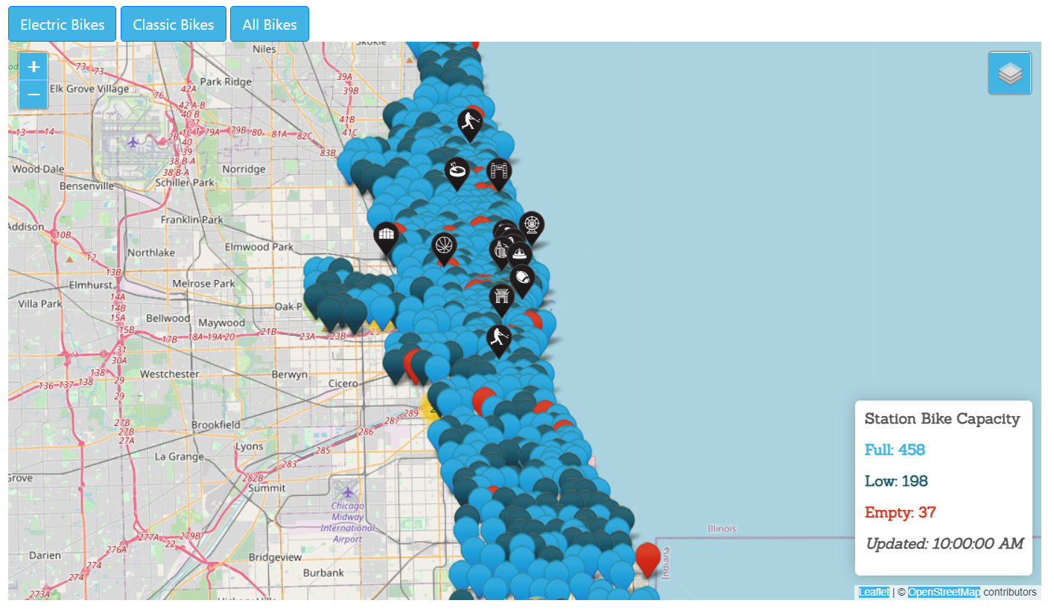
INITIAL VIEW

Slide 11
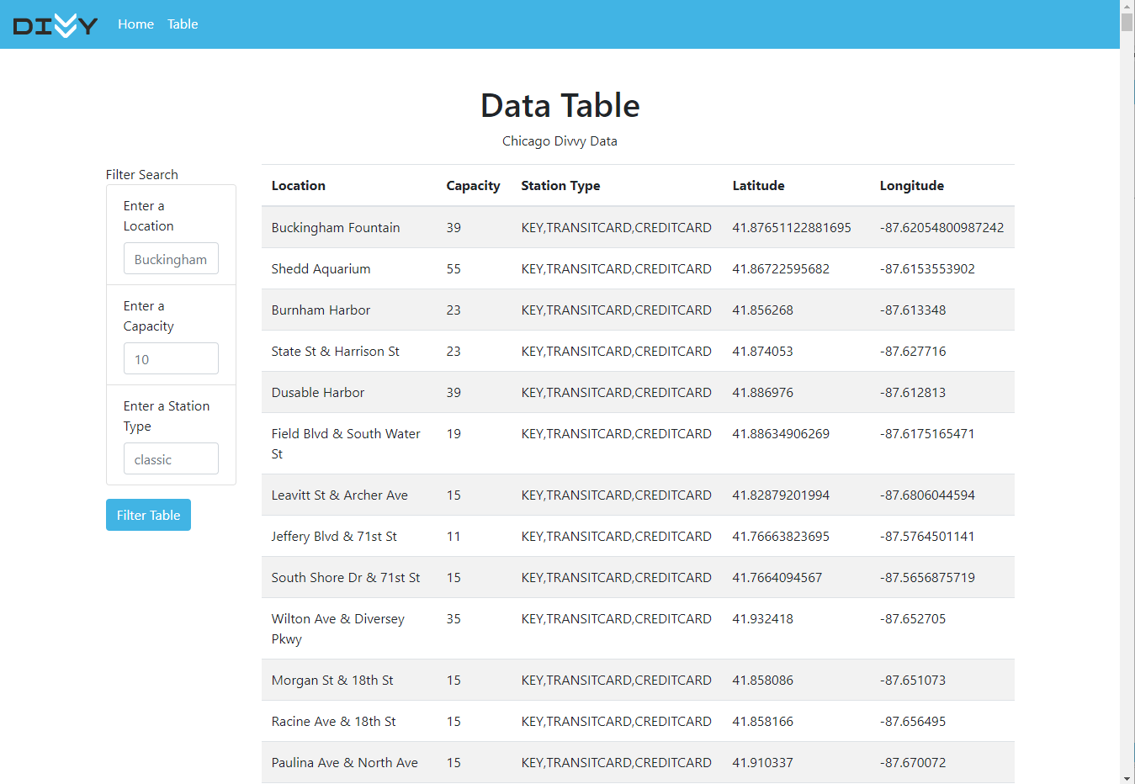
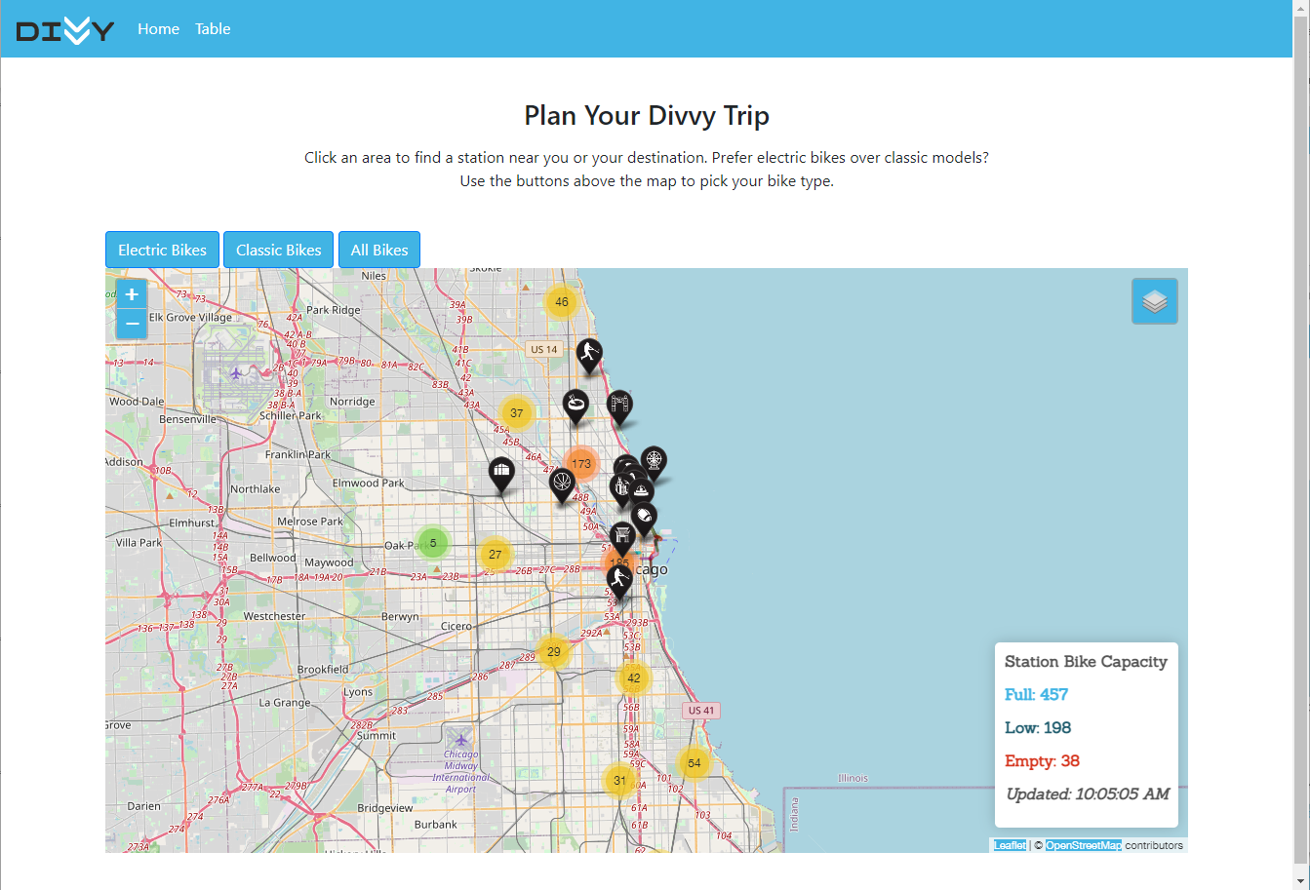
LANDING PAGE

Slide 12
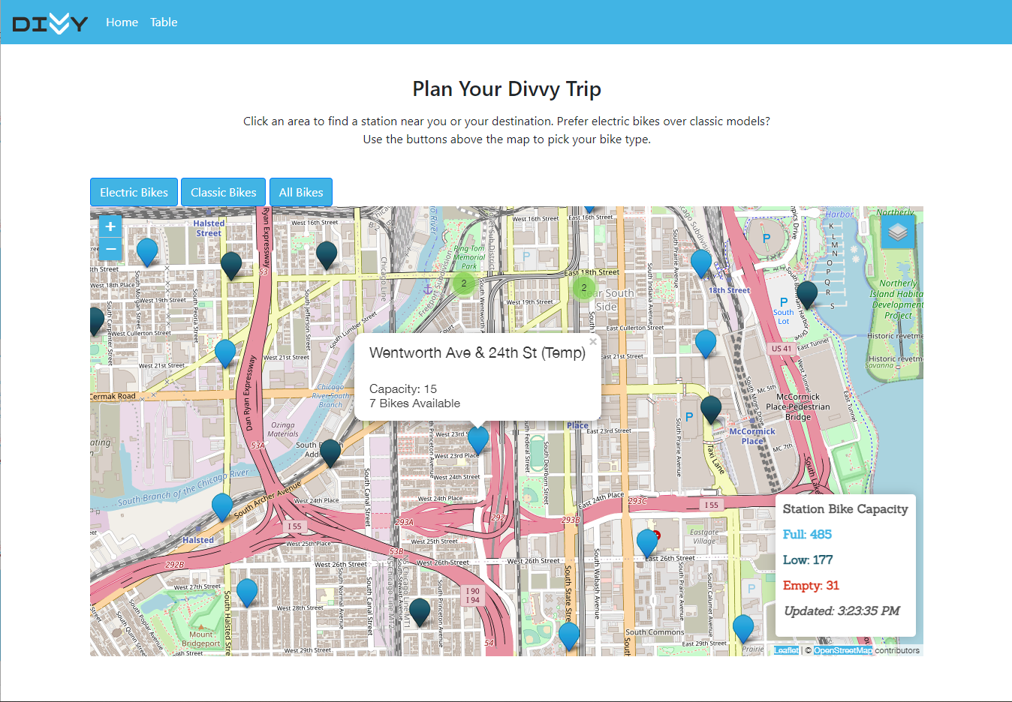
LIVE TABLE

Slide 13
THE SITE

Slide 14
TEAM OBSERVATIONS
1. GROUP EFFORT! COMMUNICATION AND CODING HANDOFFS WENT SMOOTHLY.
2. QUICKLY ADAPTING AND CHANGING COURSE BECAME NECESSARY AFTER OUR INITIAL IDEA WENT BUST.
3. GLOBAL BIKE FEED SPECIFICATION.

Slide 15
</>

