Slide 1
Atom Typing Color Nomenclature
Purple means IFF additions that are found
Blue means IFF additions that are not found
Green means CAN find atom type
Light Green means CAN find atom type, but possibly needs more logic
Orange means can not distinguish between atom type
Red means method CANNOT find atom type
Highlighted in grey means a user input to help find correct atom types
Black means could be switched out in the if/elif/else statements because of an overlap issue. System and user preference dependent.

Slide 2
Sp1 Carbon
ct 12.011150 C 2 Sp carbon involved in triple bond
1 cvff Sp Carbon

Slide 3
Sp1 Carbon
ct 12.01115 C 2 sp carbon involved in a triple bond
If ring_size == 0 and atom type == “C” and nb <= 2:
# Sp1 Carbon
nta[atom-id] = “ct”

Slide 4
Sp2 Carbon
13-cvff Sp2 Carbons
c+ 12.011150 C 3 C in guanidinium group
cr 12.011150 C 3 Carbon in guanidinium group (HN=C(NH2)2)
c- 12.011150 C 3 Carbon in charged carboxylate (COO-) group
c' 12.011150 C 3 Sp2 carbon in carbonyl (C=O) group
c* 12.011150 C 3 Carbon in carbonyl group, non_amides
c" 12.011150 C 3 Carbon in carbonyl group, non_amides
c5 12.011150 C 3 Sp2 aromatic carbon in five membered ring
cs 12.011150 C 3 Sp2 carbon involved in thiophene
cp 12.011150 C 3 Sp2 aromatic carbon (partial double bonds)
ci 12.011150 C 3 Aromatic carbon in a charged imidazole ring (HIS+)
c= 12.011150 C 3 Non-aromatic end doubly bonded carbon
c=1 12.011150 C 3 Non-aromatic, next to end doubly bonded carbon
c=2 12.011150 C 3 Non-aromatic doubly bonded carbon

Slide 5
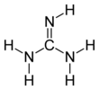
Sp2 Carbon “c+”
c+ 12.01115 C 3 C in guanidinium group
If atom type == ’C’ and nb == 3:
# Guanidinium group
If ring_size == 0 and formula == ’C1-H5-N3’:
nta[atom-id] = ’c+’
https://en.wikipedia.org/wiki/Guanidine

Slide 6
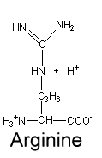

Sp2 Carbon “cr”
cr 12.01115 C 3 C in neutral arginine
If atom type == ’C’ and num of connects == 3:
# Arginine
elif ring_size == 0 and elements1.count(’C’) == 2 and elements1.count(’N’) == 1:
nta[atom-id] = ’cr’
elif ring_size == 0 and elements1.count(’N’) == 3:
nta[atom-id] = ’cr’
https://www2.chem.wisc.edu/deptfiles/genchem/netorial/modules/biomolecules/modules/protein1/prot14.htm#:~:text=There%20are%20three%20amino%20acids,%2C%20and%20histidine%20(His).&text=Their%20side%20chains%20have%20carboxylic,negatively%20charged%20in%20the%20process.
https://en.wikipedia.org/wiki/Arginine

Slide 7
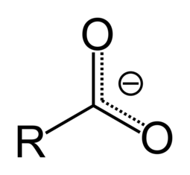
Sp2 Carbon “c-”
c- 12.01115 C 3 C in charged carboxylate
https://en.wikipedia.org/wiki/Carboxylate#:~:text=A%20carboxylate%20is%20the%20conjugate,or%20RCO2R%E2%80%B2
If atom type == ’C’ and nb == 3:
# Carboxylate
elif ring_size == 0 and elements1.count(’C’) == 1 and elements1.count(’O’) == 2:
if ring2 == 0 and ring3 == 0:
nta[atom-id] = ’c-’

Slide 8
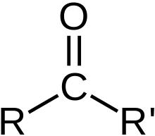
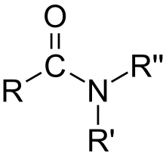
Sp2 Carbon “c*” or ‘ c” ‘
c* 12.011150 C 3 Carbon in carbonyl group, non_amides
c" 12.011150 C 3 Carbon in carbonyl group, non_amides
If atom type == ’C’ and nb == 3:
elif ring_size == 0 and elements1.count(’C’) == 1 and elements1.count(’O’) == 1 and nbs1[2] == 1:
nta[atom-id] = “ c* ”
Carbonyl
https://en.wikipedia.org/wiki/Carbonyl_group

Slide 9
Sp2 Carbon “c’”
c' 12.011150 C 3 Sp2 carbon in carbonyl (C=O) group
If atom type == ’C’ and nb == 3:
elif ring_size == 0 and elements1.count(’C’) >= 1 and elements1.count(’O’) == 1 and nbs1[2] == 1:
nta[atom-id] = “ c’ ”
Carbonyl
https://en.wikipedia.org/wiki/Carbonyl_group

Slide 10
Sp2 Carbon “c5”
c5 12.01115 C 3 sp2 aromatic carbon in 5-membered ring
If atom type == ’C’ and nb== 3:
# 5 Member Ring
elif ring_size == 5 and elements1.count(’S’) == 0:
nta[atom-id] = ’c5’

Slide 11
Sp2 Carbon “cs”
cs 12.01115 C 3 sp2 aromatic carbon in 5 membered ring next to S
If atom type == ’C’ and nb== 3:
# 5 Member Ring
elif ring_size == 5 and elements1.count(’S’) > 0:
nta[atom-id] = ’cs’

Slide 12
Sp2 Carbon “cp”
cp 12.01115 C 3 sp2 aromatic carbon
If atom type == ’C’ and nb == 3:
# 6 Member Ring
elif ring_size == 6 and not use_graphene_types:
nta[atom-id] = ’cp’
elif ring_size == 6 and rings1.count(6) <= 2:
nta[atom-id] = ’cp’

Slide 13
Sp3 Carbon
c3h 12.011150 C 4 Sp3 carbon in 3-membered ring with hydrogens
c3m 12.011150 C 4 Sp3 carbon in 3-membered ring
c4h 12.011150 C 4 Sp3 carbon in 4-membered ring with hydrogens
c4m 12.011150 C 4 Sp3 carbon in 4-membered ring
ca 12.011150 C 4 General amino acid alpha carbon (sp3)
cg 12.011150 C 4 Sp3 alpha carbon in glycine
co 12.011150 C 4 Sp3 carbon in acetals
coh 12.011150 C 4 Sp3 carbon in acetals with hydrogen
cn 12.011150 C 4 Sp3 Carbon bonded to N
c1 12.011150 C 4 Sp3 carbon bonded to 1 H, 3 Heavy atoms
c2 12.011150 C 4 Sp3 carbon bonded to 2 H's, 2 heavy atoms
c3 12.011150 C 4 Sp3 carbon in methyl (CH3) group
c 12.011150 C 4 Sp3 aliphatic carbon
c$ 12.011150 C 4 Carbon atom for automatic parameter assignment
ce1 12.011150 C 4 Carbon atom in backbone or terminal group in PEO
15 cvff Sp3 Carbons

Slide 14
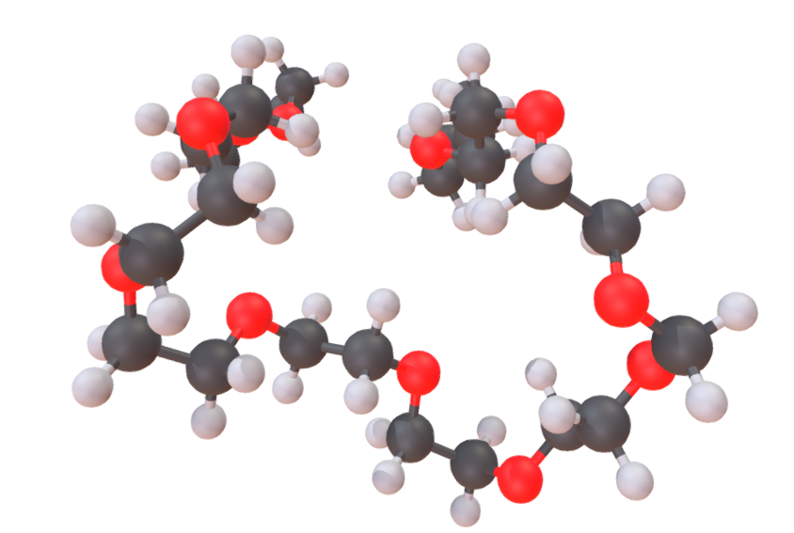
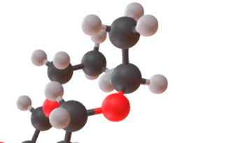

Sp3 Carbon “ce1” CODE FUNCTION
ce1 12.01115 C 4 Carbon atom in backbone or terminal group in PEO
If atom type == ‘C’ and num of connects == 4:
# ce1 12.01115 C 4 Carbon atom in backbone or terminal group in PEO
elif ring_size == 0 and type1 == ’C’ and type2 = ’H’ and type3 == ’H’ or type4 == ’O’:
nta[atom-id] = ’ce1’
https://en.wikipedia.org/wiki/Polyethylene_glycol
https://sketchfab.com/3d-models/polyethylene-glycol-peg-3b9fee27f4de4b34ba0c434c154ccca9

Slide 15
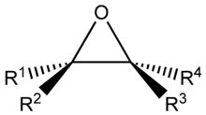
Sp3 Carbon “c3h”
c3h 12.01115 C 4 sp3 carbon in 3-membered ring with hydrogens
If atom type == ’C’ and num of connects == 4 :
# c3h
if ring_size == 3 and ’H’ in elements1:
nta[atom-id] = ’c3h’
https://en.wikipedia.org/wiki/Epoxide

Slide 16
Sp3 Carbon “c3m”
c3m 12.01115 C 4 sp3 carbon in 3-membered ring
If atom type == ’C’ and num of connects == 4 :
# c3h
elif ring_size == 3:
nta[atom-id] = ’c3m’
https://en.wikipedia.org/wiki/Epoxide

Slide 17
Sp3 Carbon “c4h”
c4h 12.01115 C 4 sp3 carbon in 4-membered ring with hydrogens
If atom type == ’C’ and num of connects == 4 :
# c4h
elif ring_size == 4 and ’H’ in elements1:
nta[atom-id] = ’c4h’

Slide 18
Sp3 Carbon “c4m”
c4m 12.01115 C 4 sp3 carbon in 4-membered ring
If atom type == ’C’ and num of connects == 4 :
# c4h
elif ring_size == 4:
nta[atom-id] = ’c4m’

Slide 19
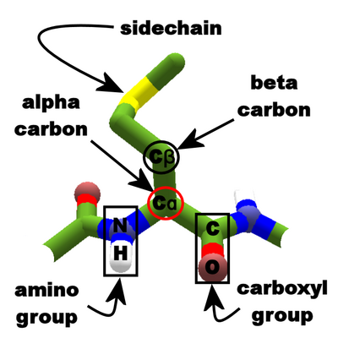
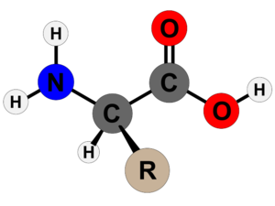
Sp3 Carbon “ca”
https://en.wikipedia.org/wiki/Amino_acid
https://foldit.fandom.com/wiki/Alpha_carbon
ca 12.011150 C 4 General amino acid alpha carbon (sp3)
If atom type == ’C’ and num of connects == 4:
# alpha carbon in amino acid
elif ring_size == 0 and elements1.count(’C’) == 2 and elements1.count(’H’) == 1 and elements1.count(’N’) == 1 : nta[atom-id] = ’ca’

Slide 20


Sp3 Carbon “cg”
cg 12.01115 C 4 sp3 alpha carbon in glycine
If atom type == ’C’ and num of connects == 4:
# carbon in glycine
elif ring_size == 0 and formula == ’C2-H5-N1-O2’:
nta[atom-id] = ’cg’
https://en.wikipedia.org/wiki/Glycine

Slide 21
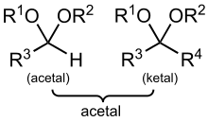
Sp3 Carbon “co”
co 12.01115 C 4 sp3 carbon in acetals
If atom type == ’C’ and num of connects == 4:
# ketals
elif ring_size == 0 and elements1.count(’C’) == 2 and elements1.count(’O’) == 2:
nta[atom-id] = ’co’
https://en.wikipedia.org/wiki/Acetal

Slide 22
Sp3 Carbon “coh”
coh 12.01115 C 4 sp3 carbon in acetals with hydrogen
If atom type == “C” and num of connects == 4:
# acetals
elif ring_size == 0 and elements1.count(’C’) == 1 and elements1.count(’O’) == 2 and elements1.count(’H’) == 1:
nta[atom-id] = ’coh’
https://en.wikipedia.org/wiki/Acetal

Slide 23
Sp3 Carbon “cn”
cn 12.011150 C 4 Sp3 Carbon bonded to N
If atom type == ‘C’ and num of connects == 4:
elif elements1.count(’N’) >= 1:
nta[atom-id] = ’cn’

Slide 24
Sp3 Carbon “c1”
c1 12.01115 C 4 sp3 carbon with 1 H 3 heavies
If atom type == ‘C’ and num of connects == 4:
# c1 12.01115 C 4 sp3 carbon with 1 H 3 heavies
elif elements1.count(’H’) == 1 and count_heavies(elements1) == 3:
nta[atom-id] = ’c1’

Slide 25
Sp3 Carbon “c2”
c2 12.01115 C 4 sp3 carbon with 2 H's, 2 Heavy’s
If atom type == ‘C’ and num of connects == 4:
# c2 12.01115 C 4 sp3 carbon with 2 H's, 2 Heavy’s
elif elements1.count(’H’) == 2 and count_heavies(elements1) == 2:
nta[atom-id] = ’c2’

Slide 26
Sp3 Carbon “c3”
c3 12.01115 C 4 sp3 carbon with 3 hHs 1 heavy
If atom type == ‘C’ and num of connects == 4:
# c3 12.01115 C 4 sp3 carbon with 3 hHs 1 heavy
elif elements1.count(’H’) == 3 and count_heavies(elements1) == 1:
nta[atom-id] = ’c3’

Slide 27
Hydrogen
13 cvff Hydrogens
hi 1.007970 H 1 Hydrogen in charged imidazole ring
hc 1.007970 H 1 Hydrogen bonded to carbon
h 1.007970 H 1 Hydrogen bonded to C. Masses from CRC 1973/74 pages B-250.
ho 1.007970 H 1 Hydrogen bonded to O
hn 1.007970 H 1 Hydrogen bonded to N
hw 1.007970 H 1 Hydrogen in water molecule
h* 1.007970 H 1 Hydrogen in water molecule
hspc 1.007970 H 1 Hydrogen in SPC water molecule
htip 1.007970 H 1 Hydrogen in TIP water molecule
hs 1.007970 H 1 Hydrogen bonded to S
hp 1.007970 H 1 Hydrogen bonded to P
h$ 1.007970 H 1 Hydrogen atom for automatic parameter assignment
h+ 1.007970 H 1 Charged hydrogen in cations
ha1 1.007970 H 1 Hydrogen atom in terminal OH group in PEO (+0.4)
he1 1.007970 H 1 Hydrogen atom in backbone or terminal group in PEO
hop 1.00800 H 1 Hydrogen atom in hydrogenphosphate and in hydroxide ion in apatite (+0.4 and +0.2)
ht5 1.00797 H 1 Hydrogen atom in TIP5P water model

Slide 28
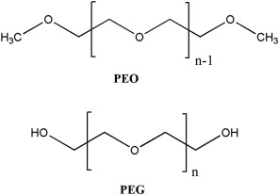
Hydrogen “he1” CODE FUNCTION
he1 1.00797 H 1 Hydrogen atom in backbone or terminal group in PEO
# he1 1.00797 H 1 Hydrogen atom in backbone or terminal group in PEO
elif type1 == ’C’ and ring1 == 0 and len(neigh_2nd_list) == 2 and count_2ndneigh_elemring(neigh_2nd_list, ’C’, 0) == 1 and count_2ndneigh_elemring(neigh_2nd_list, ’O’, 0) == 1:
nta[atom-id] = ’he1’
https://en.wikipedia.org/wiki/Polyethylene_glycol
https://sketchfab.com/3d-models/polyethylene-glycol-peg-3b9fee27f4de4b34ba0c434c154ccca9
https://www.sciencedirect.com/topics/materials-science/polyethylene-glycol

Slide 29
Hydrogen “ha1” CODE FUNCTION
ha1 1.00797 H 1 Hydrogen atom in terminal OH group in PEO (+0.4)
# he1 1.00797 H 1 Hydrogen atom in backbone or terminal group in PEO
elif type1 == ’O’ and ring1 == 0 and len(neigh_2nd_list) == 1 and count_2ndneigh_elemring(neigh_2nd_list, ’C’, 0) == 1:
nta[atom-id] = ’he1’
https://en.wikipedia.org/wiki/Polyethylene_glycol
https://sketchfab.com/3d-models/polyethylene-glycol-peg-3b9fee27f4de4b34ba0c434c154ccca9
https://www.sciencedirect.com/topics/materials-science/polyethylene-glycol

Slide 30
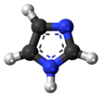
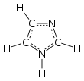
Hydrogen “hi”
hi 1.00797 H 1 Hydrogen in charged imidazole ring
If atom type == ‘H’ and num of connects == 1:
if rings1.count(5) > 0 and count_neigh_info(neigh2, element=‘N’, ring= 5, nb= False) > 0 and formula == ‘C3-H4-N2’:
nta[atom-id] = ’hi’

Slide 31
Hydrogen “hc”
hc 1.00797 H 1 hydrogen bonded to carbon
If atom type == ‘H’ and num of connects == 1:
# bonded to C
if elements1[0] == ’C’:
nta[atom-id] = ’hc’

Slide 32
Hydrogen “hw”
hw 1.00797 H 1 hydrogen in water (+0.41 in this model !)
hspc 1.007970 H 1 Hydrogen in SPC water molecule
htip 1.007970 H 1 Hydrogen in TIP water molecule
If atom type == ‘H’ and num of connects == 1:
elif formula[atom-id] == ’H2-O1’:
nta[atom-id] = ’hw’

Slide 33
Hydrogen “ho”
ho 1.00797 H 1 hydrogen bonded to oxygen
If atom type == ‘H’ and num of connects == 1:
elif type1 == ’O’:
nta[atom-id] = ’ho’

Slide 34
Oxygen 1 Connects
o' 15.999400 O 1 Oxygen in carbonyl (C=O) group
o- 15.999400 O 1 Oxygen in charged carboxylate (COO-) group
oz 15.999400 O 1 Oxygen in Zeolite
oc1 15.99940 O 1 Oxygen atom silicate ion in Ca3SiO5 (-1.0)
oc2 15.99940 O 0 Oxide ion in Ca3SiO5 (-1.5)
oc4 15.99940 O 1 Oxygen atom in apical position in Ca3Al2O6 (-1.35)
oap1 15.99940 O 1 Oxygen atom in (hydrogen)phosphate ion in hydroxyapatite (-0.8 to -0.6)
oap2 15.99940 O 1 Oxygen atom in hydroxide ion in hydroxyapatite (-1.1)
3 cvff 1-Connect Oxygens

Slide 35

1-Connect Oxygen “ o’ ” and “ o- ”
o' 15.999400 O 1 Oxygen in carbonyl (C=O) group
o- 15.999400 O 1 Oxygen in charged carboxylate (COO-) group
If atom type == “O” and num of connects == 1:
# o' 15.999400 O 1 Oxygen in carbonyl (C=O) group
if type1 == ’C’ and ring1 = 0 and ’C’ in neigh_2nd_list:
nta[atom-id] = “ o’ ’
# o- 15.999400 O 1 Oxygen in charged carboxylate (COO-) group
if type1 == ’C’ and ring1 = 0 and ’O’ in neigh_2nd_list:
nta[atom-id] = ’o-’
Carbonyl
Carboxylate (COO-)

Slide 36
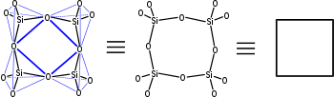
1-Connect Oxygen “ oz ”
oz 15.999400 O 1 Oxygen in Zeolite
If atom type == “O” and num of connects == 1:
# o' 15.999400 O 1 Oxygen in carbonyl (C=O) group
if type1 == ’Si’:
nta[atom-id] = ’oz’
https://en.wikipedia.org/wiki/Zeolite

Slide 37
Oxygen 2 Connects
12 cvff 2-Connect Oxygens
o* 15.999400 O 2 Oxygen in water molecule
ospc 15.999400 O 2 Oxygen in SPC water molecule
otip 15.999400 O 2 Oxygen in TIP3P water molecule
oe 15.999400 O 2 Sp3 oxygen in ester
oc 15.999400 O 2 Sp3 oxygen in ether or acetals
o 15.999400 O 2 Sp3 oxygen in ether or ester groups
o3e 15.999400 O 2 Sp3 oxygen in three membered ring
o4e 15.999400 O 2 Sp3 oxygen in four membered ring
op 15.999400 O 2 Oxygen in aromatic rings. e.g. furan
oh 15.999400 O 2 Oxygen in hydroxyl (OH) group
of 15.999400 O 2 Oxygen
o$ 15.999400 O 2 Oxygen atom for automatic parameter assignment
oa1 15.999400 O 2 Oxygen atom in terminal OH group in PEO (-0.6)
oat5 14.999400 O 2 Oxygen atom in terminal OH group in PEO with lone pairs et5 attached (et5=-0.18)
oe1 15.999400 O 2 Oxygen atom in PEO backbone
oet5 14.999400 O 2 Oxygen atom in PEO backbone with lone pairs et5 attached (et5=-0.12)
oy1 15.999400 O 2 Oxygen atom in silicate sheet, surface (-0.55, -0.783 if next to Al defect)
oy2 15.999400 O 2 Oxygen atom in silicate sheet, surface (-0.55, -0.783 if next to Al defect)
oy3 15.999400 O 2 Oxygen atom in silicate sheet, surface (-0.55, -0.783 if next to Al defect)
oc3 15.99940 O 2 Oxygen atom in aluminate ring in Ca3Al2O6 (-0.75)
oc5 15.99940 O 2 Oxygen atom in ettringite, Al(OH)6 unit (-0.9) and in superficial hydroxide ions (-1.05)
oc23 15.99940 O 2 Oxygen atom in bulk silica (-0.55)
oc24 15.99940 O 2 Oxygen atom on silica surface and clay edges (-0.675 in Si-OH, -0.9 in SiO-)
ot5 14.99940 O 2 Oxygen atom in TIP5P water model

Slide 38
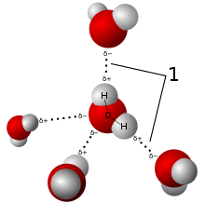
2-Connect Oxygen “o*”
o* 15.999400 O 2 Oxygen in water molecule
ospc 15.999400 O 2 Oxygen in SPC water molecule
otip 15.999400 O 2 Oxygen in TIP3P water molecule
If atom type == ‘O’ and num of connects == 2:
if formula == ’H2-O1’:
nta[atom-id] = ’o*’
https://en.wikipedia.org/wiki/Water

Slide 39
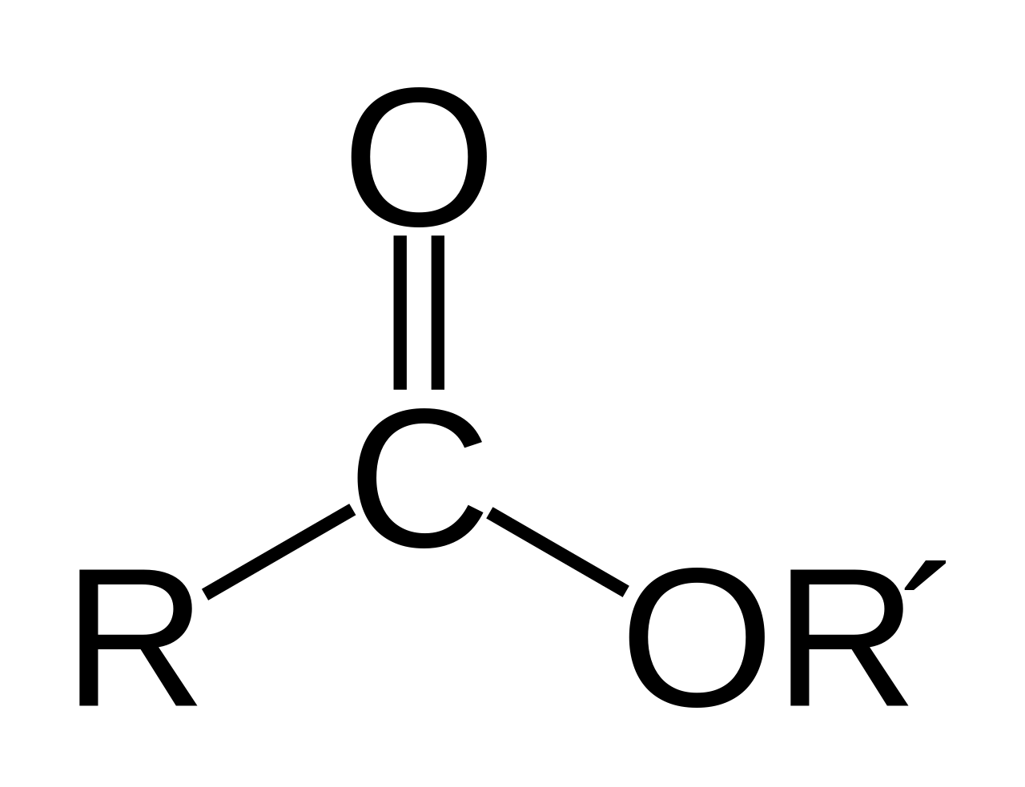
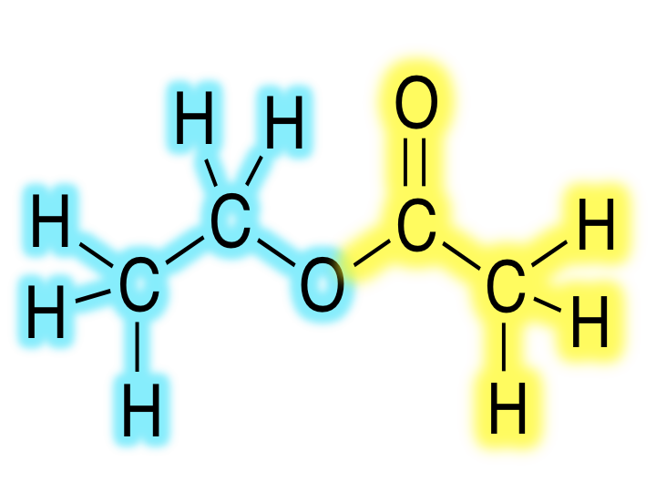
2-Connect Oxygen “oe” USING FOR ESTERS ONLY
oe 15.999400 O 2 Sp3 oxygen in ester
Ester Oxygen
elif ring_size == 0 and all(rings1) == 0 and elements1.count(’C’) == 2 and count_neigh(neighbor_info[2], element=‘O', ring= 0, nb=1) == 1:
if elements2.count(’C’) == 2 :
nta[atom-id] = ’oe’
# o_2 15.99940 O 2 ester oxygen
elif ring_size == 0 and type1 = ’C’ and ring1 == 0 and type2 = ’C’ and ring2 == 0 and count_2ndneigh_elemringnb(neigh_2nd_list, ’O’, 0, 1) == 1 :
nta[atom-id] = ’o_2’
https://en.wikipedia.org/wiki/Ester
https://chem.libretexts.org/Courses/Athabasca_University/Chemistry_350%3A_Organic_Chemistry_I/01%3A_Structure_and_Bonding/1.11%3A_Hybridization_of_Nitrogen_Oxygen_Phosphorus_and_Sulfur

Slide 40

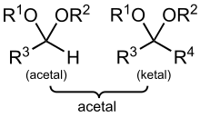
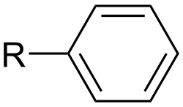

2-Connect Oxygen “oc” USING FOR ACETALS
oc 15.999400 O 2 Sp3 oxygen in ether or acetals
Ether: R–O–R′, where R and R′ represent the alkyl or aryl groups
aryl
If atom type == ‘O’ and num of connects == 2:
if elements1.count(’C’) == 2 and elements2.count(’O’) == 1 :
nta[atom-id] = ’oc’
alkyl
https://en.wikipedia.org/wiki/Ether
https://en.wikipedia.org/wiki/Alkyl
https://en.wikipedia.org/wiki/Acetal

Slide 41
2-Connect Oxygen “o” USING FOR GENERAL ETHERS
o 15.999400 O 2 Sp3 oxygen in ether or ester groups
Ether: R–O–R′, where R and R′ represent the alkyl or aryl groups
aryl
If atom type == ‘O’ and num of connects == 2:
if elements1.count(’C’) == 2:
nta[atom-id] = ’o’
alkyl
https://en.wikipedia.org/wiki/Ether
https://en.wikipedia.org/wiki/Alkyl
https://en.wikipedia.org/wiki/Acetal

Slide 42
2-Connect Oxygen “o3e”
o3e 15.99940 O 2 sp3 oxygen in three membered ring
If atom type == ’O’ and num of connects == 2 :
elif ring_size == 3:
nta[atom-id] = ’o3e’

Slide 43
2-Connect Oxygen “o4e”
o4e 15.99940 O 2 sp3 oxygen in four membered ring
If atom type == ’O’ and num of connects == 2:
elif ring_size == 4:
nta[atom-id] = ’o4e’

Slide 44
2-Connect Oxygen “op”
op 15.99940 O 2 sp2 aromatic in 5 membered ring
If atom type == ’O’ and num of connects == 2:
elif ring_size == 5:
nta[atom-id] = ’op’

Slide 45
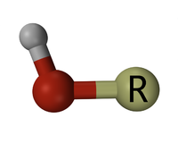
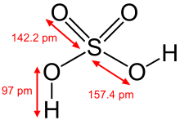
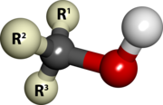
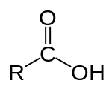
2-Connect Oxygen “oh”
oh 15.999400 O 2 Oxygen in hydroxyl (OH) group
hydroxyl
Sulfuric acid
alcohol
Carboxylic acid
If atom type == ’O’ and num of connects == 2:
elif ring_size == 0 and elements1.count(’C’) == 1 and elements1.count(’H’) == 1:
nta[atom-id] = ’o2h’
https://en.wikipedia.org/wiki/Hydroxy_group

Slide 46
Oxygen 3 Connects
12 cvff 2-Connect Oxygens
oy4 15.999400 O 3 Oxygen atom in octahedral aluminate sheet (-0.758, -0.867 if next to Mg defect)
oy5 15.999400 O 3 Oxygen atom in octahedral aluminate sheet (-0.758, -0.867 if next to Mg defect)
oy6 15.999400 O 3 Oxygen atom in octahedral aluminate sheet (-0.683, -0.792 if next to Mg defect)
oy7 15.999400 O 3 Oxygen atom in octahedral aluminate sheet (-0.758, -0.867 if next to Mg defect)
oy8 15.999400 O 3 Oxygen atom in octahedral aluminate sheet (-0.758, -0.867 if next to Mg defect)
oy9 15.999400 O 3 Oxygen atom in octahedral aluminate sheet (-0.683, -0.792 if next to Mg defect)

Slide 47
1 connect Nitrogen
nt 14.00670 N 1 sp nitrogen involved in a triple bond
nz 14.00670 N 1 sp3 nitrogen bonded to two atoms
2 IFF 1 connect Nitrogen

Slide 48
2 connect Nitrogen
np 14.006700 N 2 Sp2 aromatic nitrogen (partial double bonds)
n= 14.006700 N 2 Non-aromatic end double bonded nitrogen
n=1 14.006700 N 2 Non-aromatic, next to end doubly bonded carbon
n=2 14.006700 N 2 Non-aromatic doubly bonded nitrogen
4 cvff 2 connect Nitrogen

Slide 49
2-Connect Nitrogen “np”
np 14.00670 N 2 sp2 nitrogen in 5- or 6- membered ring
If atom type == ’N’ and num of connects == 2:
if ring_size >= 5:
nta[atom-id] = ’np’

Slide 50
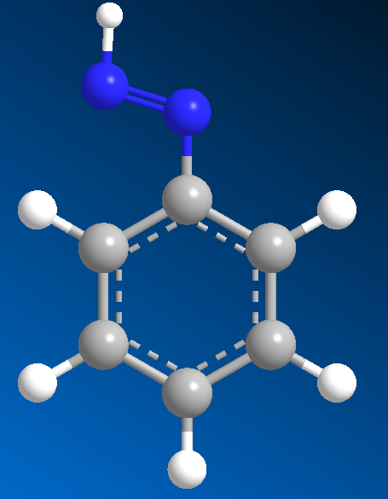
2-Connect Nitrogen “n=”
n= 14.00670 N 2 non aromatic end doubly bonded nitrogen
nb1 == 1
9
n=
1
2
10
8
14
3
7
4
6
If atom type == ’N’ and num of connects == 2:
elif ring_size == 0 and and nbs1.count(1) >= 1:
nta[atom-id] = ’n=’
11
5
13
12

Slide 51
2-Connect Nitrogen “n=1”
n=1 14.00670 N 2 non aromatic, next to end doubly bonded carbon
9
nb2 == 1
1
2
10
8
14
3
7
4
6
11
5
13
12
If atom type == ’N’ and num of connects == 2:
elif ring_size == 0 and nbs2.count(1) >= 1:
nta[atom-id] = ’n=’

Slide 52
2-Connect Nitrogen “n=2”
n=2 14.00670 N 2 non aromatic doubly bonded nitrogen
If atom type == ’N’ and num of connects == 2:
# n=2 14.00670 N 2 non aromatic doubly bonded nitrogen
elif ring_size == 0:
nta[atom-id] = ’n=2’

Slide 53
3 connect Nitrogen
19 cvff 3 connect Nitrogen
n1 14.006700 N 3 Sp2 nitrogen in charged arginine
n2 14.006700 N 3 Sp2 nitrogen (NH2 in the guanidinium group (HN=C(NH2)2))
nr 14.006700 N 3 Sp2 nitrogen (NH2) in guanidinium group (HN=C(NH2)2)
ni 14.006700 N 3 Sp2 nitrogen in a charged imidazole ring (HIS+)
nho 14.006700 N 3 Sp2 nitrogen in 6- membered ring next to a carbonyl group and with a hydrogen
npc 14.006700 N 3 Sp2 nitrogen in 5- or 6- membered ring bonded to a heavy atom
nh 14.006700 N 3 Sp2 nitrogen in 5-or 6- membered ring with hydrogen attached
nh+ 14.006700 N 3 Protonated nitrogen in 6- membered ring with hydrogen attached (WOULD HAVE 4Nb – set with 4 connected)
n3n 14.00670 N 3 Sp2 nitrogen in 3- membered ring
n3m 14.006700 N 3 Sp3 nitrogen in 3- membered ring
n4n 14.00670 N 3 Sp2 nitrogen in 4- membered ring
n4m 14.006700 N 3 Sp3 nitrogen in 4- membered ring
n 14.006700 N 3 Sp2 nitrogen with 1 H, 2 heavy atoms (amide group)
nn 14.006700 N 3 Sp2 nitrogen in aromatic amines
nb 14.006700 N 3 Sp2 nitrogen in aromatic amines
na 14.006700 N 3 Sp3 nitrogen in amines
no 14.006700 N 3 Sp2 nitrogen in nitro group
n3 14.006700 N 3 Sp3 nitrogen with three substituents
n$ 14.006700 N 3 Nitrogen atom for automatic parameter assignment

Slide 54


3-Connect Nitrogen “n1”
n1 14.00670 N 3 sp2 nitrogen in charged arginine
If atom type == ’N’ and num of connects == 3 :
if ring == 0 and formula ==’C6-H14-N4-O2’ :
nta[atom-id] = ’n_2’
https://en.wikipedia.org/wiki/Arginine

Slide 55

3-Connect Nitrogen “n2” or “nr”
n2 14.00670 N 3 sp2 nitrogen (NH2) in guanidinium group (HN=C(NH2)2)
nr 14.00670 N 3 sp2 nitrogen (NH2) in guanidinium group (HN=C(NH2)2)
If atom type == ’N’ and num of connects == 3 :
if ring == 0 and type_list.count(’C’) == 1 and formula ==’C1-H5-N3’ :
nta[atom-id] = ’n2’
https://en.wikipedia.org/wiki/Guanidine

Slide 56
3-Connect Nitrogen “ni”
ni 14.00670 N 3 nitrogen in charged imidazole ring
If atom type == ‘N’ and num of connects == 3:
if ring == 5 and count_neigh(neighbor_info[1], element=‘C', ring= 5, nb=3) >= 2 and formula == ‘C3-H4-N2’:
nta[atom-id] = ’ni’
If atom type == ‘N’ and num of connects == 2:
if ring == 5 and count_neigh(neighbor_info[1], element=‘C', ring= 5, nb=3) >= 2 and formula == ‘C3-H4-N2’:
nta[atom-id] = ’ni’

Slide 57
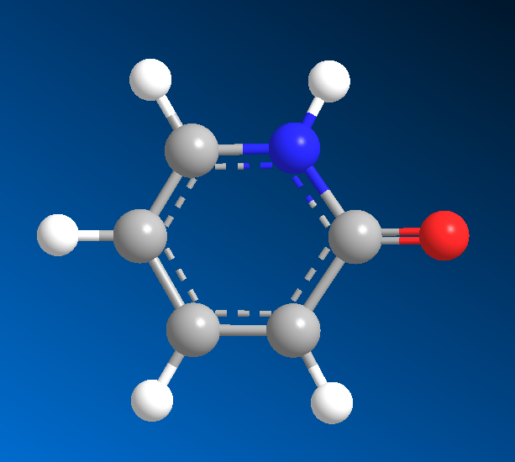
3-Connect Nitrogen “nho”
nho 14.00670 N 3 sp2 nitrogen in 6 membered ring next to a carbonyl
Carbonyl
# o_2 15.99940 O 2 ester oxygen
elif ring_size == 6 and count_neigh(neighbor_info[2], element=‘O', ring=0, nb=1) >= 1 and ’C’ in elements1:
nta[atom-id] = ’nho’

Slide 58
3-Connect Nitrogen “npc”
npc 14.00670 N 3 sp2 nitrogen in 5- or 6- membered ring and with a heavy atom
If atom type == ’N’ and num of connects == 3:
if ring_size >= 5 and count_heavies(neighbors) > 0 :
nta[atom-id] = ’npc’

Slide 59
3-Connect Nitrogen “nh”
nh 14.00670 N 3 sp2 nitrogen in 5 or 6 membered ring
If atom type == ’N’ and num of connects == 3:
if ring_size >= 5 :
nta[atom-id] = ’nh’

Slide 60
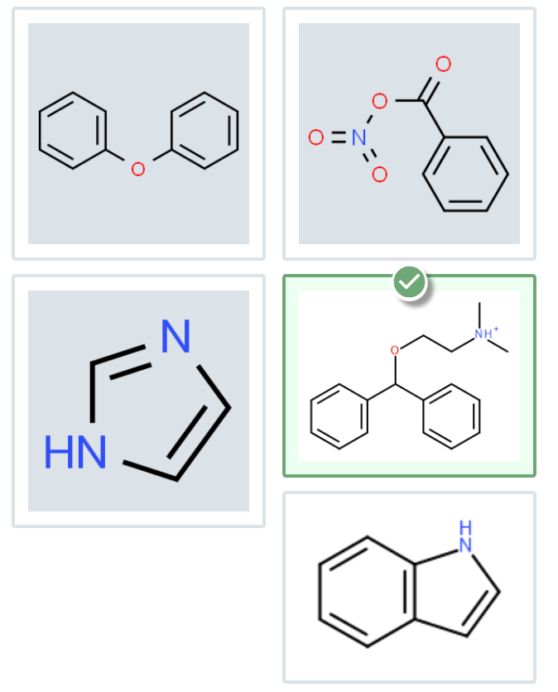
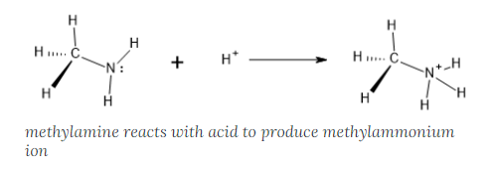
3-Connect Nitrogen “nh+”
nh+ 14.00670 N 3 protonated nitrogen in 6 membered ring
If atom type == ’N’ and num of connects == 4:
if ring_size >= 6:
nta[atom-id] = ’nh+’
https://openoregon.pressbooks.pub/introductoryorganic/chapter/amine-protonation/

Slide 61
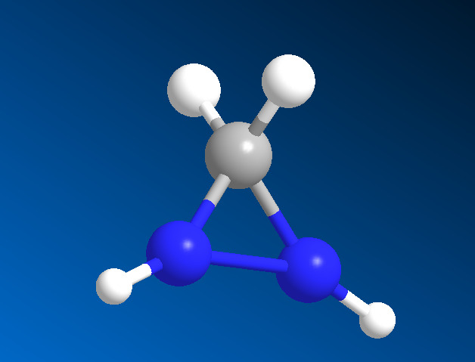
3-Connect Nitrogen “n3n”
n3n 14.00670 N 3 sp2 nitrogen in 3- membered ring (ASSUME n means w/ N like H for c3h)
If atom type == ’N’ and num of connects == 3:
# c4h
elif ring_size == 3 and ’N’ in typelist:
nta[atom-id] = ’n3n’

Slide 62
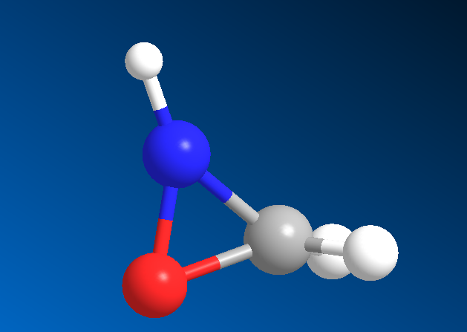
3-Connect Nitrogen “n3m”
n3m 14.00670 N 3 sp3 nitrogen in 3- membered ring (ASSUME m means member like m for c3m)
If atom type == ’N’ and num of connects == 3 :
# c4h
elif ring_size == 3:
nta[atom-id] = ’n3m’

Slide 63
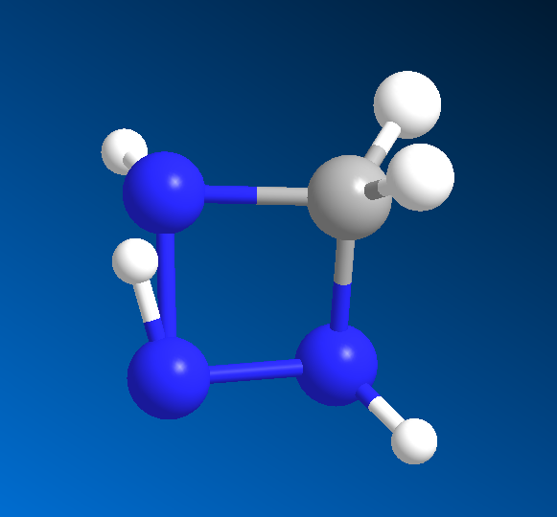
3-Connect Nitrogen “n4n”
n4n 14.00670 N 3 sp2 nitrogen in 4- membered ring (ASSUME n means w/ N like H for c4h)
If atom type == ’N’ and num of connects == 3 :
# c4h
elif ring_size == 4 and ’N’ in elements1 or ’N’ in elements2:
nta[atom-id] = ’n4n’

Slide 64
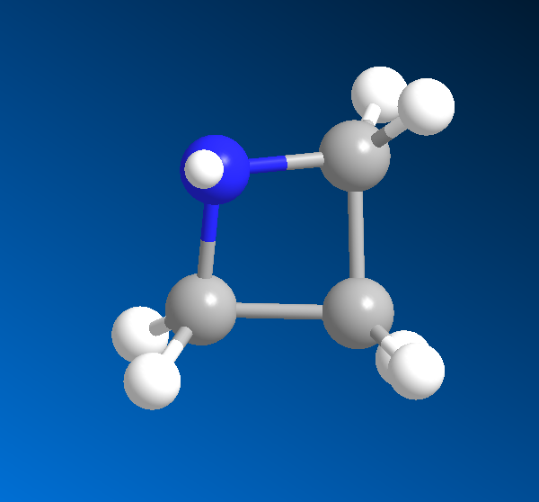
3-Connect Nitrogen “n4m”
n4m 14.00670 N 3 sp3 nitrogen in 4- membered ring (ASSUME m means member like m for c4m)
If atom type == ’N’ and num of connects == 3 :
elif ring_size == 4 :
nta[atom-id] = ’n4m’

Slide 65
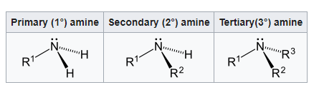
3-Connect Nitrogen “n”
n 14.006700 N 3 Sp2 nitrogen with 1 H, 2 heavy atoms (amide group)
If atom type == ’N’ and num of connects == 3 :
elif ring == 0 and elements1.count(’H’) == 1 and elements1.count(’C’) == 2:
nta[atom-id] = ’n’
https://en.wikipedia.org/wiki/Amine

Slide 66
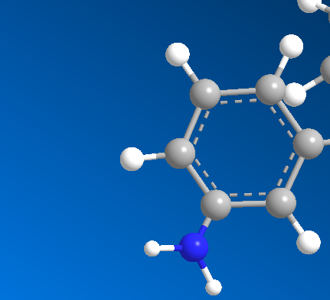
3-Connect Nitrogen “nn”
nn 14.00670 N 3 sp2 nitrogen in aromatic amines
nb 14.00670 N 3 sp2 nitrogen in aromatic amines
If atom type == ’N’ and num of connects == 3 :
elif any(rings1) > 0 and 3 in nbs1 :
nta[atom-id] = ’nn’
https://en.wikipedia.org/wiki/Amine

Slide 67
3-Connect Nitrogen “na”
na 14.00670 N 3 sp3 nitrogen in amines
If atom type == ’N’ and num of connects == 3 :
elif ring == 0 and elements1.count(’H’) == 2 and elements1.count(’C’) == 1:
nta[atom-id] = ’na’
elif ring == 0 and elements1.count(’C’) == 3:
nta[atom-id] = ’na’
https://en.wikipedia.org/wiki/Amine

Slide 68
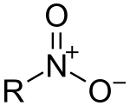
3-Connect Nitrogen “no”
no 14.006700 N 3 Sp2 nitrogen in nitro group
If atom type == ’N’ and num of connects == 3:
if ring_size = 0 and elements1.count(’O’) == 2 and elements1.count(’C’) == 1:
nta[atom-id] = ’no’
https://en.wikipedia.org/wiki/Nitro_compound#:~:text=The%20nitro%20group%20is%20one,nitro%20group%20can%20be%20acidic.

Slide 69
4 connect Nitrogen
nh+ 14.00670 N 3 protonated nitrogen in 6 membered ring (WOULD HAVE 4Nb – set with 4 connected)
n4 14.00670 N 4 sp3 nitrogen in protonated amines
n+ 14.00670 N 4 sp3 nitrogen in protonated amines
2 IFF 4 connect Nitrogen

Slide 70
1 connect Sulfur
s- 32.06400 S 1 partial double sulfur
3 IFF 1 connect Nitrogen

Slide 71
2 connect Sulfur
s3e 32.06400 S 2 Sulfur in three membered ring
s4e 32.06400 S 2 Sulfur in four membered ring
sp 32.064000 S 2 Sulfur in thiophene
sh 32.064000 S 2 Sulfur in sulfhydryl (-SH) group
s1 32.064000 S 2 Sulfur involved in S-S disulfide bond
sc 32.064000 S 2 Sp3 sulfur in methionines (C-S-C) group
s 32.064000 S 2 Sulfur in methionine (C-S-C) group
s' 32.064000 S 2 Sulfur in thioketone (>C=S) group
s$ 32.064000 S 2 Sulfur atom for automatic parameter assignment
9 cvff 2 connect Sulfur

Slide 72
2-Connect Nitrogen “s3e”
s3e 32.06400 S 2 sulfur in three membered ring
If atom type == ’S’ and num of connects == 2 :
elif ring_size == 3:
nta[atom-id] = ’s3e’

Slide 73
2-Connect Nitrogen “s4e”
s4e 32.06400 S 2 sulfur in four membered ring
If atom type == ’S’ and num of connects == 2 :
elif ring_size == 4:
nta[atom-id] = ’s4e’

Slide 74
2-Connect Nitrogen “sp”
sp 32.06400 S 2 sulfur in an aromatic ring (e.g. thiophene)
If atom type == ’S’ and num of connects == 2 :
elif ring_size > 4:
nta[atom-id] = ’sp’

Slide 75
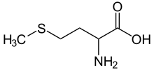
2-Connect Nitrogen “ s’ ”
s' 32.064000 S 2 Sulfur in thioketone (>C=S) group
If atom type == ’S’ and num of connects == 2 :
elif ring_size == 0 and elements1.count(’C’) == 1 :
nta[atom-id] = ” s’ ”
https://en.wikipedia.org/wiki/Methionine

Slide 76
2-Connect Nitrogen “sc”
sc 32.06400 S 2 sp3 sulfur in methionines (C-S-C) group
s 32.064000 S 2 Sulfur in methionine (C-S-C) group
If atom type == ’S’ and num of connects == 2 :
elif ring_size == 0 and elements1.count(’C’) == 2 :
nta[atom-id] = ’sc’
https://en.wikipedia.org/wiki/Methionine

Slide 77
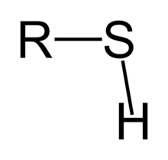
2-Connect Nitrogen “sh”
sh 32.06400 S 2 sp3 sulfur in sulfhydryl (-SH) group (e.g. cysteine)
If atom type == ’S’ and num of connects == 2 :
elif elements1.count(’H’) >= 1 and elements1.count(’C’) >= 1 :
nta[atom-id] = ’sh’
https://en.wikibooks.org/wiki/Structural_Biochemistry/Organic_Chemistry/Organic_Functional_Group/Sulfhydryl#:~:text=A%20sulfhydryl%20is%20a%20functional,great%20affinity%20for%20soft%20metals.

Slide 78
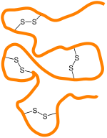
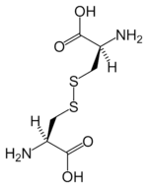
2-Connect Nitrogen “s1”
s1 32.06400 S 2 sp3 sulfur involved in (S-S) group of disulfides
If atom type == ’S’ and num of connects == 2 :
elif elements1.count(’S’) >= 1 :
nta[atom-id] = ’s1’
https://en.wikipedia.org/wiki/Disulfide

Slide 79
Silicon
si 28.086000 Si 4 Silicon
sz 28.086000 Si 1 Silicon atom in a Zeolite or Silicate
sy1 28.086000 Si 4 Silicon atom in tetrahedral silicate sheet (+1.1)
sy2 28.086000 Si 4 Silicon atom in tetrahedral silicate sheet (+1.1)
sc1 28.08600 Si 4 Silicon atom in silicate ion in Ca3SiO5 (+1.0)
sc4 28.08600 Si 4 Silicon atom in silica (+1.1 in bulk SiO2 or SiOH, +0.725 in SiO-)

Slide 80
Phosphorous
p 30.973800 P 4 General phosphorous atom
pz 30.973800 P 1 Phosphorous atom in ALPO type structure
p$ 30.973800 P 4 Phosphorous atom for automatic parameter assignment
pap 30.97380 P 4 Phosphorus atom in (hydrogen)phosphate ion in hydroxyapatite (+1.0)

Slide 81
Simple singular element atom types
f 18.998400 F 1 Fluorine bonded to a carbon
he 4.002600 He 0 Helium atom
dw 2.014000 D 1 Deuterium in heavy water (D2O)
d 2.014000 D 1 General Deuterium Atom
Cl 35.453000 Cl 1 Chloride ion Cl-
ca+ 40.079800 Ca Calcium ion Ca2+, mass = mass of Ca - 2*electron mass.
br 79.909000 Br 1 Bromine bonded to a carbon
Br 79.904000 Br 1 Bromide ion Br-
ar 39.948 Ar 0 Argon atom
ca++ 40.08000 Ca 0 Calcium ion in Ca3SiO5 (+1.5) and organic salts
ca+a 40.08000 Ca 0 Calcium ion in Ca3Al2O6 (+1.5)
ca+h 40.08000 Ca 0 Calcium ion in hydroxyapatite (+1.5)
k+ 39.098300 K 0 Potassium ion in mica, montmorillonite, and other clays (+1.0)
na+ 22.989800 Na 0 Sodium ion in silica, clays, and organic salts

Slide 82

I AM HERE

Slide 83
Acknowledgements
Dr. Gregory Odegard
CMMR Lab Group
Superior: Dr. Gowtham
Special Thanks to:
Prathamesh Deshpande, Sagar Patil, Hashim Al Mahud, Will Pisani, and Ivan Gallegos

