Slide 1
Atom Typing Color Nomenclature
Green means CAN find atom type
Light Green means CAN find atom type, but possibly needs more logic
Orange means can not distinguish between atom type
Red means method CANNOT find atom type
Highlighted in grey means a user input to help find correct atom types
Black means could be switched out in the if/elif/else statements because of an overlap issue. System and user preference dependent.

Slide 2
Hydrogen
h* 1.007970 H 1 spc water H 0.41
ho 1.007970 H 1 hydroxyl H 0.425
2 Clay-FF Hydrogen

Slide 3
Hydrogen “h*”
h* 1.007970 H 1 spc water H 0.41
If atom type == ‘H’ and num of connects == 1:
elif formula[atom-id] == ’H2-O1’:
nta[atom-id] = ’h*’

Slide 4
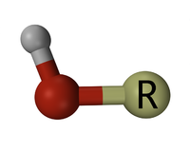
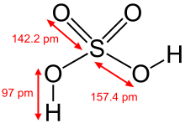
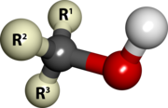
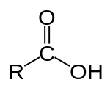
Hydrogen “ho”
ho 1.007970 H 1 hydroxyl H 0.425
hydroxyl
Sulfuric acid
alcohol
Carboxylic acid
If atom type == ‘H’ and num of connects == 1:
elif type1 == ’O’ in elements1:
nta[atom-id] = ’ho’
https://en.wikipedia.org/wiki/Hydroxy_group

Slide 5
Oxygen
o* 15.99940 O 2 spc water O -0.82
oh- 15.99940 O 1 hydroxide O
oh 15.99940 O 2 hydroxyl O -0.95
ohs 15.99940 O 2 hydroxyl O sub. -1.0808
obts 15.99940 O 2 oxygen tet. sub. -1.1688
obos 15.99940 O 2 oxygen oct. sub. -1.1808
ob 15.99940 O 2 bridging oxygen -1.05
obss 15.99940 O 3 oxygen double sub. -1.2996
8 Clay-FF Oxygen

Slide 6
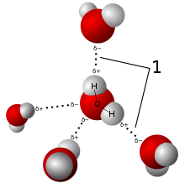
2-Connect Oxygen “o*”
o* 15.99940 O 2 spc water O -0.82
If atom type == ‘O’ and num of connects == 2:
if formula == ’H2-O1’:
nta[atom-id] = ’o*’
https://en.wikipedia.org/wiki/Water

Slide 7

Hydrogen “oh-”
oh- 15.99940 O 1 hydroxide O
If atom type == ‘O’ :
if nb == 1:
nta[atom-id] = ’oh-’

Slide 8
2-Connect Oxygen “oh”
oh 15.99940 O 2 hydroxyl O -0.95
ohs 15.99940 O 2 hydroxyl O sub. -1.0808
hydroxyl
Sulfuric acid
alcohol
Carboxylic acid
If atom type == ’O’ and num of connects == 2:
elif ring_size == 0 and elements1.count(’H’) == 1:
nta[atom-id] = ’o2h’
https://en.wikipedia.org/wiki/Hydroxy_group

Slide 9
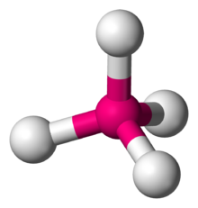
Hydrogen “obts”
obts 15.99940 O 2 oxygen tet. sub. -1.1688
If atom type == ‘O’ :
if nb == 2 and 4 in nbs1:
nta[atom-id] = ’obts’

Slide 10
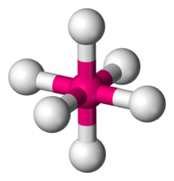
Hydrogen “obts”
obos 15.99940 O 2 oxygen oct. sub. -1.1808
If atom type == ‘O’ :
if nb == 2 and 6 in nbs1:
nta[atom-id] = ’obos’

Slide 11
Hydrogen “ob” and “obss”
ob 15.99940 O 2 bridging oxygen -1.05
obss 15.99940 O 3 oxygen double sub. -1.2996
If atom type == ‘O’ :
if nb == 2:
nta[atom-id] = ’ob’
if nb == 3:
nta[atom-id] = ’obss’

Slide 12
Calcium
cah 40.08000 Ca 6 hydroxide calcium 1.05
cao 40.08000 Ca 6 octahedral calcium
Ca 40.07980 Ca 0 calcium ion 2.0 (nb == 0)
8 Clay-FF Oxygen

Slide 13
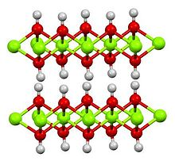
Hydrogen “cah”
cah 40.08000 Ca 6 hydroxide calcium 1.05
If atom type == ‘Ca’ :
# for non-terminal
if nb == 6 and elements1.count(‘O’) == 6 and elements1.count(‘H’) == 6:
nta[atom-id] = ’cah’
# for terminal
if nb == 2 and elements1.count(‘O’) == 2 and elements1.count(‘H’) == 2:
nta[atom-id] = ’cah’

Slide 14
Hydrogen “cao”
cao 40.08000 Ca 6 octahedral calcium
If atom type == ‘Ca’ :
if nb == 6:
nta[atom-id] = ’cao’

Slide 15
Aluminum
ao 26.98154 Al 6 octahedral aluminum 1.575 (nb == 6)
at 26.98154 Al 4 tetrahedral aluminum 1.575 (nb == 4)
2 Clay-FF Aluminum

Slide 16
Magnesium
mgh 24.30500 Mg 6 hydroxide magnesium 1.05
mgo 24.30500 Mg 6 octahedral magnesium 1.36 (nb==6)
Mg 24.3050 Mg 0 magnesium ion 2.0 (nb==0)
3 Clay-FF Magnesium

Slide 17
Magnesium “mgh”
mgh 24.30500 Mg 6 hydroxide magnesium 1.05
If atom type == ‘Mg’ :
# for non-terminal
if nb == 6 and elements1.count(‘O’) == 6 and elements1.count(‘H’) == 6:
nta[atom-id] = ’cgh’
# for terminal
if nb == 2 and elements1.count(‘O’) == 2 and elements1.count(‘H’) == 2:
nta[atom-id] = ’cgh’

Slide 18
Simple singular element atom types
st 28.08550 Si 4 tetrahedral silicon 2.1
Cl 35.45300 Cl 0 chloride ion -1.0
feo 55.84700 Fe 6 octahedral iron 1.575
lio 6.941000 Li 6 octahedral lithium 0.525
Cs 132.9100 Cs 0 cesium ion 1.0
Ba 137.3300 Ba 0 barium ion 2.0
Sr 87.6200 Sr 0 strontium ion 2.0

Slide 19
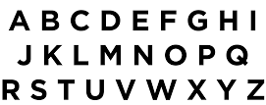
I AM HERE

Slide 20
Acknowledgements
Dr. Gregory Odegard
CMMR Lab Group
Superior: Dr. Gowtham
Special Thanks to:
Prathamesh Deshpande, Sagar Patil, Hashim Al Mahud, Will Pisani, and Ivan Gallegos

