Slide 1
Atom Typing Color Nomenclature
Green means CAN find atom type
Light Green means CAN find atom type, but possibly needs more logic
Orange means can not distinguish between atom type
Red means method CANNOT find atom type
Highlighted in grey means a user input to help find correct atom types
Black means could be switched out in the if/elif/else statements because of an overlap issue. System and user preference dependent.

Slide 2
Carbon
CT 12.011150 C 4 Aliphatic C
CG 12.011150 C 1 Graphite C
CC 12.011150 C 3 Carbonate ion C, AMBER
1 IFF Sp Carbon

Slide 3
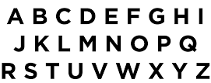
I AM HERE

Slide 4
Acknowledgements
Dr. Gregory Odegard
CMMR Lab Group
Superior: Dr. Gowtham
Special Thanks to:
Prathamesh Deshpande, Sagar Patil, Hashim Al Mahud, Will Pisani, and Ivan Gallegos

