Slide 1
Atom Typing Color Nomenclature
Green means CAN find atom type
Light Green means CAN find atom type, but possibly needs more logic
Orange means can not distinguish between atom type
Red means method CANNOT find atom type
Highlighted in grey means a user input to help find correct atom types
Black means could be switched out in the if/elif/else statements because of an overlap issue. System and user preference dependent.

Slide 2
Sp1 Carbon
ct 12.01115 C 2 sp carbon involved in a triple bond
1 IFF Sp Carbon

Slide 3
Sp1 Carbon
ct 12.01115 C 2 sp carbon involved in a triple bond
If ring_size == 0 and atom type == “C” and nb <= 2:
# Sp1 Carbon
nta[atom-id] = “ct”

Slide 4
Sp2 Carbon
c+ 12.01115 C 3 C in guanidinium group
cr 12.01115 C 3 C in neutral arginine
c- 12.01115 C 3 C in charged carboxylate
c5 12.01115 C 3 sp2 aromatic carbon in 5-membered ring
cs 12.01115 C 3 sp2 aromatic carbon in 5 membered ring next to S
cp 12.01115 C 3 sp2 aromatic carbon
c_0 12.01115 C 3 carbonyl carbon of aldehydes, ketones
c_1 12.01115 C 3 carbonyl carbon of acid, ester, amide
c_2 12.01100 C 3 carbonyl carbon of carbamate, urea
cz 12.01100 C 3 carbonyl carbon of carbonate
ci 12.01115 C 3 sp2 aromatic carbon in charged imidazole ring (His+)
c= 12.01115 C 3 non aromatic end doubly bonded carbon
c=1 12.01115 C 3 non aromatic, next to end doubly bonded carbon
c=2 12.01115 C 3 non aromatic doubly bonded carbon
15-PCFF Sp2 Carbons

Slide 5
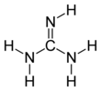
Sp2 Carbon “c+”
c+ 12.01115 C 3 C in guanidinium group
If atom type == ’C’ and nb == 3:
# Guanidinium group
If ring_size == 0 and formula == ’C1-H5-N3’:
nta[atom-id] = ’c+’
https://en.wikipedia.org/wiki/Guanidine

Slide 6
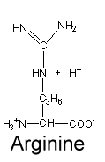

Sp2 Carbon “cr”
cr 12.01115 C 3 C in neutral arginine
If atom type == ’C’ and num of connects == 3:
# Arginine
elif ring_size == 0 and elements1.count(’C’) == 2 and elements1.count(’N’) == 1:
nta[atom-id] = ’cr’
elif ring_size == 0 and elements1.count(’N’) == 3:
nta[atom-id] = ’cr’
https://www2.chem.wisc.edu/deptfiles/genchem/netorial/modules/biomolecules/modules/protein1/prot14.htm#:~:text=There%20are%20three%20amino%20acids,%2C%20and%20histidine%20(His).&text=Their%20side%20chains%20have%20carboxylic,negatively%20charged%20in%20the%20process.
https://en.wikipedia.org/wiki/Arginine

Slide 7
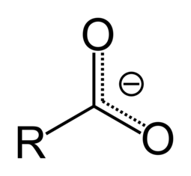
Sp2 Carbon “c-”
c- 12.01115 C 3 C in charged carboxylate
https://en.wikipedia.org/wiki/Carboxylate#:~:text=A%20carboxylate%20is%20the%20conjugate,or%20RCO2R%E2%80%B2
If atom type == ’C’ and nb == 3:
# Carboxylate
elif ring_size == 0 and elements1.count(’C’) == 1 and elements1.count(’O’) == 2:
if ring2 == 0 and ring3 == 0:
nta[atom-id] = ’c-’

Slide 8
Sp2 Carbon “c5”
c5 12.01115 C 3 sp2 aromatic carbon in 5-membered ring
If atom type == ’C’ and nb== 3:
# 5 Member Ring
elif ring_size == 5 and elements1.count(’S’) == 0:
nta[atom-id] = ’c5’

Slide 9
Sp2 Carbon “cs”
cs 12.01115 C 3 sp2 aromatic carbon in 5 membered ring next to S
If atom type == ’C’ and nb== 3:
# 5 Member Ring
elif ring_size == 5 and elements1.count(’S’) > 0:
nta[atom-id] = ’cs’

Slide 10
Sp2 Carbon “cp”
cp 12.01115 C 3 sp2 aromatic carbon
If atom type == ’C’ and nb == 3:
# 6 Member Ring
elif ring_size == 6 and not use_graphene_types:
nta[atom-id] = ’cp’
elif ring_size == 6 and rings1.count(6) <= 2:
nta[atom-id] = ’cp’

Slide 11
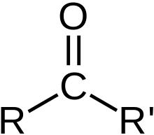
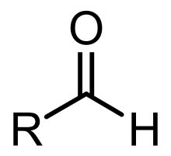
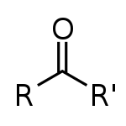
Sp2 Carbon “c_0”
c_0 12.01115 C 3 carbonyl carbon of aldehydes, ketones
Carbonyl
If atom type == ’C’ and nb == 3:
# Ketone
elif ring_size == 0 and elements1.count(’C’) == 2 and elements1.count(’O’) == 1 and nbs1[2] == 1:
nta[atom-id] = ’c_0’
# Aldehyde
elif ring_size == 0 and elements1.count(’C’) == 1 and elements1.count(’H’) == 1 and elements1.count(’O’) == 1 and nbs1[2] == 1 : nta[atom-id] = ’c_0’
Aldehyde
Ketone
https://en.wikipedia.org/wiki/Carbonyl_group
https://en.wikipedia.org/wiki/Aldehyde
https://en.wikipedia.org/wiki/Ketone

Slide 12
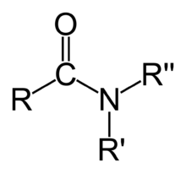
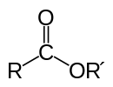
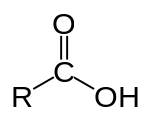
Sp2 Carbon “c_1”
c_1 12.01115 C 3 carbonyl carbon of acid, ester, amide
Carbonyl
Amide
Ester
Carboxylic acid
If atom type == ’C’ and num of connects == 3:
# Amide
elif ring_size == 0 and elements1[0] == ’C’ and elements1[1] == ’N’ and elements1[2] == ’N’ and rings1.count[0] == 3:
nta[atom-id] = ’c_1’
# Ester, Carboxylic acid
elif ring_size == 0 and elements1[0] == ’C’ and elements1[1] == ’O’ and elements1[2] == ’O’ and rings1.count[0] == 3:
nta[atom-id] = ‘c_1’
https://en.wikipedia.org/wiki/Carbonyl_group
https://en.wikipedia.org/wiki/Amide
https://en.wikipedia.org/wiki/Ester
https://en.wikipedia.org/wiki/Acid
https://en.wikipedia.org/wiki/Carboxylic_acid
Look for other acid types other then Carboxylic

Slide 13
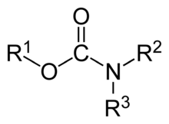

Sp2 Carbon “c_2”
c_2 12.01100 C 3 carbonyl carbon of carbamate, urea
Carbonyl
Carbamate
Urea
If atom type == ’C’ and num of connects == 3:
# Carbamate
elif ring_size == 0 and elements1[0] == ’N’ and elements1[1] == ’O’ and elements1[2] == ’O’ and rings1.count[0] == 3:
nta[atom-id] = ’c_2’
# Urea
elif ring_size == 0 and elements1[0] == ’N’ and elements1[1] == ’N’ and elements1[2] == ’O’ and rings1.count[0] == 3:
nta[atom-id] = ‘c_2’
https://en.wikipedia.org/wiki/Carbonyl_group
https://en.wikipedia.org/wiki/Carbamate
https://en.wikipedia.org/wiki/Urea

Slide 14
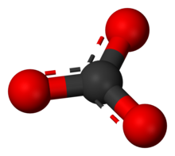
Sp2 Carbon “cz”
cz 12.01100 C 3 carbonyl carbon of carbonate
Carbonyl
Carbanate
If atom type == ’C’ and num of connects == 3:
# Carbanate
elif ring_size == 0 and elements1.count(’O’) == 3:
nta[atom-id] =’cz’
https://en.wikipedia.org/wiki/Carbonyl_group
https://en.wikipedia.org/wiki/Carbonate

Slide 15
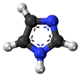
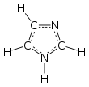
Sp2 Carbon “ci”
ci 12.01115 C 3 sp2 aromatic carbon in charged imidazole ring (His+)
C-C: type1
C-H: type2
C-N: type3
C-H: type1
C-N: type2
C-N: type3
If atom type == ’C’ and num of connects == 3:
# imidazole ring for Carbon
elif ring_size >= 5 and type3 = ’N’ and ring3 == 5 and formula == ‘C3-H4-N2’: :
nta[atom-id] = ’ci’
https://en.wikipedia.org/wiki/Imidazole

Slide 16
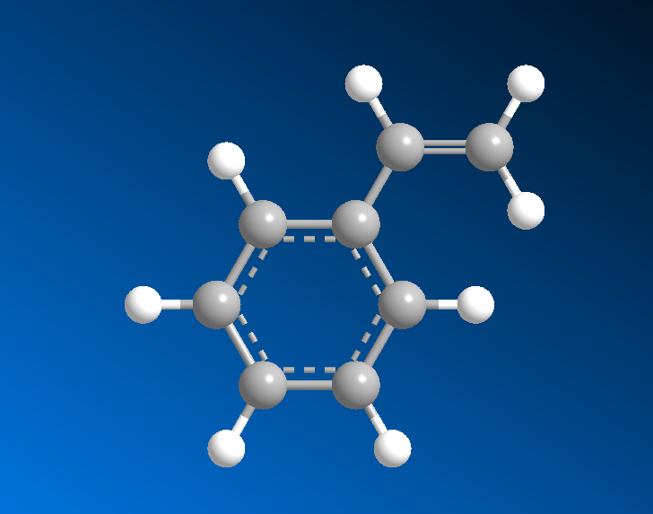
Sp2 Carbon “c=”
c= 12.01115 C 3 nonaromatic end doubly bonded carbon
C=
nb1 == 1
If atom type == ’C’ and num of connects == 3:
# c= 12.01115 C 3 nonaromatic end doubly bonded carbon
elif ring_size == 0 and nbs1.count(1) == 2:
nta[atom-id] = ’c=’
https://en.wikipedia.org/wiki/Imidazole

Slide 17
Sp2 Carbon “c=1”
c=1 12.01115 C 3 nonaromatic, next to end doubly bonded carbon
C=1
If atom type == ’C’ and num of connects == 3:
# c= 12.01115 C 3 nonaromatic end doubly bonded carbon
elif ring_size == 0 and nbs2.count(1) >= 2:
nta[atom-id] = ’c=1’

Slide 18
Sp2 Carbon non-aromatic assumed
c=2 12.01115 C 3 nonaromatic doubly bonded carbon
Type | NonB | Bond | Angle | Torsion | OOP
C= | C= | C= | C= | C= | C=
C=1 | C= | C=1 | C= | C=1 | C=
C=2 | C= | C=2 | C= | C=2 | C=
If atom type == “C” and num of connects == 3:
# c=2 12.01115 C 3 nonaromatic doubly bonded carbon
elif ring_size == 0:
nta[atom-id] = ’c=2’

Slide 19
Sp3 Carbon
c3h 12.01115 C 4 sp3 carbon in 3-membered ring with hydrogens
c3m 12.01115 C 4 sp3 carbon in 3-membered ring
c4h 12.01115 C 4 sp3 carbon in 4-membered ring with hydrogens
c4m 12.01115 C 4 sp3 carbon in 4-membered ring
c_a 12.01115 C 4 general amino acid alpha carbon (sp3)
cg 12.01115 C 4 sp3 alpha carbon in glycine
co 12.01115 C 4 sp3 carbon in acetals
coh 12.01115 C 4 sp3 carbon in acetals with hydrogen
c1 12.01115 C 4 sp3 carbon with 1 H 3 heavies
c2 12.01115 C 4 sp3 carbon with 2 H's, 2 Heavy’s
c3 12.01115 C 4 sp3 carbon with 3 hHs 1 heavy
c 12.01115 C 4 generic SP3 carbon
12 PCFF Sp3 Carbons

Slide 20
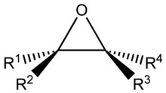
Sp3 Carbon “c3h”
c3h 12.01115 C 4 sp3 carbon in 3-membered ring with hydrogens
If atom type == ’C’ and num of connects == 4 :
# c3h
if ring_size == 3 and ’H’ in elements1:
nta[atom-id] = ’c3h’
https://en.wikipedia.org/wiki/Epoxide

Slide 21
Sp3 Carbon “c3m”
c3m 12.01115 C 4 sp3 carbon in 3-membered ring
If atom type == ’C’ and num of connects == 4 :
# c3h
elif ring_size == 3:
nta[atom-id] = ’c3m’
https://en.wikipedia.org/wiki/Epoxide

Slide 22
Sp3 Carbon “c4h”
c4h 12.01115 C 4 sp3 carbon in 4-membered ring with hydrogens
If atom type == ’C’ and num of connects == 4 :
# c4h
elif ring_size == 4 and ’H’ in elements1:
nta[atom-id] = ’c4h’

Slide 23
Sp3 Carbon “c4m”
c4m 12.01115 C 4 sp3 carbon in 4-membered ring
If atom type == ’C’ and num of connects == 4 :
# c4h
elif ring_size == 4:
nta[atom-id] = ’c4m’

Slide 24
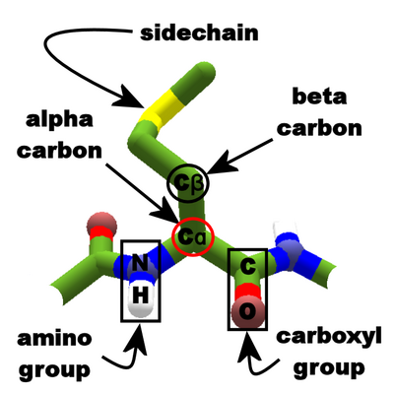
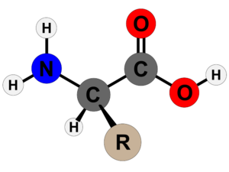
Sp3 Carbon “c_a”
https://en.wikipedia.org/wiki/Amino_acid
https://foldit.fandom.com/wiki/Alpha_carbon
c_a 12.01115 C 4 general amino acid alpha carbon (sp3)
If atom type == ’C’ and num of connects == 4:
# alpha carbon in amino acid
elif ring_size == 0 and elements1.count(’C’) == 2 and elements1.count(’H’) == 1 and elements1.count(’N’) == 1 : nta[atom-id] = ’c_a’

Slide 25


Sp3 Carbon “cg”
cg 12.01115 C 4 sp3 alpha carbon in glycine
If atom type == ’C’ and num of connects == 4:
# carbon in glycine
elif ring_size == 0 and formula == ’C2-H5-N1-O2’:
nta[atom-id] = ’cg’
https://en.wikipedia.org/wiki/Glycine

Slide 26
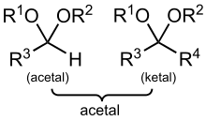
Sp3 Carbon “co”
co 12.01115 C 4 sp3 carbon in acetals
If atom type == ’C’ and num of connects == 4:
# ketals
elif ring_size == 0 and elements1.count(’C’) == 2 and elements1.count(’O’) == 2:
nta[atom-id] = ’co’
https://en.wikipedia.org/wiki/Acetal

Slide 27
Sp3 Carbon “coh”
coh 12.01115 C 4 sp3 carbon in acetals with hydrogen
If atom type == “C” and num of connects == 4:
# acetals
elif ring_size == 0 and elements1.count(’C’) == 1 and elements1.count(’O’) == 2 and elements1.count(’H’) == 1:
nta[atom-id] = ’coh’
https://en.wikipedia.org/wiki/Acetal

Slide 28
Sp3 Carbon “c1”
c1 12.01115 C 4 sp3 carbon with 1 H 3 heavies
If atom type == ‘C’ and num of connects == 4:
# c1 12.01115 C 4 sp3 carbon with 1 H 3 heavies
elif elements1.count(’H’) == 1 and count_heavies(elements1) == 3:
nta[atom-id] = ’c1’

Slide 29
Sp3 Carbon “c2”
c2 12.01115 C 4 sp3 carbon with 2 H's, 2 Heavy’s
If atom type == ‘C’ and num of connects == 4:
# c2 12.01115 C 4 sp3 carbon with 2 H's, 2 Heavy’s
elif elements1.count(’H’) == 2 and count_heavies(elements1) == 2:
nta[atom-id] = ’c2’

Slide 30
Sp3 Carbon “c3”
c3 12.01115 C 4 sp3 carbon with 3 hHs 1 heavy
If atom type == ‘C’ and num of connects == 4:
# c3 12.01115 C 4 sp3 carbon with 3 hHs 1 heavy
elif elements1.count(’H’) == 3 and count_heavies(elements1) == 1:
nta[atom-id] = ’c3’

Slide 31
Atom Typing Color Nomenclature
Green means CAN find atom type
Light Green means CAN find atom type, but possibly needs more logic
Orange means can not distinguish between atom type
Red means method CANNOT find atom type
Highlighted in grey means a user input to help find correct atom types
Black means could be switched out in the if/elif/else statements because of an overlap issue. System and user preference dependent.

Slide 32
Hydrogen
16 PCFF Hydrogens
hi 1.00797 H 1 Hydrogen in charged imidazole ring
hc 1.00797 H 1 hydrogen bonded to carbon
hw 1.00797 H 1 hydrogen in water
hos 1.00782 H 1 hydrogen atom in terminal hydroxyl group on silicon
ho2 1.00800 H 1 hydroxyl hydrogen
ho 1.00797 H 1 hydrogen bonded to oxygen
hn2 1.00800 H 1 amino hydrogen
hn 1.00797 H 1 hydrogen bonded to nitrogen
h* 1.00797 H 1 hydrogen bonded to nitrogen, Oxygen
hsi 1.00800 H 1 silane hydrogen
hs 1.00797 H 1 hydrogen bonded to sulfur
h 1.00797 H 1 generic hydrogen bound to C, Si,or H
h+ 1.00797 H 1 charged hydrogen in cations
hb 1.00782 H 1 hydrogen atom in bridging hydroxyl group
hoa 1.00782 H 1 hydrogen atom in terminal hydroxyl group on aluminium
hp 1.00797 H 1 hydrogen bonded to phosphorus

Slide 33
Hydrogen “hi”
hi 1.00797 H 1 Hydrogen in charged imidazole ring
If atom type == ‘H’ and num of connects == 1:
if rings1.count(5) > 0 and count_neigh_info(neigh2, element=‘N’, ring= 5, nb= False) > 0 and formula == ‘C3-H4-N2’:
nta[atom-id] = ’hi’

Slide 34
Hydrogen “hc”
hc 1.00797 H 1 hydrogen bonded to carbon
If atom type == ‘H’ and num of connects == 1:
# bonded to C
if elements1[0] == ’C’:
nta[atom-id] = ’hc’

Slide 35
Hydrogen “hw”
hw 1.00797 H 1 hydrogen in water (+0.41 in this model !)
If atom type == ‘H’ and num of connects == 1:
elif formula[atom-id] == ’H2-O1’:
nta[atom-id] = ’hw’

Slide 36
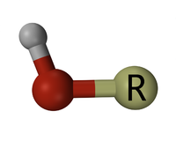
Hydrogen “hos”
hos 1.00782 H 1 hydrogen atom in terminal hydroxyl group on silicon
Si
hydroxyl
If atom type == ‘H’ and num of connects == 1:
elif type1 == ’O’ and ’Si’ in neigh_2nd_list:
nta[atom-id] = ’hos’
https://en.wikipedia.org/wiki/Hydroxy_group

Slide 37
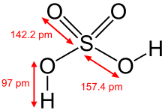
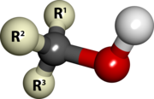
Hydrogen “ho2”
ho2 1.00800 H 1 hydroxyl hydrogen
hydroxyl
Sulfuric acid
alcohol
Carboxylic acid
If atom type == ‘H’ and num of connects == 1:
elif type1 == ’O’ and ’C’ in neigh_2nd_list or ’S’ in neigh_2nd_list:
nta[atom-id] = ’ho2’
https://en.wikipedia.org/wiki/Hydroxy_group

Slide 38
Hydrogen “ho”
ho 1.00797 H 1 hydrogen bonded to oxygen
If atom type == ‘H’ and num of connects == 1:
elif type1 == ’O’:
nta[atom-id] = ’ho’

Slide 39
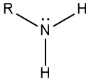
Hydrogen “hn2”
hn2 1.00800 H 1 amino hydrogen
If atom type == ‘H’ and num of connects == 1:
elif type1 == ’N’ and ’C’ in neigh_2nd_list :
nta[atom-id] = ’hn2’
https://chemistrytalk.org/amino-functional-group/#:~:text=An%20amino%20group%20is%20a,nitrogen%20with%20a%20lone%20pair.

Slide 40
Hydrogen “hn”
hn 1.00797 H 1 hydrogen bonded to nitrogen
If atom type == ‘H’ and num of connects == 1:
elif type1 == ’N’:
nta[atom-id] = ’hn’

Slide 41
Hydrogen “h*”
h* 1.00797 H 1 hydrogen bonded to nitrogen, Oxygen
If atom type == ‘H’ and num of connects == 1:
elif type1 == ’N’ or type1 == ’O’ :
nta[atom-id] = ’h*’

Slide 42
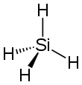
Hydrogen “hsi”
hsi 1.00800 H 1 silane hydrogen
If atom type == ‘H’ and num of connects == 1:
elif type1 == ’Si’ and formula == ‘H4-Si1’:
nta[atom-id] = ’hsi’
https://en.wikipedia.org/wiki/Silane#:~:text=Silane%20is%20an%20inorganic%20compound,a%20precursor%20to%20elemental%20silicon.

Slide 43
Hydrogen “hs”
hs 1.00797 H 1 hydrogen bonded to sulfur
If atom type == ‘H’ and num of connects == 1:
elif type1 == ’S’:
nta[atom-id] = ’hs’

Slide 44
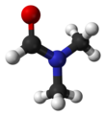
Hydrogen “hdm”
hdm 1.00797 H 1 Hydrogen atom in DMF (smaller sigma to reproduce density)
If atom type == ‘H’ and num of connects == 1:
elif type1 == ’C’ and ring1 == 0 and formula[atom-id] == ’C3-H7-N1-O1’ :
nta[atom-id] = ’hdm’
https://en.wikipedia.org/wiki/Dimethylformamide

Slide 45
Hydrogen “h”
h 1.00797 H 1 generic hydrogen bound to C, Si,or H
If atom type == ‘H’ and num of connects == 1:
elif type1 == ’C’ or type1 == ’Si’ or type1 == ’H’ :
nta[atom-id] = ’hdm’

Slide 46
Oxygen 1 Connects
o_1 15.99940 O 1 oxygen in carbonyl group
oo 15.99940 O 1 oxygen in carbonyl group, carbonate only
o= 15.99940 O 1 oxygen double bonded to O, C, S, N, P
o- 15.99940 O 1 partial double oxygen
4 PCFF 1-Connect Oxygens

Slide 47
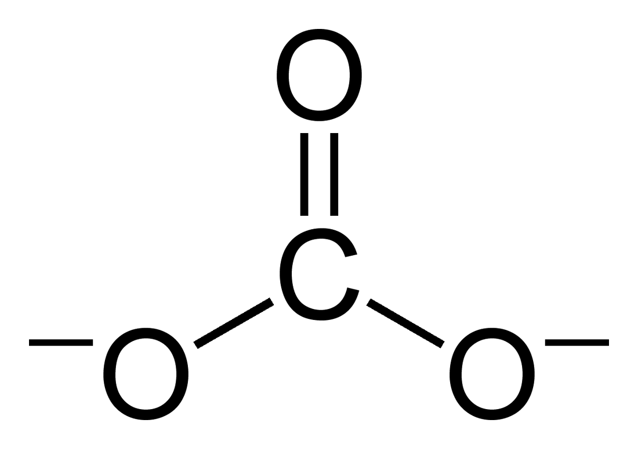
1-Connect Oxygen “o_1” and “oo”
o_1 15.99940 O 1 oxygen in carbonyl group
oo 15.99940 O 1 oxygen in carbonyl group, carbonate only
If atom type == “O” and num of connects == 1:
# o_1 15.99940 O 1 oxygen in carbonyl group
if type1 == ’C’ and ring1 = 0 and ’C’ in neigh_2nd_list:
nta[atom-id] = ’o_1’
# oo 15.99940 O 1 oxygen in carbonyl group, carbonate only
if type1 == ’C’ and ring1 = 0 and ’O’ in neigh_2nd_list:
nta[atom-id] = ’oo’
Carbonyl
carbonate

Slide 48
1-Connect Oxygen “o=”
o= 15.99940 O 1 oxygen double bonded to O, C, S, N, P
If atom type == ‘O’ and num of connects == 1:
if type1 == ’C’ or type1 = ’N’ or type1 == ’O’ type1 == ’S’ or type1 == ’P’:
nta[atom-id] = ‘o=‘

Slide 49
1-Connect Oxygen “o-”
o- 15.99940 O 1 partial double oxygen
If atom type == ‘O’ and num of connects == 1:
if atom type == ‘O’:
nta[atom-id] = ‘o-‘

Slide 50
Oxygen 2 Connects
15 PCFF 2-Connect Oxygens
o* 15.99940 O 2 oxygen in water
oz 15.99940 O 2 ester oxygen in carbonate
o_2 15.99940 O 2 ester oxygen
oe 15.99940 O 2 sp3 oxygen in ester
oc 15.99940 O 2 sp3 oxygen in ether or acetals
o3e 15.99940 O 2 sp3 oxygen in three membered ring
o4e 15.99940 O 2 sp3 oxygen in four membered ring
op 15.99940 O 2 sp2 aromatic in 5 membered ring
osh 15.99491 O 2 oxygen atom in terminal hydroxyl group on silicon
osi 16.00000 O 2 siloxane oxygen
oss 15.99491 O 2 oxygen atom between two silicons
oh 15.99940 O 2 oxygen bonded to hydrogen
o 15.99940 O 2 generic SP3 oxygen
oah 15.99491 O 2 oxygen atom in terminal hydroxyl group on aluminium
oas 15.99491 O 2 oxygen atom between aluminium and silicon

Slide 51
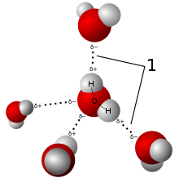
2-Connect Oxygen “o*”
o* 15.99940 O 2 oxygen in water (-0.82 in this moddel !)
If atom type == ‘O’ and num of connects == 2:
if formula == ’H2-O1’:
nta[atom-id] = ’o*’
https://en.wikipedia.org/wiki/Water

Slide 52
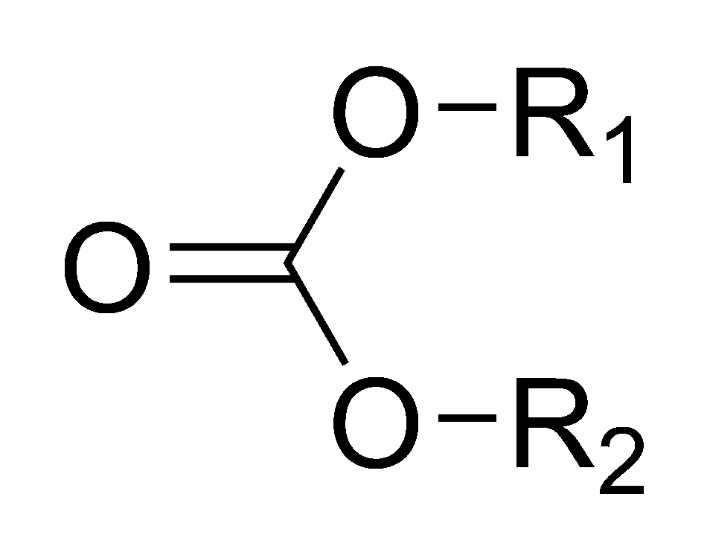
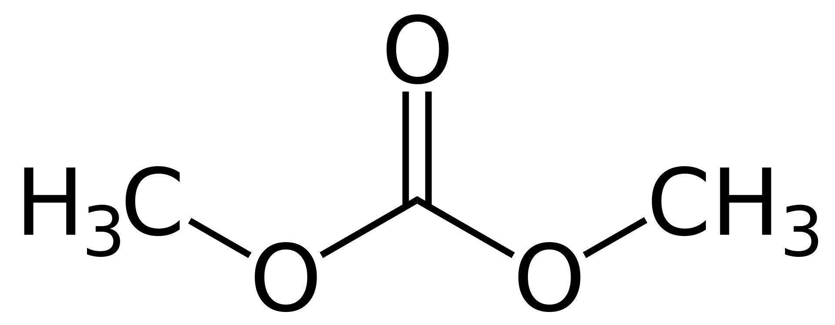
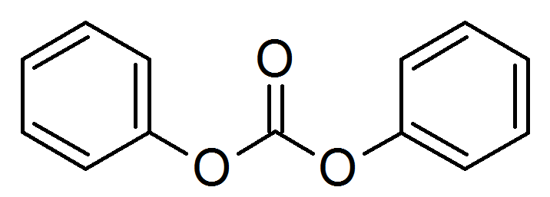
2-Connect Oxygen “oz”
oz 15.99940 O 2 ester oxygen in carbonate
elif ring_size == 0 and all(rings1) == 0 and elements1.count(’C’) == 2 and count_neigh(neighbor_info[2], element=‘O', ring= 0, nb=1) == 1:
if count_neigh(neighbor_info[2], element=‘O', ring= 0, nb=2) == 1:
nta[atom-id] = ’oz’
https://en.wikipedia.org/wiki/Carbonate_ester#/media/File:Diphenyl_carbonate.png

Slide 53
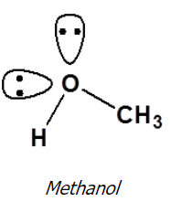
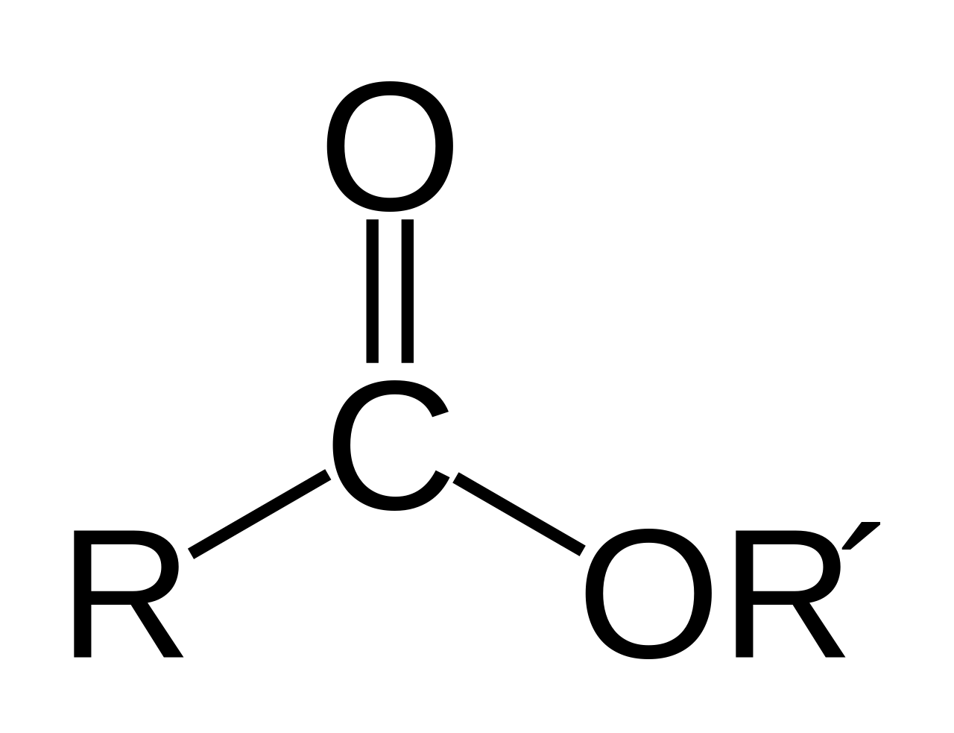
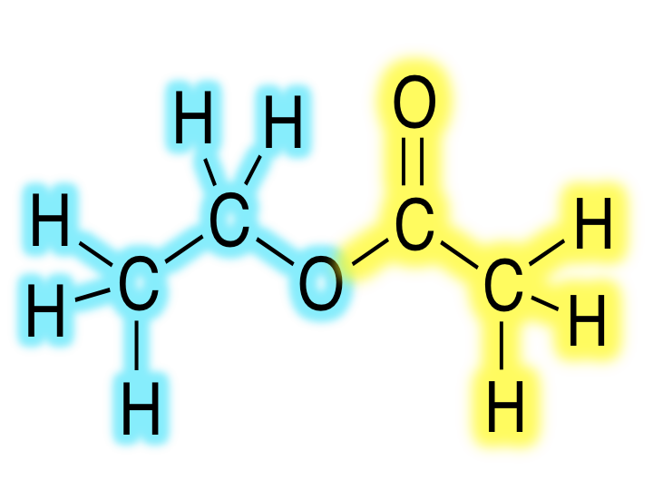
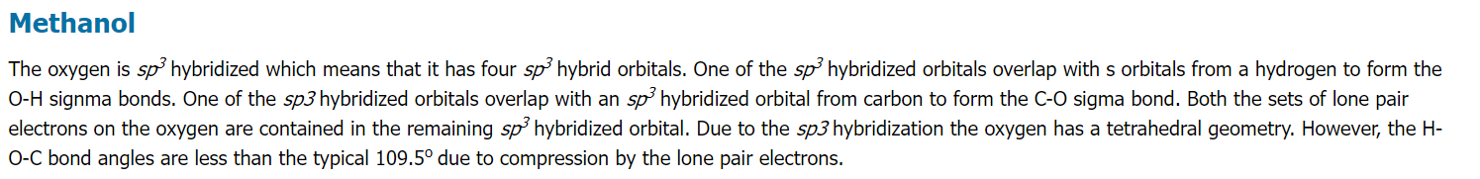
2-Connect Oxygen “o_2” or “oe”
o_2 15.99940 O 2 ester oxygen
Ester Oxygen
elif ring_size == 0 and all(rings1) == 0 and elements1.count(’C’) == 2 and count_neigh(neighbor_info[2], element=‘O', ring= 0, nb=1) == 1:
if elements2.count(’C’) == 2 :
nta[atom-id] = ’o_2’
# o_2 15.99940 O 2 ester oxygen
elif ring_size == 0 and type1 = ’C’ and ring1 == 0 and type2 = ’C’ and ring2 == 0 and count_2ndneigh_elemringnb(neigh_2nd_list, ’O’, 0, 1) == 1 :
nta[atom-id] = ’o_2’
https://en.wikipedia.org/wiki/Ester
https://chem.libretexts.org/Courses/Athabasca_University/Chemistry_350%3A_Organic_Chemistry_I/01%3A_Structure_and_Bonding/1.11%3A_Hybridization_of_Nitrogen_Oxygen_Phosphorus_and_Sulfur

Slide 54

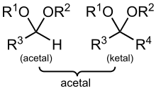
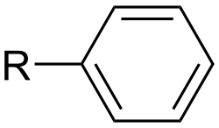

2-Connect Oxygen “oc” or “oe”
oc 15.99940 O 2 sp3 oxygen in ether or acetals
oe 15.99940 O 2 sp3 oxygen in ester
Ether: R–O–R′, where R and R′ represent the alkyl or aryl groups
aryl
If atom type == ‘O’ and num of connects == 2:
if elements1.count(’C’) == 2:
nta[atom-id] = ’oc’
alkyl
https://en.wikipedia.org/wiki/Ether
https://en.wikipedia.org/wiki/Alkyl
https://en.wikipedia.org/wiki/Acetal

Slide 55
2-Connect Oxygen “o3e”
o3e 15.99940 O 2 sp3 oxygen in three membered ring
If atom type == ’O’ and num of connects == 2 :
elif ring_size == 3:
nta[atom-id] = ’o3e’

Slide 56
2-Connect Oxygen “o4e”
o4e 15.99940 O 2 sp3 oxygen in four membered ring
If atom type == ’O’ and num of connects == 2:
elif ring_size == 4:
nta[atom-id] = ’o4e’

Slide 57
2-Connect Oxygen “op”
op 15.99940 O 2 sp2 aromatic in 5 membered ring
If atom type == ’O’ and num of connects == 2:
elif ring_size == 5:
nta[atom-id] = ’op’

Slide 58
2-Connect Oxygen “osh”
osh 15.99491 O 2 oxygen atom in terminal hydroxyl group on silicon
Si
hydroxyl
If atom type == ’O’ and num of connects == 2:
elif ring_size == 0 and elements1.count(’C’) == 1 and elements1.count(’Si’) == 1:
nta[atom-id] = ’osh’

Slide 59
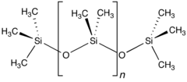
2-Connect Oxygen “osi” or “oss”
osi 16.00000 O 2 siloxane oxygen
oss 15.99491 O 2 oxygen atom between two silicons
If atom type == ’O’ and num of connects == 2:
elif ring_size == 0 and ’Si’ in elements1 and type2 == ’O’ in elements2:
nta[atom-id] = ’osi’
https://en.wikipedia.org/wiki/Siloxane

Slide 60
2-Connect Oxygen “oh”
oh 15.99940 O 2 oxygen bonded to hydrogen
If atom type == “O” and num of connects == 2:
elif ’H’ in ements1:
nta[atom-id] = ‘oh’
https://en.wikipedia.org/wiki/Ether
https://en.wikipedia.org/wiki/Alkyl

Slide 61
Oxygen 3 Connects
ob 15.99491 O 3 oxygen atom in bridging hydroxyl group
15 IFF 2-Connect Oxygens

Slide 62
3-Connect Oxygen “ob”
ob 15.99491 O 3 oxygen atom in bridging hydroxyl group
If atom type == “O” and num of connects == 3:
nta[atom-id] = ’ob’

Slide 63
1 connect Nitrogen
nt 14.00670 N 1 sp nitrogen involved in a triple bond
nz 14.00670 N 1 sp3 nitrogen bonded to two atoms
2 IFF 1 connect Nitrogen

Slide 64
2 connect Nitrogen
np 14.00670 N 2 sp2 nitrogen in 5- or 6- membered ring
n= 14.00670 N 2 non aromatic end doubly bonded nitrogen
n=1 14.00670 N 2 non aromatic, next to end doubly bonded carbon
n=2 14.00670 N 2 non aromatic doubly bonded nitrogen
4 PCFF 2 connect Nitrogen

Slide 65
2-Connect Nitrogen “np”
np 14.00670 N 2 sp2 nitrogen in 5- or 6- membered ring
If atom type == ’N’ and num of connects == 2:
if ring_size > 3:
nta[atom-id] = ’np’

Slide 66
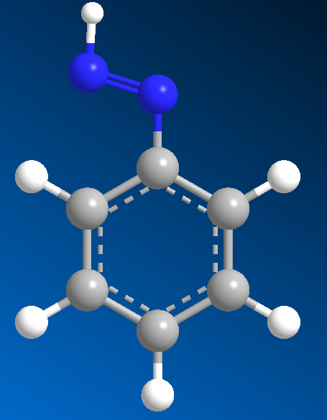
2-Connect Nitrogen “n=1”
n=1 14.00670 N 2 non aromatic, next to end doubly bonded carbon
9
nb2 == 1
1
2
10
8
14
3
7
4
6
11
5
13
12
If atom type == ’N’ and num of connects == 2:
elif ring_size == 0 and nbs2.count(1) >= 1:
nta[atom-id] = ’n=’

Slide 67
2-Connect Nitrogen “n=2”
n=2 14.00670 N 2 non aromatic doubly bonded nitrogen
If atom type == ’N’ and num of connects == 2:
# n=2 14.00670 N 2 non aromatic doubly bonded nitrogen
elif ring_size == 0:
nta[atom-id] = ’n=2’

Slide 68
2-Connect Nitrogen “n=”
n= 14.00670 N 2 non aromatic end doubly bonded nitrogen
nb1 == 1
9
n=
1
2
10
8
14
3
7
4
6
If atom type == ’N’ and num of connects == 2:
elif ring_size == 0 and and nbs1.count(1) >= 1:
nta[atom-id] = ’n=’
11
5
13
12

Slide 69
3 connect Nitrogen
17 PCFF 3 connect Nitrogen
n1 14.00670 N 3 sp2 nitrogen in charged arginine
n2 14.00670 N 3 sp2 nitrogen (NH2) in guanidinium group (HN=C(NH2)2)
nr 14.00670 N 3 sp2 nitrogen (NH2) in guanidinium group (HN=C(NH2)2)
n_2 14.01000 N 3 nitrogen of urethane
nn 14.00670 N 3 sp2 nitrogen in aromatic amines
nb 14.00670 N 3 sp2 nitrogen in aromatic amines
na 14.00670 N 3 sp3 nitrogen in amines
nho 14.00670 N 3 sp2 nitrogen in 6 membered ring next to a carbonyl
ni 14.00670 N 3 nitrogen in charged imidazole ring
npc 14.00670 N 3 sp2 nitrogen in 5- or 6- membered ring and with a heavy atom
nh 14.00670 N 3 sp2 nitrogen in 5 or 6 membered ring
n3n 14.00670 N 3 sp2 nitrogen in 3- membered ring
n3m 14.00670 N 3 sp3 nitrogen in 3- membered ring
n4n 14.00670 N 3 sp2 nitrogen in 4- membered ring
n4m 14.00670 N 3 sp3 nitrogen in 4- membered ring
n 14.00670 N 3 generic sp2 nitrogen (in amids))
nh+ 14.00670 N 3 protonated nitrogen in 6 membered ring (WOULD HAVE 4Nb – set with 4 connected)

Slide 70


3-Connect Nitrogen “n1”
n1 14.00670 N 3 sp2 nitrogen in charged arginine
If atom type == ’N’ and num of connects == 3 :
if ring == 0 and formula ==’C6-H14-N4-O2’ :
nta[atom-id] = ’n_2’
https://en.wikipedia.org/wiki/Arginine

Slide 71

3-Connect Nitrogen “n2” or “nr”
n2 14.00670 N 3 sp2 nitrogen (NH2) in guanidinium group (HN=C(NH2)2)
nr 14.00670 N 3 sp2 nitrogen (NH2) in guanidinium group (HN=C(NH2)2)
If atom type == ’N’ and num of connects == 3 :
if ring == 0 and type_list.count(’C’) == 1 and formula ==’C1-H5-N3’ :
nta[atom-id] = ’n2’
https://en.wikipedia.org/wiki/Guanidine

Slide 72
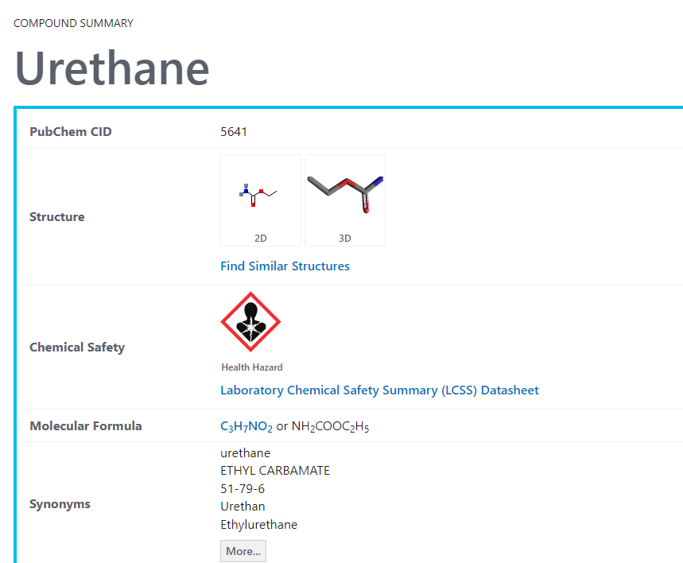
3-Connect Nitrogen “n_2”
n_2 14.01000 N 3 nitrogen of urethane
If atom type == ’N’ and num of connects == 3 :
if ring == 0 and formula ==’C3-H7-N1-O2’ :
nta[atom-id] = ’n_2’
https://pubchem.ncbi.nlm.nih.gov/compound/Urethane

Slide 73
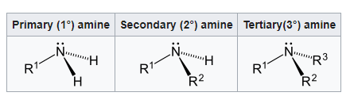
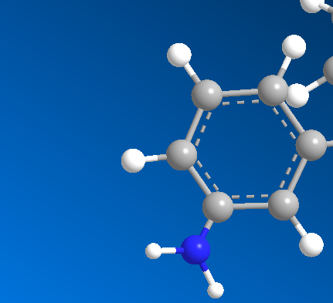
3-Connect Nitrogen “nn”
nn 14.00670 N 3 sp2 nitrogen in aromatic amines
nb 14.00670 N 3 sp2 nitrogen in aromatic amines
If atom type == ’N’ and num of connects == 3 :
elif any(rings1) > 0 and 3 in nbs1 :
nta[atom-id] = ’nn’
https://en.wikipedia.org/wiki/Amine

Slide 74
3-Connect Nitrogen “na”
na 14.00670 N 3 sp3 nitrogen in amines
If atom type == ’N’ and num of connects == 3 :
elif ring == 0 and elements1.count(’H’) == 2 and elements1.count(’C’) == 1:
nta[atom-id] = ’na’
elif ring == 0 and elements1.count(’H’) == 1 and elements1.count(’C’) == 2:
nta[atom-id] = ’na’
elif ring == 0 and elements1.count(’C’) == 3:
nta[atom-id] = ’na’
https://en.wikipedia.org/wiki/Amine

Slide 75
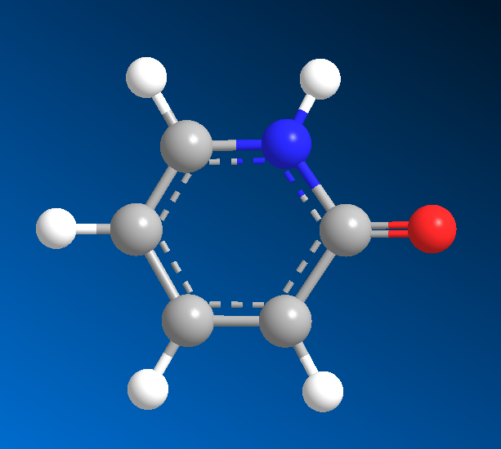
3-Connect Nitrogen “nho”
nho 14.00670 N 3 sp2 nitrogen in 6 membered ring next to a carbonyl
Carbonyl
# o_2 15.99940 O 2 ester oxygen
elif ring_size == 6 and count_neigh(neighbor_info[2], element=‘O', ring=0, nb=1) >= 1 and ’C’ in elements1:
nta[atom-id] = ’nho’

Slide 76
3-Connect Nitrogen “ni”
ni 14.00670 N 3 nitrogen in charged imidazole ring
If atom type == ‘N’ and num of connects == 3:
if ring == 5 and count_neigh(neighbor_info[1], element=‘C', ring= 5, nb=3) >= 2 and formula == ‘C3-H4-N2’:
nta[atom-id] = ’ni’
If atom type == ‘N’ and num of connects == 2:
if ring == 5 and count_neigh(neighbor_info[1], element=‘C', ring= 5, nb=3) >= 2 and formula == ‘C3-H4-N2’:
nta[atom-id] = ’ni’

Slide 77
3-Connect Nitrogen “npc”
npc 14.00670 N 3 sp2 nitrogen in 5- or 6- membered ring and with a heavy atom
If atom type == ’N’ and num of connects == 3:
if ring_size >= 5 and count_heavies(neighbors) > 0 :
nta[atom-id] = ’npc’

Slide 78
3-Connect Nitrogen “nh”
nh 14.00670 N 3 sp2 nitrogen in 5 or 6 membered ring
If atom type == ’N’ and num of connects == 3:
if ring_size >= 5 :
nta[atom-id] = ’nh’

Slide 79
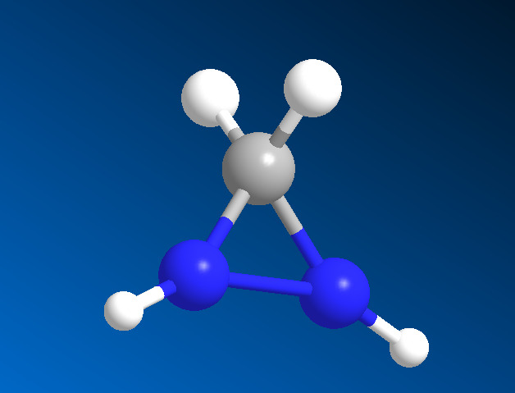
3-Connect Nitrogen “n3n”
n3n 14.00670 N 3 sp2 nitrogen in 3- membered ring (ASSUME n means w/ N like H for c3h)
If atom type == ’N’ and num of connects == 3:
# c4h
elif ring_size == 3 and ’N’ in typelist:
nta[atom-id] = ’n3n’

Slide 80
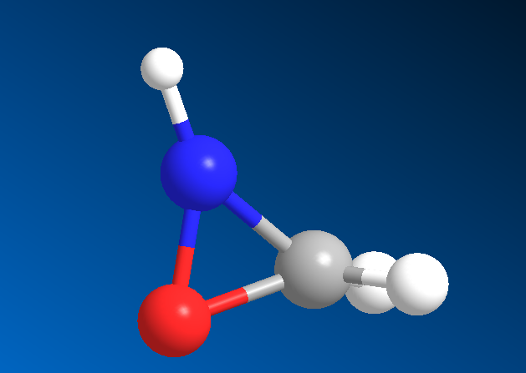
3-Connect Nitrogen “n3m”
n3m 14.00670 N 3 sp3 nitrogen in 3- membered ring (ASSUME m means member like m for c3m)
If atom type == ’N’ and num of connects == 3 :
# c4h
elif ring_size == 3:
nta[atom-id] = ’n3m’

Slide 81
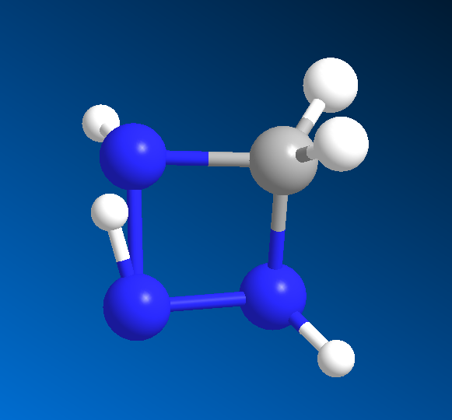
3-Connect Nitrogen “n4n”
n4n 14.00670 N 3 sp2 nitrogen in 4- membered ring (ASSUME n means w/ N like H for c4h)
If atom type == ’N’ and num of connects == 3 :
# c4h
elif ring_size == 4 and ’N’ in elements1 or ’N’ in elements2:
nta[atom-id] = ’n4n’

Slide 82
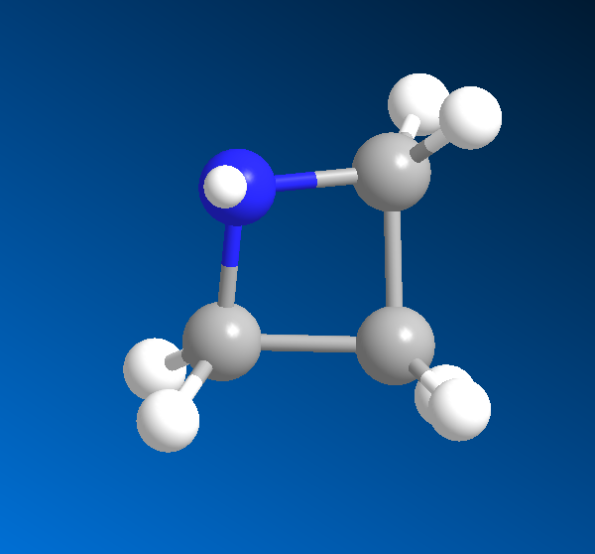
3-Connect Nitrogen “n4m”
n4m 14.00670 N 3 sp3 nitrogen in 4- membered ring (ASSUME m means member like m for c4m)
If atom type == ’N’ and num of connects == 3 :
elif ring_size == 4 :
nta[atom-id] = ’n4m’

Slide 83
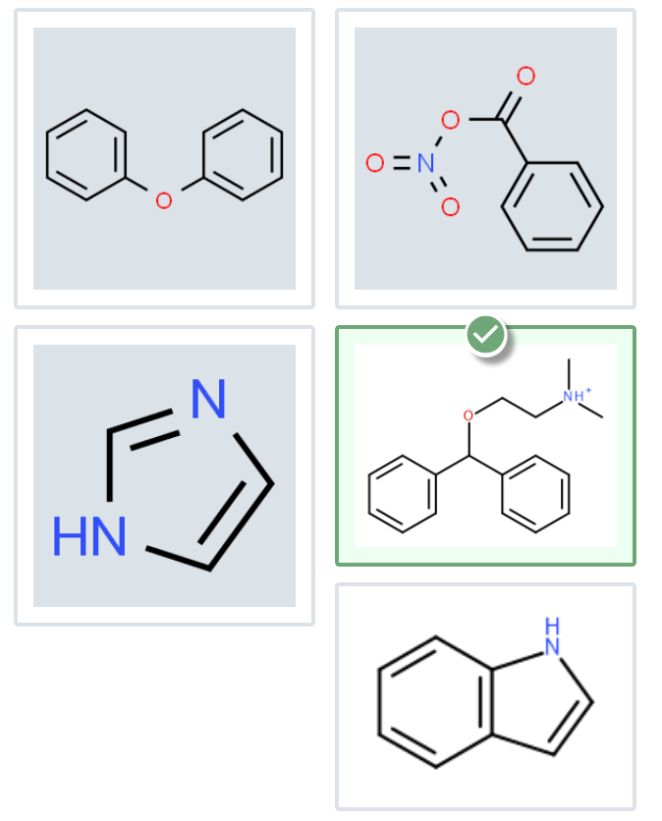
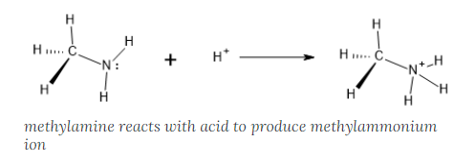
3-Connect Nitrogen “nh+”
nh+ 14.00670 N 3 protonated nitrogen in 6 membered ring
If atom type == ’N’ and num of connects == 4:
if ring_size >= 6:
nta[atom-id] = ’nh+’
https://openoregon.pressbooks.pub/introductoryorganic/chapter/amine-protonation/

Slide 84
4 connect Nitrogen
nh+ 14.00670 N 3 protonated nitrogen in 6 membered ring (WOULD HAVE 4Nb – set with 4 connected)
n4 14.00670 N 4 sp3 nitrogen in protonated amines
n+ 14.00670 N 4 sp3 nitrogen in protonated amines
2 IFF 4 connect Nitrogen

Slide 85
1 connect Sulfur
s' 32.06400 S 1 S in thioketone group
s- 32.06400 S 1 partial double sulfur
sf 32.06400 S 1 S in sulfonate group (IT APPEARS TO HAVE 4 BONDED ATOMS – USE 4-CONNECT SECTION)
3 PCFF 1 connect Nitrogen

Slide 86
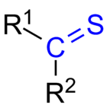
1 Connect Sulfur “s’”
s' 32.06400 S 1 S in thioketone group
If atom type == ’S’ and num of connects == 1:
if ’C’ in elements1:
nta[atom-id] = ’s’
https://en.wikipedia.org/wiki/Thioketone

Slide 87
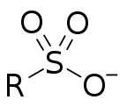
1 Connect Sulfur “sf”
sf 32.06400 S 1 S in sulfonate group
If atom type == ’S’ and num of connects == 4 :
elif elements1.count(’O’) == 3 :
nta[atom-id] = ’sf’
https://en.wikipedia.org/wiki/Sulfonate#:~:text=In%20organosulfur%20chemistry%2C%20a%20sulfonate,non%2Doxidizing%2C%20and%20colorless.

Slide 88
2 connect Sulfur
s3e 32.06400 S 2 sulfur in three membered ring
s4e 32.06400 S 2 sulfur in four membered ring
sp 32.06400 S 2 sulfur in an aromatic ring (e.g. thiophene)
sc 32.06400 S 2 sp3 sulfur in methionines (C-S-C) group
sh 32.06400 S 2 sp3 sulfur in sulfhydryl (-SH) group (e.g. cysteine)
s1 32.06400 S 2 sp3 sulfur involved in (S-S) group of disulfides
s 32.06400 S 2 sp3 sulfur
7 PCFF 2 connect Sulfur

Slide 89
2-Connect Nitrogen “s3e”
s3e 32.06400 S 2 sulfur in three membered ring
If atom type == ’S’ and num of connects == 2 :
elif ring_size == 3:
nta[atom-id] = ’s3e’

Slide 90
2-Connect Nitrogen “s4e”
s4e 32.06400 S 2 sulfur in four membered ring
If atom type == ’S’ and num of connects == 2 :
elif ring_size == 4:
nta[atom-id] = ’s4e’

Slide 91
2-Connect Nitrogen “sp”
sp 32.06400 S 2 sulfur in an aromatic ring (e.g. thiophene)
If atom type == ’S’ and num of connects == 2 :
elif ring_size > 4:
nta[atom-id] = ’sp’

Slide 92
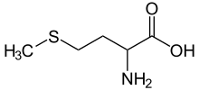
2-Connect Nitrogen “sc”
sc 32.06400 S 2 sp3 sulfur in methionines (C-S-C) group
If atom type == ’S’ and num of connects == 2 :
elif ring_size == 0 and elements1.count(’C’) == 1 :
nta[atom-id] = ’sc’
https://en.wikipedia.org/wiki/Methionine

Slide 93

2-Connect Nitrogen “sh”
sh 32.06400 S 2 sp3 sulfur in sulfhydryl (-SH) group (e.g. cysteine)
If atom type == ’S’ and num of connects == 2 :
elif elements1.count(’H’) >= 1 and elements1.count(’C’) >= 1 :
nta[atom-id] = ’sh’
https://en.wikibooks.org/wiki/Structural_Biochemistry/Organic_Chemistry/Organic_Functional_Group/Sulfhydryl#:~:text=A%20sulfhydryl%20is%20a%20functional,great%20affinity%20for%20soft%20metals.

Slide 94


2-Connect Nitrogen “s1”
s1 32.06400 S 2 sp3 sulfur involved in (S-S) group of disulfides
If atom type == ’S’ and num of connects == 2 :
elif elements1.count(’S’) >= 1 :
nta[atom-id] = ’s1’
https://en.wikipedia.org/wiki/Disulfide

Slide 95
4 connect Sulfur
sf 32.06400 S 1 S in sulfonate group (IT APPEARS TO HAVE 4 BONDED ATOMS – USE 4-CONNECT SECTION)
1 PCFF 4 connect Sulfur

Slide 96
4-Connect Sulfur “sf”
sf 32.06400 S 1 S in sulfonate group
If atom type == ’S’ and num of connects == 4 :
elif elements1.count(’O’) == 3 :
nta[atom-id] = ’sf’
https://en.wikipedia.org/wiki/Sulfonate#:~:text=In%20organosulfur%20chemistry%2C%20a%20sulfonate,non%2Doxidizing%2C%20and%20colorless.

Slide 97
4 connect silicon
sio 28.08600 Si 4 siloxane silicon
si 28.08600 Si 4 silicon atom
sz 28.08600 Si 4 silicon atom in zeolites

Slide 98
2-Connect Oxygen “sio”
sio 28.08600 Si 4 siloxane silicon
If atom type == ’Si’ and num of connects == 4:
elif ring_size == 0 and ’O’ in elements1 and type2 == ’Si’ in elements2:
nta[atom-id] = ’sio’
https://en.wikipedia.org/wiki/Siloxane

Slide 99
Phosphorous
p 30.97380 P 4 general phosphorous atom
p= 30.97380 P 5 phosphazene phosphorous atom

Slide 100
Simple singular element atom types
f 18.99840 F 1 fluorine atom
xe 131.30000 Xe 0 Xenon ne 20.18300 Ne 0 Neon
kr 83.80000 Kr 0 Krypton
he 4.00300 He 0 Helium
dw 2.01400 D 1 deuterium in heivy water
cl 35.45300 Cl 1 chlorine atom
ca+ 40.08000 Ca 1 calcium ion
br 79.90900 Br 1 bromine atom
ar 39.94400 Ar 0 Argon

Slide 101

I AM HERE

Slide 102
Acknowledgements
Dr. Gregory Odegard
CMMR Lab Group
Superior: Dr. Gowtham
Special Thanks to:
Prathamesh Deshpande, Sagar Patil, Hashim Al Mahud, Will Pisani, and Ivan Gallegos

