Slide 1
Sp1 Carbon
ct 12.01115 C 2 sp carbon involved in a triple bond
1 IFF Sp Carbon

Slide 2
Sp1 Carbon
ct 12.01115 C 2 sp carbon involved in a triple bond
If ring_size == 0 and atom type == “C” and nb <= 2:
# Sp1 Carbon
nta[atom-id] = “ct”

Slide 3
Atom Typing Color Nomenclature
Green means CAN find atom type
Light Green means CAN find atom type, but possibly needs more logic
Orange means can not distinguish between atom type
Red means method CANNOT find atom type
Highlighted in grey means a user input to help find correct atom types
Black means could be switched out in the if/elif/else statements because of an overlap issue. System and user preference dependent.

Slide 4
Functions
check_elements2element([lst], ‘element’)
returns True
if all elements in [lst] equal ‘element’
returns False
if all elements in [lst] DO NOT equal ‘element’

Slide 5
Sp2 Carbon
c+ 12.01115 C 3 C in guanidinium group
cr 12.01115 C 3 C in neutral arginine
c- 12.01115 C 3 C in charged carboxylate
c5 12.01115 C 3 sp2 aromatic carbon in 5-membered ring
cs 12.01115 C 3 sp2 aromatic carbon in 5 membered ring next to S
cp 12.01115 C 3 sp2 aromatic carbon
cg1 10.011150 C 3 sp2 hybridized carbon atom in graphene sheet
c_0 12.01115 C 3 carbonyl carbon of aldehydes, ketones
c_1 12.01115 C 3 carbonyl carbon of acid, ester, amide
c_2 12.01100 C 3 carbonyl carbon of carbamate, urea
cz 12.01100 C 3 carbonyl carbon of carbonate
ci 12.01115 C 3 sp2 aromatic carbon in charged imidazole ring (His+)
c= 12.01115 C 3 nonaromatic end doubly bonded carbon
c=1 12.01115 C 3 nonaromatic, next to end doubly bonded carbon
c=2 12.01115 C 3 nonaromatic doubly bonded carbon
15 IFF Sp2 Carbons

Slide 6
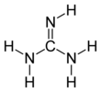
Sp2 Carbon “c+”
c+ 12.01115 C 3 C in guanidinium group
If atom type == ’C’ and nb == 3:
# Guanidinium group
If ring_size == 0 and formula == ’C1-H5-N3’:
nta[atom-id] = ’c+’
https://en.wikipedia.org/wiki/Guanidine

Slide 7
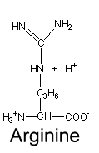

Sp2 Carbon “cr”
cr 12.01115 C 3 C in neutral arginine
If atom type == ’C’ and num of connects == 3:
# Arginine
elif ring_size == 0 and elements1.count(’C’) == 2 and elements1.count(’N’) == 1:
nta[atom-id] = ’cr’
elif ring_size == 0 and elements1.count(’N’) == 3:
nta[atom-id] = ’cr’
https://www2.chem.wisc.edu/deptfiles/genchem/netorial/modules/biomolecules/modules/protein1/prot14.htm#:~:text=There%20are%20three%20amino%20acids,%2C%20and%20histidine%20(His).&text=Their%20side%20chains%20have%20carboxylic,negatively%20charged%20in%20the%20process.
https://en.wikipedia.org/wiki/Arginine

Slide 8
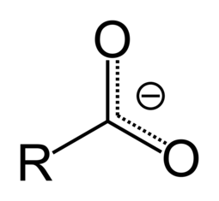
Sp2 Carbon “c-”
c- 12.01115 C 3 C in charged carboxylate
https://en.wikipedia.org/wiki/Carboxylate#:~:text=A%20carboxylate%20is%20the%20conjugate,or%20RCO2R%E2%80%B2
If atom type == ’C’ and nb == 3:
# Carboxylate
elif ring_size == 0 and elements1.count(’C’) == 1 and elements1.count(’O’) == 2:
if ring2 == 0 and ring3 == 0:
nta[atom-id] = ’c-’

Slide 9
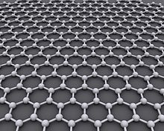
Sp2 Carbon “cg1”
cg1 10.011150 C 3 sp2 hybridized carbon atom in graphene sheet
If atom type == “C” and num of connects == 3:
# Graphene
elif ring_size == 6 and 6 in rings1 and rings3.count(6) >= 3 and use_graphene_types:
nta[atom-id] = ’cg1’
https://en.wikipedia.org/wiki/Graphene

Slide 10
Sp2 Carbon “c5”
c5 12.01115 C 3 sp2 aromatic carbon in 5-membered ring
If atom type == ’C’ and nb== 3:
# 5 Member Ring
elif ring_size == 5 and elements1.count(’S’) == 0:
nta[atom-id] = ’c5’

Slide 11
Sp2 Carbon “cs”
cs 12.01115 C 3 sp2 aromatic carbon in 5 membered ring next to S
If atom type == ’C’ and nb== 3:
# 5 Member Ring
elif ring_size == 5 and elements1.count(’S’) > 0:
nta[atom-id] = ’cs’

Slide 12
Sp2 Carbon “cp”
cp 12.01115 C 3 sp2 aromatic carbon
If atom type == ’C’ and nb == 3:
# 6 Member Ring
elif ring_size == 6 and not use_graphene_types:
nta[atom-id] = ’cp’
elif ring_size == 6 and rings1.count(6) <= 2:
nta[atom-id] = ’cp’

Slide 13
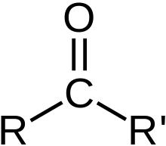
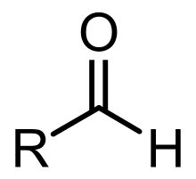
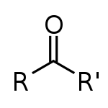
Sp2 Carbon “c_0”
c_0 12.01115 C 3 carbonyl carbon of aldehydes, ketones
Carbonyl
If atom type == ’C’ and nb == 3:
# Ketone
elif ring_size == 0 and elements1.count(’C’) == 2 and elements1.count(’O’) == 1 and nbs1[2] == 1:
nta[atom-id] = ’c_0’
# Aldehyde
elif ring_size == 0 and elements1.count(’C’) == 1 and elements1.count(’H’) == 1 and elements1.count(’O’) == 1 and nbs1[2] == 1 : nta[atom-id] = ’c_0’
Aldehyde
Ketone
https://en.wikipedia.org/wiki/Carbonyl_group
https://en.wikipedia.org/wiki/Aldehyde
https://en.wikipedia.org/wiki/Ketone

Slide 14
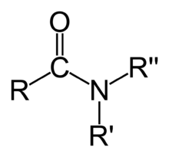
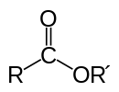
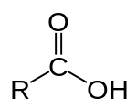
Sp2 Carbon “c_1”
c_1 12.01115 C 3 carbonyl carbon of acid, ester, amide
Carbonyl
Amide
Ester
Carboxylic acid
If atom type == ’C’ and num of connects == 3:
# Amide
elif ring_size == 0 and elements1[0] == ’C’ and elements1[1] == ’N’ and elements1[2] == ’N’ and rings1.count[0] == 3:
nta[atom-id] = ’c_1’
# Ester, Carboxylic acid
elif ring_size == 0 and elements1[0] == ’C’ and elements1[1] == ’O’ and elements1[2] == ’O’ and rings1.count[0] == 3:
nta[atom-id] = ‘c_1’
https://en.wikipedia.org/wiki/Carbonyl_group
https://en.wikipedia.org/wiki/Amide
https://en.wikipedia.org/wiki/Ester
https://en.wikipedia.org/wiki/Acid
https://en.wikipedia.org/wiki/Carboxylic_acid
Look for other acid types other then Carboxylic

Slide 15
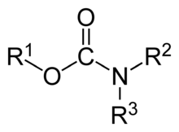

Sp2 Carbon “c_2”
c_2 12.01100 C 3 carbonyl carbon of carbamate, urea
Carbonyl
Carbamate
Urea
If atom type == ’C’ and num of connects == 3:
# Carbamate
elif ring_size == 0 and elements1[0] == ’N’ and elements1[1] == ’O’ and elements1[2] == ’O’ and rings1.count[0] == 3:
nta[atom-id] = ’c_2’
# Urea
elif ring_size == 0 and elements1[0] == ’N’ and elements1[1] == ’N’ and elements1[2] == ’O’ and rings1.count[0] == 3:
nta[atom-id] = ‘c_2’
https://en.wikipedia.org/wiki/Carbonyl_group
https://en.wikipedia.org/wiki/Carbamate
https://en.wikipedia.org/wiki/Urea

Slide 16
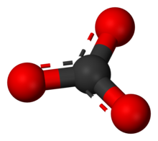
Sp2 Carbon “cz”
cz 12.01100 C 3 carbonyl carbon of carbonate
Carbonyl
Carbanate
If atom type == ’C’ and num of connects == 3:
# Carbanate
elif ring_size == 0 and elements1.count(’O’) == 3:
nta[atom-id] =’cz’
https://en.wikipedia.org/wiki/Carbonyl_group
https://en.wikipedia.org/wiki/Carbonate

Slide 17
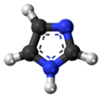
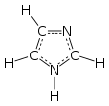
Sp2 Carbon “ci”
ci 12.01115 C 3 sp2 aromatic carbon in charged imidazole ring (His+)
C-C: type1
C-H: type2
C-N: type3
C-H: type1
C-N: type2
C-N: type3
If atom type == ’C’ and num of connects == 3:
# imidazole ring for Carbon
elif ring_size >= 5 and type3 = ’N’ and ring3 == 5 and formula == ‘C3-H4-N2’: :
nta[atom-id] = ’ci’
https://en.wikipedia.org/wiki/Imidazole

Slide 18
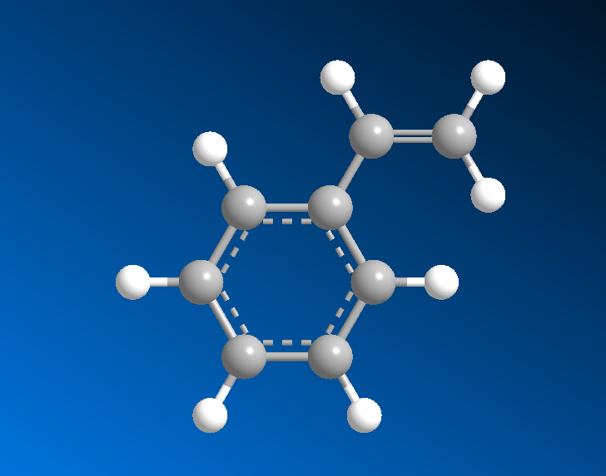
Sp2 Carbon “c=”
c= 12.01115 C 3 nonaromatic end doubly bonded carbon
C=
nb1 == 1
If atom type == ’C’ and num of connects == 3:
# c= 12.01115 C 3 nonaromatic end doubly bonded carbon
elif ring_size == 0 and nbs1.count(1) == 2:
nta[atom-id] = ’c=’
https://en.wikipedia.org/wiki/Imidazole

Slide 19
Sp2 Carbon “c=1”
c=1 12.01115 C 3 nonaromatic, next to end doubly bonded carbon
C=1
2nd-neighs
If atom type == ’C’ and num of connects == 3:
# c= 12.01115 C 3 nonaromatic end doubly bonded carbon
elif ring_size == 0 and nbs2.count(1) >= 2:
nta[atom-id] = ’c=1’

Slide 20
Sp2 Carbon non-aromatic assumed
c=2 12.01115 C 3 nonaromatic doubly bonded carbon
Type | NonB | Bond | Angle | Torsion | OOP
C= | C= | C= | C= | C= | C=
C=1 | C= | C=1 | C= | C=1 | C=
C=2 | C= | C=2 | C= | C=2 | C=
If atom type == “C” and num of connects == 3:
# c=2 12.01115 C 3 nonaromatic doubly bonded carbon
elif ring_size == 0:
nta[atom-id] = ’c=2’

Slide 21
Sp3 Carbon
c3h 12.01115 C 4 sp3 carbon in 3-membered ring with hydrogens
c3m 12.01115 C 4 sp3 carbon in 3-membered ring
c4h 12.01115 C 4 sp3 carbon in 4-membered ring with hydrogens
c4m 12.01115 C 4 sp3 carbon in 4-membered ring
c_a 12.01115 C 4 general amino acid alpha carbon (sp3)
cg 12.01115 C 4 sp3 alpha carbon in glycine
co 12.01115 C 4 sp3 carbon in acetals
coh 12.01115 C 4 sp3 carbon in acetals with hydrogen
ce1 12.01115 C 4 Carbon atom in backbone or terminal group in PEO
c1 12.01115 C 4 sp3 carbon with 1 H 3 heavies
c2 12.01115 C 4 sp3 carbon with 2 H's, 2 Heavy’s
c3 12.01115 C 4 sp3 carbon with 3 hHs 1 heavy
c4o 12.01115 C 4 Carbon atom, sp3, bonded to oxygen (+0.054, compass)
c 12.01115 C 4 generic SP3 carbon
c4 12.01115 C 4 Carbon atom, sp3, generic, 4 bonds (compass)
15 IFF Sp3 Carbons

Slide 22
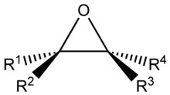
Sp3 Carbon “c3h”
c3h 12.01115 C 4 sp3 carbon in 3-membered ring with hydrogens
If atom type == ’C’ and num of connects == 4 :
# c3h
if ring_size == 3 and ’H’ in elements1:
nta[atom-id] = ’c3h’
https://en.wikipedia.org/wiki/Epoxide

Slide 23
Sp3 Carbon “c3m”
c3m 12.01115 C 4 sp3 carbon in 3-membered ring
If atom type == ’C’ and num of connects == 4 :
# c3h
elif ring_size == 3:
nta[atom-id] = ’c3m’
https://en.wikipedia.org/wiki/Epoxide

Slide 24
Sp3 Carbon “c4h”
c4h 12.01115 C 4 sp3 carbon in 4-membered ring with hydrogens
If atom type == ’C’ and num of connects == 4 :
# c4h
elif ring_size == 4 and ’H’ in elements1:
nta[atom-id] = ’c4h’

Slide 25
Sp3 Carbon “c4m”
c4m 12.01115 C 4 sp3 carbon in 4-membered ring
If atom type == ’C’ and num of connects == 4 :
# c4h
elif ring_size == 4:
nta[atom-id] = ’c4m’

Slide 26
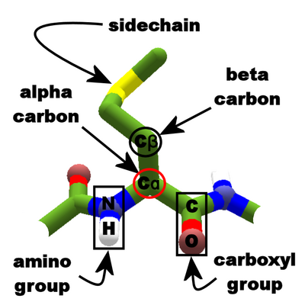
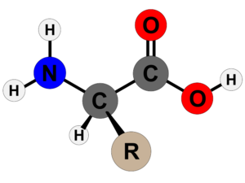
Sp3 Carbon “c_a”
https://en.wikipedia.org/wiki/Amino_acid
https://foldit.fandom.com/wiki/Alpha_carbon
c_a 12.01115 C 4 general amino acid alpha carbon (sp3)
If atom type == ’C’ and num of connects == 4:
# alpha carbon in amino acid
elif ring_size == 0 and elements1.count(’C’) == 2 and elements1.count(’H’) == 1 and elements1.count(’N’) == 1 : nta[atom-id] = ’c_a’

Slide 27


Sp3 Carbon “cg”
cg 12.01115 C 4 sp3 alpha carbon in glycine
If atom type == ’C’ and num of connects == 4:
# carbon in glycine
elif ring_size == 0 and formula == ’C2-H5-N1-O2’:
nta[atom-id] = ’cg’
https://en.wikipedia.org/wiki/Glycine

Slide 28
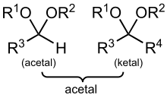
Sp3 Carbon “co”
co 12.01115 C 4 sp3 carbon in acetals
If atom type == ’C’ and num of connects == 4:
# ketals
elif ring_size == 0 and elements1.count(’C’) == 2 and elements1.count(’O’) == 2:
nta[atom-id] = ’co’
https://en.wikipedia.org/wiki/Acetal

Slide 29
Sp3 Carbon “coh”
coh 12.01115 C 4 sp3 carbon in acetals with hydrogen
If atom type == “C” and num of connects == 4:
# acetals
elif ring_size == 0 and elements1.count(’C’) == 1 and elements1.count(’O’) == 2 and elements1.count(’H’) == 1:
nta[atom-id] = ’coh’
https://en.wikipedia.org/wiki/Acetal

Slide 30
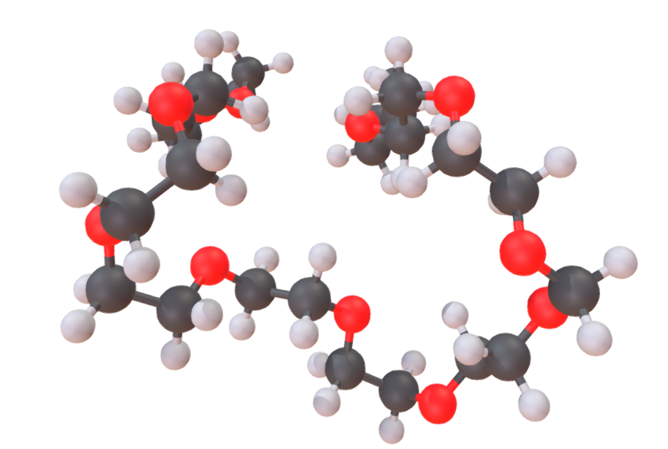
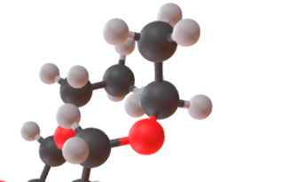

Sp3 Carbon “ce1” CODE FUNCTION
ce1 12.01115 C 4 Carbon atom in backbone or terminal group in PEO
If atom type == ‘C’ and num of connects == 4:
# ce1 12.01115 C 4 Carbon atom in backbone or terminal group in PEO
elif ring_size == 0 and type1 == ’C’ and type2 = ’H’ and type3 == ’H’ or type4 == ’O’:
nta[atom-id] = ’ce1’
https://en.wikipedia.org/wiki/Polyethylene_glycol
https://sketchfab.com/3d-models/polyethylene-glycol-peg-3b9fee27f4de4b34ba0c434c154ccca9

Slide 31
Sp3 Carbon “c1”
c1 12.01115 C 4 sp3 carbon with 1 H 3 heavies
If atom type == ‘C’ and num of connects == 4:
# c1 12.01115 C 4 sp3 carbon with 1 H 3 heavies
elif elements1.count(’H’) == 1 and count_heavies(elements1) == 3:
nta[atom-id] = ’c1’

Slide 32
Sp3 Carbon “c2”
c2 12.01115 C 4 sp3 carbon with 2 H's, 2 Heavy’s
If atom type == ‘C’ and num of connects == 4:
# c2 12.01115 C 4 sp3 carbon with 2 H's, 2 Heavy’s
elif elements1.count(’H’) == 2 and count_heavies(elements1) == 2:
nta[atom-id] = ’c2’

Slide 33
Sp3 Carbon “c3”
c3 12.01115 C 4 sp3 carbon with 3 hHs 1 heavy
If atom type == ‘C’ and num of connects == 4:
# c3 12.01115 C 4 sp3 carbon with 3 hHs 1 heavy
elif elements1.count(’H’) == 3 and count_heavies(elements1) == 1:
nta[atom-id] = ’c3’

Slide 34
Sp3 Carbon “c4o”
c4o 12.01115 C 4 Carbon atom, sp3, bonded to oxygen (+0.054, compass)
If atom type == ‘C’ and num of connects == 4:
# c4o 12.01115 C 4 Carbon atom, sp3, bonded to oxygen (+0.054, compass) elif ’O’ in typelist:
nta[atom-id] = ’c4o’

Slide 35
Atom Typing Color Nomenclature
Green means CAN find atom type
Light Green means CAN find atom type, but possibly needs more logic
Orange means can not distinguish between atom type
Red means method CANNOT find atom type
Highlighted in grey means a user input to help find correct atom types
Black means could be switched out in the if/elif/else statements because of an overlap issue. System and user preference dependent.

Slide 36
Hydrogen
22 IFF Hydrogens
hi 1.00797 H 1 Hydrogen in charged imidazole ring
he1 1.00797 H 1 Hydrogen atom in backbone or terminal group in PEO
ha1 1.00797 H 1 Hydrogen atom in terminal OH group in PEO (+0.4)
hc 1.00797 H 1 Hydrogen bonded to carbon
hpan 1.00797 H 1 Hydrogen atom in PAN (smaller sigma to reproduce density)
hw 1.00797 H 1 hydrogen in water (+0.41 in this model !)
ht5 1.00797 H 1 Hydrogen atom in TIP5P water model
ho2 1.00800 H 1 hydroxyl hydrogen
ho 1.00797 H 1 hydrogen bonded to oxygen
hos 1.00782 H 1 hydrogen atom in terminal hydroxyl group on silicon
hoy 1.00800 H 1 Hydrogen atom in (Al,Mg,Si)OH and OH- groups in clay, silica, cement (excl. ettr)
hn2 1.00800 H 1 amino hydrogen
hn 1.00797 H 1 hydrogen bonded to nitrogen
h* 1.00797 H 1 hydrogen bonded to nitrogen, Oxygen
h1o 1.00797 H 1 Hydrogen atom bonded to oxygen, nitrogen (compass)
hs 1.00797 H 1 hydrogen bonded to sulfur
hsi 1.00800 H 1 silane hydrogen
hdm 1.00797 H 1 Hydrogen atom in DMF (smaller sigma to reproduce density)
h 1.00797 H 1 generic hydrogen bound to C, Si,or H
h+ 1.00797 H 1 charged hydrogen in cations
hb 1.00782 H 1 hydrogen atom in bridging hydroxyl group
h1 1.00797 H 1 Hydrogen atom, nonpolar (compass)

Slide 37
Hydrogen
6 IFF Hydrogens
cge 1.000000 H 1 Dummy atom attached delocalized carbon of graphene
hp 1.00797 H 1 hydrogen bonded to phosphorus
hoa 1.00782 H 1 hydrogen atom in terminal hydroxyl group on aluminium
hok 1.00800 H 1 Hydrogen atom in AlOH surface group in kaolinite (+0.2)
hoc 1.00797 H 1 Hydrogen atom in OH group of ettringite (+0.35) and in superficial hydroxide ions (+0.3)
hop 1.00800 H 1 Hydrogen atom in hydrogenphosphate and in hydroxide ion in apatite (+0.4 and +0.2)

Slide 38
Hydrogen “hi”
hi 1.00797 H 1 Hydrogen in charged imidazole ring
If atom type == ‘H’ and num of connects == 1:
if rings1.count(5) > 0 and count_neigh_info(neigh2, element=‘N’, ring= 5, nb= False) > 0 and formula == ‘C3-H4-N2’:
nta[atom-id] = ’hi’

Slide 39
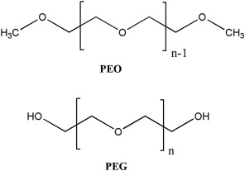
Hydrogen “he1” CODE FUNCTION
he1 1.00797 H 1 Hydrogen atom in backbone or terminal group in PEO
# he1 1.00797 H 1 Hydrogen atom in backbone or terminal group in PEO
elif type1 == ’C’ and ring1 == 0 and len(neigh_2nd_list) == 2 and count_2ndneigh_elemring(neigh_2nd_list, ’C’, 0) == 1 and count_2ndneigh_elemring(neigh_2nd_list, ’O’, 0) == 1:
nta[atom-id] = ’he1’
https://en.wikipedia.org/wiki/Polyethylene_glycol
https://sketchfab.com/3d-models/polyethylene-glycol-peg-3b9fee27f4de4b34ba0c434c154ccca9
https://www.sciencedirect.com/topics/materials-science/polyethylene-glycol

Slide 40
Hydrogen “ha1” CODE FUNCTION
ha1 1.00797 H 1 Hydrogen atom in terminal OH group in PEO (+0.4)
# he1 1.00797 H 1 Hydrogen atom in backbone or terminal group in PEO
elif type1 == ’O’ and ring1 == 0 and len(neigh_2nd_list) == 1 and count_2ndneigh_elemring(neigh_2nd_list, ’C’, 0) == 1:
nta[atom-id] = ’he1’
https://en.wikipedia.org/wiki/Polyethylene_glycol
https://sketchfab.com/3d-models/polyethylene-glycol-peg-3b9fee27f4de4b34ba0c434c154ccca9
https://www.sciencedirect.com/topics/materials-science/polyethylene-glycol

Slide 41
Hydrogen “hc” and “hpan”
hc 1.00797 H 1 hydrogen bonded to carbon
hpan 1.00797 H 1 Hydrogen atom in PAN (smaller sigma to reproduce density)
If atom type == ‘H’ and num of connects == 1:
# bonded to C
if elements1[0] == ’C’ rings1[0]== 0:
nta[atom-id] = ’hc’
elif elements1[0]== ’C’ rings1[0] > 0:
nta[atom-id] = ’hpan’

Slide 42
Hydrogen “hw” and “ht5”
hw 1.00797 H 1 hydrogen in water (+0.41 in this model !)
ht5 1.00797 H 1 Hydrogen atom in TIP5P water model
If atom type == ‘H’ and num of connects == 1:
elif formula[atom-id] == ’H2-O1’:
nta[atom-id] = ’hw’

Slide 43
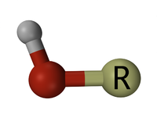
Hydrogen “hos”
hos 1.00782 H 1 hydrogen atom in terminal hydroxyl group on silicon
Si
hydroxyl
If atom type == ‘H’ and num of connects == 1:
elif type1 == ’O’ and ’Si’ in neigh_2nd_list:
nta[atom-id] = ’hos’
https://en.wikipedia.org/wiki/Hydroxy_group

Slide 44
Hydrogen “hoy”
hoy 1.00800 H 1 Hydrogen atom in (Al,Mg,Si)OH and OH- groups in clay, silica, cement (excl. ettr)
hydroxyl
If atom type == ‘H’ and num of connects == 1:
elif type1 == ’O’ and ’Si’ in neigh_2nd_list or ’Mg’ in neigh_2nd_list or ’Al’ in neigh_2nd_list:
nta[atom-id] = ’ho2’
https://en.wikipedia.org/wiki/Hydroxy_group

Slide 45
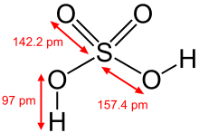
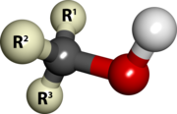
Hydrogen “ho2”
ho2 1.00800 H 1 hydroxyl hydrogen
hydroxyl
Sulfuric acid
alcohol
Carboxylic acid
If atom type == ‘H’ and num of connects == 1:
elif type1 == ’O’ and ’C’ in neigh_2nd_list or ’S’ in neigh_2nd_list:
nta[atom-id] = ’ho2’
https://en.wikipedia.org/wiki/Hydroxy_group

Slide 46
Hydrogen “ho”
ho 1.00797 H 1 hydrogen bonded to oxygen
If atom type == ‘H’ and num of connects == 1:
elif type1 == ’O’:
nta[atom-id] = ’ho’

Slide 47
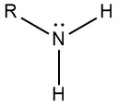
Hydrogen “hn2”
hn2 1.00800 H 1 amino hydrogen
If atom type == ‘H’ and num of connects == 1:
elif type1 == ’N’ and ’C’ in neigh_2nd_list :
nta[atom-id] = ’hn2’
https://chemistrytalk.org/amino-functional-group/#:~:text=An%20amino%20group%20is%20a,nitrogen%20with%20a%20lone%20pair.

Slide 48
Hydrogen “hn”
hn 1.00797 H 1 hydrogen bonded to nitrogen
If atom type == ‘H’ and num of connects == 1:
elif type1 == ’N’:
nta[atom-id] = ’hn’

Slide 49
Hydrogen “h*”
h* 1.00797 H 1 hydrogen bonded to nitrogen, Oxygen
If atom type == ‘H’ and num of connects == 1:
elif type1 == ’N’ or type1 == ’O’ :
nta[atom-id] = ’h*’

Slide 50
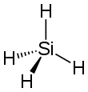
Hydrogen “hsi”
hsi 1.00800 H 1 silane hydrogen
If atom type == ‘H’ and num of connects == 1:
elif type1 == ’Si’ and formula == ‘H4-Si1’:
nta[atom-id] = ’hsi’
https://en.wikipedia.org/wiki/Silane#:~:text=Silane%20is%20an%20inorganic%20compound,a%20precursor%20to%20elemental%20silicon.

Slide 51
Hydrogen “hs”
hs 1.00797 H 1 hydrogen bonded to sulfur
If atom type == ‘H’ and num of connects == 1:
elif type1 == ’S’:
nta[atom-id] = ’hs’

Slide 52
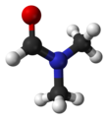
Hydrogen “hdm”
hdm 1.00797 H 1 Hydrogen atom in DMF (smaller sigma to reproduce density)
If atom type == ‘H’ and num of connects == 1:
elif type1 == ’C’ and ring1 == 0 and formula[atom-id] == ’C3-H7-N1-O1’ :
nta[atom-id] = ’hdm’
https://en.wikipedia.org/wiki/Dimethylformamide

Slide 53
Hydrogen “h”
h 1.00797 H 1 generic hydrogen bound to C, Si,or H
If atom type == ‘H’ and num of connects == 1:
elif type1 == ’C’ or type1 == ’Si’ or type1 == ’H’ :
nta[atom-id] = ’hdm’

Slide 54
Oxygen 1 Connects
o_1 15.99940 O 1 oxygen in carbonyl group
oo 15.99940 O 1 oxygen in carbonyl group, carbonate only
o= 15.99940 O 1 oxygen double bonded to O, C, S, N, P
o- 15.99940 O 1 partial double oxygen
oap2 15.99940 O 1 Oxygen atom in hydroxide ion in hydroxyapatite (-1.1)
oap1 15.99940 O 1 Oxygen atom in (hydrogen)phosphate ion in hydroxyapatite (-0.8 to -0.6)
oc1 15.99940 O 1 Oxygen atom silicate ion in Ca3SiO5 (-1.0)
oc4 15.99940 O 1 Oxygen atom in apical position in Ca3Al2O6 (-1.35)
oc11 15.99940 O 1 Oxygen atom in ettringite, sulfate unit (-0.6)
oc13 15.99940 O 1 Oxygen atom in tobermorite in apical position (-0.925 in tob 11A, -1.0 in tob 14A)
oc15 15.99940 O 1 Oxygen atom in monosulfate, sulfate unit (-0.6)
oc22 15.99940 O 1 Oxygen atom in tobermorite 14A, apical (-1.0)
oc25 15.99940 O 1 Oxygen atom in sulfate ion (gypsum, -0.65)
4 IFF 1-Connect Oxygens

Slide 55
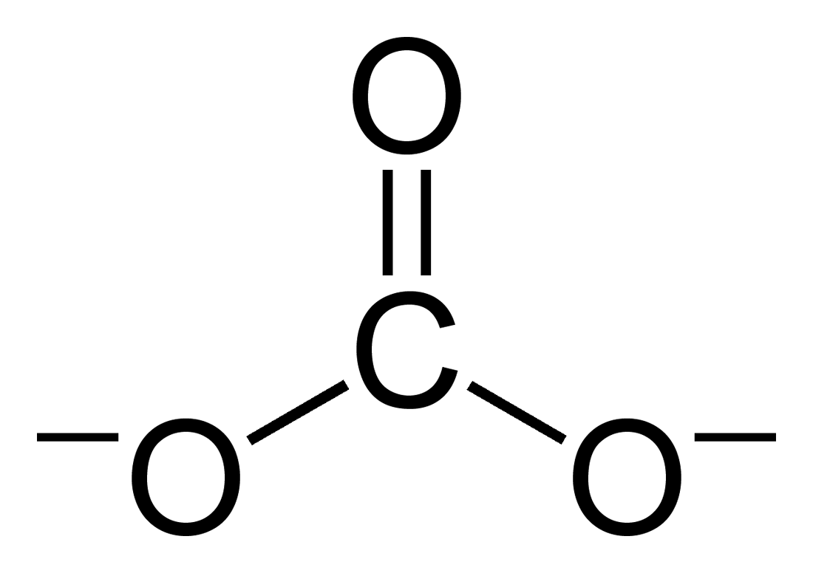
1-Connect Oxygen “o_1” and “oo”
o_1 15.99940 O 1 oxygen in carbonyl group
oo 15.99940 O 1 oxygen in carbonyl group, carbonate only
If atom type == “O” and num of connects == 1:
# o_1 15.99940 O 1 oxygen in carbonyl group
if type1 == ’C’ and ring1 = 0 and ’C’ in neigh_2nd_list:
nta[atom-id] = ’o_1’
# oo 15.99940 O 1 oxygen in carbonyl group, carbonate only
if type1 == ’C’ and ring1 = 0 and ’O’ in neigh_2nd_list:
nta[atom-id] = ’oo’
Carbonyl
carbonate

Slide 56
1-Connect Oxygen “o=”
o= 15.99940 O 1 oxygen double bonded to O, C, S, N, P
If atom type == ‘O’ and num of connects == 1:
if type1 == ’C’ or type1 = ’N’ or type1 == ’O’ type1 == ’S’ or type1 == ’P’:
nta[atom-id] = ‘o=‘

Slide 57
1-Connect Oxygen “o-”
o- 15.99940 O 1 partial double oxygen
If atom type == ‘O’ and num of connects == 1:
if atom type == ‘O’:
nta[atom-id] = ‘o-‘

Slide 58
Oxygen 2 Connects
22 IFF 2-Connect Oxygens
o* 15.99940 O 2 oxygen in water (-0.82 in this moddel !)
o2* 15.99940 O 2 Oxygen atom in water (-0.82, compass)
ot5 14.99940 O 2 Oxygen atom in TIP5P water model
oe1 15.99940 O 2 Oxygen atom in PEO backbone
oet5 14.99940 O 2 Oxygen atom in PEO backbone with lone pairs et5 attached (et5=-0.12)
oa1 15.99940 O 2 Oxygen atom in terminal OH group in PEO (-0.6)
oz 15.99940 O 2 ester oxygen in carbonate
o_2 15.99940 O 2 ester oxygen
oe 15.99940 O 2 sp3 oxygen in ester
oc 15.99940 O 2 sp3 oxygen in ether or acetals
o2e 15.99940 O 2 Oxygen atom in ether (-0.32, compass)
o3e 15.99940 O 2 sp3 oxygen in three membered ring
o4e 15.99940 O 2 sp3 oxygen in four membered ring
op 15.99940 O 2 sp2 aromatic in 5 membered ring
o2h 15.99940 O 2 Oxygen atom in hydroxyl group (-0.57, compass)
osh 15.99491 O 2 oxygen atom in terminal hydroxyl group on silicon
osi 16.00000 O 2 siloxane oxygen
oss 15.99491 O 2 oxygen atom betweem two silicons
oc23 15.99940 O 2 Oxygen atom in bulk silica (-0.55)
oc24 15.99940 O 2 Oxygen atom on silica surface and clay edge (-0.675 in Si-OH, -0.9 in SiO-)
oh 15.99940 O 2 oxygen bonded to hydrogen
o 15.99940 O 2 generic SP3 oxygen

Slide 59
Oxygen 2 Connects
25 IFF 2-Connect Oxygens
oah 15.99491 O 2 oxygen atom in terminal hydroxyl group on aluminium
oas 15.99491 O 2 oxygen atom between aluminium and silicon)
oah 15.99491 O 2 oxygen atom in terminal hydroxyl group on aluminium
oas 15.99491 O 2 oxygen atom between aluminium and silicon
oy1 15.99940 O 2 Oxygen atom in silicate sheet, surface (-0.55, -0.783 if next to Al defect)
oy2 15.99940 O 2 Oxygen atom in silicate sheet, surface (-0.55, -0.783 if next to Al defect)
oy3 15.99940 O 2 Oxygen atom in silicate sheet, surface (-0.55, -0.783 if next to Al defect)
oc3 15.99940 O 2 Oxygen atom in aluminate ring in Ca3Al2O6 (-0.75)
oc5 15.99940 O 2 Oxygen atom in ettringite, Al(OH)6 unit (-0.9) and in superficial hydroxide ions (-1.05)
oc6 15.99940 O 2 Oxygen atom in ettringite, Al(OH)6 unit (-0.9)
oc7 15.99940 O 2 Oxygen atom in ettringite, Al(OH)6 unit (-0.9)
oc8 15.99940 O 2 Oxygen atom in ettringite, Al(OH)6 unit (-0.9)
oc9 15.99940 O 2 Oxygen atom in ettringite, Al(OH)6 unit (-0.9)
oc10 15.99940 O 2 Oxygen atom in ettringite, Al(OH)6 unit (-0.9)
oc11 15.99940 O 1 Oxygen atom in ettringite, sulfate unit (-0.6)
oc12 15.99940 O 2 Oxygen atom in tobermorite ring (-0.6 and -0.5)
oc13 15.99940 O 1 Oxygen atom in tobermorite in apical position (-0.925 in tob 11A, -1.0 in tob 14A)
oc14 15.99940 O 2 Oxygen atom in tobermorite, SiOH unit (-0.66)
oc15 15.99940 O 1 Oxygen atom in monosulfate, sulfate unit (-0.6)
oc16 15.99940 O 2 Oxygen atom in monosulfate, Al(OH)6 unit (-0.8)
oc17 15.99940 O 2 Oxygen atom in monosulfate, Al(OH)6 unit (-0.8)
oc18 15.99940 O 2 Oxygen atom in monosulfate, Al(OH)6 unit (-0.8)
oc19 15.99940 O 2 Oxygen atom in monosulfate, Al(OH)6 unit (-0.8)
oc20 15.99940 O 2 Oxygen atom in monosulfate, Al(OH)6 unit (-0.8)
oc21 15.99940 O 2 Oxygen atom in monosulfate, Al(OH)6 unit (-0.8)

Slide 60
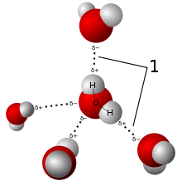
2-Connect Oxygen “o*”
o* 15.99940 O 2 oxygen in water (-0.82 in this moddel !)
o2* 15.99940 O 2 Oxygen atom in water (-0.82, compass)
ot5 14.99940 O 2 Oxygen atom in TIP5P water model
If atom type == ‘O’ and num of connects == 2:
if formula == ’H2-O1’:
nta[atom-id] = ’o*’
https://en.wikipedia.org/wiki/Water

Slide 61
2-Connect Oxygen “oe1”
oe1 15.99940 O 2 Oxygen atom in PEO backbone
elif type1 == ’C’ and ring1 == 0 and type2 == ’C’ and ring2 == 0 and len(neigh_2nd_list) == 2 and count_2ndneigh_elemringnb(neigh_2nd_list, ’C’, 0, 3) == 2 :
nta[atom-id] = ’oe1’
https://en.wikipedia.org/wiki/Polyethylene_glycol
https://sketchfab.com/3d-models/polyethylene-glycol-peg-3b9fee27f4de4b34ba0c434c154ccca9
https://www.sciencedirect.com/topics/materials-science/polyethylene-glycol

Slide 62
2-Connect Oxygen “oa1”
oa1 15.99940 O 2 Oxygen atom in terminal OH group in PEO (-0.6)
elif type1 == ’C’ and ring1 == 0 and type2 == ’H’ and ring2 == 0 and len(neigh_2nd_list) == 1 and count_2ndneigh_elemringnb(neigh_2nd_list, ’C’, 0, 3) == 1:
nta[atom-id] = ’oe1’
https://en.wikipedia.org/wiki/Polyethylene_glycol
https://sketchfab.com/3d-models/polyethylene-glycol-peg-3b9fee27f4de4b34ba0c434c154ccca9
https://www.sciencedirect.com/topics/materials-science/polyethylene-glycol

Slide 63
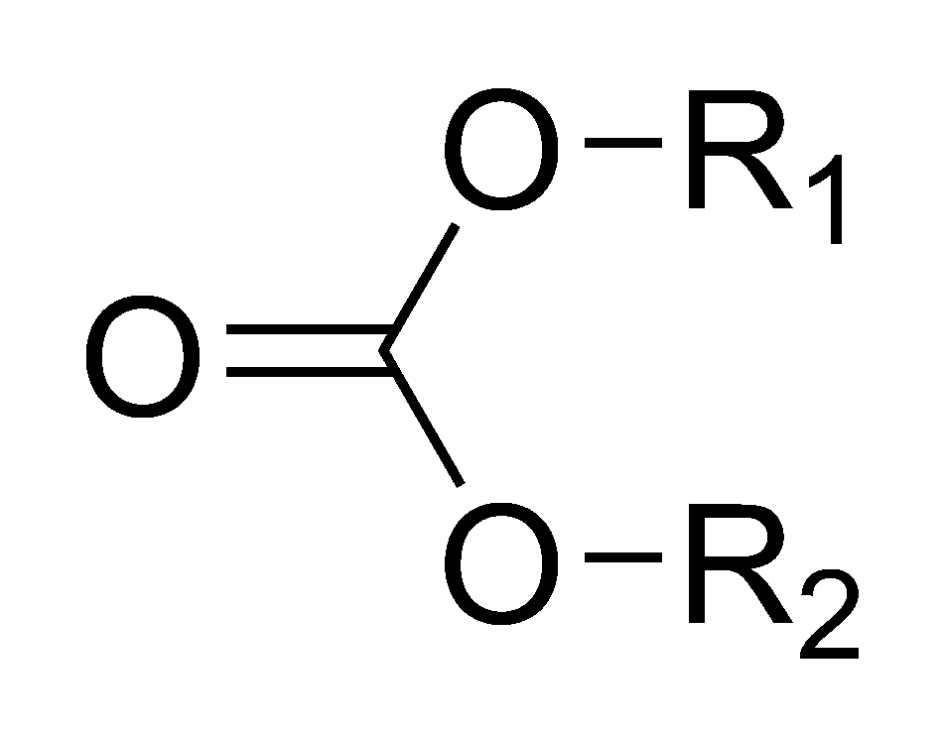
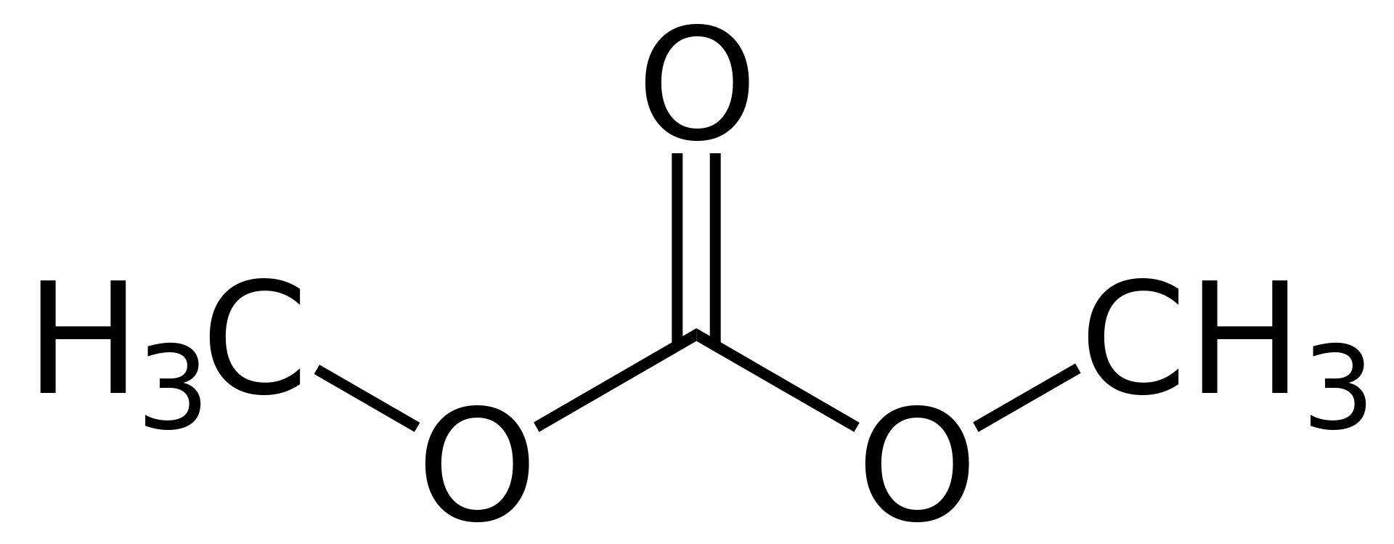
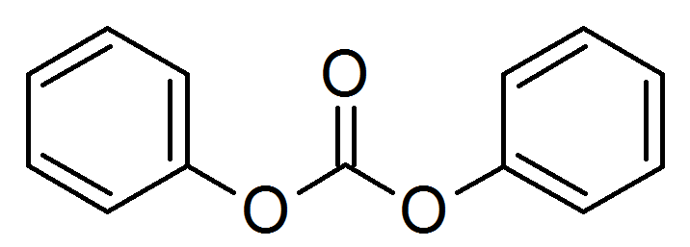
2-Connect Oxygen “oz”
oz 15.99940 O 2 ester oxygen in carbonate
elif ring_size == 0 and all(rings1) == 0 and elements1.count(’C’) == 2 and count_neigh(neighbor_info[2], element=‘O', ring= 0, nb=1) == 1:
if count_neigh(neighbor_info[2], element=‘O', ring= 0, nb=2) == 1:
nta[atom-id] = ’oz’
https://en.wikipedia.org/wiki/Carbonate_ester#/media/File:Diphenyl_carbonate.png

Slide 64
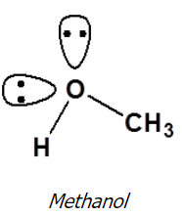
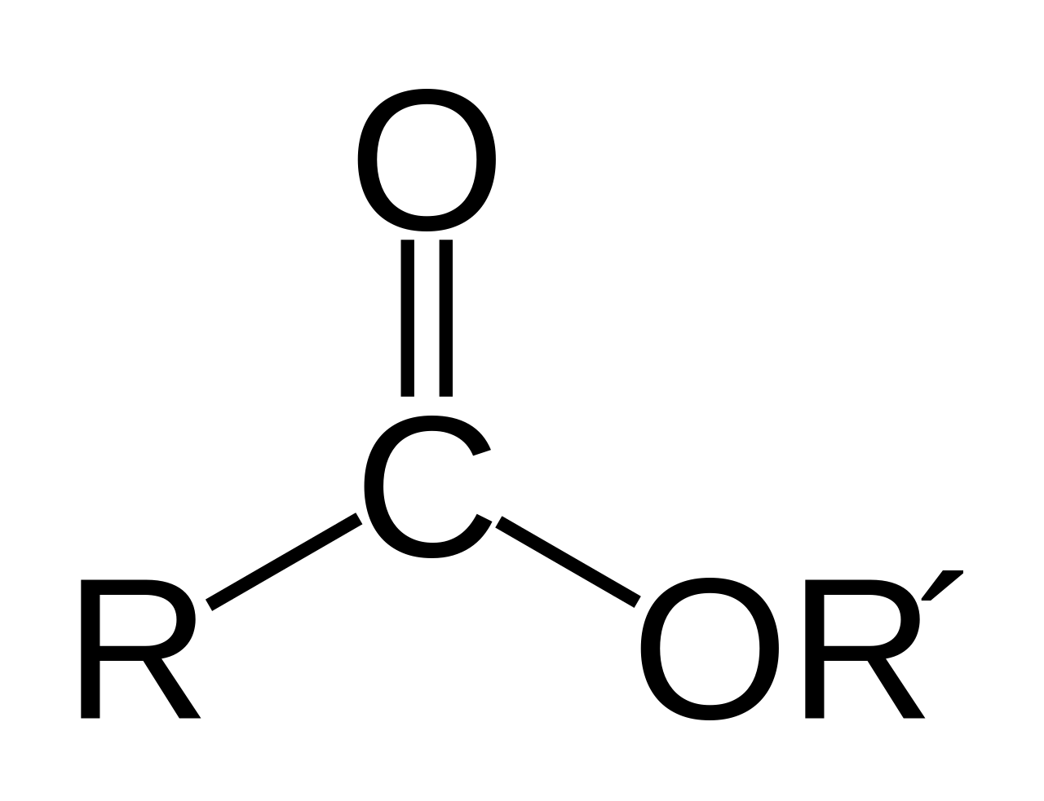
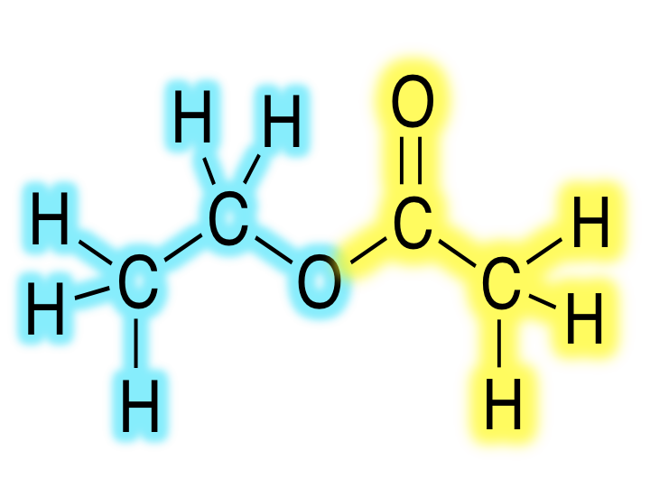
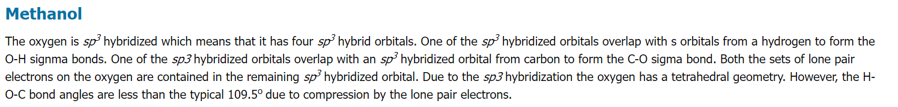
2-Connect Oxygen “o_2” or “oe”
o_2 15.99940 O 2 ester oxygen
oe 15.99940 O 2 sp3 oxygen in ester
Ester Oxygen
elif ring_size == 0 and all(rings1) == 0 and elements1.count(’C’) == 2 and count_neigh(neighbor_info[2], element=‘O', ring= 0, nb=1) == 1:
if elements2.count(’C’) == 2 :
nta[atom-id] = ’o_2’
# o_2 15.99940 O 2 ester oxygen
elif ring_size == 0 and type1 = ’C’ and ring1 == 0 and type2 = ’C’ and ring2 == 0 and count_2ndneigh_elemringnb(neigh_2nd_list, ’O’, 0, 1) == 1 :
nta[atom-id] = ’o_2’
https://en.wikipedia.org/wiki/Ester
https://chem.libretexts.org/Courses/Athabasca_University/Chemistry_350%3A_Organic_Chemistry_I/01%3A_Structure_and_Bonding/1.11%3A_Hybridization_of_Nitrogen_Oxygen_Phosphorus_and_Sulfur

Slide 65

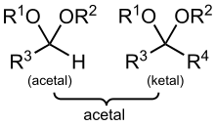
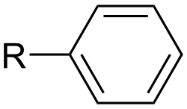

2-Connect Oxygen “oc”
oc 15.99940 O 2 sp3 oxygen in ether or acetals
o2e 15.99940 O 2 Oxygen atom in ether (-0.32, compass)
Ether: R–O–R′, where R and R′ represent the alkyl or aryl groups
aryl
If atom type == ‘O’ and num of connects == 2:
if elements1.count(’C’) == 2:
nta[atom-id] = ’oc’
alkyl
https://en.wikipedia.org/wiki/Ether
https://en.wikipedia.org/wiki/Alkyl
https://en.wikipedia.org/wiki/Acetal

Slide 66
2-Connect Oxygen “o3e”
o3e 15.99940 O 2 sp3 oxygen in three membered ring
If atom type == ’O’ and num of connects == 2 :
elif ring_size == 3:
nta[atom-id] = ’o3e’

Slide 67
2-Connect Oxygen “o4e”
o4e 15.99940 O 2 sp3 oxygen in four membered ring
If atom type == ’O’ and num of connects == 2:
elif ring_size == 4:
nta[atom-id] = ’o4e’

Slide 68
2-Connect Oxygen “op”
op 15.99940 O 2 sp2 aromatic in 5 membered ring
If atom type == ’O’ and num of connects == 2:
elif ring_size == 5:
nta[atom-id] = ’op’

Slide 69
2-Connect Oxygen “o2h”
o2h 15.99940 O 2 Oxygen atom in hydroxyl group (-0.57, compass)
hydroxyl
Sulfuric acid
alcohol
Carboxylic acid
If atom type == ’O’ and num of connects == 2:
elif ring_size == 0 and elements1.count(’C’) == 1 and elements1.count(’H’) == 1:
nta[atom-id] = ’o2h’
https://en.wikipedia.org/wiki/Hydroxy_group

Slide 70
2-Connect Oxygen “osh”
osh 15.99491 O 2 oxygen atom in terminal hydroxyl group on silicon
Si
hydroxyl
If atom type == ’O’ and num of connects == 2:
elif ring_size == 0 and elements1.count(’C’) == 1 and elements1.count(’Si’) == 1:
nta[atom-id] = ’osh’

Slide 71
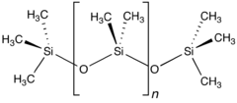
2-Connect Oxygen “osi”
osi 16.00000 O 2 siloxane oxygen
oss 15.99491 O 2 oxygen atom between two silicons
If atom type == ’O’ and num of connects == 2:
elif ring_size == 0 and ’Si’ in elements1 and type2 == ’O’ in elements2:
nta[atom-id] = ’osi’
https://en.wikipedia.org/wiki/Siloxane

Slide 72

2-Connect Oxygen “oc23”
oc23 15.99940 O 2 Oxygen atom in bulk silica (-0.55)
oc24 15.99940 O 2 Oxygen atom on silica surface and clay edge (-0.675 in Si-OH, -0.9 in SiO-)
If atom type == ‘O’ and num of connects == 2:
if formula[atom-id] == ’O2-Si1’:
nta[atom-id] = ’oc23’
https://www.calstatela.edu/sites/default/files/dept/chem/07summer/158/25-words-silica.pdf

Slide 73
2-Connect Oxygen “oh”
oh 15.99940 O 2 oxygen bonded to hydrogen
If atom type == “O” and num of connects == 2:
elif ’H’ in ements1:
nta[atom-id] = ‘oh’
https://en.wikipedia.org/wiki/Ether
https://en.wikipedia.org/wiki/Alkyl

Slide 74
Oxygen 3 Connects
ob 15.99491 O 3 oxygen atom in bridging hydroxyl group
oy4 15.99940 O 3 Oxygen atom in octahedral aluminate sheet (-0.758, -0.867 if next to Mg defect)
oy5 15.99940 O 3 Oxygen atom in octahedral aluminate sheet (-0.758, -0.867 if next to Mg defect)
oy6 15.99940 O 3 Oxygen atom in octahedral aluminate sheet (-0.683, -0.792 if next to Mg defect)
oy7 15.99940 O 3 Oxygen atom in octahedral aluminate sheet (-0.758, -0.867 if next to Mg defect)
oy8 15.99940 O 3 Oxygen atom in octahedral aluminate sheet (-0.758, -0.867 if next to Mg defect)
oy9 15.99940 O 3 Oxygen atom in octahedral aluminate sheet (-0.683, -0.792 if next to Mg defect)
15 IFF 2-Connect Oxygens

Slide 75
3-Connect Oxygen “ob”
ob 15.99491 O 3 oxygen atom in bridging hydroxyl group
If atom type == “O” and num of connects == 3:
nta[atom-id] = ’ob’

Slide 76
1 connect Nitrogen
nt 14.00670 N 1 sp nitrogen involved in a triple bond
nz 14.00670 N 1 sp3 nitrogen bonded to two atoms
2 cvff 1 connect Nitrogen

Slide 77
2 connect Nitrogen
ni 14.00670 N 3 nitrogen in charged imidazole ring
np 14.00670 N 2 sp2 nitrogen in 5- or 6- membered ring
n= 14.00670 N 2 non aromatic end doubly bonded nitrogen
n=1 14.00670 N 2 non aromatic, next to end doubly bonded carbon
n=2 14.00670 N 2 non aromatic doubly bonded nitrogen
4 IFF 2 connect Nitrogen

Slide 78
2-Connect Nitrogen “ni”
ni 14.00670 N 3 nitrogen in charged imidazole ring
If atom type == ’N’ and num of connects == 2:
if ring_size == 5 and ’C’ in elements1:
nta[atom-id] = ’np’

Slide 79
2-Connect Nitrogen “np”
np 14.00670 N 2 sp2 nitrogen in 5- or 6- membered ring
If atom type == ’N’ and num of connects == 2:
if ring_size > 3:
nta[atom-id] = ’np’

Slide 80
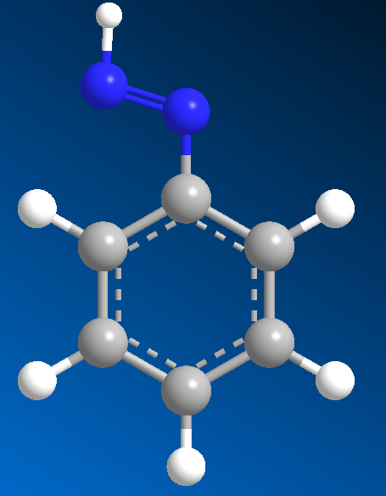
2-Connect Nitrogen “n=”
n= 14.00670 N 2 non aromatic end doubly bonded nitrogen
nb1 == 1
9
n=
1
2
10
8
14
3
7
4
6
If atom type == ’N’ and num of connects == 2:
elif ring_size == 0 and and nbs1.count(1) >= 1:
nta[atom-id] = ’n=’
11
5
13
12

Slide 81
2-Connect Nitrogen “n=1”
n=1 14.00670 N 2 non aromatic, next to end doubly bonded carbon
9
nb2 == 1
1
2
10
8
14
3
7
4
6
11
5
13
12
If atom type == ’N’ and num of connects == 2:
elif ring_size == 0 and nbs2.count(1) >= 1:
nta[atom-id] = ’n=’

Slide 82
2-Connect Nitrogen “n=2”
n=2 14.00670 N 2 non aromatic doubly bonded nitrogen
If atom type == ’N’ and num of connects == 2:
# n=2 14.00670 N 2 non aromatic doubly bonded nitrogen
elif ring_size == 0:
nta[atom-id] = ’n=2’

Slide 83
3 connect Nitrogen
nh+ 14.00670 N 3 protonated nitrogen in 6 membered ring (WOULD HAVE 4Nb – set with 4 connected)
n_2 14.01000 N 3 nitrogen of urethane
n1 14.00670 N 3 sp2 nitrogen in charged arginine
nr 14.00670 N 3 sp2 nitrogen (NH2) in guanidinium group (HN=C(NH2)2)
n2 14.00670 N 3 sp2 nitrogen (NH2) in guanidinium group (HN=C(NH2)2)
nho 14.00670 N 3 sp2 nitrogen in 6 membered ring next to a carbonyl
ni 14.00670 N 3 nitrogen in charged imidazole ring
npc 14.00670 N 3 sp2 nitrogen in 5- or 6- membered ring and with a heavy atom
nh 14.00670 N 3 sp2 nitrogen in 5 or 6 membered ring
n3n 14.00670 N 3 sp2 nitrogen in 3- membered ring (ASSUME n means w/ N like H for c3h)
n3m 14.00670 N 3 sp3 nitrogen in 3- membered ring (ASSUME m means member like m for c3m)
n4n 14.00670 N 3 sp2 nitrogen in 4- membered ring (ASSUME n means w/ N like H for c4h)
n4m 14.00670 N 3 sp3 nitrogen in 4- membered ring (ASSUME m means member like m for c4m)
nn 14.00670 N 3 sp2 nitrogen in aromatic amines
nb 14.00670 N 3 sp2 nitrogen in aromatic amines
na 14.00670 N 3 sp3 nitrogen in amines
n 14.00670 N 3 generic sp2 nitrogen (in amids))
17 IFF 3 connect Nitrogen

Slide 84


3-Connect Nitrogen “n1”
n1 14.00670 N 3 sp2 nitrogen in charged arginine
If atom type == ’N’ and num of connects == 3 :
if ring == 0 and formula ==’C6-H14-N4-O2’ :
nta[atom-id] = ’n_2’
https://en.wikipedia.org/wiki/Arginine

Slide 85

3-Connect Nitrogen “n2” or “nr”
n2 14.00670 N 3 sp2 nitrogen (NH2) in guanidinium group (HN=C(NH2)2)
nr 14.00670 N 3 sp2 nitrogen (NH2) in guanidinium group (HN=C(NH2)2)
If atom type == ’N’ and num of connects == 3 :
if ring == 0 and type_list.count(’C’) == 1 and formula ==’C1-H5-N3’ :
nta[atom-id] = ’n2’
https://en.wikipedia.org/wiki/Guanidine

Slide 86
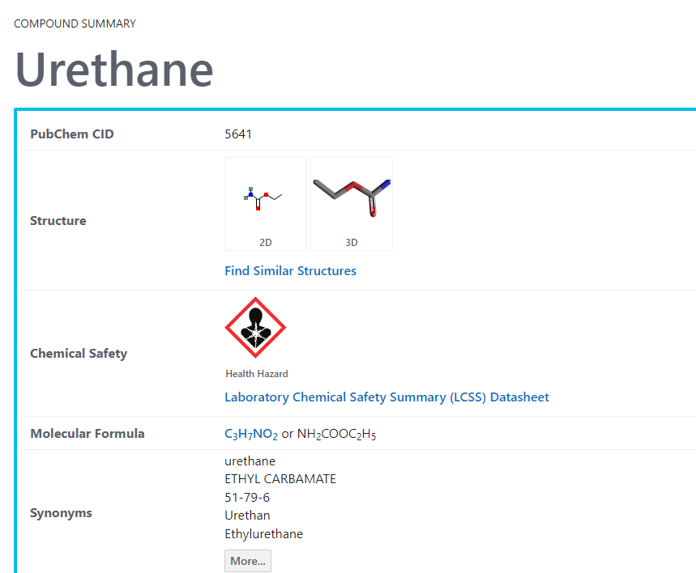
3-Connect Nitrogen “n_2”
n_2 14.01000 N 3 nitrogen of urethane
If atom type == ’N’ and num of connects == 3 :
if ring == 0 and formula ==’C3-H7-N1-O2’ :
nta[atom-id] = ’n_2’
https://pubchem.ncbi.nlm.nih.gov/compound/Urethane

Slide 87
3-Connect Nitrogen “ni”
ni 14.00670 N 3 nitrogen in charged imidazole ring
If atom type == ‘N’ and num of connects == 3:
if ring == 5 and count_neigh(neighbor_info[1], element=‘C', ring= 5, nb=3) >= 2 and formula == ‘C3-H4-N2’:
nta[atom-id] = ’ni’
If atom type == ‘N’ and num of connects == 2:
if ring == 5 and count_neigh(neighbor_info[1], element=‘C', ring= 5, nb=3) >= 2 and formula == ‘C3-H4-N2’:
nta[atom-id] = ’ni’

Slide 88
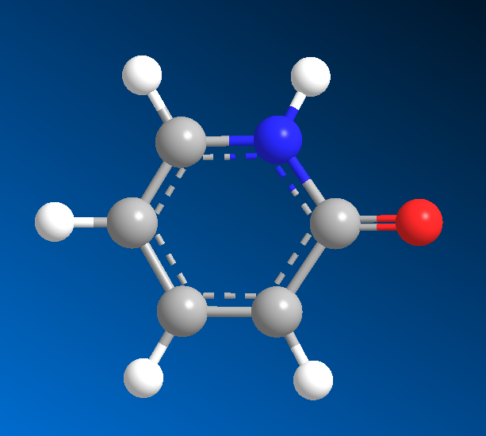
3-Connect Nitrogen “nho”
nho 14.00670 N 3 sp2 nitrogen in 6 membered ring next to a carbonyl
Carbonyl
# o_2 15.99940 O 2 ester oxygen
elif ring_size == 6 and count_neigh(neighbor_info[2], element=‘O', ring=0, nb=1) >= 1 and ’C’ in elements1:
nta[atom-id] = ’nho’

Slide 89
3-Connect Nitrogen “npc”
npc 14.00670 N 3 sp2 nitrogen in 5- or 6- membered ring and with a heavy atom
If atom type == ’N’ and num of connects == 3:
if ring_size >= 5 and count_heavies(neighbors) > 0 :
nta[atom-id] = ’npc’

Slide 90
3-Connect Nitrogen “nh”
nh 14.00670 N 3 sp2 nitrogen in 5 or 6 membered ring
If atom type == ’N’ and num of connects == 3:
if ring_size >= 5 :
nta[atom-id] = ’nh’

Slide 91
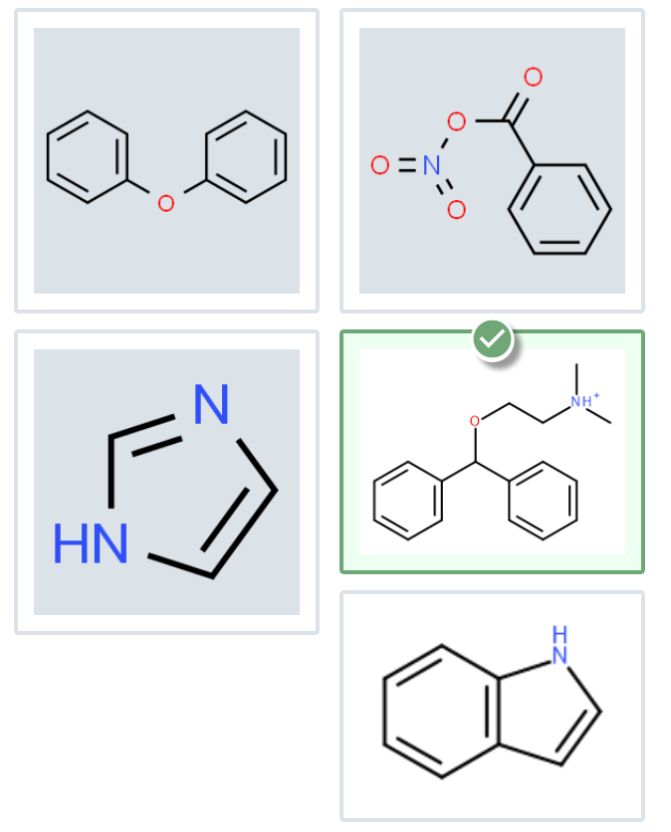
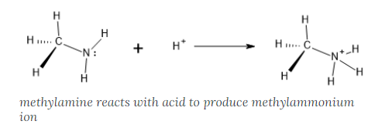
3-Connect Nitrogen “nh+”
nh+ 14.00670 N 3 protonated nitrogen in 6 membered ring
If atom type == ’N’ and num of connects == 4:
if ring_size >= 6:
nta[atom-id] = ’nh+’
https://openoregon.pressbooks.pub/introductoryorganic/chapter/amine-protonation/

Slide 92
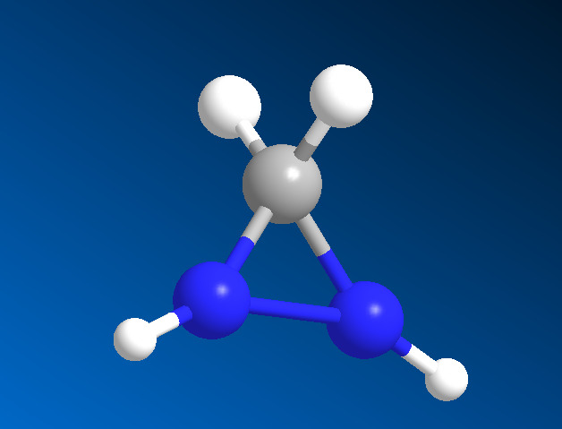
3-Connect Nitrogen “n3n”
n3n 14.00670 N 3 sp2 nitrogen in 3- membered ring (ASSUME n means w/ N like H for c3h)
If atom type == ’N’ and num of connects == 3:
# c4h
elif ring_size == 3 and ’N’ in typelist:
nta[atom-id] = ’n3n’

Slide 93
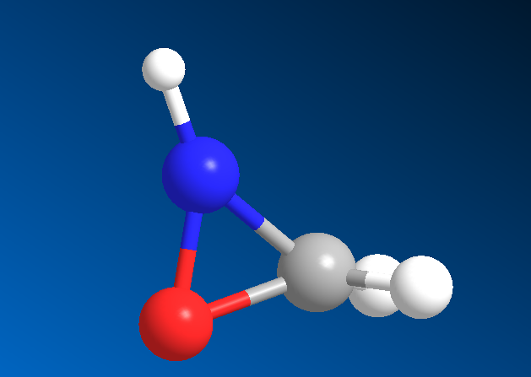
3-Connect Nitrogen “n3m”
n3m 14.00670 N 3 sp3 nitrogen in 3- membered ring (ASSUME m means member like m for c3m)
If atom type == ’N’ and num of connects == 3 :
# c4h
elif ring_size == 3:
nta[atom-id] = ’n3m’

Slide 94
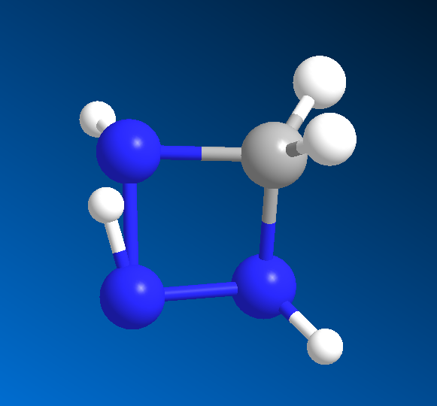
3-Connect Nitrogen “n4n”
n4n 14.00670 N 3 sp2 nitrogen in 4- membered ring (ASSUME n means w/ N like H for c4h)
If atom type == ’N’ and num of connects == 3 :
# c4h
elif ring_size == 4 and ’N’ in elements1 or ’N’ in elements2:
nta[atom-id] = ’n4n’

Slide 95
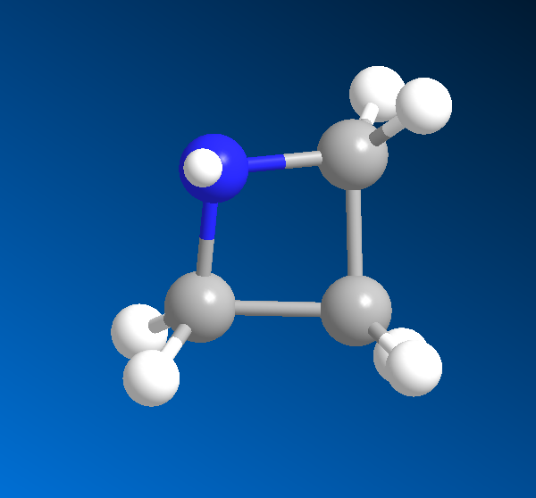
3-Connect Nitrogen “n4m”
n4m 14.00670 N 3 sp3 nitrogen in 4- membered ring (ASSUME m means member like m for c4m)
If atom type == ’N’ and num of connects == 3 :
elif ring_size == 4 :
nta[atom-id] = ’n4m’

Slide 96
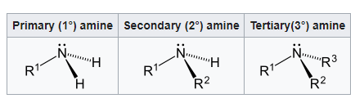

3-Connect Nitrogen “nn”
nn 14.00670 N 3 sp2 nitrogen in aromatic amines
nb 14.00670 N 3 sp2 nitrogen in aromatic amines
If atom type == ’N’ and num of connects == 3 :
elif any(rings1) > 0 and 3 in nbs1 :
nta[atom-id] = ’nn’
https://en.wikipedia.org/wiki/Amine

Slide 97
3-Connect Nitrogen “na”
na 14.00670 N 3 sp3 nitrogen in amines
If atom type == ’N’ and num of connects == 3 :
elif ring == 0 and elements1.count(’H’) == 2 and elements1.count(’C’) == 1:
nta[atom-id] = ’na’
elif ring == 0 and elements1.count(’H’) == 1 and elements1.count(’C’) == 2:
nta[atom-id] = ’na’
elif ring == 0 and elements1.count(’C’) == 3:
nta[atom-id] = ’na’
https://en.wikipedia.org/wiki/Amine

Slide 98
4 connect Nitrogen
nh+ 14.00670 N 3 protonated nitrogen in 6 membered ring (WOULD HAVE 4Nb – set with 4 connected)
n4 14.00670 N 4 sp3 nitrogen in protonated amines
n+ 14.00670 N 4 sp3 nitrogen in protonated amines
2 IFF 4 connect Nitrogen

Slide 99
1 connect Sulfur
s' 32.06400 S 1 S in thioketone group
s- 32.06400 S 1 partial double sulfur
sf 32.06400 S 1 S in sulfonate group (IT APPEARS TO HAVE 4 BONDED ATOMS – USE 4-CONNECT SECTION)
3 IFF 1 connect Nitrogen

Slide 100

1 Connect Sulfur “s’”
s' 32.06400 S 1 S in thioketone group
If atom type == ’S’ and num of connects == 1:
if ’C’ in elements1:
nta[atom-id] = ’s’
https://en.wikipedia.org/wiki/Thioketone

Slide 101

1 Connect Sulfur “sf”
sf 32.06400 S 1 S in sulfonate group
If atom type == ’S’ and num of connects == 4 :
elif elements1.count(’O’) == 3 :
nta[atom-id] = ’sf’
https://en.wikipedia.org/wiki/Sulfonate#:~:text=In%20organosulfur%20chemistry%2C%20a%20sulfonate,non%2Doxidizing%2C%20and%20colorless.

Slide 102
2 connect Sulfur
s3e 32.06400 S 2 sulfur in three membered ring
s4e 32.06400 S 2 sulfur in four membered ring
sp 32.06400 S 2 sulfur in an aromatic ring (e.g. thiophene)
sc 32.06400 S 2 sp3 sulfur in methionines (C-S-C) group
sh 32.06400 S 2 sp3 sulfur in sulfhydryl (-SH) group (e.g. cysteine)
s1 32.06400 S 2 sp3 sulfur involved in (S-S) group of disulfides
s 32.06400 S 2 sp3 sulfur
7 IFF 2 connect Nitrogen

Slide 103
2-Connect Nitrogen “s3e”
s3e 32.06400 S 2 sulfur in three membered ring
If atom type == ’S’ and num of connects == 2 :
elif ring_size == 3:
nta[atom-id] = ’s3e’

Slide 104
2-Connect Nitrogen “s4e”
s4e 32.06400 S 2 sulfur in four membered ring
If atom type == ’S’ and num of connects == 2 :
elif ring_size == 4:
nta[atom-id] = ’s4e’

Slide 105
2-Connect Nitrogen “sp”
sp 32.06400 S 2 sulfur in an aromatic ring (e.g. thiophene)
If atom type == ’S’ and num of connects == 2 :
elif ring_size > 4:
nta[atom-id] = ’sp’

Slide 106

2-Connect Nitrogen “sc”
sc 32.06400 S 2 sp3 sulfur in methionines (C-S-C) group
If atom type == ’S’ and num of connects == 2 :
elif ring_size == 0 and elements1.count(’C’) == 1 :
nta[atom-id] = ’sc’
https://en.wikipedia.org/wiki/Methionine

Slide 107

2-Connect Nitrogen “sh”
sh 32.06400 S 2 sp3 sulfur in sulfhydryl (-SH) group (e.g. cysteine)
If atom type == ’S’ and num of connects == 2 :
elif elements1.count(’H’) >= 1 and elements1.count(’C’) >= 1 :
nta[atom-id] = ’sh’
https://en.wikibooks.org/wiki/Structural_Biochemistry/Organic_Chemistry/Organic_Functional_Group/Sulfhydryl#:~:text=A%20sulfhydryl%20is%20a%20functional,great%20affinity%20for%20soft%20metals.

Slide 108


2-Connect Nitrogen “s1”
s1 32.06400 S 2 sp3 sulfur involved in (S-S) group of disulfides
If atom type == ’S’ and num of connects == 2 :
elif elements1.count(’S’) >= 1 :
nta[atom-id] = ’s1’
https://en.wikipedia.org/wiki/Disulfide

Slide 109
4 connect Sulfur
s_m 32.06400 S 4 Sulfur atom in sulfate ion in monosulfate (+1.0; note +0.5 better)
sf 32.06400 S 1 S in sulfonate group (IT APPEARS TO HAVE 4 BONDED ATOMS – USE 4-CONNECT SECTION)
1 IFF 4 connect Nitrogen

Slide 110
4-Connect Sulfur “sf”
sf 32.06400 S 1 S in sulfonate group
If atom type == ’S’ and num of connects == 4 :
elif elements1.count(’O’) == 3 :
nta[atom-id] = ’sf’
https://en.wikipedia.org/wiki/Sulfonate#:~:text=In%20organosulfur%20chemistry%2C%20a%20sulfonate,non%2Doxidizing%2C%20and%20colorless.

Slide 111
4 connect silicon
sc4 28.08600 Si 4 Silicon atom in silica (+1.1 in bulk SiO2 or SiOH, +0.725 in SiO-)
sy1 28.08600 Si 4 Silicon atom in tetrahedral silicate sheet (+1.1)
sy2 28.08600 Si 4 Silicon atom in tetrahedral silicate sheet (+1.1)
sio 28.08600 Si 4 siloxane silicon
sc1 28.08600 Si 4 Silicon atom in silicate ion in Ca3SiO5 (+1.0)
si 28.08600 Si 4 silicon atom (elif element == ‘Si’)
NOT SURE WHAT TO DO WITH
sz 28.08600 Si 4 silicon atom in zeolites
sc2 28.08600 Si 4 Silicon atom in tobermorite ring (+1.0)
sc3 28.08600 Si 4 Silicon atom in tobermorite ring junction (+1.0)

Slide 112

4-Connect Silicon “sc4”
sc4 28.08600 Si 4 Silicon atom in silica (+1.1 in bulk SiO2 or SiOH, +0.725 in SiO-)
sio2
If atom type == ’Si’ and num of connects == 4:
elif ring_size == 0 and elements1.count(‘O’) == 4:
nta[atom-id] = ’sc4’
https://en.wikipedia.org/wiki/Silicon_dioxide

Slide 113


4-Connect Silicon “sy1” or “sy2”
sy1 28.08600 Si 4 Silicon atom in tetrahedral silicate sheet (+1.1)
sy2 28.08600 Si 4 Silicon atom in tetrahedral silicate sheet (+1.1)
If atom type == ’Si’ and num of connects == 4:
elif ring_size == 0 and elements1.count(‘O’) == 4:
nta[atom-id] = ’sy1’
http://butane.chem.uiuc.edu/pshapley/Environmental/L28/1.html

Slide 114
2-Connect Oxygen “sio”
sio 28.08600 Si 4 siloxane silicon
If atom type == ’Si’ and num of connects == 4:
elif ring_size == 0 and ’O’ in elements1 and type2 == ’Si’ in elements2:
nta[atom-id] = ’sio’
https://en.wikipedia.org/wiki/Siloxane

Slide 115

4-Connect Silicon “sc1”
sc1 28.08600 Si 4 Silicon atom in silicate ion in Ca3SiO5 (+1.0)
If atom type == ’Si’ and num of connects == 4:
elif formula == ’Ca1-O5-Si1’:
nta[atom-id] = ‘sc1’
https://pubchem.ncbi.nlm.nih.gov/compound/Tricalcium-silicate#section=Synonyms

Slide 116
Phosphorous
p 30.97380 P 4 general phosphorous atom
p= 30.97380 P 5 phosphazene phosphorous atom
pap 30.97380 P 4 Phosphorus atom in (hydrogen)phosphate ion in hydroxyapatite (+1.0)

Slide 117
Simple singular element atom types
f 18.99840 F 1 fluorine atom
xe 131.30000 Xe 0 Xenon ne 20.18300 Ne 0 Neon
kr 83.80000 Kr 0 Krypton
he 4.00300 He 0 Helium
dw 2.01400 D 1 deuterium in heivy water
cl 35.45300 Cl 1 chlorine atom
br 79.90900 Br 1 bromine atom
ar 39.94400 Ar 0 Argon
ca+ 40.08000 Ca 1 calcium ion
ca++ 40.08000 Ca 0 Calcium ion in Ca3SiO5 (+1.5) and organic salts
ca+a 40.08000 Ca 0 Calcium ion in Ca3Al2O6 (+1.5)
ca+e 40.08000 Ca 0 Calcium ion in ettringite (+1.6)
ca+t 40.08000 Ca 0 Calcium ion in tobermorite (+1.5)
ca+m 40.08000 Ca 0 Calcium ion in monosulfate (+1.4)
ca+g 40.08000 Ca 0 Calcium ion in gypsum, hemihydrate, and anhydrite (+1.5)
ca+h 40.08000 Ca 0 Calcium ion in hydroxyapatite (+1.5)

Slide 118

I AM HERE

Slide 119
Acknowledgements
Dr. Gregory Odegard
CMMR Lab Group
Superior: Dr. Gowtham
Special Thanks to:
Prathamesh Deshpande, Sagar Patil, Hashim Al Mahud, Will Pisani, and Ivan Gallegos

