Slide 1
Atom Typing Color Nomenclature
Green means CAN find atom type
Light Green means CAN find atom type, but possibly needs more logic
Orange means can not distinguish between atom type
Red means method CANNOT find atom type
Highlighted in grey means a user input to help find correct atom types
Black means could be switched out in the if/elif/else statements because of an overlap issue. System and user preference dependent.

Slide 2
Sp1 Carbon
c1o 12.01115 C carbon in CO
c2= 12.01115 C carbon in CO2 and CS2
Formula == ‘C1-O1’ -> c1o
Formula == ‘C1-O2’ -> c2=
1 compass Sp Carbon

Slide 3
Sp2 Carbon
c3’ 12.01115 C carbonyl carbon [one polar substituent]
c3a 12.01115 C aromatic carbon
If ring >= 5: -> c3a
2 compass Sp Carbon

Slide 4
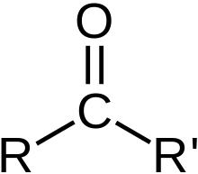
Sp2 Carbon “c_0”
c3’ 12.01115 C carbonyl carbon [one polar substituent]
Carbonyl
If atom type == ’C’ and nb == 3:
elif ring_size == 0 and elements1.count(’C’) == 2 and elements1.count(’O’) == 1:
nta[atom-id] = ’c_0’
https://en.wikipedia.org/wiki/Carbonyl_group
https://en.wikipedia.org/wiki/Aldehyde
https://en.wikipedia.org/wiki/Ketone

Slide 5
Sp3 Carbon
c41o 12.01115 C carbon, sp3, in methanol
c43o 12.01115 C carbon, sp3 in secondary alcohols
c43 12.01115 C sp3 carbon with three heavy atoms attached
c44 12.01115 C sp3 carbon with four heavy atoms attached
c4z 12.01115 C carbon, sp3, bonded to -N3 (azides)
c4o 12.01115 C alpha carbon
c4 12.01115 C generic sp3 carbon
7 compass Sp3 Carbon

Slide 6

Sp2 Carbon “c41o”
c41o 12.01115 C carbon, sp3, in methanol
If atom type == ’C’ and nb == 3:
elif ring_size == 0 and formula == ’C1-H4-O1’:
nta[atom-id] = ’c41o’
methanol
https://en.wikipedia.org/wiki/Methanol

Slide 7
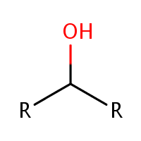
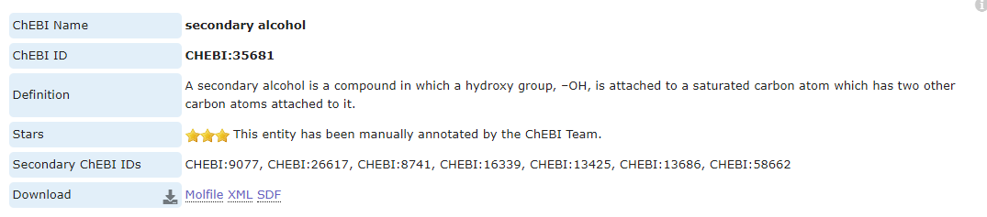
Sp2 Carbon “c41o”
c43o 12.01115 C carbon, sp3 in secondary alcohols
If atom type == ’C’ and nb == 3:
elif ring_size == 0 and elements1.count(’C’) == 2 and elements1.count(’O’) == 1 and elements2.count(’H’)>= 1 :
nta[atom-id] = ’c43o’
Secondary alcohol
https://www.ebi.ac.uk/chebi/searchId.do?chebiId=35681

Slide 8
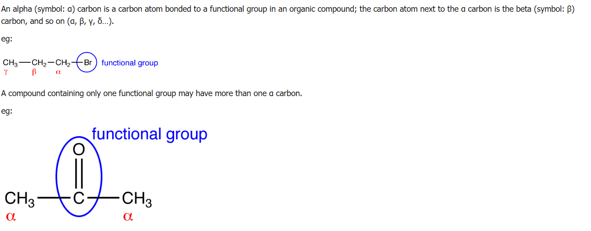
Sp2 Carbon “c41o”
c4o 12.01115 C alpha carbon (e.g. alpha to oxygen in ethers and alcohols)
If atom type == ’C’ and nb == 3:
elif ring_size == 0 and alpha_carbon_functional_flag:
nta[atom-id] = ’c4o’
https://chem.libretexts.org/Ancillary_Materials/Reference/Organic_Chemistry_Glossary/Alpha_Carbon

Slide 9
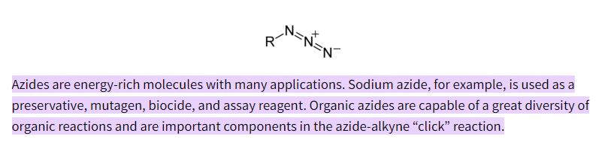
Sp2 Carbon “c4z”
c4z 12.01115 C carbon, sp3, bonded to -N3 (azides)
If atom type == ’C’ and nb == 3:
elif elements1.count(’N’) == 1 and elements2.count(’N’) == 1 and elements3.count(’N’) == 1:
nta[atom-id] = ’c4z’
https://chem.libretexts.org/Ancillary_Materials/Reference/Organic_Chemistry_Glossary/Alpha_Carbon

Slide 10
Sp2 Carbon “c43” and “c44”
c43 12.01115 C sp3 carbon with three heavy atoms attached
c44 12.01115 C sp3 carbon with four heavy atoms attached
If atom type == ’C’ and nb == 3:
elif count_heavies(elements1) == 3:
nta[atom-id] = ’c43’
elif count_heavies(elements1) == 4:
nta[atom-id] = ’c44’
https://chem.libretexts.org/Ancillary_Materials/Reference/Organic_Chemistry_Glossary/Alpha_Carbon

Slide 11
Hydrogen
3 compass Hydrogens
h1h 1.00797 H hydrogen in H2 if formula == ’H2’:
h1o 1.00797 H strongly polar hydrogen, bonded to O,F if elements1.count(’O’) >= 1 or elements3.count(’F’) >= 1
h1 1.00797 H nonpolar hydrogen if elements == ’H’

Slide 12
Oxygen 1 Connects
o1= 15.99940 O oxygen in NO2 and SO2 [and carbonyl]
o2n 15.99940 O oxygen in nitrates
o1=* 15.99940 O oxygen in CO2
o1c 15.99940 O oxygen in CO
o1n 15.99940 O oxygen in NO
o1o 15.99940 O oxygen in O2
o12 15.99940 O oxygen in nitro group (-NO2)
7 compass 1-Connect Oxygens

Slide 13


1-Connect Oxygen “o1=”
o1= 15.99940 O oxygen in NO2 and SO2 [and carbonyl]
If atom type == “O” and num of connects == 1:
# oxygen in carbonyl group
if type1 == ’C’ and ring1 = 0 and ’C’ in elements2:
nta[atom-id] = ’o1=’
# NO2
if formula == ’N1-O2’:
nta[atom-id] = ’o1=’
# SO2
if formula == ’O2-S1’:
nta[atom-id] = ’o1=’
NO2
SO2
https://en.wikipedia.org/wiki/Nitrogen_dioxide
https://en.wikipedia.org/wiki/Sulfur_dioxide
https://en.wikipedia.org/wiki/Carbonyl_group
Carbonyl

Slide 14
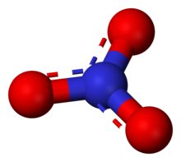
2-Connect Oxygen “o2n”
o2n 15.99940 O oxygen in nitrates
If atom type == ‘O’ and num of connects == 2:
if formula == ’N1-O3’: :
nta[atom-id] = ’o2n’
https://en.wikipedia.org/wiki/Nitrate

Slide 15
1-Connect Oxygen “o1=*” and “o1c”
o1=* 15.99940 O oxygen in CO2
o1c 15.99940 O oxygen in CO
If atom type == “O” and num of connects == 1:
# o1=*
if formula == ’C1-O2’:
nta[atom-id] = ’o1=*’
# o1c
if formula == ’C1-O1’:
nta[atom-id] = ’o1c’

Slide 16
1-Connect Oxygen “o1n*” and “o1o”
o1n 15.99940 O oxygen in NO
o1o 15.99940 O oxygen in O2
If atom type == “O” and num of connects == 1:
# o1n
if formula == ’N1-O1’:
nta[atom-id] = ’o1n’
# o1o
if formula == ’O2’:
nta[atom-id] = ’o1o’

Slide 17
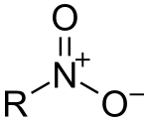
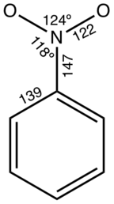
1-Connect Oxygen “o12”
o12 15.99940 O oxygen in nitro group (-NO2)
If atom type == “O” and num of connects == 1:
if elements1.count(’N’) == 1 and elements2.count(’O’) == 1 and elements2.count(’C’) == 1 :
nta[atom-id] = ’o12’
https://en.wikipedia.org/wiki/Nitro_compound

Slide 18
Oxygen 2 Connects
o2s 15.99940 O ester oxygen
o2h 15.99940 O hydroxyl oxygen
o2e 15.99940 O ether oxygen
o2z 15.99940 O oxygen, in siloxanes and zeolites
o2 15.99940 O generic oxygen with two bonds attached
5 compass 2-Connect Oxygens

Slide 19
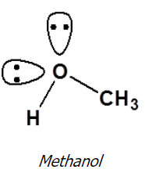
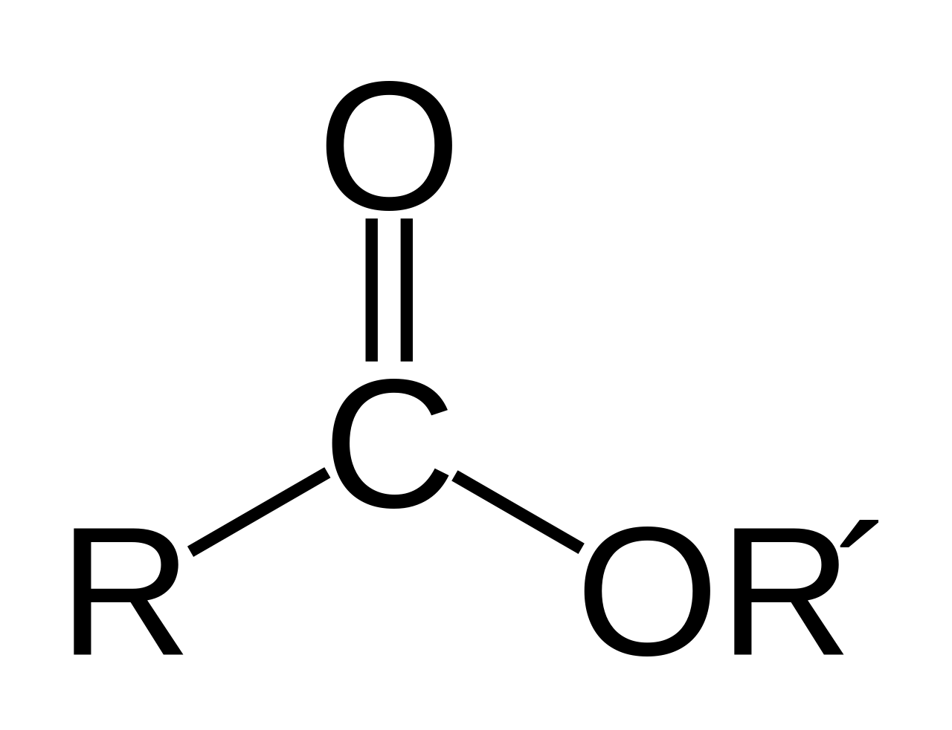
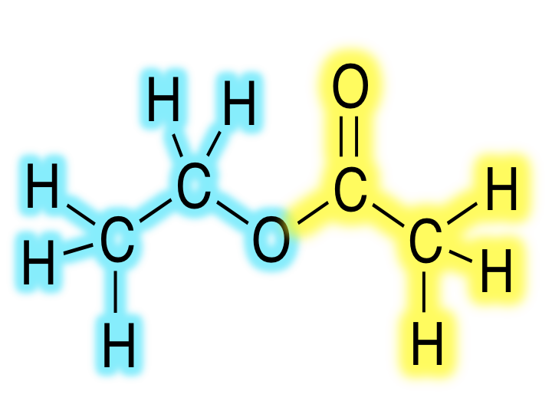
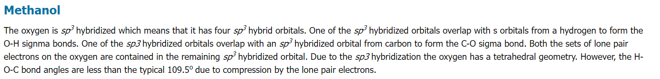
2-Connect Oxygen “o_2” or “oe”
o2s 15.99940 O ester oxygen
Ester Oxygen
elif ring_size == 0 and all(rings1) == 0 and elements1.count(’C’) == 2 and count_neigh(neighbor_info[2], element=‘O', ring= 0, nb=1) == 1:
if elements2.count(’C’) == 2 :
nta[atom-id] = ’o_2’
# o_2 15.99940 O 2 ester oxygen
elif ring_size == 0 and type1 = ’C’ and ring1 == 0 and type2 = ’C’ and ring2 == 0 and count_2ndneigh_elemringnb(neigh_2nd_list, ’O’, 0, 1) == 1 :
nta[atom-id] = ’o_2’
https://en.wikipedia.org/wiki/Ester
https://chem.libretexts.org/Courses/Athabasca_University/Chemistry_350%3A_Organic_Chemistry_I/01%3A_Structure_and_Bonding/1.11%3A_Hybridization_of_Nitrogen_Oxygen_Phosphorus_and_Sulfur

Slide 20
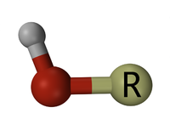
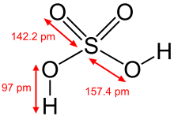
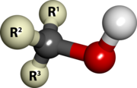
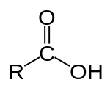
2-Connect Oxygen “o2h”
o2h 15.99940 O hydroxyl oxygen
hydroxyl
Sulfuric acid
alcohol
Carboxylic acid
If atom type == ’O’ and num of connects == 2:
elif ring_size == 0 and elements1.count(’C’) == 1 and elements1.count(’H’) == 1:
nta[atom-id] = ’o2h’
https://en.wikipedia.org/wiki/Hydroxy_group

Slide 21

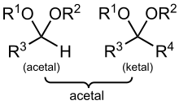
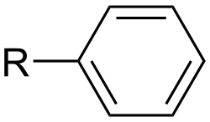

2-Connect Oxygen “o2e”
o2e 15.99940 O ether oxygen
Ether: R–O–R′, where R and R′ represent the alkyl or aryl groups
aryl
If atom type == ‘O’ and num of connects == 2:
if elements1.count(’C’) == 2:
nta[atom-id] = ’oc’
alkyl
https://en.wikipedia.org/wiki/Ether
https://en.wikipedia.org/wiki/Alkyl
https://en.wikipedia.org/wiki/Acetal

Slide 22
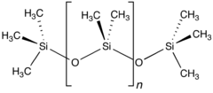
2-Connect Oxygen “osi”
o2z 15.99940 O oxygen, in siloxanes and zeolites
If atom type == ’O’ and num of connects == 2:
elif ring_size == 0 and ’Si’ in elements1 and type2 == ’O’ in elements2:
nta[atom-id] = ’o2z’
https://en.wikipedia.org/wiki/Siloxane

Slide 23
Nitrogen 1 Connects
n1z 14.00670 N nitrogen, terminal atom in -N3 (azides)
n1n 14.00670 N nitrogen in N2
n1o 14.00670 N nitrogen in NO
3 compass 1-Connect Nitrogens

Slide 24
1-connect Nitrogen “n1z”
n1z 14.00670 N nitrogen, terminal atom in -N3 (azides)
If atom type == ’N’ and nb == 1:
elif elements1.count(’N’) == 1 and elements2.count(’N’) == 1 and elements3.count(’C’) == 1:
nta[atom-id] = ’n1z’
https://chem.libretexts.org/Ancillary_Materials/Reference/Organic_Chemistry_Glossary/Alpha_Carbon

Slide 25
1-Connect Nitrogen “n1n*” and “n1o”
n1n 14.00670 N nitrogen in N2
n1o 14.00670 N nitrogen in NO
If atom type == ‘N’ and nb == 1 :
# n1n
if formula == ’N2’:
nta[atom-id] = ’n1n’
# n1o
if formula == ’N1-O1’:
nta[atom-id] = ’n1o’

Slide 26
Nitrogen 2 Connects
n2t 14.00670 N nitrogen, central atom in -N3 (azides)
n2z 14.00670 N nitrogen, first atom in -N3 (azides)
n2o 14.00670 N nitrogen in NO2
n2= 14.00670 N nitrogen
4 compass 2-Connect Nitrogen's

Slide 27
1-connect Nitrogen “n2t”
n2t 14.00670 N nitrogen, central atom in -N3 (azides)
If atom type == ‘N’ and nb == 2 :
elif elements1.count(’N’) == 2 and elements2.count(’C’) >= 1:
nta[atom-id] = ’n2t’
https://chem.libretexts.org/Ancillary_Materials/Reference/Organic_Chemistry_Glossary/Alpha_Carbon

Slide 28
1-connect Nitrogen “n2z”
n2z 14.00670 N nitrogen, first atom in -N3 (azides)
If atom type == ‘N’ and nb == 2 :
elif elements1.count(’N’) == 1 and elements1.count(’C’) >= 1 and elements2.count(’N’) >= 1 :
nta[atom-id] = ’n2z’
https://chem.libretexts.org/Ancillary_Materials/Reference/Organic_Chemistry_Glossary/Alpha_Carbon

Slide 29

2-Connect Nitrogen “n2o”
n2o 14.00670 N nitrogen in NO2
If atom type == ‘N’ and nb == 1 :
# n1n
if formula == ’N1-O2’:
nta[atom-id] = ’n2o’
’

Slide 30
Nitrogen 3 Connects
n3o 14.00670 N nitrogen in nitro group
n3m 14.00670 N sp3 nitrogen in amides without hydrogen
2 compass 3-Connect Nitrogens

Slide 31
3-Connect Nitrogen “n3o”
n3o 14.00670 N nitrogen in nitro group
If atom type == “N” and num of connects == 3:
if elements1.count(’O’) == 2 and elements1.count(’C’) == 1 :
nta[atom-id] = ’o12’
https://en.wikipedia.org/wiki/Nitro_compound

Slide 32
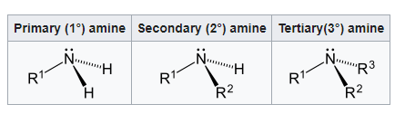
3-Connect Nitrogen “n3m”
n3m 14.00670 N sp3 nitrogen in amides without hydrogen
If atom type == ’N’ and num of connects == 3 :
elif ring == 0 and elements1.count(’C’) == 3:
nta[atom-id] = ’n3m’
https://en.wikipedia.org/wiki/Amine

Slide 33
1 connect Sulfur
s1= 32.06400 S sulfur in CS2
s2= 32.06400 S sulfur in SO2
If atom type == ‘S’ and nb == 1 :
# s1=
if formula == ’C1-S2’:
nta[atom-id] = ’s2=’
# s2=
if formula == ’O2-S1’:
nta[atom-id] = ’s2=’
2 compass 1 connect Sulfur

Slide 34
4 connect silicon
si4c 28.08600 Si a subset of si4, non-hydrogen atom attached [siloxanes]
si4 28.08600 Si generic silicon with four bonds attached

Slide 35
Simple singular element atom types
xe 1 31.30000 Xe xenon
ne 20.18300 Ne neon
kr 83.80000 Kr krypton
he 4.00300 He helium
ar 39.94400 Ar argon
p4= 30.97380 P phosphorous

Slide 36

I AM HERE

Slide 37
Acknowledgements
Dr. Gregory Odegard
CMMR Lab Group
Superior: Dr. Gowtham
Special Thanks to:
Prathamesh Deshpande, Sagar Patil, Hashim Al Mahud, Will Pisani, and Ivan Gallegos

