Slide 1

Automated ARP Poison Tool
Arjen Kılıç
CMPE 487 Final Project Presentation
Department of Computer Engineering
Bogazici University

Slide 2
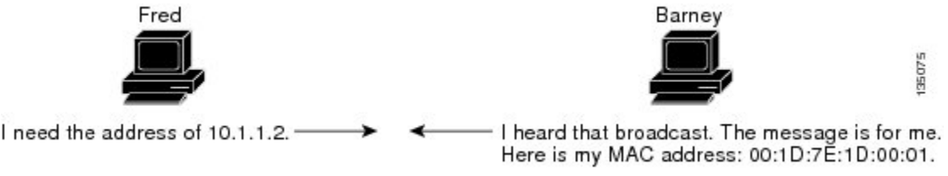

What is ARP
Address Resolution Protocol
Maps IP addresses to MAC addresses
Request is broadcast, response is unicast

Slide 3
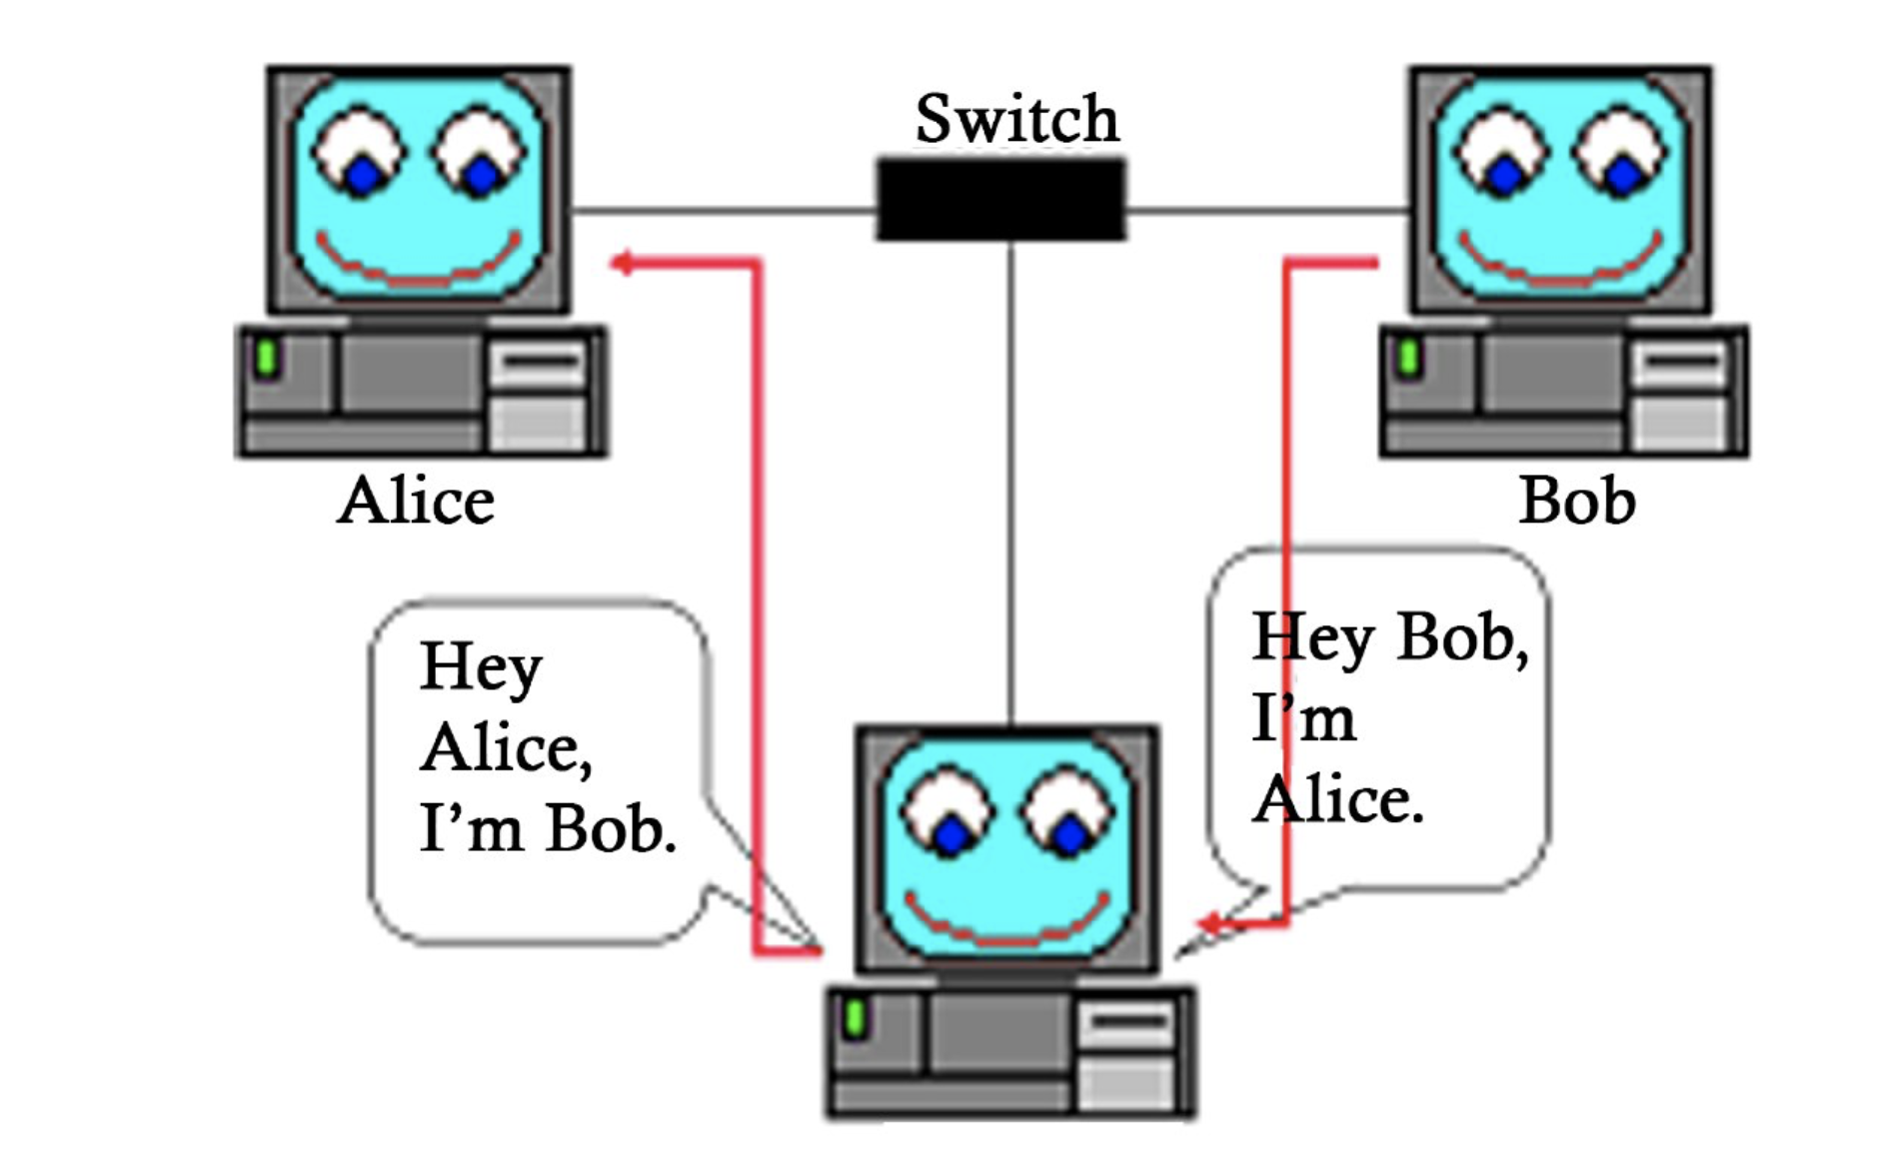
ARP Poison
Send false ARP requests
Enable IP forwarding

Slide 4
Project Details
Poison the network with false ARP requests
Sniff the traffic between router and victim. Save it as .pcap file
Analyze the traffic to extract some information like visited websites, OS and browser versions, possible credentials.
Does NOT support HTTPS
Implemented in Python3
Mainly used packages; Scapy and dpkt

