Slide 1

Category Code: C5
Problem Statement Title: AI-Powered Investment & Trading Assistant
Team Name: T-bits
Institute Name: Vivekanand Education Society’s Institute of Technology

Slide 2

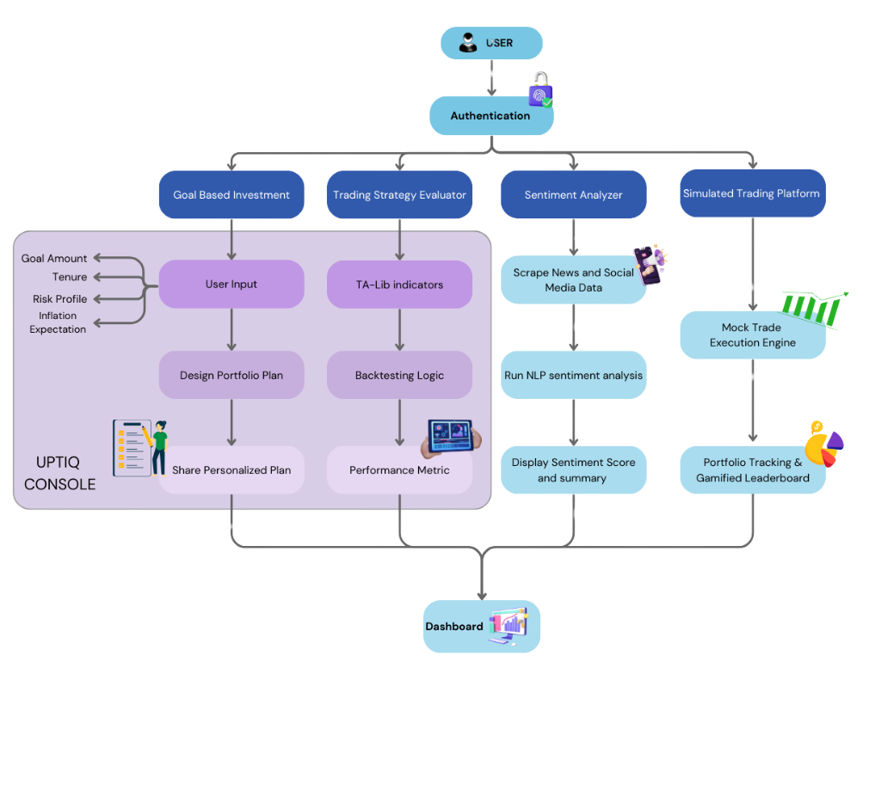
Idea / Approach details (& implemented features)
Problem Statement
Retail investors lack personalized guidance and real-time insights.
Evaluating strategies and analyzing sentiment requires expertise, leading to poor decisions.
Solution
AI-powered assistant integrates goal-based planning, strategy evaluation, sentiment analysis, and simulated trading.
Uses UPTIQ Console to automate financial decisions and provide personalized recommendations.

Slide 3
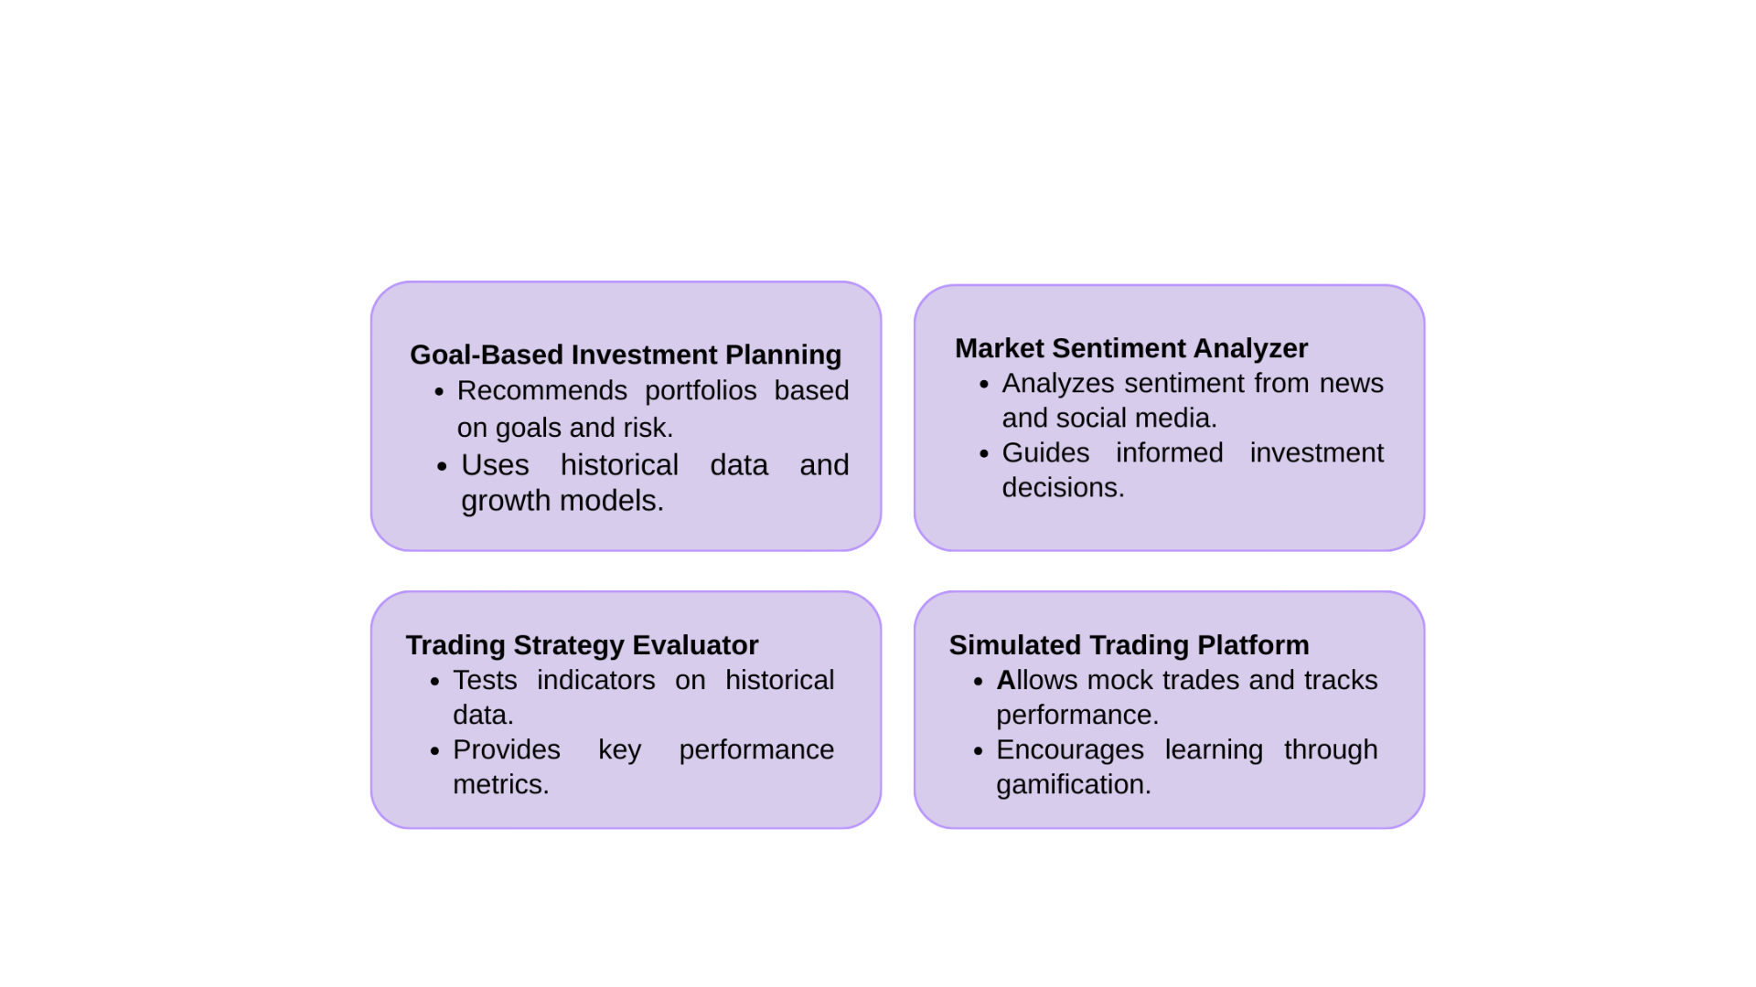
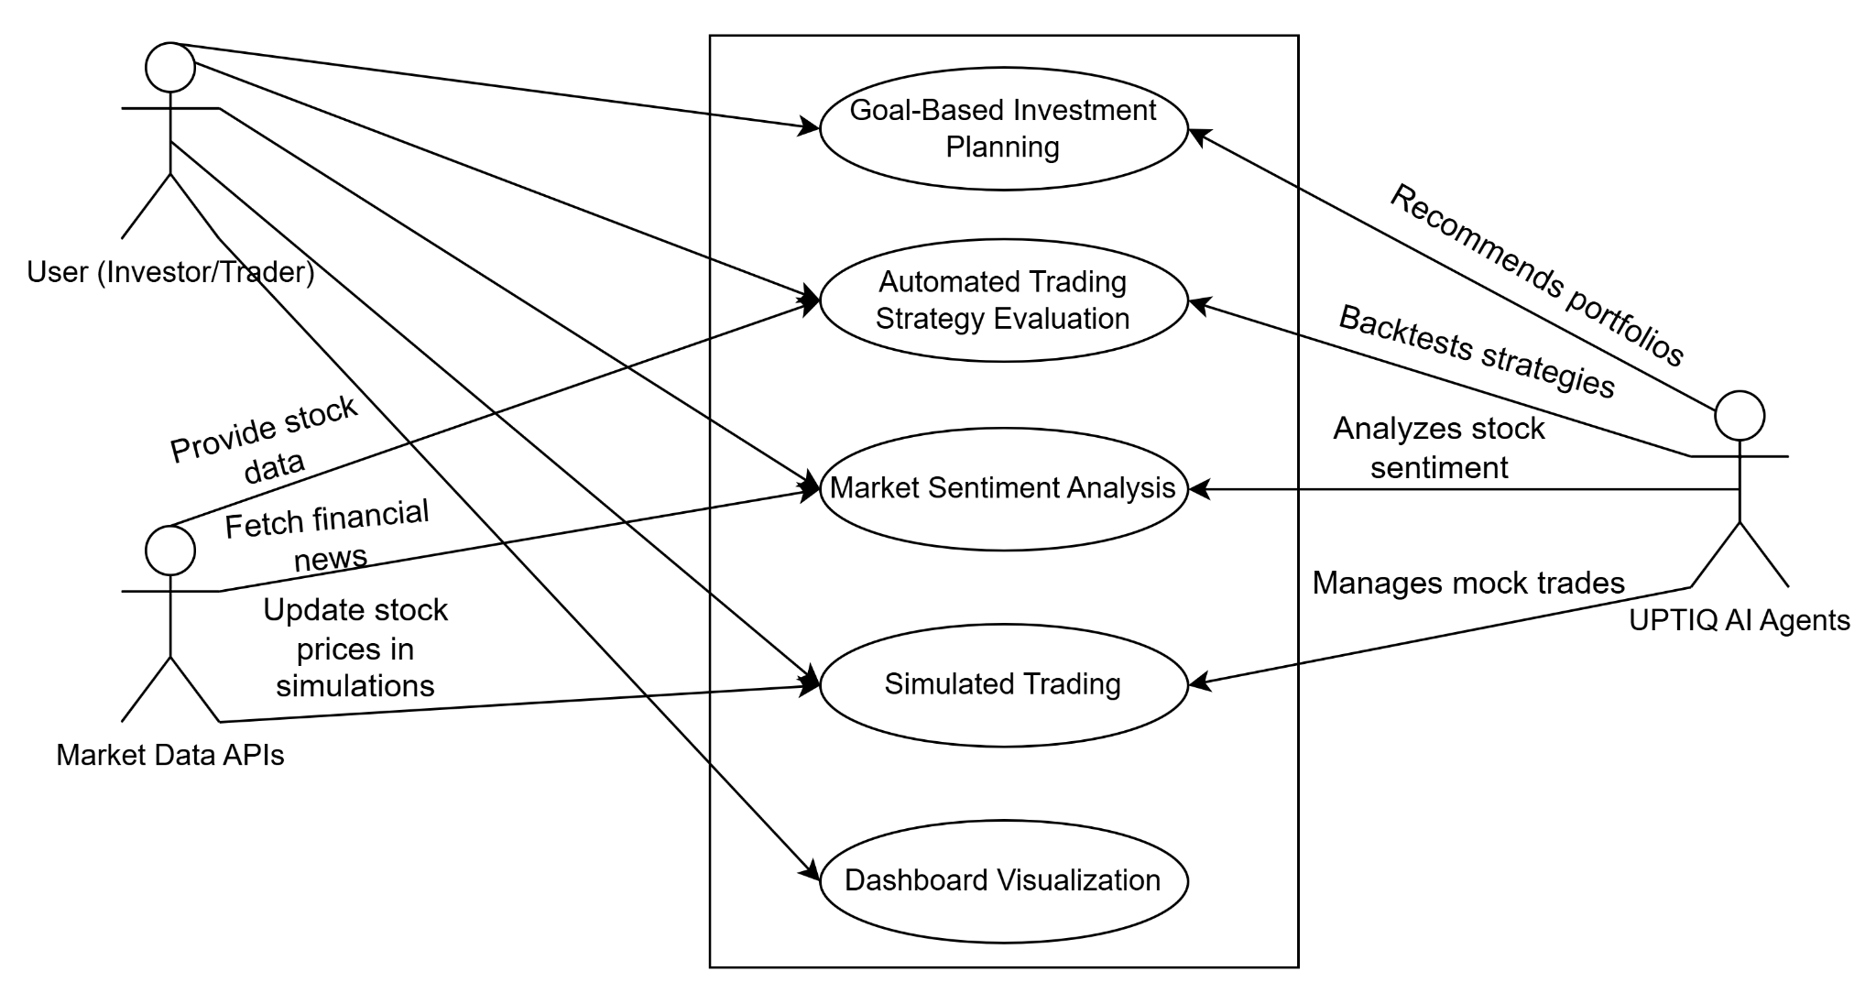
Innovation (Showstopper)/ Use Case Diagram

Slide 4
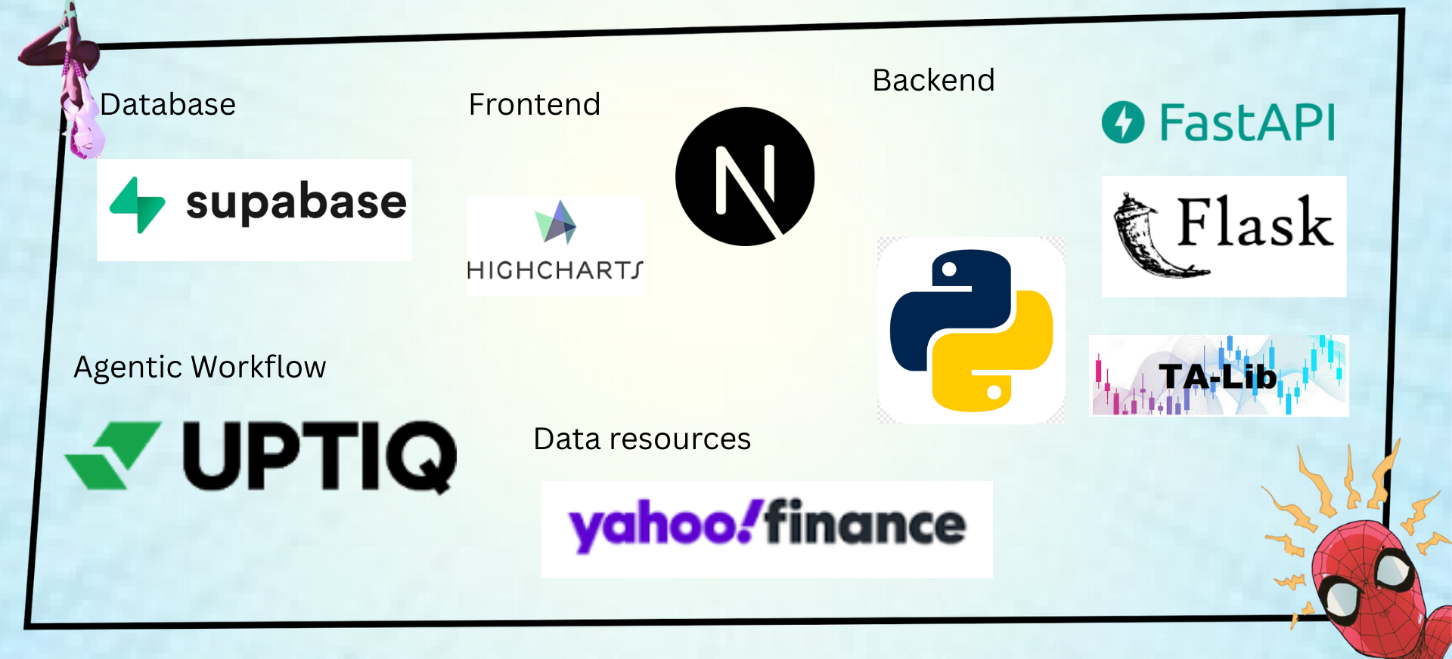
Tech Stack

Slide 5
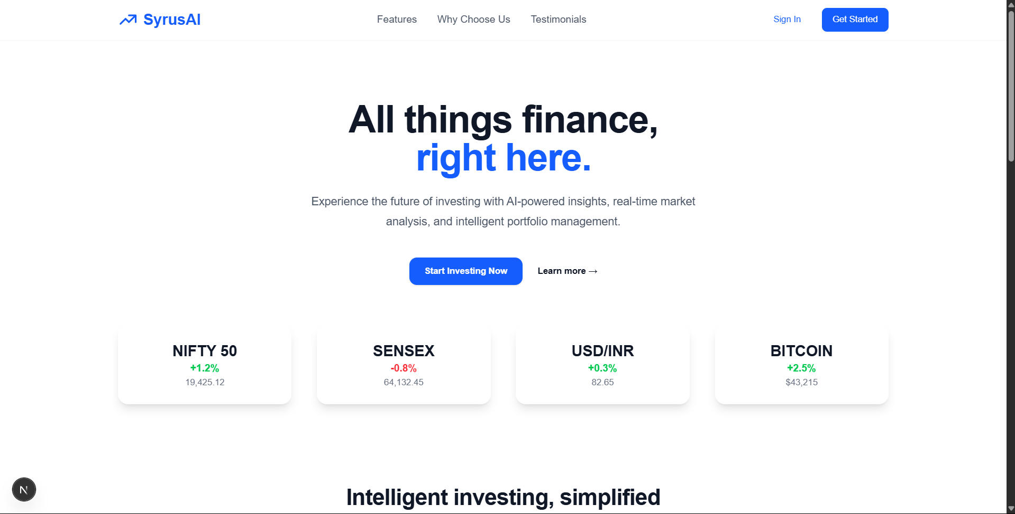
Implementation/Prototype/Use Case Diagram (screenshots)

Slide 6
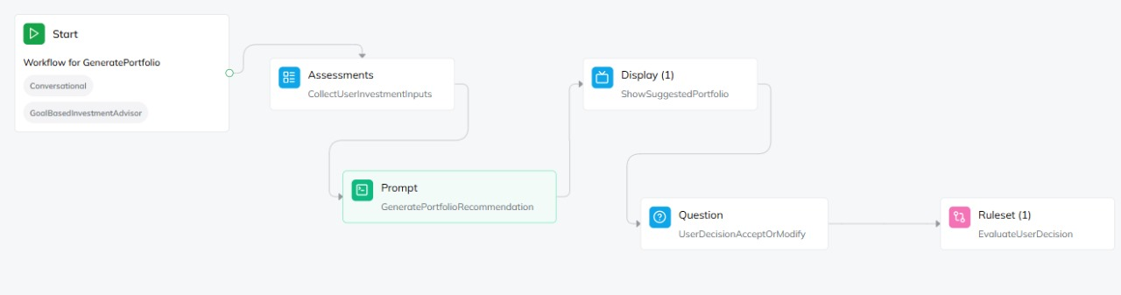
In case of Uptiq category - Your Uptiq Agent (explain in detail)
User Input: Goal, amount, duration, and risk.
AI Recommendation: Asset allocation with future value.
User Choice: Accept or modify.
Confirmation: Confirms or stores portfolio.
Modification: AI re-evaluates custom allocation.
Final Confirmation: Displays and confirms updated portfolio.

Slide 7
Future Objectives
Improve AI Accuracy – Integrate deep learning to detect patterns, e.g., Tesla stock surging after earnings reports, for better predictions.
Multi-Asset Support – Expand analysis to crypto (Bitcoin trends), ETFs (S&P 500), and commodities (Gold price shifts) for diversified insights.
Real-Time Risk Alerts – AI detects sudden Nvidia stock drops (e.g., 5% in pre-market) and alerts users instantly.
Personalized Strategies – AI adapts; e.g., if a user prefers low-risk dividend stocks, it suggests Coca-Cola over Tesla.

