Slide 1

The History and Evolution of Java
From the Oak tree to Java 28
Assignment: Concepts, Syntax, Lexical Analysis
Mohammad Khazaeli, Jason Wu, Jiao Wang, Karina Chiste
Notes:
*Used Claude AI to get help with designing and polishing the Template of the PPT

Slide 2



Java: A Brief Overview
May 1995
Editions
Java 27
-Announced by Sun Microsystems to the public
-Designed by James Gosling
-Java Card
-Java Platform, Micro Ed
-Java Platform, Standard Ed
-Java Platform, Enterprise Ed
-Last stable version, released September 15, 2026

Slide 3
Timeline: The Green Project
1991
The Start of The Green Project. James Gosling, Mike Sheridan and Patrick Naughton supervised a team of engineers to explore a new technology. The project aimed to build a software that can run on different types of hardware and can allow electronic devices to communicate in a heterogenous network.
1992-93
The language "Oak" is built for the project. Named after a tree that stood outside Gosling’s office. Originally, the team wanted to use C++ for the project, but it wasn’t sufficient for memory management and was too complex to use.
Jan 1995
“Oak” is renamed to “Java”. This happened because of a trademark conflict with Oak technologies. They chose Java because it was catchy and unique. Java refers to Java Island in Indonesia where it plays major role in coffee trading.
May 1995
Sun Microsystems officially announces Java at “SunWorld” Conference. The first JDK and the HotJava browser was demonstrated, followed by Netscape support.

Slide 4
How Java Code Runs?
JVM on Windows
Source code
.java
Java Compiler
javac
Bytecode
.class
JVM on Linux
JVM on macOS
Good Performance
JIT compilation prevents slow running code in VM’s
Write Once, Run Everywhere
This is the principle of a Java Code
Advanced Memory Management
Using garbage collection, java reclaims memory filled by objects.

Slide 5
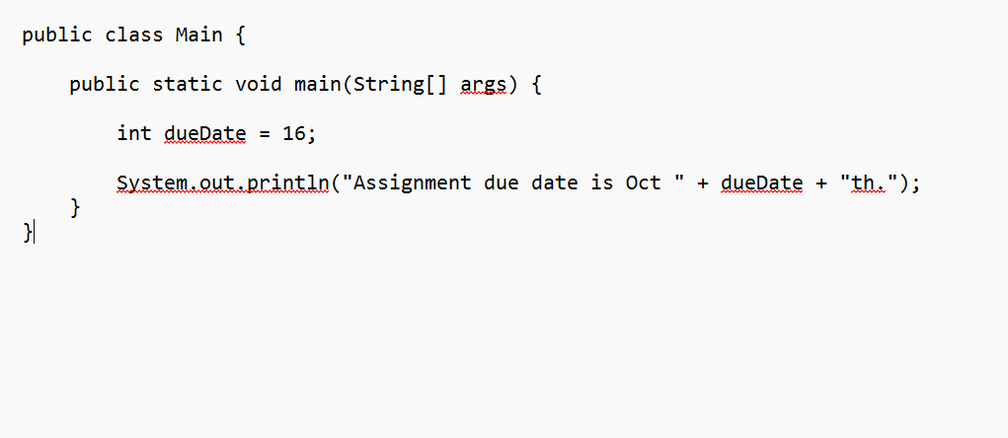
Java Code Example
Class: Every Java code
lives inside a class.
Main: where the program
execution begins.
int: variable with declared
type.
System.out.printIn: Prints the line.
Output:
Assignment due date is Oct 16th.

Slide 6
Early milestones, 1996-2014
1996
1998
2004
2006
2014
Java 1.0
First official public release.
Java 2
Major improvements such as better UI and expanded framework.
Java 5
Codenamed “Tiger”
Introduced generics and annotations
Open source
Sun releases Java's source code technology (OpenJDK) under GPL.
Java 8 (LTS)
Lambdas change everyday code.

Slide 7
Java’s Change of Ownership “The Oracle Era”
2006
Sun starts open-sourcing Java, releases java implantation code under JDK.
“The acquisition of Sun transforms the IT industry, combining best-in-class enterprise software and mission-critical computing systems”
Larry Ellison – CEO of Oracle
2007
A fully buildable OpenJDK implementation is released.
What this meant for Java’s History?
More investment on Java.
Better server infrastructure.
Increased support of Java tools and platforms.
2008
Sun is under financial pressure and acquisition threat.
2009 - 2010
By 2009, Oracle comes to an agreement to acquire Sun for 7.4 billion dollars and completes the acquisition by Jan 2010.

Slide 8


Oracle v. Google: Part I
What is an API?
A collection of established rules that enables different software applications to communicate and exchange data with each other.
What was at stake?
Not just money but also the future of software development. Significant financial liability putting android’s future and developer freedom at risk.
2010
May 2012
May 2014
Jun 2015
Oracle sues Google over Android's use of Java. Claiming violation of Java’s copyright and foundation
Federal court rules the Java APIs were not copyrightable.
Oracle wins the appeal, claiming some Java APIs could receive protection.
Supreme Court declines to review the case.

Slide 9
Oracle v. Google: Part II
May 2016
The jury finds Google's use of Java’s API to be under fair use. Oracle files for an appeal again.
gtg
Mar 2018
Oracle wins the appeal again. Google asks the supreme to court to review the case.
Nov 2019
The Supreme Court agrees to hear Google's appeal.
Why it mattered?
Because it shaped how fair use applied to software cases and how reusing interfaces for compatibility mattered.
Apr 2021
The Supreme Court rules 6-2 in favor of Google. Making the use of API’s fair use under the United States copyright law.

Slide 10
How the language evolved after Oracle
Java 8 - 2014
Lambda expressions and modern API made data processing easier.
Java 11 - 2018
Long term support for businesses.
Java 17 - 2021
Adds switch expressions and improved security.
Java 21 - 2023
Virtual threads, records and pattern matching improved concurrency and data management.
Java 26 - 2026
The newest LTS, updating features such HTTP/3, simpler language and performance.

Slide 11

The Future of Java
OpenJDK
The community contributed a lot to the project and helping to expand.
JDK 28
Expected March 2027
Project Valhalla: Led by Brian Goetz and wants to modernize java while increasing performance such as inlining data directly on enclosing layouts and minimizing memory footprints.
It is being praised for continued support even 25 years after release.
Java 29 in September 2027
Next Planned LTS release.

Slide 12
Why Java over other languages?
1
Platform Independence: Java can run on different OS’s using a compatible JVM.
2
Better security and performance: constant updates and language features makes the coding easier.
3
Extensions and libraries: Using Java gives you access to mature libraries and frameworks.
4
Long Continued Support: Open-source development such as OpenJDK still exists and helps developers around the world to evolve java and help the community.
Notes:
Wrap up by tying the story together: purpose, ownership, release model, and where Java is heading.

Slide 13
References
Mahmoud, Q. H. (2002). Java introduction. University of Guelph.
https://www.cis.uoguelph.ca/~qmahmoud/teaching/fall2004/dcct1020/java-intro.pdf
Gosling, J., & McGilton, H. (1996, May). The Java language environment: A white paper. Oracle. https://www.oracle.com/java/technologies/language-environment.html
Oracle. (n.d.). Oracle Java SE support roadmap. Retrieved October 16, 2026, from https://www.oracle.com/java/technologies/java-se-support-roadmap.html
Oracle. (2019). A brief history of Java [Infographic]. https://www.oracle.com/a/ocom/docs/dc/ww-brief-history-java-infographic.pdf
Oracle. (2009, April 20). Oracle buys Sun [Press release]. https://www.oracle.com/corporate/pressrelease/oracle-buys-sun-042009.html
Behler, M. (2026, May 18). Java versions and features. https://www.marcobehler.com/guides/a-guide-to-java-versions-and-features
Electronic Frontier Foundation. (2021, October 15). Oracle v. Google. https://www.eff.org//oracle-v-google
Google LLC v. Oracle America, Inc., 141 S. Ct. 1183 (2021). https://www.supremecourt.gov/opinions/20pdf/18-956_d18f.pdf
Harvard Law Review. (2021, November 10). Google LLC v. Oracle America, Inc. https://harvardlawreview.org/print/vol-135/google-llc-v-oracle-america-inc/
Oracle. (2026, September 15). Oracle releases Java 27 and strengthens post-quantum cryptography support. https://www.oracle.com/nl/news/announcement/oracle-releases-java-27-and-strengthens-post-quantum-cryptography-support-2026-09-15/
Redlich, M. (2026, March 2). Java news roundup: Lazy constants, TornadoVM 3.0, NetBeans 29, Quarkus, JReleaser, Open Liberty. InfoQ. https://www.infoq.com/news/2026/03/java-news-roundup-feb23-2026/
Smith, D. (n.d.). JEP 401: Value classes and objects (Preview). OpenJDK. https://openjdk.org/jeps/401

