Slide 1
Unit Testing and Test Driven Development

Slide 2
Learning Objectives
Why write unit tests
Writing testbenches
Regression testing
Test oracles
Test driven development

Slide 3
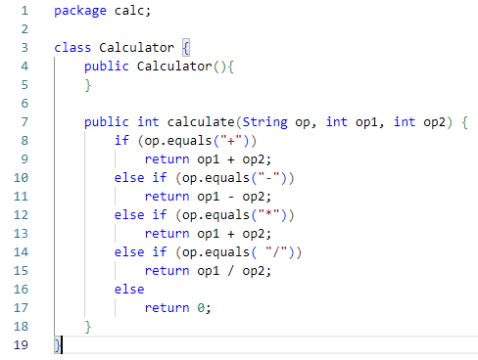
Running example for the class: Calculator

Slide 4
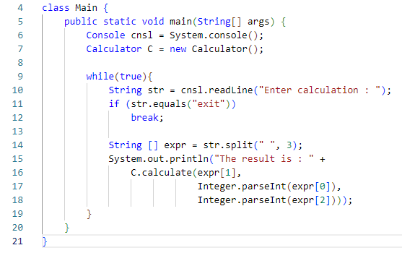
Main code for calculator

Slide 5
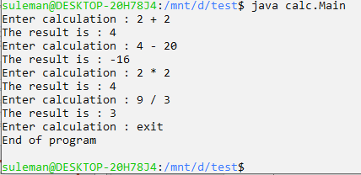
Example Run
Notes:
STOP and ask the discussion question: How do we make sure that this calculator will work correctly? The answer to that question is today’s lecture.

Slide 6
Testing
Run the program and check if the output is correct
Problems in testing complete programs
Too many possible inputs
Hard to localize the bug in case of test failure (multiple bugs possible)
Extremely time / energy consuming
Solution: Unit testing = Test each method independently
Core idea: If all units are working properly then the whole program has a high chance of working properly

Slide 7
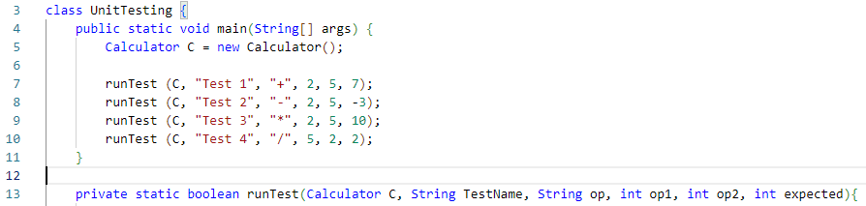
Unit Testing Implementation
Testbench: a program which tests another program
Call method under test with some inputs
Check the result
Needs to run independent of the other methods in the program
Runs multiple tests on the same method

Slide 8
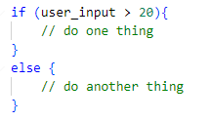
Properties of a good testbench
Independent test cases
High code coverage (ideally 100%)
Test edge cases
Produces enough information to understand failed tests and localize fault

Slide 9
Regression Testing
Running unit tests whenever we change a class / methods
For large code bases, no one knows the entire code. Regression testing highlights unintended changes.
Tests evolve with the code base
Development cycle:
Make changes to code
Write / Update tests to test new behavior
Run related tests
Testing takes a significant amount of development time

Slide 10
Writing Tests
Write new testbench classes for every class
Managing the testbench classes
Too much repetitive work
We want to write just the important stuff:
“runTest (C, "Test 4", "/", 5, 2, 2);”
Unit Testing frameworks: Junit, pytest, Google test (for C/C++)

Slide 11
Where do expected test outputs come from?
For calculator:
Input: “+”, 5, 2
Output: 7

Slide 12
Test Oracle
Tells us what the expected test output is
Possible test oracle
Legacy software (in software modernization process)
Requirement specifications
Humans (especially true for user interface applications)
Expected outputs don’t come from system under test

Slide 13

Test Driven Development
It’s possible to write and run the tests before implementing a method

Slide 14
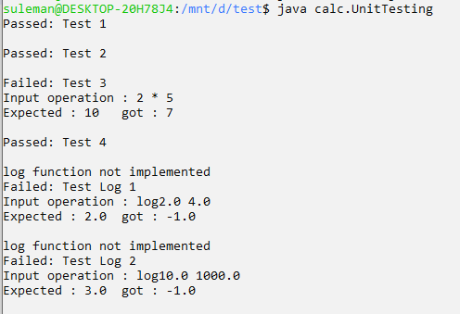
Test Results

Slide 15
Test Driven Development
Tests guide software development
Creates milestone to aim for
Usually results in high coverage test benches (because its common to forget the cases if you write tests at the end)
Testing after implementing logic for each test catches bugs early

Slide 16
Write a stub and tests for sine x

