Slide 1






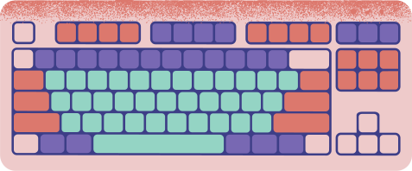
COMPUTER PARTS
FUN QUIZ

Slide 2


INSTRUCTIONS
You will be shown several pictures of computer parts
Write the name of each part down on a piece of paper
Give yourself one point for each correct answer
The one who gets the most points wins

Slide 3
THIS PART
is called a ...

Slide 4
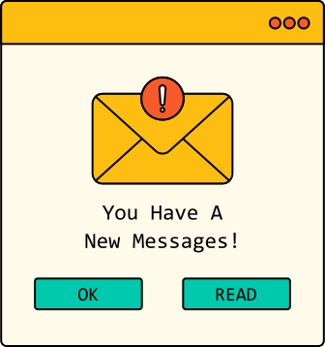

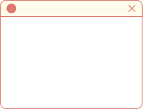


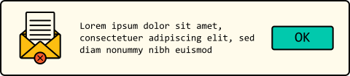
ANSWER
MONITOR

Slide 5
THIS PART
is called a ...

Slide 6
ANSWER
MOUSE

Slide 7
THIS PART
is called a ...

Slide 8
ANSWER
KEYBOARD

Slide 9




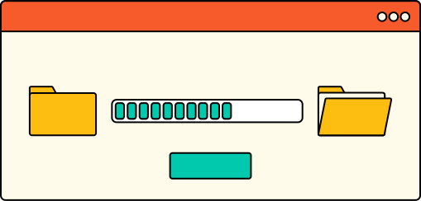
HOW WELL DID YOU DO?

Slide 10



THANKS FOR PLAYING

