Slide 1

Amit Riswadkar Booz Allen Hamilton

Slide 2
About Me
Currently Associate at Booz Allen Hamilton’s Commercial practice
Cyber Defense product management
Previously in Data Protection
Previously Zurich Insurance / Farmers Insurance
Security Engineer
Business Analyst
Education:
B.S. Computer Information Systems and Risk Management & Insurance
Pursuing M.S. in Cyber Security at Georgia Tech online

Slide 3
About Booz Allen
Heritage
Booz Allen Hamilton is the first management consulting firm
National Service
provides many types of government services including civil agencies and defense
Commercial Sector
Provides cybersecurity services and expertise to many Fortune 500 companies

Slide 4
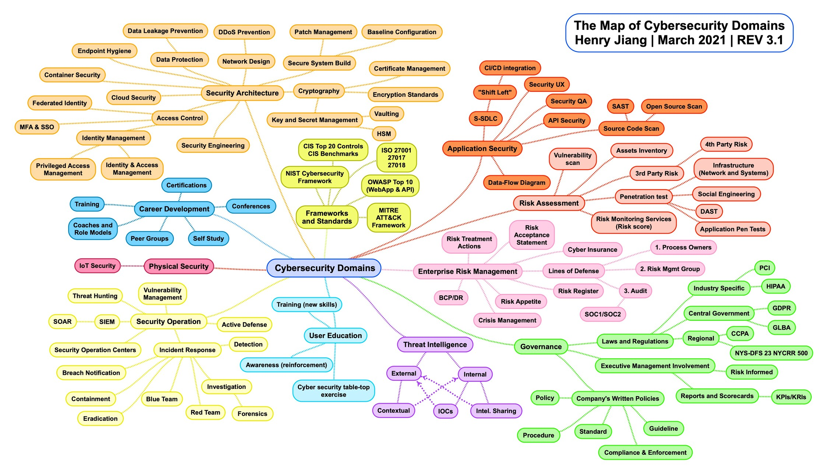
Too Many Domains
https://www.linkedin.com/pulse/cybersecurity-domain-map-ver-30-henry-jiang/

Slide 5
Resources for learning about applied cybersecurity
Twitter accounts
@hacksforpancakes
@runasand
@JohnLaTwc
@evacide
@tavisormandy
@marcusjcarey
@CISA
Podcasts
ISC SANS
Discord/Slack Channels
Slack Brakeing Down Security
CTFs
Google Gruyere
HacktheBox
CTFtime.org
CTF.hacker101.org
picoCTF
Tryhackme.com
Conferences
Bsides / ISSA
Many offer discounted student tickets

Slide 6
Musings
Getting in the door
Talk about how your coursework / projects relate to security
Check out Building Virtual Machine Labs: A Hands On Guide
Consider Certifications help you get in the door, but they don’t hurt get especially ones like Security+
The field is continuing to grow
Companies are looking for entry-level analysts
Areas that are developing / growing
Analytics & Automation
Data Protection including technologies like Data Loss Prevention

Slide 7

Any Questions?

