Slide 1
Cluster Analysis: Basic Concepts and Algorithms
Lecture Notes for Chapter 8
Introduction to Data Mining
by
Tan, Steinbach, Kumar
© Tan,Steinbach, Kumar Introduction to Data Mining 4/18/2004 1

Slide 2
What is Cluster Analysis?
Finding groups of objects such that the objects in a group will be similar (or related) to one another and different from (or unrelated to) the objects in other groups
Inter-cluster distances are maximized
Intra-cluster distances are minimized

Slide 3
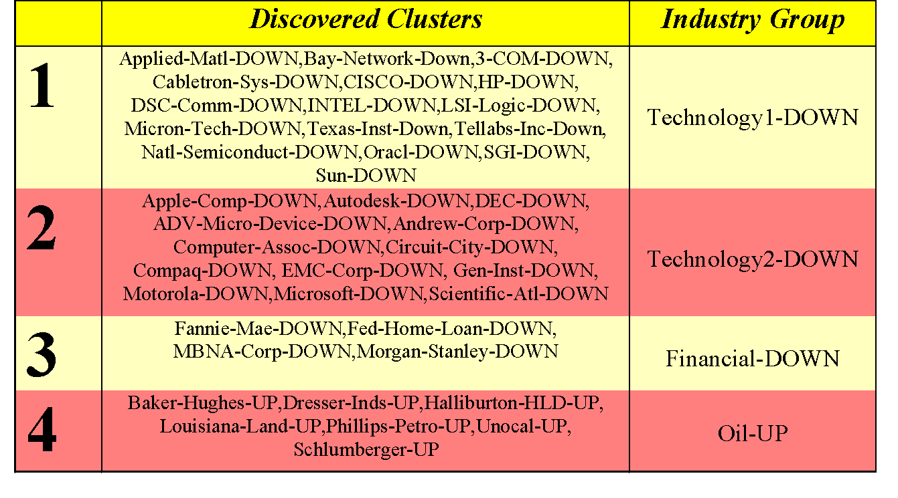
Applications of Cluster Analysis
For Understanding
Information Retrieval Group related documents for browsing, group genes and proteins that have similar functionality, or group stocks with similar price fluctuations
Biology Find groups of genes that have similar functions.
Medicine Detect patterns in the spatial or temporal distribution of a disease.
Business ??

Slide 4
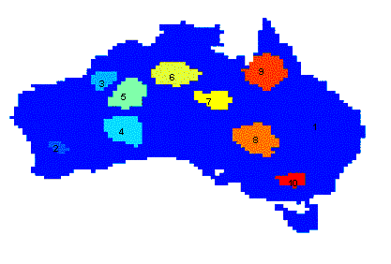
Applications of Cluster Analysis
For Utility
Provide an abstraction of a dataset using a cluster prototype, which is a data object that is representative of other objects in same clusters.
Summarization Reduce the size of large data sets.
Compression Use a prototype table.
Clustering precipitation in Australia

Slide 5
What is not Cluster Analysis?
Supervised classification
Have class label information
Simple segmentation
Dividing students into different registration groups alphabetically, by last name
Results of a query
Groupings are a result of an external specification

Slide 6
Notion of a Cluster can be Ambiguous
What is a cluster?
How many clusters?
Two Clusters
Four Clusters
Six Clusters

Slide 7
Types of Clusters
Well-separated clusters
Center-based clusters
Contiguous clusters
Density-based clusters

Slide 8
Types of Clusters: Well-Separated
Well-Separated Clusters:
A cluster is a set of points such that any point in a cluster is closer (or more similar) to every other point in the cluster than to any point not in the cluster.
How many well-separated clusters?

Slide 9
Types of Clusters: Center-Based
Center-based
A cluster is a set of objects such that an object in a cluster is closer (more similar) to the “center” of a cluster, than to the center of any other cluster
The center of a cluster is often a centroid, the average of all the points in the cluster, or a medoid, the most “representative” point of a cluster
How many center-based clusters?

Slide 10
Types of Clusters: Contiguity-Based
Contiguous Cluster (Graph-Based)
A cluster is a set of points such that a point in a cluster is closer (or more similar) to one or more other points in the cluster than to any point not in the cluster.
How many graph-based clusters?

Slide 11
Types of Clusters: Density-Based
Density-based
A cluster is a dense region of points, which is separated by low-density regions, from other regions of high density.
Used when the clusters are irregular or intertwined, and when noise and outliers are present.
How many density-based clusters?

Slide 12
Types of Clusterings
A clustering is a set of clusters
Important distinction between hierarchical and partitional sets of clusters
Partitional Clustering
A division data objects into non-overlapping subsets (clusters) such that each data object is in exactly one subset
Hierarchical clustering
A set of nested clusters organized as a hierarchical tree

Slide 13
Characteristics of the Input Data Are Important
Type of proximity or density measure
This is a derived measure, but central to clustering
Sparseness
Dictates type of similarity
Adds to efficiency
Attribute type
Dictates type of similarity
Type of Data
Dictates type of similarity
Other characteristics, e.g., autocorrelation
Dimensionality
Noise and Outliers
Type of Distribution

Slide 14
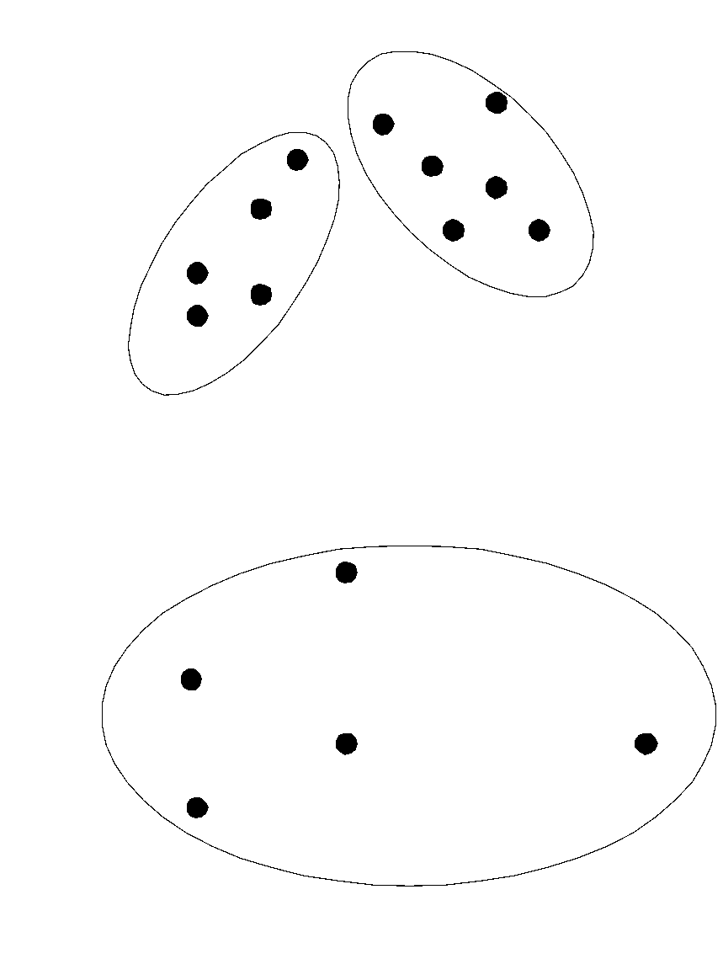
Partitional Clustering
Original Points
A Partitional Clustering

Slide 15
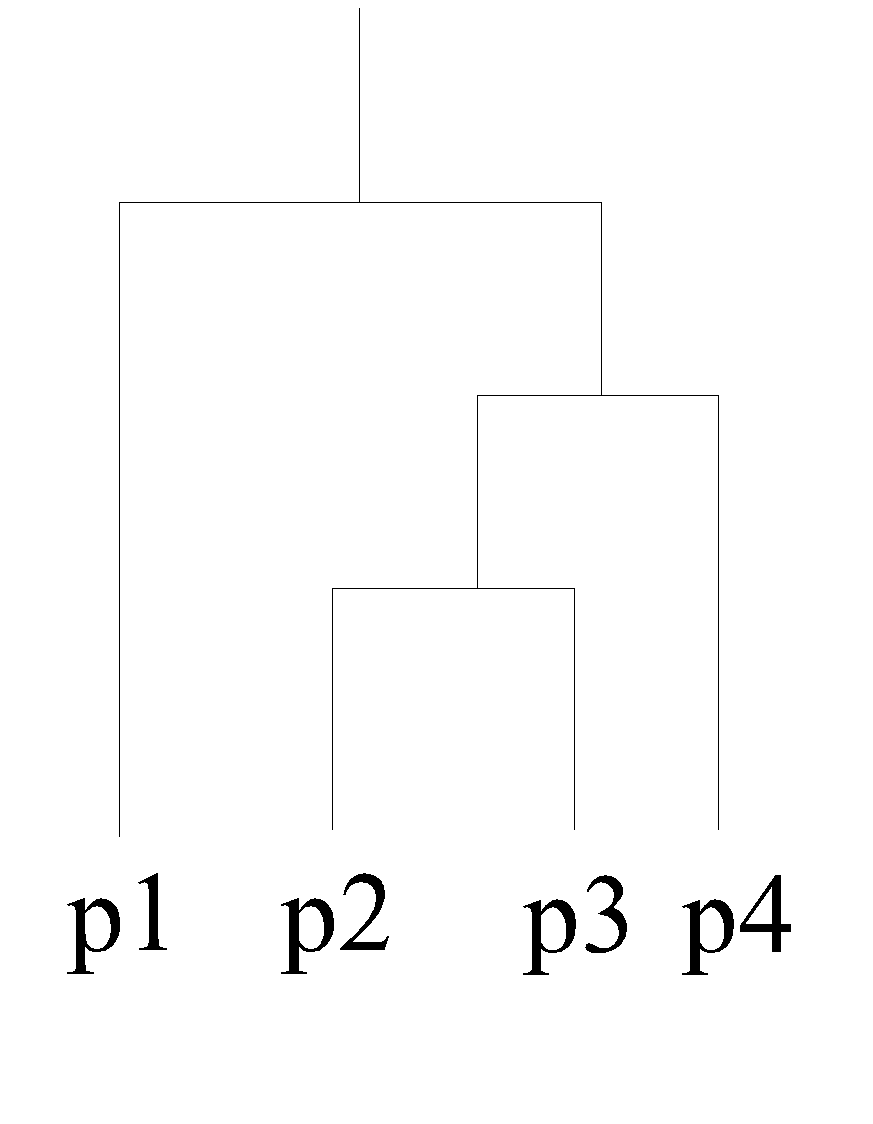
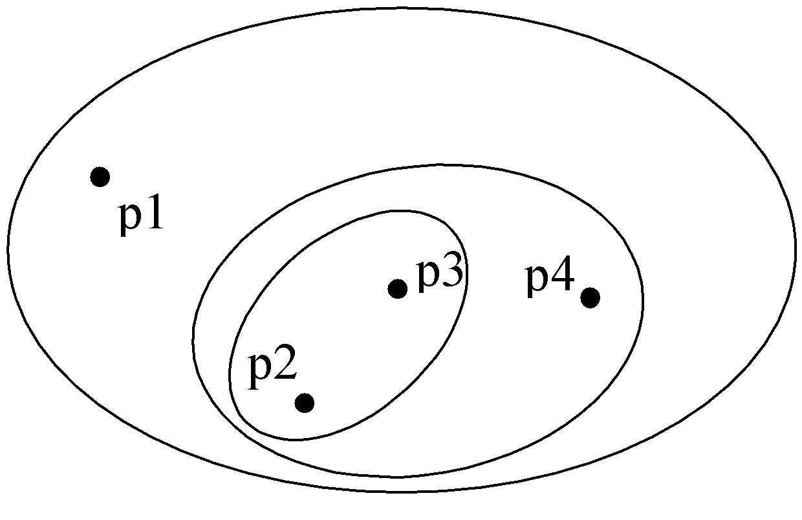
Hierarchical Clustering
Traditional Hierarchical Clustering
Traditional Dendrogram

Slide 16
Clustering Algorithms
K-means and its variants
Hierarchical clustering
Density-based clustering

Slide 17
K-means Clustering
Partitional clustering approach
Each cluster is associated with a centroid (center point)
Each point is assigned to the cluster with the closest centroid
Number of clusters, K, must be specified
The basic algorithm is very simple

Slide 18
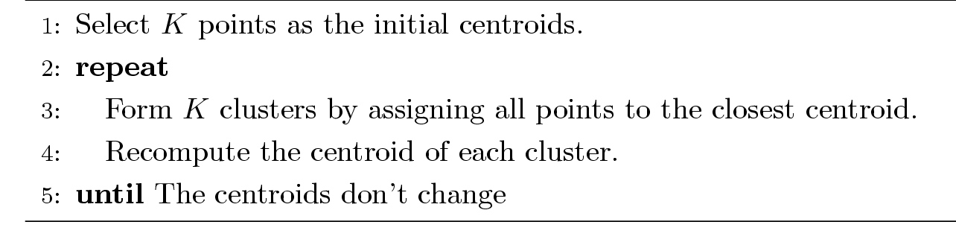
K-means Clustering
Partitional clustering approach
Each cluster is associated with a centroid (center point)
Each point is assigned to the cluster with the closest centroid
Number of clusters, K, must be specified
The basic algorithm is very simple

Slide 19
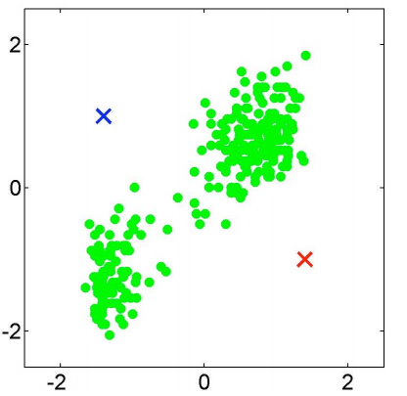
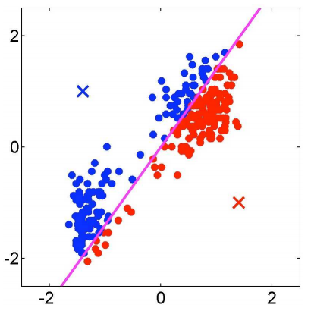
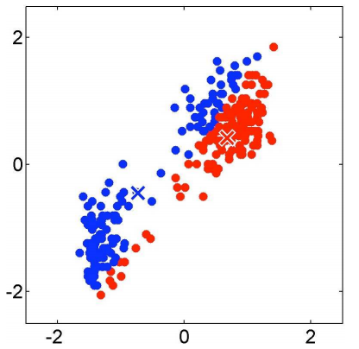
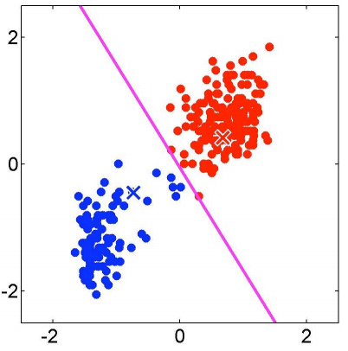
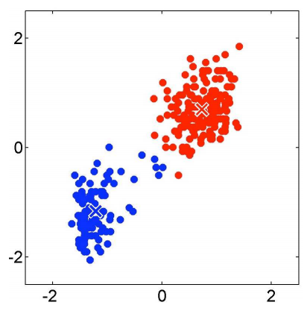
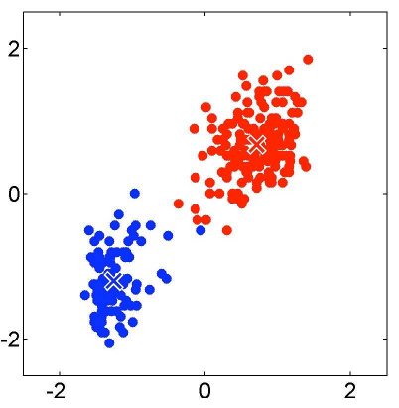
K-Means
Assign
Points
(1)
Recompute Cluster Centers
(1)
..
(k)
Assign
Points
(2)
Recompute Cluster Centers
(2)

Slide 20
K-means Clustering – Details
How to choose initial centroids ?
Will different choices of initial centroids effect the final results?
How to calculate the centroid ?
How to measure ‘Closeness?
When should this algorithms stop?
Will K-means always converge to some clusters?
What is the time complexity of K-Means?

Slide 21
K-means Clustering – Details
Initial centroids are often chosen randomly.
Clusters produced vary from one run to another.
The centroid is (typically) the mean of the points in the cluster.
‘Closeness’ is measured by Euclidean distance, cosine similarity, correlation, etc.
K-means will converge for common similarity measures mentioned above.
Most of the convergence happens in the first few iterations.
Often the stopping condition is changed to ‘Until relatively few points change clusters’
Complexity is O( n * K * I * d )
n = number of points, K = number of clusters, I = number of iterations, d = number of attributes

Slide 22
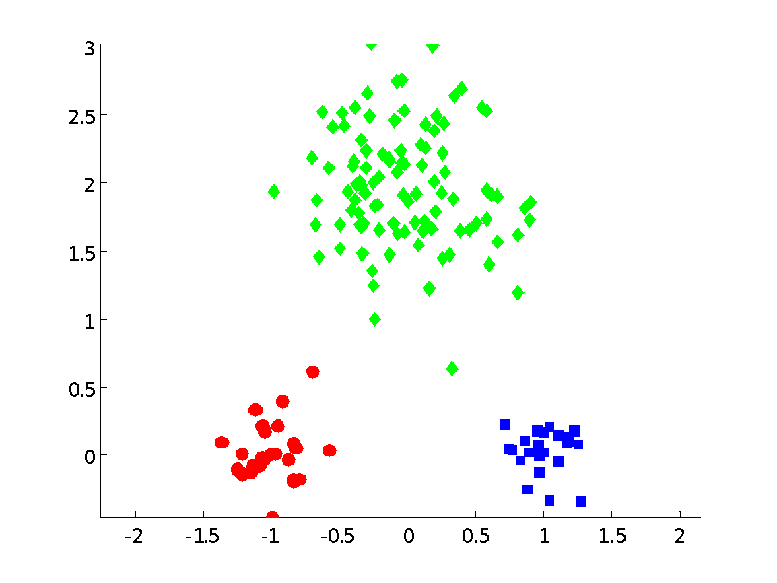
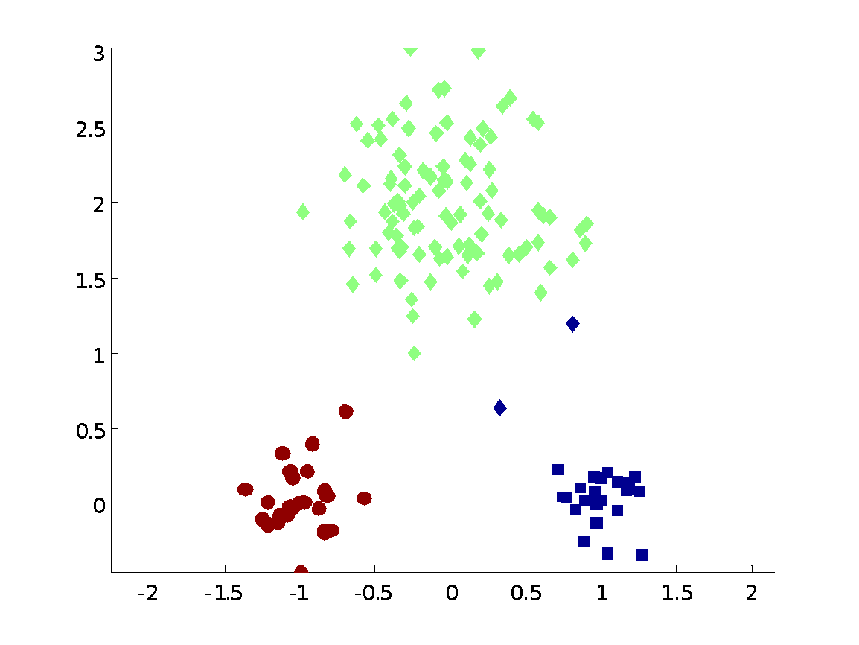
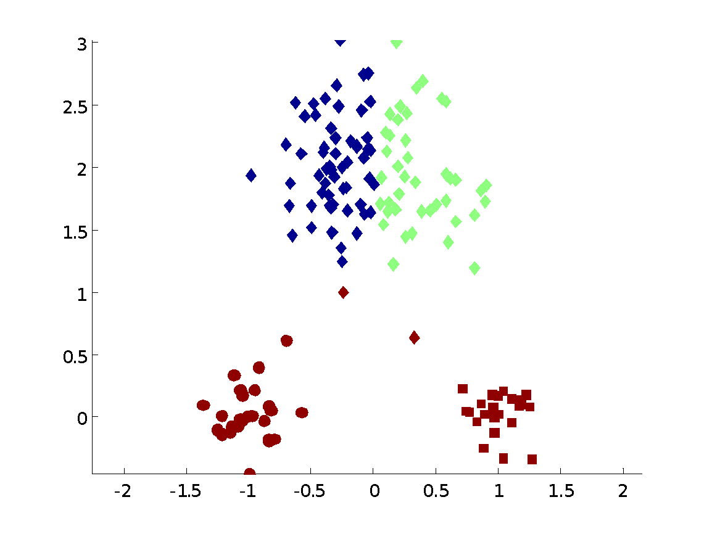
Two different K-means Clusterings
Original Points
Optimal Clustering
Sub-optimal Clustering

Slide 23
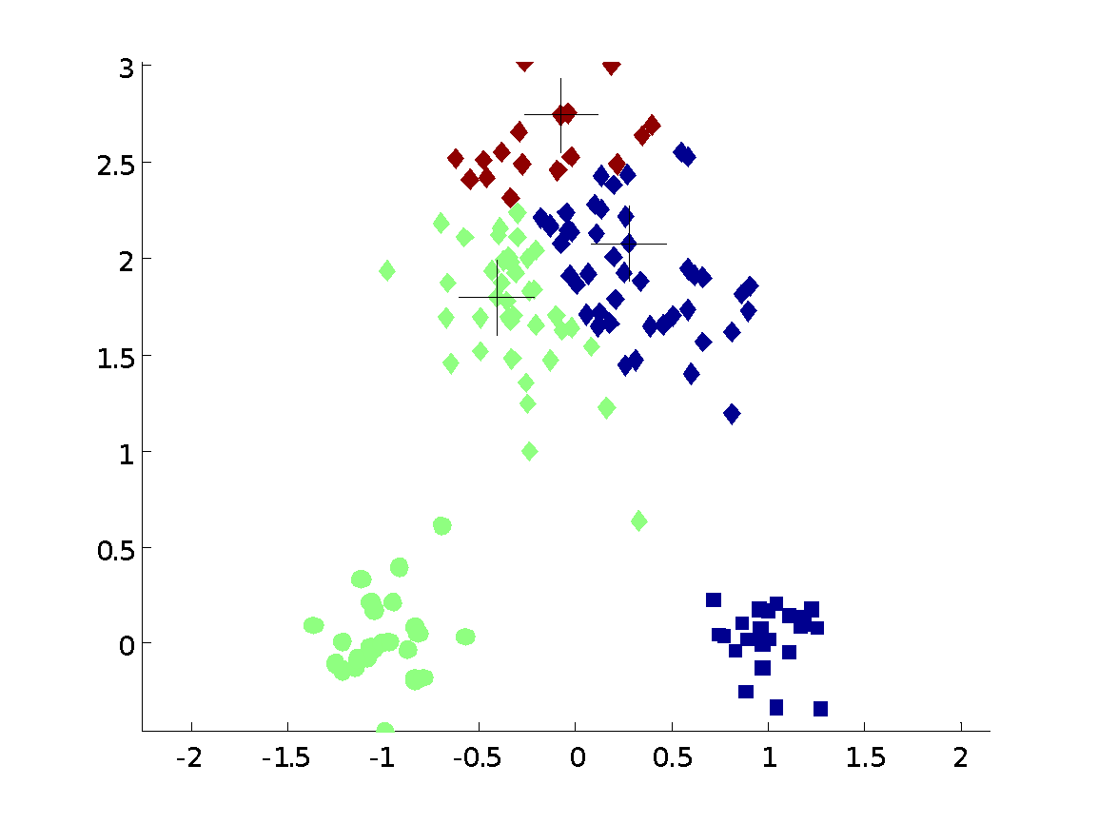
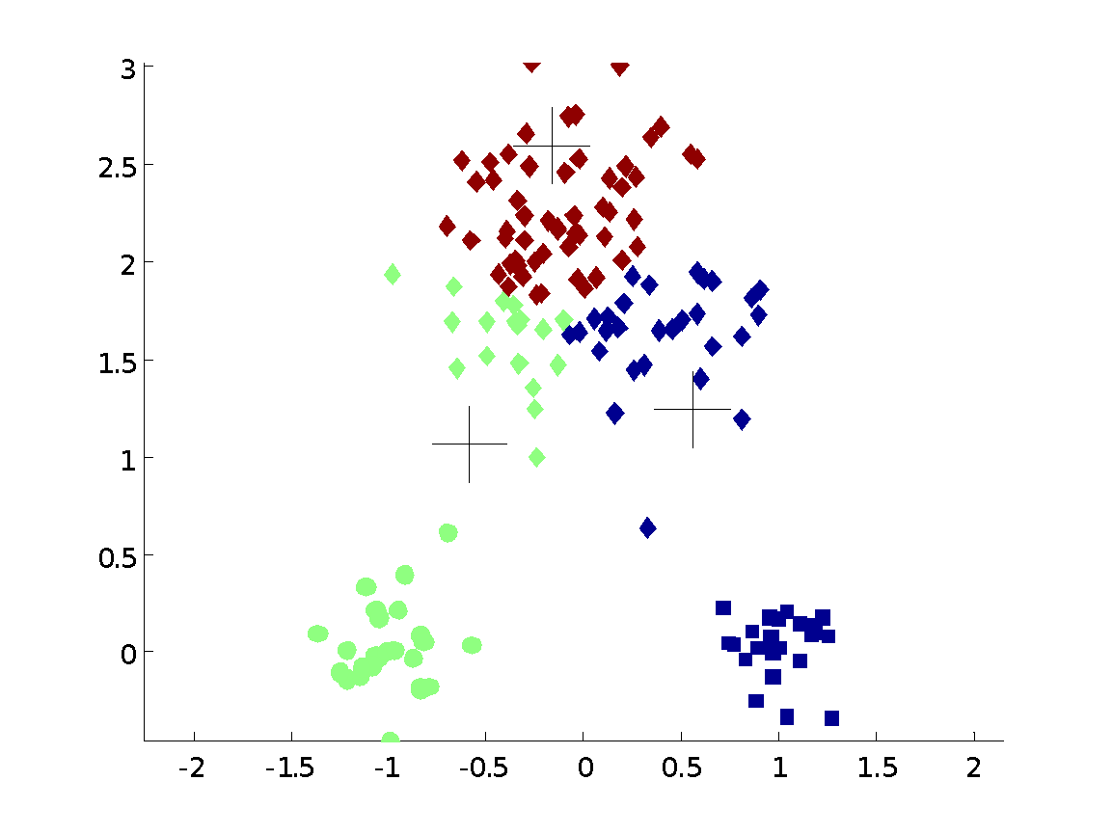
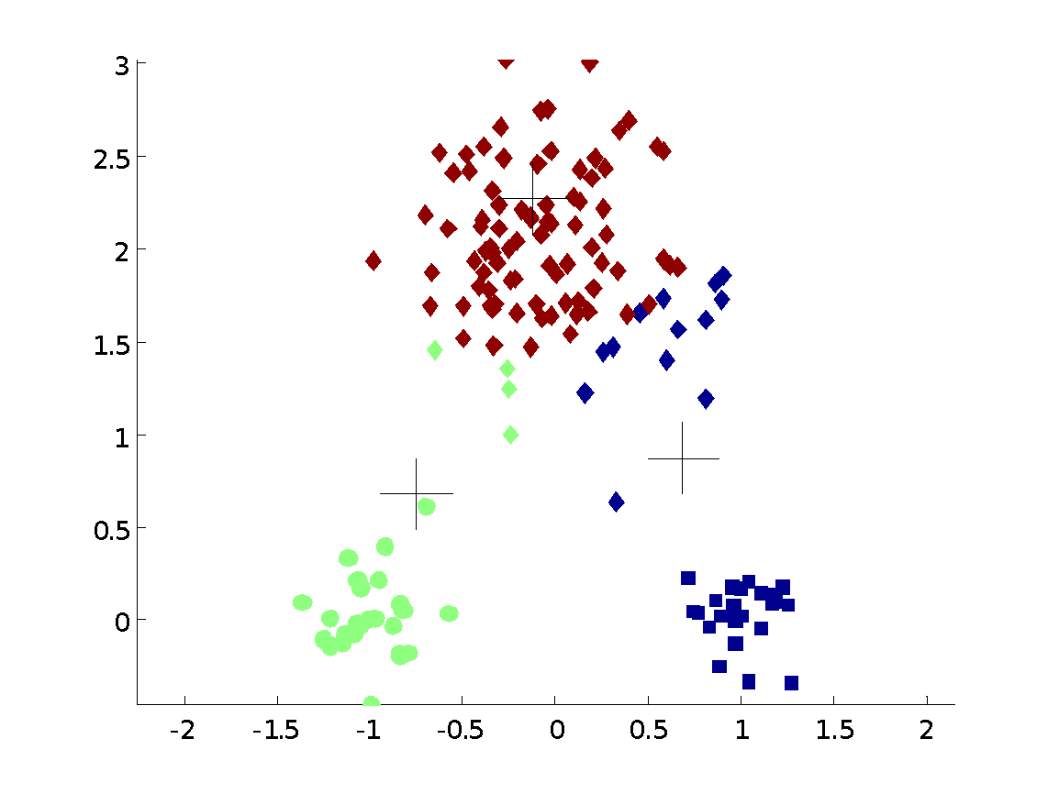
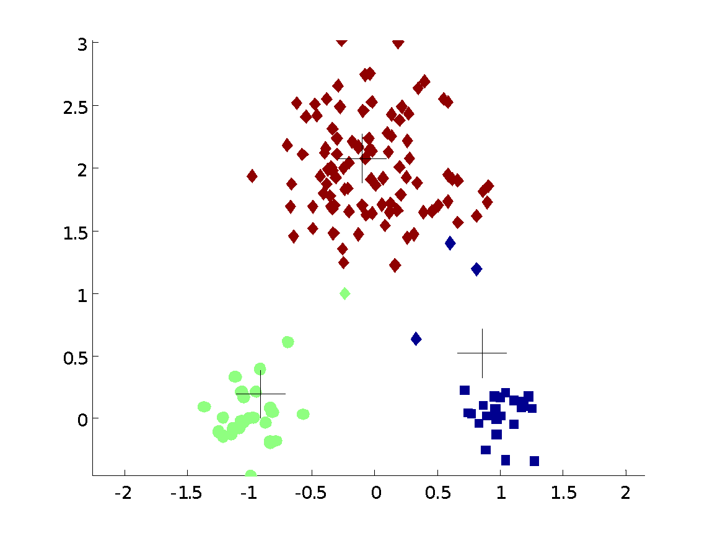


Importance of Choosing Initial Centroids

Slide 24
Importance of Choosing Initial Centroids

Slide 25
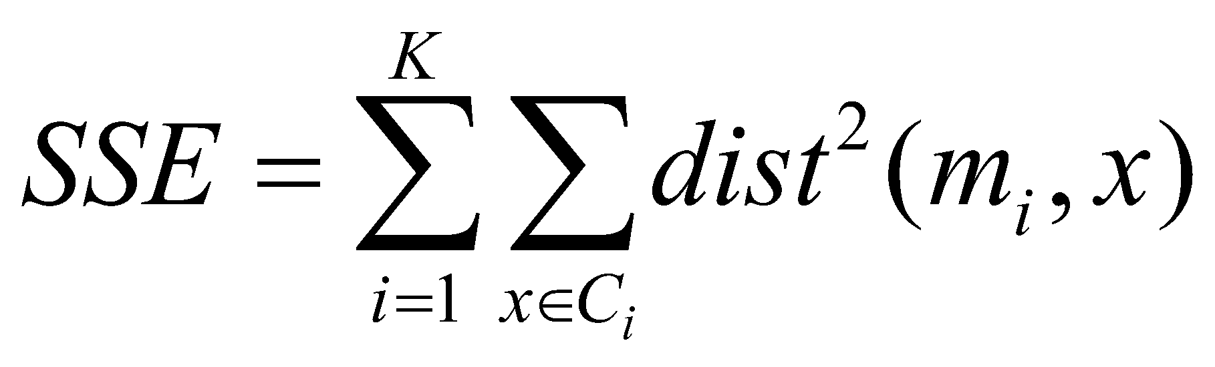
Evaluating K-means Clusters
Most common measure is Sum of Squared Error (SSE)
For each point, the error is the distance to the nearest cluster
To get SSE, we square these errors and sum them.
x is a data point in cluster C_{i} and m_{i} is the representative point for cluster C_{i}
can show that m_{i} corresponds to the center (mean) of the cluster
Given two clusters, we can choose the one with the smallest error
One easy way to reduce SSE is to increase K, the number of clusters
A good clustering with smaller K can have a lower SSE than a poor clustering with higher K

Slide 26
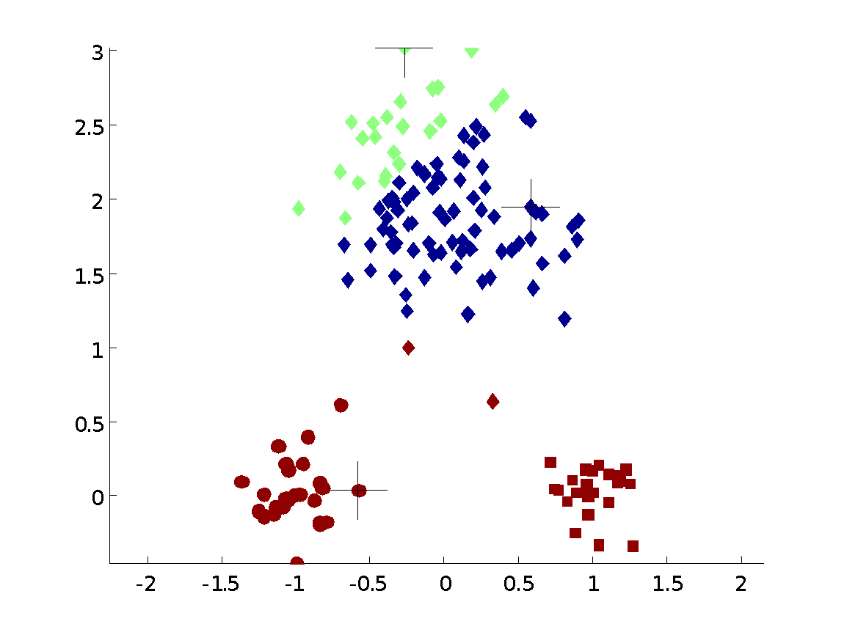
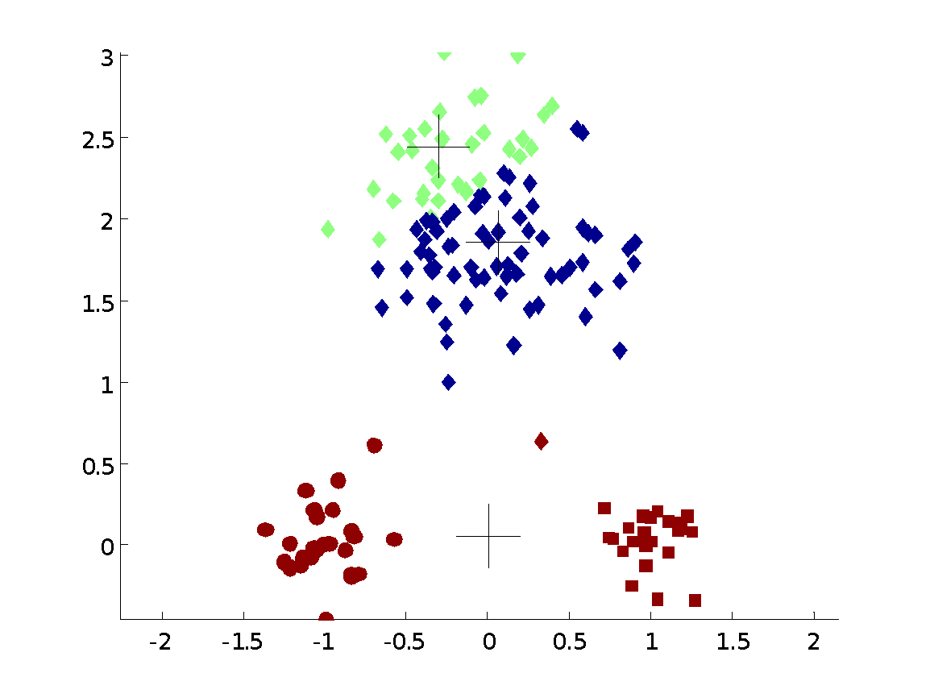
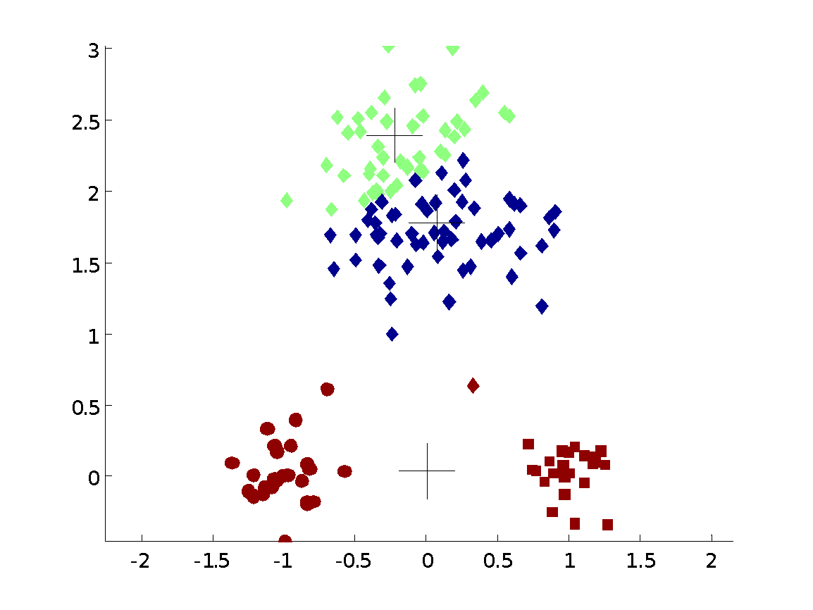
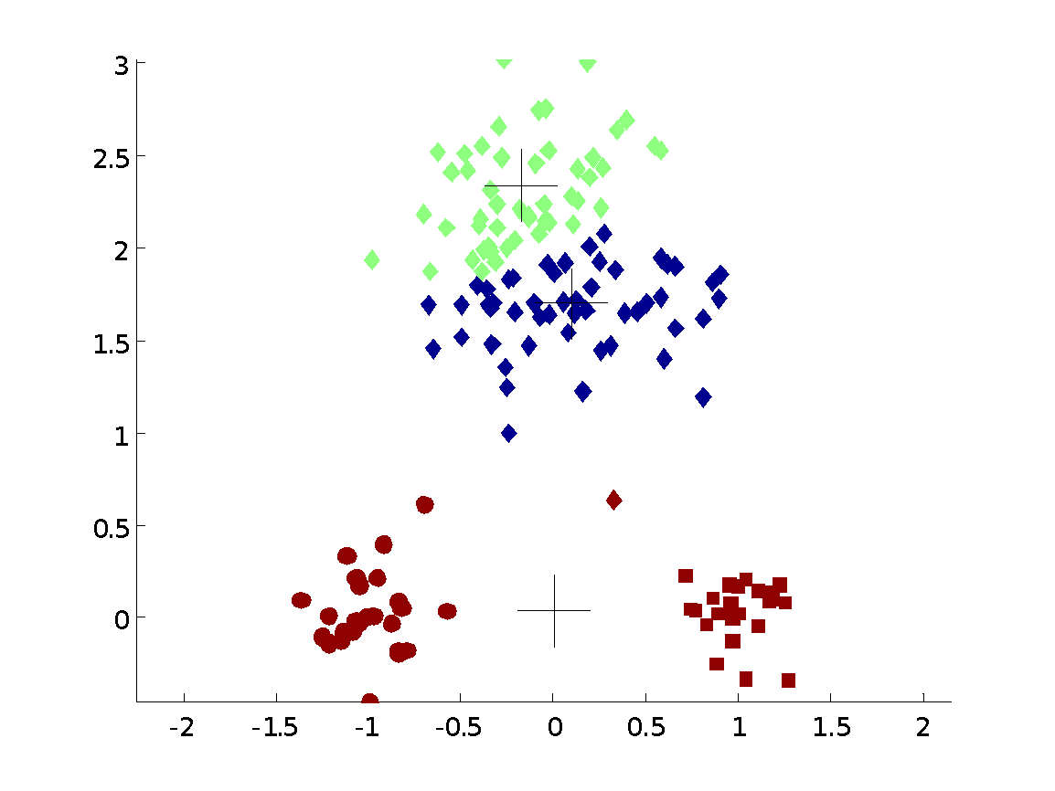

Importance of Choosing Initial Centroids …

Slide 27
Importance of Choosing Initial Centroids …

Slide 28
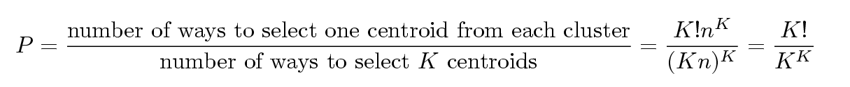
Problems with Selecting Initial Points
If there are K ‘real’ clusters then the chance of selecting one centroid from each cluster is small.
Chance is relatively small when K is large
If clusters are the same size, n, then
For example, if K = 10, then probability = 10!/10¹⁰ = 0.00036
Sometimes the initial centroids will readjust themselves in ‘right’ way, and sometimes they don’t
Consider an example of five pairs of clusters

Slide 29
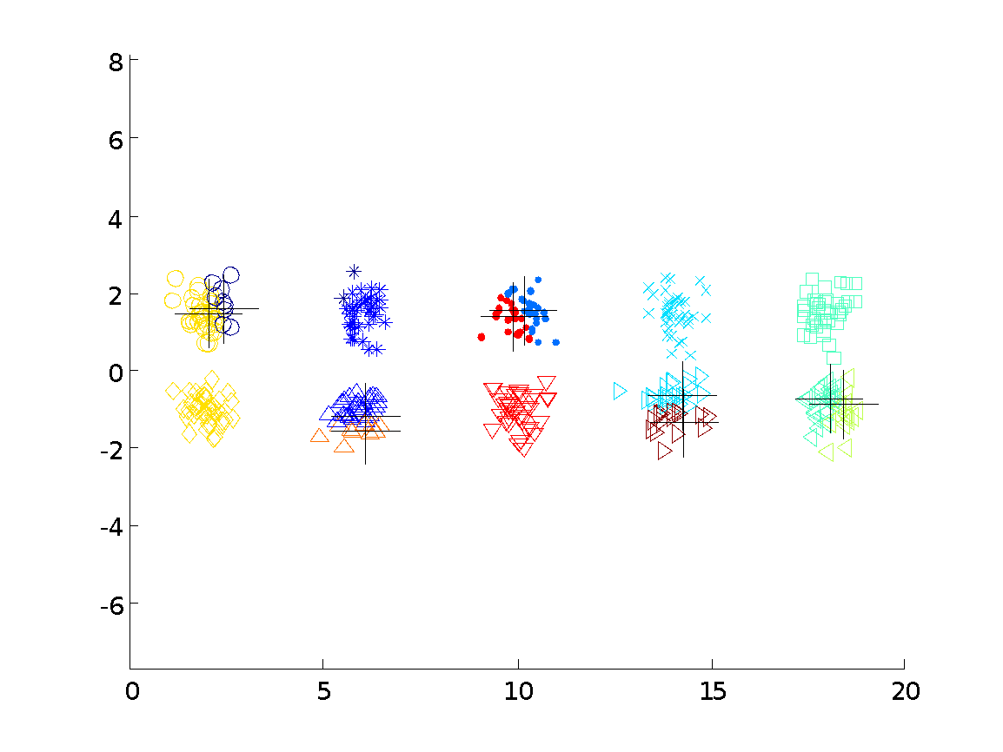
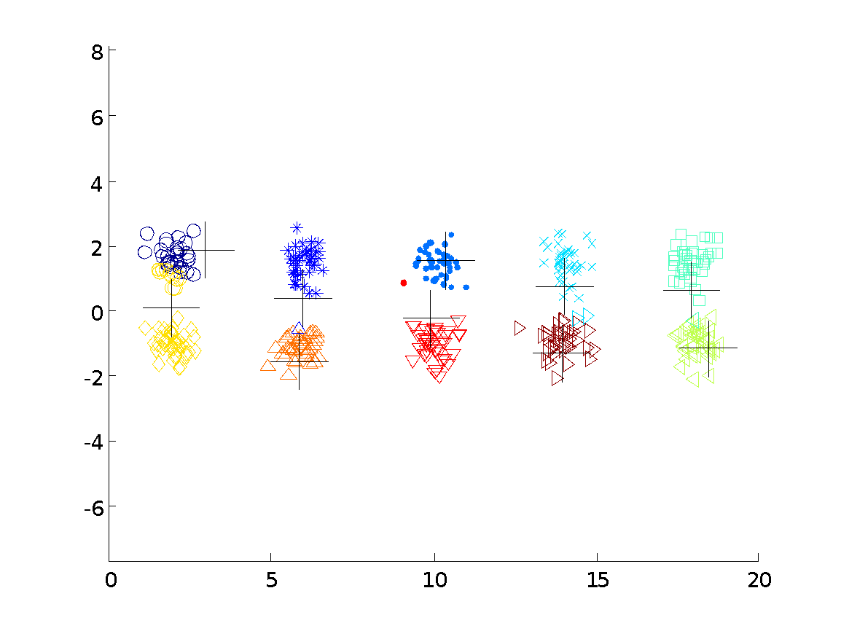
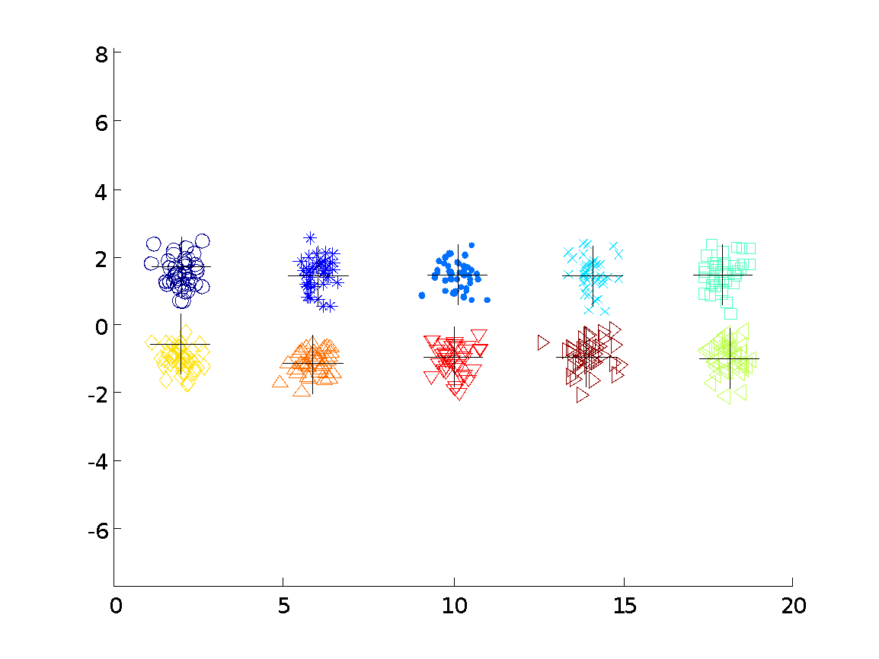

10 Clusters Example
Starting with two initial centroids in one cluster of each pair of clusters

Slide 30
10 Clusters Example
Starting with two initial centroids in one cluster of each pair of clusters

Slide 31
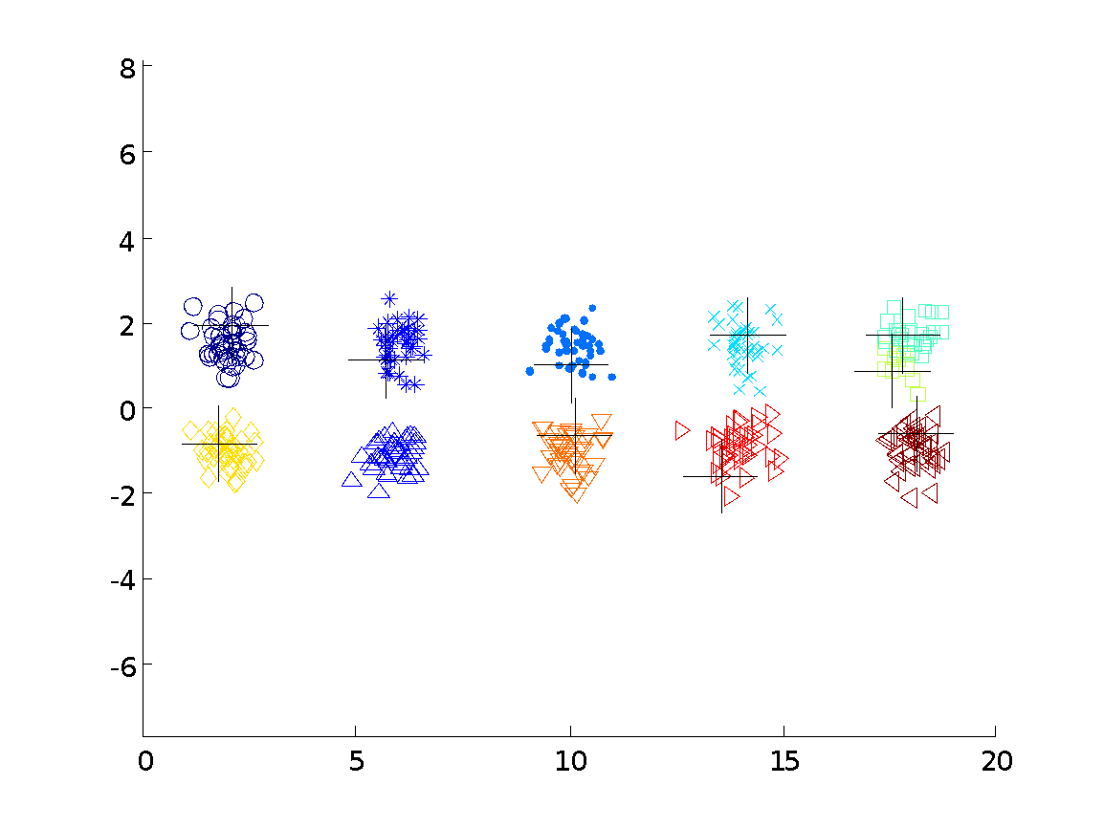



10 Clusters Example
Starting with some pairs of clusters having three initial centroids, while other have only one.

Slide 32
10 Clusters Example
Starting with some pairs of clusters having three initial centroids, while other have only one.

Slide 33
Solutions to Initial Centroids Problem
????

Slide 34
Solutions to Initial Centroids Problem
Multiple runs
Helps, but probability is not on your side
Sample and use hierarchical clustering to determine initial centroids
Select more than k initial centroids and then select among these initial centroids
Select most widely separated
Postprocessing

Slide 35
Handling Empty Clusters
Basic K-means algorithm can yield empty clusters
Several strategies
???

Slide 36
Handling Empty Clusters
Basic K-means algorithm can yield empty clusters
Several strategies
Choose the point that contributes most to SSE
Choose a point from the cluster with the highest SSE
If there are several empty clusters, the above can be repeated several times.

Slide 37
Pre-processing and Post-processing
Pre-processing
??
??
Post-processing
??
??
??

Slide 38
Pre-processing and Post-processing
Pre-processing
Normalize the data
Eliminate outliers
Post-processing
Eliminate small clusters that may represent outliers
Split ‘loose’ clusters, i.e., clusters with relatively high SSE
Merge clusters that are ‘close’ and that have relatively low SSE

Slide 39
Limitations of K-means
K-means has problems when clusters are of differing
Sizes
Densities
Non-globular shapes
K-means has problems when the data contains outliers.

Slide 40
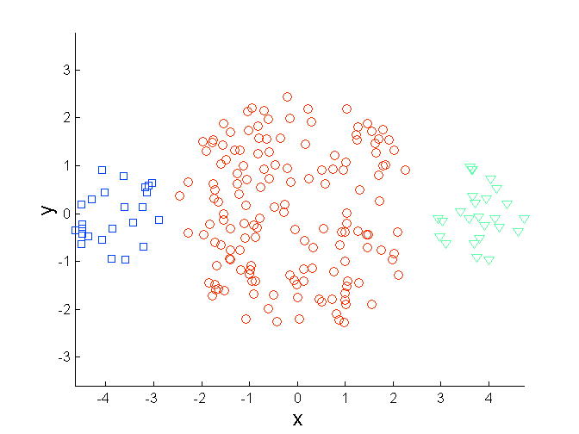
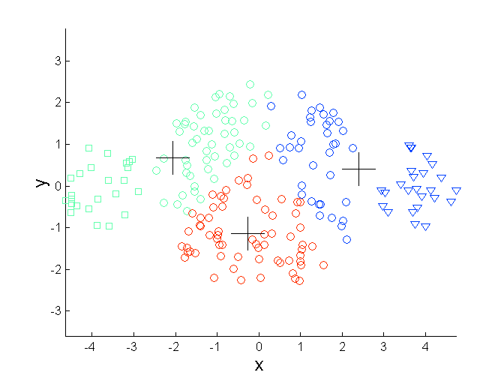
Limitations of K-means: Differing Sizes
Original Points
K-means (3 Clusters)

Slide 41
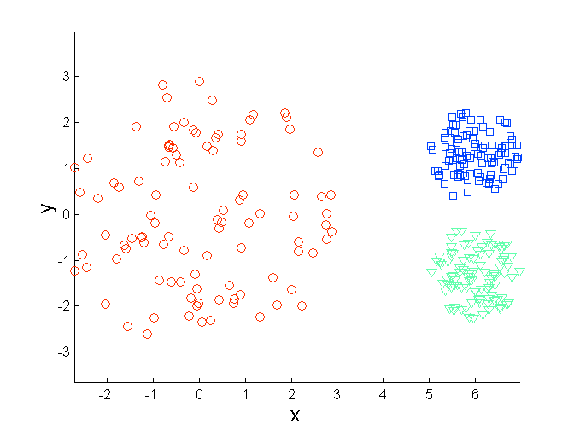
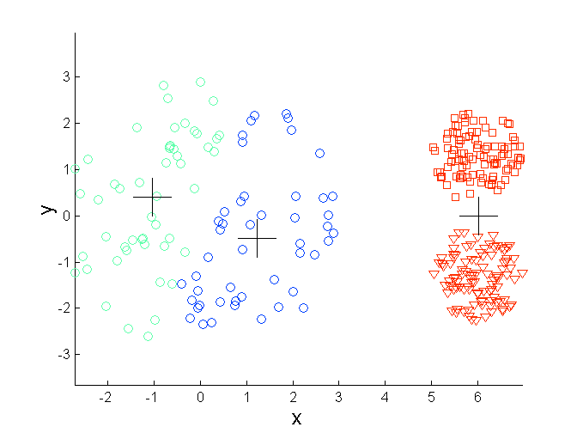
Limitations of K-means: Differing Density
Original Points
K-means (3 Clusters)

Slide 42
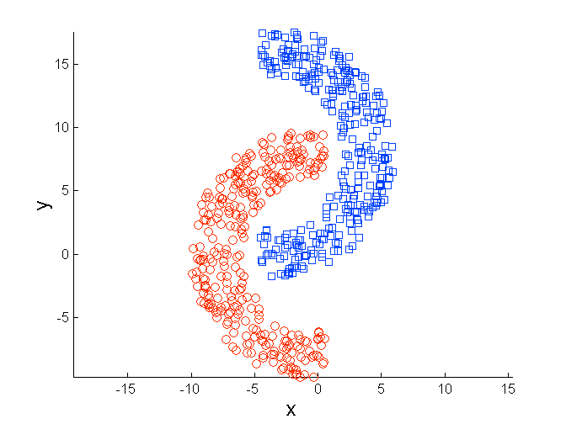
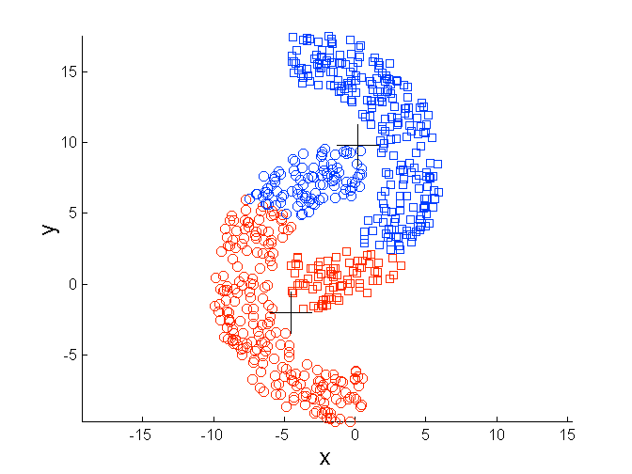
Limitations of K-means: Non-globular Shapes
Original Points
K-means (2 Clusters)

Slide 43
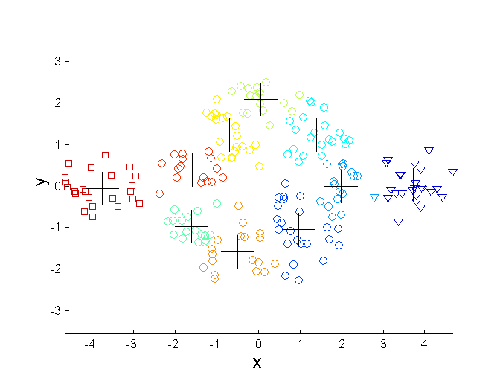
Overcoming K-means Limitations
Original Points K-means Clusters
One solution is to use many clusters.
Find parts of clusters, but need to put together.

Slide 44
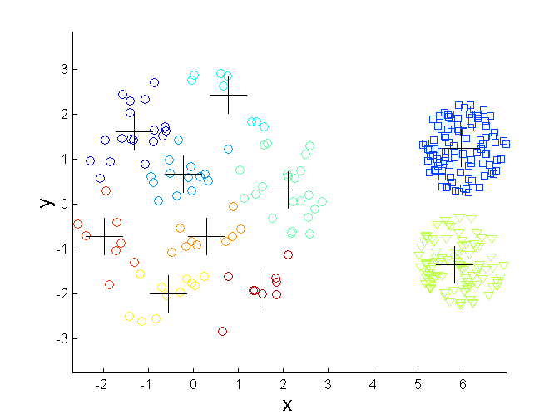
Overcoming K-means Limitations
Original Points K-means Clusters

Slide 45
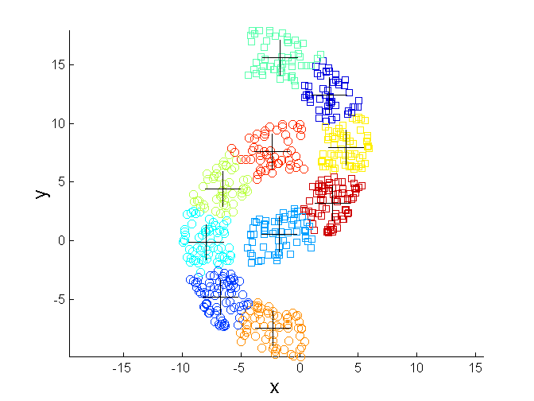
Overcoming K-means Limitations
Original Points K-means Clusters

Slide 46
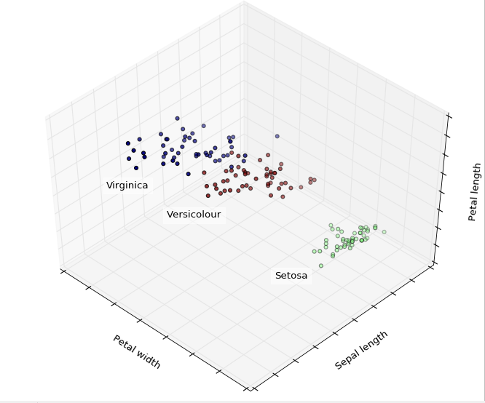
Lab on Thursday
Iris flower data set

Slide 47
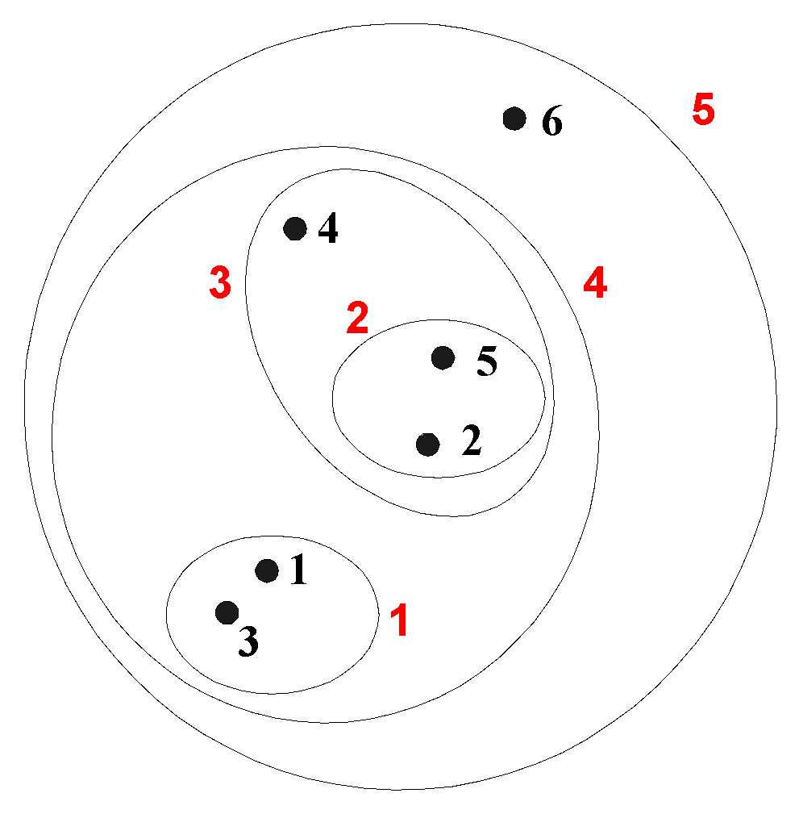
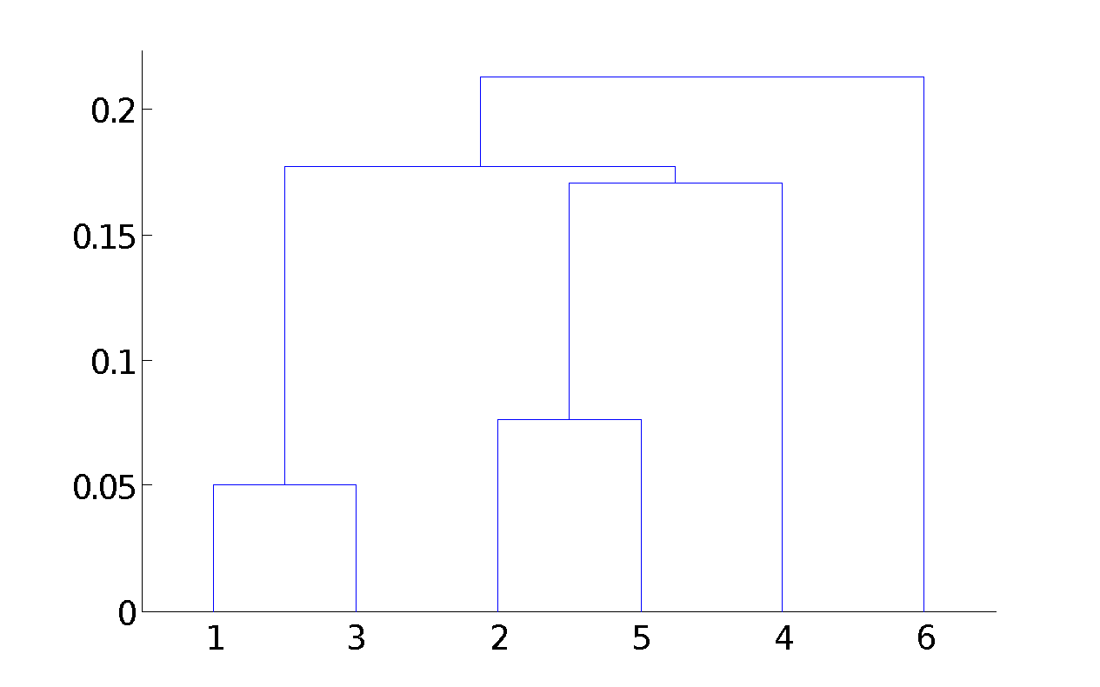
Hierarchical Clustering
Produces a set of nested clusters organized as a hierarchical tree
Can be visualized as a dendrogram
A tree like diagram that records the sequences of merges or splits

Slide 48
Strengths of Hierarchical Clustering
Do not have to assume any particular number of clusters
Any desired number of clusters can be obtained by ‘cutting’ the dendogram at the proper level
They may correspond to meaningful taxonomies
Example in biological sciences (e.g., animal kingdom, phylogeny reconstruction, …)

Slide 49
Hierarchical Clustering
Two main types of hierarchical clustering
Agglomerative:
Start with the points as individual clusters
At each step, merge the closest pair of clusters until only one cluster (or k clusters) left
Divisive:
Start with one, all-inclusive cluster
At each step, split a cluster until each cluster contains a point (or there are k clusters)
Traditional hierarchical algorithms use a similarity or distance matrix
Merge or split one cluster at a time

Slide 50
Agglomerative Clustering Algorithm
More popular hierarchical clustering technique
Basic algorithm is straightforward
Compute the proximity matrix
Let each data point be a cluster
Repeat
Merge the two closest clusters
Update the proximity matrix
Until only a single cluster remains
Key operation is the computation of the proximity of two clusters
Different approaches to defining the distance between clusters distinguish the different algorithms

Slide 51
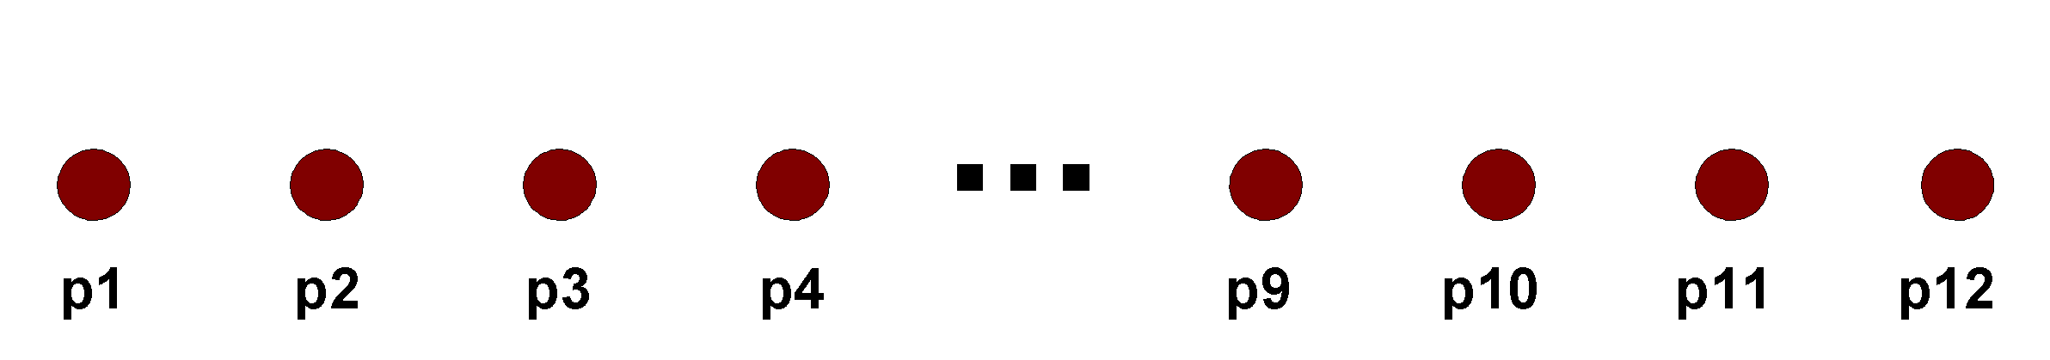
Starting Situation
Start with clusters of individual points and a proximity matrix
p1
p2
p3
p4
p5
. . .
p1
p2
p3
p4
p5
.
.
.
Proximity Matrix

Slide 52
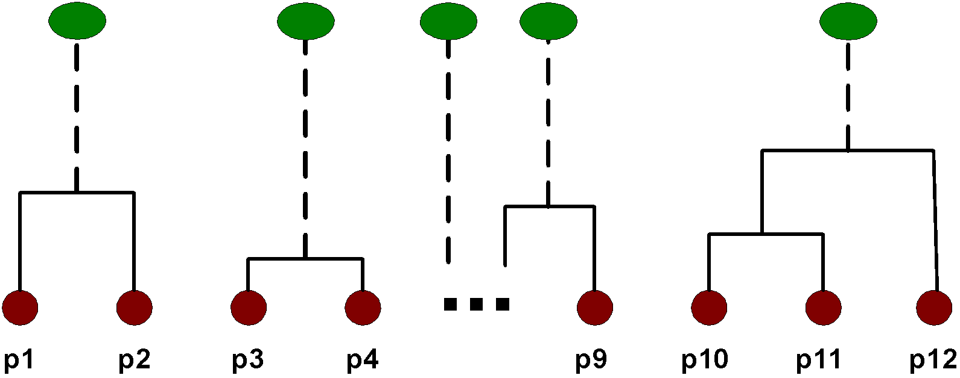
Intermediate Situation
After some merging steps, we have some clusters
C1
C2
C3
C4
C5
C1
C2
C3
C3
C4
C4
C5
Proximity Matrix
C1
C2
C5

Slide 53
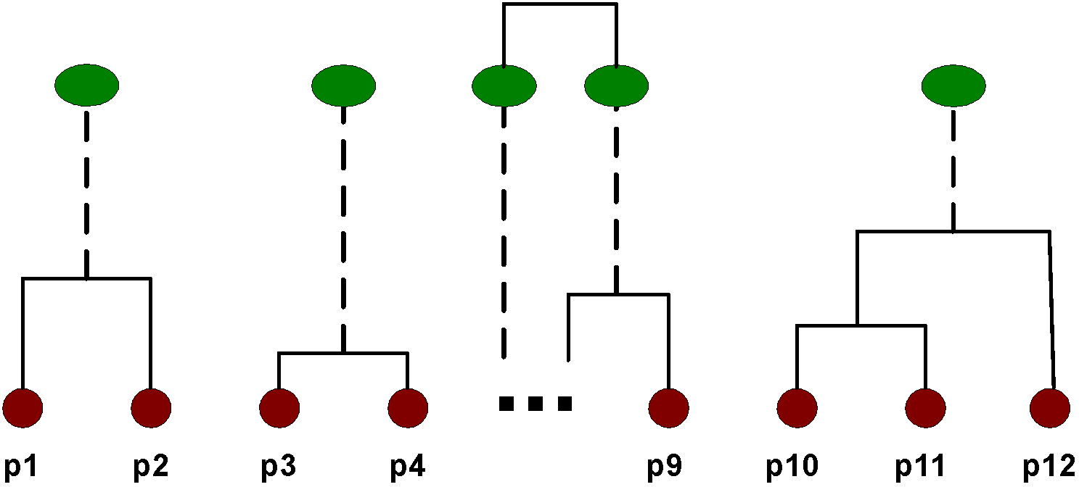
Intermediate Situation
We want to merge the two closest clusters (C2 and C5) and update the proximity matrix.
C1
C2
C3
C4
C5
C1
C2
C3
C3
C4
C4
C5
Proximity Matrix
C1
C2
C5

Slide 54
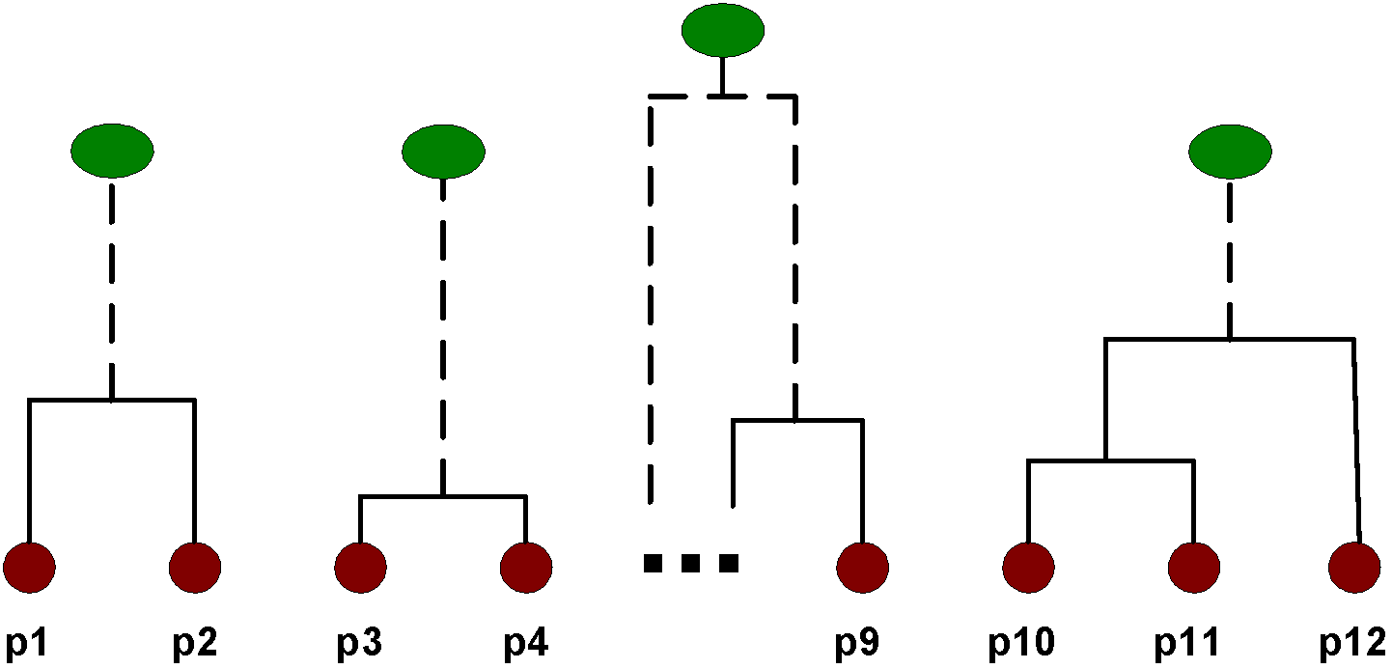
After Merging
The question is “How do we update the proximity matrix?”
C2 U C5
C1
C3
C4
C1
?
C2 U C5
? ? ? ?
C3
C3
?
C4
C4
?
Proximity Matrix
C1
C2 U C5

Slide 55
How to Define Inter-Cluster Similarity
p1
p2
p3
p4
p5
. . .
p1
Similarity?
p2
p3
p4
p5
MIN
MAX
Group Average
Distance Between Centroids
Other methods driven by an objective function
Ward’s Method uses squared error
.
.
.
Proximity Matrix

Slide 56
How to Define Inter-Cluster Similarity
p1
p2
p3
p4
p5
. . .
p1
p2
p3
p4
p5
MIN
MAX
Group Average
Distance Between Centroids
Other methods driven by an objective function
Ward’s Method uses squared error
.
.
.
Proximity Matrix

Slide 57
How to Define Inter-Cluster Similarity
p1
p2
p3
p4
p5
. . .
p1
p2
p3
p4
p5
MIN
MAX
Group Average
Distance Between Centroids
Other methods driven by an objective function
Ward’s Method uses squared error
.
.
.
Proximity Matrix

Slide 58
How to Define Inter-Cluster Similarity
p1
p2
p3
p4
p5
. . .
p1
p2
p3
p4
p5
MIN
MAX
Group Average
Distance Between Centroids
Other methods driven by an objective function
Ward’s Method uses squared error
.
.
.
Proximity Matrix

Slide 59
How to Define Inter-Cluster Similarity
p1
p2
p3
p4
p5
. . .
p1
×
×
p2
p3
p4
p5
MIN
MAX
Group Average
Distance Between Centroids
Other methods driven by an objective function
Ward’s Method uses squared error
.
.
.
Proximity Matrix

Slide 60
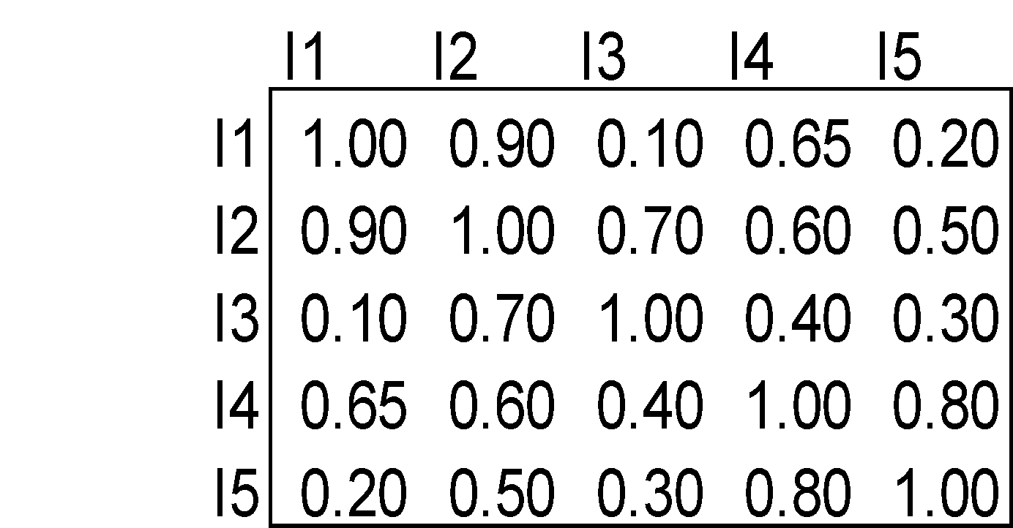
Cluster Similarity: MIN or Single Link
Similarity of two clusters is based on the two most similar (closest) points in the different clusters
Determined by one pair of points, i.e., by one link in the proximity graph.
1
2
3
4
5

Slide 61
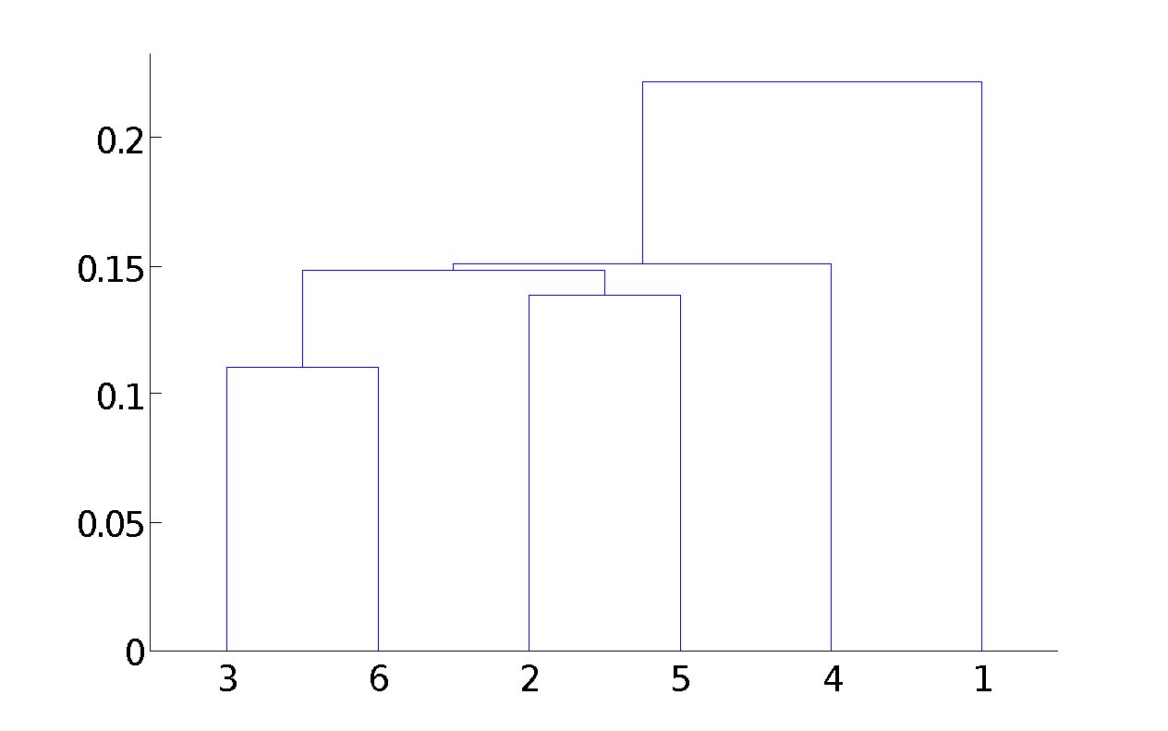
Hierarchical Clustering: MIN
5
1
3
5
2
1
2
3
6
4
4
Nested Clusters
Dendrogram

Slide 62
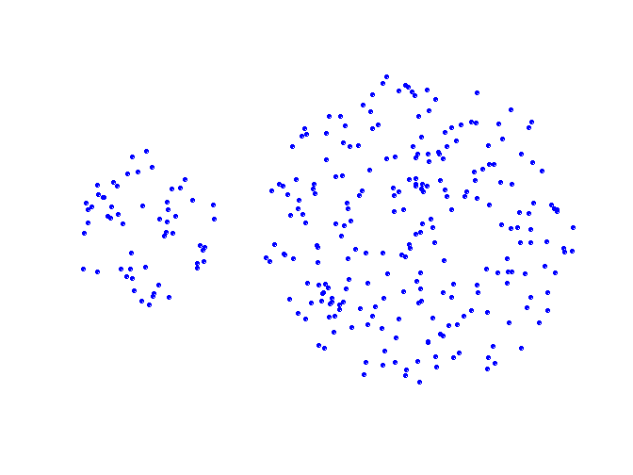
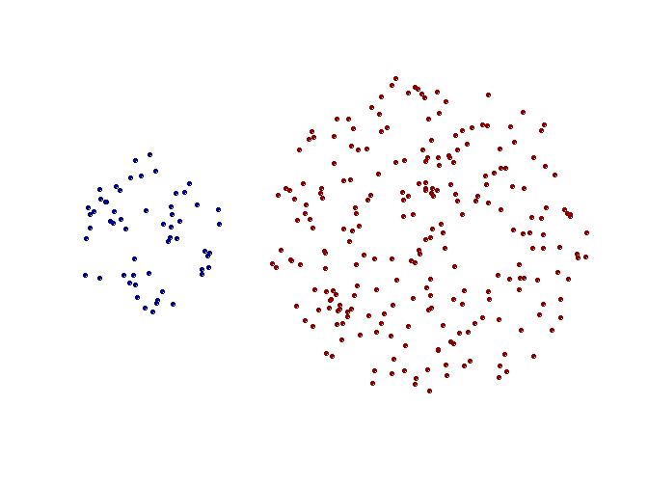
Strength of MIN
Original Points
Two Clusters
Can handle non-elliptical shapes

Slide 63
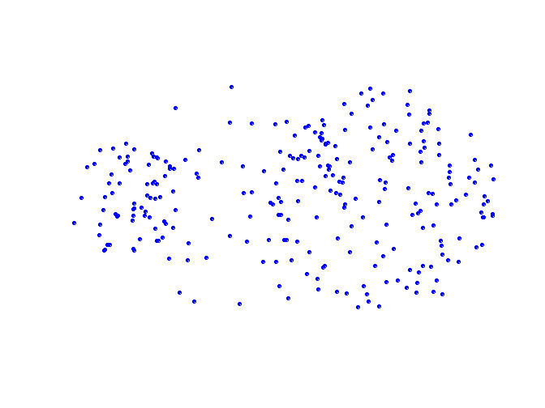

Limitations of MIN
Original Points
Two Clusters
Sensitive to noise and outliers

Slide 64

Cluster Similarity: MAX or Complete Linkage
Similarity of two clusters is based on the two least similar (most distant) points in the different clusters
Determined by all pairs of points in the two clusters
1
2
3
4
5

Slide 65

Hierarchical Clustering: MAX
4
1
2
5
5
2
3
6
3
1
4
Nested Clusters
Dendrogram

Slide 66

Strength of MAX
Original Points
Two Clusters
Less susceptible to noise and outliers

Slide 67


Limitations of MAX
Original Points
Two Clusters
Tends to break large clusters
Biased towards globular clusters

Slide 68


Cluster Similarity: Group Average
Proximity of two clusters is the average of pairwise proximity between points in the two clusters.
Need to use average connectivity for scalability since total proximity favors large clusters
1
2
3
4
5

Slide 69

Hierarchical Clustering: Group Average
5
4
1
2
5
2
3
6
1
4
3
Nested Clusters
Dendrogram

Slide 70
Hierarchical Clustering: Group Average
Compromise between Single and Complete Link
Strengths
Less susceptible to noise and outliers
Limitations
Biased towards globular clusters

Slide 71
Cluster Similarity: Ward’s Method
Similarity of two clusters is based on the increase in squared error when two clusters are merged
Similar to group average if distance between points is distance squared
Less susceptible to noise and outliers
Biased towards globular clusters
Hierarchical analogue of K-means
Can be used to initialize K-means

Slide 72
Hierarchical Clustering: Comparison
5
1
4
1
3
2
5
5
5
2
1
MIN
2
MAX
2
3
6
3
3
6
1
4
4
4
5
5
1
4
1
2
2
5
2
Ward’s Method
5
2
3
6
Group Average
3
3
6
4
1
1
4
4
3

Slide 73
Hierarchical Clustering: Time and Space requirements
O(N²) space since it uses the proximity matrix.
N is the number of points.
O(N³) time in many cases
There are N steps and at each step the size, N², proximity matrix must be updated and searched
Complexity can be reduced to O(N² log(N) ) time for some approaches

Slide 74
Hierarchical Clustering: Problems and Limitations
Once a decision is made to combine two clusters, it cannot be undone
No objective function is directly minimized
Different schemes have problems with one or more of the following:
Sensitivity to noise and outliers
Difficulty handling different sized clusters and convex shapes
Breaking large clusters

Slide 75


MST: Divisive Hierarchical Clustering
Build MST (Minimum Spanning Tree)
Start with a tree that consists of any point
In successive steps, look for the closest pair of points (p, q) such that one point (p) is in the current tree but the other (q) is not
Add q to the tree and put an edge between p and q

Slide 76

MST: Divisive Hierarchical Clustering
Use MST for constructing hierarchy of clusters

