Slide 1
Data Mining: Data
Lecture Notes for Chapter 2
Introduction to Data Mining
by
Tan, Steinbach, Kumar

Slide 2
Feature Subset Selection
Another way to reduce dimensionality of data
Redundant features
  duplicate much or all of the information contained in one or more other attributes
  Example: purchase price of a product and the amount of sales tax paid
Irrelevant features
  contain no information that is useful for the data mining task at hand
  Example: students' ID is often irrelevant to the task of predicting students' GPA

Slide 3
Feature Subset Selection
Techniques:
  Brute-force approch:
    Try all possible feature subsets as input to data mining algorithm
  Embedded approaches:
    Feature selection occurs naturally as part of the data mining algorithm
  Filter approaches:
    Features are selected before data mining algorithm is run
  Wrapper approaches:
    Use the data mining algorithm as a black box to find best subset of attributes

Slide 4
Feature Selection
There is a high relationship between good feature and the target.
Good feature can distinguish different targets very well.
Good feature can explain the target.

Slide 5
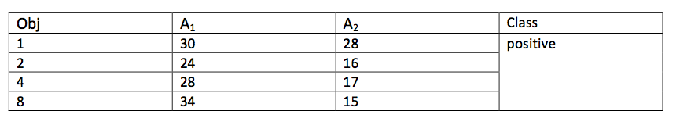
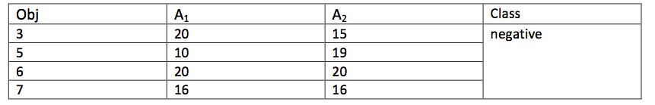

Slide 6
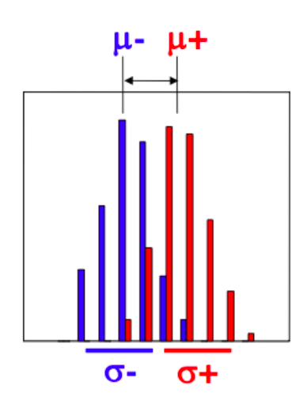
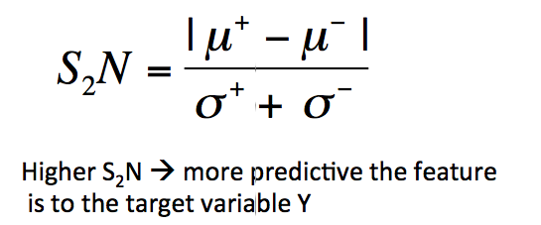
Filter Approach: Signal to Noise Ratio

Slide 7
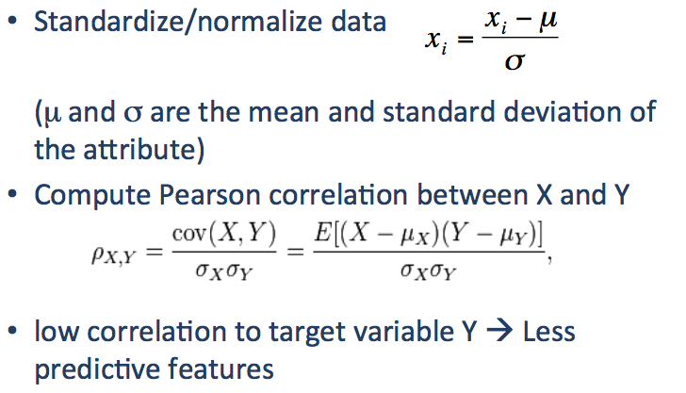
Filter Approach: Pearson Correlation

Slide 8
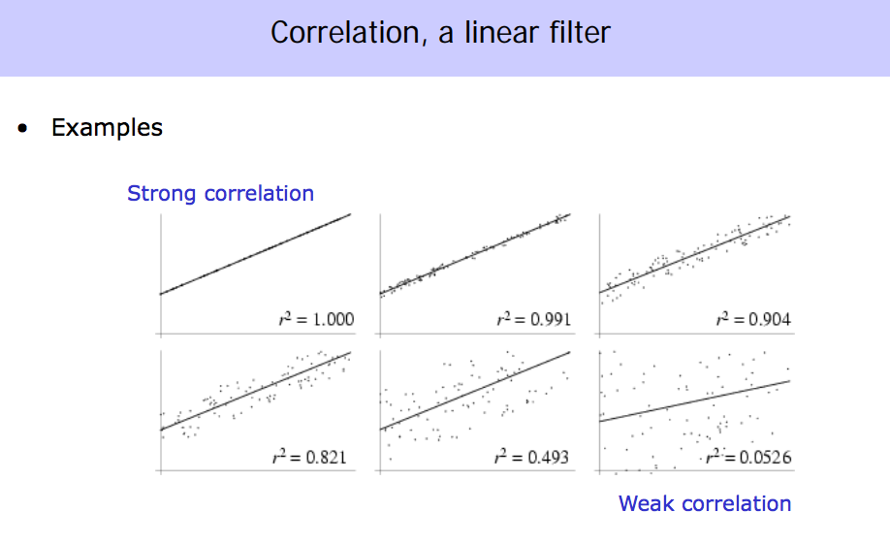


Slide 9
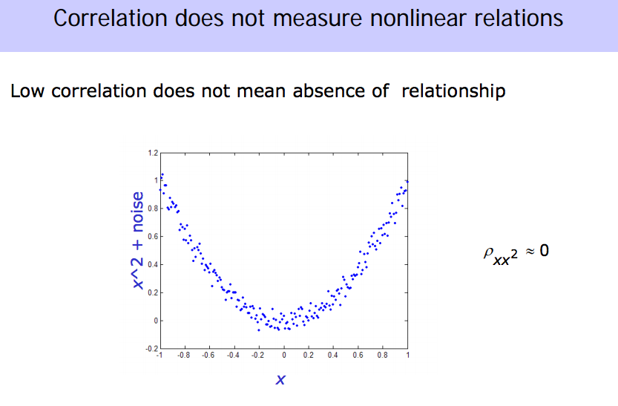

Slide 10
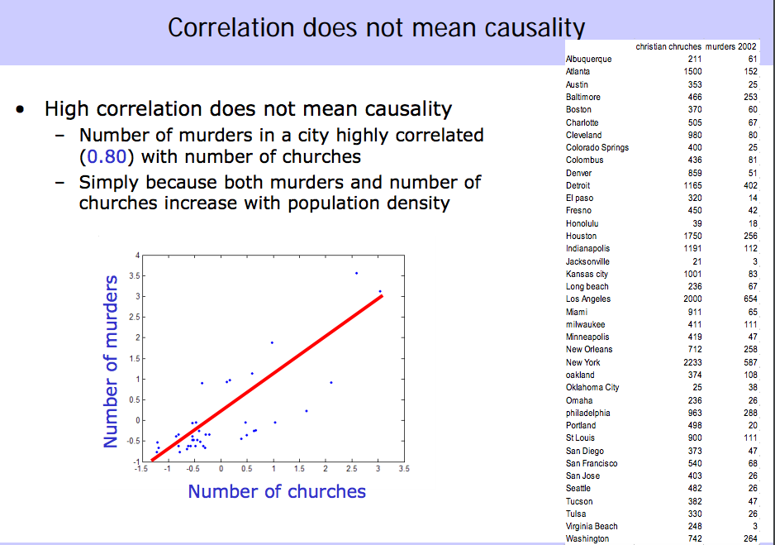

Slide 11
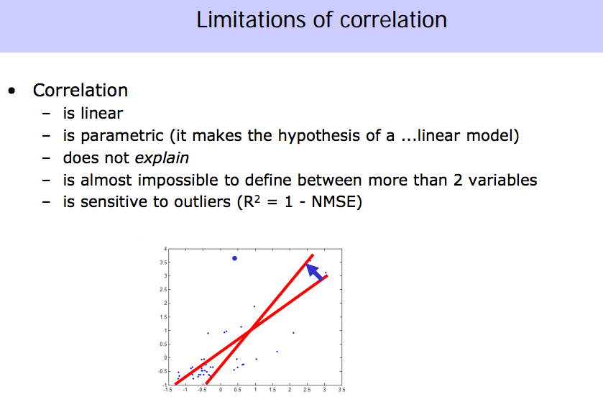

Slide 12
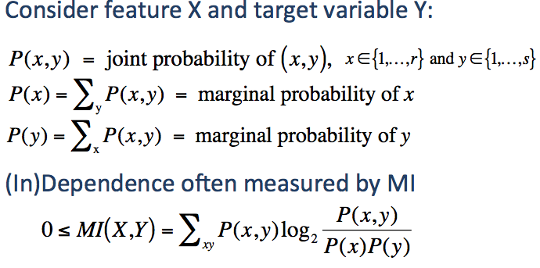
Filter Approach: Mutual Information

Slide 13
Example
Let X represent whether it is sunny or rainy in a particular town on a given day. Let Y represent whether it is above 70 degrees or below seventy degrees. Calculate the mutual information between X and Y.
 | Weather | Temperature
Day1 | Sunny | 75
Day2 | Sunny | 80
Day3 | Rainy | 73
Day4 | Sunny | 65

Slide 14
Example
 | Weather (X) | Temperature (Y)
Day1 | Sunny | 75
Day2 | Sunny | 80
Day3 | Rainy | 73
Day4 | Sunny | 65
Use 1/2 to represent sunny/rainy.
Use 1/2 to represent hot/cool.
 | Weather (X) | Temperature (Y)
Day1 | 1 | ?
Day2 | 1 | ?
Day3 | 2 | ?
Day4 | 1 | ?

Slide 15
Example
 | Weather (X) | Temperature (Y)
Day1 | Sunny | 75
Day2 | Sunny | 80
Day3 | Rainy | 73
Day4 | Sunny | 65
Use 1/2 to represent sunny/rainy.
Use 1/2 to represent hot/cool.
 | Weather (X) | Temperature (Y)
Day1 | 1 | 1
Day2 | 1 | 1
Day3 | 2 | 1
Day4 | 1 | 2

Slide 16
Example
 | Weather (X) | Temperature (Y)
Day1 | 1 | 1
Day2 | 1 | 1
Day3 | 2 | 1
Day4 | 1 | 2
Two-dimension Probability Table.
 | Sunny (1) | Rainy (2)
Hot (1) | ? | ?
Cool (2) | ? | ?

Slide 17
Example
 | Weather (X) | Temperature (Y)
Day1 | 1 | 1
Day2 | 1 | 1
Day3 | 2 | 1
Day4 | 1 | 2
Two-dimension Probability Table.
 | Sunny (1) | Rainy (2)
Hot (1) | 1/2 | 1/4
Cool (2) | 1/4 | 0

Slide 18
Example
Two-dimension Probability Table.
 | Sunny (1) | Rainy (2)
Hot (1) | 1/2 | 1/4
Cool (2) | 1/4 | 0
Marginal Probability.
 | Sunny (1) | Rainy (2)
Hot (1) | 1/2 | 1/4 | ?
Cool (2) | 1/4 | 0 | ?
 | ? | ?

Slide 19
Example
Two-dimension Probability Table.
 | Sunny (1) | Rainy (2)
Hot (1) | 1/2 | 1/4
Cool (2) | 1/4 | 0
Marginal Probability.
 | Sunny (1) | Rainy (2)
Hot (1) | 1/2 | 1/4 | 3/4
Cool (2) | 1/4 | 0 | 1/4
 | 3/4 | 1/4

Slide 20
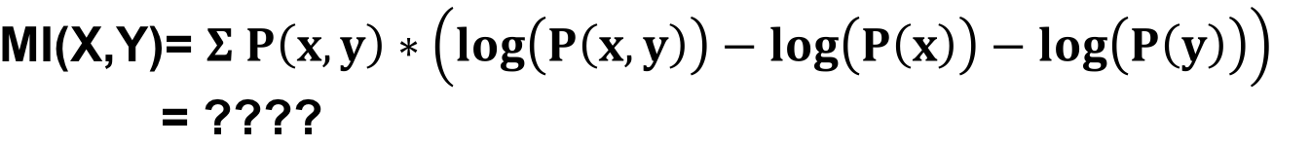
Example
Two-dimension Probability Table.
 | Sunny (1) | Rainy (2)
Hot (1) | 1/2 | 1/4 | 3/4
Cool (2) | 1/4 | 0 | 1/4
 | 3/4 | 1/4

Slide 21
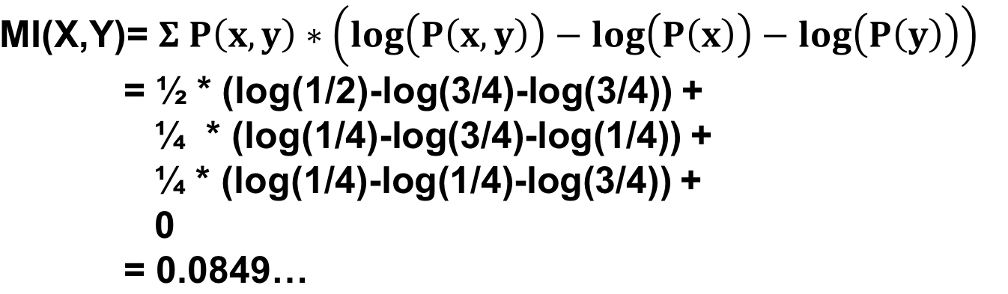
Example
Two-dimension Probability Table.
 | Sunny (1) | Rainy (2)
Hot (1) | 1/2 | 1/4 | 3/4
Cool (2) | 1/4 | 0 | 1/4
 | 3/4 | 1/4

Slide 22
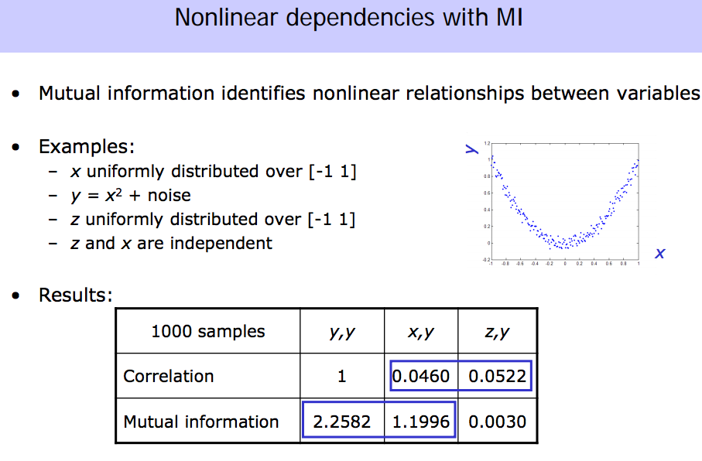

Slide 23
Feature Creation
Create new attributes that can capture the important information in a data set much more efficiently than the original attributes
Three general methodologies:
  Feature Extraction
    domain-specific
  Mapping Data to New Space
  Feature Construction
    combining features

