Slide 1

How to determine the Best Split
Before Splitting: 10 records of class 0,
10 records of class 1
Which test condition is the best?

Slide 2


How to determine the Best Split
Greedy approach:
  Nodes with homogeneous class distribution are preferred
Need a measure of node impurity:
Non-homogeneous,
High degree of impurity
Homogeneous,
Low degree of impurity

Slide 3
Measures of Node Impurity
Gini Index
Entropy
Misclassification error

Slide 4





How to Find the Best Split
Before Splitting:
M0
A?
B?
Yes
No
Yes
No
Node N1
Node N2
Node N3
Node N4
M1
M2
M3
M4
M12
M34
Gain = M0 – M12 vs M0 – M34

Slide 5





Measure of Impurity: GINI
Gini Index for a given node t :
    (NOTE: p( j | t) is the relative frequency of class j at node t).
  Maximum (1 - 1/n_{c}) when records are equally distributed among all classes, implying least interesting information
  Minimum (0.0) when all records belong to one class, implying most interesting information

Slide 6



Examples for computing GINI
P(C1) = 0/6 = 0 P(C2) = 6/6 = 1
Gini = 1 – P(C1)² – P(C2)² = 1 – 0 – 1 = 0
P(C1) = 1/6 P(C2) = 5/6
Gini = 1 – (1/6)² – (5/6)² = 0.278
P(C1) = 2/6 P(C2) = 4/6
Gini = 1 – (2/6)² – (4/6)² = 0.444

Slide 7

Splitting Based on GINI
Used in CART, SLIQ, SPRINT.
When a node p is split into k partitions (children), the quality of split is computed as,
where, n_{i} = number of records at child i,
n = number of records at node p.

Slide 8

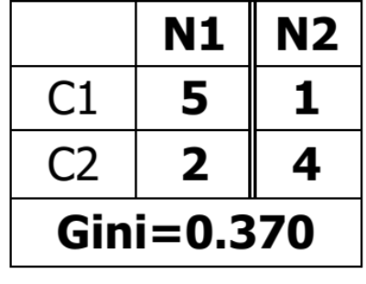
Binary Attributes: Computing GINI Index
Splits into two partitions
Effect of Weighing partitions:
  Larger and Purer Partitions are sought for.
B?
Yes
No
Node N1
Node N2
Gini(N1)
= 1 – (5/7)² – (2/7)²
= 0.408
Gini(N2)
= 1 – (1/5)² – (4/5)²
= 0.319
Gini(Children)
= 7/12 * 0.408 +
5/12 * 0.319
= 0.370

Slide 9



Categorical Attributes: Computing Gini Index
For each distinct value, gather counts for each class in the dataset
Use the count matrix to make decisions
Multi-way split
Two-way split
(find best partition of values)

Slide 10

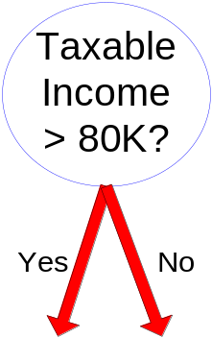
Continuous Attributes: Computing Gini Index
Use Binary Decisions based on one value
Several Choices for the splitting value
  Number of possible splitting values
  = Number of distinct values
Each splitting value has a count matrix associated with it
  Class counts in each of the partitions, A < v and A ≥ v
Simple method to choose best v
  For each v, scan the database to gather count matrix and compute its Gini index
  Computationally Inefficient! Repetition of work.

Slide 11

Continuous Attributes: Computing Gini Index...
For efficient computation: for each attribute,
  Sort the attribute on values
  Linearly scan these values, each time updating the count matrix and computing gini index
  Choose the split position that has the least gini index
Sorted Values
Split Positions

Slide 12

Splitting Criteria based on Classification Error
Classification error at a node t :
Measures misclassification error made by a node.
    Maximum (1 - 1/n_{c}) when records are equally distributed among all classes, implying least interesting information
    Minimum (0.0) when all records belong to one class, implying most interesting information

Slide 13
Examples for Computing Error
P(C1) = 0/6 = 0 P(C2) = 6/6 = 1
Error = 1 – max (0, 1) = 1 – 1 = 0
P(C1) = 1/6 P(C2) = 5/6
Error = 1 – max (1/6, 5/6) = 1 – 5/6 = 1/6
P(C1) = 2/6 P(C2) = 4/6
Error = 1 – max (2/6, 4/6) = 1 – 4/6 = 1/3
Notes:
Information Gain?

Slide 14
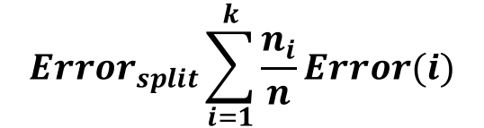
Splitting based on Classification Error

Slide 15
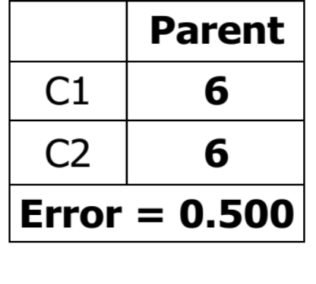
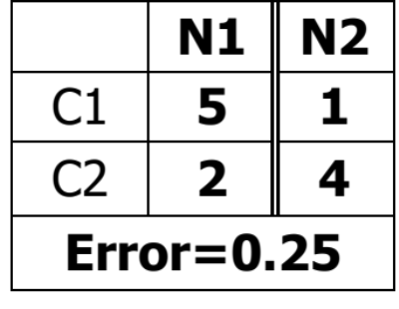
Splits into two partitions
Effect of Weighing partitions:
  Larger and Purer Partitions are sought for.
B?
Error(N1)
= 1-5/7=2/7
Error(N2)
= 1-4/5=1/5
Error(Children)
=7/12 * 2/7 + 5/12 * 1/5 = 1/4
Yes
No
Node N1
Node N2

Slide 16

Alternative Splitting Criteria based on INFO
Entropy at a given node t:
    (NOTE: p( j | t) is the relative frequency of class j at node t).
  Measures homogeneity of a node.
    Maximum (log n_{c}) when records are equally distributed among all classes implying least information
    Minimum (0.0) when all records belong to one class, implying most information
  Entropy based computations are similar to the GINI index computations

Slide 17

Examples for computing Entropy
P(C1) = 0/6 = 0 P(C2) = 6/6 = 1
Entropy = – 0 log 0 – 1 log 1 = – 0 – 0 = 0
P(C1) = 1/6 P(C2) = 5/6
Entropy = – (1/6) log₂ (1/6) – (5/6) log₂ (5/6) = 0.65
P(C1) = 2/6 P(C2) = 4/6
Entropy = – (2/6) log₂ (2/6) – (4/6) log₂ (4/6) = 0.92

Slide 18

Splitting Based on INFO...
Information Gain:
    Parent Node, p is split into k partitions;
    n_{i} is number of records in partition i
  Measures Reduction in Entropy achieved because of the split. Choose the split that achieves most reduction (maximizes GAIN)
  Used in ID3 and C4.5
  Disadvantage: Tends to prefer splits that result in large number of partitions, each being small but pure.

Slide 19
Larger number of splits
Before Splitting: 10 records of class 0,
10 records of class 1
Which test condition is the best?

Slide 20


Splitting Based on INFO...
Gain Ratio:
    Parent Node, p is split into k partitions
    n_{i} is the number of records in partition i
  Adjusts Information Gain by the entropy of the partitioning (SplitINFO). Higher entropy partitioning (large number of small partitions) is penalized!
  Used in C4.5
  Designed to overcome the disadvantage of Information Gain

Slide 21

Comparison among Splitting Criteria
For a 2-class problem:

