Slide 1
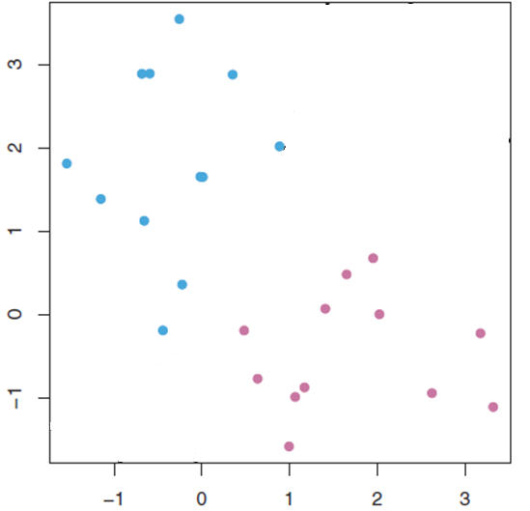
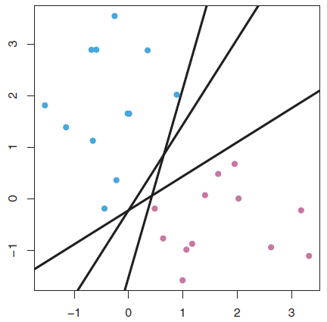
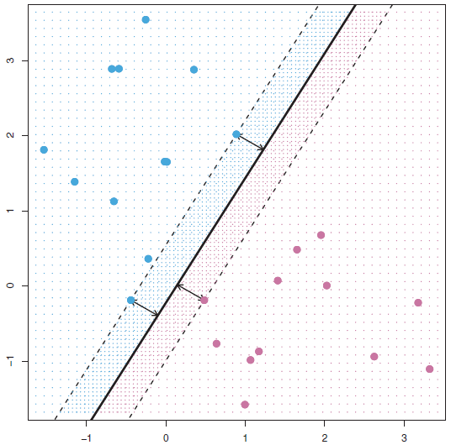
2.3. Machine Learning: SVM
SVM: Linear Case.
Margin
Notes:
https://www.quora.com/What-are-Kernels-in-Machine-Learning-and-SVM

Slide 2
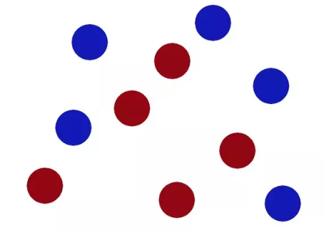
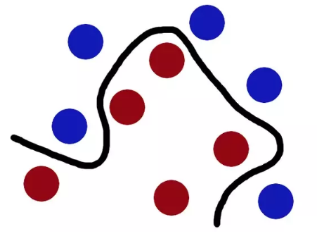
2.3. Machine Learning: SVM
SVM: Nonlinear Case.

Slide 3
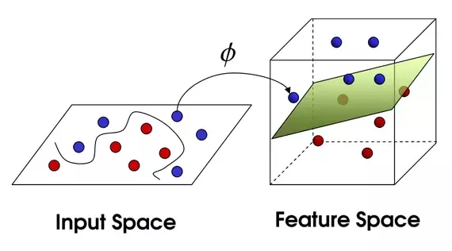
2.3. Machine Learning: Kernel Method
SVM: Kernel Method.
Notes:
Light and heavy balls.

