Slide 1
Data Mining
Association Analysis: Basic Concepts and Algorithms
Lecture Notes for Chapter 6
Introduction to Data Mining
by
Tan, Steinbach, Kumar
© Tan,Steinbach, Kumar Introduction to Data Mining 4/18/2004 <number>

Slide 2

Association Rule Mining
Given a set of transactions, find rules that will predict the occurrence of an item based on the occurrences of other items in the transaction
Market-Basket transactions
Example of Association Rules
{Diaper} → {Beer},
{Milk, Bread} → {Eggs,Coke},
{Beer, Bread} → {Milk},
Implication means co-occurrence, not causality!

Slide 3

Definition: Frequent Itemset
Itemset
  A collection of one or more items
    Example: {Milk, Bread, Diaper}
  k-itemset
    An itemset that contains k items
Support count (σ)
  Frequency of occurrence of an itemset
  E.g. σ({Milk, Bread,Diaper}) = 2
Support
  Fraction of transactions that contain an itemset
  E.g. s({Milk, Bread, Diaper}) = 2/5
Practice
  s({Bread, Milk}) = ??
  s({Milk, Bread, Coke}) = ??

Slide 4
Definition: Frequent Itemset
Support
  Fraction of transactions that contain an itemset
  E.g. s({Milk, Bread, Diaper}) = 2/5
Practice
  s({Bread, Milk}) = 3/5
  s({Milk, Bread, Coke}) = 1/5
Frequent Itemset
  An itemset whose support is greater than or equal to a minsup threshold

Slide 5
Definition: Frequent Itemset
Support
  Fraction of transactions that contain an itemset
  E.g. s({Milk, Bread, Diaper}) = 2/5
Practice
  s({Bread, Milk}) = ??
  s({Milk, Bread, Coke}) = ??
Frequent Itemset
  An itemset whose support is greater than or equal to a minsup threshold
Practice
  If minsup is 3/5, are the above three itemsets frequent itemset?

Slide 6



Definition: Association Rule
Association Rule
  An implication expression of the form X → Y, where X and Y are itemsets
  Example:
  {Milk, Diaper} → {Beer}
Rule Evaluation Metrics
  Support (s)
    Fraction of transactions that contain both X and Y
  Confidence (c)
    Measures how often items in Y
    appear in transactions that
    contain X
Example:

Slide 7
Definition: Association Rule
Association Rule
  An implication expression of the form X → Y, where X and Y are itemsets
  Example:
  {Milk, Diaper} → {Beer}
Rule Evaluation Metrics
  Support (s)
    Fraction of transactions that contain both X and Y
  Confidence (c)
    Measures how often items in Y
    appear in transactions that
    contain X
Practice:
{Milk, Beer} -> {Diaper}
{Diaper} -> {Milk, Beer}

Slide 8
Association Rule Mining Task
Given a set of transactions T, the goal of association rule mining is to find all rules having
  support ≥ minsup threshold
  confidence ≥ minconf threshold
Brute-force approach:
  List all possible association rules
  Compute the support and confidence for each rule
  Prune rules that fail the minsup and minconf thresholds
  ⇒ Computationally prohibitive!

Slide 9
Mining Association Rules
Example of Rules:
{Milk,Diaper} → {Beer} (s=0.4, c=0.67)
{Milk,Beer} → {Diaper} (s=0.4, c=1.0)
{Diaper,Beer} → {Milk} (s=0.4, c=0.67)
{Beer} → {Milk,Diaper} (s=0.4, c=0.67)
{Diaper} → {Milk,Beer} (s=0.4, c=0.5)
{Milk} → {Diaper,Beer} (s=0.4, c=0.5)
Observations:
???
???

Slide 10
Mining Association Rules
Example of Rules:
{Milk,Diaper} → {Beer} (s=0.4, c=0.67)
{Milk,Beer} → {Diaper} (s=0.4, c=1.0)
{Diaper,Beer} → {Milk} (s=0.4, c=0.67)
{Beer} → {Milk,Diaper} (s=0.4, c=0.67)
{Diaper} → {Milk,Beer} (s=0.4, c=0.5)
{Milk} → {Diaper,Beer} (s=0.4, c=0.5)
Observations:
All the above rules are binary partitions of the same itemset:
{Milk, Diaper, Beer}
Rules originating from the same itemset have identical support but
can have different confidence
Thus, we may decouple the support and confidence requirements

Slide 11
Mining Association Rules
Two-step approach:
  Frequent Itemset Generation
    Generate all itemsets whose support ≥ minsup
  Rule Generation
    Generate high confidence rules from each frequent itemset, where each rule is a binary partitioning of a frequent itemset
Frequent itemset generation is still computationally expensive

Slide 12

Frequent Itemset Generation
Given d items, there are 2^{d} possible candidate itemsets

Slide 13

Frequent Itemset Generation
Brute-force approach:
  Each itemset in the lattice is a candidate frequent itemset
  Count the support of each candidate by scanning the database
  Match each transaction against every candidate
  Complexity ~ O(NMw) => Expensive since M = 2^{d} !!!

Slide 14
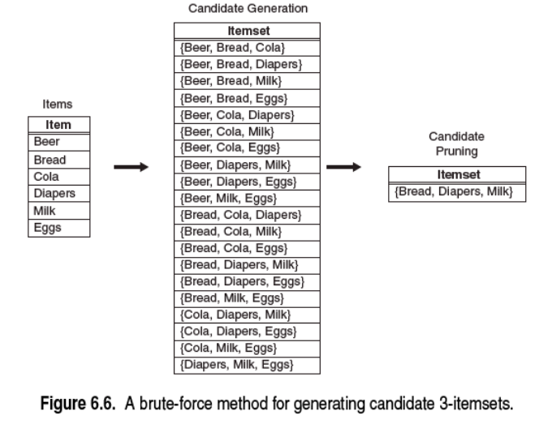
Frequent Itemset Generation
Brute-force approach:

Slide 15
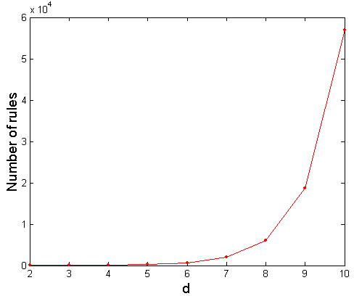
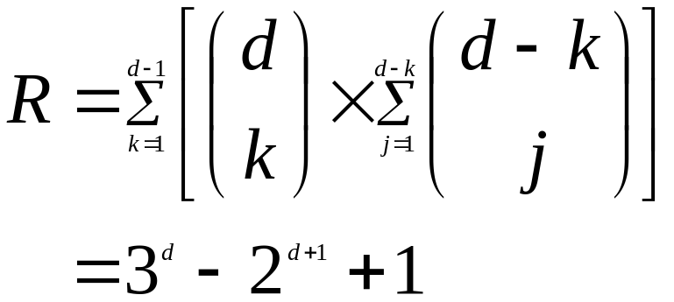
Computational Complexity
Given d unique items:
  Total number of itemsets = 2^{d}
  Total number of possible association rules:
If d=6, R = 602 rules

Slide 16
Frequent Itemset Generation Strategies
Reduce the number of candidates (M)
  Complete search: M=2^{d}
  Use pruning techniques to reduce M
Reduce the number of transactions (N)
  Reduce size of N as the size of itemset increases
  Used by DHP and vertical-based mining algorithms
Reduce the number of comparisons (NM)
  Use efficient data structures to store the candidates or transactions
  No need to match every candidate against every transaction

Slide 17
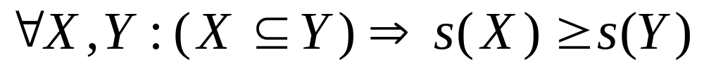
Reducing Number of Candidates
Apriori principle:
  If an itemset is frequent, then all of its subsets must also be frequent
Apriori principle holds due to the following property of the support measure:
  Support of an itemset never exceeds the support of its subsets
  This is known as the anti-monotone property of support

Slide 18
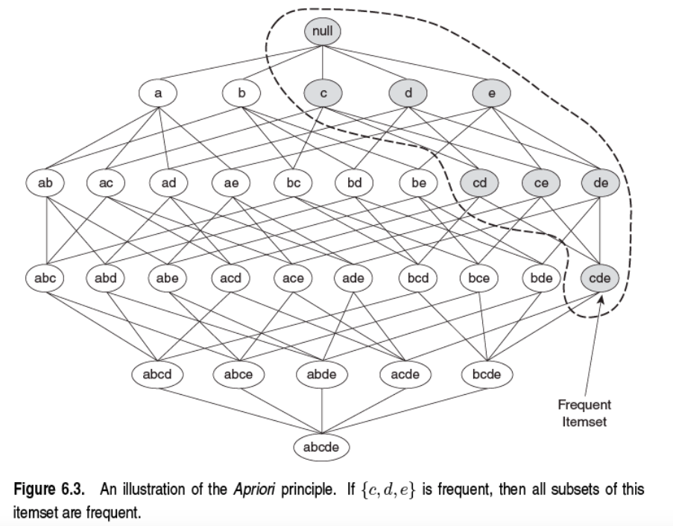
Illustrating Apriori Principle

Slide 19


Illustrating Apriori Principle
Found to be Infrequent
Pruned supersets

Slide 20
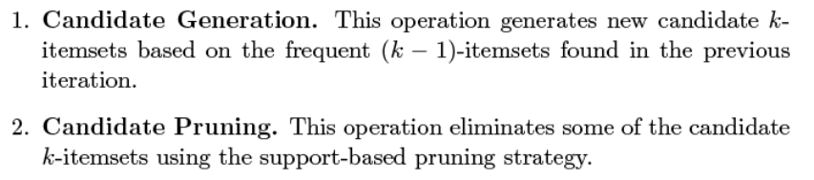
Apriori Algorithm
Candidate Generation and Pruning

Slide 21
Apriori Algorithm
Method:
  Let k=1
  Generate frequent itemsets of length 1
  Repeat until no new frequent itemsets are identified
    Generate length (k+1) candidate itemsets from length k frequent itemsets
    Prune candidate itemsets containing subsets of length k that are infrequent
    Count the support of each candidate by scanning the DB
    Eliminate candidates that are infrequent, leaving only those that are frequent

Slide 22

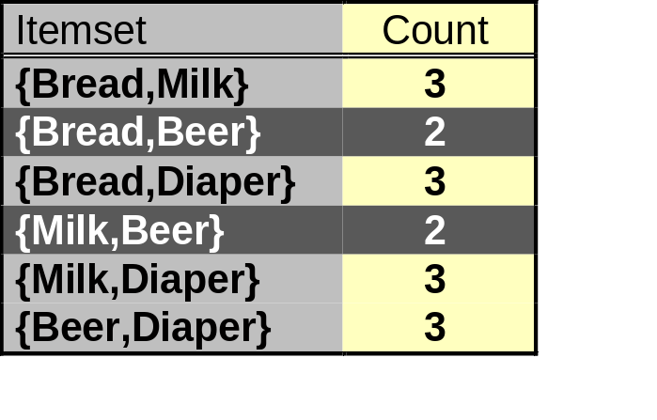
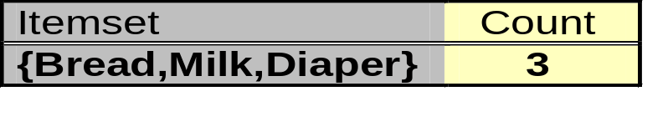
Illustrating Apriori Principle
Items (1-itemsets)
Pairs (2-itemsets)
(No need to generate
candidates involving Coke
or Eggs)
Minimum Support = 3
Triplets (3-itemsets)
If every subset is considered,
⁶C₁ + ⁶C₂ + ⁶C₃ = 41
With support-based pruning,
6 + 6 + 1 = 13

Slide 23
Illustrating Apriori Principle
Find all frequent itemsets in a tree structure.

Slide 24
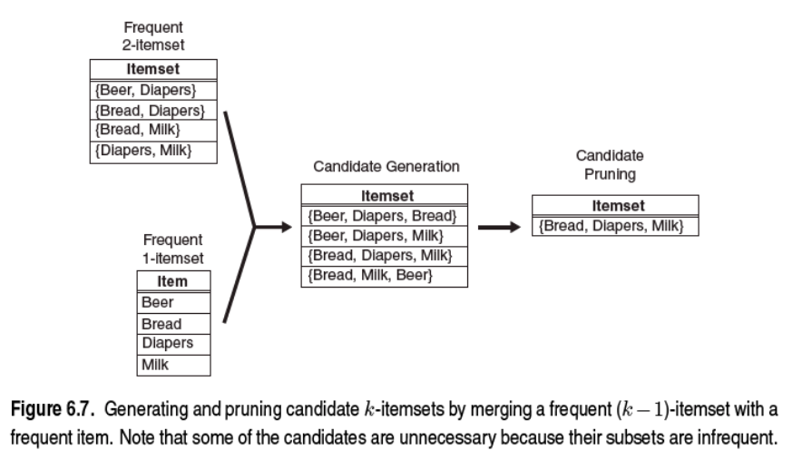
F_{k-1} * F₁

Slide 25
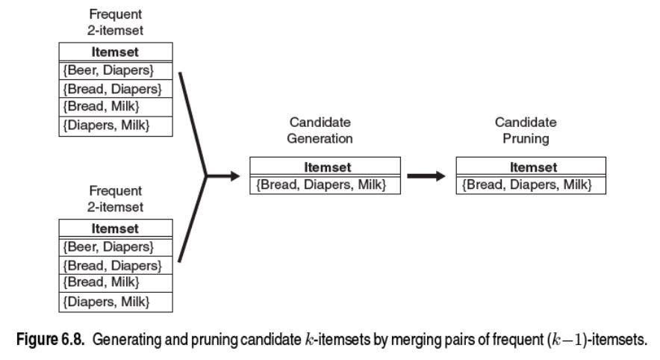
F_{k-1} * F_{k-1}

Slide 26
Rule Generation
Given a frequent itemset L, find all non-empty subsets f ⊂ L such that f → L – f satisfies the minimum confidence requirement
  If {A,B,C,D} is a frequent itemset, candidate rules:
    ABC →D, ABD →C, ACD →B, BCD →A,
    A →BCD, B →ACD, C →ABD, D →ABC
    AB →CD, AC → BD, AD → BC, BC →AD,
    BD →AC, CD →AB,
If |L| = k, then there are 2^{k} – 2 candidate association rules (ignoring L → ∅ and ∅ → L)

Slide 27
Rule Generation
How to efficiently generate rules from frequent itemsets?
  In general, confidence does not have an anti-monotone property
    c(ABC →D) can be larger or smaller than c(AB →D)
  But confidence of rules generated from the same itemset has an anti-monotone property
  e.g., L = {A,B,C,D}:
  c(ABC → D) ≥ c(AB → CD) ≥ c(A → BCD)
    Confidence is anti-monotone w.r.t. number of items on the RHS of the rule

Slide 28
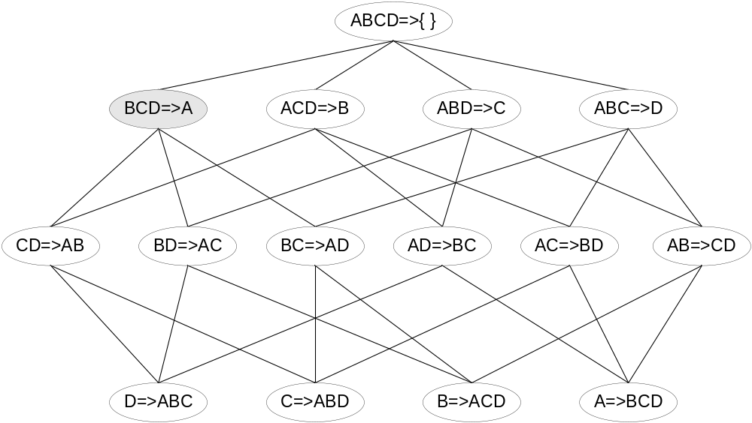

Rule Generation for Apriori Algorithm
Lattice of rules
Low Confidence Rule
Pruned Rules

Slide 29
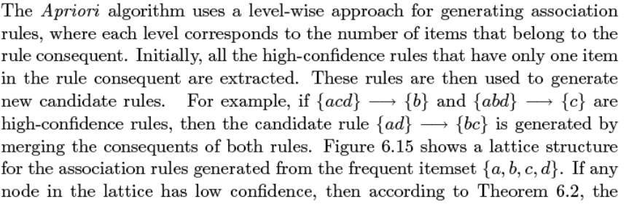
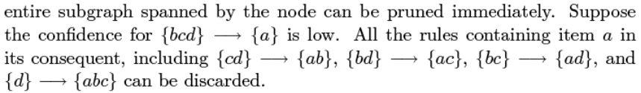
Rule Generation for Apriori Algorithm

Slide 30
In class practice
Find all associate rules with MinSup=3 and MinConf = 0.6

