Slide 1
Data Mining
Classification: Basic Concepts, Decision Trees, and Model Evaluation
Lecture Notes for Chapter 4
Introduction to Data Mining
by
Tan, Steinbach, Kumar
© Tan,Steinbach, Kumar Introduction to Data Mining 4/18/2004 <number>

Slide 2
Classification: Definition
Given a collection of records (training set )
  Each record contains a set of attributes, one of the attributes is the class.
Find a model for class attribute as a function of the values of other attributes.
Goal: previously unseen records should be assigned a class as accurately as possible.
  A test set is used to determine the accuracy of the model. Usually, the given data set is divided into training and test sets, with training set used to build the model and test set used to validate it.

Slide 3

Illustrating Classification Task

Slide 4




Examples of Classification Task
Predicting tumor cells as benign or malignant
Classifying credit card transactions
as legitimate or fraudulent
Classifying secondary structures of protein
as alpha-helix, beta-sheet, or random
coil
Categorizing news stories as finance,
weather, entertainment, sports, etc

Slide 5
Classification Techniques
Decision Tree based Methods
Rule-based Methods
Memory based reasoning
Neural Networks
Naïve Bayes and Bayesian Belief Networks
Support Vector Machines

Slide 6

Decision Tree
categorical
categorical
continuous
class
Notes:
Ask a series of questions. Yes -> no. married->no. income 80

Slide 7
Example of a Decision Tree
categorical
categorical
continuous
class
Splitting Attributes
Refund
Yes
No
NO
MarSt
Single, Divorced
Married
TaxInc
NO
< 80K
> 80K
NO
YES
Training Data
Model: Decision Tree

Slide 8
Another Example of Decision Tree
categorical
categorical
continuous
class
MarSt
Single, Divorced
Married
NO
Refund
Yes
No
NO
TaxInc
< 80K
> 80K
NO
YES
There could be more than one tree that fits the same data!

Slide 9

Decision Tree Classification Task
Decision Tree

Slide 10

Apply Model to Test Data
Test Data
Start from the root of tree.
Refund
Yes
No
NO
MarSt
Single, Divorced
Married
TaxInc
NO
< 80K
> 80K
NO
YES

Slide 11
Apply Model to Test Data
Test Data
Refund
Yes
No
NO
MarSt
Single, Divorced
Married
TaxInc
NO
< 80K
> 80K
NO
YES

Slide 12

Apply Model to Test Data
Test Data
Refund
Yes
No
NO
MarSt
Single, Divorced
Married
TaxInc
NO
< 80K
> 80K
NO
YES

Slide 13
Apply Model to Test Data
Test Data
Refund
Yes
No
NO
MarSt
Single, Divorced
Married
TaxInc
NO
< 80K
> 80K
NO
YES

Slide 14

Apply Model to Test Data
Test Data
Refund
Yes
No
NO
MarSt
Single, Divorced
Married
TaxInc
NO
< 80K
> 80K
NO
YES

Slide 15
Apply Model to Test Data
Test Data
Refund
Yes
No
NO
MarSt
Single, Divorced
Married
Assign Cheat to “No”
TaxInc
NO
< 80K
> 80K
NO
YES
Notes:
More example. in class questions.

Slide 16

Decision Tree Classification Task
Decision Tree

Slide 17
Decision Tree Induction
Many Algorithms:
  Hunt’s Algorithm (one of the earliest)
  CART
  C4.5

Slide 18

General Structure of Hunt’s Algorithm
Let D_{t} be the set of training records that reach a node t
General Procedure:
  If D_{t} contains records that belong the same class y_{t}, then t is a leaf node labeled as y_{t}
  If D_{t} is an empty set, then t is a leaf node labeled by the default class, y_{d}
  If D_{t} contains records that belong to more than one class, use an attribute test to split the data into smaller subsets. Recursively apply the procedure to each subset.
D_{t}
?

Slide 19

Hunt’s Algorithm
Refund
Don’t
Cheat
Yes
No
Don’t
Cheat
Don’t
Cheat
Refund
Refund
Yes
No
Yes
No
Don’t
Cheat
Marital
Status
Don’t
Cheat
Marital
Status
Single,
Divorced
Single,
Divorced
Married
Married
Cheat
Don’t
Cheat
Taxable
Income
Don’t
Cheat
< 80K
>= 80K
Don’t
Cheat
Cheat

Slide 20
Tree Induction
Greedy strategy.
  Split the records based on an attribute test that optimizes certain criterion.
Issues
  Determine how to split the records
    How to specify the attribute test condition?
    How to determine the best split?
  Determine when to stop splitting

Slide 21
Tree Induction
Greedy strategy.
  Split the records based on an attribute test that optimizes certain criterion.
Issues
  Determine how to split the records
    How to specify the attribute test condition?
    How to determine the best split?
  Determine when to stop splitting

Slide 22
How to Specify Test Condition?
Depends on attribute types
  Nominal
  Ordinal
  Continuous
Depends on number of ways to split
  2-way split
  Multi-way split

Slide 23
Splitting Based on Nominal Attributes
Multi-way split: Use as many partitions as distinct values.
Binary split: Divides values into two subsets.
Need to find optimal partitioning.
CarType
Family
Luxury
Sports
CarType
CarType
{Sports, Luxury}
OR
{Family,
Luxury}
{Family}
{Sports}

Slide 24
Splitting Based on Ordinal Attributes
Multi-way split: Use as many partitions as distinct values.
Binary split: Divides values into two subsets.
Need to find optimal partitioning.
What about this split?
Size
Small
Large
Medium
Size
Size
{Small, Medium}
OR
{Medium,
Large}
{Large}
{Small}
Size
{Small, Large}
{Medium}

Slide 25
Splitting Based on Continuous Attributes
Different ways of handling
  Discretization to form an ordinal categorical attribute
    Static – discretize once at the beginning
    Dynamic – ranges can be found by equal interval bucketing, equal frequency bucketing
    (percentiles), or clustering.
  Binary Decision: (A < v) or (A ≥ v)
    consider all possible splits and finds the best cut
    can be more compute intensive

Slide 26
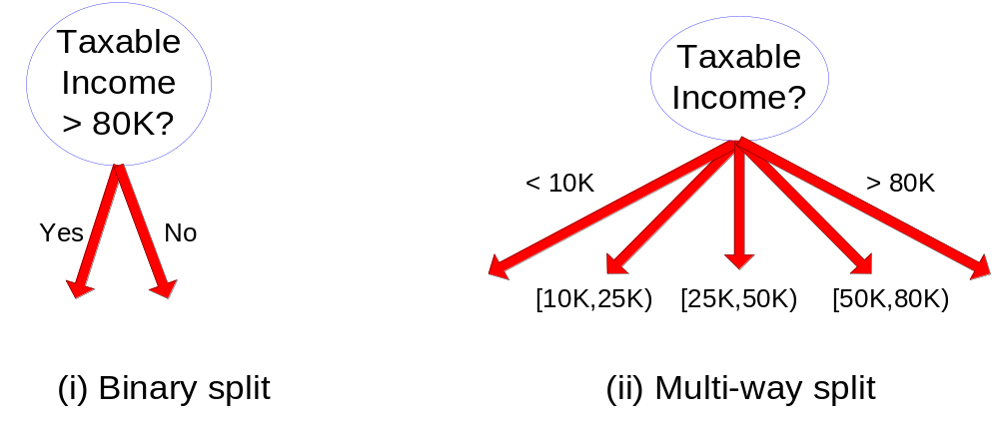
Splitting Based on Continuous Attributes

Slide 27
Tree Induction
Greedy strategy.
  Split the records based on an attribute test that optimizes certain criterion.
Issues
  Determine how to split the records
    How to specify the attribute test condition?
    How to determine the best split?
  Determine when to stop splitting

Slide 28

How to determine the Best Split
Before Splitting: 10 records of class 0,
10 records of class 1
Which test condition is the best?

Slide 29


How to determine the Best Split
Greedy approach:
  Nodes with homogeneous class distribution are preferred
Need a measure of node impurity:
Non-homogeneous,
High degree of impurity
Homogeneous,
Low degree of impurity

Slide 30
Measures of Node Impurity
Gini Index
Entropy
Misclassification error

Slide 31





How to Find the Best Split
Before Splitting:
M0
A?
B?
Yes
No
Yes
No
Node N1
Node N2
Node N3
Node N4
M1
M2
M3
M4
M12
M34
Gain = M0 – M12 vs M0 – M34

Slide 32





Measure of Impurity: GINI
Gini Index for a given node t :
    (NOTE: p( j | t) is the relative frequency of class j at node t).
  Maximum (1 - 1/n_{c}) when records are equally distributed among all classes, implying least interesting information
  Minimum (0.0) when all records belong to one class, implying most interesting information

Slide 33



Examples for computing GINI
P(C1) = 0/6 = 0 P(C2) = 6/6 = 1
Gini = 1 – P(C1)² – P(C2)² = 1 – 0 – 1 = 0
P(C1) = ? P(C2) = ?
Gini = ?
P(C1) = ? P(C2) = ?
Gini = ?

Slide 34
Examples for computing GINI
P(C1) = 0/6 = 0 P(C2) = 6/6 = 1
Gini = 1 – P(C1)² – P(C2)² = 1 – 0 – 1 = 0
P(C1) = 1/6 P(C2) = 5/6
Gini = 1 – (1/6)² – (5/6)² = 0.278
P(C1) = 2/6 P(C2) = 4/6
Gini = 1 – (2/6)² – (4/6)² = 0.444

Slide 35

Splitting Based on GINI
Used in CART, SLIQ, SPRINT.
When a node p is split into k partitions (children), the quality of split is computed as,
where, n_{i} = number of records at child i,
n = number of records at node p.

Slide 36

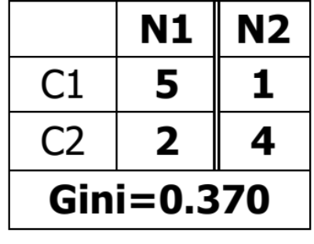
Binary Attributes: Computing GINI Index
Splits into two partitions
Effect of Weighing partitions:
  Larger and Purer Partitions are sought for.
B?
Gini(N1)
= ?
Gini(N2)
= ?
Gini(Children)
=?
Yes
No
Node N1
Node N2

Slide 37
Binary Attributes: Computing GINI Index
Splits into two partitions
Effect of Weighing partitions:
  Larger and Purer Partitions are sought for.
B?
Yes
No
Node N1
Node N2
Gini(N1)
= 1 – (5/7)² – (2/7)²
= 0.408
Gini(N2)
= 1 – (1/5)² – (4/5)²
= 0.319
Gini(Children)
= 7/12 * 0.408 +
5/12 * 0.319
= 0.370

Slide 38



Categorical Attributes: Computing Gini Index
For each distinct value, gather counts for each class in the dataset
Use the count matrix to make decisions
Multi-way split
Two-way split
(find best partition of values)

Slide 39

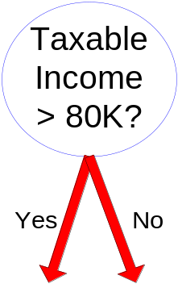
Continuous Attributes: Computing Gini Index
Use Binary Decisions based on one value
Several Choices for the splitting value
  Number of possible splitting values
  = Number of distinct values
Each splitting value has a count matrix associated with it
  Class counts in each of the partitions, A < v and A ≥ v
Simple method to choose best v
  For each v, scan the database to gather count matrix and compute its Gini index
  Computationally Inefficient! Repetition of work.

Slide 40

Continuous Attributes: Computing Gini Index...
For efficient computation: for each attribute,
  Sort the attribute on values
  Linearly scan these values, each time updating the count matrix and computing gini index
  Choose the split position that has the least gini index
Sorted Values
Split Positions

Slide 41

Splitting Criteria based on Classification Error
Classification error at a node t :
Measures misclassification error made by a node.
    Maximum (1 - 1/n_{c}) when records are equally distributed among all classes, implying least interesting information
    Minimum (0.0) when all records belong to one class, implying most interesting information

Slide 42
Examples for Computing Error
P(C1) = 0/6 = 0 P(C2) = 6/6 = 1
Error = 1 – max (0, 1) = 1 – 1 = 0
P(C1) = ? P(C2) = ?
Error = ?
P(C1) = ? P(C2) = ?
Error = ?

Slide 43
Examples for Computing Error
P(C1) = 0/6 = 0 P(C2) = 6/6 = 1
Error = 1 – max (0, 1) = 1 – 1 = 0
P(C1) = 1/6 P(C2) = 5/6
Error = 1 – max (1/6, 5/6) = 1 – 5/6 = 1/6
P(C1) = 2/6 P(C2) = 4/6
Error = 1 – max (2/6, 4/6) = 1 – 4/6 = 1/3
Notes:
Information Gain?

Slide 44
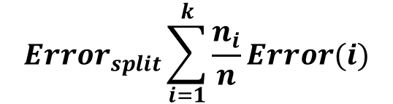
Splitting based on Classification Error

Slide 45
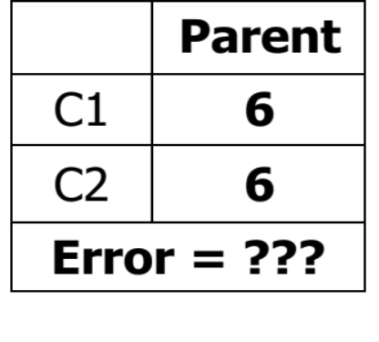
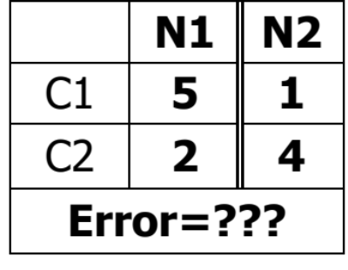
Splits into two partitions
Effect of Weighing partitions:
  Larger and Purer Partitions are sought for.
B?
Error(N1)
= ??
Error(N2)
= ??
Error(Children)
= ??
Yes
No
Node N1
Node N2

Slide 46
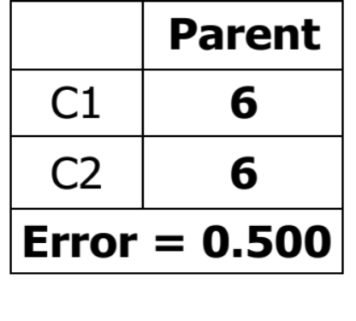
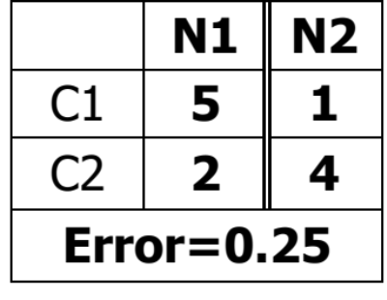
Splits into two partitions
Effect of Weighing partitions:
  Larger and Purer Partitions are sought for.
B?
Error(N1)
= 1-5/7=2/7
Error(N2)
= 1-4/5=1/5
Error(Children)
=7/12 * 2/7 + 5/12 * 1/5 = 1/4
Yes
No
Node N1
Node N2

Slide 47

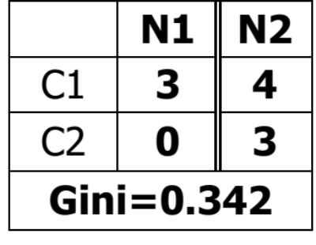
Misclassification Error vs Gini
A?
Yes
No
Node N1
Node N2
Gini(N1)
= 1 – (3/3)² – (0/3)²
= 0
Gini(N2)
= 1 – (4/7)² – (3/7)²
= 0.489
Gini(Children)
= 3/10 * 0
+ 7/10 * 0.489
= 0.342
Gini improves !!
What about misclassification error?
Notes:
Why? Mis same. 3/10 * 0 + 7/10 * (1-4/7)=3/10

Slide 48

Alternative Splitting Criteria based on INFO
Entropy at a given node t:
    (NOTE: p( j | t) is the relative frequency of class j at node t).
  Measures homogeneity of a node.
    Maximum (log n_{c}) when records are equally distributed among all classes implying least information
    Minimum (0.0) when all records belong to one class, implying most information
  Entropy based computations are similar to the GINI index computations

Slide 49

Examples for computing Entropy
P(C1) = 0/6 = 0 P(C2) = 6/6 = 1
Entropy = – 0 log 0 – 1 log 1 = – 0 – 0 = 0
P(C1) = ? P(C2) = ?
Entropy = ?
P(C1) = ? P(C2) = ?
Entropy = ?

Slide 50
Examples for computing Entropy
P(C1) = 0/6 = 0 P(C2) = 6/6 = 1
Entropy = – 0 log 0 – 1 log 1 = – 0 – 0 = 0
P(C1) = 1/6 P(C2) = 5/6
Entropy = – (1/6) log₂ (1/6) – (5/6) log₂ (5/6) = 0.65
P(C1) = 2/6 P(C2) = 4/6
Entropy = – (2/6) log₂ (2/6) – (4/6) log₂ (4/6) = 0.92

Slide 51

Splitting Based on INFO...
Information Gain:
    Parent Node, p is split into k partitions;
    n_{i} is number of records in partition i
  Measures Reduction in Entropy achieved because of the split. Choose the split that achieves most reduction (maximizes GAIN)
  Used in ID3 and C4.5
  Disadvantage: Tends to prefer splits that result in large number of partitions, each being small but pure.

Slide 52
Larger number of splits
Before Splitting: 10 records of class 0,
10 records of class 1
Which test condition is the best?

Slide 53


Splitting Based on INFO...
Gain Ratio:
    Parent Node, p is split into k partitions
    n_{i} is the number of records in partition i
  Adjusts Information Gain by the entropy of the partitioning (SplitINFO). Higher entropy partitioning (large number of small partitions) is penalized!
  Used in C4.5
  Designed to overcome the disadvantage of Information Gain

Slide 54

Comparison among Splitting Criteria
For a 2-class problem:

Slide 55
Tree Induction
Greedy strategy.
  Split the records based on an attribute test that optimizes certain criterion.
Issues
  Determine how to split the records
    How to specify the attribute test condition?
    How to determine the best split?
  Determine when to stop splitting

Slide 56
Stopping Criteria for Tree Induction
Stop expanding a node when all the records belong to the same class
Stop expanding a node when all the records have similar attribute values
Early termination (to be discussed later)

Slide 57
Decision Tree Based Classification
Advantages:
  Inexpensive to construct
  Extremely fast at classifying unknown records
  Easy to interpret for small-sized trees
  Accuracy is comparable to other classification techniques for many simple data sets

Slide 58
CART
Classification and Regression Tree
Binary split only.

Slide 59
Example: C4.5
Simple depth-first construction.
Uses Information Gain
Sorts Continuous Attributes at each node.
Needs entire data to fit in memory.
Unsuitable for Large Datasets.
  Needs out-of-core sorting.
You can download the software from:
http://www.cse.unsw.edu.au/~quinlan/c4.5r8.tar.gz

