Slide 1
Data Mining Cluster Analysis: Basic Concepts and Algorithms
Lecture Notes for Chapter 8
Introduction to Data Mining
by
Tan, Steinbach, Kumar
© Tan,Steinbach, Kumar Introduction to Data Mining 4/18/2004 1

Slide 2
DBSCAN
DBSCAN is a density-based algorithm.
Density = number of points within a specified radius (Eps)
A point is a core point if it has more than a specified number of points (MinPts) within Eps
These are points that are at the interior of a cluster
A border point has fewer than MinPts within Eps, but is in the neighborhood of a core point
A noise point is any point that is not a core point or a border point.

Slide 3
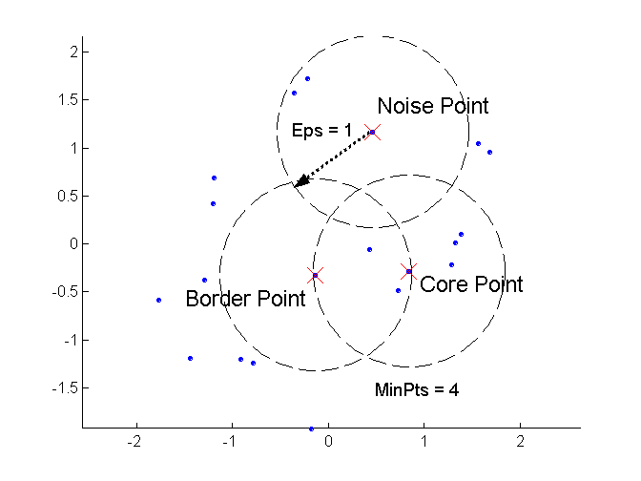
DBSCAN: Core, Border, and Noise Points

Slide 4
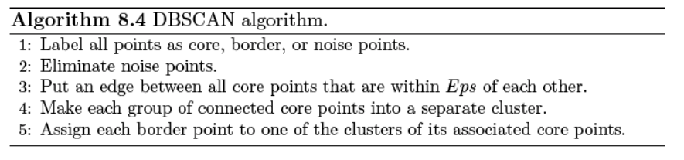
DBSCAN Algorithm
Eliminate noise points
Perform clustering on the remaining points

Slide 5
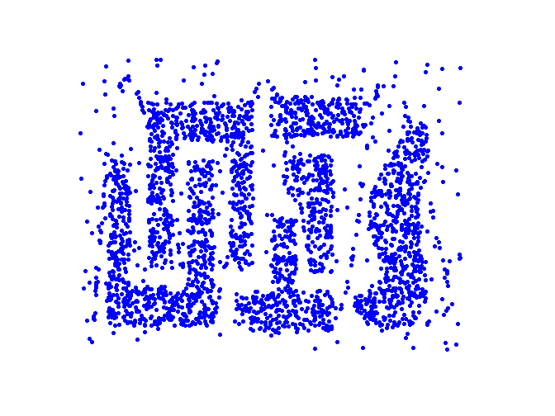
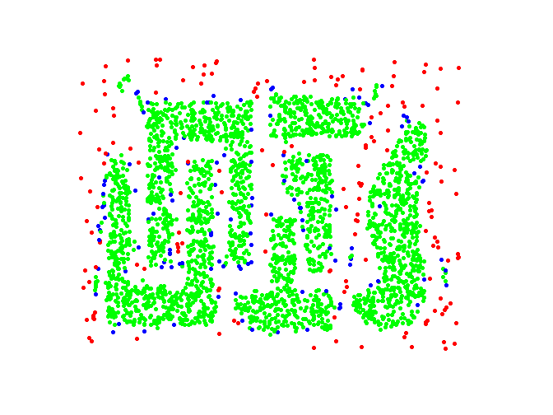
DBSCAN: Core, Border and Noise Points
Original Points
Point types: core, border and noise
Eps = 10, MinPts = 4

Slide 6
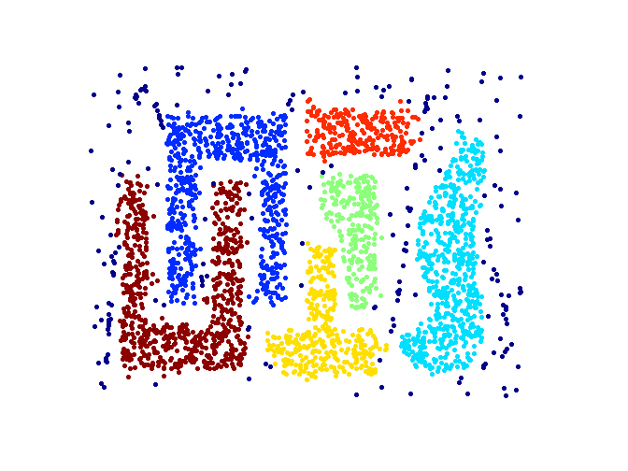
When DBSCAN Works Well
Original Points
Clusters
Resistant to Noise
Can handle clusters of different shapes and sizes

Slide 7
How do we choose Eps and MinPts?

Slide 8
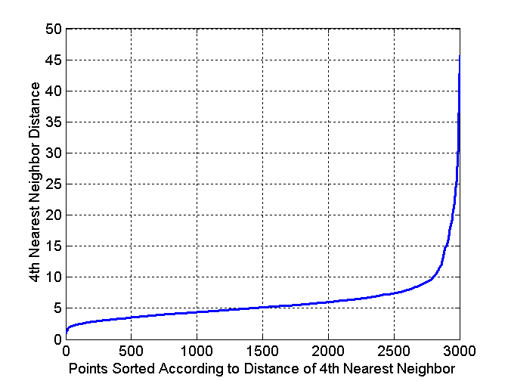
DBSCAN: Determining EPS and MinPts
Idea is that for points in a cluster, their k^{th} nearest neighbors are at roughly the same distance
Noise points have the k^{th} nearest neighbor at farther distance
So, plot sorted distance of every point to its k^{th} nearest neighbor

Slide 9
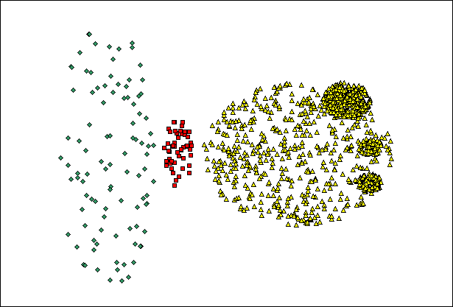
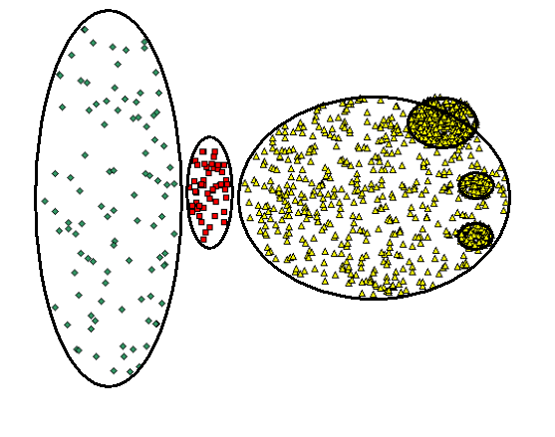
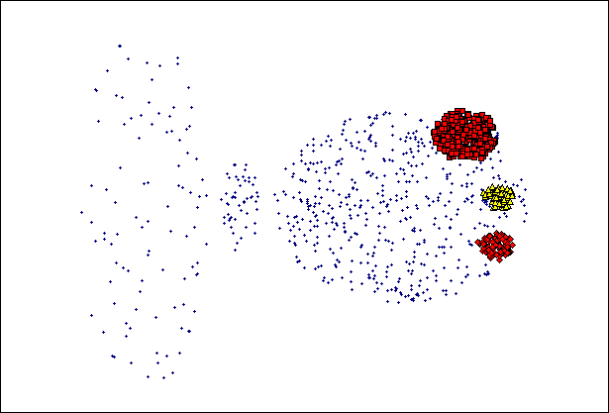
When DBSCAN Does NOT Work Well
(MinPts=4, Eps=9.75).
Original Points
Varying densities
High-dimensional data
(MinPts=4, Eps=9.92)

Slide 10
Cluster Validity
For supervised classification we have a variety of measures to evaluate how good our model is
Accuracy, precision, recall
For cluster analysis, the analogous question is how to evaluate the “goodness” of the resulting clusters?
But “clusters are in the eye of the beholder”!
Then why do we want to evaluate them?
To avoid finding patterns in noise
To compare clustering algorithms
To compare two sets of clusters
To compare two clusters

Slide 11
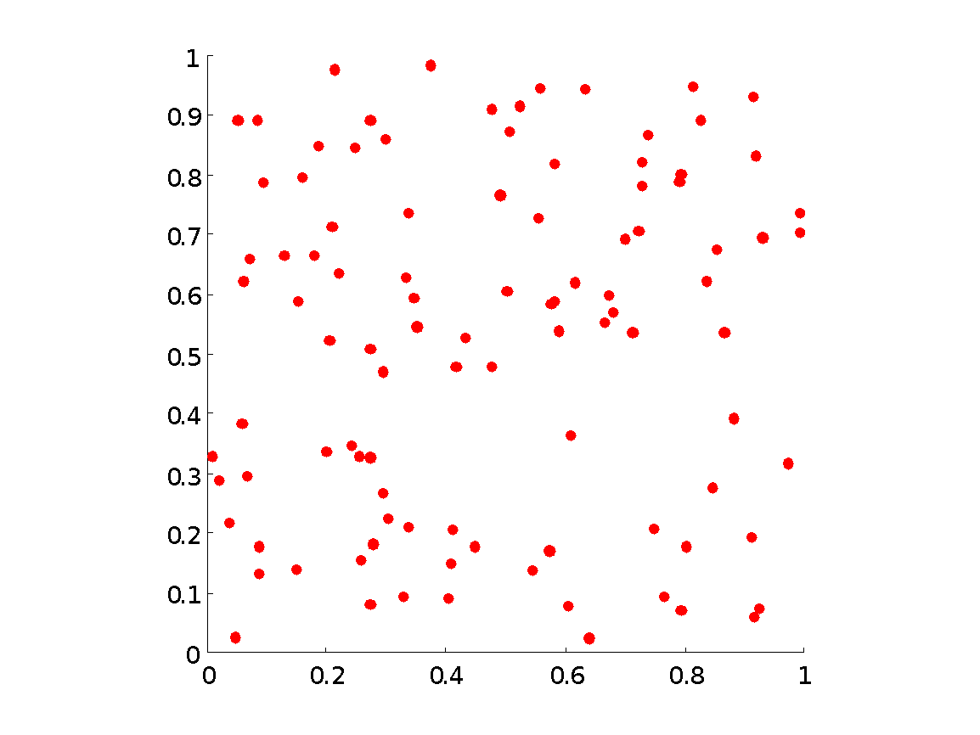
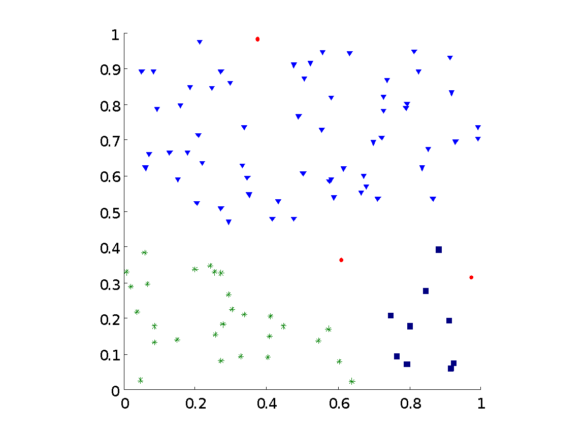
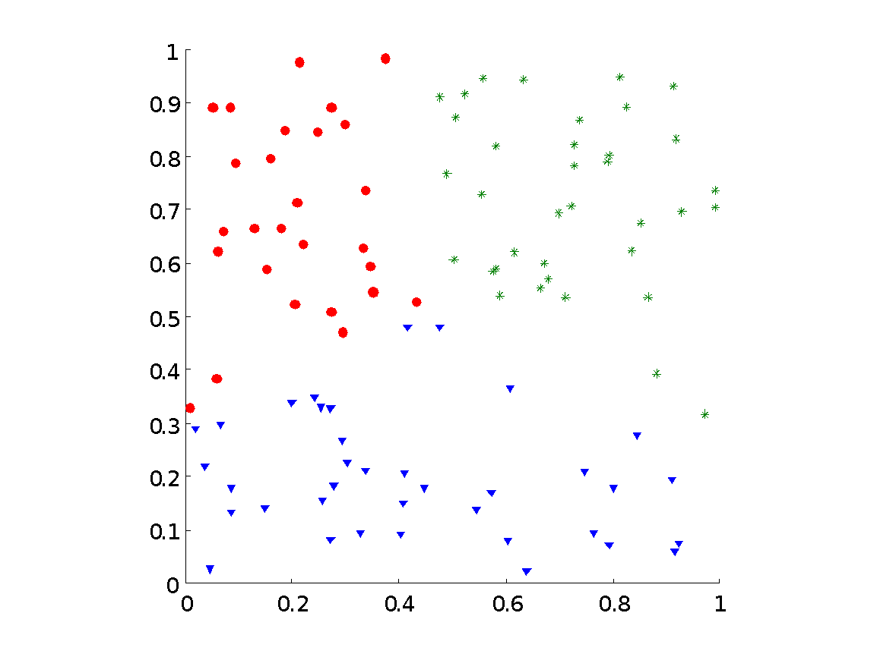
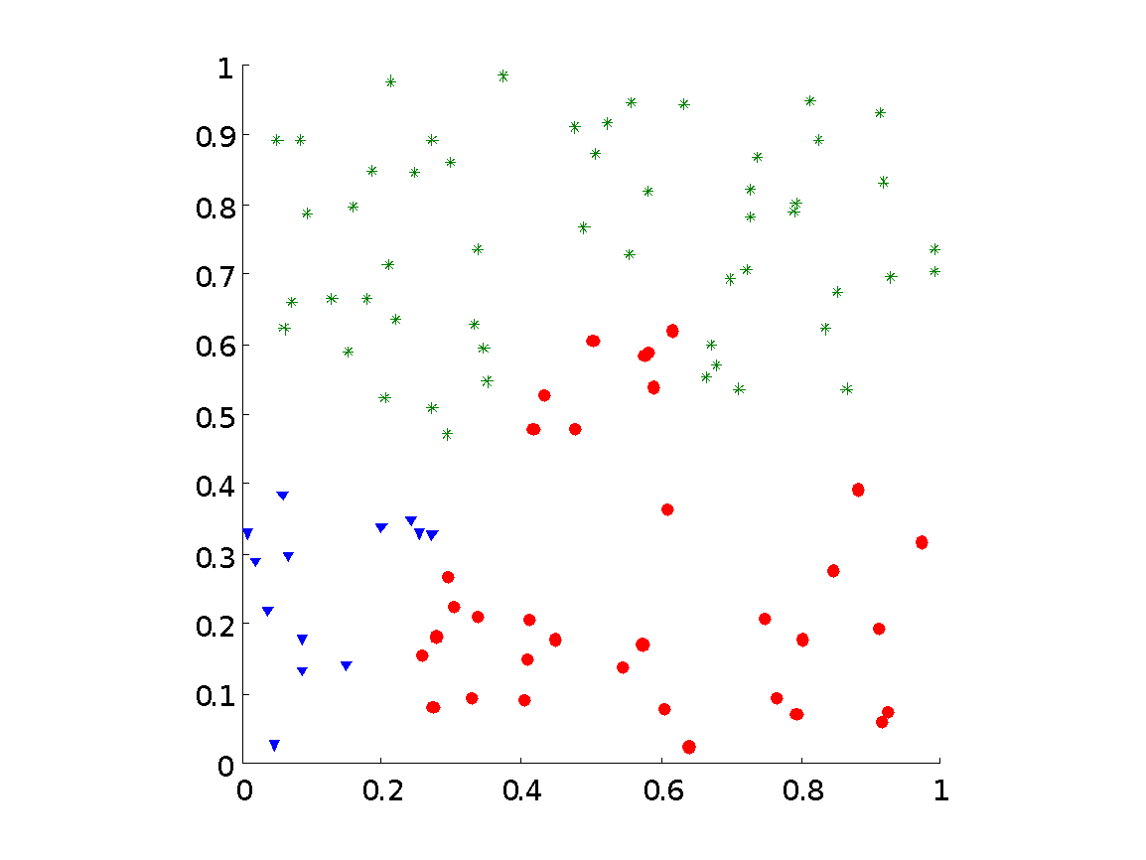
Clusters found in Random Data
Random Points
DBSCAN
K-means
Complete Link

Slide 12
Different Aspects of Cluster Validation
What aspects should be considered for
cluster validation?

Slide 13
Different Aspects of Cluster Validation
Determining the clustering tendency of a set of data, i.e., distinguishing whether non-random structure actually exists in the data.
Comparing the results of a cluster analysis to externally known results, e.g., to externally given class labels.
Evaluating how well the results of a cluster analysis fit the data without reference to external information.
- Use only the data
Comparing the results of two different sets of cluster analyses to determine which is better.
Determining the ‘correct’ number of clusters.
For 2, 3, and 4, we can further distinguish whether we want to evaluate the entire clustering or just individual clusters.

Slide 14
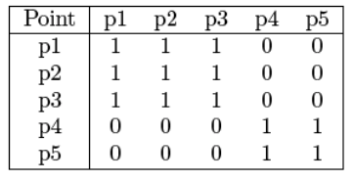
Measuring Cluster Validity Via Correlation
Two matrices
Proximity Matrix
“Incidence” Matrix
One row and one column for each data point
An entry is 1 if the associated pair of points belong to the same cluster
An entry is 0 if the associated pair of points belongs to different clusters
Compute the correlation between the two matrices
Since the matrices are symmetric, only the correlation between n(n-1) / 2 entries needs to be calculated.
High correlation indicates that points that belong to the same cluster are close to each other.
Not a good measure for some density or contiguity based clusters.

Slide 15
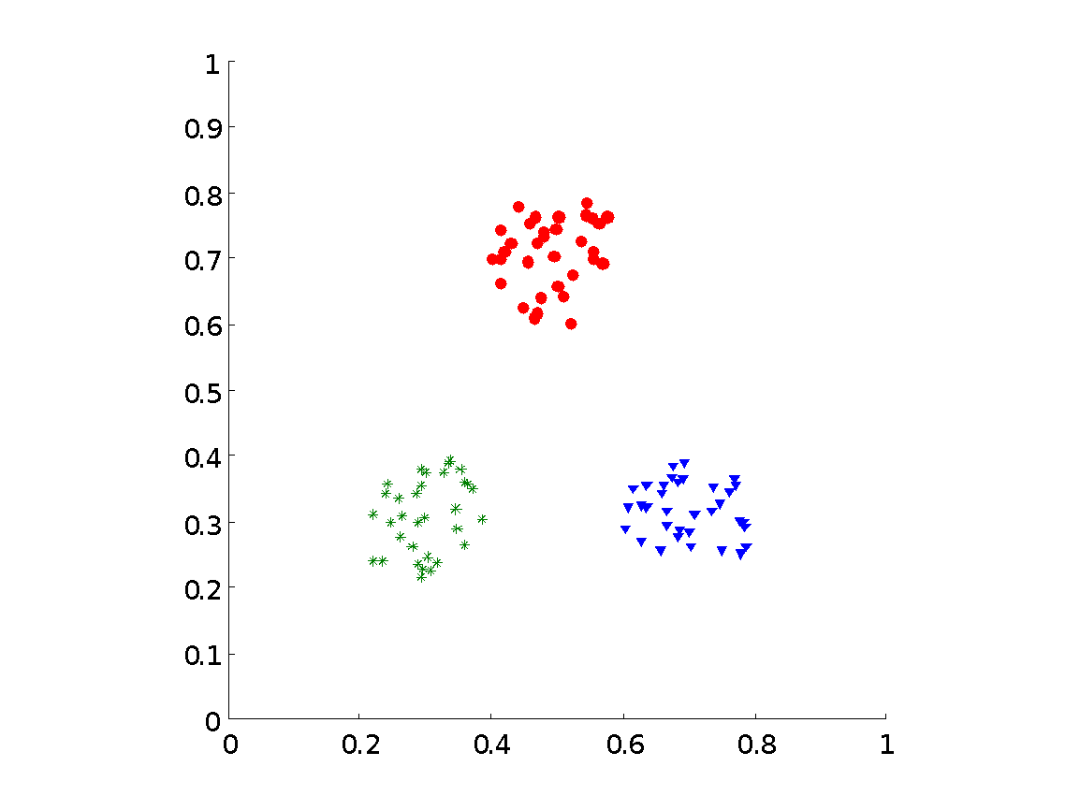
Measuring Cluster Validity Via Correlation
Correlation of incidence and proximity matrices for the K-means clusterings of the following two data sets.
Corr = -0.9235
Corr = -0.5810

Slide 16
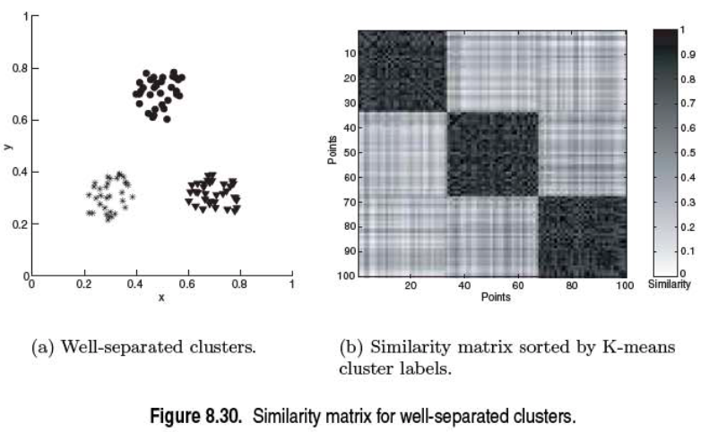
Using Similarity Matrix for Cluster Validation
Order the similarity matrix with respect to cluster labels and inspect visually.

Slide 17
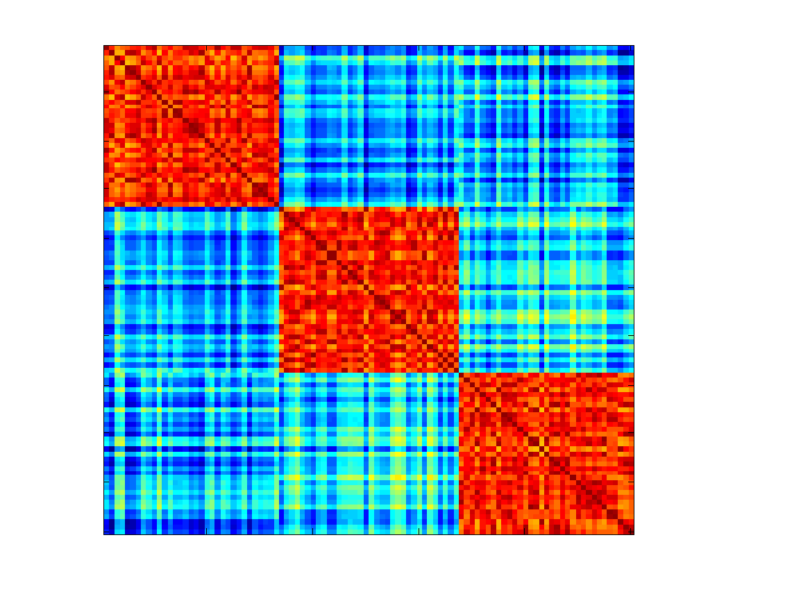
Using Similarity Matrix for Cluster Validation
Order the similarity matrix with respect to cluster labels and inspect visually.

Slide 18
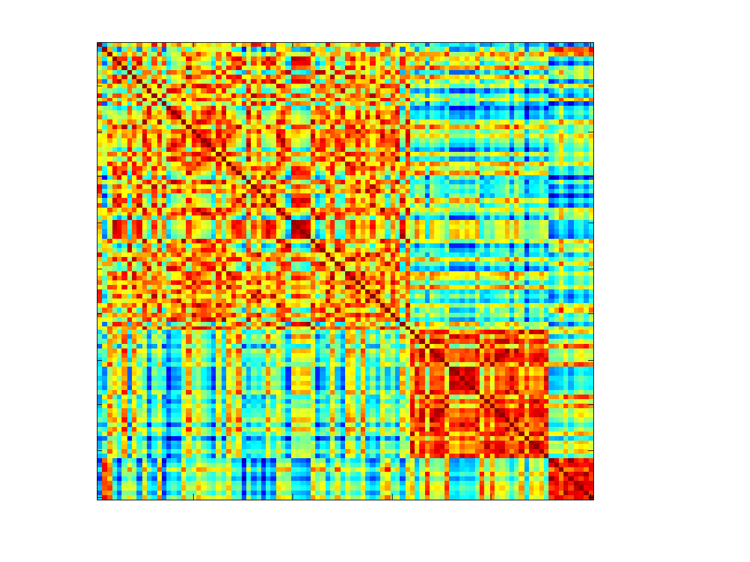
Using Similarity Matrix for Cluster Validation
Clusters in random data are not so crisp
DBSCAN

Slide 19
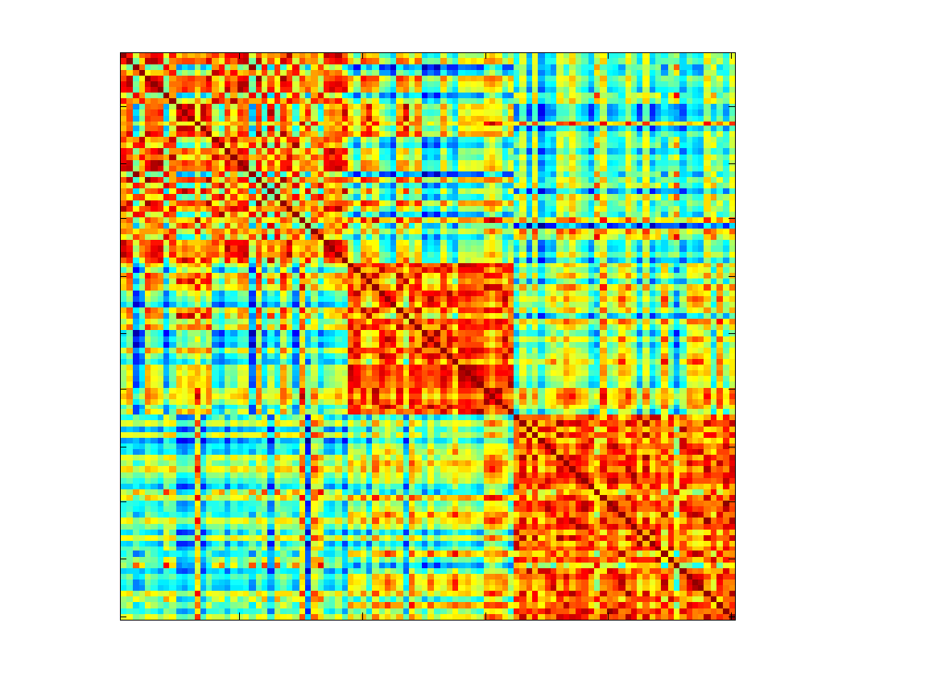
Using Similarity Matrix for Cluster Validation
Clusters in random data are not so crisp
K-means

Slide 20
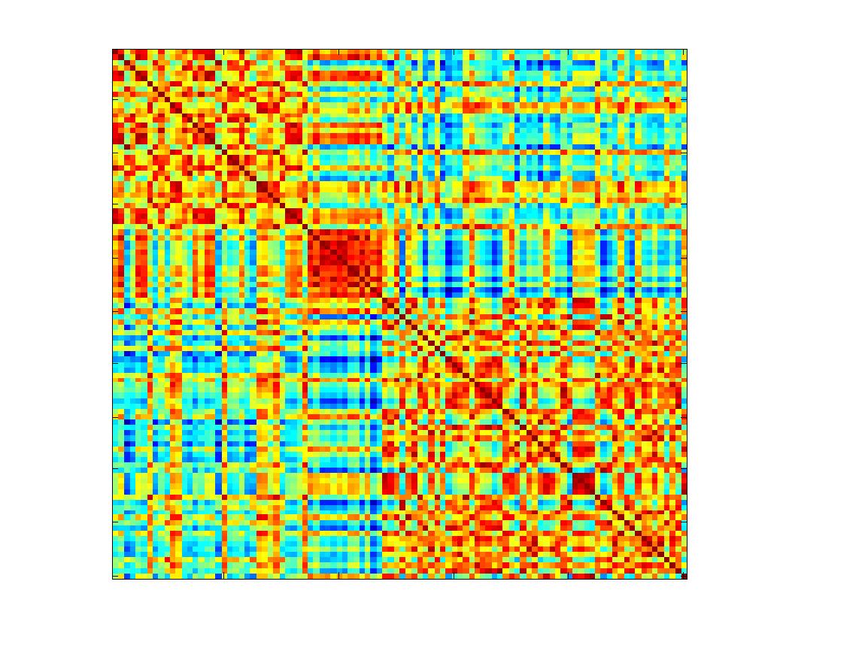
Using Similarity Matrix for Cluster Validation
Clusters in random data are not so crisp
Complete Link

