Slide 1
Data Mining
Classification: Basic Concepts, Decision Trees, and Model Evaluation
Lecture Notes for Chapter 4
Introduction to Data Mining
by
Tan, Steinbach, Kumar
© Tan,Steinbach, Kumar Introduction to Data Mining 4/18/2004 <number>

Slide 2
Practical Issues of Classification
Underfitting and Overfitting

Slide 3
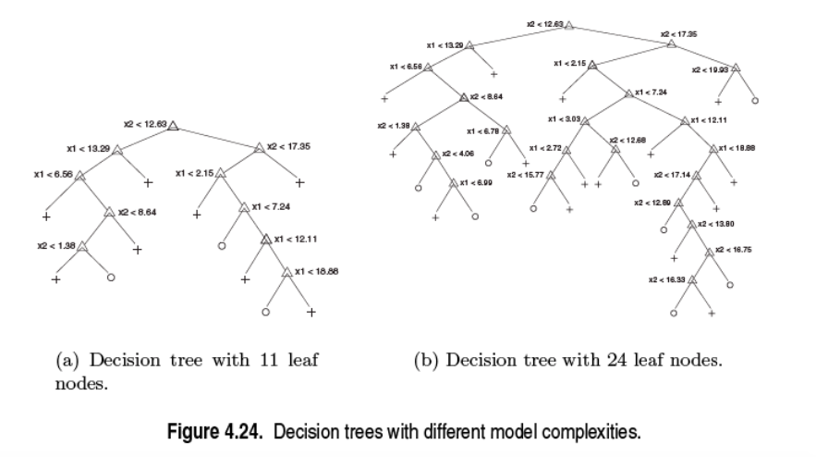

Slide 4
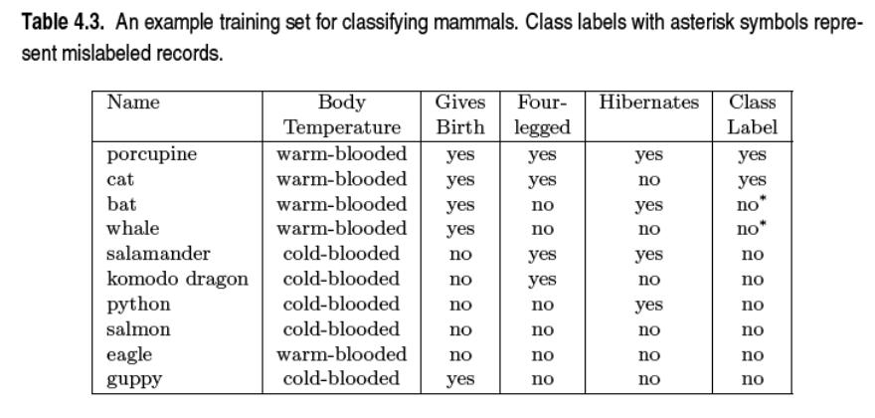
Training Set

Slide 5

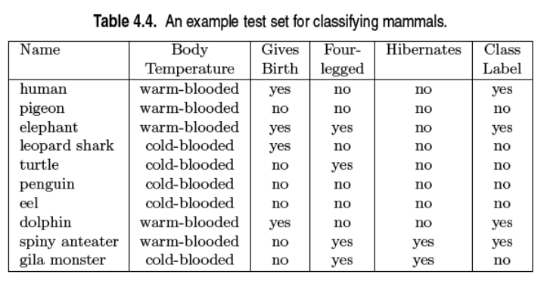
Test Set

Slide 6

Underfitting and Overfitting
Overfitting
Underfitting: when model is too simple, both training and test errors are large

Slide 7

Overfitting due to Noise
Decision boundary is distorted by noise point

Slide 8
Training Set (Noise)

Slide 9
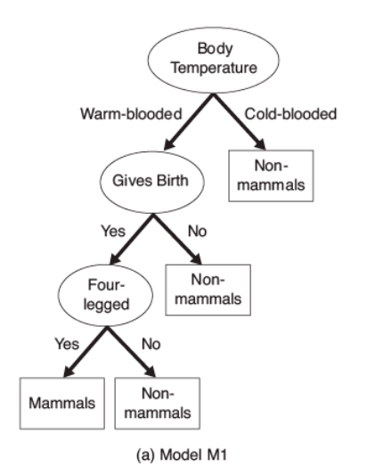
Overfitting Tree

Slide 10
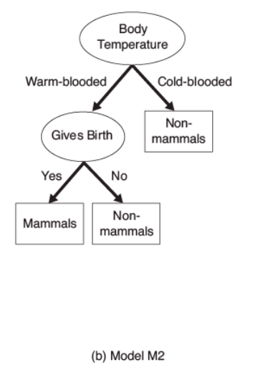

Slide 11

Overfitting due to Insufficient Examples
Lack of data points in the lower half of the diagram makes it difficult to predict correctly the class labels of that region
- Insufficient number of training records in the region causes the decision tree to predict the test examples using other training records that are irrelevant to the classification task

Slide 12
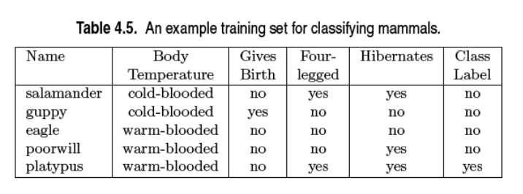
Training Set (Lack of Representative Samples)

Slide 13
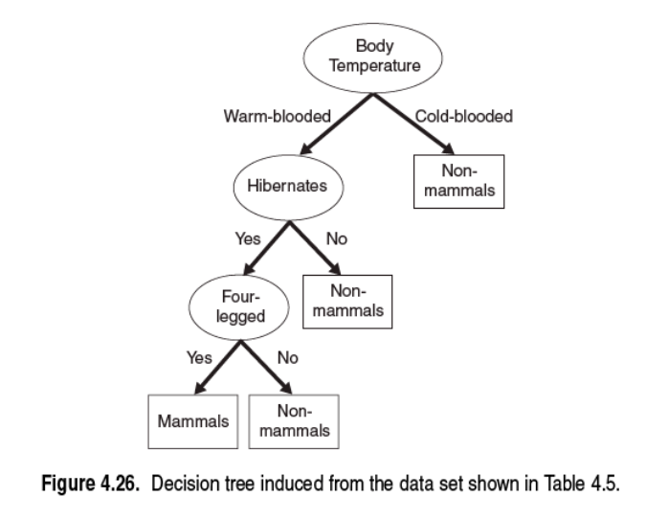
Overfitting Tree

Slide 14
Notes on Overfitting
Overfitting results in decision trees that are more complex than necessary
Training error no longer provides a good estimate of how well the tree will perform on previously unseen records
Need new ways for estimating errors

Slide 15
How to Address Overfitting
Pre-Pruning (Early Stopping Rule)
  Stop the algorithm before it becomes a fully-grown tree
  Full stopping conditions for a node:
    Stop if all instances belong to the same class
    Stop if all the attribute values are the same
  Early Stopping:
    ??
    ??

Slide 16
How to Address Overfitting
Pre-Pruning (Early Stopping Rule)
  Stop the algorithm before it becomes a fully-grown tree
  Full stopping conditions for a node:
    Stop if all instances belong to the same class
    Stop if all the attribute values are the same
  Early Stopping:
    Stop if number of instances is less than some user-specified threshold
    Stop if expanding the current node does not improve impurity
    measures (e.g., Gini or information gain).

Slide 17
How to Address Overfitting
Pre-Pruning (Early Stopping Rule)
  Stop the algorithm before it becomes a fully-grown tree
  Full stopping conditions for a node:
    Stop if all instances belong to the same class
    Stop if all the attribute values are the same
  Early Stopping:
    Stop if number of instances is less than some user-specified threshold
    Stop if expanding the current node does not improve impurity
    measures (e.g., Gini or information gain).
  Advantage and disadvantage:
    ??
    ??

Slide 18
How to Address Overfitting
Pre-Pruning (Early Stopping Rule)
  Early Stopping:
    Stop if number of instances is less than some user-specified threshold
    Stop if expanding the current node does not improve impurity
    measures (e.g., Gini or information gain).
  Advantage:
    Avoid generating overly complex subtrees.
  Disadvantage:
    It is difficult to choose the right threshold.

Slide 19
How to Address Overfitting…
Post-pruning
  Grow decision tree to its entirety
  Trim the nodes of the decision tree in a bottom-up fashion
  How???

Slide 20
How to Address Overfitting…
Post-pruning
  Grow decision tree to its entirety
  Trim the nodes of the decision tree in a bottom-up fashion
  Replace sub-tree by a leaf node or replace subtree by the most frequently used branch of the subtree.

Slide 21
How to Address Overfitting…
Post-pruning
  Grow decision tree to its entirety
  Trim the nodes of the decision tree in a bottom-up fashion
  Replace sub-tree by a leaf node or replace subtree by the most frequently used branch of the subtree.
  Advantage
  ???
Disadvantage
  ???

Slide 22
How to Address Overfitting…
Post-pruning
  Grow decision tree to its entirety
  Trim the nodes of the decision tree in a bottom-up fashion
  Replace sub-tree by a leaf node or replace subtree by the most frequently used branch of the subtree.
  Advantage
  Give better result. Why?
Disadvantage
  May waste additional computations

