Slide 1
Coding Problem
Coding: assignment of bit strings to alphabet characters
Codewords: bit strings assigned for characters of alphabet
Two types of codes:
fixed-length encoding (e.g., ASCII)
variable-length encoding (e,g., Morse code)
Prefix-free codes: no codeword is a prefix of another codeword
Problem: If frequencies of the character occurrences are
known, what is the best binary prefix-free code?
A. Levitin “Introduction to the Design & Analysis of Algorithms,” 3rd ed., Ch. 9 ©2012 Pearson Education, Inc. Upper Saddle River, NJ. All Rights Reserved.

Slide 2

fixed-length encoding (ASCII)
A. Levitin “Introduction to the Design & Analysis of Algorithms,” 3rd ed., Ch. 9 ©2012 Pearson Education, Inc. Upper Saddle River, NJ. All Rights Reserved.

Slide 3
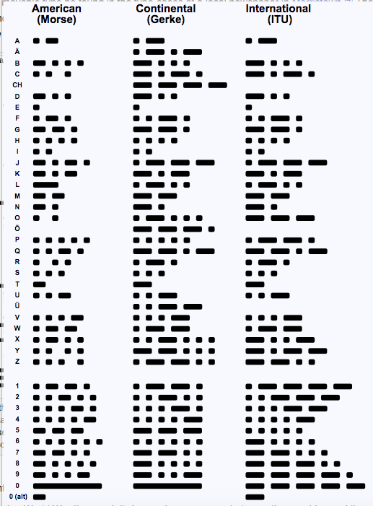
variable-length encoding (Morse code)
A. Levitin “Introduction to the Design & Analysis of Algorithms,” 3rd ed., Ch. 9 ©2012 Pearson Education, Inc. Upper Saddle River, NJ. All Rights Reserved.

Slide 4
Huffman codes
Any binary tree with edges labeled with 0’s and 1’s yields a prefix-free code of characters assigned to its leaves
Optimal binary tree minimizing the expected (weighted average) length of a codeword can be constructed as follows
Huffman’s algorithm
Initialize n one-node trees with alphabet characters and the tree weights with their frequencies.
Repeat the following step n-1 times: join two binary trees with smallest weights into one (as left and right subtrees) and make its weight equal the sum of the weights of the two trees.
Mark edges leading to left and right subtrees with 0’s and 1’s, respectively.
A. Levitin “Introduction to the Design & Analysis of Algorithms,” 3rd ed., Ch. 9 ©2012 Pearson Education, Inc. Upper Saddle River, NJ. All Rights Reserved.

Slide 5
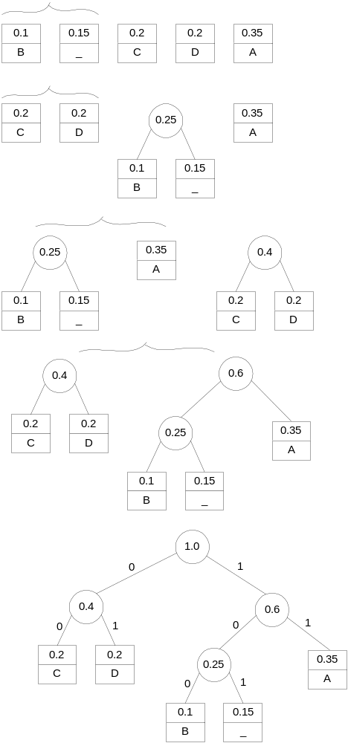
Example
character A B C D _
frequency 0.35 0.1 0.2 0.2 0.15
codeword 11 100 00 01 101
average bits per character: 2.25
for fixed-length encoding: 3
compression ratio: (3-2.25)/3*100% = 25%
A. Levitin “Introduction to the Design & Analysis of Algorithms,” 3rd ed., Ch. 9 ©2012 Pearson Education, Inc. Upper Saddle River, NJ. All Rights Reserved.

Slide 6
character A B C D _
codeword 11 100 00 01 101
DAD is encoded as 011101
BAD_AD ???
A. Levitin “Introduction to the Design & Analysis of Algorithms,” 3rd ed., Ch. 9 ©2012 Pearson Education, Inc. Upper Saddle River, NJ. All Rights Reserved.

Slide 7
In class exercise
character A D E * F
frequency 0.1 0.35 0.1 0.3 0.15
What is Huffman code of DEAF?
A. Levitin “Introduction to the Design & Analysis of Algorithms,” 3rd ed., Ch. 9 ©2012 Pearson Education, Inc. Upper Saddle River, NJ. All Rights Reserved.

