Slide 1
Heaps and Heapsort
Definition A heap is a binary tree with keys at its nodes (one key per node) such that:
It is essentially complete, i.e., all its levels are full except possibly the last level, where only some rightmost keys may be missing
The key at each node is ≥ keys at its children
A. Levitin “Introduction to the Design & Analysis of Algorithms,” 3rd ed., Ch. 6 ©2012 Pearson Education, Inc. Upper Saddle River, NJ. All Rights Reserved.

Slide 2
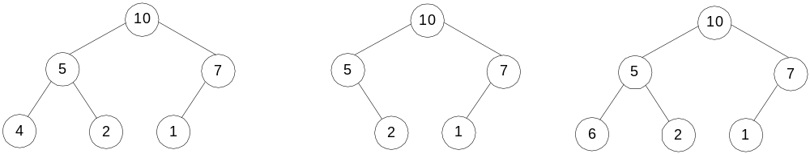
Illustration of the heap’s definition
a heap
not a heap
not a heap
Note: Heap’s elements are ordered top down (along any path
down from its root), but they are not ordered left to right
A. Levitin “Introduction to the Design & Analysis of Algorithms,” 3rd ed., Ch. 6 ©2012 Pearson Education, Inc. Upper Saddle River, NJ. All Rights Reserved.

Slide 3
Some Important Properties of a Heap
Given n, there exists a unique binary tree with n nodes that
is essentially complete, with h = ⎣log₂ n⎦
The root contains the largest key
The subtree rooted at any node of a heap is also a heap
A heap can be represented as an array
A. Levitin “Introduction to the Design & Analysis of Algorithms,” 3rd ed., Ch. 6 ©2012 Pearson Education, Inc. Upper Saddle River, NJ. All Rights Reserved.

Slide 4
Heap’s Array Representation
Store heap’s elements in an array (whose elements indexed, for convenience, 1 to n) in top-down left-to-right order
Example:
Left child of node j is at 2j
Right child of node j is at 2j+1
Parent of node j is at ⎣j/2⎦
Parental nodes are represented in the first ⎣n/2⎦ locations
9
1 2 3 4 5 6
5
3
9 5 3 1 4 2
1
4
2
A. Levitin “Introduction to the Design & Analysis of Algorithms,” 3rd ed., Ch. 6 ©2012 Pearson Education, Inc. Upper Saddle River, NJ. All Rights Reserved.

Slide 5
Heap Construction (bottom-up)
Step 0: Initialize the structure with keys in the order given
Step 1: Starting with the last (rightmost) parental node, fix the heap rooted at it, if it doesn’t satisfy the heap condition: keep exchanging it with its largest child until the heap condition holds
Step 2: Repeat Step 1 for the preceding parental node
A. Levitin “Introduction to the Design & Analysis of Algorithms,” 3rd ed., Ch. 6 ©2012 Pearson Education, Inc. Upper Saddle River, NJ. All Rights Reserved.

Slide 6
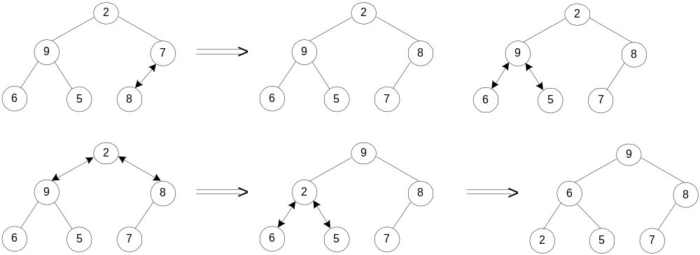
Example of Heap Construction
Construct a heap for the list 2, 9, 7, 6, 5, 8
A. Levitin “Introduction to the Design & Analysis of Algorithms,” 3rd ed., Ch. 6 ©2012 Pearson Education, Inc. Upper Saddle River, NJ. All Rights Reserved.

Slide 7
In class exercise
Construct a max heap for this list: 1, 5, 2, 8, 6, 9
A. Levitin “Introduction to the Design & Analysis of Algorithms,” 3rd ed., Ch. 6 ©2012 Pearson Education, Inc. Upper Saddle River, NJ. All Rights Reserved.

Slide 8
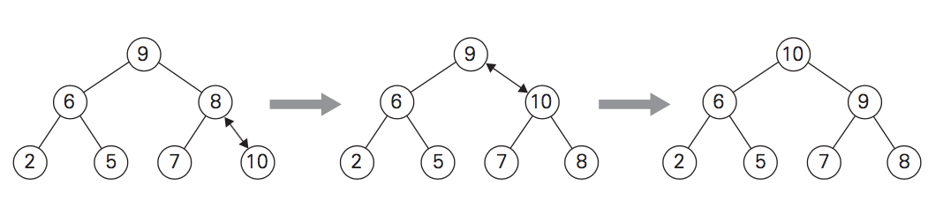
Heap Insertion: top-down
Insert the element into the right-most position.
Keep exchanging this element up until it satisfies the heap condition.
Example: Insert 10
A. Levitin “Introduction to the Design & Analysis of Algorithms,” 3rd ed., Ch. 6 ©2012 Pearson Education, Inc. Upper Saddle River, NJ. All Rights Reserved.

Slide 9
In class exercise
Insert 9 into this heap: 10,8,2,5,6,1,0
A. Levitin “Introduction to the Design & Analysis of Algorithms,” 3rd ed., Ch. 6 ©2012 Pearson Education, Inc. Upper Saddle River, NJ. All Rights Reserved.

Slide 10
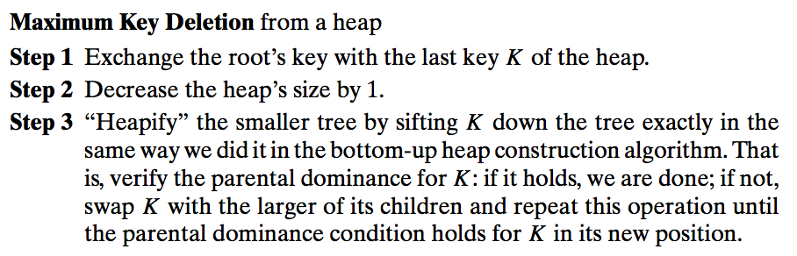
Heap Deletion
A. Levitin “Introduction to the Design & Analysis of Algorithms,” 3rd ed., Ch. 6 ©2012 Pearson Education, Inc. Upper Saddle River, NJ. All Rights Reserved.

Slide 11
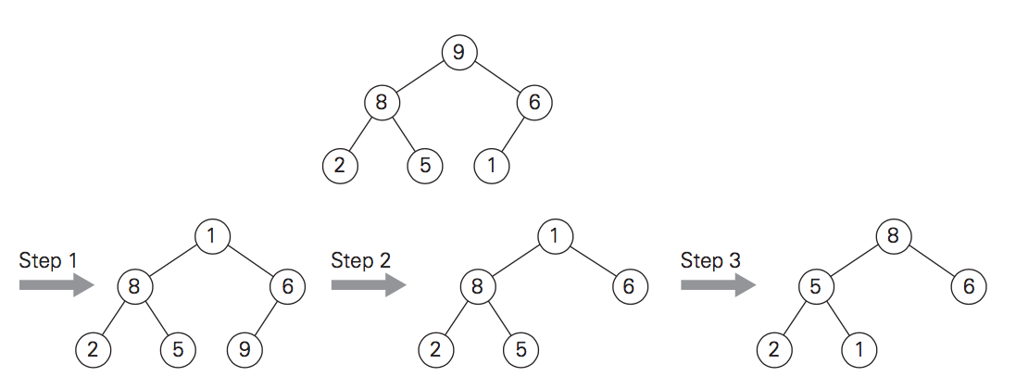
Heap Deletion
Example: delete 9
A. Levitin “Introduction to the Design & Analysis of Algorithms,” 3rd ed., Ch. 6 ©2012 Pearson Education, Inc. Upper Saddle River, NJ. All Rights Reserved.

Slide 12
In class exercise
Delete max root from this heap: 10, 8, 2, 5, 6, 1, 0
A. Levitin “Introduction to the Design & Analysis of Algorithms,” 3rd ed., Ch. 6 ©2012 Pearson Education, Inc. Upper Saddle River, NJ. All Rights Reserved.

Slide 13
Heapsort
Stage 1: Construct a heap for a given list of n keys
Stage 2: Repeat operation of root removal n-1 times:
    Exchange keys in the root and in the last (rightmost) leaf
    Decrease heap size by 1
    If necessary, swap new root with larger child until the heap condition holds
A. Levitin “Introduction to the Design & Analysis of Algorithms,” 3rd ed., Ch. 6 ©2012 Pearson Education, Inc. Upper Saddle River, NJ. All Rights Reserved.

Slide 14
Example of Sorting by Heapsort
Sort the list 2, 9, 7, 6, 5, 8 by heapsort
Stage 1 (heap construction) Stage 2 (root/max removal)
1 9 7 6 5 8 9 6 8 2 5 7
2 9 8 6 5 7 7 6 8 2 5 | 9
2 9 8 6 5 7 8 6 7 2 5 | 9
9 2 8 6 5 7 5 6 7 2 | 8 9
9 6 8 2 5 7 7 6 5 2 | 8 9
2 6 5 | 7 8 9
6 2 5 | 7 8 9
5 2 | 6 7 8 9
5 2 | 6 7 8 9
2 | 5 6 7 8 9
A. Levitin “Introduction to the Design & Analysis of Algorithms,” 3rd ed., Ch. 6 ©2012 Pearson Education, Inc. Upper Saddle River, NJ. All Rights Reserved.

Slide 15
Priority Queue
A priority queue is the ADT of a set of elements with
numerical priorities with the following operations:
  find element with highest priority
  delete element with highest priority
  insert element with assigned priority (see below)
Heap is a very efficient way for implementing priority queues
Two ways to handle priority queue in which
highest priority = smallest number
A. Levitin “Introduction to the Design & Analysis of Algorithms,” 3rd ed., Ch. 6 ©2012 Pearson Education, Inc. Upper Saddle River, NJ. All Rights Reserved.

