Slide 1
Greedy Technique
Constructs a solution to an optimization problem piece by
piece through a sequence of choices that are:
feasible
locally optimal
irrevocable
For some problems, yields an optimal solution for every instance.
For most, does not but can be useful for fast approximations.
A. Levitin “Introduction to the Design & Analysis of Algorithms,” 3rd ed., Ch. 9 ©2012 Pearson Education, Inc. Upper Saddle River, NJ. All Rights Reserved.

Slide 2
Applications of the Greedy Strategy
Optimal solutions:
  change making for “normal” coin denominations
  minimum spanning tree (MST)
  single-source shortest paths
  simple scheduling problems
  Huffman codes
Approximations:
  traveling salesman problem (TSP)
  knapsack problem
  other combinatorial optimization problems
A. Levitin “Introduction to the Design & Analysis of Algorithms,” 3rd ed., Ch. 9 ©2012 Pearson Education, Inc. Upper Saddle River, NJ. All Rights Reserved.

Slide 3
Change-Making Problem
Given unlimited amounts of coins of denominations d₁ > … > d_{m} ,
give change for amount n with the least number of coins
Example: d₁ = 25c, d₂ =10c, d₃ = 5c, d₄ = 1c and n = 48c
Greedy solution:
Greedy solution is
optimal for any amount and “normal’’ set of denominations
may not be optimal for arbitrary coin denominations
A. Levitin “Introduction to the Design & Analysis of Algorithms,” 3rd ed., Ch. 9 ©2012 Pearson Education, Inc. Upper Saddle River, NJ. All Rights Reserved.

Slide 4
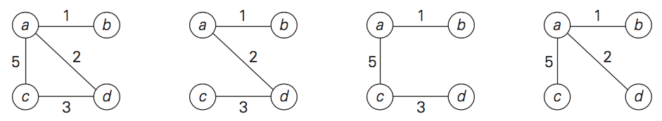
Minimum Spanning Tree (MST)
Spanning tree of a connected graph G: a connected acyclic subgraph of G that includes all of G’s vertices
Minimum spanning tree of a weighted, connected graph G: a spanning tree of G of minimum total weight
A. Levitin “Introduction to the Design & Analysis of Algorithms,” 3rd ed., Ch. 9 ©2012 Pearson Education, Inc. Upper Saddle River, NJ. All Rights Reserved.

Slide 5
Prim’s MST algorithm
Start with tree T₁ consisting of one (any) vertex and “grow” tree one vertex at a time to produce MST through a series of expanding subtrees T₁, T₂, …, T_{n}
On each iteration, construct T_{i+1} from T_{i} by adding vertex not in T_{i} that is closest to those already in T_{i} (this is a “greedy” step!)
Stop when all vertices are included
A. Levitin “Introduction to the Design & Analysis of Algorithms,” 3rd ed., Ch. 9 ©2012 Pearson Education, Inc. Upper Saddle River, NJ. All Rights Reserved.

Slide 6
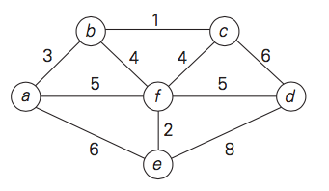
Example
A. Levitin “Introduction to the Design & Analysis of Algorithms,” 3rd ed., Ch. 9 ©2012 Pearson Education, Inc. Upper Saddle River, NJ. All Rights Reserved.

Slide 7
Practice
4
c
a
1
6
2
d
b
3
A. Levitin “Introduction to the Design & Analysis of Algorithms,” 3rd ed., Ch. 9 ©2012 Pearson Education, Inc. Upper Saddle River, NJ. All Rights Reserved.

Slide 8
Notes about Prim’s algorithm
Proof by induction that this construction actually yields MST
Needs priority queue for locating closest fringe vertex
Efficiency
  O(n²) for weight matrix representation of graph and array implementation of priority queue
  O(m log n) for adjacency list representation of graph with n vertices and m edges and min-heap implementation of priority queue
A. Levitin “Introduction to the Design & Analysis of Algorithms,” 3rd ed., Ch. 9 ©2012 Pearson Education, Inc. Upper Saddle River, NJ. All Rights Reserved.

Slide 9
Another greedy algorithm for MST: Kruskal’s
Sort the edges in nondecreasing order of lengths
“Grow” tree one edge at a time to produce MST through a series of expanding forests F₁, F₂, …, F_{n-1}
On each iteration, add the next edge on the sorted list unless this would create a cycle. (If it would, skip the edge.)
A. Levitin “Introduction to the Design & Analysis of Algorithms,” 3rd ed., Ch. 9 ©2012 Pearson Education, Inc. Upper Saddle River, NJ. All Rights Reserved.

Slide 10
Example
A. Levitin “Introduction to the Design & Analysis of Algorithms,” 3rd ed., Ch. 9 ©2012 Pearson Education, Inc. Upper Saddle River, NJ. All Rights Reserved.

Slide 11
Practice
4
c
a
1
6
2
d
b
3
A. Levitin “Introduction to the Design & Analysis of Algorithms,” 3rd ed., Ch. 9 ©2012 Pearson Education, Inc. Upper Saddle River, NJ. All Rights Reserved.

Slide 12
Notes about Kruskal’s algorithm
Algorithm looks easier than Prim’s but is harder to implement (checking for cycles!)
Cycle checking: a cycle is created iff added edge connects vertices in the same connected component
Union-find algorithms
A. Levitin “Introduction to the Design & Analysis of Algorithms,” 3rd ed., Ch. 9 ©2012 Pearson Education, Inc. Upper Saddle River, NJ. All Rights Reserved.

Slide 13
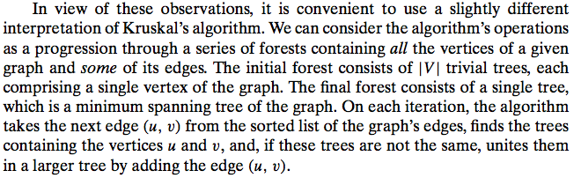
A. Levitin “Introduction to the Design & Analysis of Algorithms,” 3rd ed., Ch. 9 ©2012 Pearson Education, Inc. Upper Saddle River, NJ. All Rights Reserved.

Slide 14
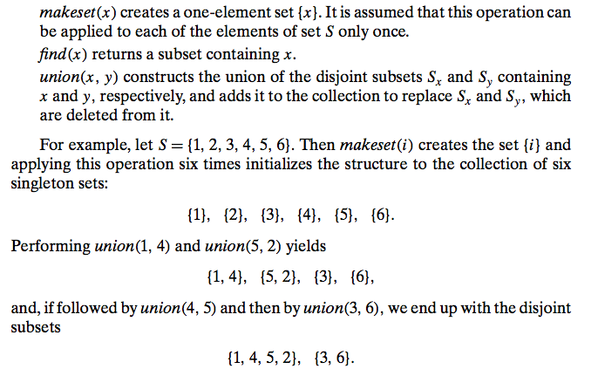
A. Levitin “Introduction to the Design & Analysis of Algorithms,” 3rd ed., Ch. 9 ©2012 Pearson Education, Inc. Upper Saddle River, NJ. All Rights Reserved.

Slide 15
Shortest paths – Dijkstra’s algorithm
Single Source Shortest Paths Problem: Given a weighted
connected graph G, find shortest paths from source vertex s
to each of the other vertices
Dijkstra’s algorithm: Similar to Prim’s MST algorithm, with
a different way of computing numerical labels: Among vertices
not already in the tree, it finds vertex u with the smallest sum
d_{v} + w(v,u)
where
v is a vertex for which shortest path has been already found
on preceding iterations (such vertices form a tree)
d_{v} is the length of the shortest path form source to v
w(v,u) is the length (weight) of edge from v to u
A. Levitin “Introduction to the Design & Analysis of Algorithms,” 3rd ed., Ch. 9 ©2012 Pearson Education, Inc. Upper Saddle River, NJ. All Rights Reserved.

Slide 16
Example
b
4
c
3
6
7
2
5
4
a
d
d
e
Tree vertices Remaining vertices
a(-,0) b(a,3) c(-,∞) d(a,7) e(-,∞)
4
b
c
3
2
6
5
a
7
d
4
e
b(a,3) c(b,3+4) d(b,3+2) e(-,∞)
b
4
c
3
6
2
5
a
7
d
4
e
d(b,5) c(b,7) e(d,5+4)
b
4
c
3
6
2
5
a
7
d
4
e
c(b,7) e(d,9)
4
b
c
3
6
2
5
a
7
d
4
e
e(d,9)
A. Levitin “Introduction to the Design & Analysis of Algorithms,” 3rd ed., Ch. 9 ©2012 Pearson Education, Inc. Upper Saddle River, NJ. All Rights Reserved.

Slide 17
Notes on Dijkstra’s algorithm
Doesn’t work for graphs with negative weights
Applicable to both undirected and directed graphs
Efficiency
  O(|V|²) for graphs represented by weight matrix and array implementation of priority queue
  O(|E|log|V|) for graphs represented by adj. lists and min-heap implementation of priority queue
Don’t mix up Dijkstra’s algorithm with Prim’s algorithm!
A. Levitin “Introduction to the Design & Analysis of Algorithms,” 3rd ed., Ch. 9 ©2012 Pearson Education, Inc. Upper Saddle River, NJ. All Rights Reserved.

