Slide 1
Dynamic Programming
Dynamic Programming is a general algorithm design technique
for solving problems defined by recurrences with overlapping
subproblems
Invented by American mathematician Richard Bellman in the 1950s to solve optimization problems and later assimilated by CS
“Programming” here means “planning”
Main idea:
    set up a recurrence relating a solution to a larger instance to solutions of some smaller instances
    - solve smaller instances once
    record solutions in a table
    extract solution to the initial instance from that table
A. Levitin “Introduction to the Design & Analysis of Algorithms,” 3rd ed., Ch. 8 ©2012 Pearson Education, Inc. Upper Saddle River, NJ. All Rights Reserved.

Slide 2
Example 1: Fibonacci numbers
Recall definition of Fibonacci numbers:
  F(n) = F(n-1) + F(n-2)
  F(0) = 0
  F(1) = 1
Computing the n^{th} Fibonacci number recursively (top-down):
F(n)
F(n-1) + F(n-2)
F(n-2) + F(n-3) F(n-3) + F(n-4)
...
A. Levitin “Introduction to the Design & Analysis of Algorithms,” 3rd ed., Ch. 8 ©2012 Pearson Education, Inc. Upper Saddle River, NJ. All Rights Reserved.

Slide 3
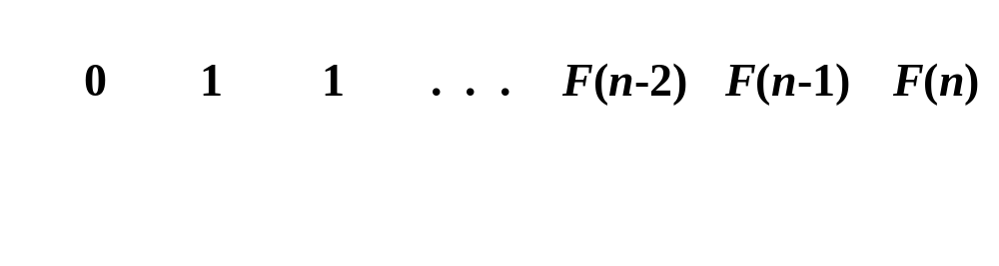
Example 1: Fibonacci numbers (cont.)
  Computing the n^{th} Fibonacci number using bottom-up iteration and recording results:
F(0) = 0
F(1) = 1
F(2) = 1+0 = 1
…
F(n-2) =
F(n-1) =
F(n) = F(n-1) + F(n-2)
Efficiency:
- time
- space
A. Levitin “Introduction to the Design & Analysis of Algorithms,” 3rd ed., Ch. 8 ©2012 Pearson Education, Inc. Upper Saddle River, NJ. All Rights Reserved.

Slide 4
Example 2: Coin-row problem
There is a row of n coins whose values are some positive integers c₁, c₂,...,c_{n}, not necessarily distinct. The goal is to pick up the maximum amount of money subject to the constraint that no two coins adjacent in the initial row can be picked up.
E.g.: 5, 1, 2, 10, 6, 2. What is the best selection?
A. Levitin “Introduction to the Design & Analysis of Algorithms,” 3rd ed., Ch. 8 ©2012 Pearson Education, Inc. Upper Saddle River, NJ. All Rights Reserved.

Slide 5
DP solution to the coin-row problem
Let F(n) be the maximum amount that can be picked up from the row of n coins. To derive a recurrence for F(n), we partition all the allowed coin selections into two groups:
those without last coin – the max amount is ?
those with the last coin -- the max amount is ?
A. Levitin “Introduction to the Design & Analysis of Algorithms,” 3rd ed., Ch. 8 ©2012 Pearson Education, Inc. Upper Saddle River, NJ. All Rights Reserved.

Slide 6
DP solution to the coin-row problem
Let F(n) be the maximum amount that can be picked up from the row of n coins. To derive a recurrence for F(n), we partition all the allowed coin selections into two groups:
those without last coin – the max amount is ?
those with the last coin -- the max amount is ?
Thus we have the following recurrence
F(n) = max{c_{n} + F(n-2), F(n-1)} for n > 1,
F(0) = 0, F(1)=c₁
A. Levitin “Introduction to the Design & Analysis of Algorithms,” 3rd ed., Ch. 8 ©2012 Pearson Education, Inc. Upper Saddle River, NJ. All Rights Reserved.

Slide 7
DP solution to the coin-row problem (cont.)
F(n) = max{c_{n} + F(n-2), F(n-1)} for n > 1,
F(0) = 0, F(1)=c₁
index | 0 | 1 | 2 | 3 | 4 | 5 | 6
coins | -- | 5 | 1 | 2 | 10 | 6 | 2
F( )
Max amount:
Coins of optimal solution:
Time efficiency:
Space efficiency:
Note: All smaller instances were solved.
A. Levitin “Introduction to the Design & Analysis of Algorithms,” 3rd ed., Ch. 8 ©2012 Pearson Education, Inc. Upper Saddle River, NJ. All Rights Reserved.

Slide 8
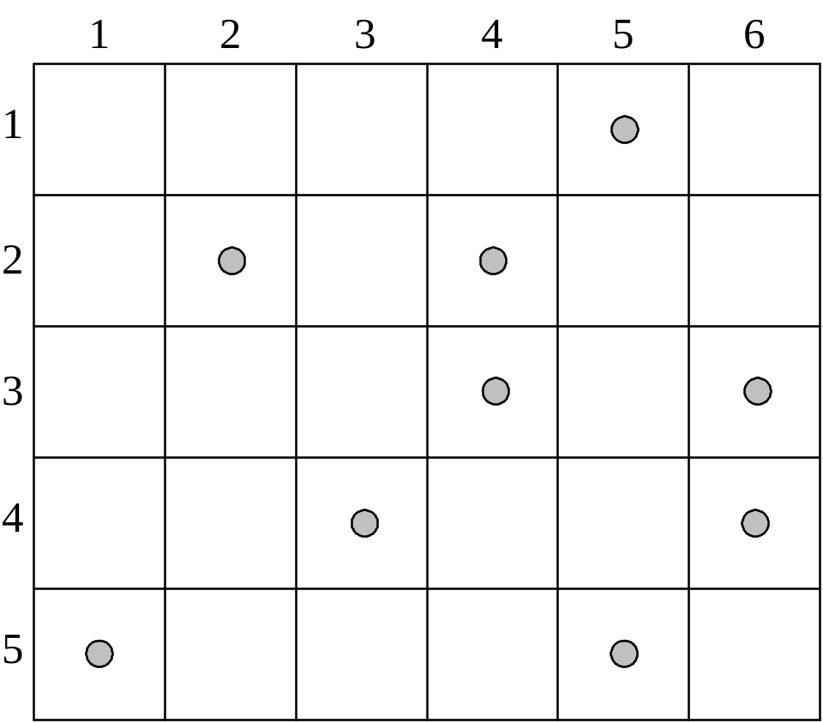
Example 3: Coin-collecting by robot
Several coins are placed in cells of an n×m board. A robot, located in the upper left cell of the board, needs to collect as many of the coins as possible and bring them to the bottom right cell. On each step, the robot can move either one cell to the right or one cell down from its current location.
A. Levitin “Introduction to the Design & Analysis of Algorithms,” 3rd ed., Ch. 8 ©2012 Pearson Education, Inc. Upper Saddle River, NJ. All Rights Reserved.

Slide 9
Solution to the coin-collecting problem
Let F(i,j) be the largest number of coins the robot can collect and bring to cell (i,j) in the ith row and jth column.
The largest number of coins that can be brought to cell (i,j):
from the left neighbor ?
from the neighbor above?
A. Levitin “Introduction to the Design & Analysis of Algorithms,” 3rd ed., Ch. 8 ©2012 Pearson Education, Inc. Upper Saddle River, NJ. All Rights Reserved.

Slide 10
Solution to the coin-collecting problem
Let F(i,j) be the largest number of coins the robot can collect and bring to cell (i,j) in the ith row and jth column.
The largest number of coins that can be brought to cell (i,j):
from the left neighbor ?
from the neighbor above?
The recurrence:
F(i, j) = max{F(i-1, j), F(i, j-1)} + c_{ij} for 1 ≤ i ≤ n, 1 ≤ j ≤ m
where c_{ij} = 1 if there is a coin in cell (i,j), and c_{ij} = 0 otherwise
F(0, j) = 0 for 1 ≤ j ≤ m and F(i, 0) = 0 for 1 ≤ i ≤ n.
A. Levitin “Introduction to the Design & Analysis of Algorithms,” 3rd ed., Ch. 8 ©2012 Pearson Education, Inc. Upper Saddle River, NJ. All Rights Reserved.

Slide 11
Solution to the coin-collecting problem (cont.)
F(i, j) = max{F(i-1, j), F(i, j-1)} + c_{ij} for 1 ≤ i ≤ n, 1 ≤ j ≤ m
where c_{ij} = 1 if there is a coin in cell (i,j), and c_{ij} = 0 otherwise
F(0, j) = 0 for 1 ≤ j ≤ m and F(i, 0) = 0 for 1 ≤ i ≤ n.
A. Levitin “Introduction to the Design & Analysis of Algorithms,” 3rd ed., Ch. 8 ©2012 Pearson Education, Inc. Upper Saddle River, NJ. All Rights Reserved.

Slide 12
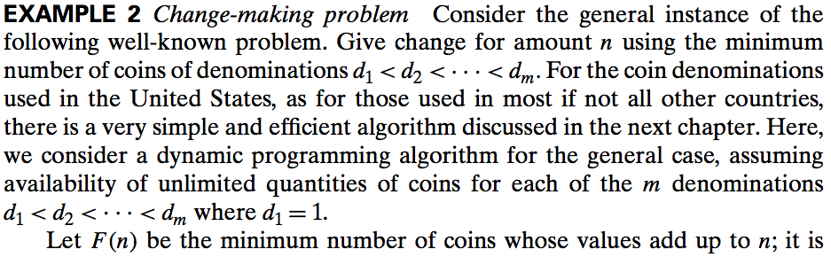
Example 4: Change-making problem
A. Levitin “Introduction to the Design & Analysis of Algorithms,” 3rd ed., Ch. 8 ©2012 Pearson Education, Inc. Upper Saddle River, NJ. All Rights Reserved.

Slide 13
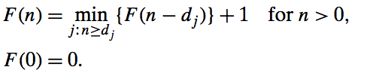
Example:
A. Levitin “Introduction to the Design & Analysis of Algorithms,” 3rd ed., Ch. 8 ©2012 Pearson Education, Inc. Upper Saddle River, NJ. All Rights Reserved.

Slide 14
Knapsack Problem by DP
Given n items of
  integer weights: w₁ w₂ … w_{n}
  values: v₁ v₂ … v_{n}
a knapsack of integer capacity W
find most valuable subset of the items that fit into the knapsack
A. Levitin “Introduction to the Design & Analysis of Algorithms,” 3rd ed., Ch. 8 ©2012 Pearson Education, Inc. Upper Saddle River, NJ. All Rights Reserved.

Slide 15
Knapsack Problem by DP
Given n items of
  integer weights: w₁ w₂ … w_{n}
  values: v₁ v₂ … v_{n}
a knapsack of integer capacity W
find most valuable subset of the items that fit into the knapsack
Consider instance defined by first i items and capacity j (j ≤ W).
Let V[i,j] be optimal value of such instance. Then
max {V[i-1,j], v_{i} + V[i-1,j- w_{i}]} if j- w_{i} ≥ 0
V[i,j] =
V[i-1,j] if j- w_{i} < 0
Initial conditions: V[0,j] = 0 and V[i,0] = 0
A. Levitin “Introduction to the Design & Analysis of Algorithms,” 3rd ed., Ch. 8 ©2012 Pearson Education, Inc. Upper Saddle River, NJ. All Rights Reserved.

Slide 16
Knapsack Problem by DP (example)
Example: Knapsack of capacity W = 5
item weight value
1 2 $12
2 1 $10
3 3 $20
4 2 $15 capacity j
0 1 2 3 4 5
0
w₁ = 2, v₁= 12 1
w₂ = 1, v₂= 10 2
w₃ = 3, v₃= 20 3
w₄ = 2, v₄= 15 4 ?
A. Levitin “Introduction to the Design & Analysis of Algorithms,” 3rd ed., Ch. 8 ©2012 Pearson Education, Inc. Upper Saddle River, NJ. All Rights Reserved.

Slide 17
Floyd’s Algorithm: All pairs shortest paths
Problem: In a weighted (di)graph, find shortest paths between
every pair of vertices
Same idea: construct solution through series of matrices D⁽⁰⁾, …,
D ^{(n)} using increasing subsets of the vertices allowed
as intermediate
Example:
4
3
1
1
6
1
5
4
2
3
A. Levitin “Introduction to the Design & Analysis of Algorithms,” 3rd ed., Ch. 8 ©2012 Pearson Education, Inc. Upper Saddle River, NJ. All Rights Reserved.

Slide 18
Floyd’s Algorithm (matrix generation)
On the k-th iteration, the algorithm determines shortest paths between every pair of vertices i, j that use only vertices among 1,…,k as intermediate
D^{(k)}[i,j] = min {D^{(k-1)}[i,j], D^{(k-1)}[i,k] + D^{(k-1)}[k,j]}
D^{(k-1)}[i,k]
k
i
D^{(k-1)}[k,j]
D^{(k-1)}[i,j]
j
A. Levitin “Introduction to the Design & Analysis of Algorithms,” 3rd ed., Ch. 8 ©2012 Pearson Education, Inc. Upper Saddle River, NJ. All Rights Reserved.

Slide 19
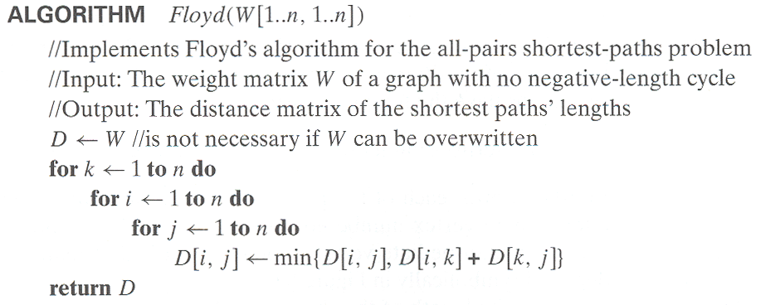
Floyd’s Algorithm (pseudocode and analysis)
Time efficiency: Θ(n³)
Space efficiency: Matrices can be written over their predecessors
Note: Shortest paths themselves can be found, too (Problem 10)
A. Levitin “Introduction to the Design & Analysis of Algorithms,” 3rd ed., Ch. 8 ©2012 Pearson Education, Inc. Upper Saddle River, NJ. All Rights Reserved.

Slide 20
Floyd’s Algorithm (example)
2
1
2
0 ∞ 3 ∞ 2 0 ∞ ∞
∞ 7 0 1
6 ∞ ∞ 0
0 ∞ 3 ∞
2 0 5 ∞
∞ 7 0 1
6 ∞ 9 0
3
6
7
D⁽⁰⁾ ⁼
D⁽¹⁾ ⁼
3
1
4
A. Levitin “Introduction to the Design & Analysis of Algorithms,” 3rd ed., Ch. 8 ©2012 Pearson Education, Inc. Upper Saddle River, NJ. All Rights Reserved.

Slide 21
Floyd’s Algorithm (example)
2
1
2
0 ∞ 3 ∞ 2 0 ∞ ∞
∞ 7 0 1
6 ∞ ∞ 0
0 ∞ 3 ∞
2 0 5 ∞
∞ 7 0 1
6 ∞ 9 0
3
6
7
D⁽⁰⁾ ⁼
D⁽¹⁾ ⁼
3
1
4
0 ∞ 3 ∞
2 0 5 ∞
9 7 0 1
6 ∞ 9 0
0 10 3 4
2 0 5 6
9 7 0 1
6 16 9 0
0 10 3 4
2 0 5 6
7 7 0 1
6 16 9 0
D⁽²⁾ ⁼
D⁽³⁾ ⁼
D⁽⁴⁾ ⁼
A. Levitin “Introduction to the Design & Analysis of Algorithms,” 3rd ed., Ch. 8 ©2012 Pearson Education, Inc. Upper Saddle River, NJ. All Rights Reserved.

Slide 22
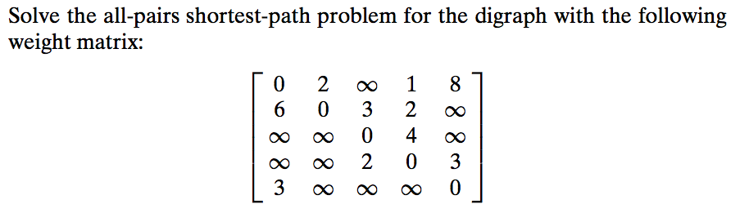
A. Levitin “Introduction to the Design & Analysis of Algorithms,” 3rd ed., Ch. 8 ©2012 Pearson Education, Inc. Upper Saddle River, NJ. All Rights Reserved.

