Slide 1
Exact Solution Strategies
exhaustive search (brute force)
  useful only for small instances
backtracking
  eliminates some unnecessary cases from consideration
  yields solutions in reasonable time for many instances but worst case is still exponential
branch-and-bound
  further refines the backtracking idea for optimization problems
A. Levitin “Introduction to the Design & Analysis of Algorithms,” 3rd ed., Ch. 12 ©2012 Pearson Education, Inc. Upper Saddle River, NJ. All Rights Reserved.

Slide 2
Backtracking
Construct the state-space tree
  nodes: partial solutions
    Promising node? Nonpromising node?
  edges: choices in extending partial solutions
DFS or BFS?
“Prune” nonpromising nodes
  stop exploring subtrees rooted at nodes that cannot lead to a solution and backtracks to such a node’s parent to continue the search
A. Levitin “Introduction to the Design & Analysis of Algorithms,” 3rd ed., Ch. 12 ©2012 Pearson Education, Inc. Upper Saddle River, NJ. All Rights Reserved.

Slide 3
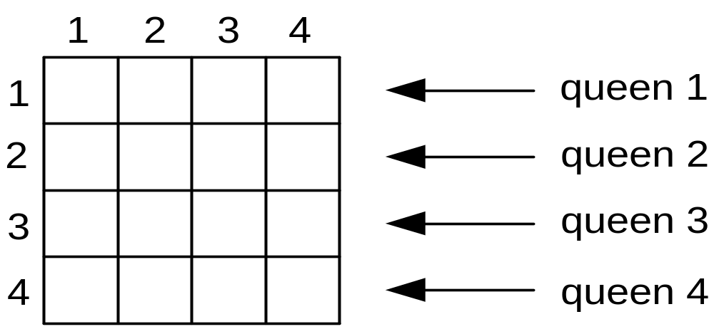
Example: n-Queens Problem
Place n queens on an n-by-n chess board so that no two of them are in the same row, column, or diagonal
A. Levitin “Introduction to the Design & Analysis of Algorithms,” 3rd ed., Ch. 12 ©2012 Pearson Education, Inc. Upper Saddle River, NJ. All Rights Reserved.

Slide 4
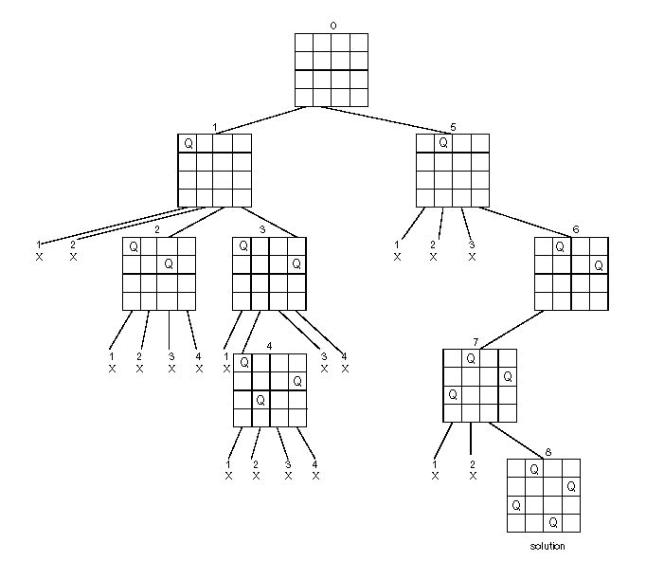
State-Space Tree of the 4-Queens Problem
A. Levitin “Introduction to the Design & Analysis of Algorithms,” 3rd ed., Ch. 12 ©2012 Pearson Education, Inc. Upper Saddle River, NJ. All Rights Reserved.

Slide 5
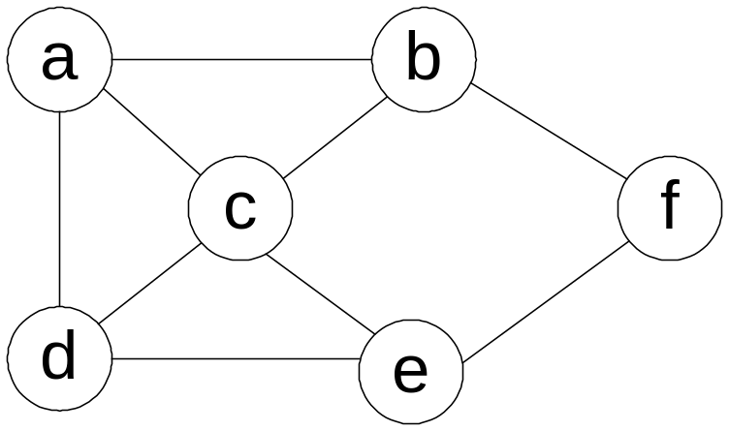
Example: Hamiltonian Circuit Problem
In the mathematical field of graph theory, a Hamiltonian path (or traceable path) is a path in an undirected or directed graph that visits each vertex exactly once. A Hamiltonian cycle(or Hamiltonian circuit) is a Hamiltonian path that is a cycle.
A. Levitin “Introduction to the Design & Analysis of Algorithms,” 3rd ed., Ch. 12 ©2012 Pearson Education, Inc. Upper Saddle River, NJ. All Rights Reserved.

Slide 6
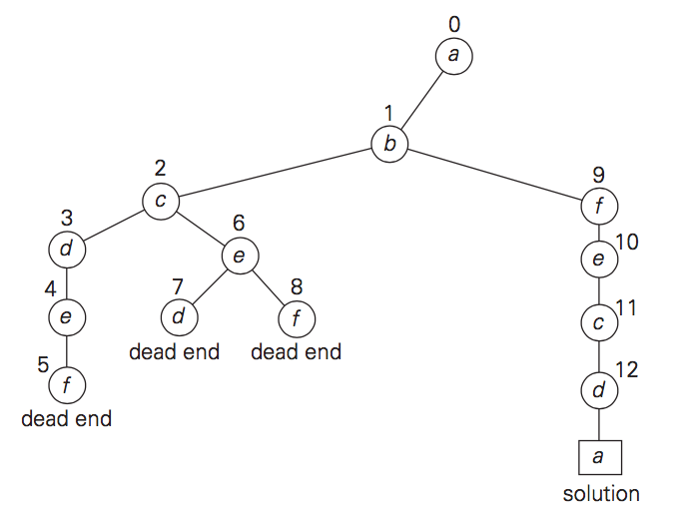

Slide 7
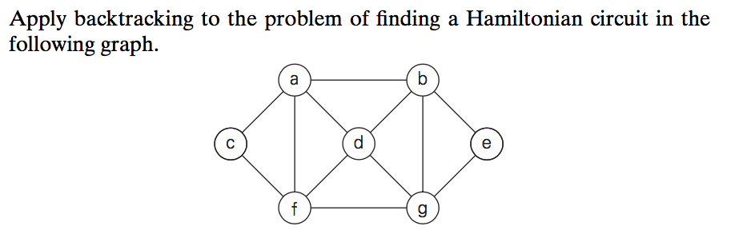

Slide 8
Subset-Sum Problem
we consider the subset-sum problem: find a subset of a given set A = {a1, . . . , an} of n positive integers whose sum is equal to a given positive integer d. For example, for A = {1, 2, 5, 6, 8} and d = 9, there are two solutions: {1, 2, 6} and {1, 8}. Of course, some instances of this problem may have no solutions.
A. Levitin “Introduction to the Design & Analysis of Algorithms,” 3rd ed., Ch. 12 ©2012 Pearson Education, Inc. Upper Saddle River, NJ. All Rights Reserved.

Slide 9
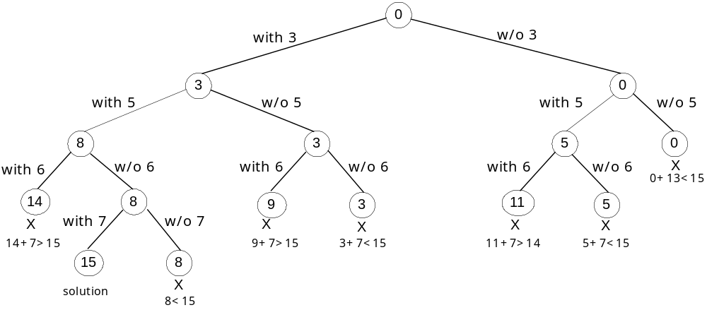
A. Levitin “Introduction to the Design & Analysis of Algorithms,” 3rd ed., Ch. 12 ©2012 Pearson Education, Inc. Upper Saddle River, NJ. All Rights Reserved.

Slide 10
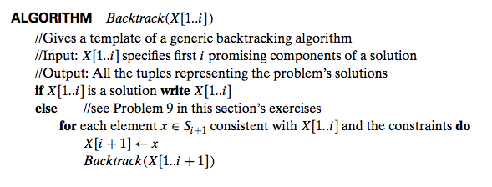
A. Levitin “Introduction to the Design & Analysis of Algorithms,” 3rd ed., Ch. 12 ©2012 Pearson Education, Inc. Upper Saddle River, NJ. All Rights Reserved.

Slide 11
Branch-and-Bound
An enhancement of backtracking
Applicable to optimization problems
For each node (partial solution) of a state-space tree, computes a bound on the value of the objective function for all descendants of the node (extensions of the partial solution)
Uses the bound for:
  ruling out certain nodes as “nonpromising” to prune the tree – if a node’s bound is not better than the best solution seen so far
  guiding the search through state-space
A. Levitin “Introduction to the Design & Analysis of Algorithms,” 3rd ed., Ch. 12 ©2012 Pearson Education, Inc. Upper Saddle River, NJ. All Rights Reserved.

Slide 12
Bound:
  Minimization: lower bound
  Maximization: upper bound
Define Bound:
  Bound of all data
  Bound including some data
A. Levitin “Introduction to the Design & Analysis of Algorithms,” 3rd ed., Ch. 12 ©2012 Pearson Education, Inc. Upper Saddle River, NJ. All Rights Reserved.

Slide 13
Example: Assignment Problem
Select one element in each row of the cost matrix C so that:
no two selected elements are in the same column
the sum is minimized
Example
Job 1 Job 2 Job 3 Job 4
Person a 9 2 7 8
Person b 6 4 3 7
Person c 5 8 1 8
Person d 7 6 9 4
A. Levitin “Introduction to the Design & Analysis of Algorithms,” 3rd ed., Ch. 12 ©2012 Pearson Education, Inc. Upper Saddle River, NJ. All Rights Reserved.

Slide 14
Example: Assignment Problem
Select one element in each row of the cost matrix C so that:
no two selected elements are in the same column
the sum is minimized
Example
Job 1 Job 2 Job 3 Job 4
Person a 9 2 7 8
Person b 6 4 3 7
Person c 5 8 1 8
Person d 7 6 9 4
Lower bound: Any solution to this problem will have total cost
at least: 2 + 3 + 1 + 4 (or 5 + 2 + 1 + 4)
A. Levitin “Introduction to the Design & Analysis of Algorithms,” 3rd ed., Ch. 12 ©2012 Pearson Education, Inc. Upper Saddle River, NJ. All Rights Reserved.

Slide 15
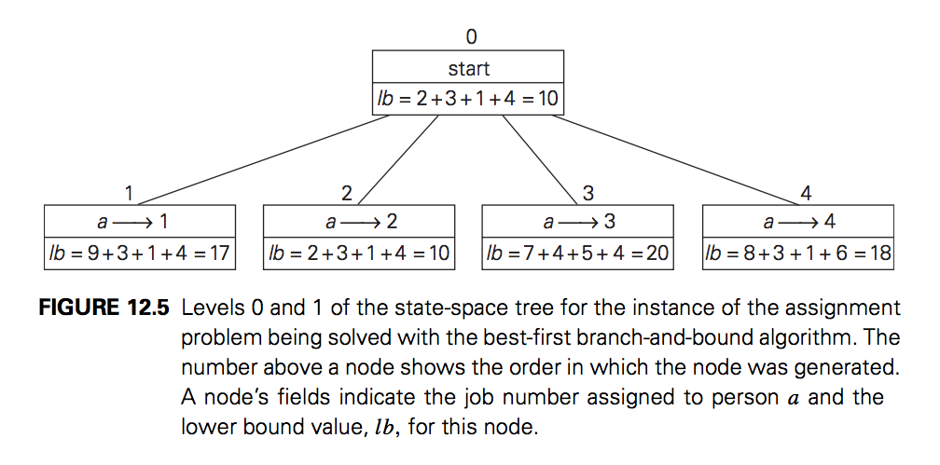
A. Levitin “Introduction to the Design & Analysis of Algorithms,” 3rd ed., Ch. 12 ©2012 Pearson Education, Inc. Upper Saddle River, NJ. All Rights Reserved.

Slide 16
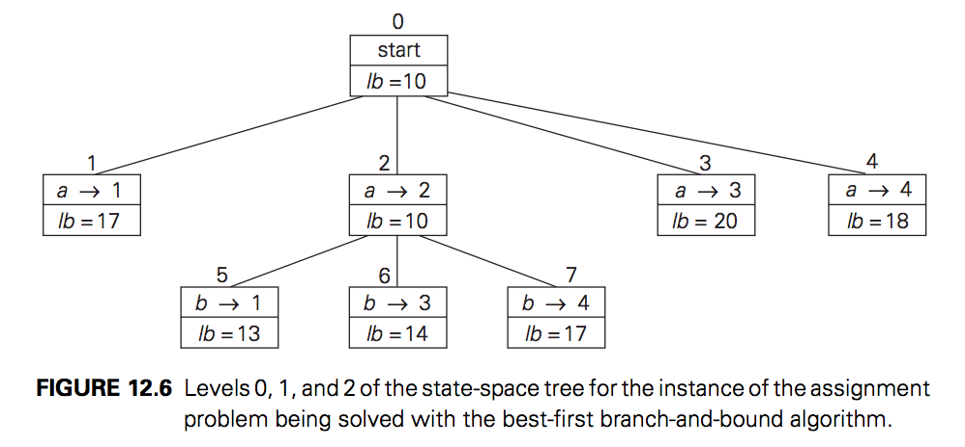
A. Levitin “Introduction to the Design & Analysis of Algorithms,” 3rd ed., Ch. 12 ©2012 Pearson Education, Inc. Upper Saddle River, NJ. All Rights Reserved.

Slide 17
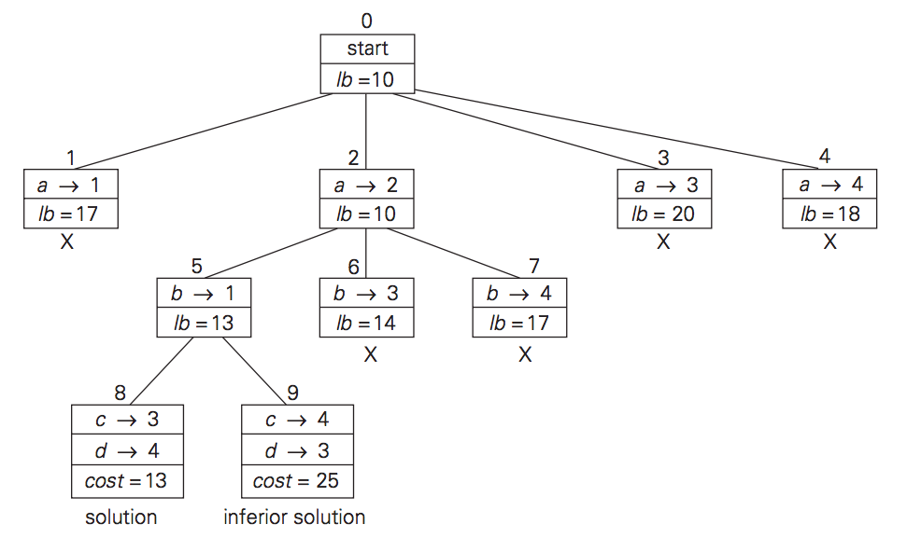
A. Levitin “Introduction to the Design & Analysis of Algorithms,” 3rd ed., Ch. 12 ©2012 Pearson Education, Inc. Upper Saddle River, NJ. All Rights Reserved.

Slide 18
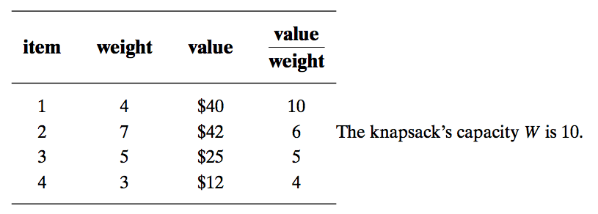
Knapsack Problem
Given n items of known weights wi and values vi, i=1,2,...,n, and a knapsack of capacity W, find the most valuable subset of the items that fit in the knapsack.
A. Levitin “Introduction to the Design & Analysis of Algorithms,” 3rd ed., Ch. 12 ©2012 Pearson Education, Inc. Upper Saddle River, NJ. All Rights Reserved.

Slide 19
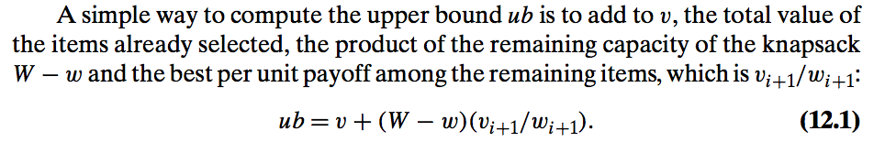
A. Levitin “Introduction to the Design & Analysis of Algorithms,” 3rd ed., Ch. 12 ©2012 Pearson Education, Inc. Upper Saddle River, NJ. All Rights Reserved.

Slide 20
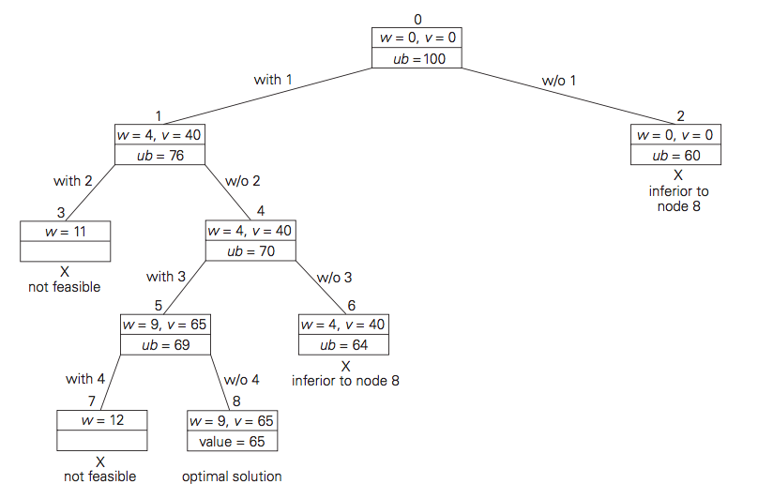
A. Levitin “Introduction to the Design & Analysis of Algorithms,” 3rd ed., Ch. 12 ©2012 Pearson Education, Inc. Upper Saddle River, NJ. All Rights Reserved.

Slide 21
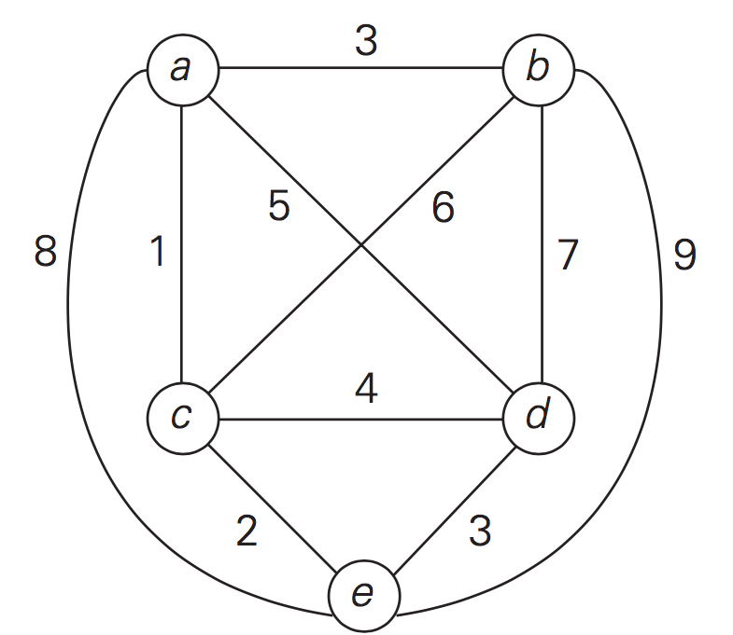
Example: Traveling Salesman Problem
A. Levitin “Introduction to the Design & Analysis of Algorithms,” 3rd ed., Ch. 12 ©2012 Pearson Education, Inc. Upper Saddle River, NJ. All Rights Reserved.

Slide 22
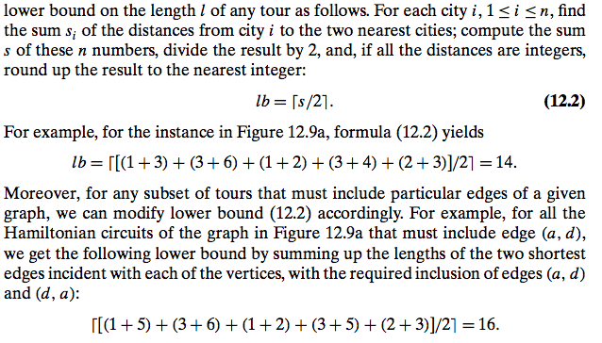
Example: Traveling Salesman Problem
A. Levitin “Introduction to the Design & Analysis of Algorithms,” 3rd ed., Ch. 12 ©2012 Pearson Education, Inc. Upper Saddle River, NJ. All Rights Reserved.

Slide 23
Any improvement?
A. Levitin “Introduction to the Design & Analysis of Algorithms,” 3rd ed., Ch. 12 ©2012 Pearson Education, Inc. Upper Saddle River, NJ. All Rights Reserved.

Slide 24
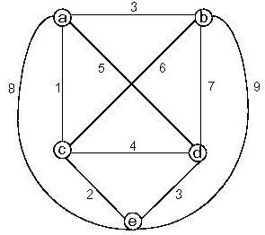
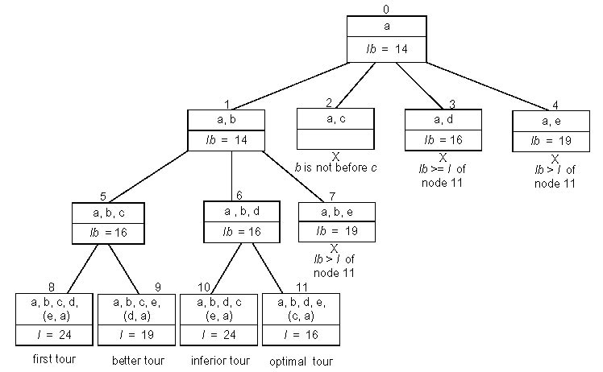
Example: Traveling Salesman Problem
A. Levitin “Introduction to the Design & Analysis of Algorithms,” 3rd ed., Ch. 12 ©2012 Pearson Education, Inc. Upper Saddle River, NJ. All Rights Reserved.

