Slide 1
Storyboard
For an App by Dev Team CorgFu

Slide 2
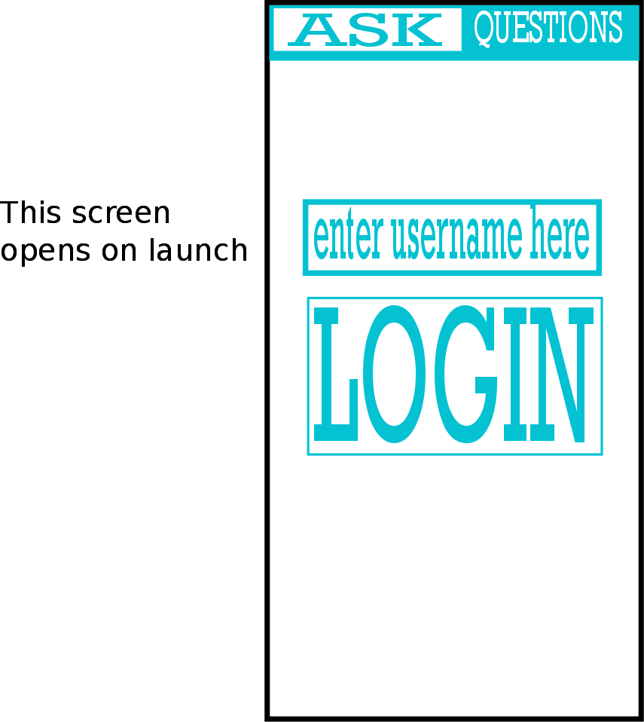
Login Screen

Slide 3
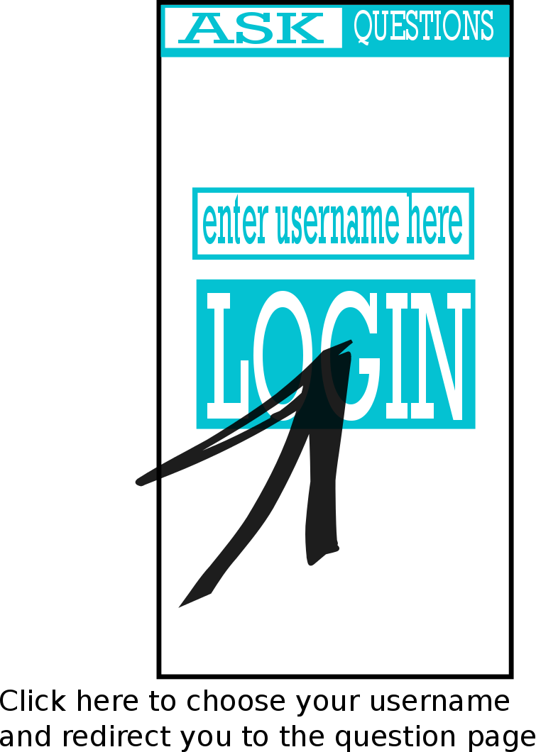
Login Screen

Slide 4
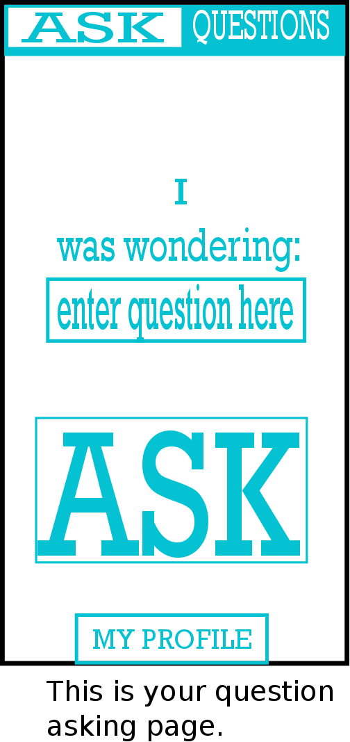
Asking a Question

Slide 5
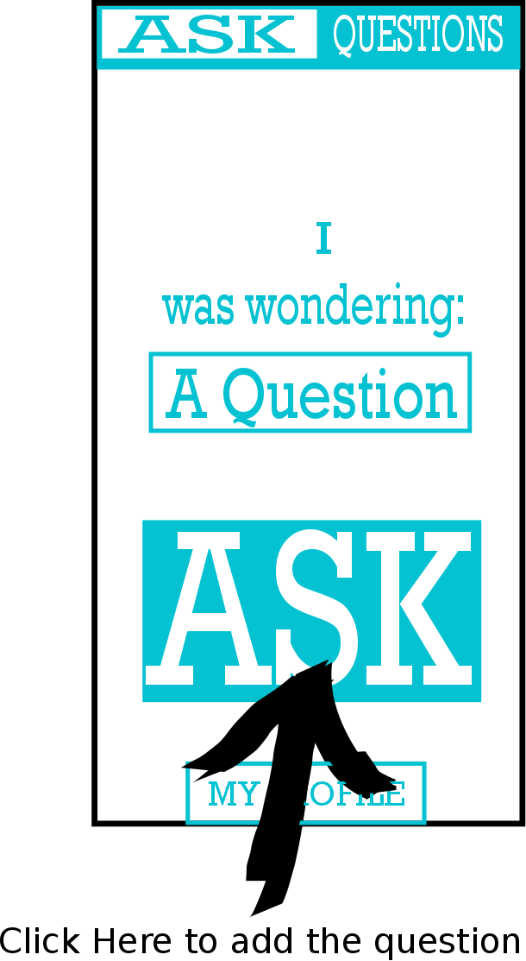
Asking a Question
Brings up a pop-up menu

Slide 6
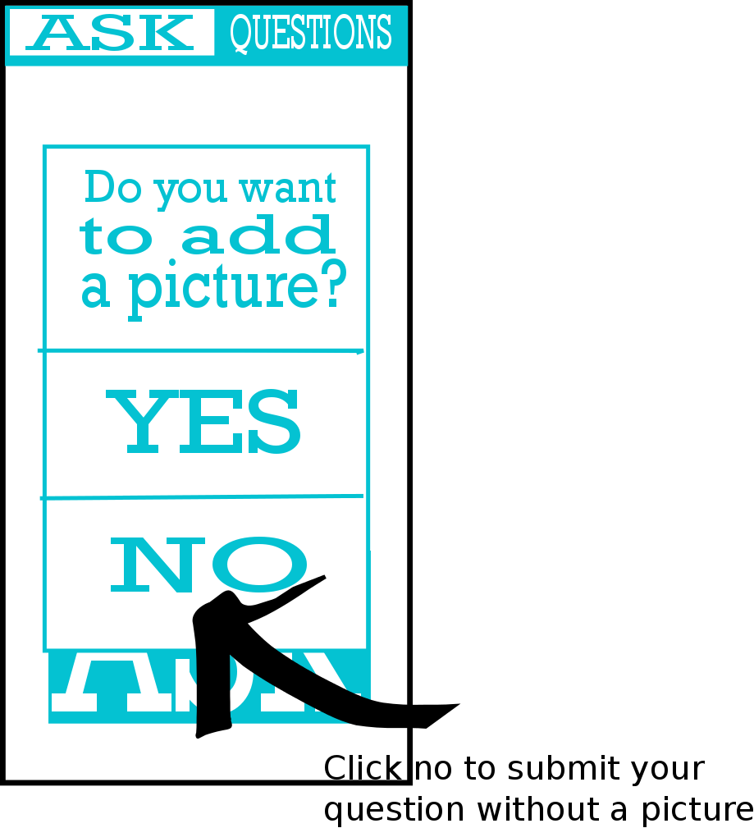
Asking a Question
Click the back button to cancel and return to the ask screen

Slide 7
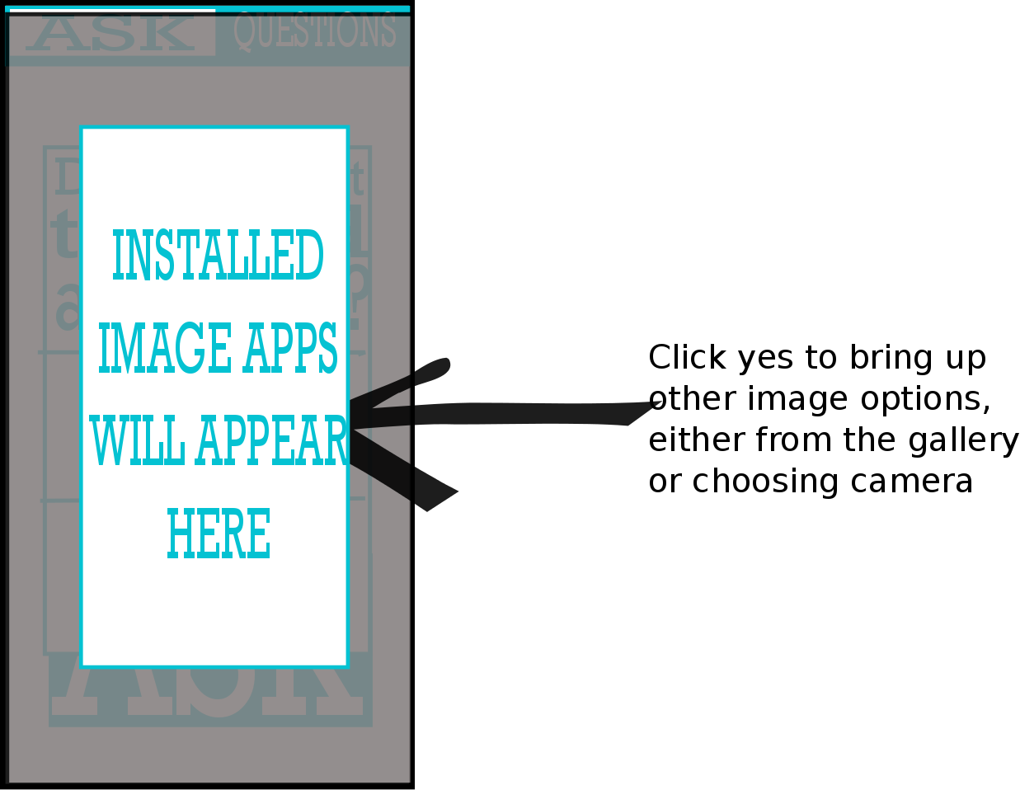
Asking a Question

Slide 8
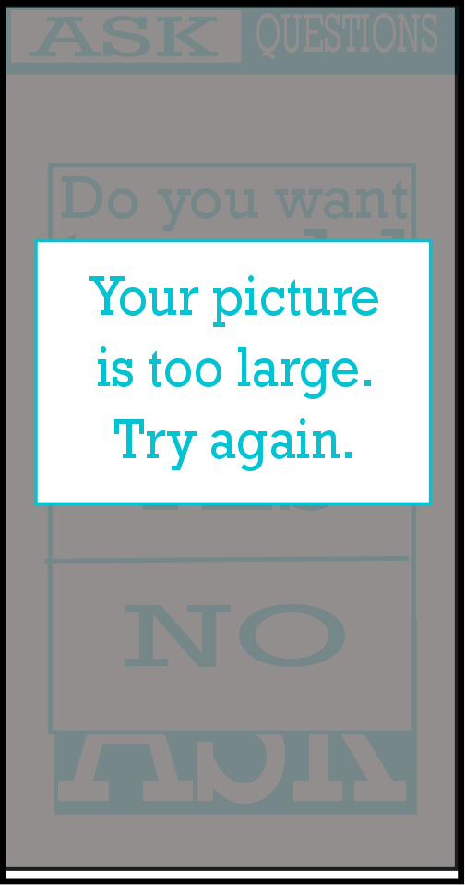
Asking a Question
If your photo that you’ve taken or tried to
Add is >64kB then, this message will appear
And then fade in a couple seconds

Slide 9

Asking a Question
If the post meets the requirements
Then this message will appear and fade in
A few seconds

Slide 10
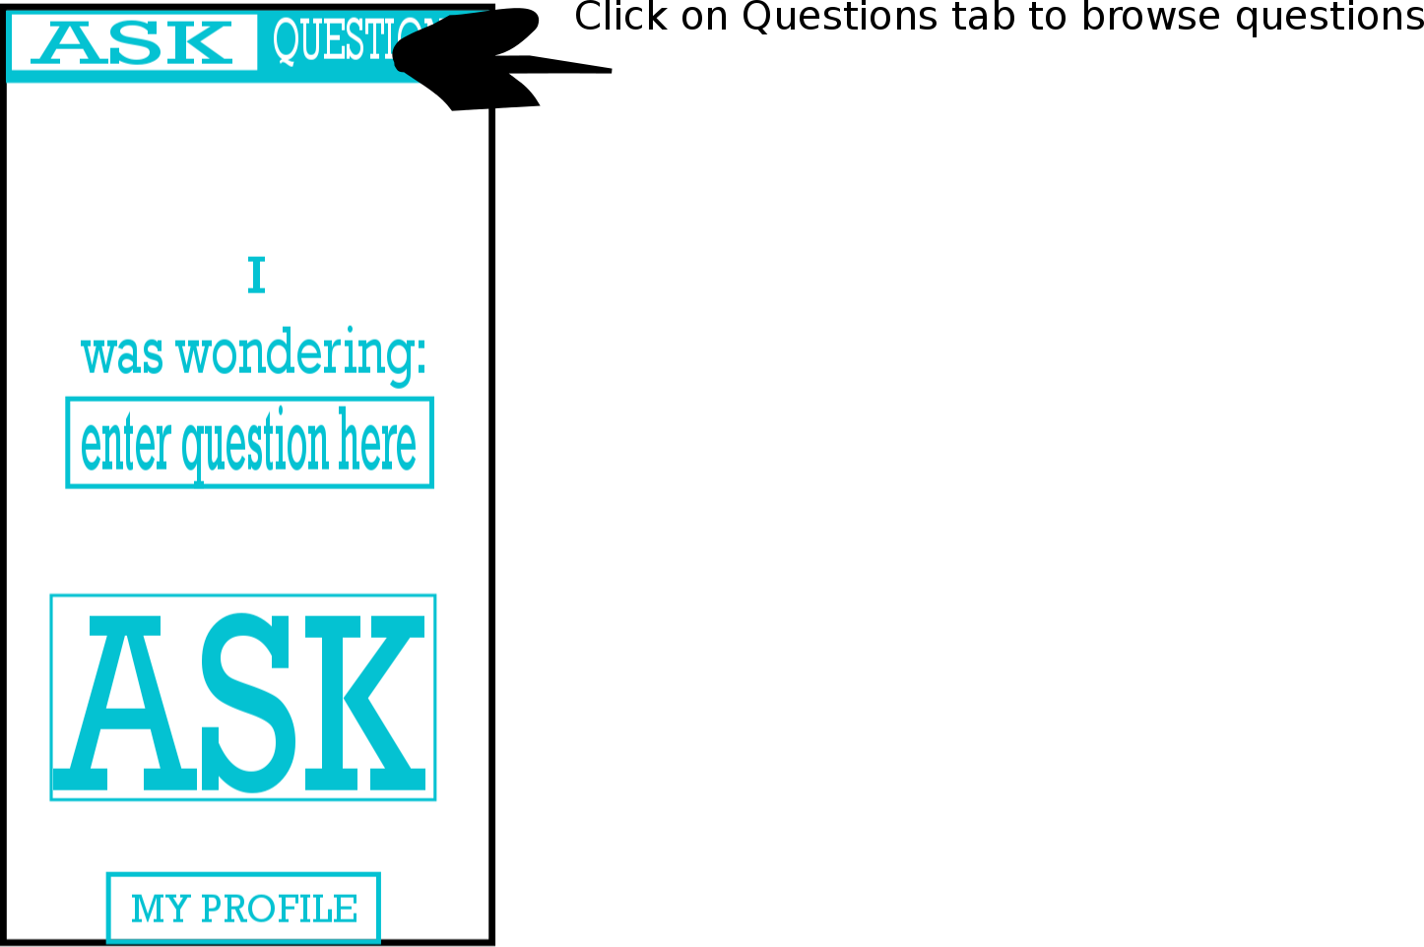
Getting to Questions

Slide 11
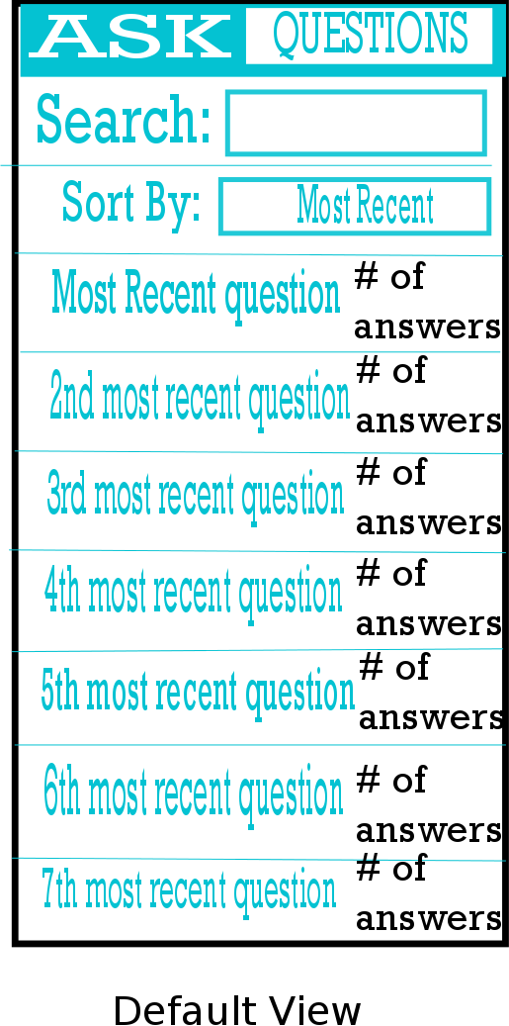
Getting to Questions
For the questions menu

Slide 12
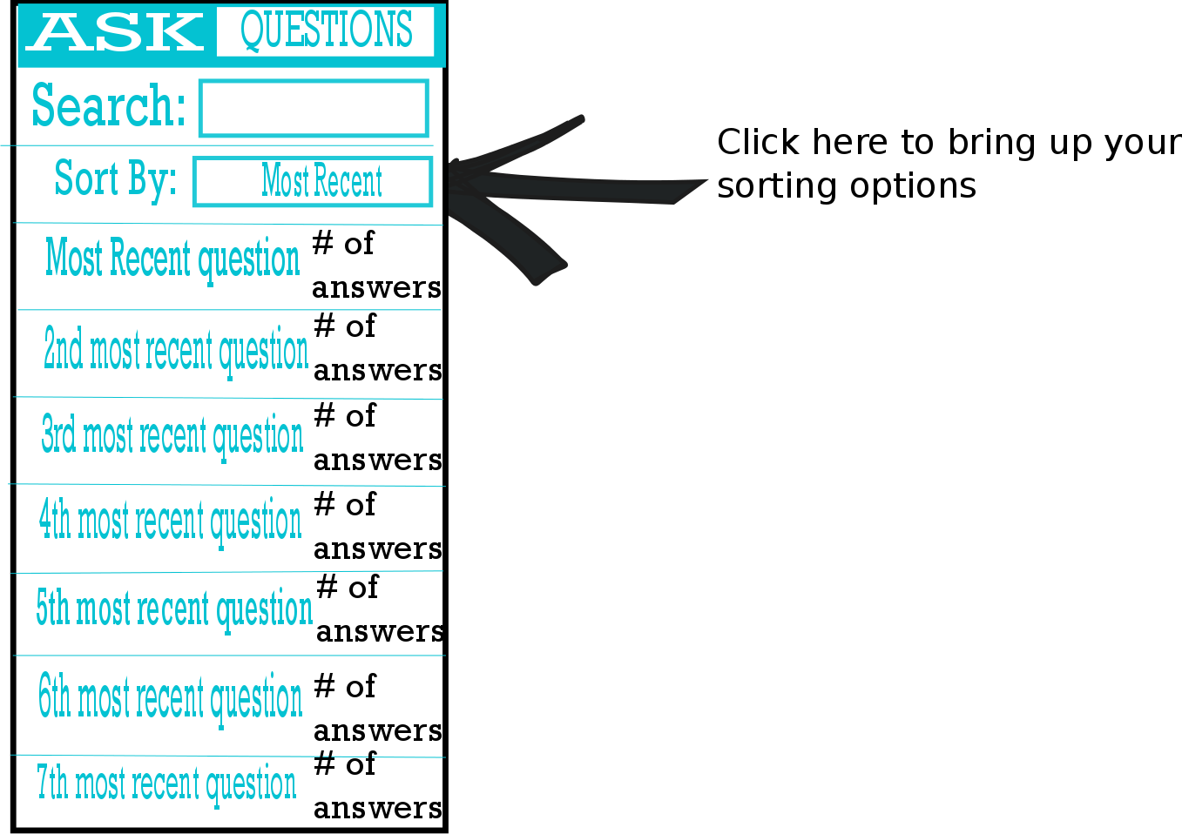
Sort Questions

Slide 13
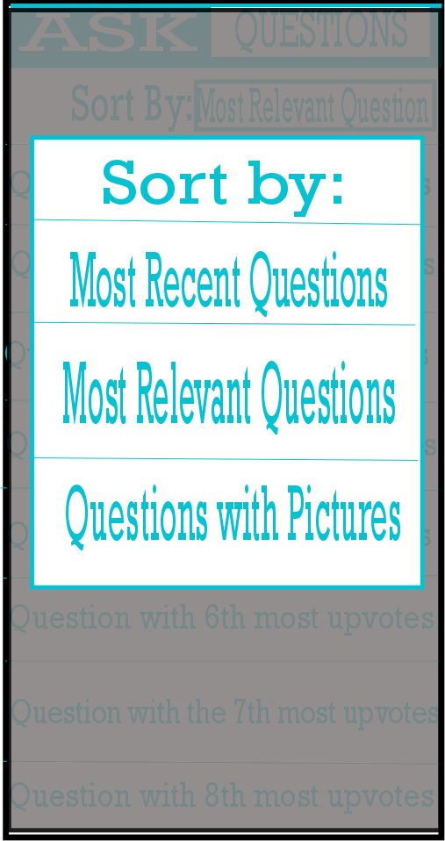
Sort Questions
This is the menu that pops up when
You click the sort by option

Slide 14
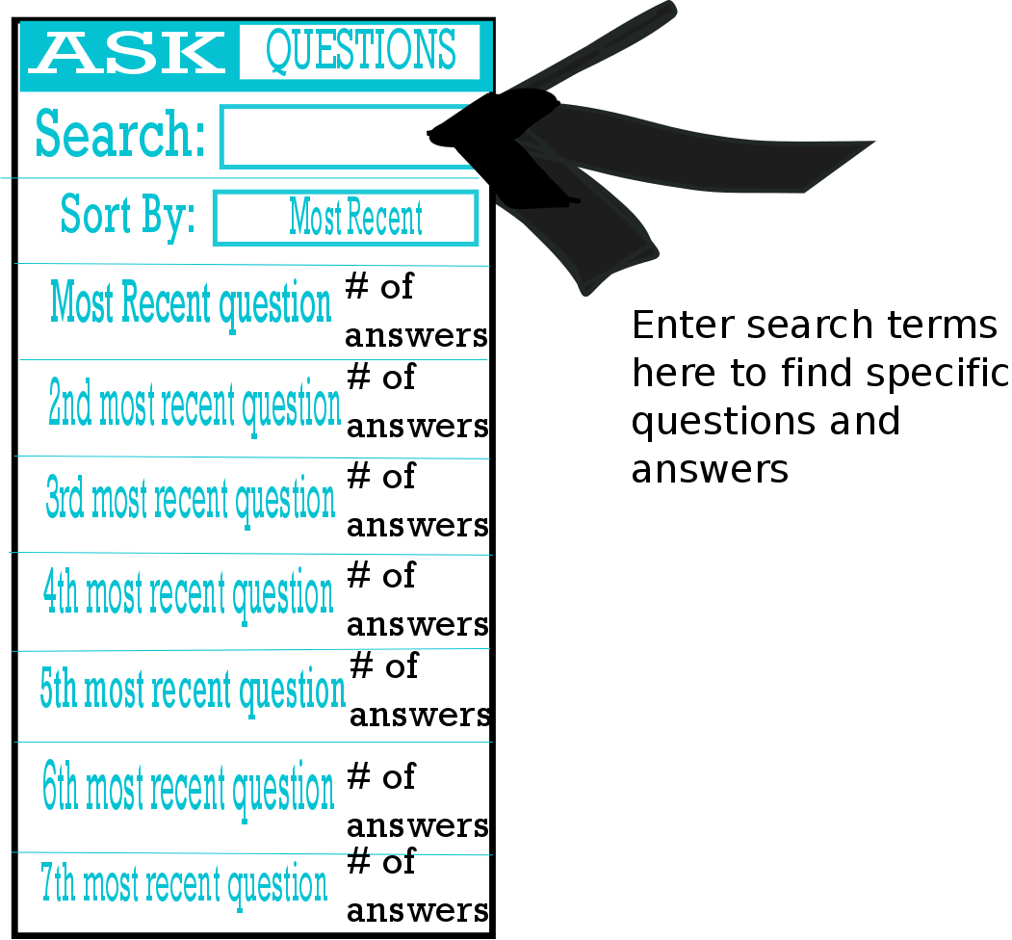
Search Questions
This is where you can
enter a search term to see
which questions and answers come up

Slide 15
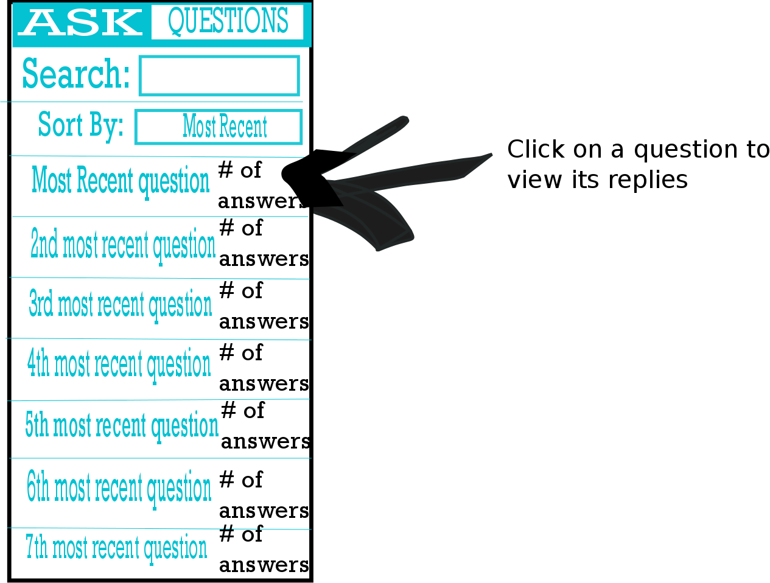
Selecting a Question

Slide 16
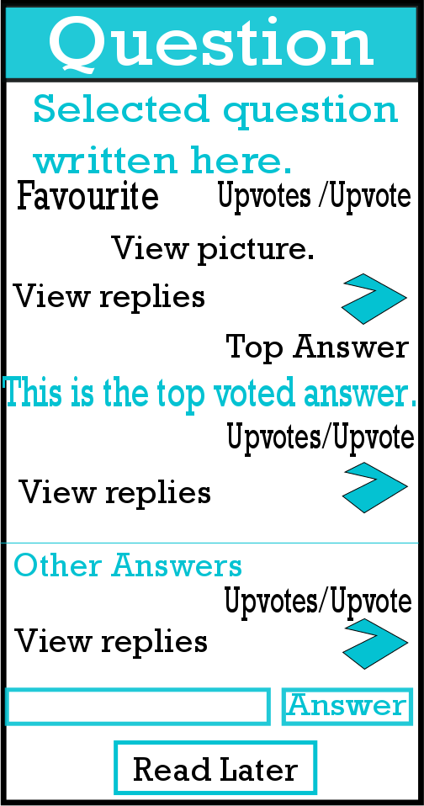
Question Screen
Default Question screen view
Select the back button to return to the question list

Slide 17
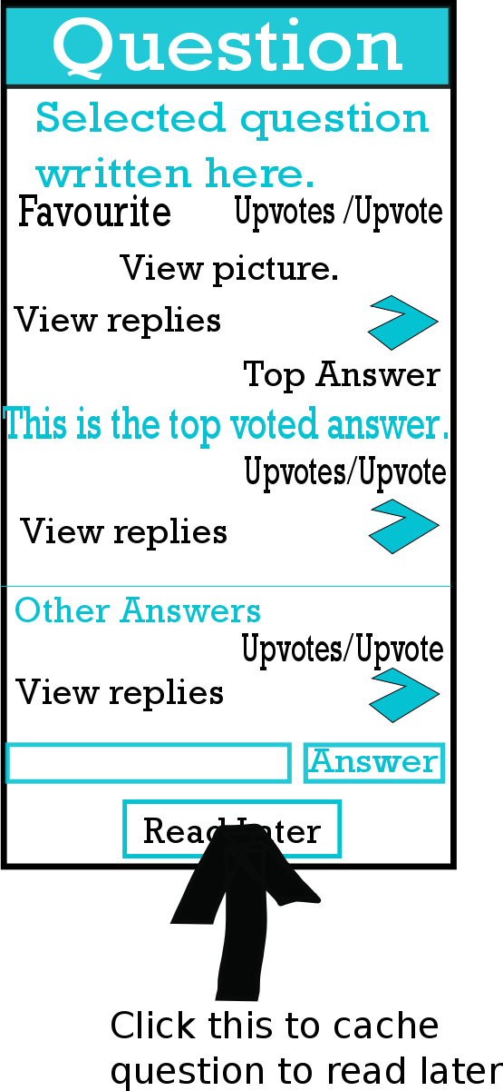
Cache a Question

Slide 18
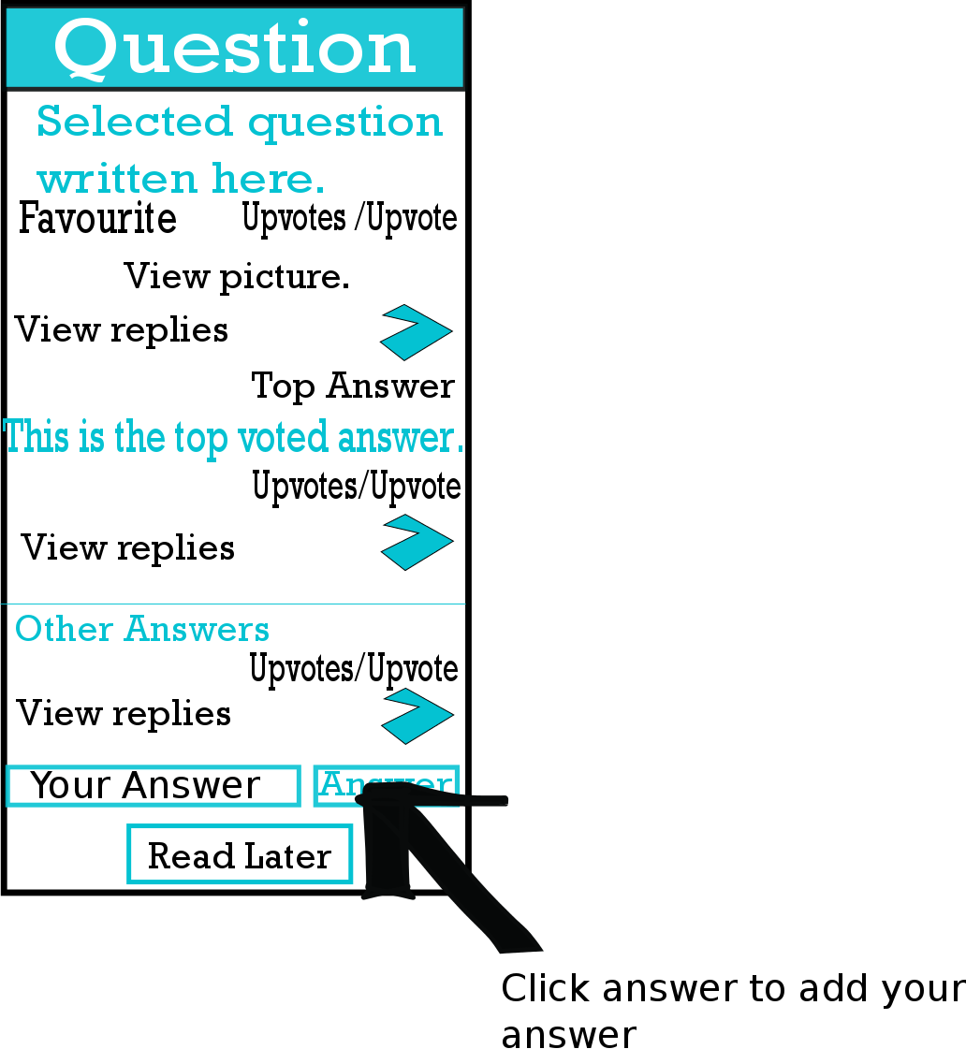
Answer a Question

Slide 19

Answer a Question
Updated view with your new answer

Slide 20
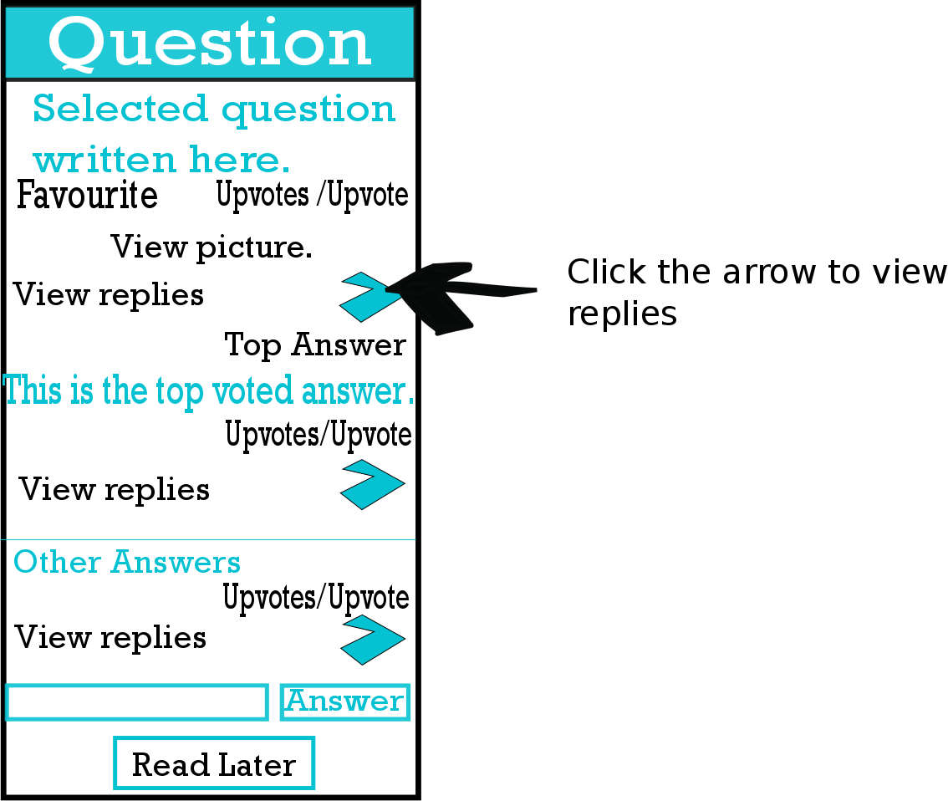
View Replies

Slide 21
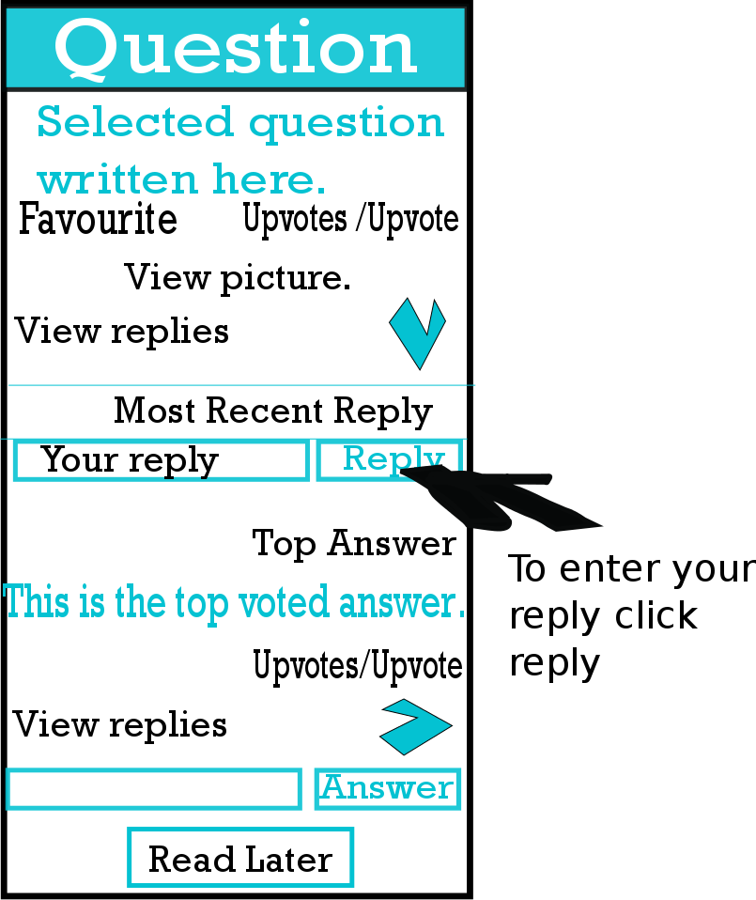
View Replies

Slide 22
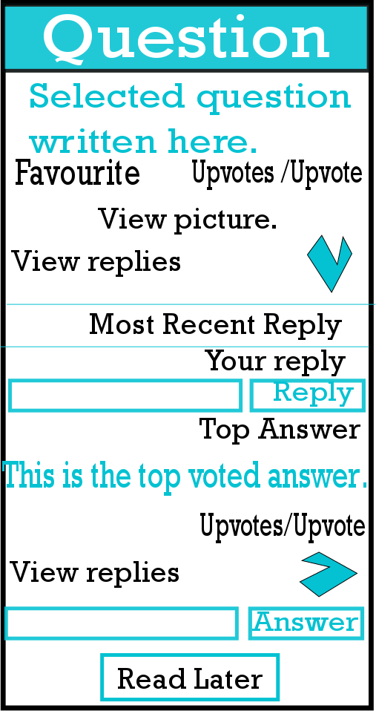
View Replies
Displays your new reply to the question
Or answer

Slide 23
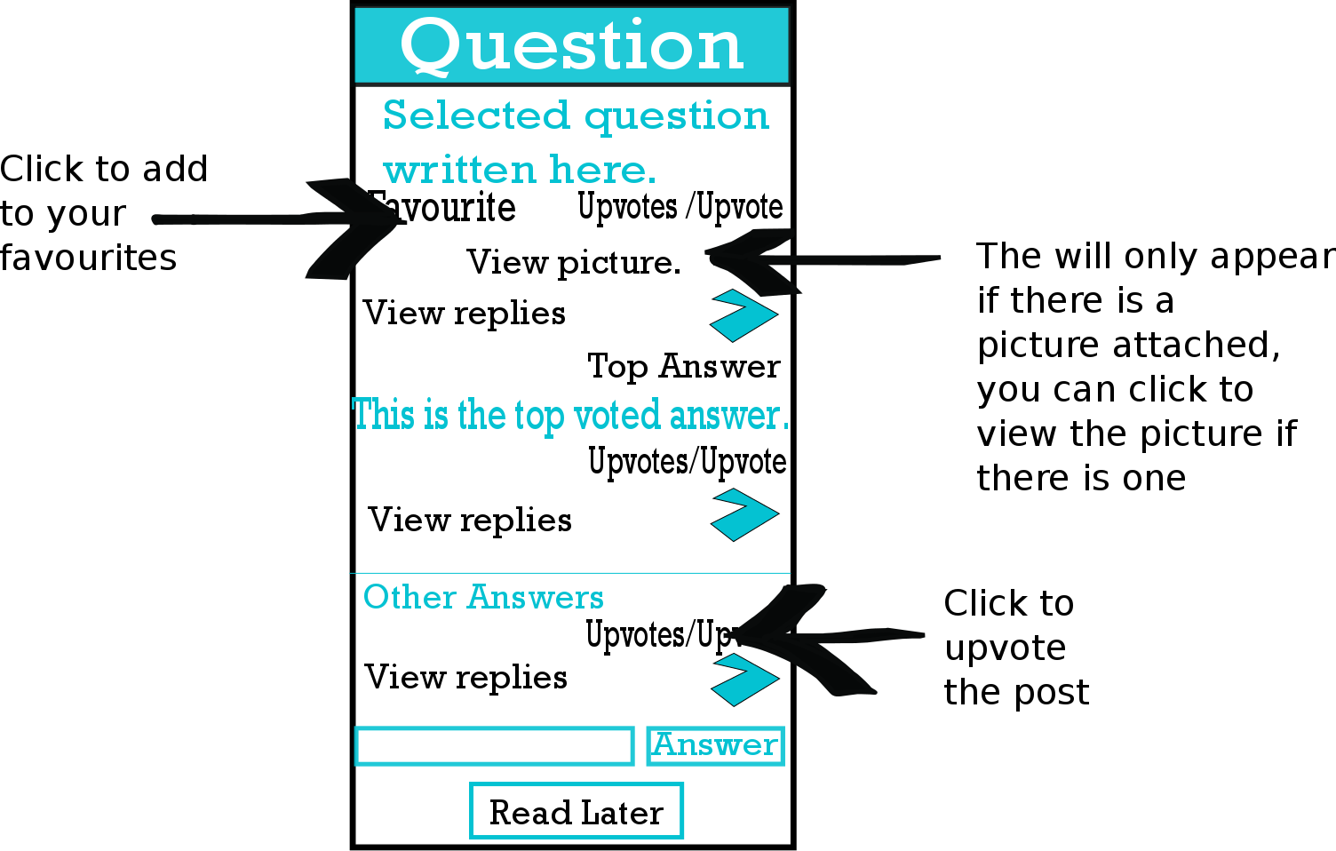
Basic Actions on the Question Page
Click the back button to return to the
List of Questions

Slide 24
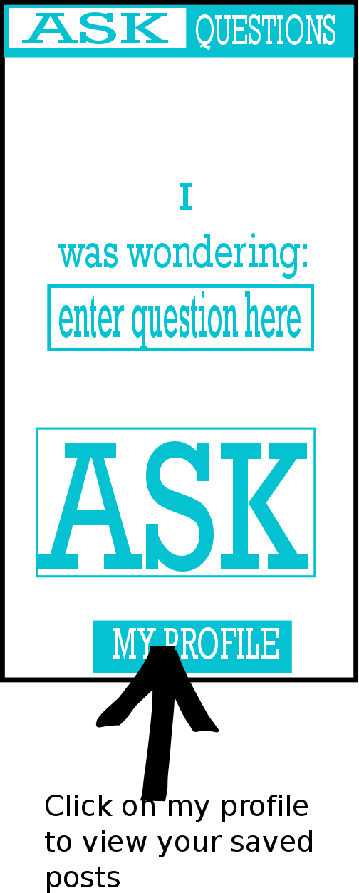
Go to My Profile

Slide 25

My Profile
Default my profile screen
Click the back button to return to the
Ask screen

Slide 26
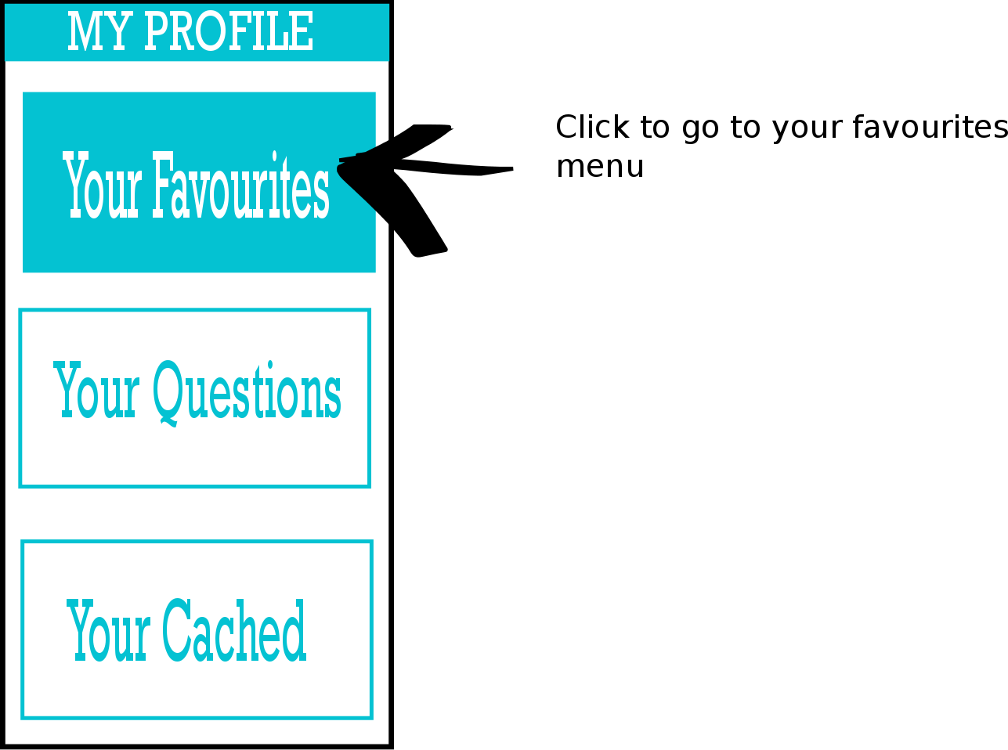
To My favourites

Slide 27
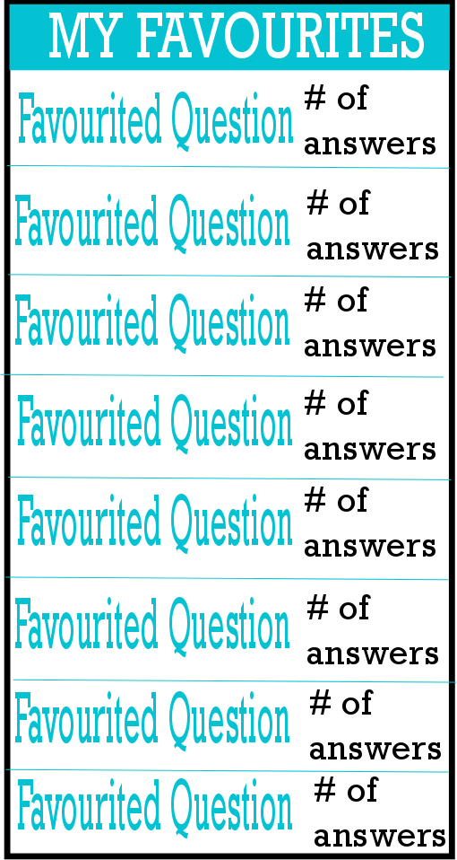
My favourites
Click the back button to return to the
MyProfile options

Slide 28
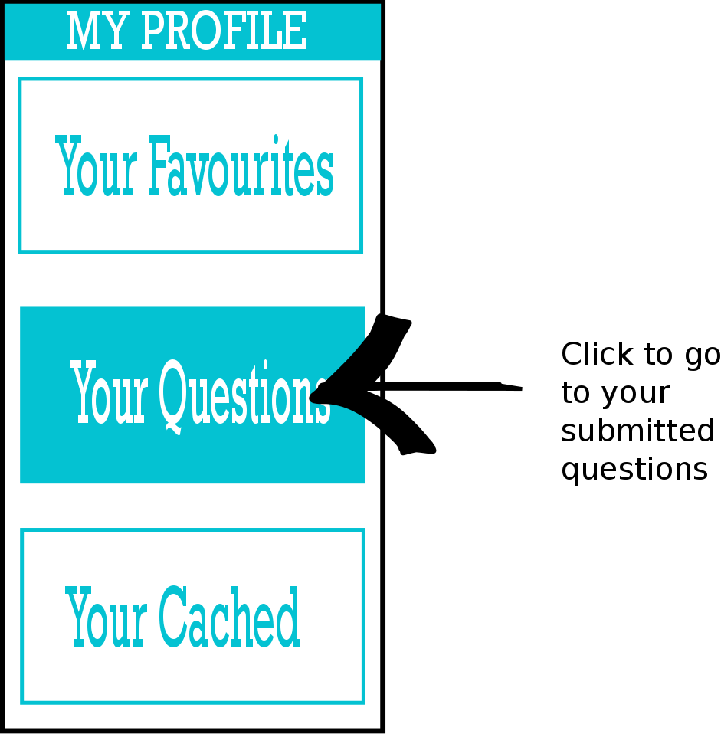
To My questions

Slide 29
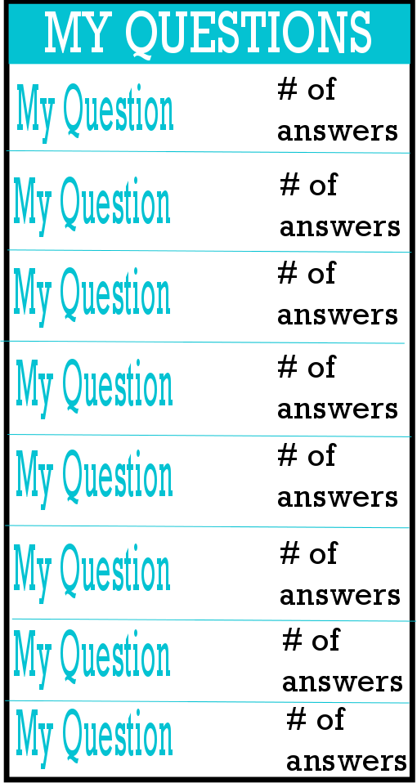
My questions
Click the back button to return to the
MyProfile options

Slide 30
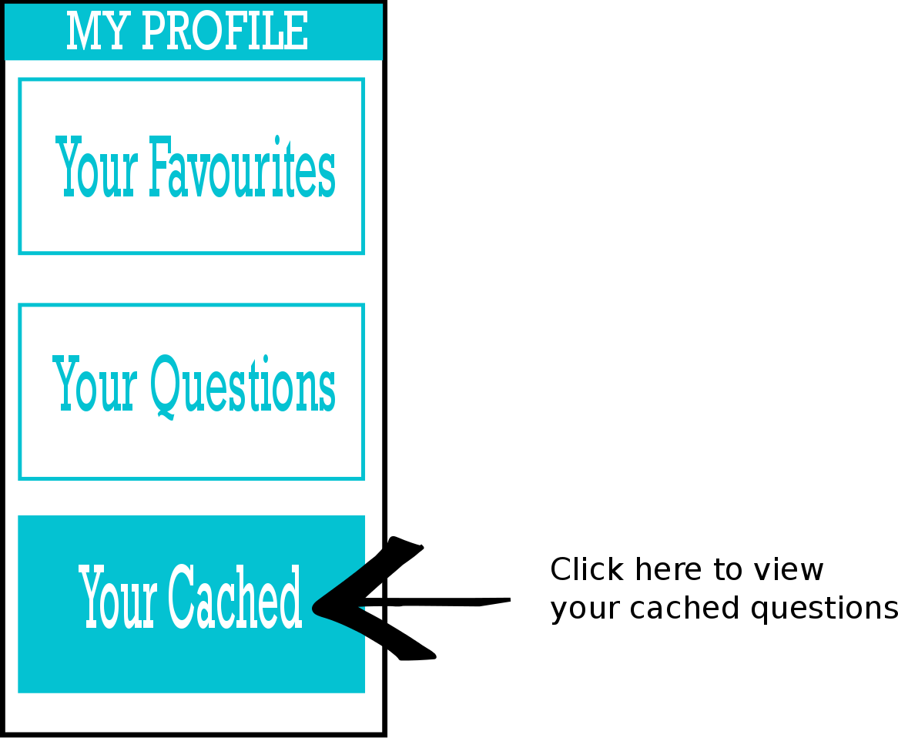
To My cache

Slide 31
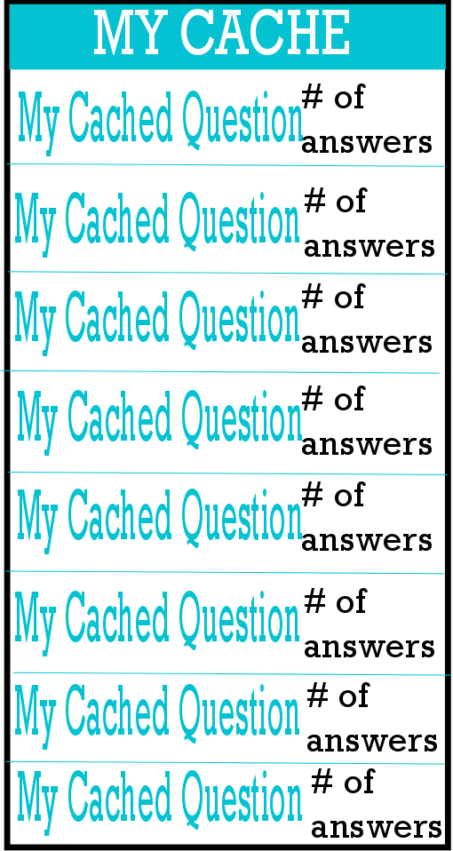
My cache
Click the back button to return to the
MyProfile options

Slide 32
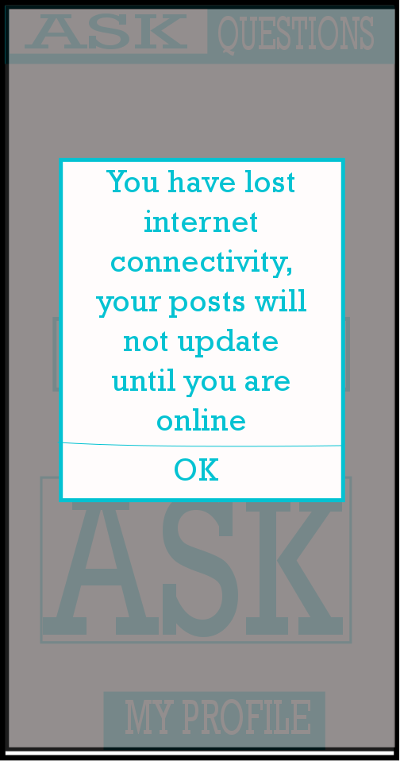
Loss of Connectivity
Clicking OK dismisses the message

