Slide 1
Storyboard
For an App by Dev Team CorgFu

Slide 2
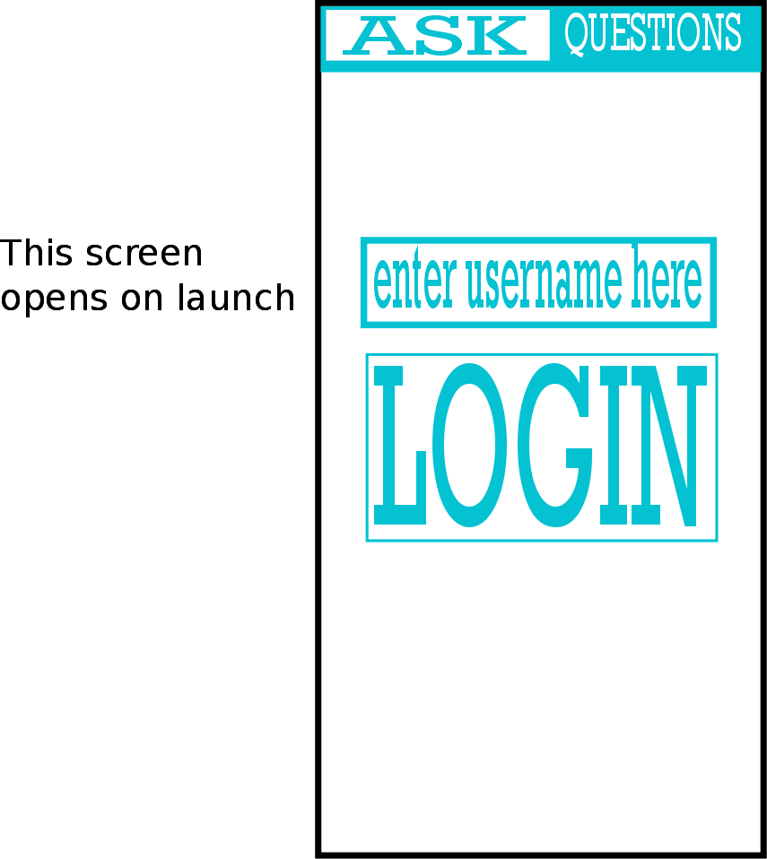
Login Screen

Slide 3
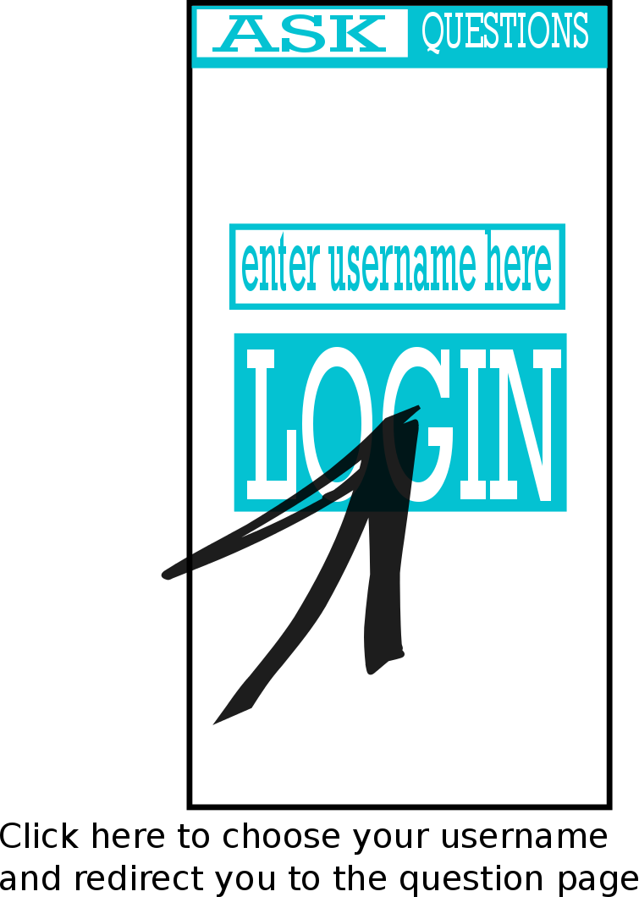
Login Screen

Slide 4
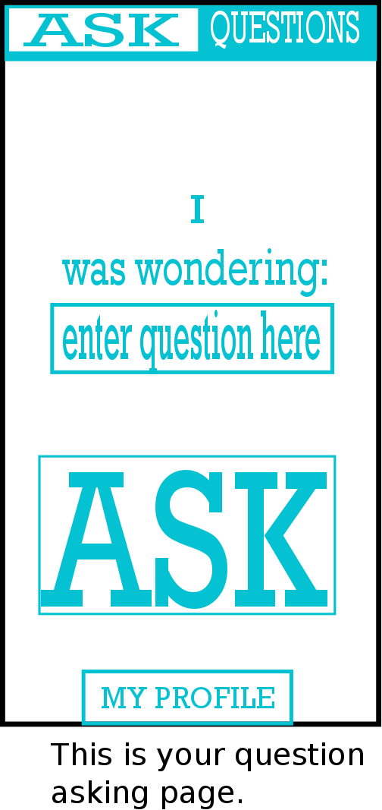
Asking a Question

Slide 5

Asking a Question

Slide 6
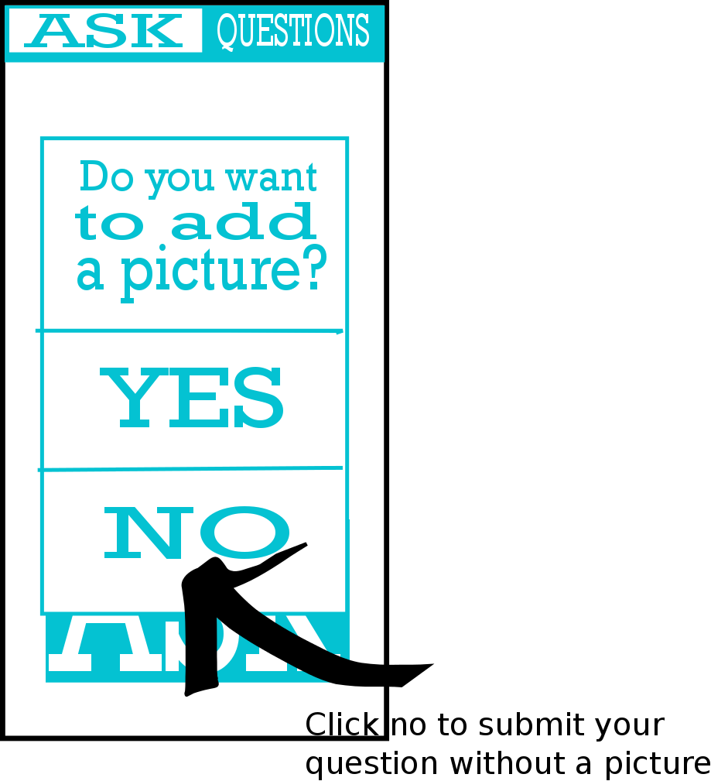
Asking a Question

Slide 7
Asking a Question

