Slide 1
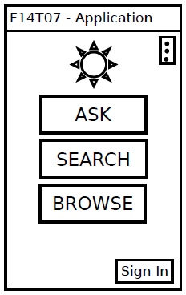
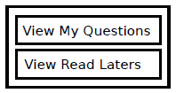
App Title
Opens the Search Screen
Brings up option menu
Opens the Browse Screen
Opens the Sign In menu
Opens the Ask Screen
Sign In:
____________

Slide 2
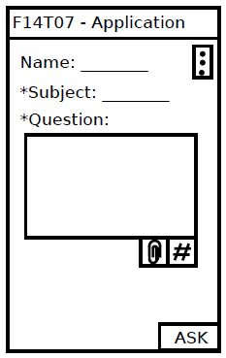
Required
Allows user to add tags
Allows user to add tags
Publishes the post

Slide 3
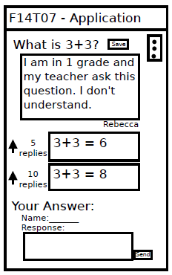
Saves the question to the user’s read later list
Allows the user to up-vote a response
Submits the user’s response
*

Slide 4
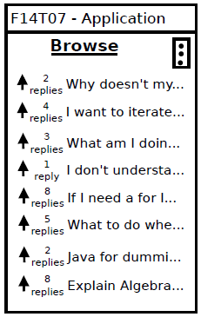
Each question can be clicked on to open the Question Screen

Slide 5
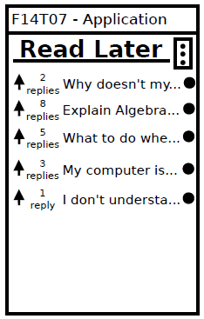

Yes No
Opens a menu that allows the user to delete a question from the read later list

Slide 6
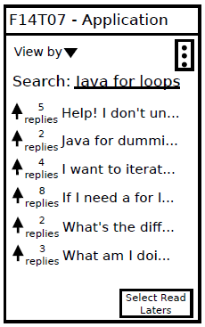
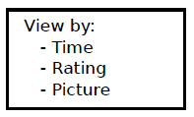
Opens the view by menu in which the user can choose the ordering of the posts
Transforms the view to allow user to save multiple questions

Slide 7
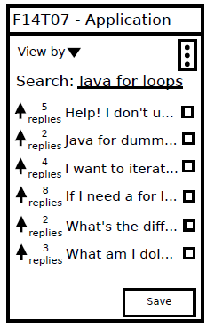
The user clicks the checkboxes to signify that they might want the question saved
Allows the user to save the selected

Slide 8
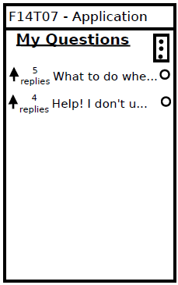
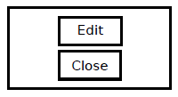
Clicking here opens the edit menu, which allows the user to edit or close their questions

