Slide 1
This story board will be used to show a rider creating a request and having it accepted by a driver!

Slide 2
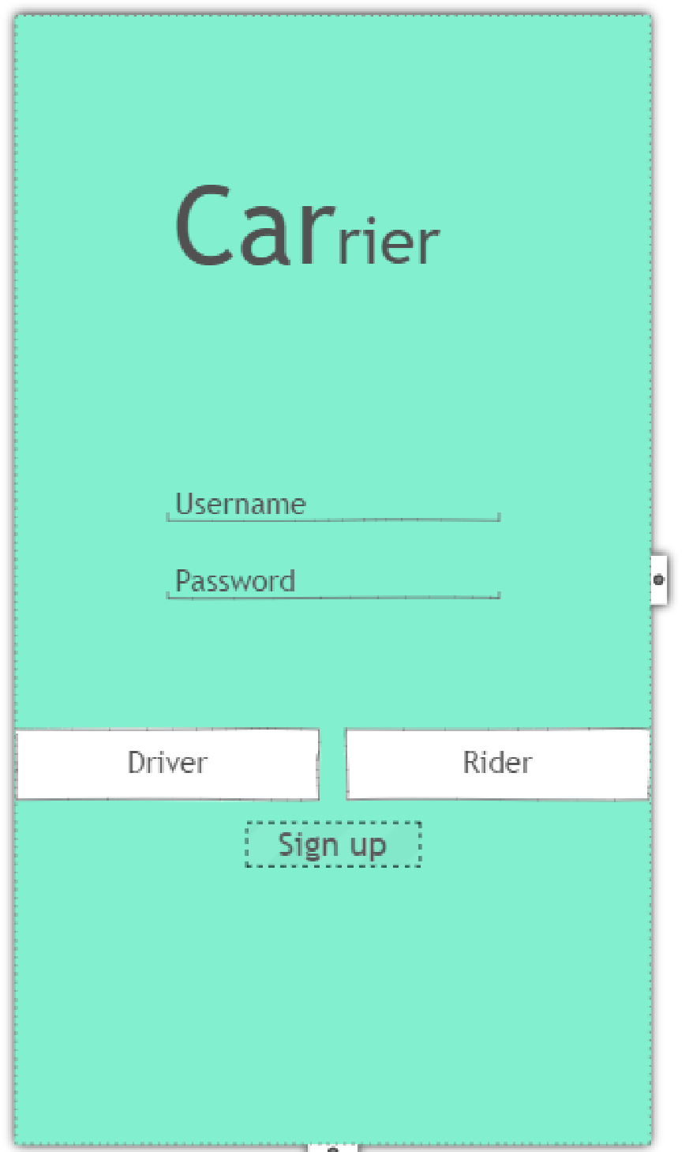

Slide 3

bob
xxxxxxx

Slide 4
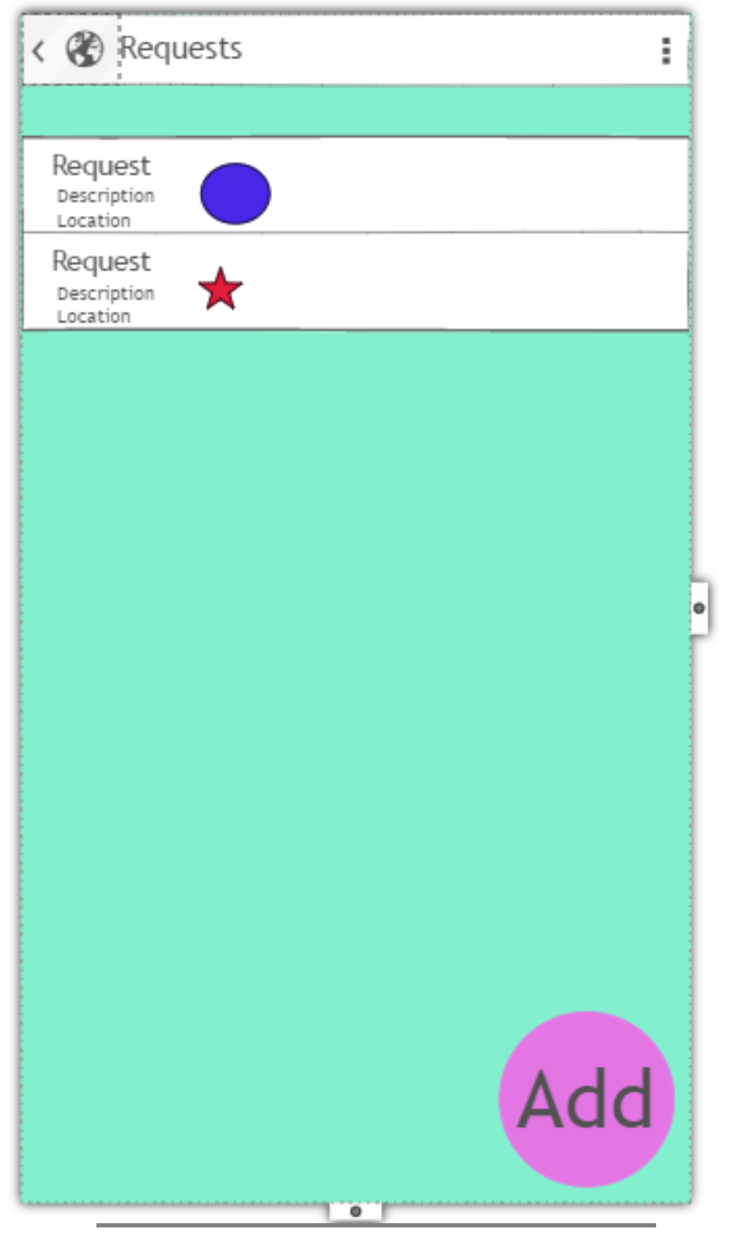
The rider will be able to see all requests here and there will be icons showing the status of requests. Blue meaning waiting for driver to offer and star meaning it has a driver. (These definitions may change)

Slide 5
The rider will be able to see all requests here and there will be icons showing the status of requests. Blue meaning waiting for driver to offer and star meaning it has a driver. (These definitions may change)

Slide 6
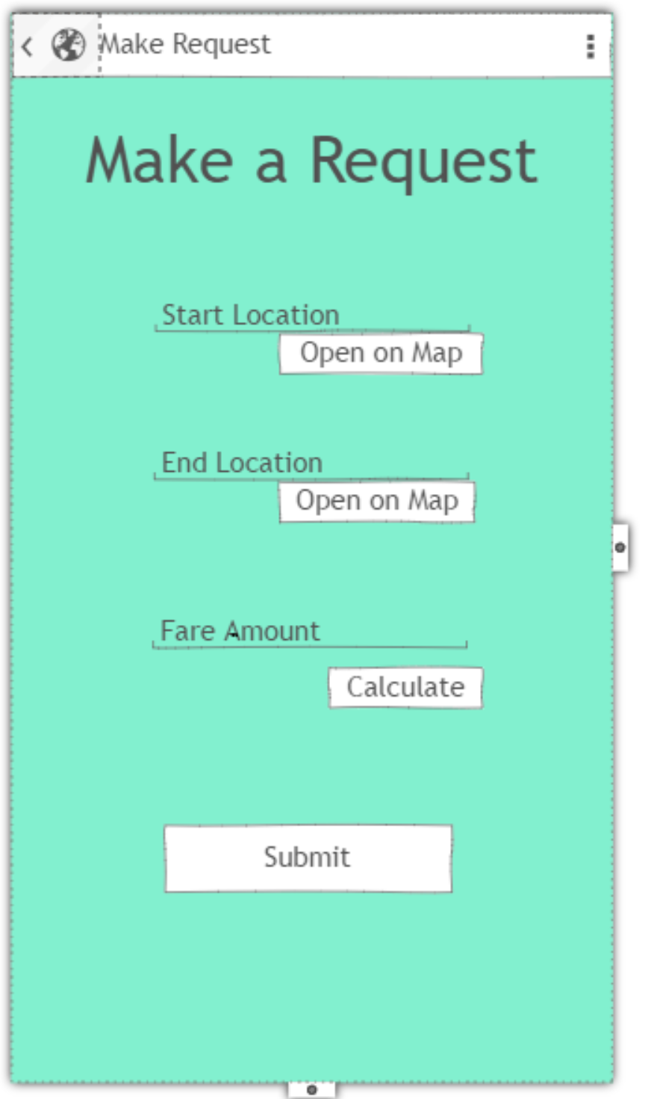

Slide 8
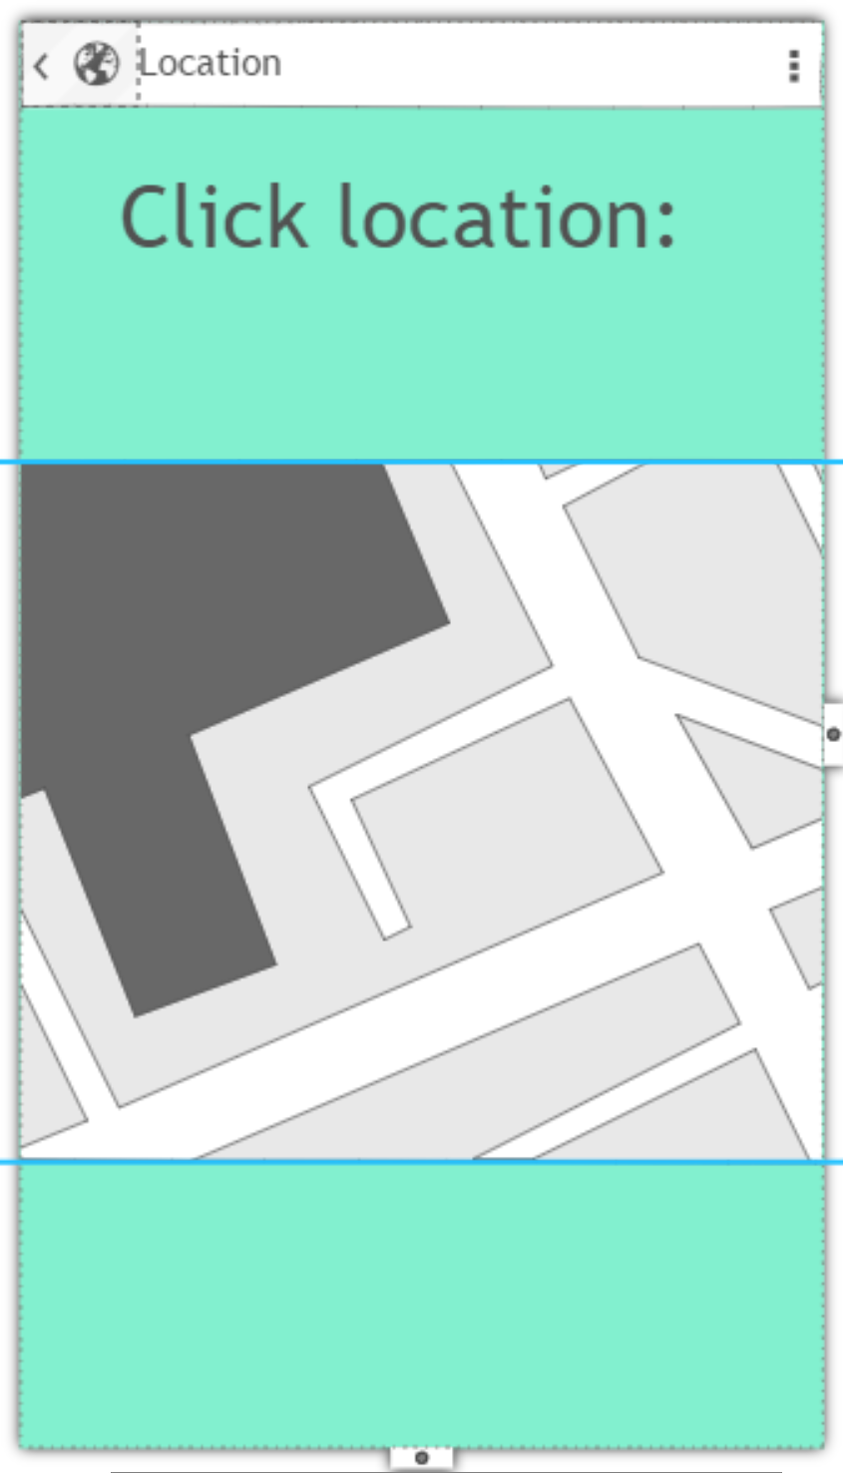

Slide 12
$20.00

Slide 13
$20.00

Slide 14
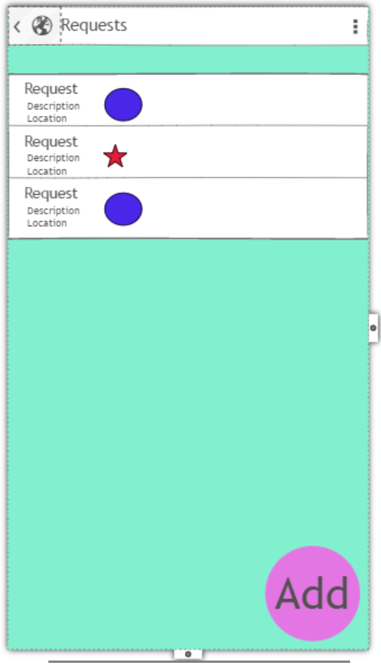
Now we have another request that is open!
We wait…

Slide 15
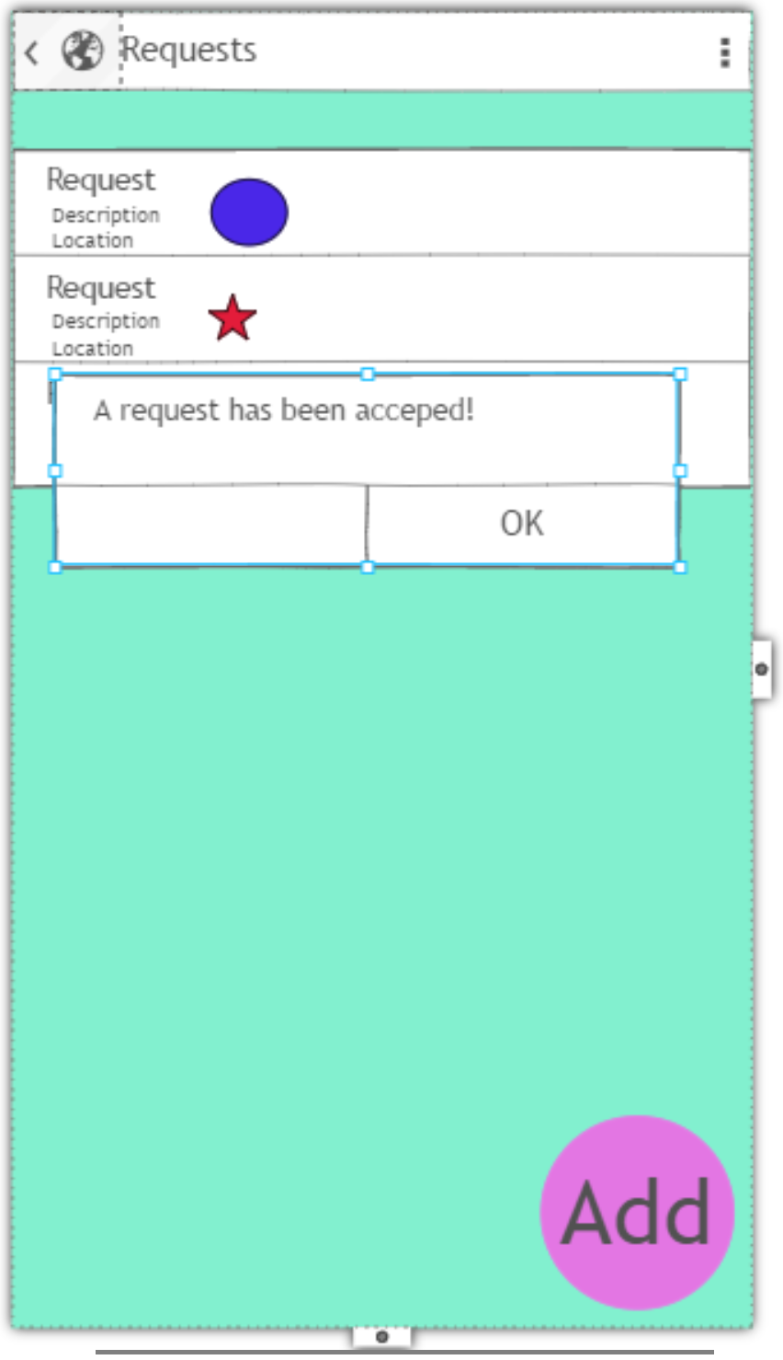
A driver has offered to take a request!
Decline

Slide 16
A driver has offered to take a request!
Decline

Slide 17
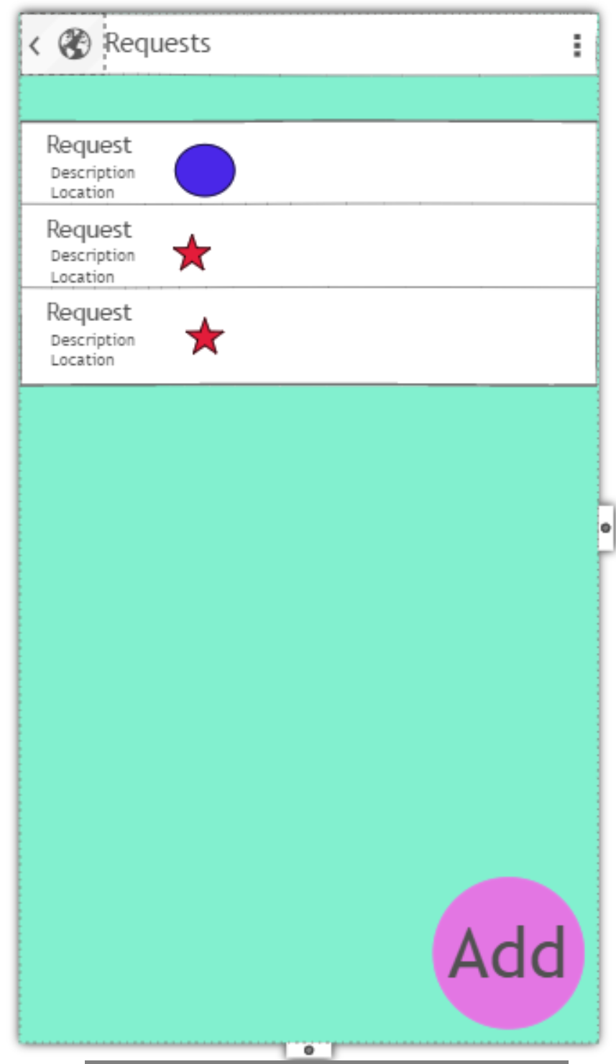
We can see the icon has changed from open blue star to confirmed red star.

Slide 18
We can click on the request to see

Slide 19
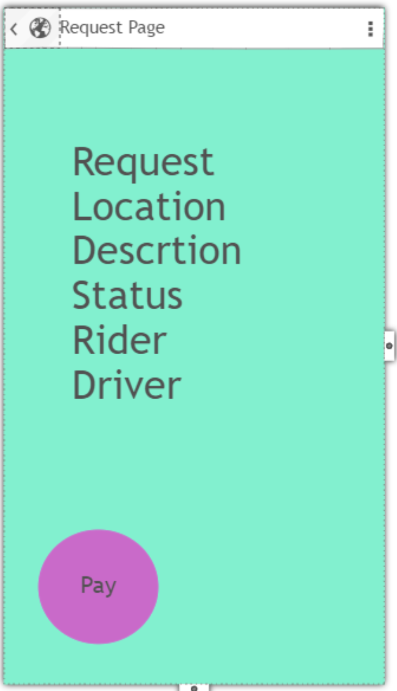
We will allow the rider to cancel after a driver has offered.
We will not allow the rider to cancel after then have confirmed the driver.
We will only allow the driver to pay if the ride has been completed and they are at their destination.

Slide 20
The rider wants to see info about the driver

Slide 21
The rider wants to see info about the driver

Slide 22
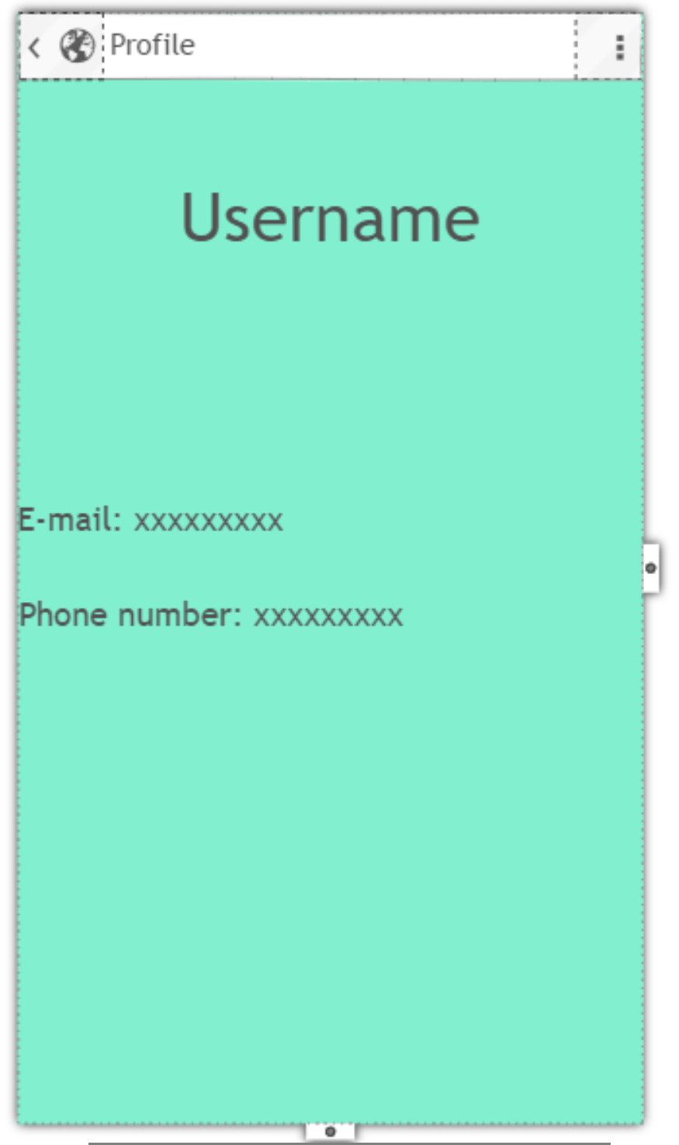

Slide 23
Source for png of hand
http://www.masterslider.com/wp-content/uploads/2014/05/hand.png

