Slide 1
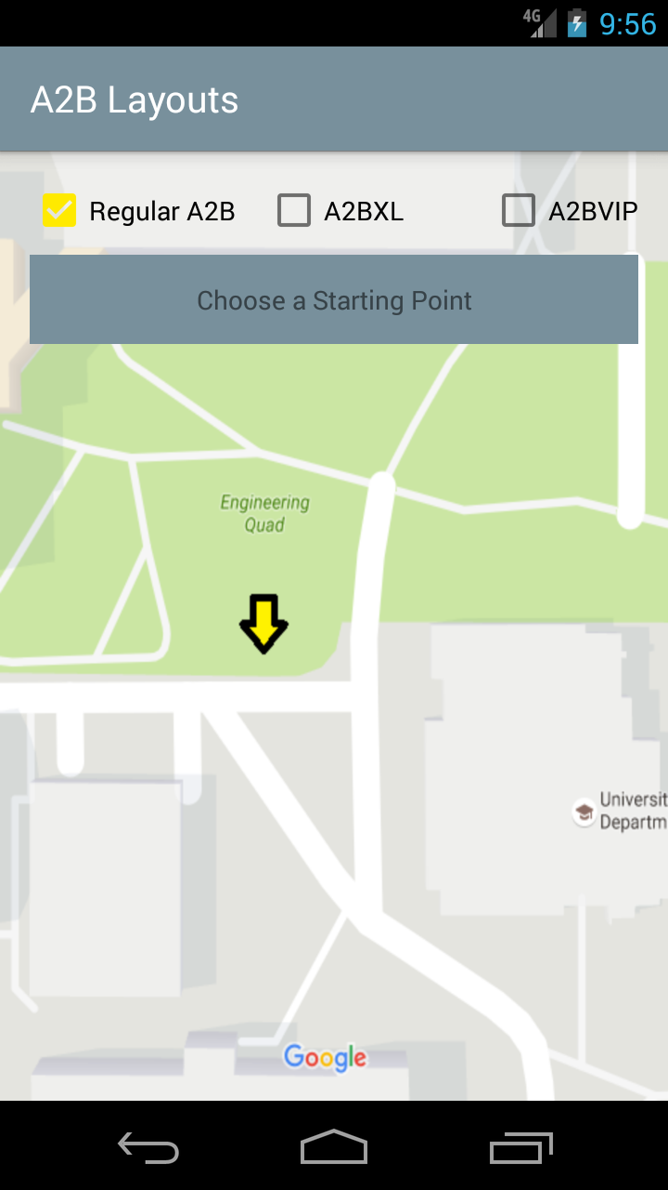
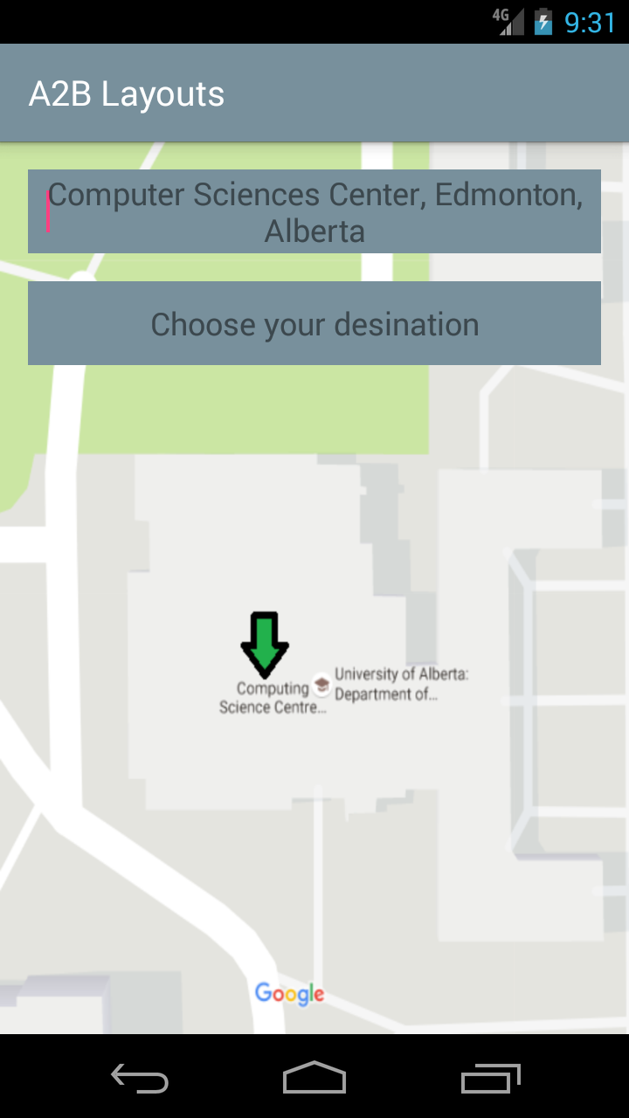
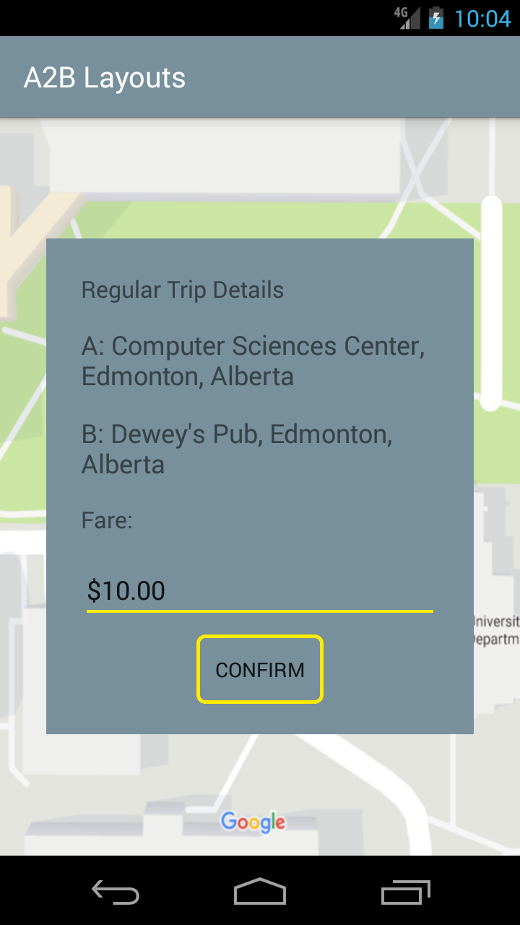
US 01.01.01
Request Rides Between Two Locations

Slide 2
US 01.02.01
FIX IN POTOSHOP

Slide 3
US 01.03.01
SKIP FOR NOW

Slide 4
US 01.04.01
NEEDS PHOTOSHOP

Slide 5
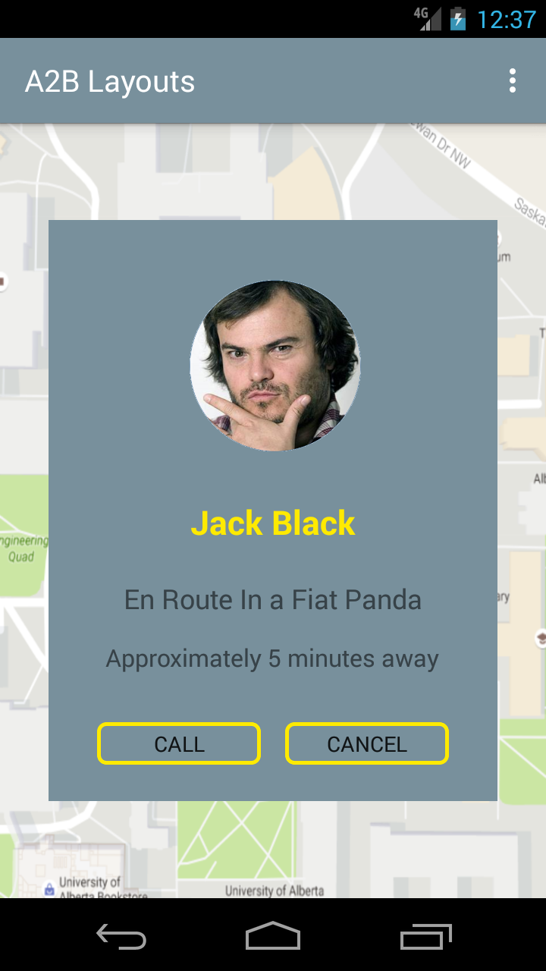
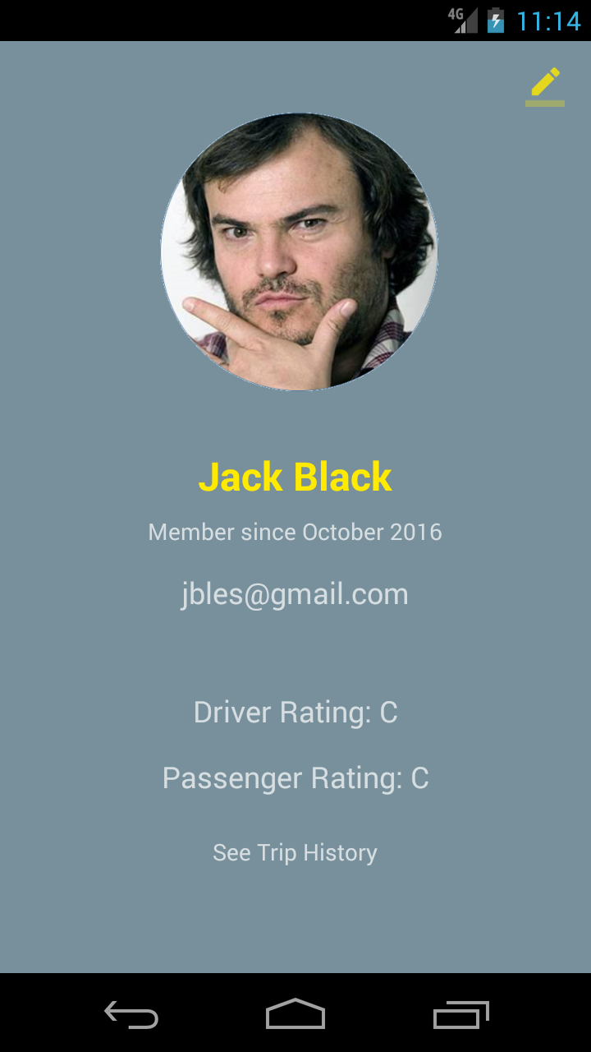
US 01.05.01
Contact the Driver
Select Contact Info
Select Further Info

Slide 6
US 01.06.01
NEEDS PHOTOSHOPFair Fare Estimate
Select Contact Info
Select Further Info

Slide 7
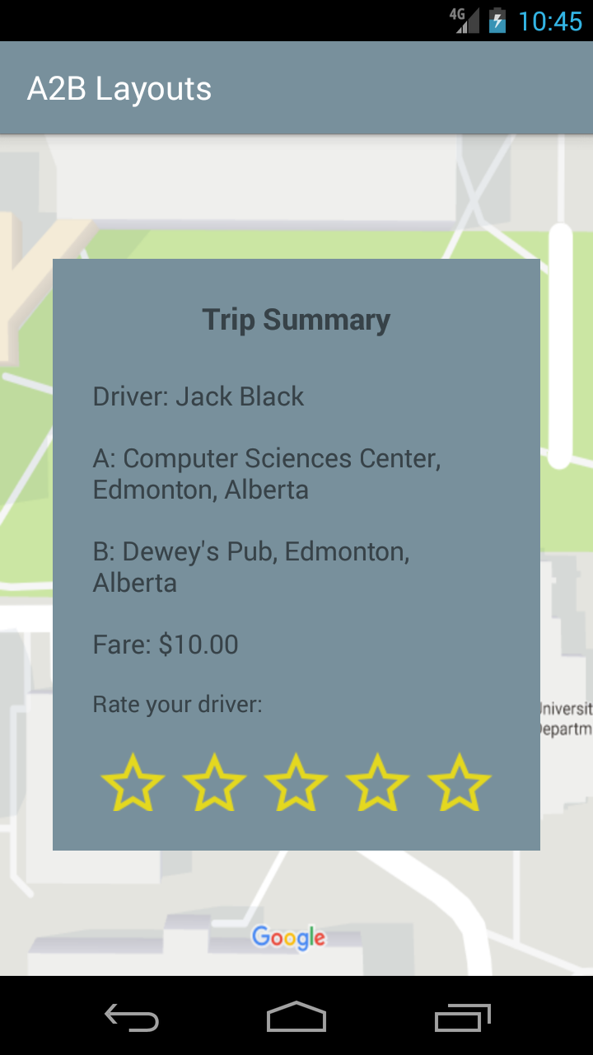
US 01.07.01
Confirm Completion of Request
Once you’ve arrived at your destination

Slide 8
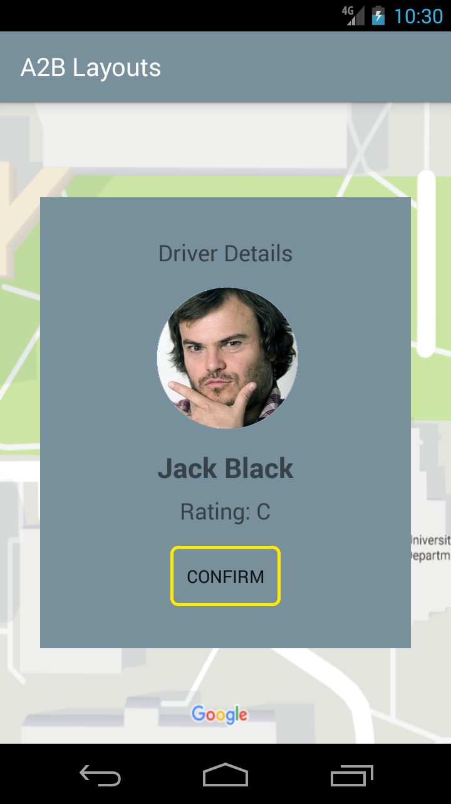
US 01.08.01
NEEDS PHOTOSHOPConfirm Drivers Acceptances
After choosing driver

Slide 9
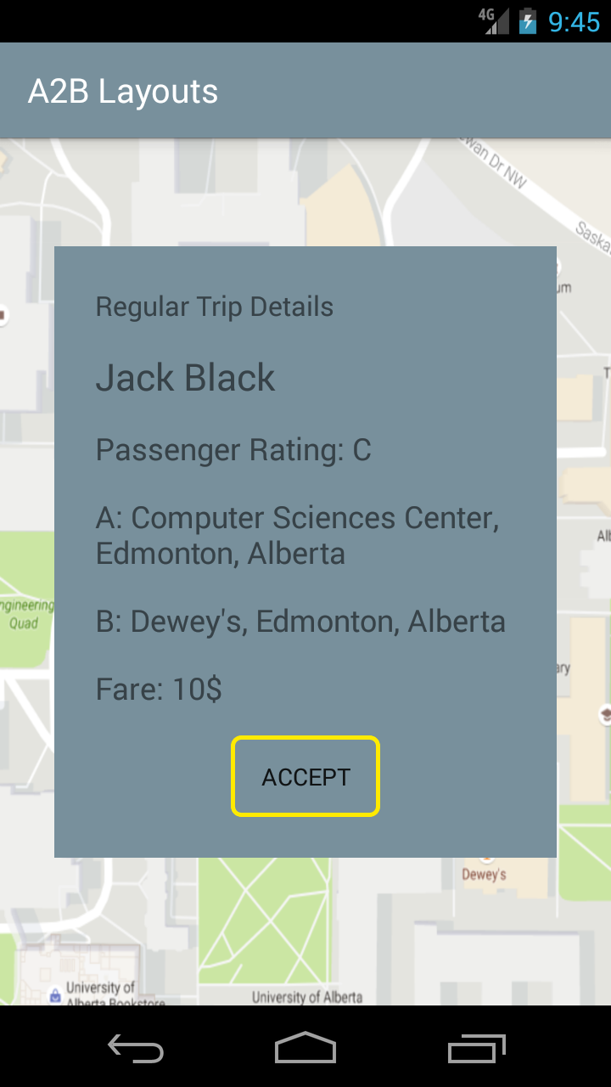
US 02.01.01
NEEDS PHOTOSHOPDriver Views Request Status
Choose Request

Slide 10
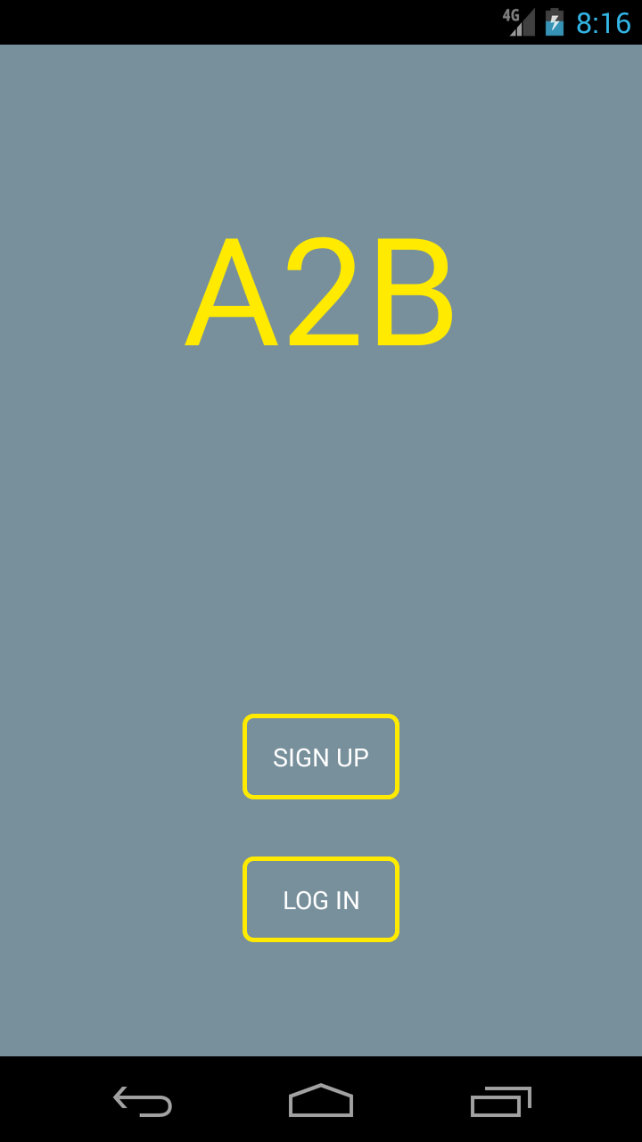
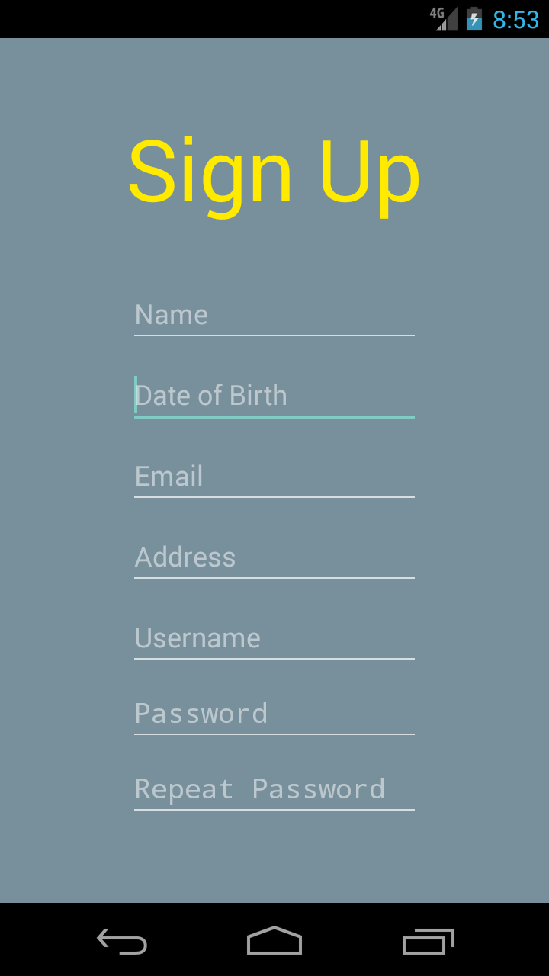
US 03.01.01
Profile Creation
Select Signup
Details Appear Something like this

Slide 11
US 03.03.01
See US 01.05.01

Slide 12
US 05.01.01
NEEDS PHOTOSHOPDriver Accepts Request
Selects a request

Slide 13
US 05.02.01
NEEDS PHOTOSHOPDriver Views Accepted Requests
Selects a request

Slide 14
US 05.03.01
Driver Views If Requests Are Accepted
See US 05.01.01 step 1

Slide 15
US 08.*
NEEDS PHOTOSHOP
Offline Warning (Appears in between steps of action regularly which is shown previously

Slide 16
US 05.02.01
NEEDS PHOTOSHOPDriver Views Accepted Requests
Selects a request

