Slide 1
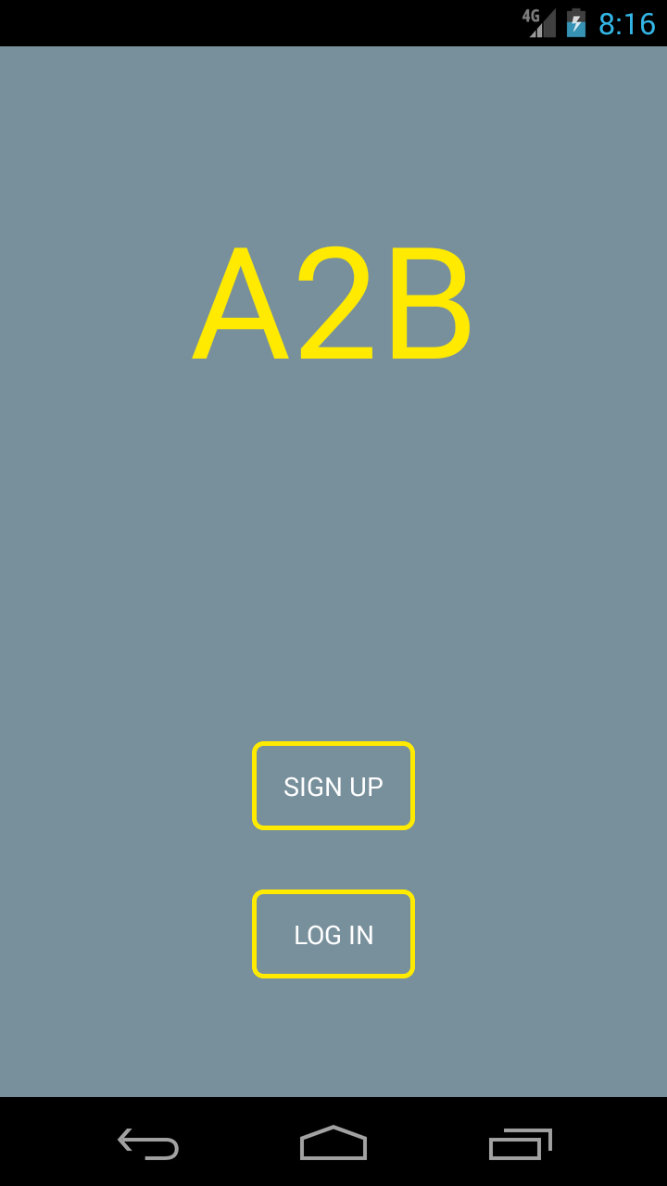
1st launch, user is prompted to sign up or log in if they already have an A2B account. For this use case the user has not yet created an account, so they select the “Sign Up” button. This brings them to the next activity where they will sign up for an A2B account.

Slide 2
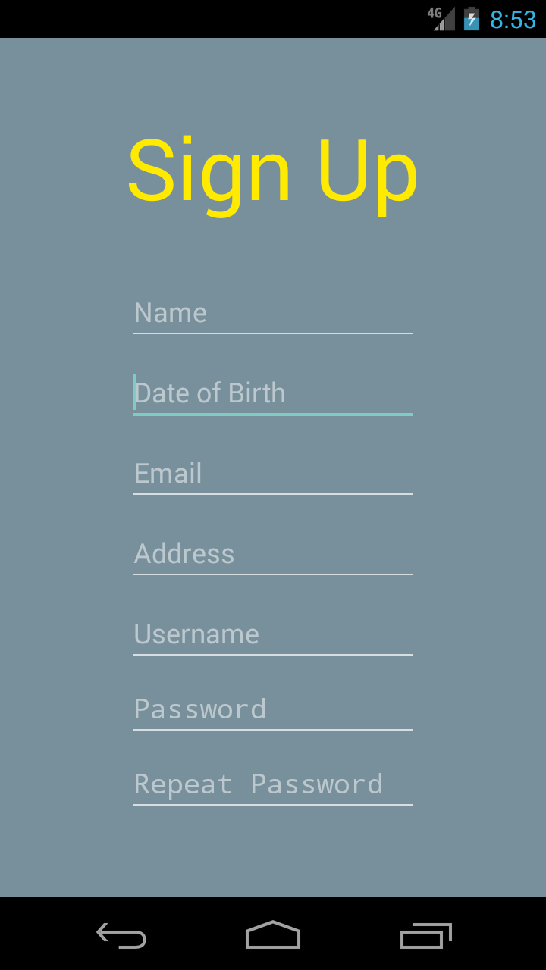
In this activity the user fills out all the necessary information to sign up. This information will be stored by A2B; the phone number and name will be displayed in order for A2B users to contact and meet each other quickly. Once the user fills out all the necessary information and scrolls down they can select a button which completes the sign up process.

Slide 3
The user is returned to this screen after signing up. From here, they will be able to press “Log In” since they now have the necessary credentials to become an A2B user.

Slide 4
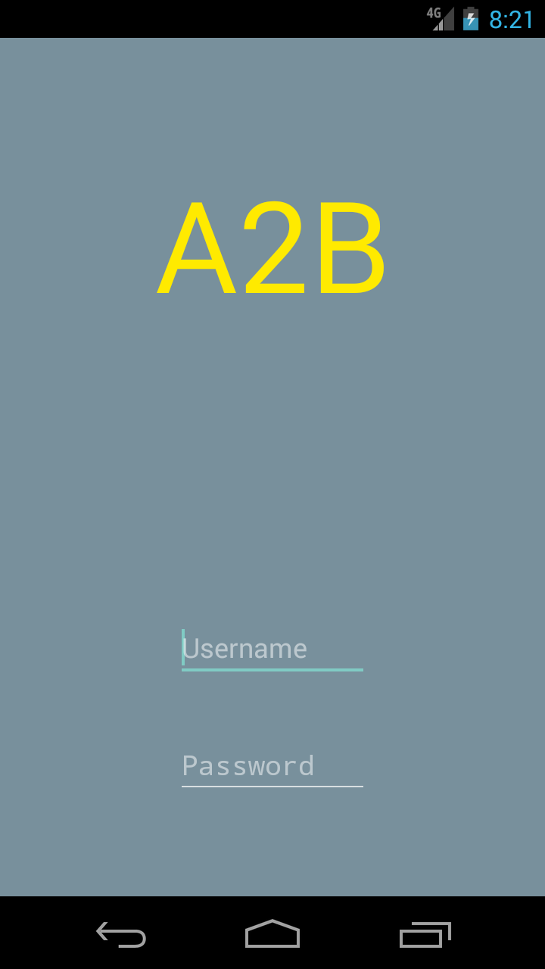
In this screen the user is required to authenticate. Once they have entries for both username and password they will be presented with an option to sign in, which will authenticate the user. For this use case the user has successfully entered their username and password, so they are presented with the next screen.
Note that further specifications have revealed passwords are unnecessary and this will be reflected in the final version.

Slide 5
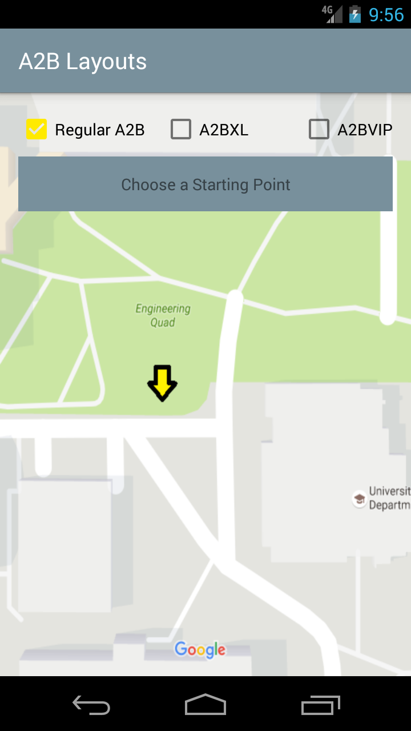
By default the user is presented with the passenger main activity view. From here they can select from the different A2B trips and select the starting point of their trip. From this menu they will also be able to switch to the driver activity and have access to a variety of other options from a menu (not shown but will be in the top right). For this use case the user is going to take a regular A2B trip, so they will press choose a starting point to begin their Trip.

Slide 6
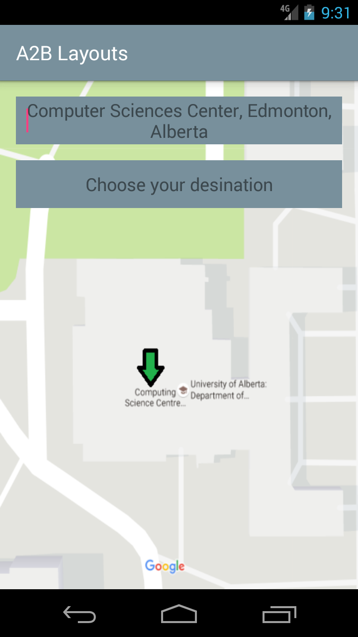
Once the rider starts entering text into the pick up location text box, the destination text box will appear on the screen. They can either enter an address or a geotag recognized by Google Maps in these text boxes. Once the location is recognized, a green arrow shows the pickup location on the map. Now that the user has entered the desired pick up location, they will select the “Choose your destination” textbox to begin entering their destination.

Slide 7
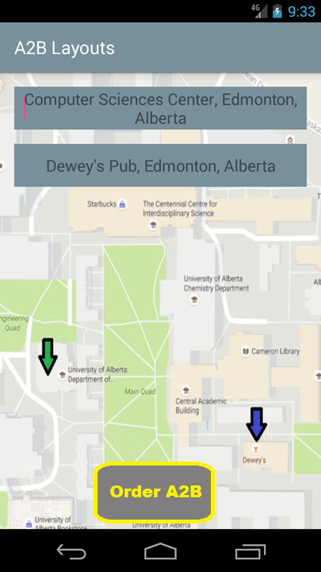
Now that they have also entered a destination, another arrow appears on the screen showing the destination. Now that they have also entered a destination, a button appears at the bottom of the screen that prompts them to order this ride. This takes them to the screen where they will enter their fare and wait for a driver to take their request.

Slide 8
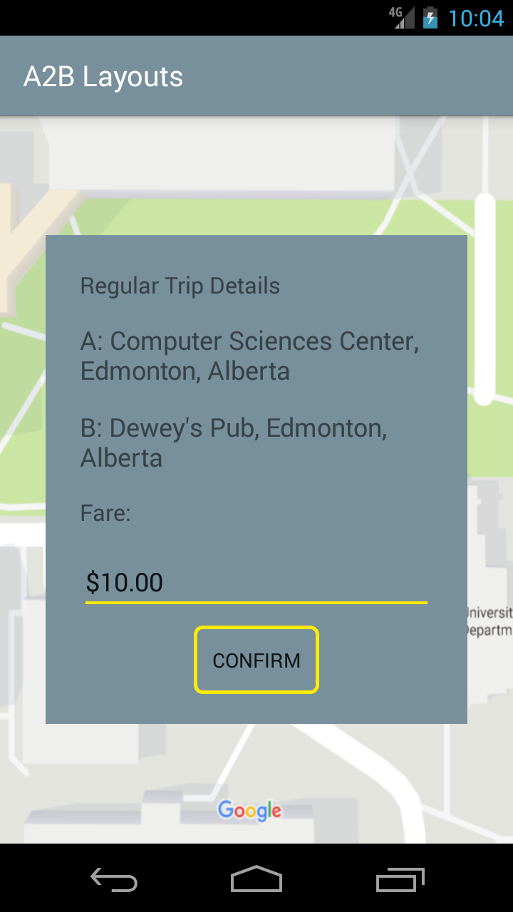
In this screen the user chooses what fare they are going to be paying for their ride. Once they enter a price and press confirm, they will see a “loading” or “waiting” graphic that will indicate they are currently waiting for a driver to accept their ride. Once a driver accepts, they are taken to the next screen.

Slide 9
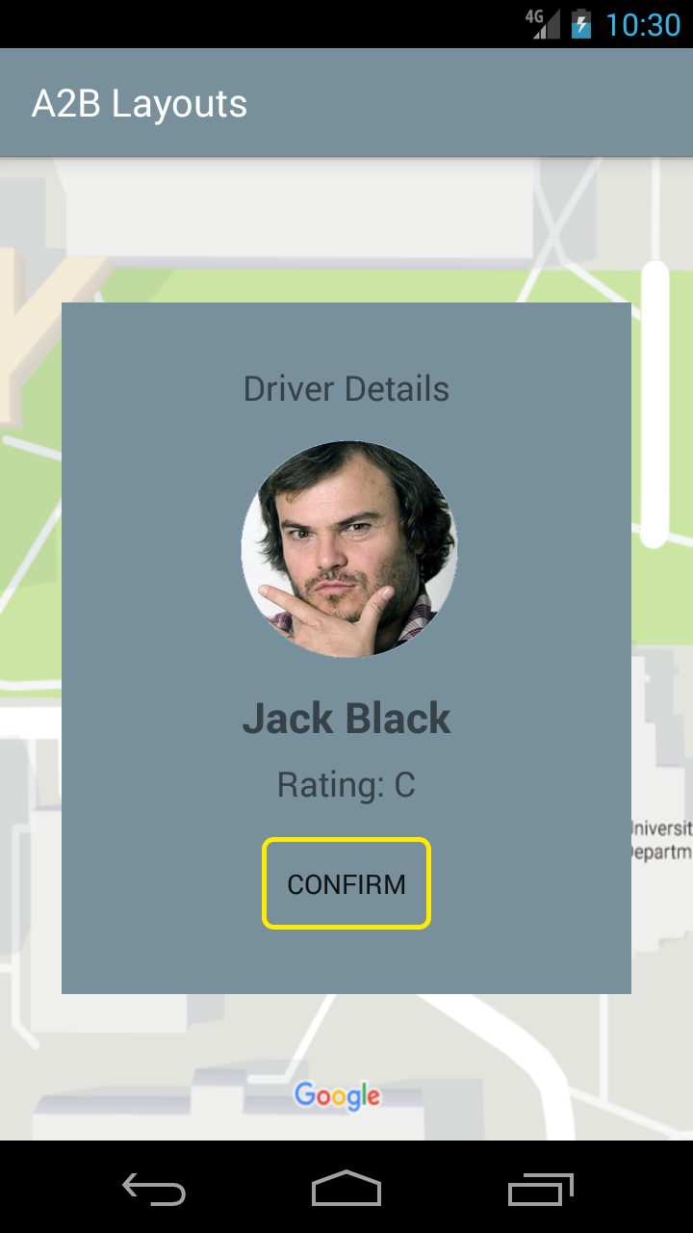
In this screen the rider views the driver info and decides whether or not they want to ride with this driver. In the actual view there will be a “Deny” button as well as the “Confirm” button that is shown, which will allow the rider to wait for another driver to accept their request. In this case the user has decided to confirm this driver.

Slide 10
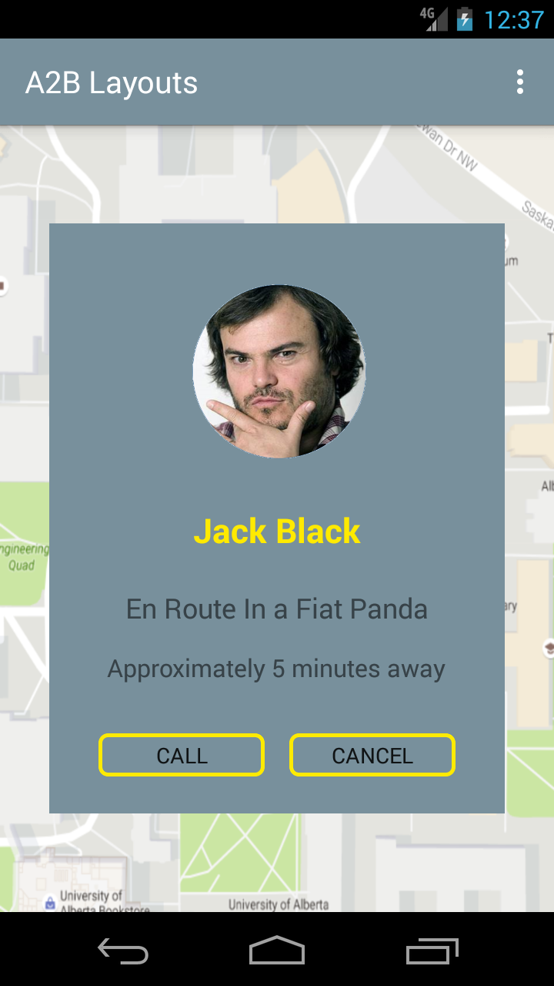
This is the screen that is presented to the user while they are waiting for their driver to show up. It gives them an estimate of how long their driver should be, as well as providing options for the rider to either contact the driver or to cancel the trip altogether. In this use case the driver was quick to pick up the user. Once the driver picks up the passenger and the two begin on their trip, the text will change to show the destination an approximate arrival time. Upon completion of the trip the user is taken to the next screen.

Slide 11
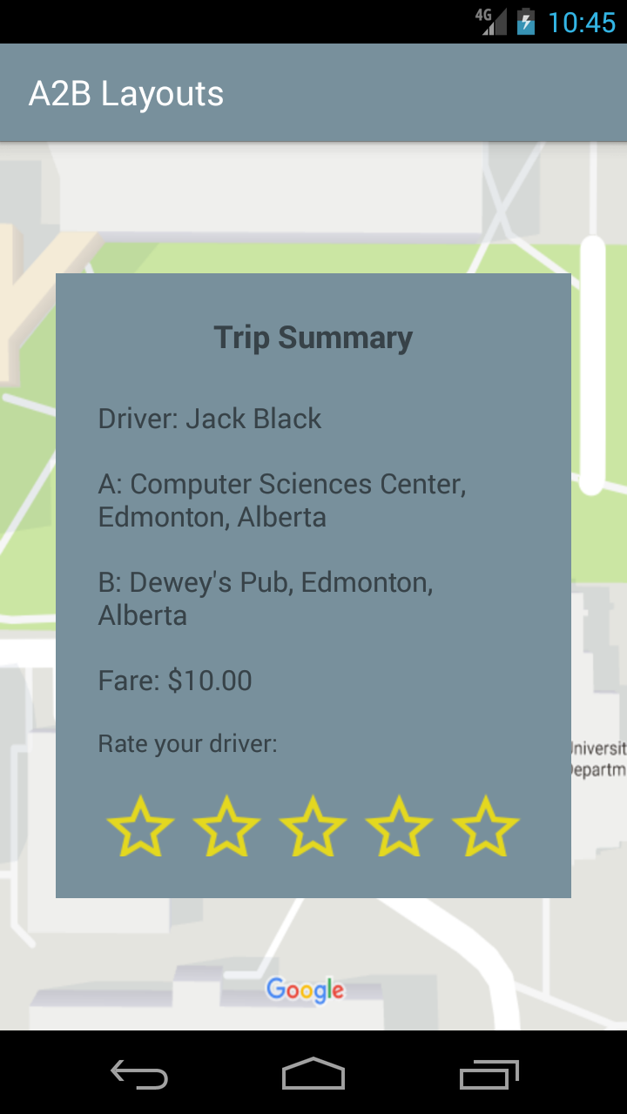
This is the screen that riders will see once they have finished a trip. It will show a summary of the trip details, as well as give the rider an option to rate the driver based on the trip. Once the user has rated the driver (or pressed outside of the trip summary dialog) they will be returned to the main passenger activity screen.

