Slide 1
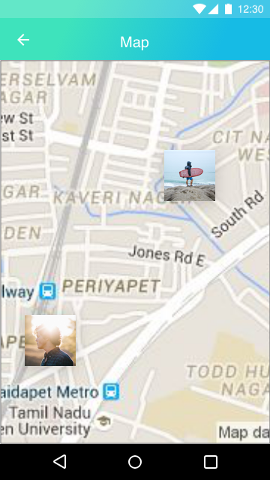
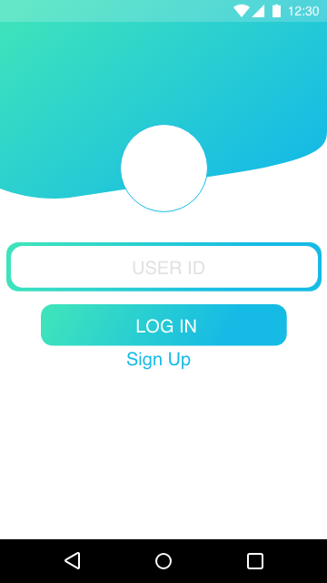
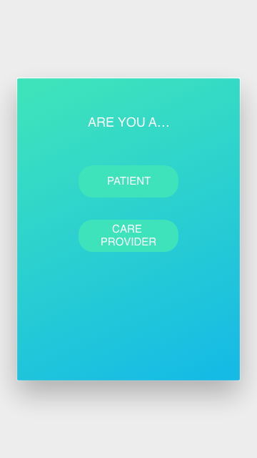
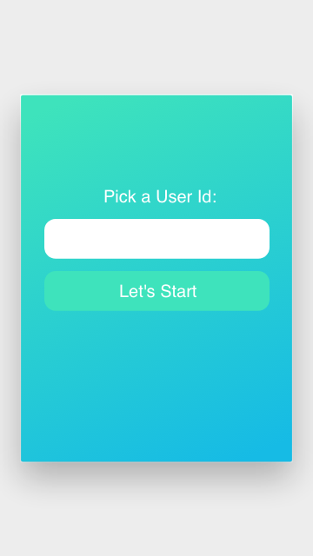
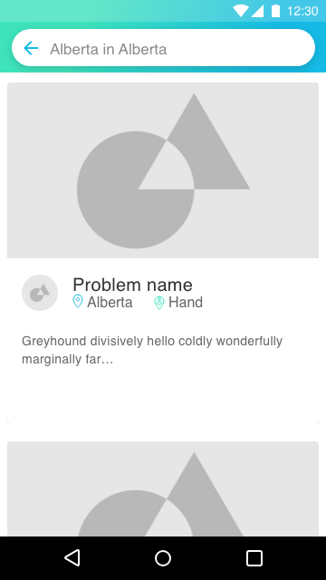
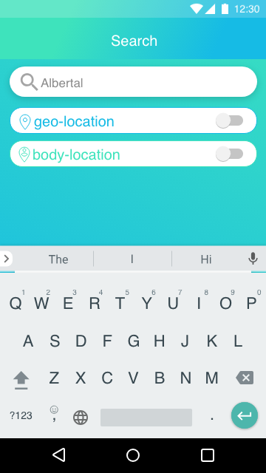
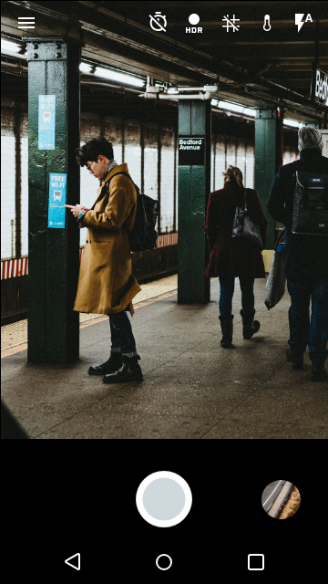
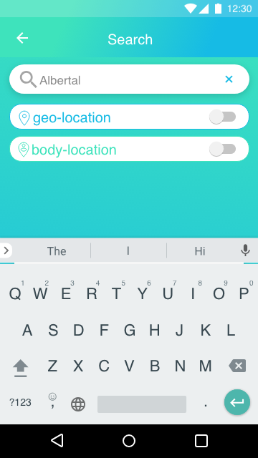
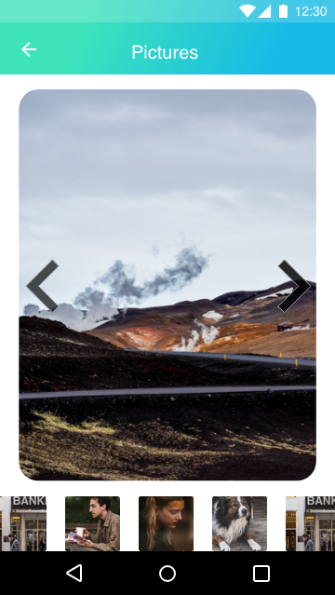
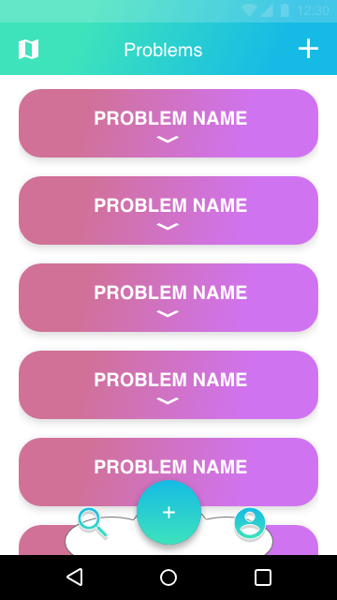
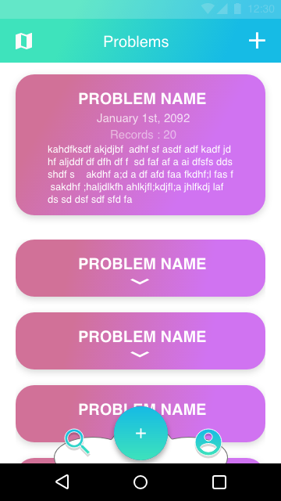
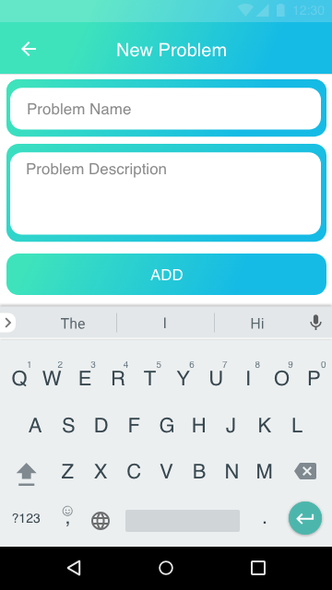
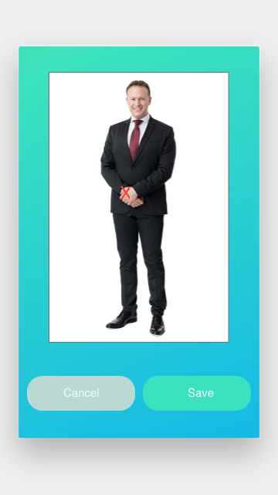
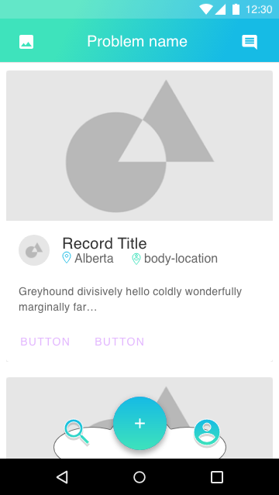
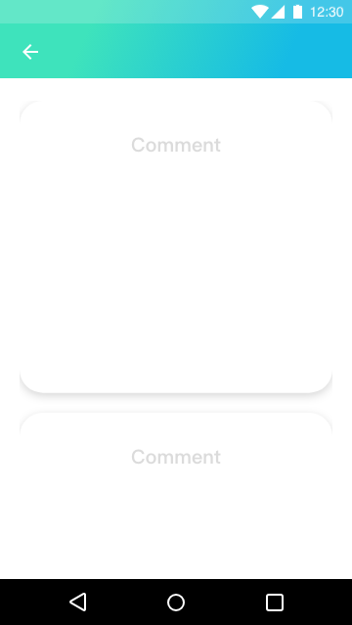
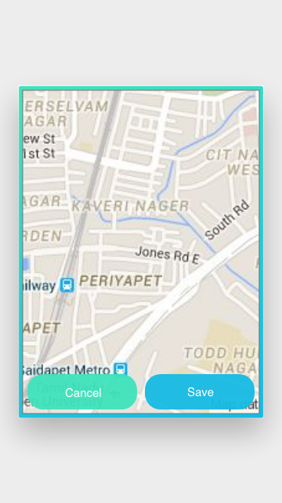
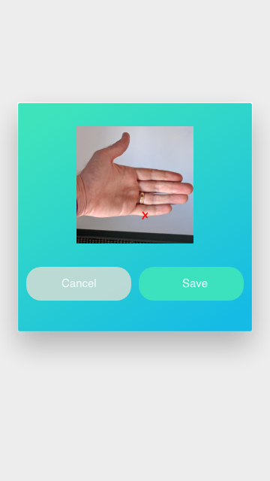
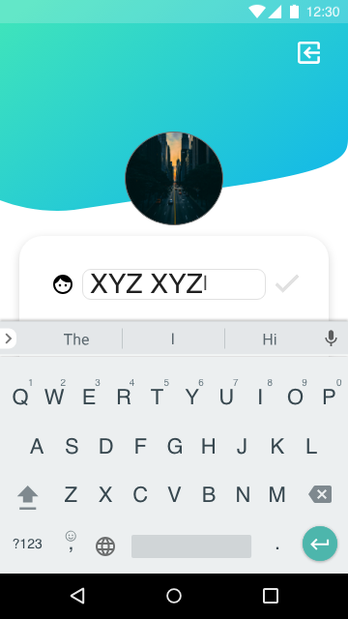
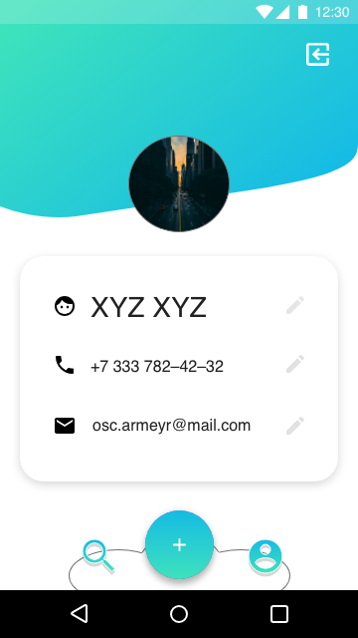
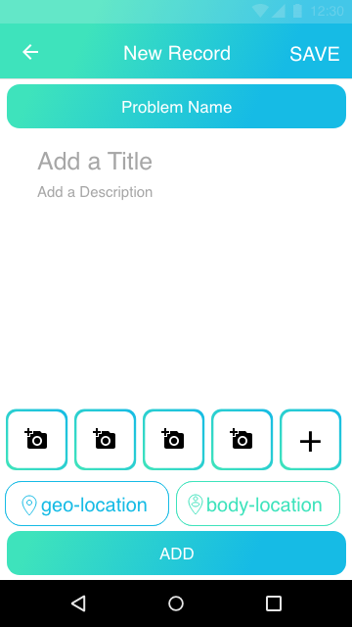
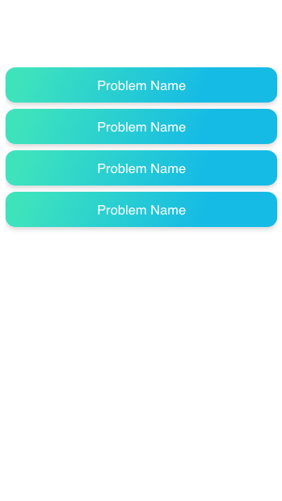
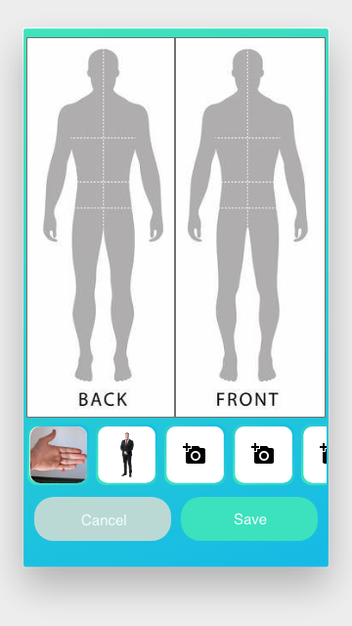

User selects map icon in top left to view all records on a map
User opens the app and encounters the login screen
User selects if they are a caregiver or patient
Results for search term are returned
User selects keyword, geo-location or body location to search
Enters user ID
User selects sign up
User is a patient and now logged in and sees problems
User selects the camera icon to launch the camera to add a photo to a record
User selects magnify glass in bottom menu to search
User selects picture icon in top left to view photo slideshow for the problem
User selects camera to take new body location photo
User selects point on new photo
User can select a problem to see more details
User sees records for that problem
User selects comment icon in top right to view care provider comments for that problem
User selects + in top right corner to add a new problem
User selects a point on a previous body location photo
User select add and returns to problem list
User selects geo-location to add a location
User selects + on bottom menu to add a new record
User selects pencil icon to edit name, phone or email
User can enter a title and description
User saves record by selecting save in the top right or add on the bottom
User selects body location to create a body location photo
User selects location on default body photo
User selects ‘problem name’ to select the problem to add record to
User selects profile icon in bottom menu

Slide 2
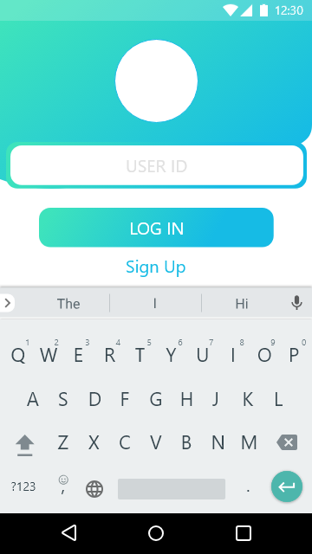
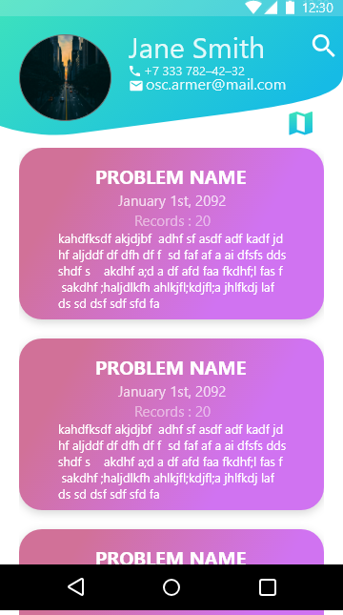

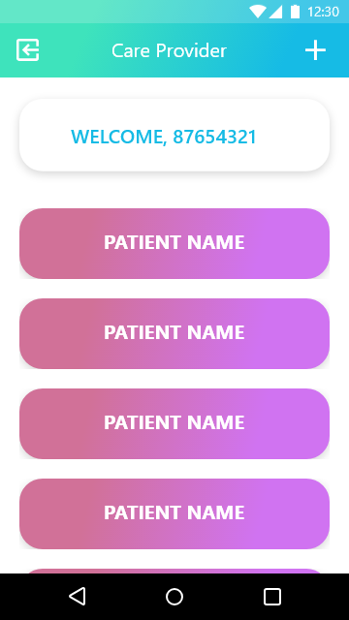


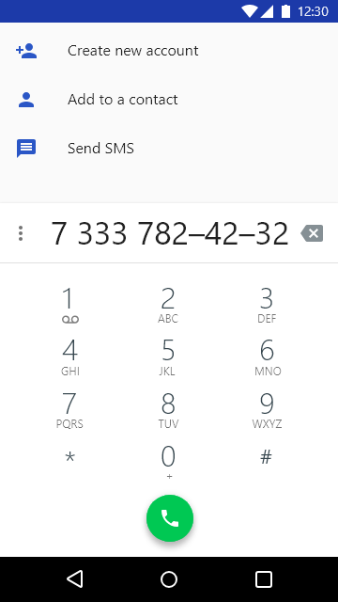
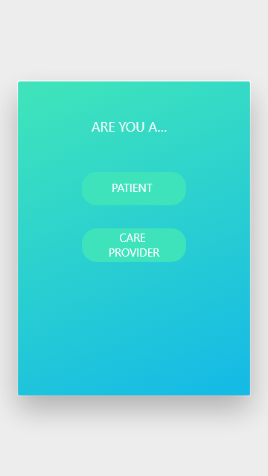
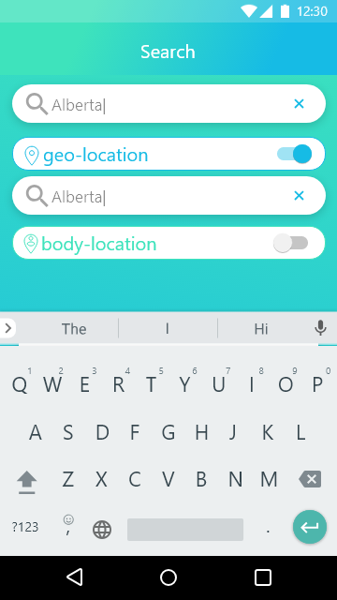
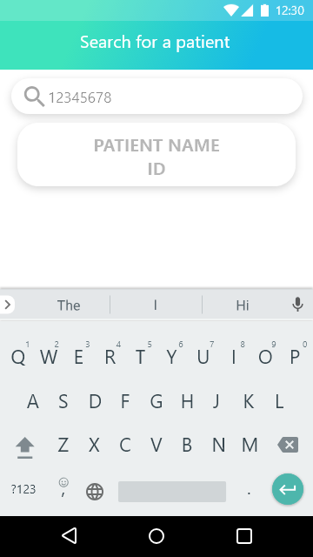
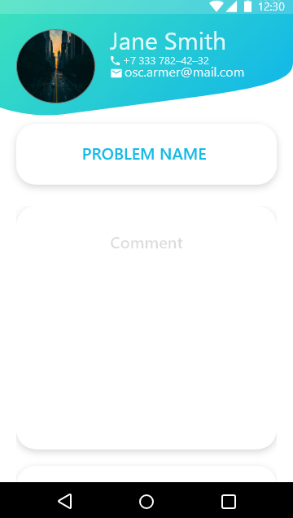

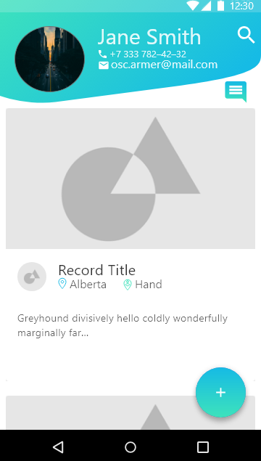
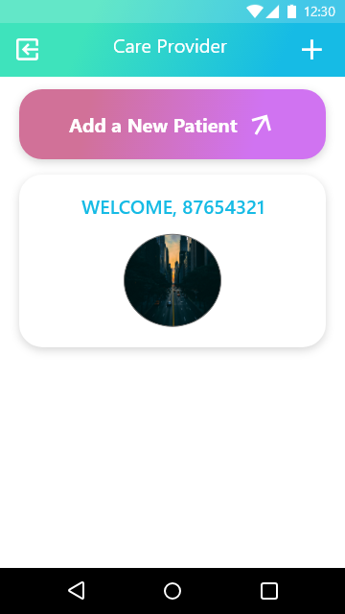
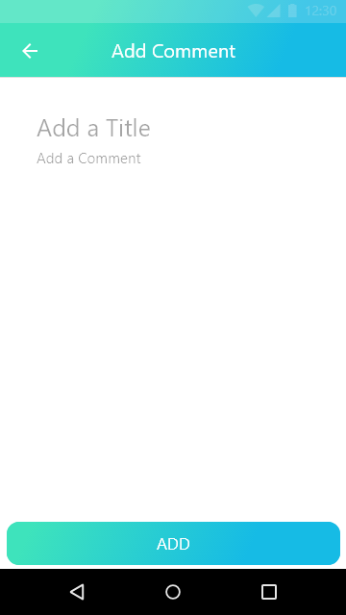
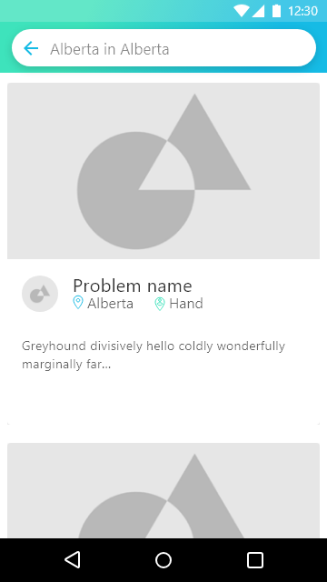
User encounters the log in screen.
User clicks on magnifying glass to search.
User clicks on a patient’s name.
User logs in.
User clicks on map.
User clicks on email.
User clicks on phone number.
User chooses sign up.
List of problems.
User adds patient by clicking the plus.
Search by geolocation by switching the slider.
User returns to list of patients with the new patient added.
User clicks on a problem.
User signs up as care provider.
Press comment icon to view comments.
Search Results.
User adds patient by clicking the plus.
List of comments.
Press plus to add a new comment.
User Enters ID.
List of records.
User sees empty list of problems.

