Slide 1
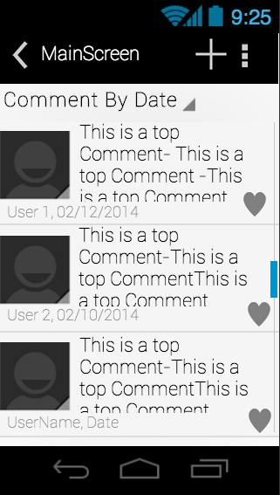
Main Screen
The main screen provides the user with a list of top level comments, with user name and date of posting under each comment. The user can click on one of the top level comments to browse comment replies, and can also click on the heart icon to save this comment as favorite (favorite comments can be read offline). The “+” icon on the right of the action bar allows user to create a top level comment. Clicking on the “Settings” next to “+” will allow user to change the user name etc. “Comment By Date” is a drop down list containing different sorting methods, and by default, comments are listed by date (most fresh ones on top).

Slide 2
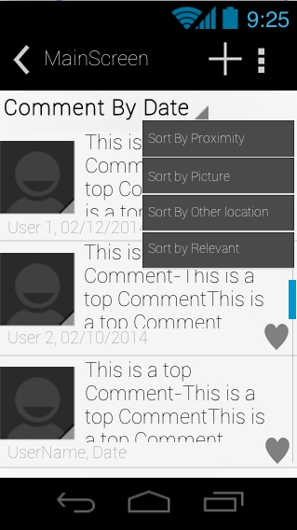
Sort Menu
This drop down menu on the main screen provides four sorting method:
Sort comments by proximity to user.
Sort comments by pictures.
Sort comments by proximity to another location.
Sort comments by relevant (some scoring system).

Slide 3
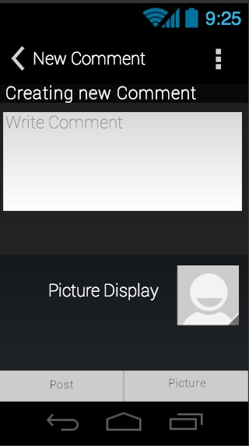
New Comment
After clicking the “+” icon on the main screen, this “New Comment” page lets user to write a new comment. By clicking the “Post” button in the bottom left corner, the comment will be posted on the main screen. And by clicking the “Picture” button in the bottom right corner, a dialogue will pop up, which will be discussed on the next page. Further more, this “New Comment” will also be used to reply to any other comments.

Slide 4
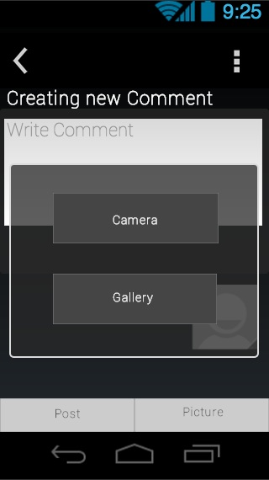
Picture Dialogue
After clicking the “Picture” button, this dialogue will ask user to either open the camera to take a new picture or select an existing picture in the local gallery.

Slide 5
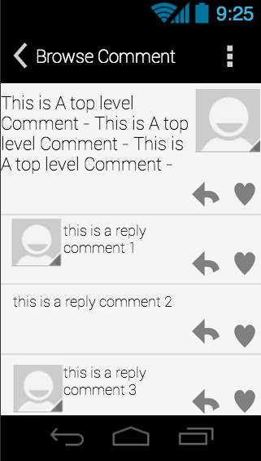
Browse Comment
This is the screen shows up after the user clicks on one of the top level comments on the main screen that is not made by him/herself. It lists a list of replies of this comment, and the user can reply to each one of the replies as well as the top level comment by clicking the arrow beside each reply/comment, and then it will take user to “New Comment” page. The user can save a certain reply/comment using the “heart” button.

Slide 6
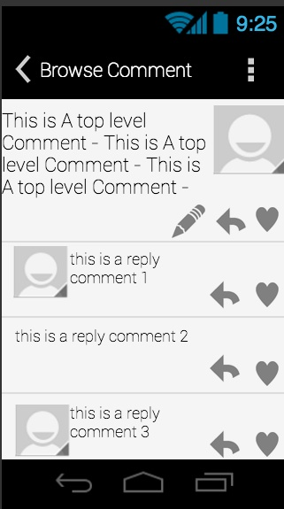
Browse Comment
This is a slightly different “Browse Comment” page. It is generated by clicking a comment made by the user him/herself. The only difference is the “pencil” icon to the left of the “arrow” icon. It allows user to edit his/her own comment.

Slide 7
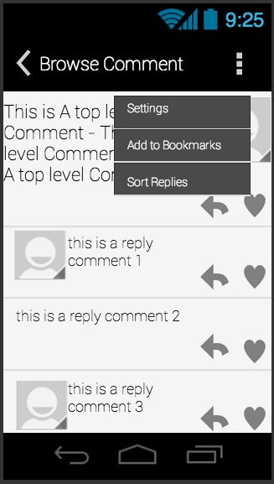
Browse Comment
The action bar in “Browse Comment” page has three options:
Settings:
Same as the one on main screen.
Add to Bookmarks:
Saves this comment and its replies to bookmarks, so the user can read them offline.
Sort Replies:
Sort the replies using different methods.

Slide 8
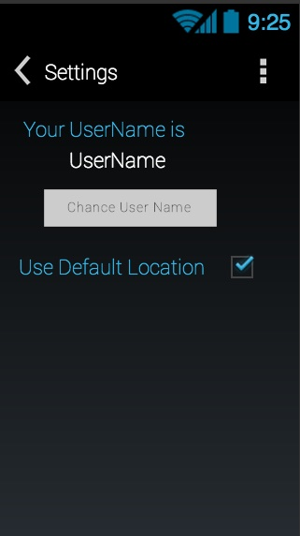
Settings
User can change his/her user name in this page, and decide whether or not to use the default location. Uncheck the box will allow users to set their own locations.

Slide 9
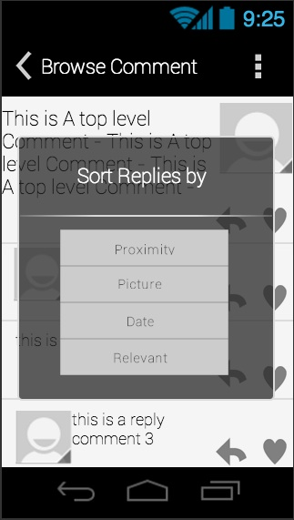
Sort Replies
This dialogue provide four sorting methods similar to the sorting methods of top level comments.

