Slide 1
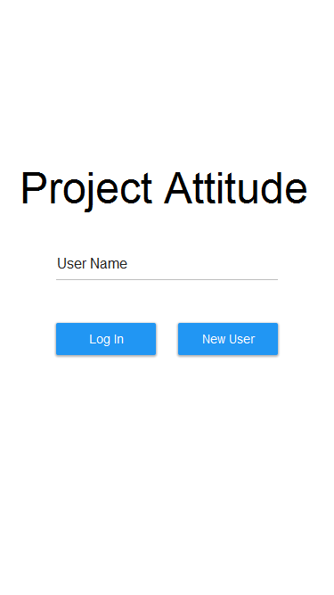
Login Screen:
Users can enter a name and will
either create a new user or log
in with the given username

Slide 2
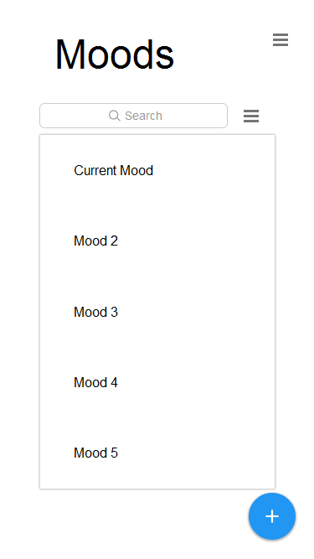
The main moods page
This shows the feed of moods, which can be sorted and filtered
There is also a hamburger menu
with the option to go to map, profile
or to logout

Slide 3
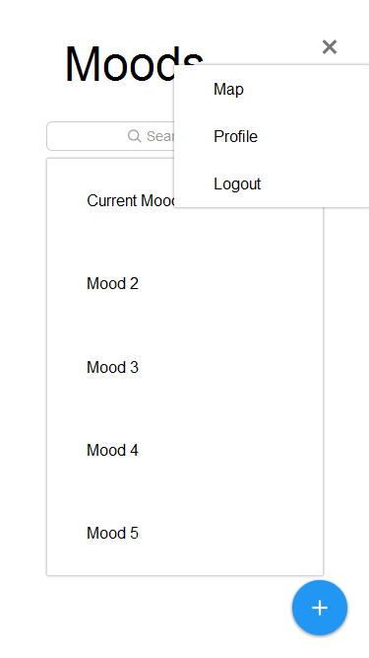
The map/profile/logout
menu

Slide 4
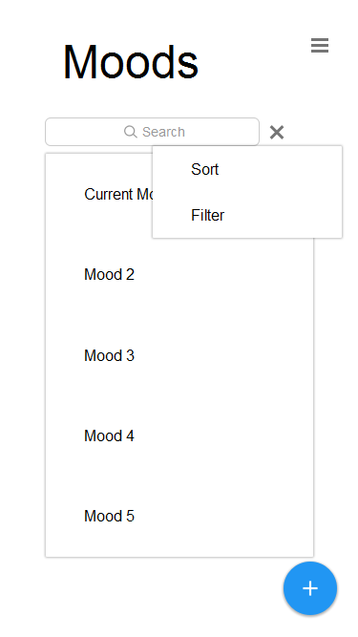
The sorting/filter menu

Slide 5
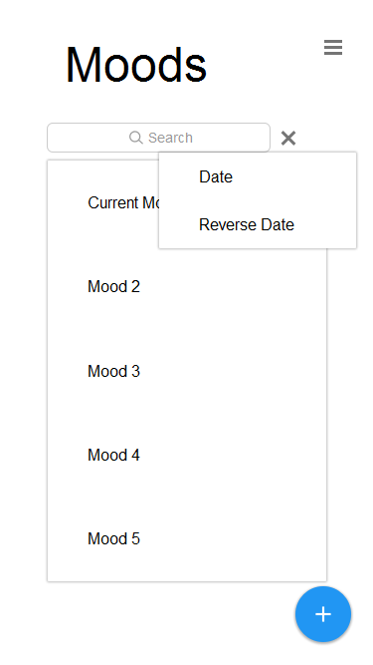

Slide 6
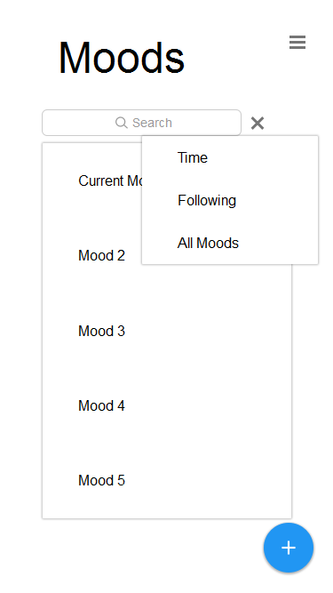

Slide 7
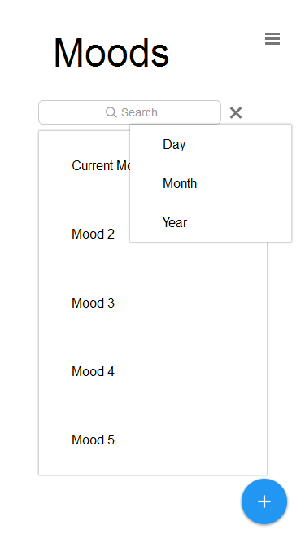

Slide 8
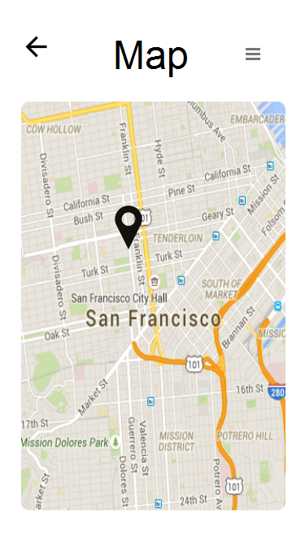
The map page
Each mood nearby is a pin which
Brings up a menu when you click
On it with the option to go to the
Person’s profile. There are also
Options to filter the results

Slide 9
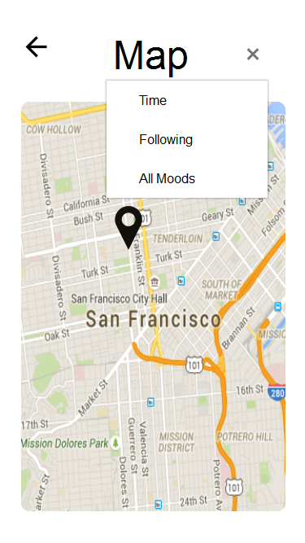

Slide 10
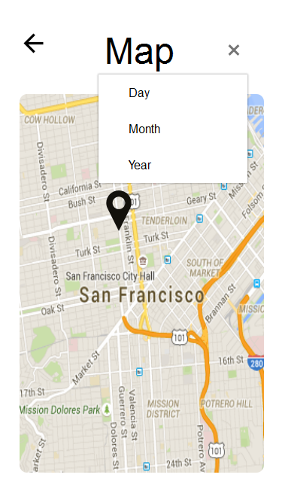

Slide 11
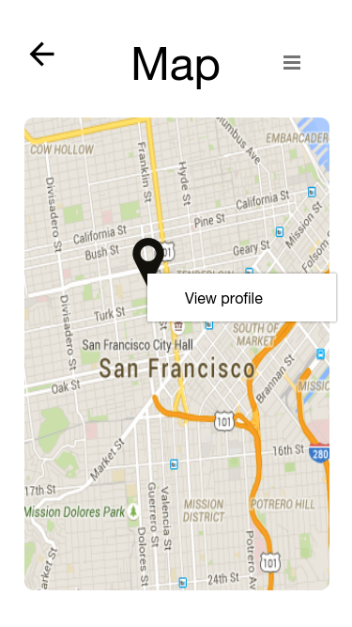

Slide 12
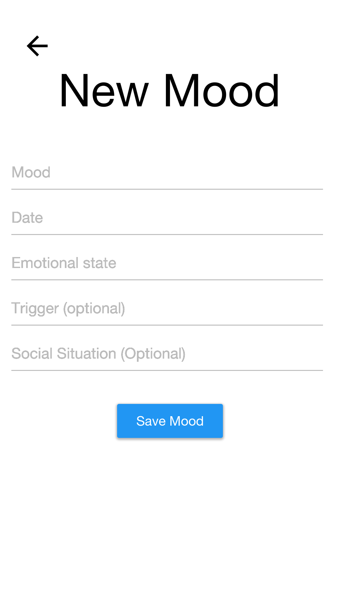
New Mood menu
Has fields for all parts of
The mood. As well as the option
To add a picture related to the
Mood
Choose photo
Save Mood

Slide 13
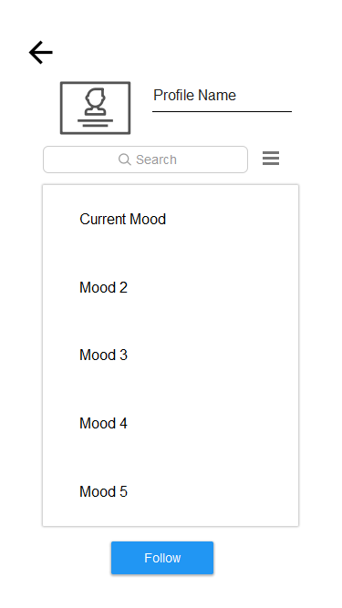
Profile page shows recent moods as well as a bit of information
For the person. You can also filter
and sort moods. When looking
At your own profile the follow button
Becomes an edit button

Slide 14
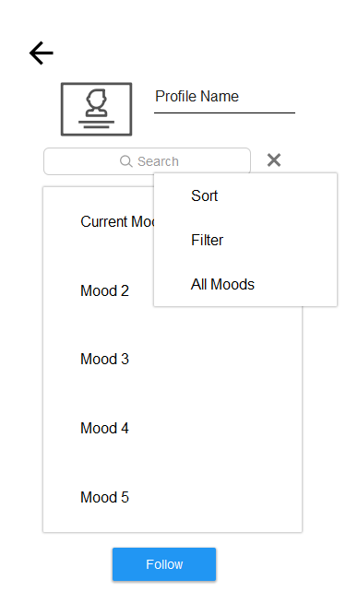

Slide 15
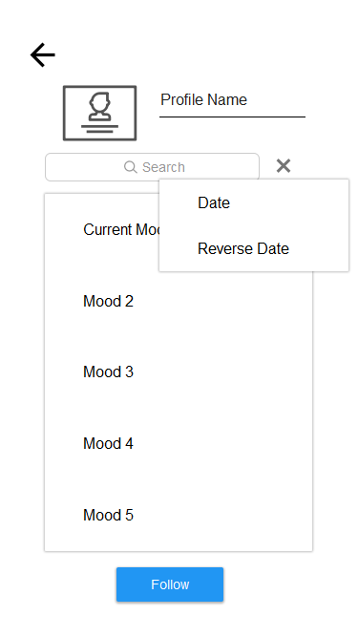

Slide 16
