Slide 1
CMPUT 301 Demo
T 16

Slide 2
Hello!
We are group 16
Jeremy Youwei
Ruohan Yuxin
WenKai Zhiyuan

Slide 3
This presentation will...
Brief introduction for our Quicar app
Demonstration
Show extra functionality other than user story / requirement
Please pay attention and it will be fun!

Slide 4

QuicaR
This is our logo

Slide 5
Mobile project
Place your screenshot here
Full rider & driver process demonstration

Slide 6
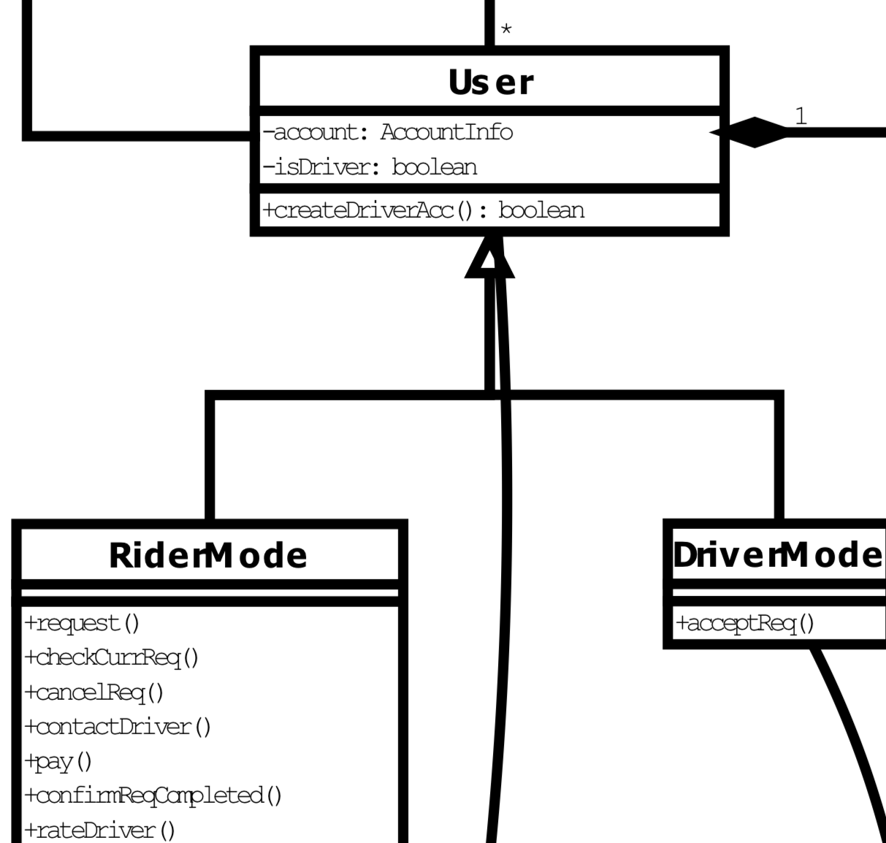
Rider & Driver mode
All users are by default riders when have an account
have access to rider mode
can request orders.
Users become drivers by registering
access to the driver mode
Accept rider requests one at a time
Restrictions:
rider can only have 1 request on-going
driver can only have 1 request on-going

Slide 7
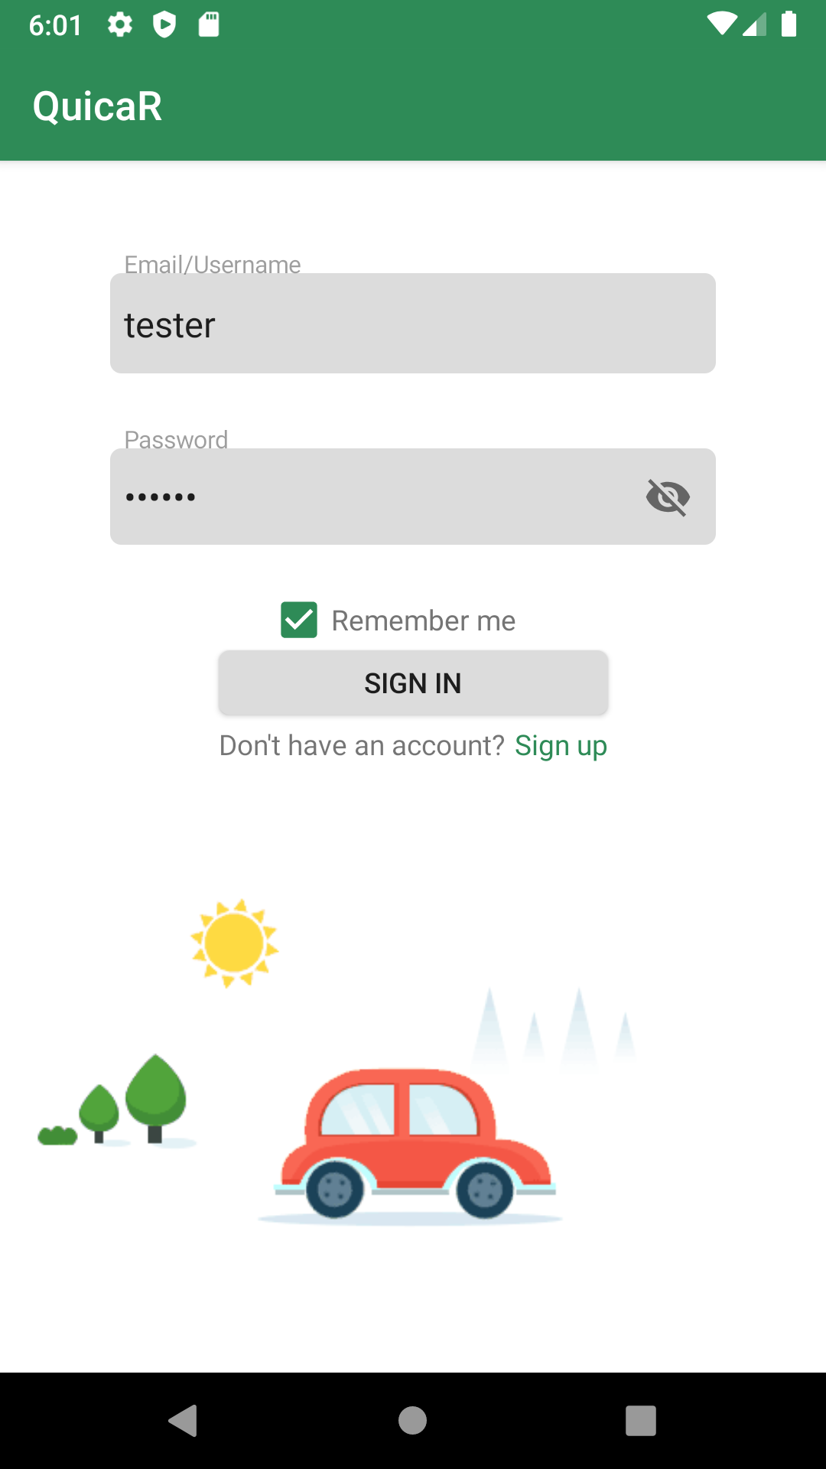
Login
Could use both username/email to login
Could remember password
Able to change email/password afterwords

Slide 8
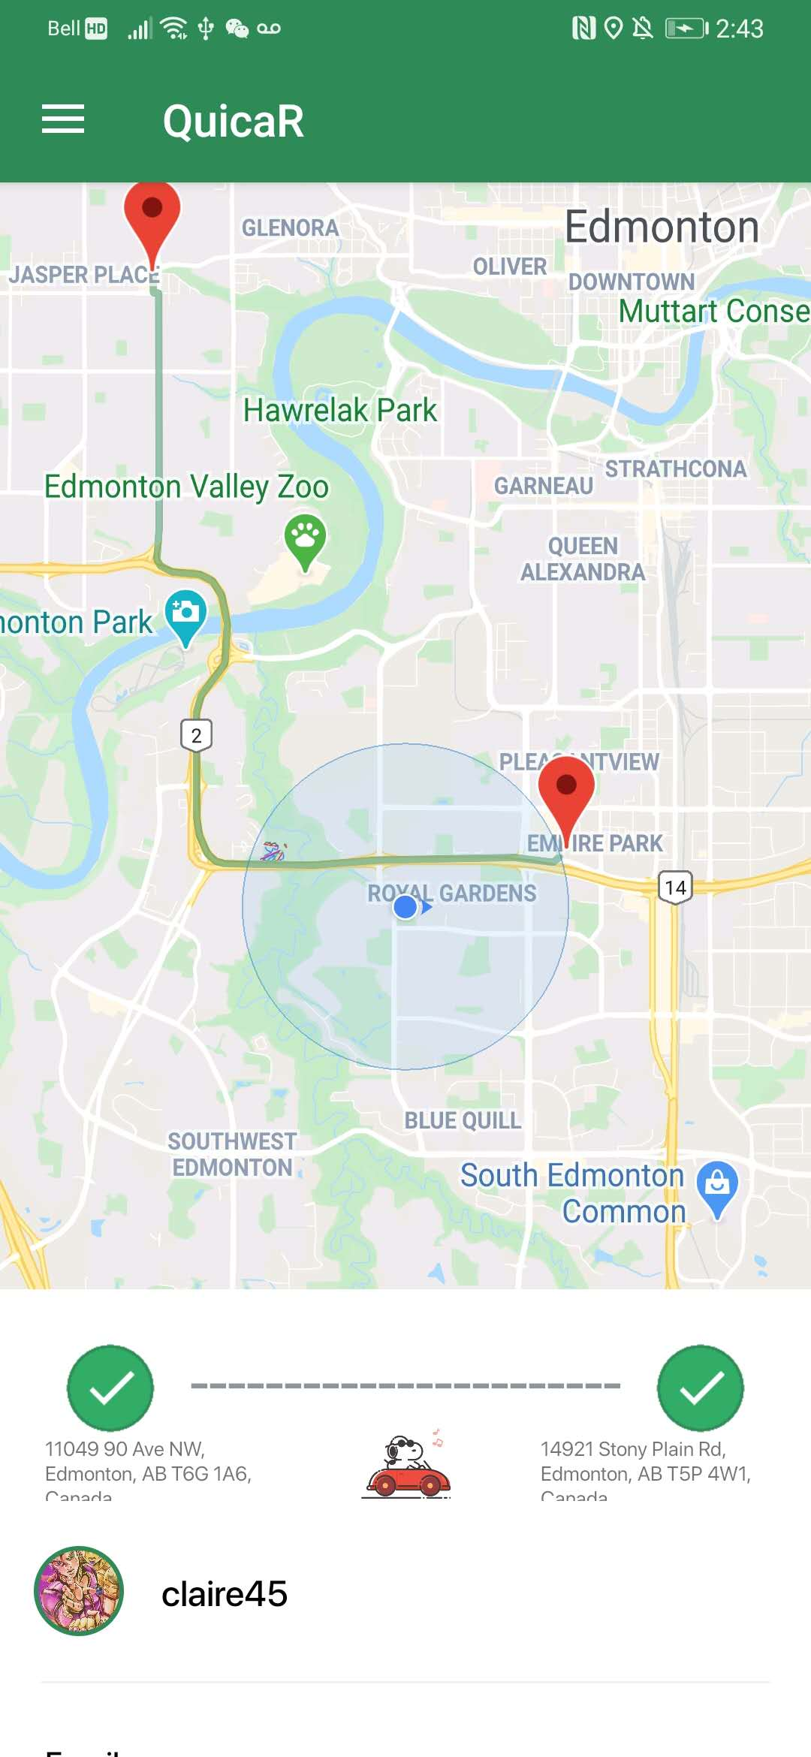
Google Map
- Autocomplete Fragment searching for location
- Direction API for precise routes
API Key => Fetch Url => JSON parser => Route
- Current traffic situation enabled

Slide 9
Rider & Driver mode Highlights
Rider
history location
Invalid route detect
Driver’s location update
Pop-up notification
Total time for ride
Driver
open requests list auto update
Out of range detect
Route from driver to rider
route from pick up location destination

Slide 10
More Highlights
User Account
Remember logged in account
Log in using either username or email (both unique)
Change email and password, and other personal info
Register as a driver for the first time(more Info)
More
According rating to change head-profile
Incompleted profile info detection alert
Re-enter app from anywhere to get back to the previous activity
Network connection changed detection
Wallet
Bind debit/master card to account
Top-up balance
Extra QR code money transfer function
More information in help menu...

Slide 11
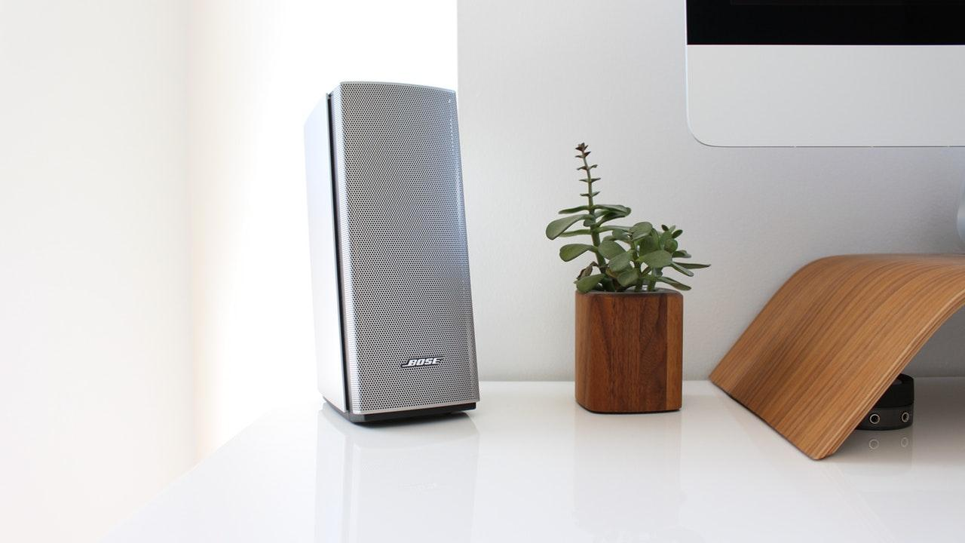

A picture is worth a thousand words
When the total commits is a special number...

Slide 12
Our process is easy
Order / Accept a ride request
Rider: Selection locations and confirm
Driver: Select a request and accept
Waiting for Pick up
Rider: Cancel the ride before pick up, or wait for notification, view driver’s info using bottom sheet
Driver: Go to pick up location, confirm picked up, view rider’s info using bottom sheet
Arrive destination
1
Rider: Review ride details, offer tax,
rate ride, provide QR code
Driver: Confirm arrive, scan QR code
2
3

Slide 13
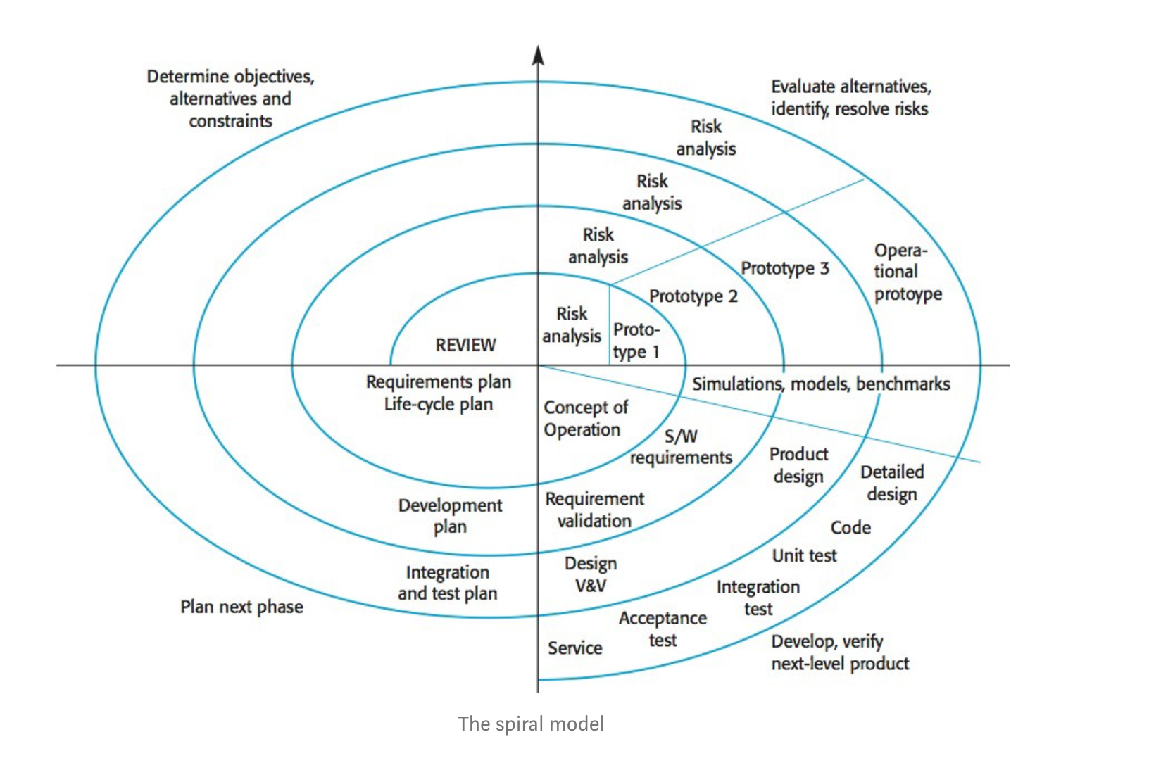
Let’s review some Design Pattern
Singleton Pattern
Firebase operation are separated to different data helper class as a singleton
Template Method Pattern
Map related activities extends an abstract base activity and implement template methods for different purposes
Scrum Meeting
MVC Design
Database as model, listeners implemented for auto updates, activities are view
Spiral Model

Slide 14
Credits
Special thanks to all the people who help us in the process especially our TA, Dong Wang. He provided us some valuable advices.

Slide 15
Thanks!
Any questions?

Slide 16
END HERE...
What can be improved in the future?

