Slide 1

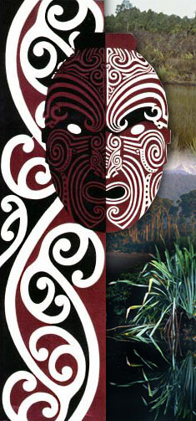

Mapping interviews with open source technologies
Dr. Chris McDowall
Landcare Research
FOSS4G, Sydney
Oct 23, 2009

Slide 2
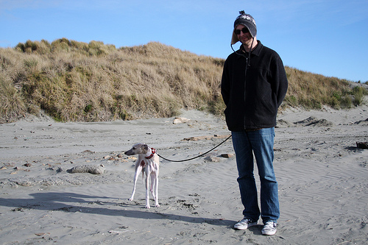
geography
making stuff
+ knowledge representation
stuff that interests me

Slide 3
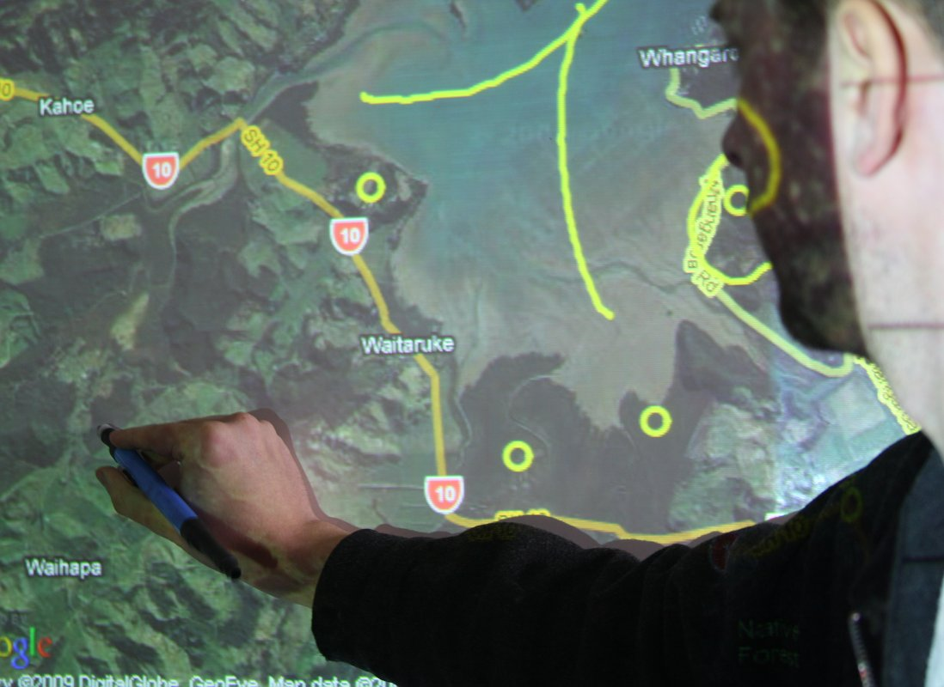
context
system
thoughts

Slide 4
[ some context ]

Slide 5
Qualitative research
is hard
Notes:
Qualitative research is very difficult to do well. It is time consuming. The information is nuanced. It is difficult to represent in a formal framework whilst retaining its integrity.

Slide 6
After participating in
interviews, two things
became clear …
Notes:
I spent a lot of time tagging along to interviews. First, with grape growers talking about vineyard planting decisions and the viticultural history of regions. Later, accompanying a social scientist speaking with Maori about the cultural history of landscapes.

Slide 7
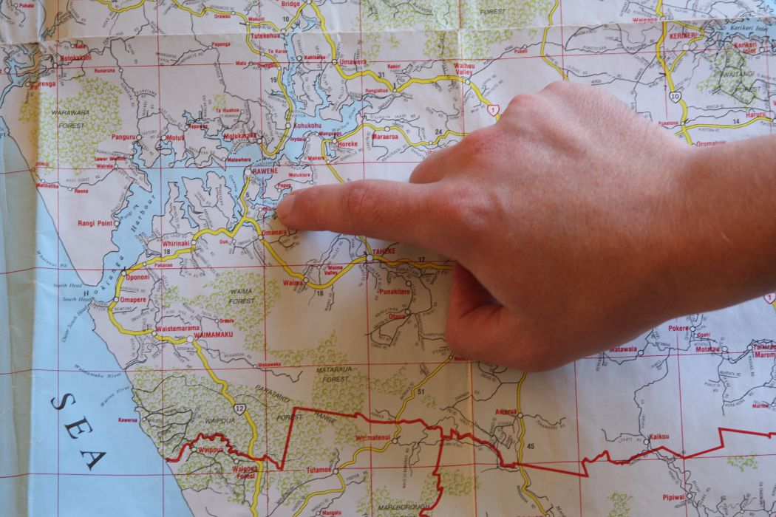
Important material is lost
Notes:
Many aspects of an interview are not captured. Facial expressions, body language, small talk. In my case I was particularly aware of the fact that we were losing the gestures that people make on maps. The “where” context was getting lost.

Slide 8
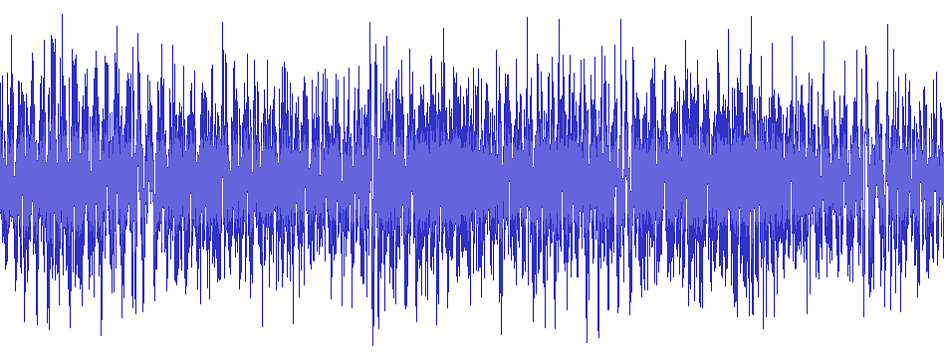
Audio is hard to analyse and search
Notes:
Same could be said for video.

Slide 9
So, this is what I did …
Notes:
Qualitative research is very difficult to do well. It is time consuming. The information is nuanced. It is difficult to represent in a formal framework whilst retaining its integrity.

Slide 10
[ early experiments ]

Slide 11
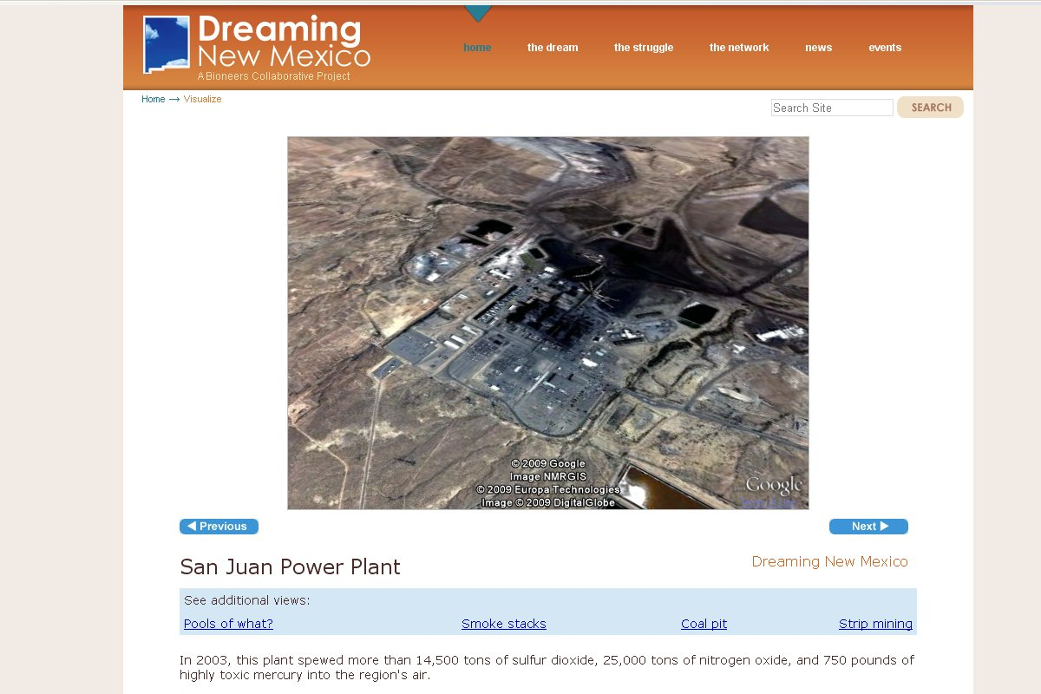
Notes:
Built on an what we saw in the Dreaming New Mexico visualization project.

Slide 12
Embed media in interactive map
User interface offers guided narrative and exploration

Slide 13
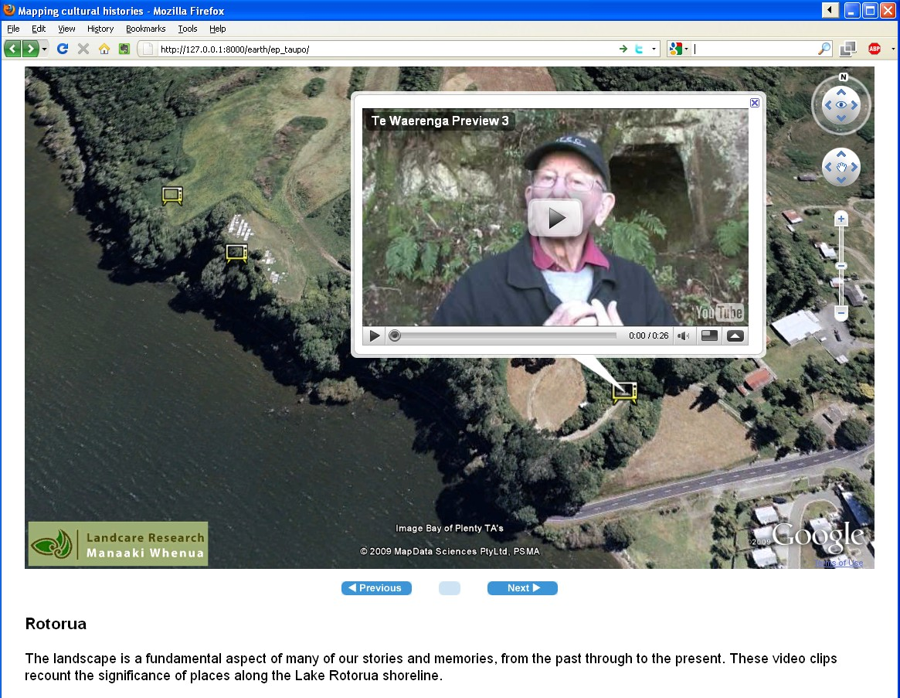

Slide 14
Good way to share and contextualise stories
Content creation is time consuming and costly

Slide 15
Does not address our interview problems

Slide 16
I kept stumbling across clues on the web …

Slide 17
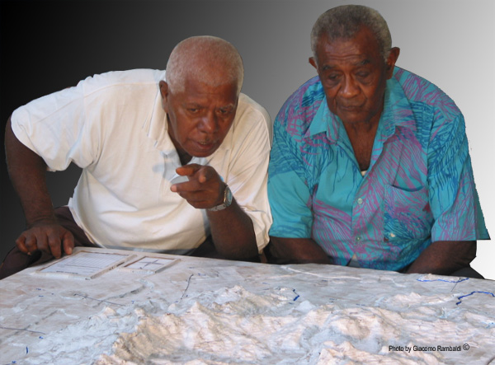
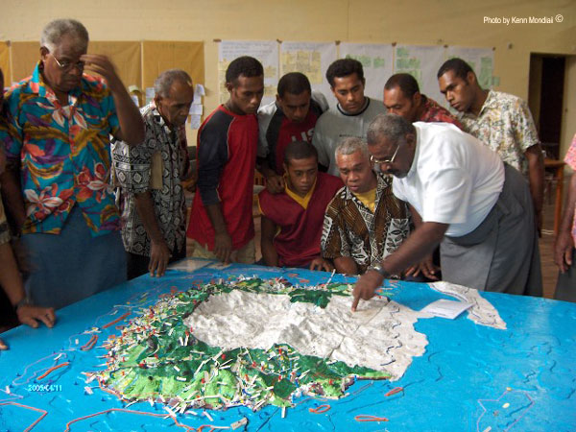
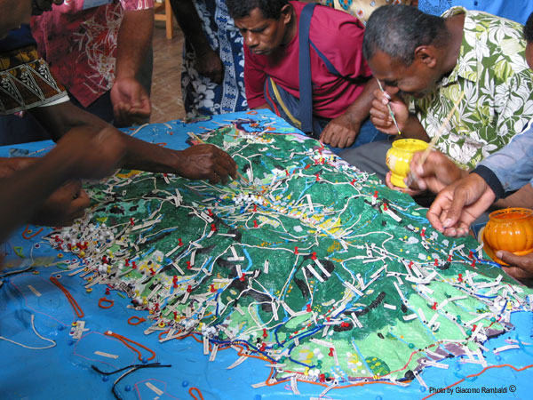
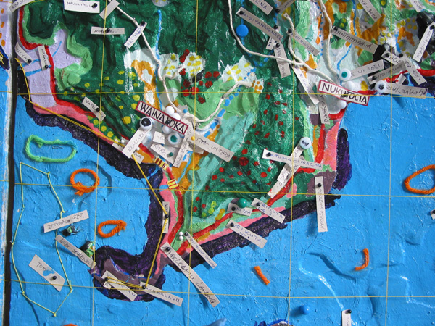
http://www.iapad.org
Notes:
Local knowledge is scattered in the mind of individuals and rarely collated, geo-referenced and visualised in the form of maps. Collaborative Resource Use Planning and Safeguarding Intangible Cultural Heritage in Fiji.

Slide 18
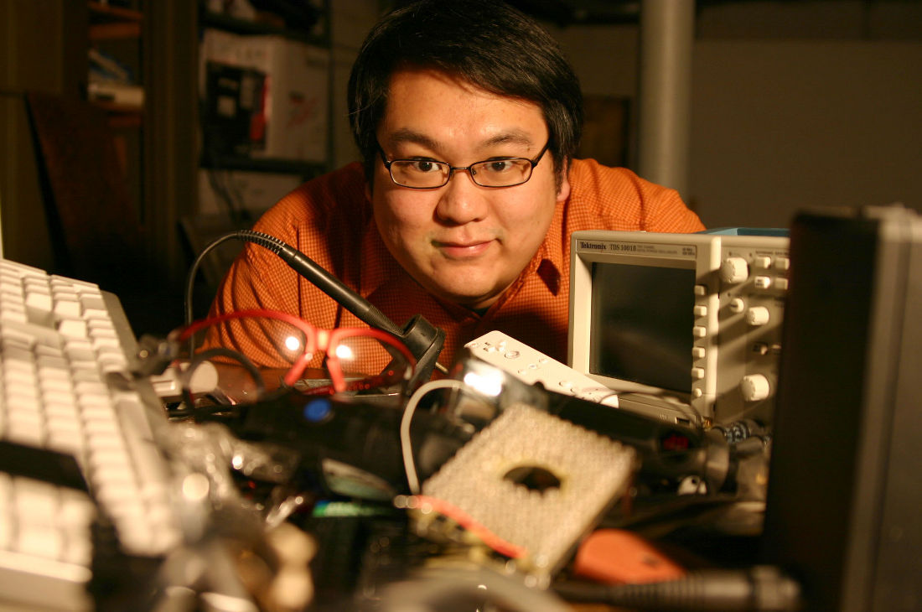
http://johnnylee.net

Slide 19
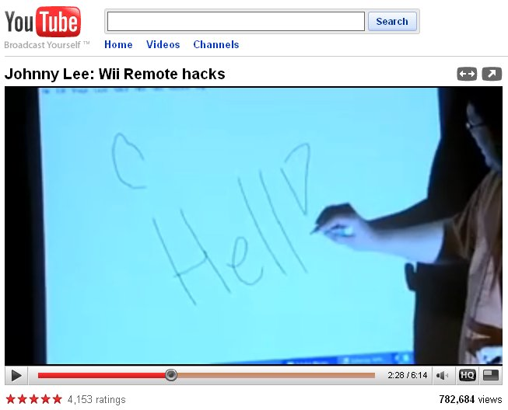

Slide 20
An idea started forming …

Slide 21
[ the system ]

Slide 22
Interview
snippet
Place name
Geo-location
Notes:
What I really wanted to do was create a data tuple consisting of three parts: a snippet of audio, a location (or set of locations) on a map and the name of a place.

Slide 23
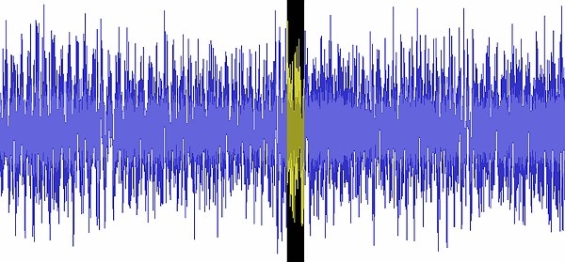
265 Queen Street,
Auckland 1010,
New Zealand
POINT(-36.8507, 174.7464)
Notes:
Something like this. Ideally, it should all be created ‘automatically’ – as a natural part of the internet process. No extra work afterwards.

Slide 24
Build a system based on
{ audio, placename, location }
that answers questions like …

Slide 25
“Take me to the bit when she talked about Rawene”
“Show me all interviews that mention Taupo”
“Make me a map of the interview”

Slide 26
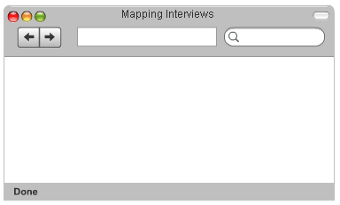


OpenLayers
SQLite

Slide 27
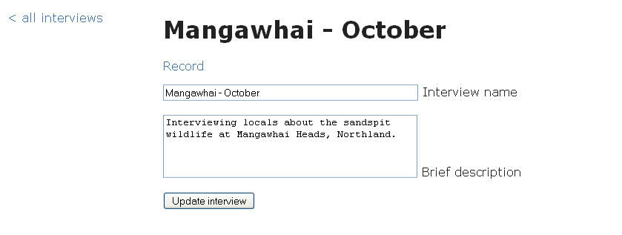
Create a new interview

Slide 28
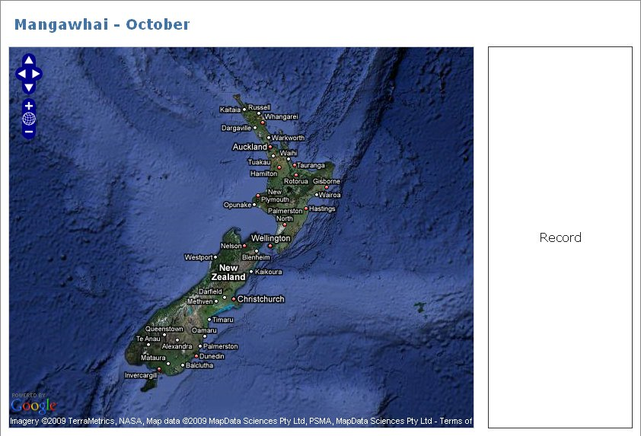
Navigate to region of interest.
Sync audio recording with the app …

Slide 29
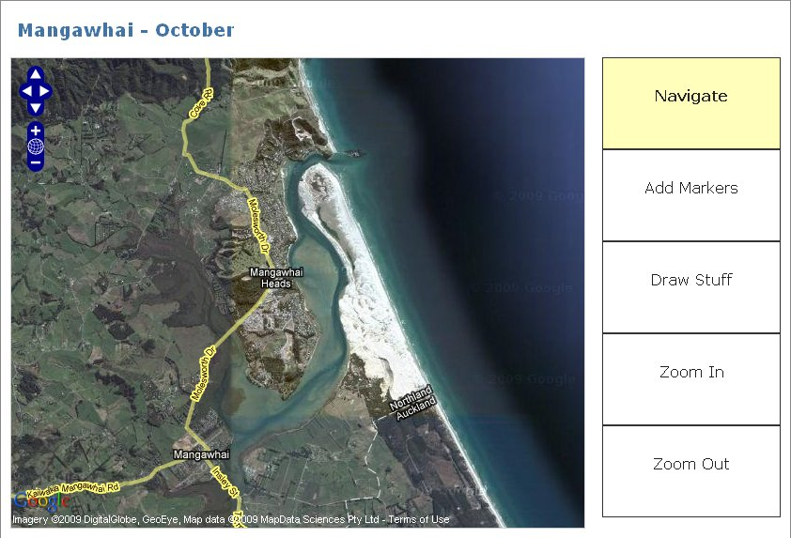
… and begin

Slide 30
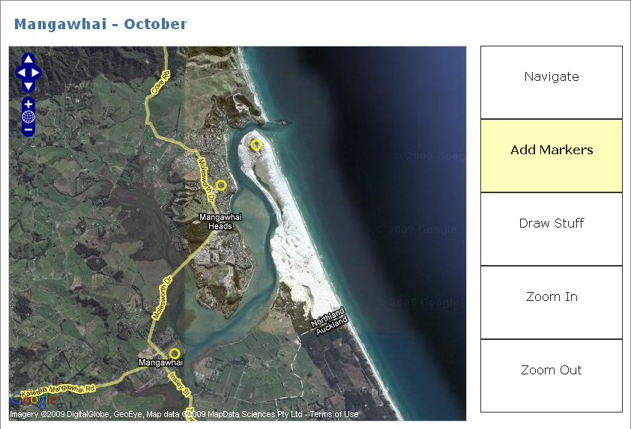
Markers are time-stamped, reverse-geocoded and sent to the database

Slide 31
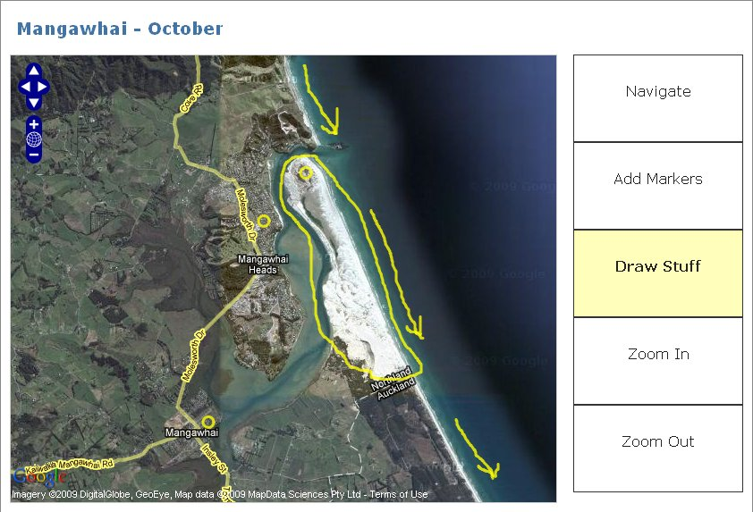
The system also recognises freehand lines

Slide 32
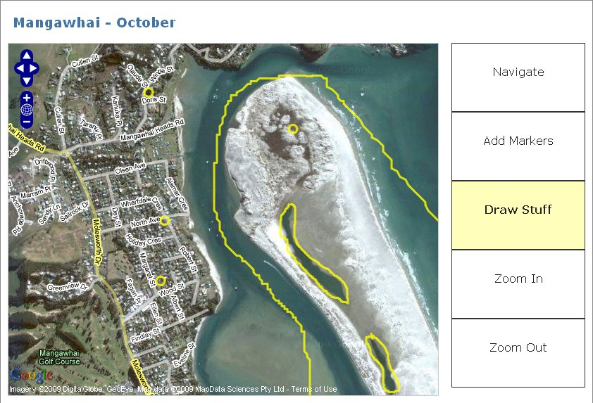
Lines and markers remember what zoom level the map was at when they were created

Slide 33
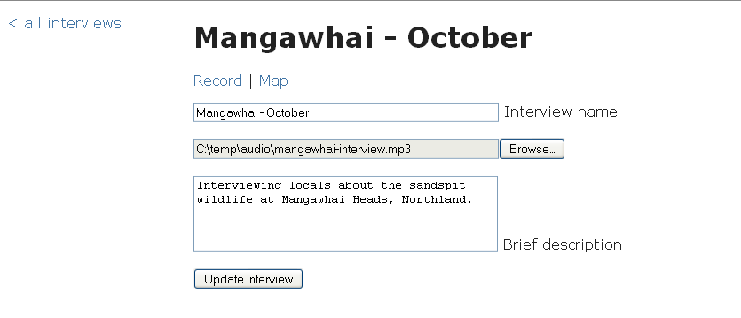
When you’re finished, upload the mp3 file …

Slide 34
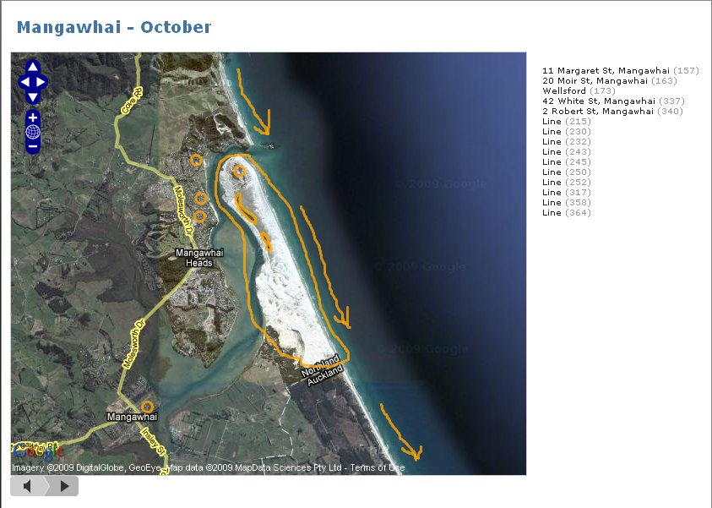
… and you have a map where audio is synced to gestures

Slide 35
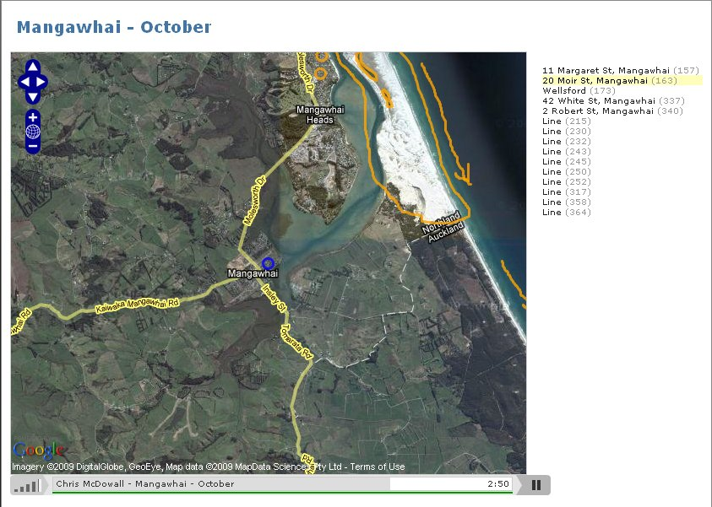
Selecting markers on map or list controls the audio playback

Slide 36
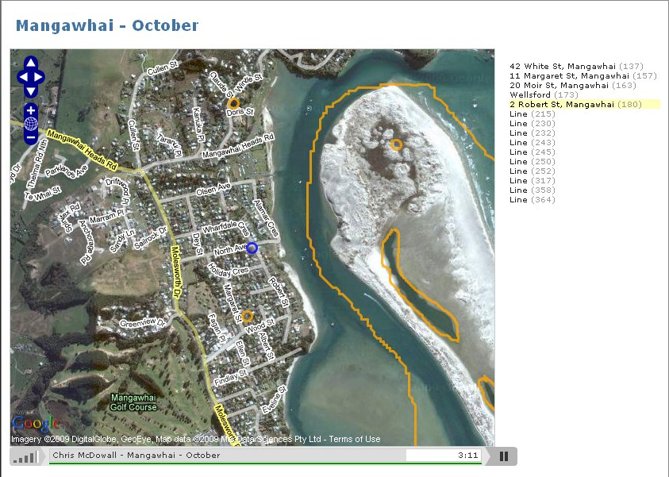
Map centers and zooms to focus

Slide 37
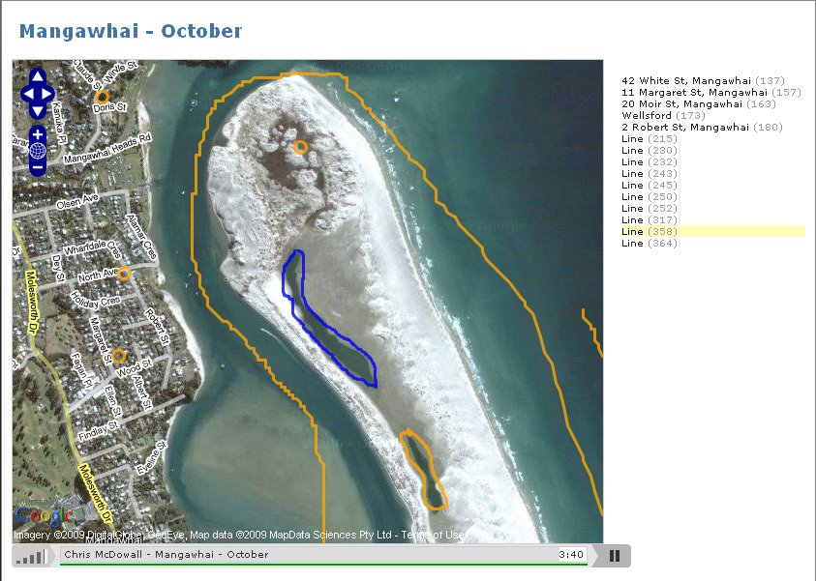
… and lines too

Slide 38
[ whiteboard ]

Slide 39
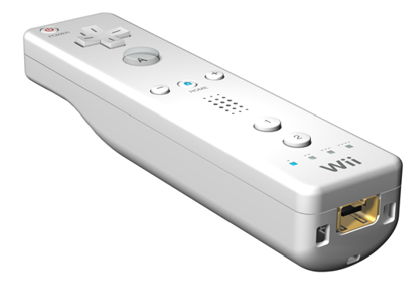
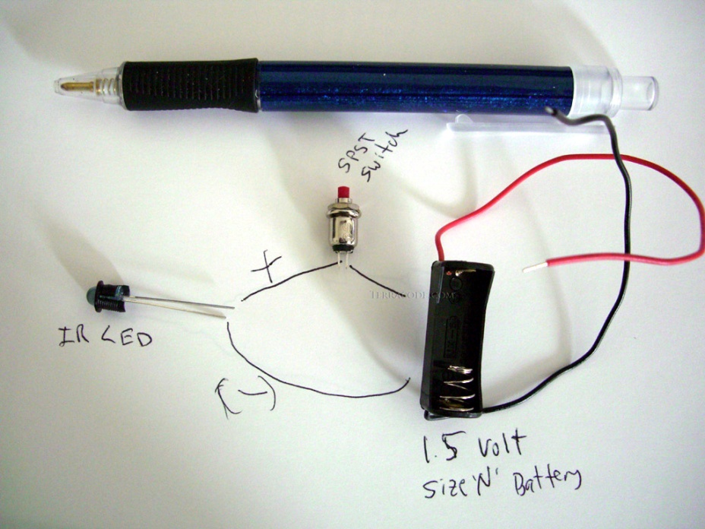
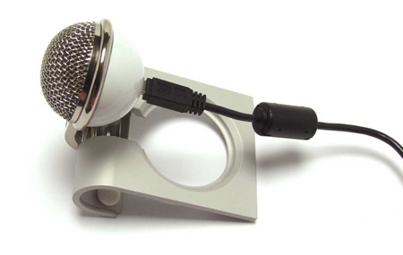
terracode.com

Slide 40
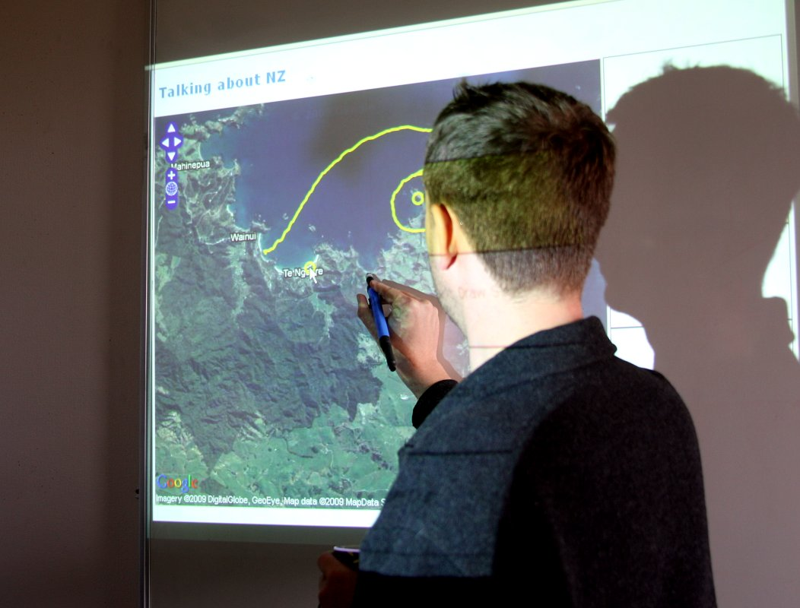

Slide 41
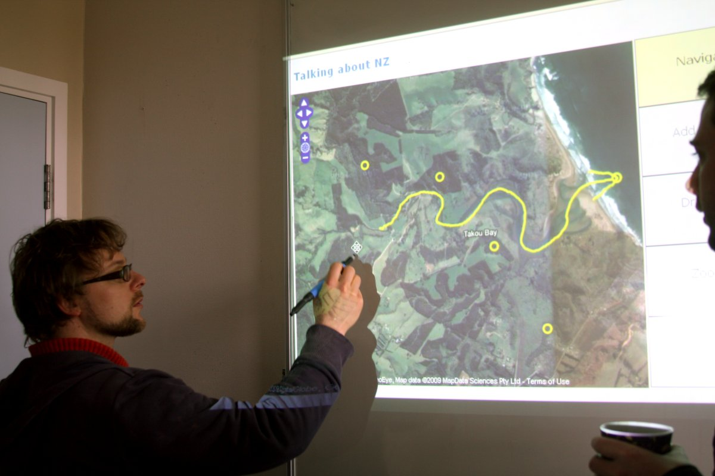
http://tinyurl.com/audiogeotag

Slide 42
[ some thoughts ]

Slide 43
This is an alpha system
Untested in a real interview
Next steps:
testing,
refine interface,
control map with player
enhanced search

Slide 44
How should the system …
. assign names to lines?
. handle multi-part lines? (e.g. arrows)
. balance ease of use with flexible options?

Slide 45
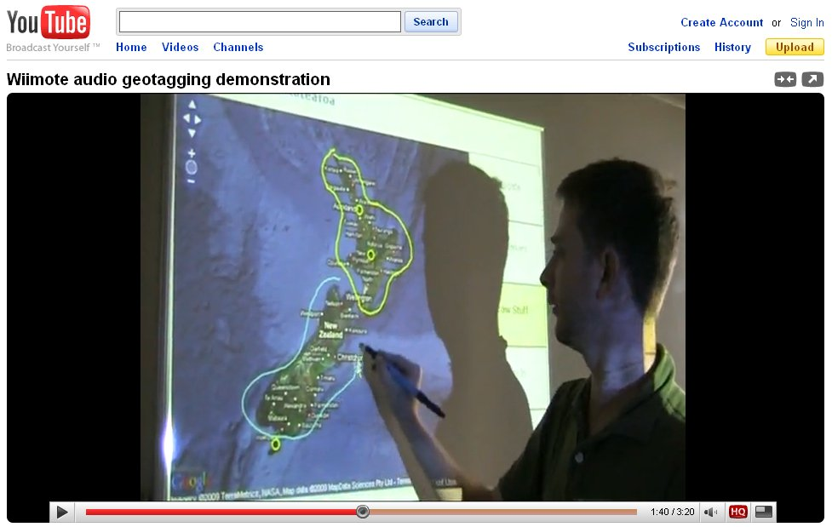
Thank you
Chris McDowall – Landcare Research
Twitter @fogonwater
search: audio geotagging

