Slide 1
Collar Cleaning User Guide

Slide 2
Sections
Processing GPS Data
Filter, Clean and Rarify Data
Cluster Generation
Merging
Matching
Collar Cleaning
User Guide
Warren Wolf Algorithm
User Guide
Cluster Processing
User Guide

Slide 3
1. Processing GPS Data
Main Programs:
cc_v35 Collar Cleaning: raw gps readings
rarify_Wloc_v5 Rarify gps locations (1 hour, 2 hour, even, odd)
Check Programs:
check_Wloc_v1

Slide 4
Processing GPs DATA aka Collar Cleaning
Processing of GPS data is brand specific.
The user location where the download ocurred and the time of year (DST or not) can affect local time processing for some models.
It is recommended that the user keep a log of When/Where the collar data is downloaded.

Slide 5
Folder Organization
Programs assume a hierarchy
C/D/E
Wolf-Projects
Data
locdataAll-CCv31
Original (cleaned collar data all in the same folder)
cc program will generate
“<filename>_analysis” as input to cluster program
“<filename>_location” as input to merge programs
If original files are organized within sub-folders then csvCopy.py program can be used
Note: change the path names to flatten all of the collar files to a single folder

Slide 6
cc_v35.py
cc == CollarClean
Note: if the files are edited with Excel versus notepad++ it is important to set the column formats of any date columns to YYYY-MM-DD
To run program: (Python 2.7.15)
Copy program into folder containing raw csv files
Open with IDLE
Run Module
Review and keep log file generated
Change Date Range if necessary
# Global variables for date range selection
# default to no selection - program always checks for date range file
daterange_parsed= False - if external date range file parsed
daterange_flag = False - if external date range defined
daterange_start = "2016-01-01“ - default, can be overridden by external file
daterange_end = "2018-12-31“ - default, can be overridden by external file

Slide 7
cc_v35.py
# Date adjustment flags – important issue
televiltDSTpresent = 1 # set to 1 if the file was downloaded during DST
televiltDSTremove = 1 # set to 1 to remove DST
if (televiltDSTpresent == 1):
print ' >>> '
print ' >>> DST Present'
print ' >>> '
if (televiltDSTremove == 1):
print ' >>> '
print ' >>> DST Removed'
print ' >>> '
else:
print ' >>> '
print ' >>> DST NOT Removed'
print ' >>> '
else:
print ' >>> '
print ' >>> DST NOT Present'
print ' >>> '

Slide 8
Time Terminology
UTC – is the Universal Coordinated Time
GMT – is a time zone in England
UTC == GMT w.r.t. actual time
DST
In regions where daylight saving time is used, it commences on the second Sunday of March, and standard time restarts on the first Sunday in November.
Local Time – may be affected by DST
LMT: not commonly used
Keep headers the same and assume LMT == LocalTime (LT)

Slide 9
Date/Time Fields – cc_v35
Collar Type | Date/Time Local | Local DST | Date/Time GMT | Date/Time in _Location YYYY-MM-DD | Date/Time in _Analysis (Input to Cluster Analysis) MM/DD/YYYY | Note
ATS | Y | N | N | Local | Local
Lotek | Y | N | Y | Local | Local
Sirtrack | N | N | Y | Calc Local from GMT | Calc Local from GMT
Televilt | Y | Y (based on date and location of actual download) | N | Calc Local (no DST) | Calc Local (no DST) | LOCATION MATTERS! This code assumes download in same timezone as collar
Telonics | N | N | Y | Calc Local from GMT | Calc Local from GMT
Set flags in cc program

Slide 10
cc program limitations (cc_v35)
Folder names can not contain “_”
Folder names cannot contain a collar type e.g. Televilt
Multiple Sirtrack Formats
Need to resave CSV UTC date column in YYYY-MM-DD format
Multiple Televilt Formats
Lotek: ignore original dateTimeGMT field
Instead use gmtDate, gmtTime
Hard coded Lat and Long checks may need to be tweaked based on study area
Check lat outside range [50,60] ➔ error
Check long outside range [-108,-97] ➔ warning

Slide 11
2. Filter, clean & Rarify Data
The cleaned collar data _location and _analysis files may not match 1:1 given the slightly different rules in the cc program.
This step will result in the _location files being further cleaned then filtered and rarified into 4 sub-folders

Slide 12
Manual Edits
Manual Editing of the cleaned files may be necessary given the data collection methods adopted for the research projetc.
Case 1: Initial period after Collaring
Remove all rows up to the following day GMT time (> 24 hours from local time of collaring)
Case 2: Mortality/Collar drop-off
Remove all rows on that same day – local time

Slide 13
Program: rarifyWloc_v5.R
Create: aaaControlFile.csv
Run program
Review and save R log into a file
Check folders (R1/R2all/R2even/R2odd)

Slide 14
aaaControlFile
WolfID: select wolf id
FilterS: remove any reading <= FilterS (seconds) default == 60s (deferred)
gen2Hall: generate 2 hour rarified data using all points (flag (0 or 1))
gen2Heven: generate 2 hour rarified data using even points (flag (0 or 1))
gen2Hodd: generate 2 hour rarified data using odd points (flag (0 or 1))
Implied:
1HourLowS == 1800
1HourHiS == 2HourLowS = 5400
Dropped: Epsilon to detect Even/Odd
Only 12 points were affected by rounding with Epsilon == 15 minutes

Slide 15
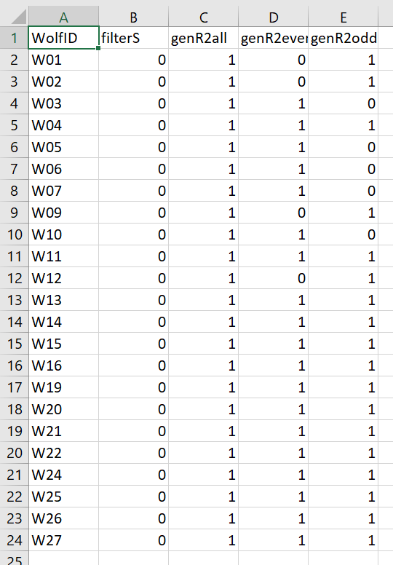
aaaControlFile – sample input

Slide 16
Folders
Folders Used:
R1: rarified to 1 hour
R2all: rarified to 2 hours
R2even: only even points, rarified to 2 hours
R2odd: only odd points, rarified to 2 hours

Slide 17
FILTER RULES
Orig == original lines read from file
Cleaned == Orig – (Lat/Long out of range)
Filtered == not implemented
SelectedEO == num of points (even or odd)
Rarified ==
num of points with step size > rareLimits
Flag == “.” iff location file == analysis file

Slide 18
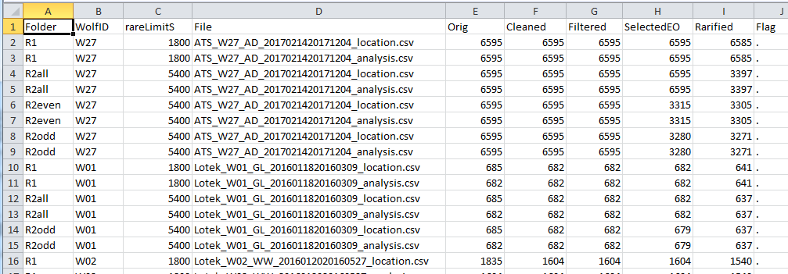
aaaRarityLog.csv – sample output

Slide 19
rarifyWloc: File Processing I
Read control file
For each input file (_location)
Determine Wolf ID
Apply existing checks
# Remove rows where Lat == 0 or Long == 0
alldata = alldata[alldata$Latitude!=0,]
alldata = alldata[alldata$Longitude!=0,]
# remove NA rows
alldata = alldata[!is.na(alldata$Latitude),]
alldata = alldata[!is.na(alldata$Longitude),]
# remove out of range rows
alldata = alldata[alldata$Longitude <= -97.0,]
alldata = alldata[alldata$Longitude >= -108.0,]
Check _location and _analysis files are the same length
If filterS <> 0
Apply FilterS
Create an OrigFixNum – so that the points can be traced back to the original points
This is important because Cluster Analysis needs FixNum’s in strict numeric order
Deferred – not needed

Slide 20
rarifyWloc: File Processing II
For each input file (_location, _analysis)
Rarify 1 hour
Use 1HLowS as limit
Write R1 files
If gen2Hall
Rarify to 2H using 2HourLowS as lower bound
Write R2all files
If gen2Heven
Select even hours
Rarify to 2H using 2HourLowS as lower bound
Write R2even files
If gen2Hodd_f
Select odd hours
Rarify to 2H using 2HourLowS as lower bound
Write R2odd files

Slide 21
checkWloc_v1: Check the Rarified Files
Program checks: Id, Lat, Long
Run program
Review and save R log in a file
As an extra check we want to ensure that the corresponding location and analysis files match exactly

Slide 22
Definitions
TBC

Slide 23
Time Terminology
UTC – is the Universal Coordinated Time
GMT – is a time zone in England
UTC == GMT w.r.t. actual time
DST
In regions where daylight saving time is used, it commences on the second Sunday of March, and standard time restarts on the first Sunday in November.
Local Time – may be affected by DST
LMT: not commonly used
Keep headers the same and assume LMT == LocalTime (LT)

Slide 24
Definitions: Long/Lat
Longitude == Easting == X axis
Latitude == Northing == Y axis
Easting refers to the eastward-measured distance (or the x-coordinate),
Northing refers to the northward-measured distance (or the y-coordinate).
Easting and Northing coordinates are commonly measured in metres from a horizontal datum.
Latitude measures angular distance from the equator to a point north or south of the equator.
Longitude is an angular measure of east/west from the Prime Meridian.
Latitude values increase or decrease along the vertical axis, the Y axis.
Longitude changes value along the horizontal access, the X axis

Slide 25
Crossing UTM Zones
https://gis.stackexchange.com/questions/151505/measuring-distances-when-crossing-utm-zones
https://community.esri.com/t5/arcgis-enterprise-portal/what-is-the-overlap-between-different-utm-zones/m-p/310773/highlight/true
Using UTM 14 for UTM 15 locations or vice versa has a worst case error of less than 1 meter
Not an issue for Cluster Matching where the tolerances are on the order of 10 to 20 meters

