Slide 1
Cluster Processing User Guide

Slide 2
Sections
Processing GPS Data
Filter, Clean and Rarify Data
Cluster Generation
Merging
Matching
Collar Cleaning
User Guide
Warren Wolf Algorithm
User Guide
Cluster Processing
User Guide

Slide 3
4. MERGING
Programs:
mergelocW_v7.R merges location files
mergeMC2_v3.R merges mikecluster2 files

Slide 4
Merging
Overview of directory structure
Key programs written in R
Tags added to each line to enable bi-directional tracing:
Rfolder: which folder rows taken from
Findex: F[ile] Index - multiple files for the same WolfID are numbered 1,2…

Slide 5
Rarify Flow
Rarify Files
(same name under sub-folders)
_Location
_Location
CC
(Collar Clean)
Prog(Py)
Raw Collar Data
_Analysis
_Analysis
For Analysis
DateRange
Deprecated
WWA*
Prog(Py)
-mikecluster
*Warren Wolf Algorithm
(Cluster Analysis)
Warren_wolf_algorithm.py
-mikecluster2
Clusters

Slide 6
Directory Structure
1Hr Rarified using all Points
2Hr Rarified using all Points
2Hr Rarified using even Points
2Hr Rarified using odd Points
Raw Collar Data
Rarify
R1
R2all
R2even
R2odd
_Location
_Location
_Location
_Location
_Location
CC
(Collar Clean)
Prog(Py)
_Analysis
_Analysis
_Analysis
_Analysis
mikecluster2
mikecluster2
mikecluster2
_Location
mikecluster2
_Analysis
Merged…
Merged…
WWA*
Prog(Py)
Results Folder
Merge Programs
Selected files to merge (even/odd)
mergelocW
mergeMC2
MergeCtrlFile

Slide 7
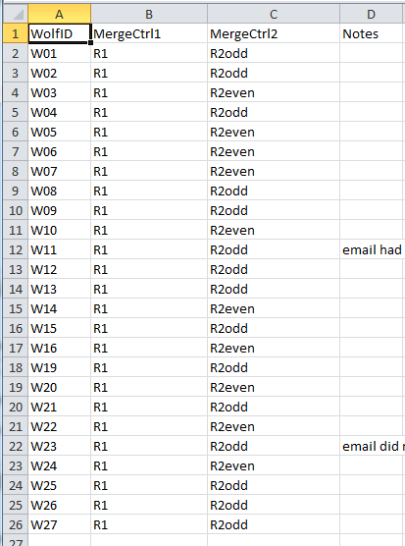
Sample: bbbMergeCtrlFile
This files directs two merges

Slide 8
Running programs
Mandatory: run Cluster merge first
mergeMC2_v3.R merges mikecluster2 files
Next: Then run Location merge
mergelocW_v7.R merges location files
Review and save log

Slide 9
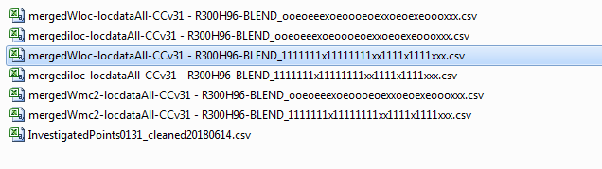
Results Folder: Merge Output
Blending Tag for Wolf# [1..30]
1 = folder R1
o = folder R2odd
e = folder R2even
x = skipped Wolf#
Source folder
mergedWmc2 = merged mikecluster2
mergediloc = merged location files - Intermediate
mergedWloc = merged location files - Final

Slide 10
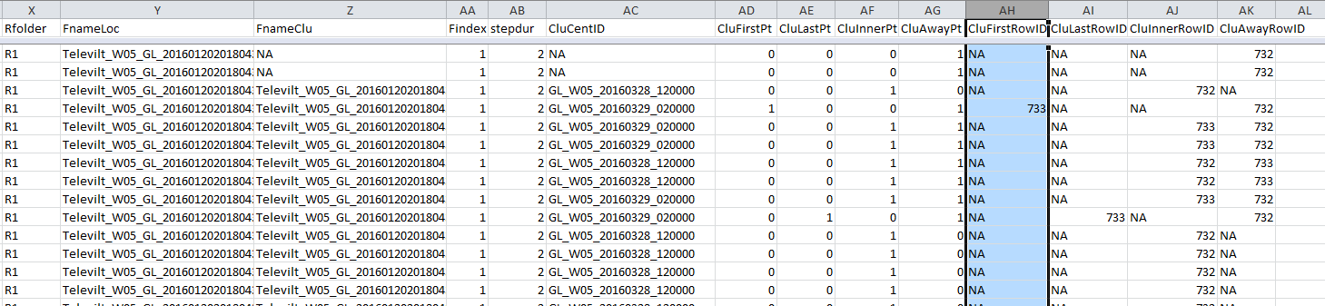
Merged Location File: Sample
Rfolder: which rarification folder
FnameLoc: source Location file
FnameClu: source Cluster file
Findex: which file if multiple files for a single Wolf
CluCentID: cross reference to CentID from merged Cluster file
CluFirstPt: 1 if first point in Cluster
CluLastPt: 1 if last point in Cluster
CluInnerPt: 1 if inner point in Cluster
CluAwayPt : >1 if first point in Cluster
CluFirstRowID: rowID of first pt in merged Cluster file
CluLastRowID: rowID of last pt in merged Cluster file
CluInnerRowID: rowID of inner pt in merged Cluster file
CluAwayRowID: rowID of away pt in merged Cluster file (only the last one found is recorded)

Slide 11
5. MATCHING
Main Programs:
matchWsites_v8 match: generated clusters (WWA) and investigated sites
joinWsites_v2.R join: generated clusters and investigated sites
cluMatch_v30.R match: clusters across multiple wolves (MW)
Check Programs:
checkInvestigated_v1.R check raw investigated site file for consistency
checkMWdata_v7.R check for consistent multi-wolf clusters

Slide 12
Matching & Joining
checkInvestigated
Investigated Sites
Match Program
Matched
Cluster Tolerance
Merged Clusters
Join Program
Joined

Slide 13
Matching
The match program takes several inputs
Edit the program before running
#
# Cluster Tolerance (tolerance in meters added to buffer)
cluster_tolerance = 5
cluster_tolerance = 0
#
# Investigation File
investFile = "InvestigatedPoints0131_cleaned20180614.csv"
#
# Merged MikeCluster2 File"
groupFile = "mergedMC2-locdataAll-CCv31-BLEND_1111111x11111111xx1111x1111xxx.csv"
#
# Results Directory
resultsDir = "locdataAll-CCv31/Results"

Slide 14
Match File
Run the program (matchWsites_v8.R)
Check the results folder, should see a file along the lines of:
Matched-CTM25-mergedMC2-locdataAll-CCv31-BLEND_ooeoeeexoeoooeoexxoeoexeoooxxx.csv
Indicates Matched, Tolerance Used, Name of merged file

Slide 15
Joining
The join program takes several inputs
Edit the program before running
##### Change the following names as required #####
#
# Results directory to use
# Investigation file to use
# Merged Cluster file to use
# Cluster Tolerance to use to create name for Matched file
#
# Results Directory
resultsDir = "locdataAll-CCv31/Results"
#
# Investigation File
investFile = "InvestigatedPoints0131_cleaned20180614.csv"
#
# Merged MikeCluster2 File
groupFile = "mergedMC2-locdataAll-CCv31-BLEND_ooeoeeexoeoooeoexxoeoexeoooxxx.csv"
#
# Cluster Tolerance (tolerance in meters added to buffer)
#
cluster_tolerance = 0
#cluster_tolerance = 25

Slide 16
Join File
Run the program (joinWsites_v2.R)
Check the results folder, should see a file along the lines of:
Join-Matched-CTM25-mergedMC2-locdataAll-CCv31-BLEND_ooeoeeexoeoooeoexxoeoexeoooxxx.csv
Indicates the Join of the Matched file with the Merged Cluster and Investigated Sites

Slide 17
Multi-Wolf Cluster Matching
Manual Edits
Matched_Clusters
(sorted Inv ID)
Matched_Clusters
(sorted Clu ID)
cluMatch
Joined
checkMWdata
All Clusters
[Matched, Clu_Only,
Inv_Only]
Sum by Wolf Statistics

Slide 18
Backup
(for Reference Only)

Slide 19
Step Duration Checks
Each species has a set of valid Step Durations which are checked with the round(step_duration) function.
Wolf – Valid Step Durations (hours) = (1, 2)
0.5 < step_duration <= 2.5
Deer – Valid Step Durations (hours) = (0.3, 2, 4)
0.25 < step_duration < 0.35 ➔ rarified to 1 hour
1.50 < step_duration <= 2.50
3.50 < step_duration <= 4.50
Moose – Valid Step Durations (hours) = (2)
1.5 < step_duration <= 2.5
Elk – Valid Step Durations (hours) = (2)
1.5 < step_duration <= 2.5

Slide 20
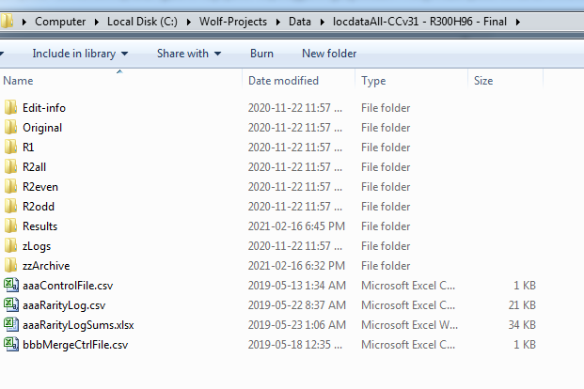
Sample Directory Structure I
Original files
After cc_v31
Rarified Files
R1
R2all, R2even and r2odd
All Results
Control file for rarification

Slide 21
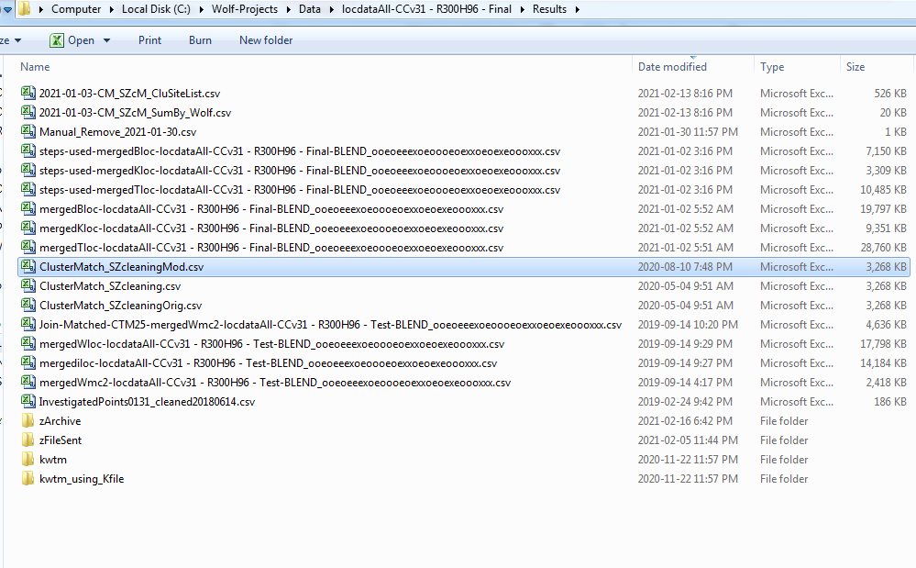
Sample Directory Structure II
Common Clusters
Step files
Between kills, Kill, Total
Location files (ttk, etc.)
K = Kill Locations
ClusterMatch_ SZcleaningMod is used
Original Join-Match and blended location and cluster files

