Slide 1
Saving User Modifications

Slide 2
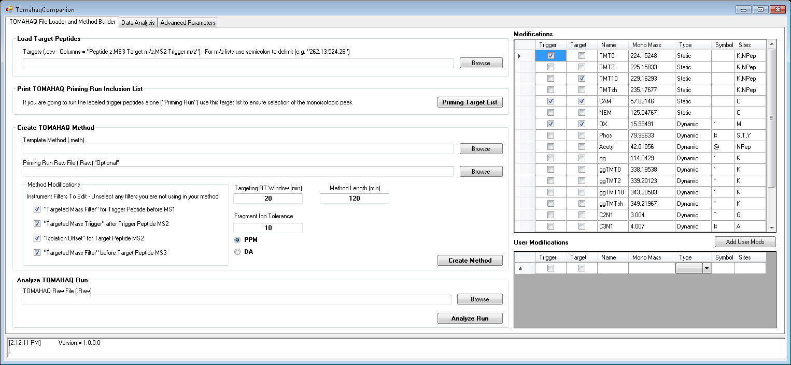
1. Open TomahaqCompanion

Slide 3
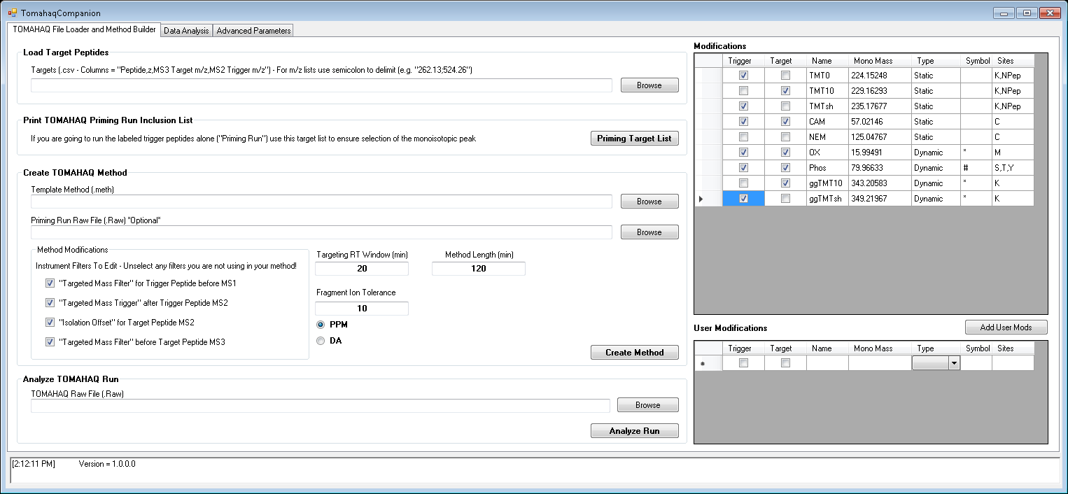
2. Select User Modifications

Slide 4
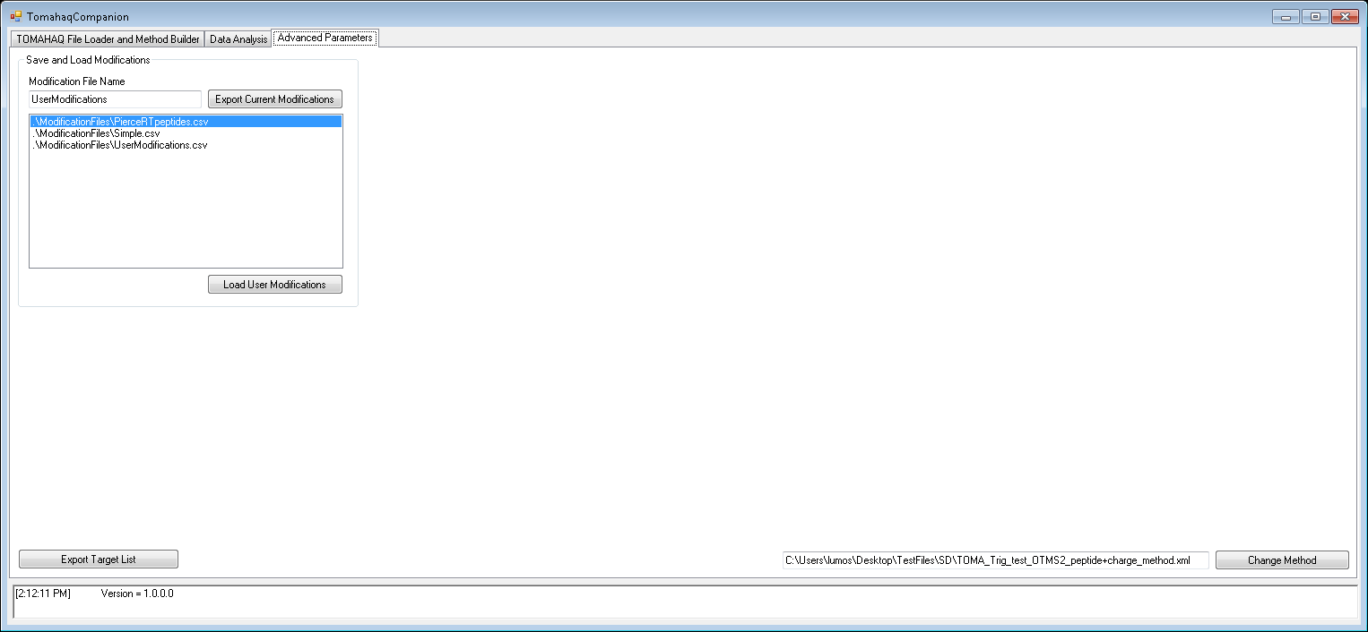
3. Select “Advanced Parameters”

Slide 5
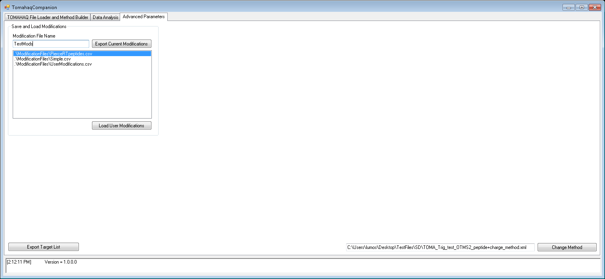
4. Name your modification file

Slide 6
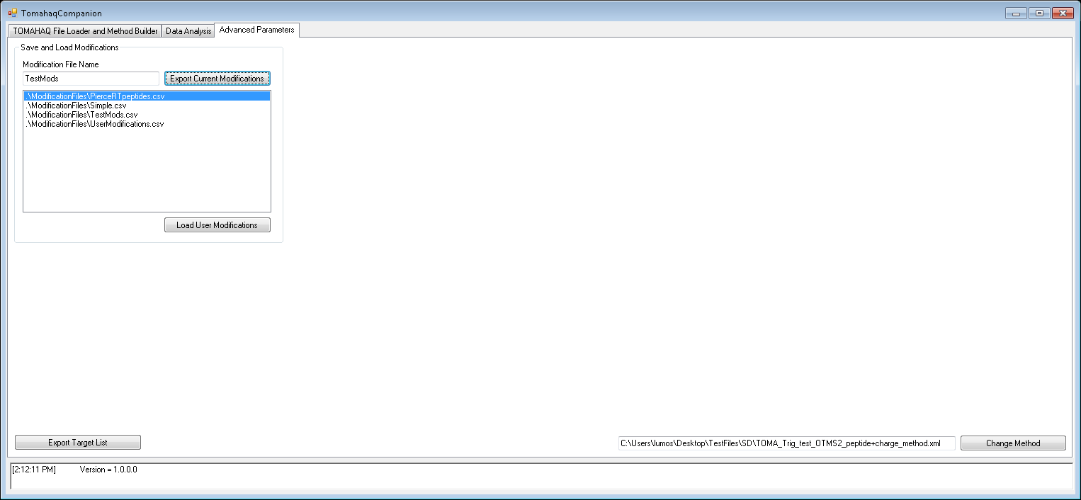
5. Select “Export Current Modificaitons”
Your file will appear in the list and will be saved for the next time you use TomahaqCompanion

Slide 7
Loading User Modifications

Slide 8

1. Open Tomahaq Companion

Slide 9

2. Select “Advanced Parameters”

Slide 10
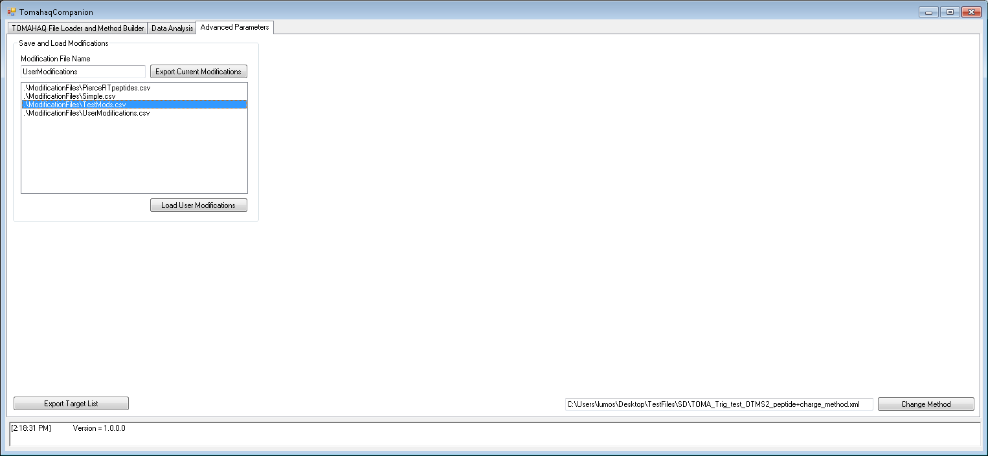
3. Select the user mod file you want to load

Slide 11
4. Press “Load User Modificaitons”

Slide 12
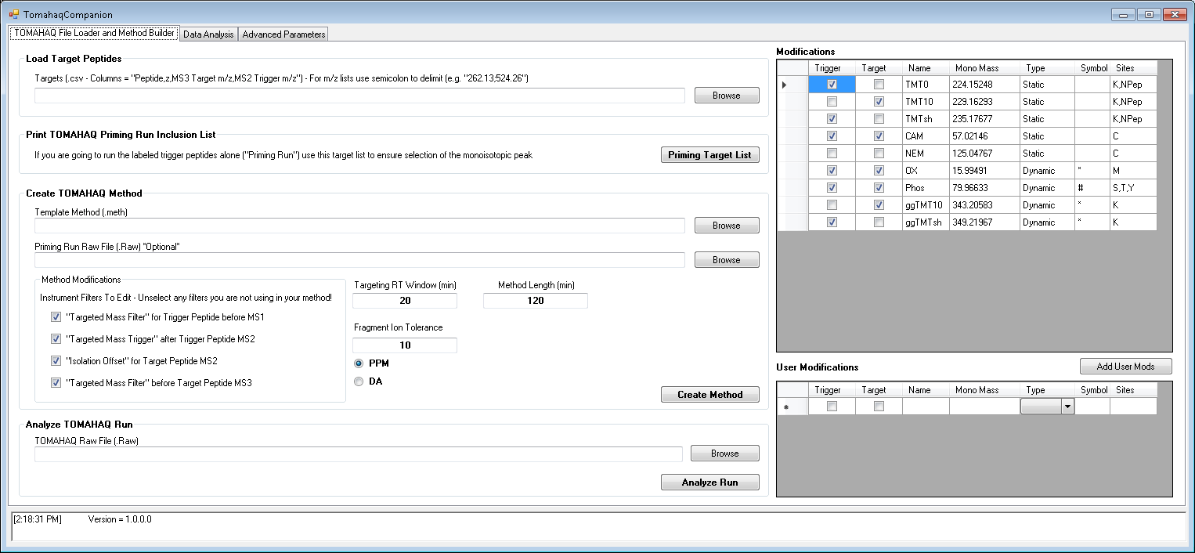
5. Return to the main tab, user mods should have uploaded into the modification grid
User modifications load from the file

Slide 13
Locating User Modifications

Slide 14
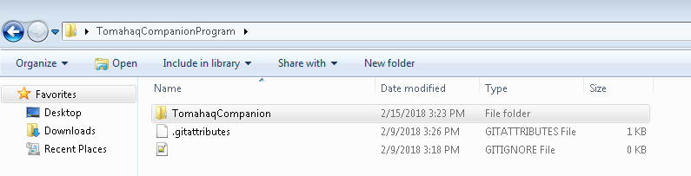
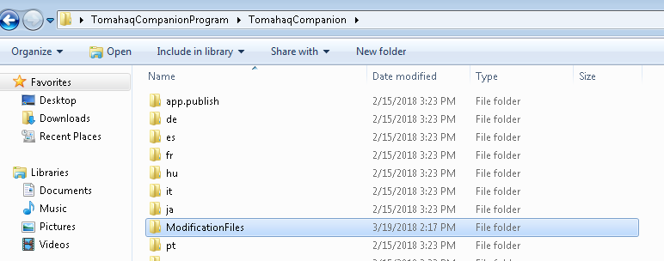
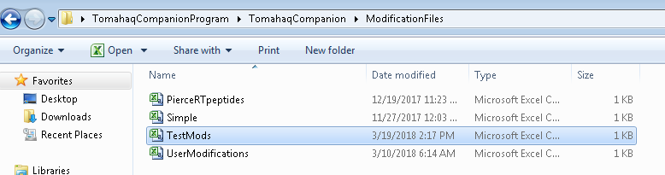
User Modifications Saved w/in Tomahaq Companion Program folder

Slide 15
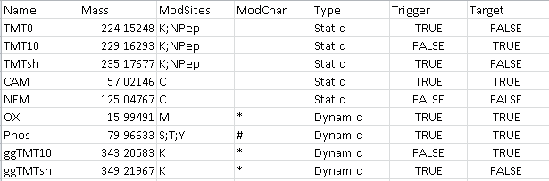
Modification files are a simple .csv file and can be edited or created outside of Tomahaq Companion

