Slide 1
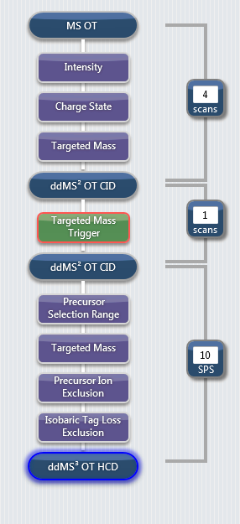
Targeted Mass Filter Miss-assignment
Scan tree from a TOMAHAQ template
Targeted Mass filter appears to be in the correct place

Slide 2
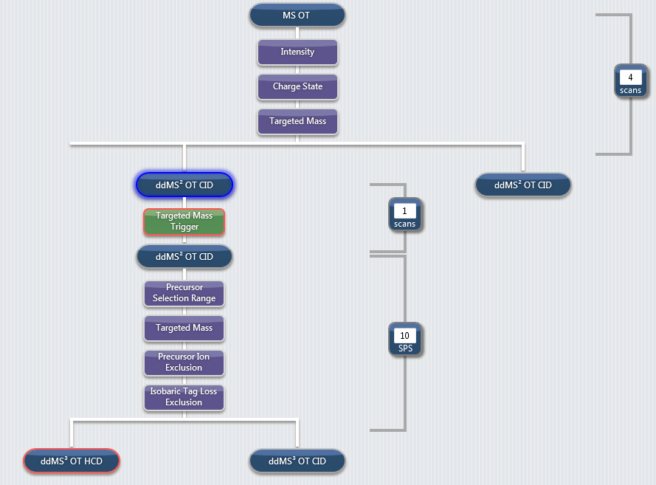
Targeted Mass Filter Miss-assignment
Scan tree from a TOMAHAQ template
Targeted Mass filter appears to be in the correct place
When another scan is placed in the tree, you can clearly see the targeted mass filter is not above the correct method node
  Methode Node = peptide specific portion of this method

Slide 3
Fix: Add in MSn scans, Move targeted mass filter
2. Move filters
1. Add these
Add another MSn scan as demonstrated in the scan tree to the left
Move the targeted mass filter the scan node we want it to be above

Slide 4
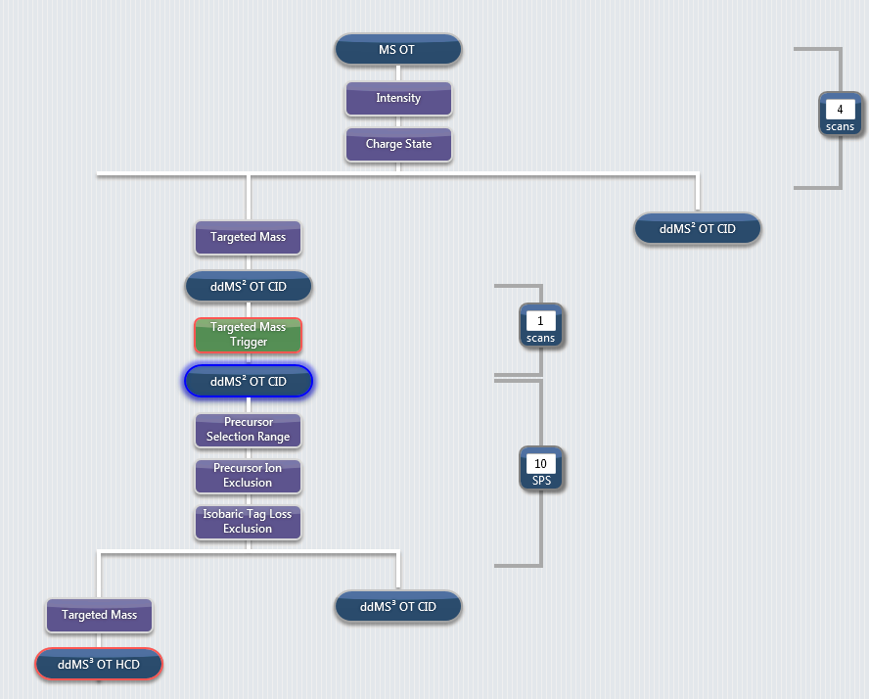
Fix: Moving the targeted mass filter
Filters now in correct place
Add another MSn scan as demonstrated in the scan tree to the left
Move the targeted mass filter the scan node we want it to be above

Slide 5
Fix: Delete the scans that you placed in there
Delete extra scans
Add another MSn scan as demonstrated in the scan tree to the left
Move the targeted mass filter the scan node we want it to be above
Delete the extra scan events

Slide 6
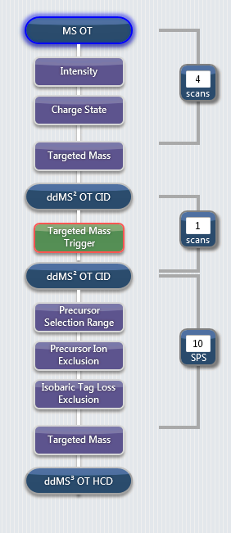
Fix: The tree looks similar, but should work
Add another MSn scan as demonstrated in the scan tree to the left
Move the targeted mass filter the scan node we want it to be above
Delete the extra scan events
The scan tree looks the same, but it should now work within TomahaqCompanion
  You will notice that the brackets which extend from the MS or MSn scan no longer include the Targeted mass filter. As long as the method looks like this it should work.

