Slide 1
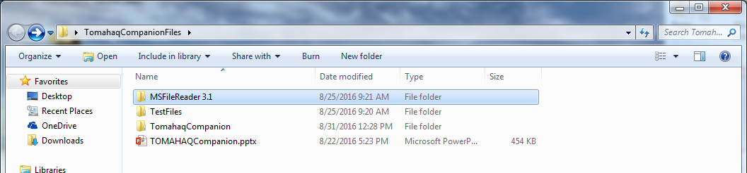
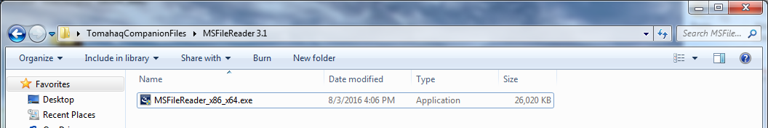
Install MSFileReader
To edit and create a new method this program must be run on an instrument computer.
A method will not be created if you are not on an instrument computer
You must install MSFileReader.
Find the MSFileReader3.1 folder
Double click the MSFileReader
Follow the instructions to install both the x86 and x64 versions

Slide 2
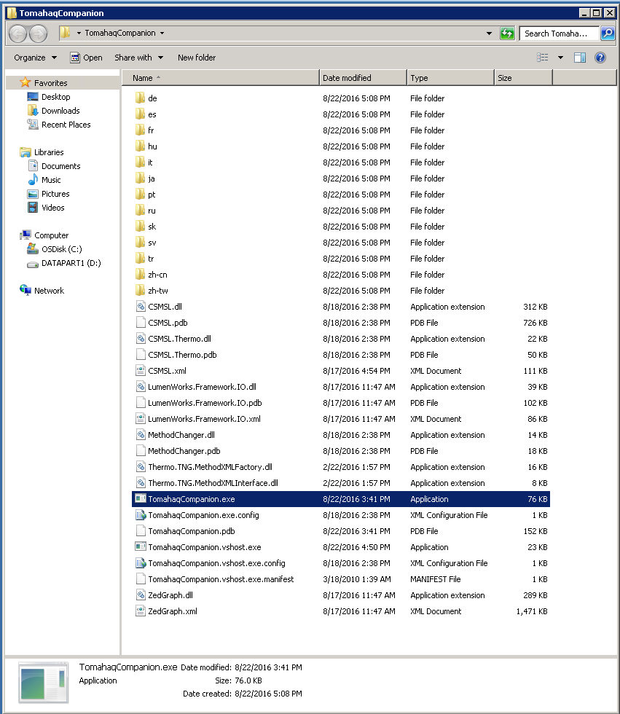
TOMAHAQ Companion
To edit and create a new method this program must be run on an instrument computer.
A method will not be created if you are not on an instrument computer
You must also install MSFileReader.
Double click on “TomahaqCompanion.exe” to open program

Slide 3
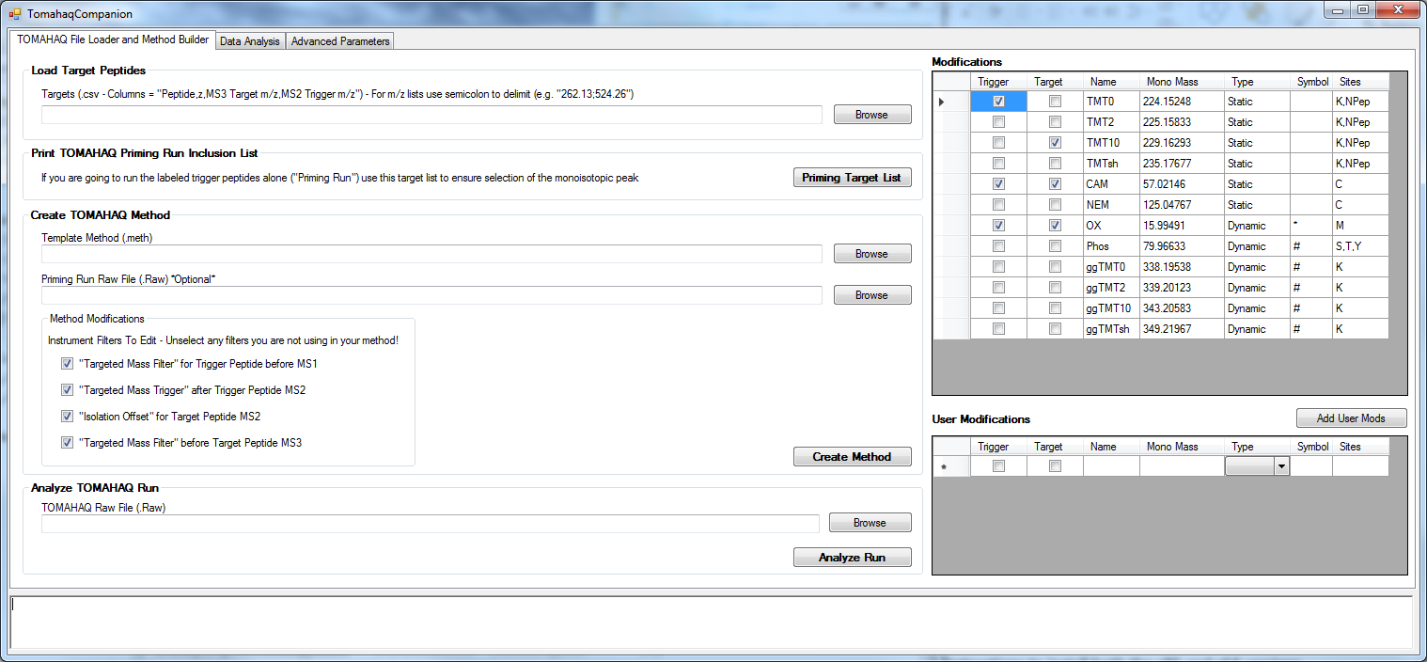
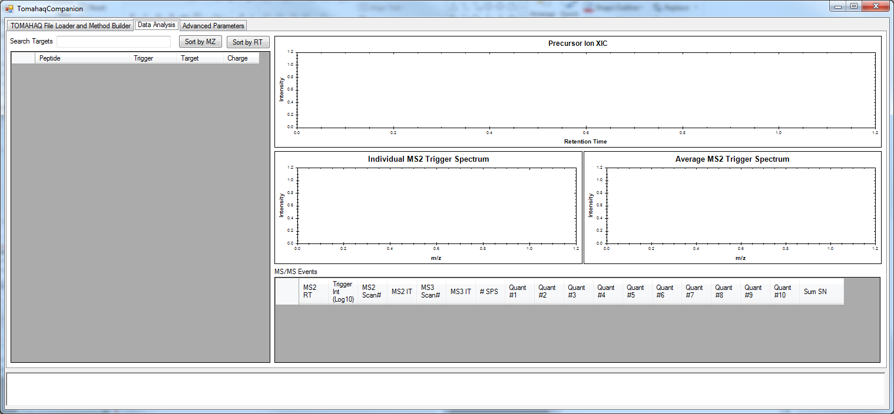
TOMAHAQ Companion Overview of Tabs
To edit and create a new method this program must be run on an instrument computer.
A method will not be created if you are not on an instrument computer
1. Tab 1 – File input for method creation and data analysis
2. Tab 2 – Display for data analysis and for method creation if there is a raw file provided

Slide 4
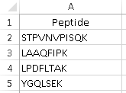
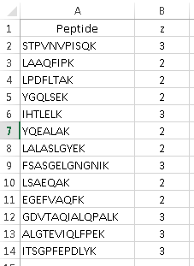
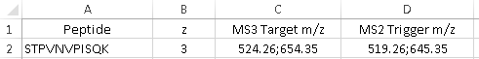
Method Creation
2
1
3
4
5
6
Load in a .CSV file of the peptides (column names must be as shown)
A.
A. Loading only peptide sequences – Creates a target list with peptides represented in all charge states 2-5. Target SPS-MS3 ions are calculated in-silico.
B.
B. Loading peptide sequences and specific charge states – Creates a target list with the specific charge state. Target SPS-MS3 ions are calculated in-silico.
C. Loading peptide sequences, charge states, target SPS-MS3 ions, and ms2 trigger ions. If MS2 trigger or MS3 target ions are provided they will be used within the method. A list of m/z values can be provided with each m/z value being separated by a semicolon.
C.

Slide 5
Method Creation –Peptides with Charge States
1
Load in a .CSV file of the peptides (column names must be exactly as shown)
Loading peptide sequences and specific charge states
Peptide sequences should only be amino acids if you do not have any dynamic (variable modifications)
If you have variable modifications you can place the symbol after the amino acid
e.g., PEPT#IDEK where # is a phosphorylation (See next slide)

Slide 6
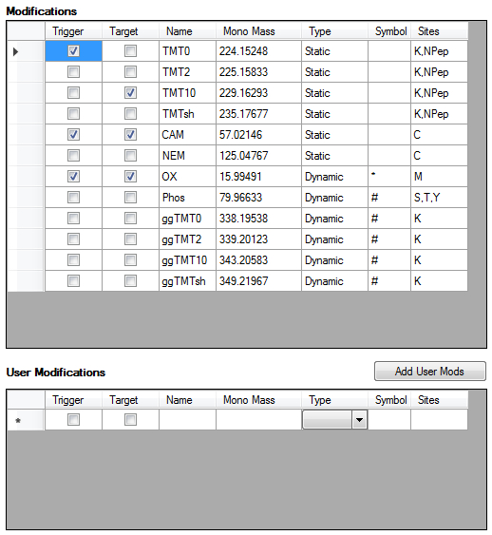
Method Creation
2
2. Select modifications
Select the check box of the modifications that are present on either the trigger peptide only, the target peptide only, or check both boxes if it on all peptides.
User modifications can be added by filling in the lower section with the appropriate information. For the user modification to be added the Name, Monoisotopic Mass, Type, and Sites must all be filled in.
Dynamic modifications are allowed. The symbol in the peptide sequence must match the symbol in the selection box of the program
PEPT#IDEK, would be the proper way to input a peptide with a phosphorylation of T. You would then select the Phos mod by checking both the trigger and target checkboxes.

Slide 7
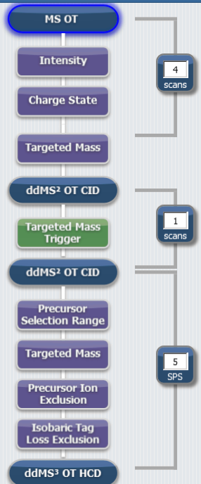
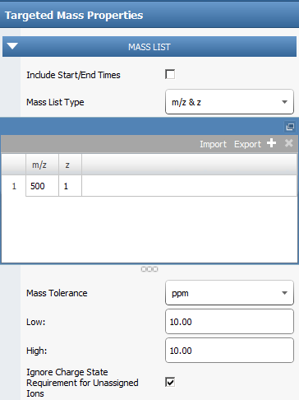
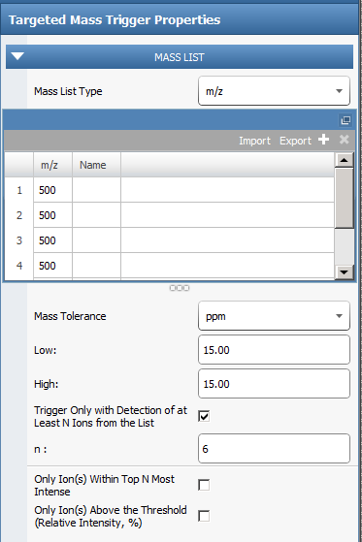
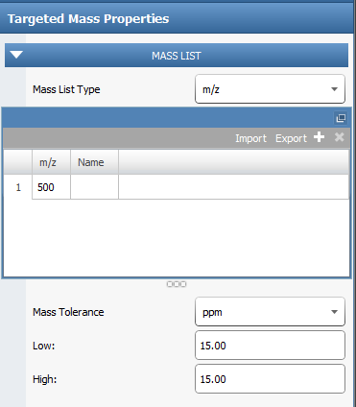
Method Creation without a “Priming Run”
3
3. Input Template Method
You can use the supplied template, or provide your own.
The template method should be some variation of TOMAHAQ. This means there is an MS1 -> Trigger MS2 -> Target MS2 -> Target MS3. All Scans are FTMS for right now.
1
2
3
1
2
3

Slide 8
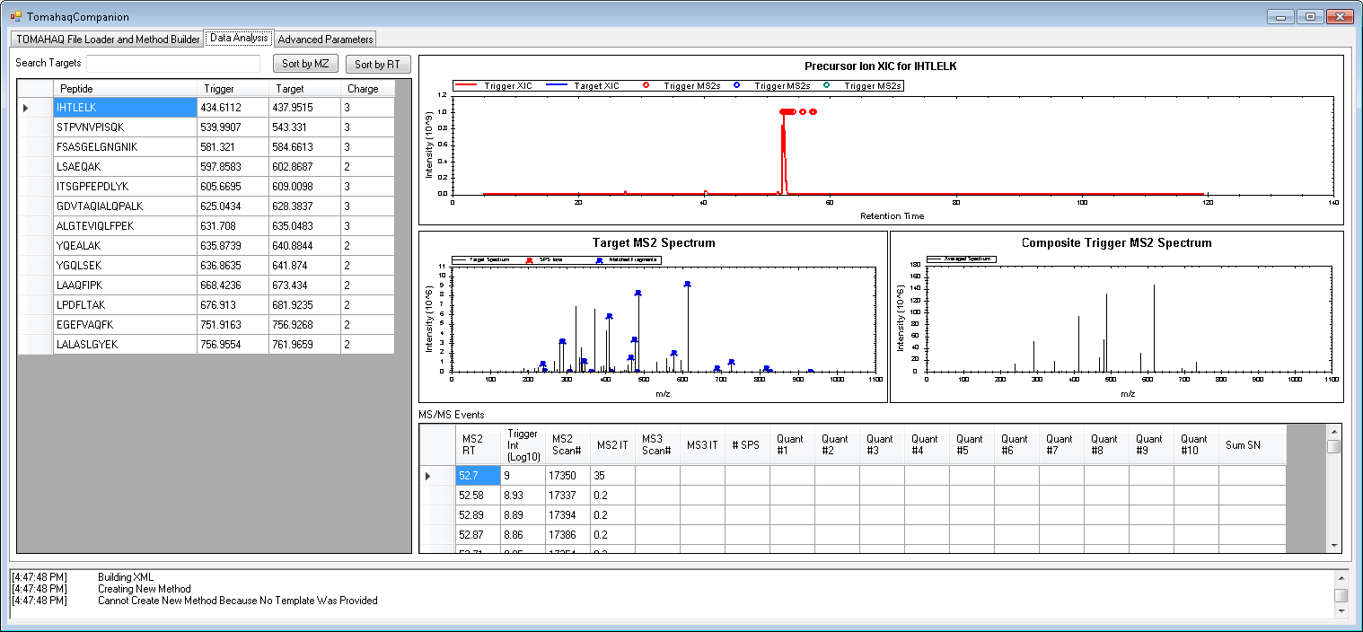
Method Creation without a “Priming Run”
4
4. Input Raw file (optional - if no raw file provided then in silico or user provided ions will be used)
If you provide a RAW file of the trigger peptides run on the instrument, then the raw file will be used to select the most intense b or y fragment ions from up to 5 MS/MS spectra.
You will also be able to view the MS/MS spectra used to select the ions and the spectrum of target SPS ions that were chosen. See example below.

Slide 9
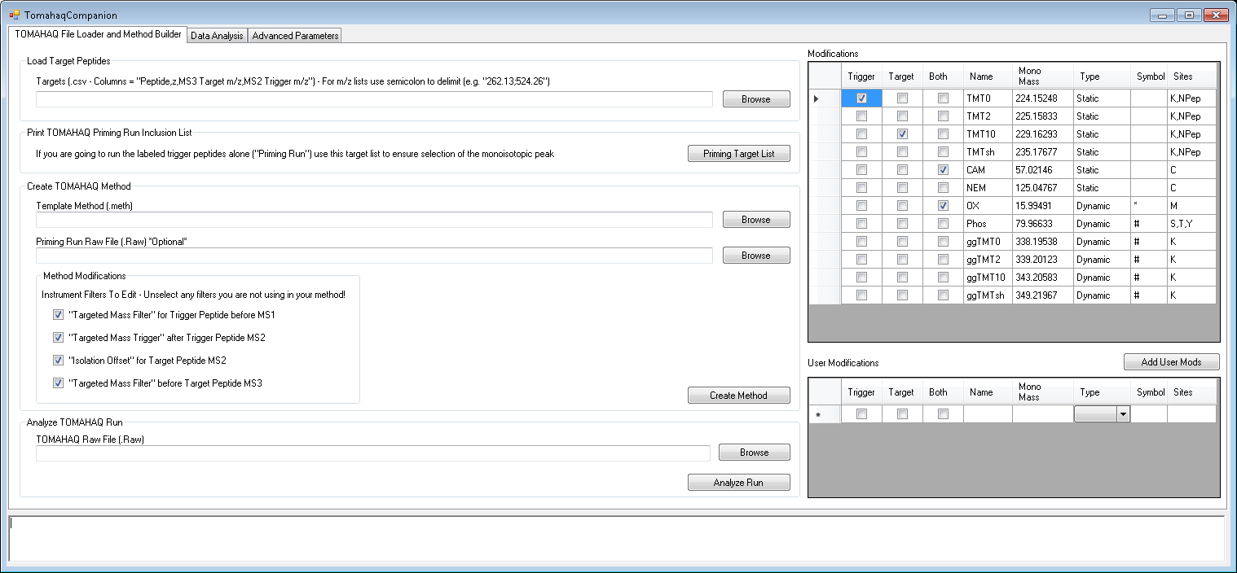
Method Creation without a “Priming Run”
5
5. Select which filters to update in the method
If you are using a provided template you do not have to change this
You will need to specify which of the filters you are attempting to edit.
If a filter is selected within TOMAHAQCompanion, but not present in the method you will receive an error in the output box and the method will not be modified.

Slide 10
Method Creation without a “Priming Run”
6
6. Click “Create Method”

Slide 11
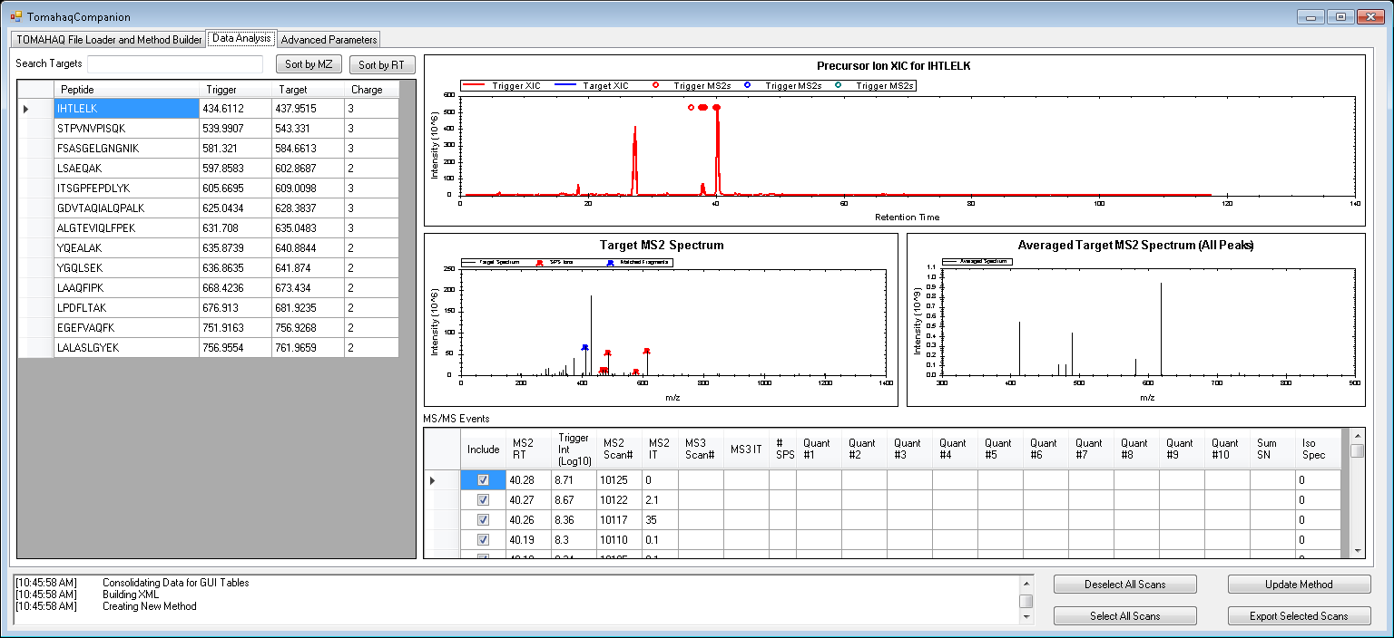
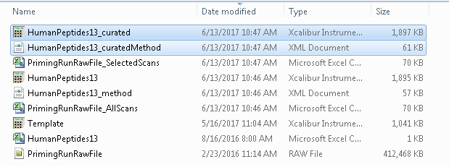
Method Curation after collecting a “Priming Run”
Method Curation
After collecting a priming run you can choose to select the scans that are used to select the Trigger and SPS-Target ions.
By default, the 5 scans closest to the trigger peak apex will be averaged to determine which ions will be picked for further analysis.
To change which scans are used to choose ions you can select/deselect the “Include” check box in the “MS/MS Events” window.
After selecting the scans you wish to use, press “Update Method” to update the method file. This will print a new XML and method file with “_curated” appended to the name.

Slide 12
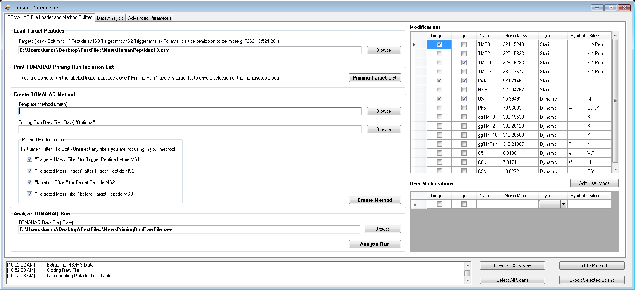
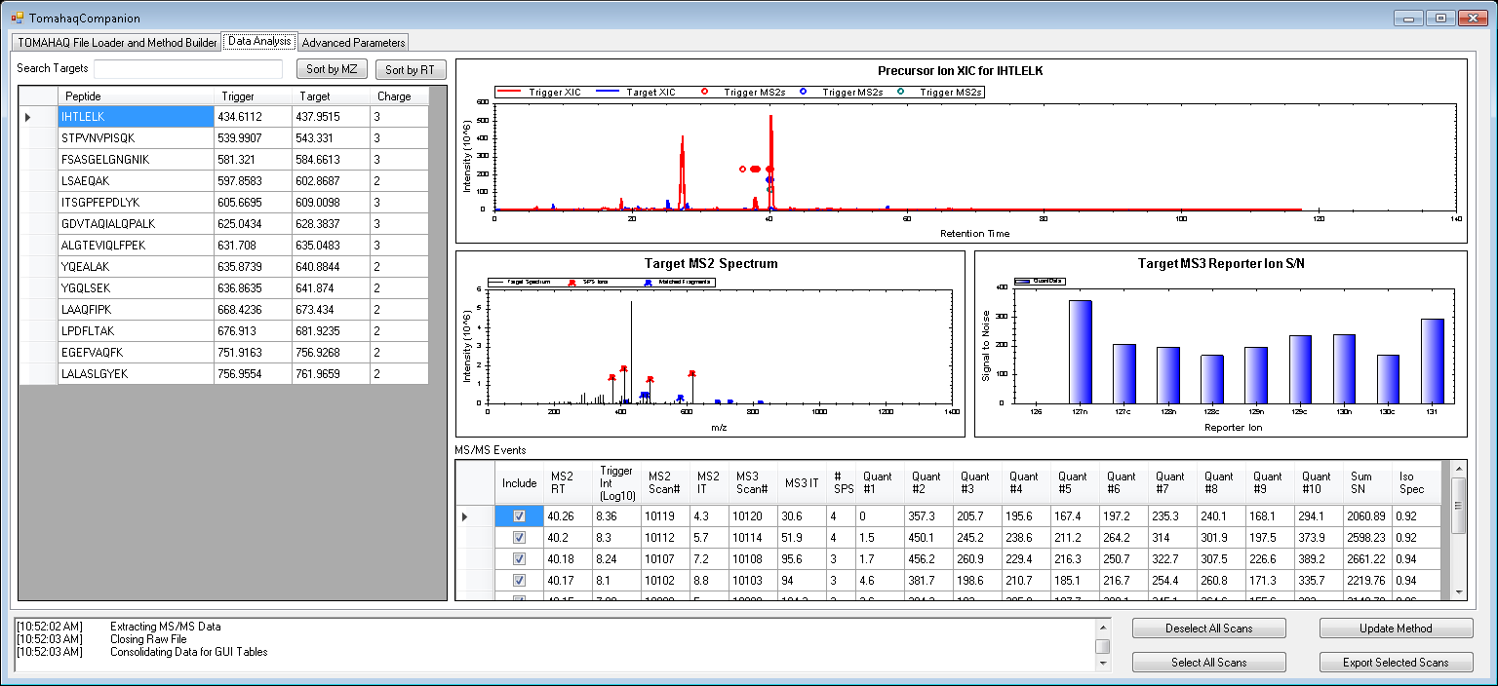
Data analysis
Data analysis
To analyze data input the list of peptides and the TOMAHAQ .RAW File.
Click “Analyze Run”
Data Curation
By default all MS/MS events will be printed to a table, but you can manually select which scans you would like to include in the output by selecting/deselecting the include check box.
When all the scans you wish to include are selected you can press the “Export Selected Scans” button to print a new table.

