Slide 1


Intro to GitHub
Tim Hesford
Summer 2023

Slide 2
Outline
Overview
Creating an account
Setting up a repository
Basic use

Slide 3
What is GitHub used for?
Collaboration
Code sharing
Tracking changes to a codebase
Resume building

Slide 4
The basics
Projects are saved in repositories.
Storage is limited
Repositories : 5 GB
Individual files : 100 MB
Repositories often include
Code
Documentation
Small data sets or sample data if applicable

Slide 5
Using repositories
Your work should be contained in a repository on the lab GitHub.
Files should be uploaded and edited using a personal account.
Records of who made what changes are saved in each repository.

Slide 6
Creating an account
Go to: https://github.com/join
Enter your email and create a username/password

Slide 7
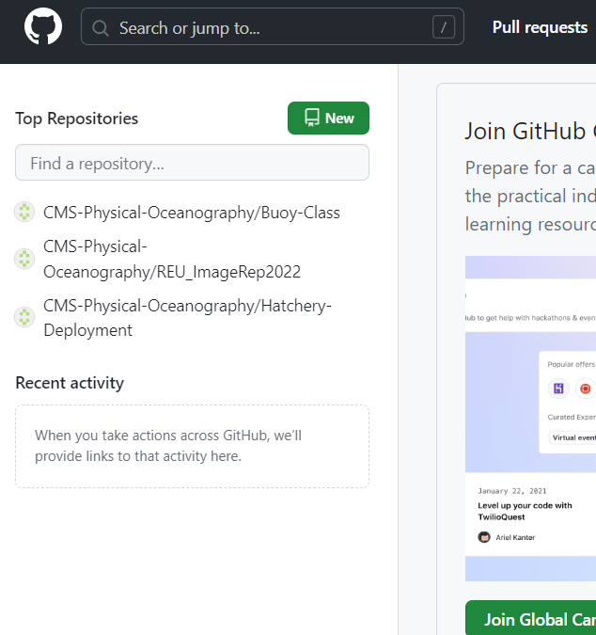
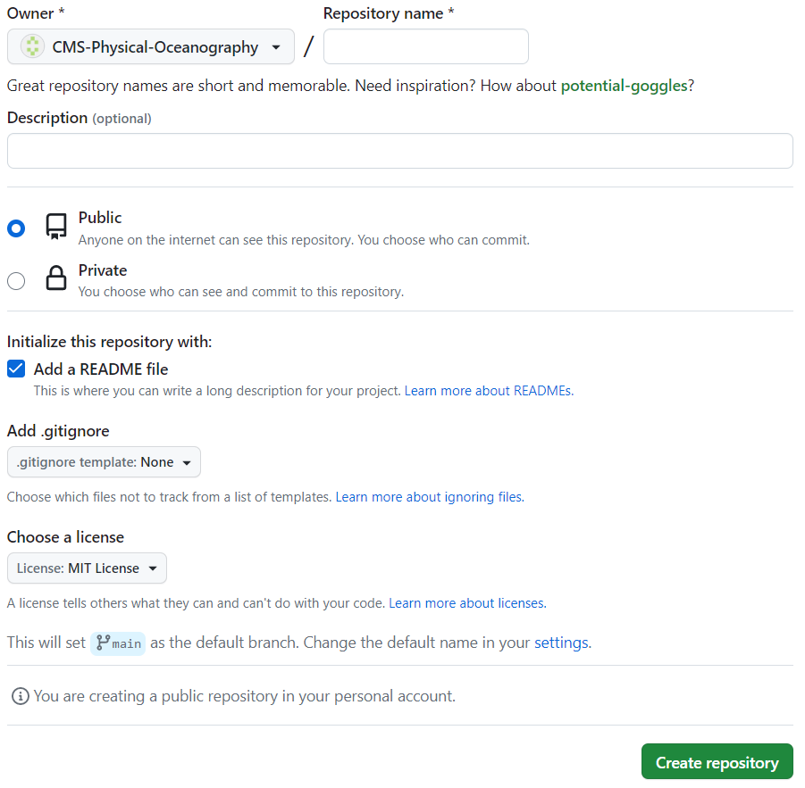
Creating a repository
Click “new” in the top left corner.
Fill out the required info.
Repository names can be changed.
Make sure to include a README file.
MIT license allows anyone to download and use your code.

Slide 8
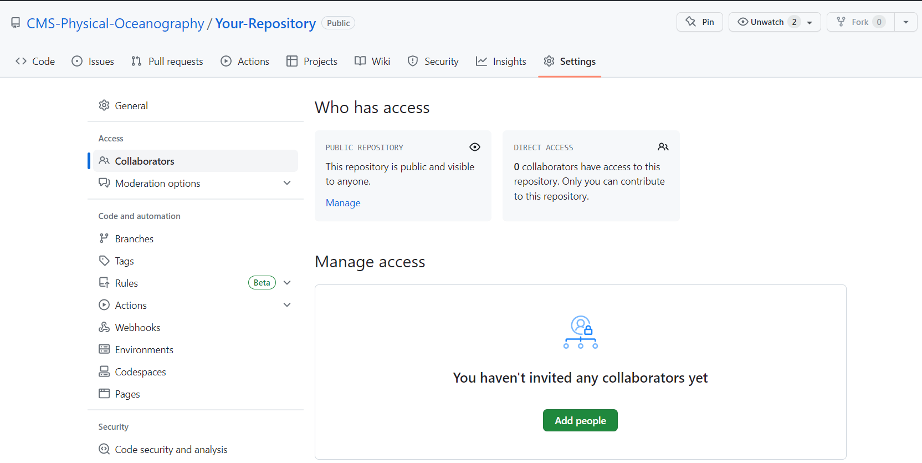
Inviting collaborators
Once your repository is set up you need to give your personal account permission to make changes.
While signed into the lab GitHub go to your new repository.
Go to settings > collaborators.
Add yourself and anyone else
who needs access.
1.
2.
3.

Slide 9
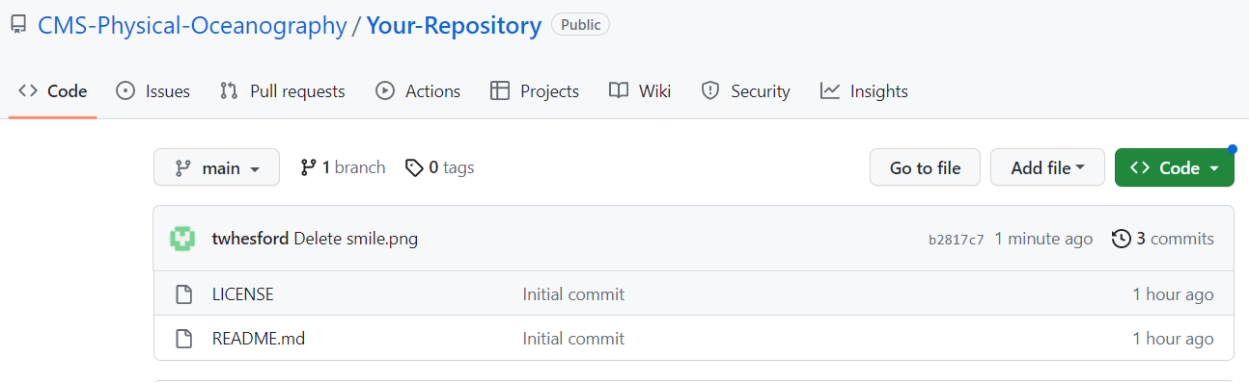
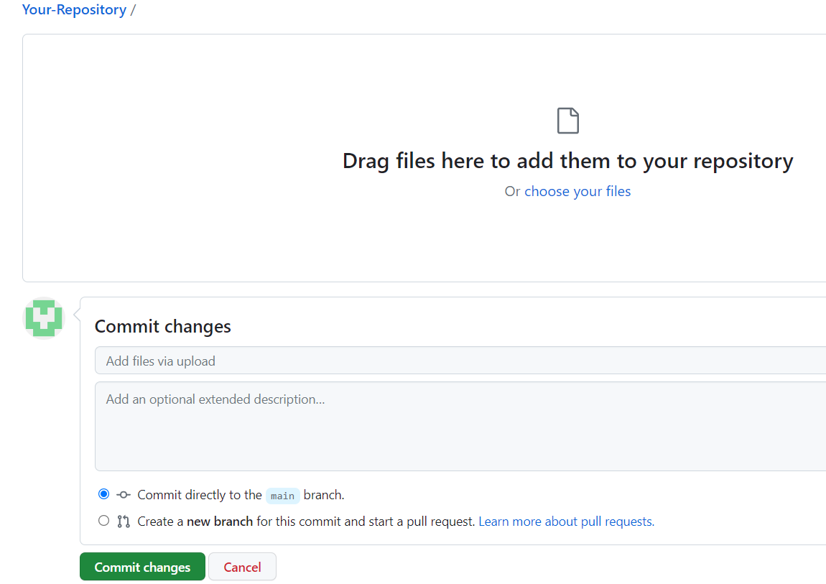
Uploading files
Sign into your personal account and accept the invitation via the email link or by viewing your repository.
Go to the lab account and select your repository.
Go to Add file then follow prompts.

Slide 10
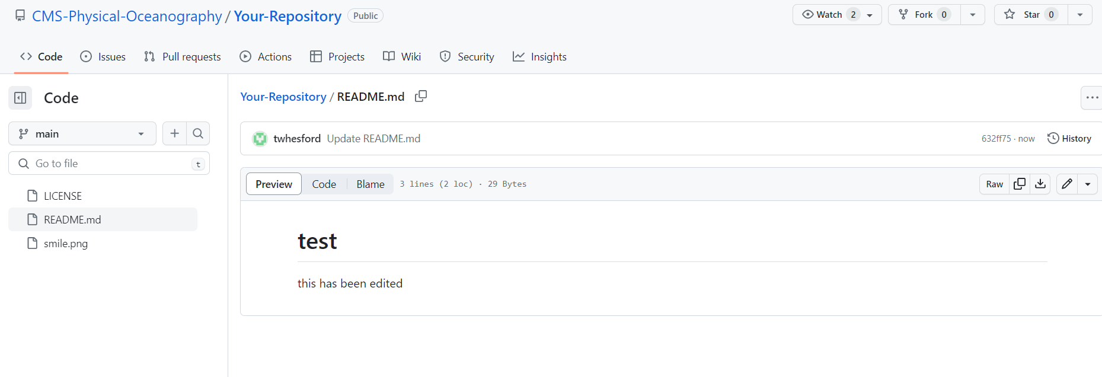
Editing files
Code and documentation can be edited within your repository.
Go to your file and click the pencil on the right side of the screen.

Slide 11
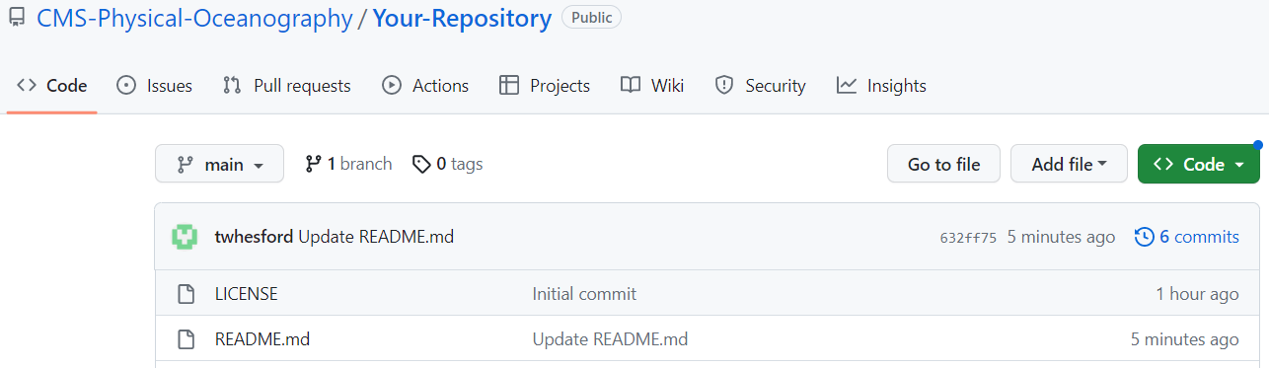
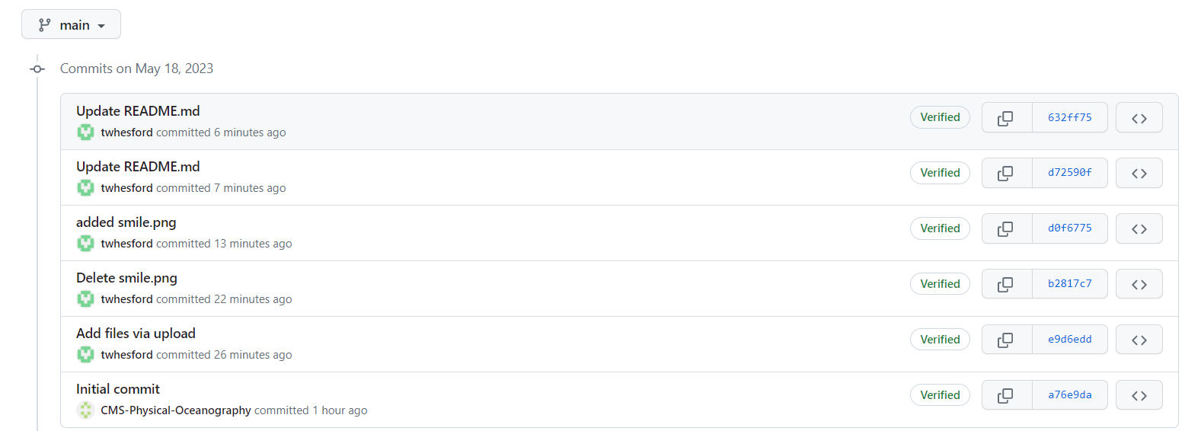
Tracking progress
GitHub tracks your progress and allows you to view earlier versions of your files.

Slide 12
Other features
Pull requests : Collaborators propose changes to a codebase which can be accepted or rejected.
Forking repositories : Clones a repository and uploads it to your GitHub allowing you to edit the code independently.
GitHub provides thorough documentation on everything discussed here and much more at https://docs.github.com/en

Slide 13
Linking your laptop to github (UNIX):
Generate ssh-key’s:
Create/edit file: ~/.ssh/config
Add the following statement:
Start an ssh-agent: Add your private key:
Copy your public key:
Add this key to your github account under “settings” and “ssh and gpg keys” select ”new SSH key” (next slide).
>> ssh-keygen -t rsa -b 4096 -C "<your email address>"
Host * AddKeysToAgent yes UseKeychain yes IdentityFile ~/.ssh/id_rsa
>> ssh-agent –s
>> ssh-add -K ~/.ssh/id_rsa
>> pbcopy < ~/.ssh/id_rsa.pub

Slide 14
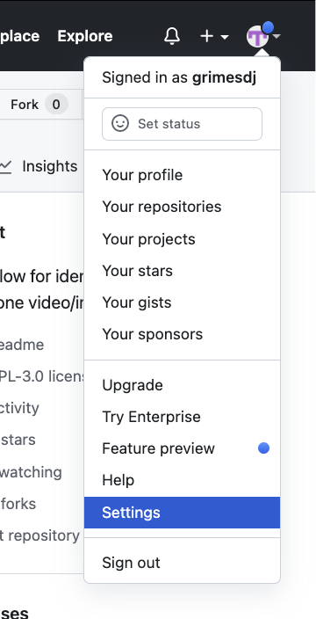
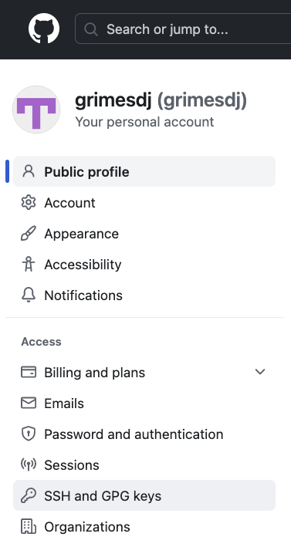
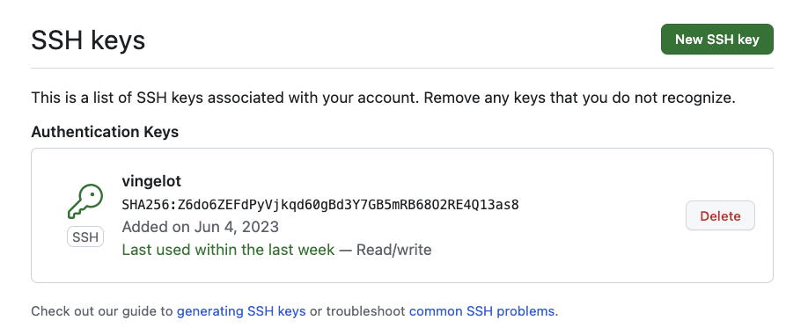
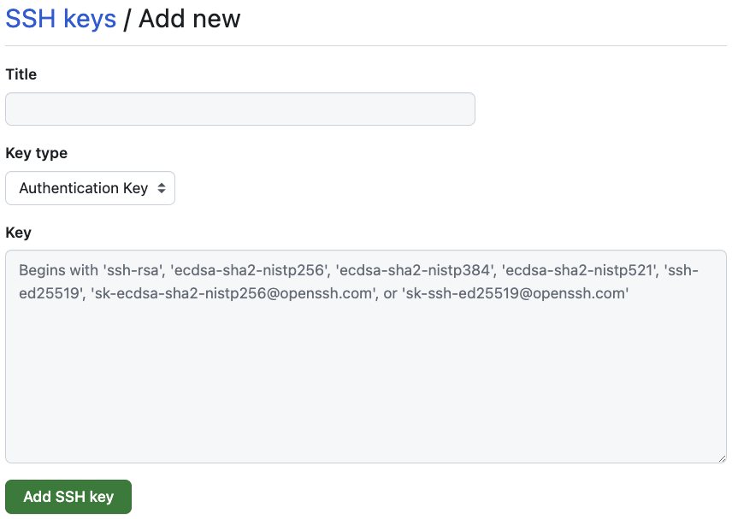
Linking your laptop to github (UNIX):
“Settings”
“SSH and GPG keys”
“New SSH key”
Title = name your key
type = Authentication
Key = paste your public key

Slide 15
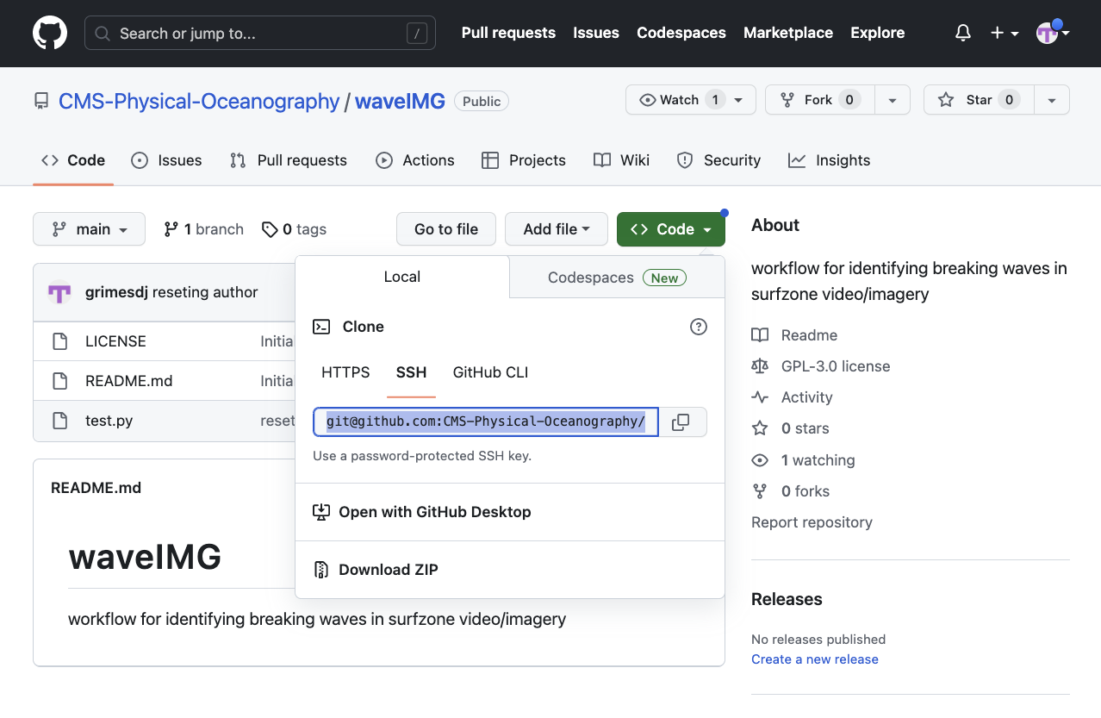
Clone a repository to your laptop
At the command line, navigate to the folder you’d like to house your repository:
To clone a repository you need the unique ssh-link. Navigate to the repository and click the green “Code” button; select SSH from the dropdown and copy the url.
Paste the url as input to the “git clone” command:
>> cd /path/to/repo
>> git clone github.com:CMS-Physical-Oce…

Slide 16
You can now edit/commit/push

