Slide 1


American International University Bangladesh Course: Advanced Computer Networks Faculty: Nahar SultAna
Group members:
HOQUE ,MAISHA-------------------(15-28988-1) REZA ,RIDITA-------------(15-28987-1) SARKER, CHRISTINE MONISHA ---(16-31255-1) MD. MOINUDDIN -------(16-31926-1) AWAL ,Muhammad ROBIUL-------(15-28902-1)

Slide 2

ACCESS CONTROL IN THE INTERNET OF THINGS: Big CHALLENGES AND NEW OPPORTUNITIES

Slide 3
MOTIVATION
Emerging developments in the field of IOT.
Security, authentication and trust.
Trustworthy communication.
Remove vulnerabilities especially on the malicious attacks of the devices
Integrity, privacy and the authenticity in the IOT devices.
Access control applicability in IOT systems.

Slide 4
INTRODUCTION
INTERNET OF THINGS(IOT):
NETWORK OF PHYSICAL OBJECTS.
EMBEDDED WITH ELECTRONICS,SOFTWARE SENSORS.
ALLOWS OBJECTS TO BE SENSED AND CONTROLLED REMOTE ACROSS EXISTING NETWORK INFRASTRUCTURE.
IMPROVED EFFICIENCY ACCURACY AND ECONOMIC BENEFIT.
ACCESS CONTROL:
AUTHENTICATION AND AUTHORIZATION.
LIMIT ACCESS BASED ON USER.
SELECTIVE DATA SHARING.
PREDICTIVE MAINTAENECE AND PROTECTION OF SENSITIVE DATA.

Slide 5

PROBLEM STATEMENT
HUGE NUMBER OF DEVICES.
CREATING HUGE SECURITY RIFT BETWEEN USERS.
SACRIFICING USABILITY FOR SECURITY.
MAILICIOUS ATTACK EXPLOITING SENSOR VULNERABILTIES.
IOT CONSTRAINTS AND LOW SECURITY MECHANISM APPLIED.

Slide 6
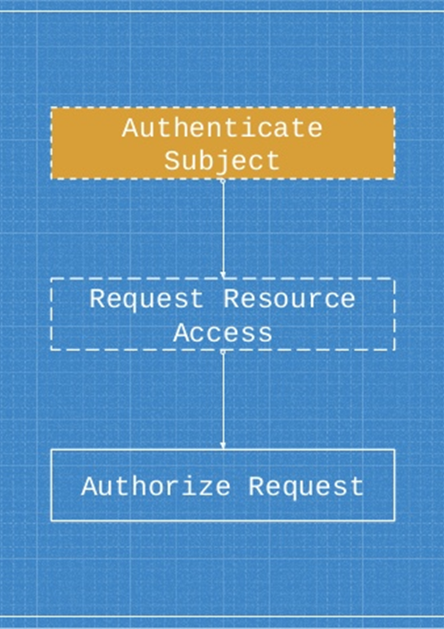
ROLE based access control(rbac):
Depends on the concept of Role
Administrator is the only one who is granted to assign the permissions to the Roles.
Admin can’t change any permissions given to a user.
Administration is centralized .
Have access to credentials and profiles on every device a person owns.

Slide 7
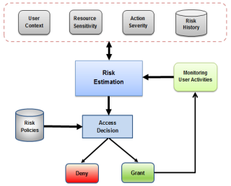
Risk based access control( rbac): (Authors proposal)
Four inputs: user context, resource sensitivity, action severity and risk history.
estimate the risk value associated
User context represents the environmental features.
Resource sensitivity represents the evaluability of resource data.

Slide 8
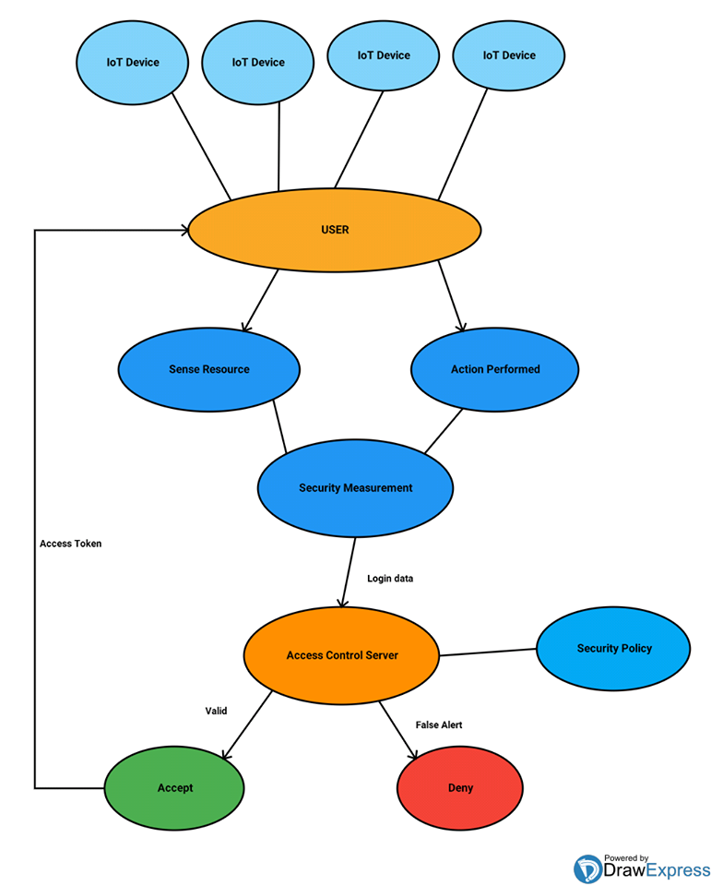
Probable solution:
Distributed/decentralized IOT devices.
Users Action and data sensed by security mechanism through access server.
Log-in data processesing in access server.
If valid → Accept and send access token to the user.
If false alert/invalid →Deny the request.

Slide 9
Conclusion:
Decentralized/Distributed DEVICES increases computational capacity.
Increase more opportunities to bring intelligence on device themselves.
User behaviour is monitored to detect any abnormal actions from authorized users.
Ensures flexibility and scalability to the IoT system into some extent.

Slide 10
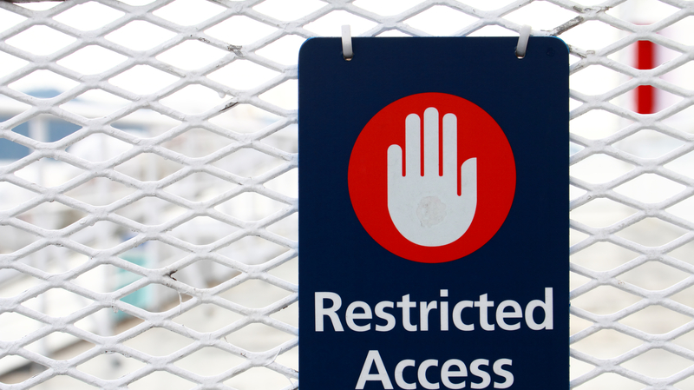
Thank you

