Slide 1
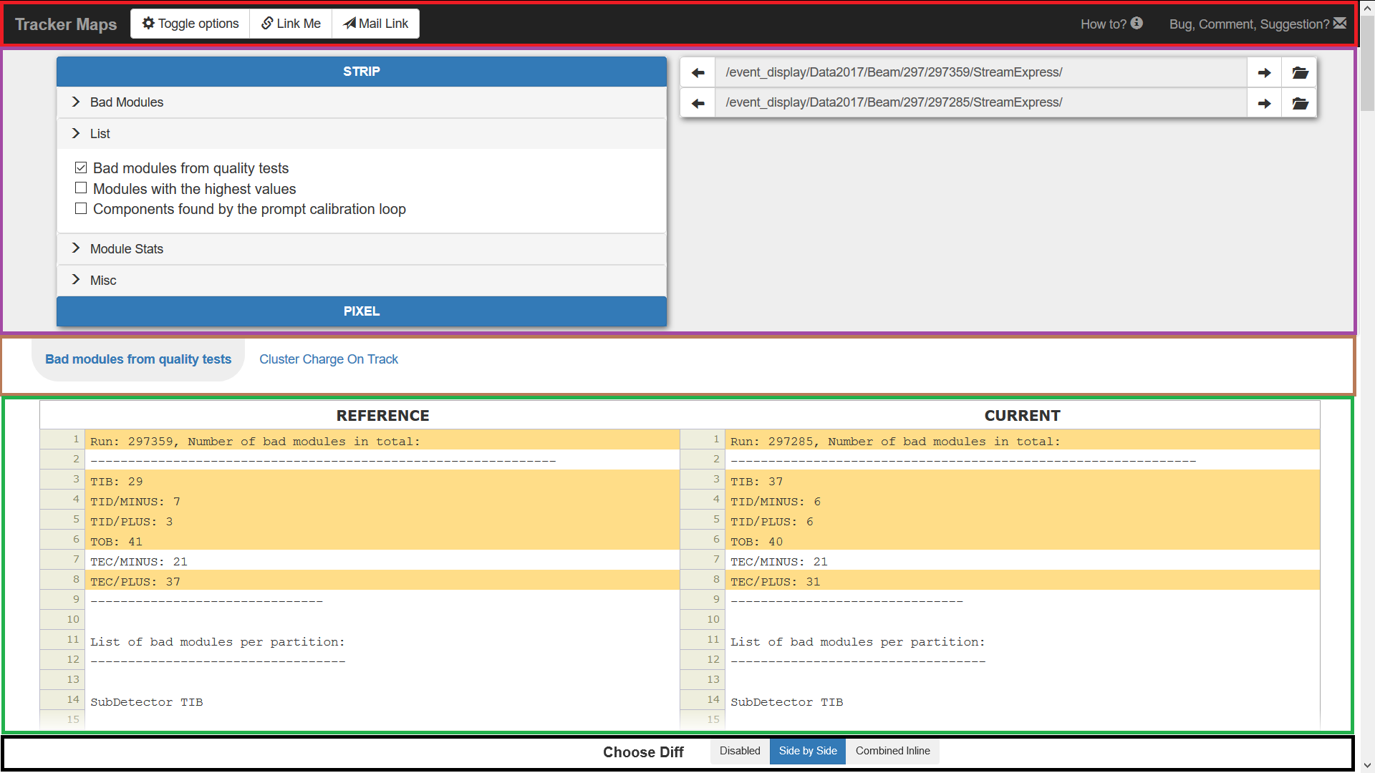
A)
B)

Slide 2
Section 1: Menu Bar
Toggle options: (un)hide Options Panel
Link Me: save current View (contents of Options Panel and currently selected Tab); new link will appear in the URL
Mail Link: save current View and open your email client; the message content will be filled with the generated link
How to?: open this document
Bug, comment, suggestion?: send email to the authors

Slide 3

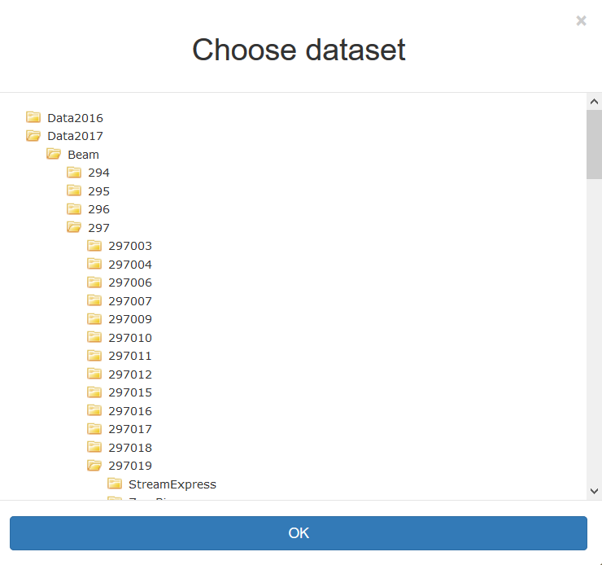



Section 2: Options Panel
A) Data picker: choose available map/log type; every ticked checkbox will result in additional Tab
B) Run picker: click on the browse button to pick desired Run
Top one input Run is considered as REFERENCE
Bottom one input Run is considered as CURRENT
Use to navigate between adjacent Runs
Tip: use your keyboard arrows to navigate in CURRENT (hold Shift + arrow to change REFERENCE); especially useful when Options Panel is hidden with

Slide 4
Section 3: Tab Bar
Populates when User decides which data to present (using Options Panel A))
Tip: if you decide you do not want given dataset (map/log) you can either uncheck corresponding checkbox on Options Panel or you can click Middle Mouse Button (MMB) to remove this; the latter is usuful with hidden Options Panel

Slide 5
Section 4: Data Show
Presents data for currently chosen dataset in Tab Bar with REFERENCE Run on the left and CURRENT on the right
Data can be either Images or Text:
Images: they allow for panning(dragging) and zooming with your Mouse and its Scroll, keeping the same transformation in both views
Text files
Both forms allow to make comparison views using Comparison Bar

Slide 6
Section 5: Comparison Bar
Comparison Bar is always docked to the bottom of current view
Type of comparison depends on the type of data:
Image: Comparison is done by subtracting values in each pixel: DIFF = REFERENCE – CURRENT Difference will show up instead of the CURRENT and its transformation (position and zoom) will be the same as transformation of the REFERENCE
Text: Side by Side or Combined Inline; color legend:
There is a differnece between the two lines
The line does not exist in the CURRENT
The line does not exist in the REFERENCE
Placeholder to keep lines in order

Slide 7
Known issues
Browsers supported:
Chrome
Firefox
Safari
Browsers NOT supported at all:
IE / Edge

