Slide 1
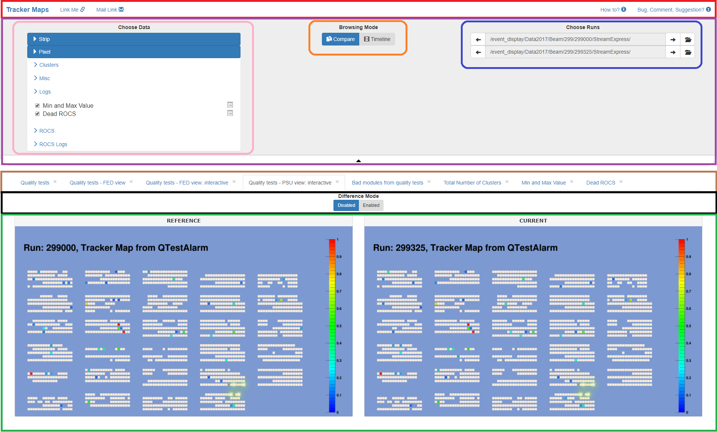

Slide 2
Section 1: Menu Bar
Link Me: save current View (contents of Options Panel – including type of Browsing Mode - and currently selected Tab); new link will appear in the URL
Mail Link: save current View and open your email client; the message content will be filled with the generated link
How to?: open this document
Bug, comment, suggestion?: send an email to the authors

Slide 3
Section 2: Options Panel
Data picker: choose available map/log type; every ticked checkbox will result in additional Tab
Browsing Mode:
Compare: allows to directly compare data from 2 different Run Datasets
Timeline: switches to slideshow mode in which Tracker Maps in a given range will be presented; only png data will be shown in this mode

Slide 4

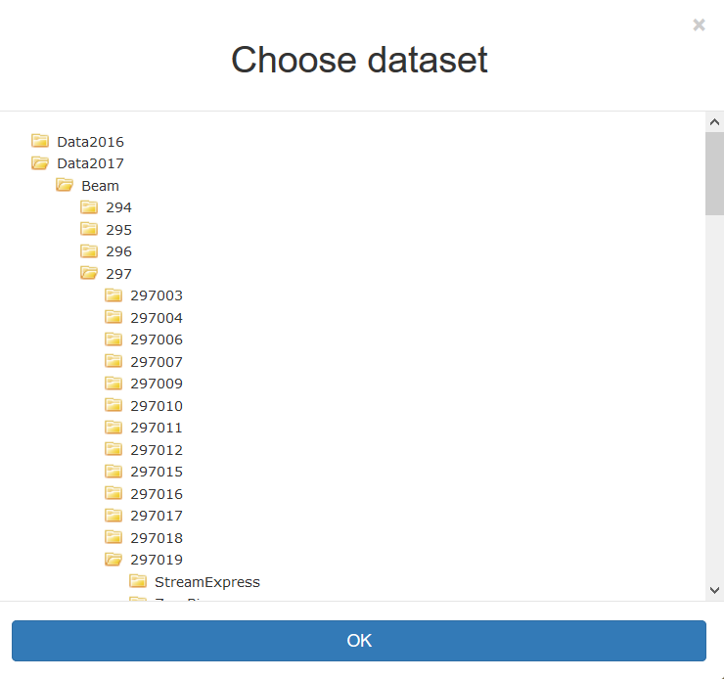


Section 2: Options Panel contd
Run picker: click on the browse button to pick desired Run dataset
Top one input Run is considered as REFERENCE/FROM (Compare/Timeline Browsing Mode)
Bottom one input Run is considered as CURRENT/TO (Compare/Timeline Browsing Mode)
Use buttons to navigate between adjacent Runs
Tip: use your keyboard to navigate between runs:
U/J – previous REFERENCE/FROM
I/K – next REFERENCE/FROM
O/L – open browser for REFERENCE/FROM
especially useful when Options Panel is hidden

Slide 5
Section 2: Options Panel contd
Very bottom button of this section - toggle options: (un)hide Options Panel

Slide 6
Section 3: Tab Bar
Populates when User decides which data to present (using Options Panel Data Picker)
If Browsing Type is changed to Timeline only tabs which present Tracker Maps will be visible (no interactive and text data allowed)
Tip: if you decide that you do not want given dataset (map/log) you can either
uncheck corresponding checkbox on Options Panel or
click close button in the top-right corner of the tab or
you can click Middle Mouse Button (MMB) to remove this tab
Last two options are handy with hidden Options Panel

Slide 7
Section 4: Comparison Bar
Type of comparison depends on the type of data:
Image: Comparison is done by subtracting values in each pixel: DIFF = REFERENCE – CURRENT Difference will show up instead of the CURRENT and its transformation (position and zoom) will be the same as transformation of the REFERENCE
Text: Side by Side or Combined Inline; color legend:
There is a differnece between the two lines
The line does not exist in the CURRENT
The line does not exist in the REFERENCE
Placeholder to keep lines in order
Comparisons are not allowed in the Timeline Browsing Mode

Slide 8
Section 5A: Data Show: Comparison
Presents data for currently chosen dataset in Tab Bar with REFERENCE Run on the left and CURRENT on the right
Data can be either Images or Text:
Images: they allow for panning(dragging) & zooming with your Mouse and its Scroll, keeping the same transformation in both views
Text files
Both forms allow to make comparison views using Comparison Bar

Slide 9
Section 5A: Data Show: Comparison contd
There is a special type of Tracker Maps – Interactive Tracker Maps
Quality tests - FED view: interactive
Quality tests - PSU view: interactive
The main difference between them and regular Tracker Maps is that when you hover over visible module:
you are informed about the current module name in the tooltip
the module gets orange highlight
clicking (LMB) on the module sets it in the metastable state
highlight changes to green
tooltip is not hiding
However tooltip is hidden when zooming and clicking MMB on the Tracker Map

Slide 10
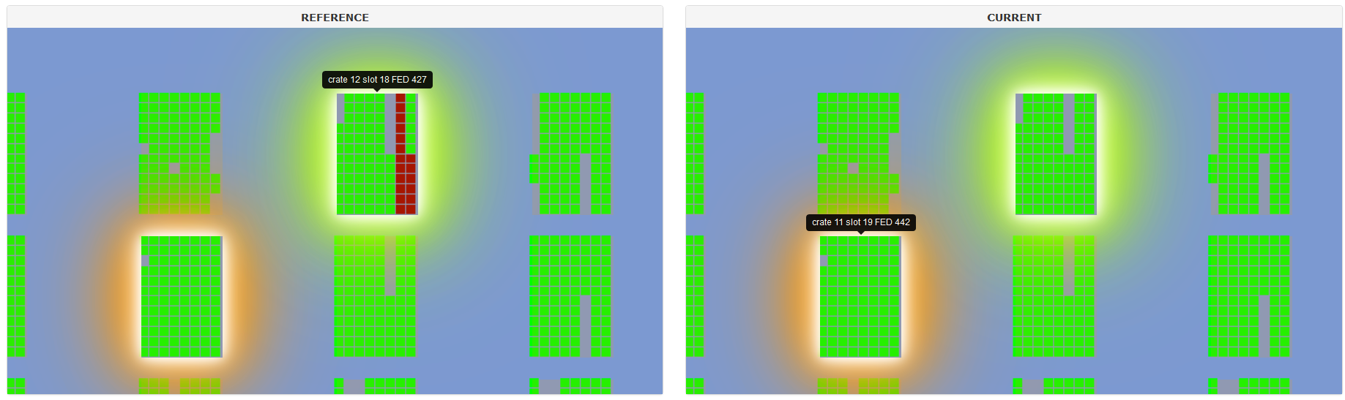
Section 5A: Data Show: Comparison contd
Interactive Tracker Maps not only have synchronized pan&zoom but also highlights
However, these Maps do not have interactive elements in the Differece View (because of the performance concerns)

Slide 11
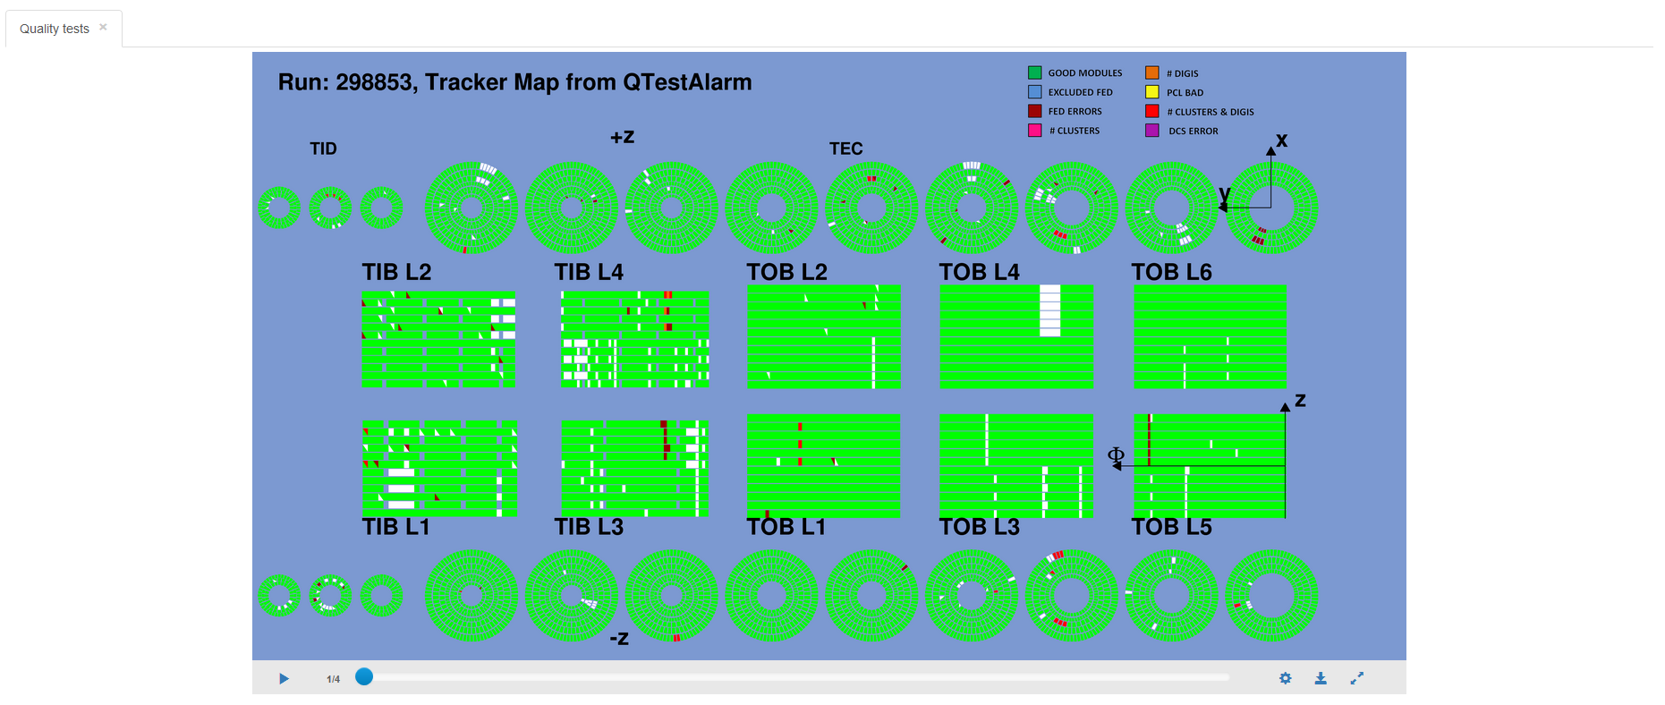
Section 5B: Data Show: Timeline
Slides
Control Panel

Slide 12
Section 5B: Data Show: Timeline
Timeline Control Panel (from left to right):
Play/Pause/Repeat button
Current slide number
Progress Bar – you can also drag it manually to adjust its position
Settings:
Enable playback looping
TkMPS: number of Tracker Maps that will be shown during 1s (min: 1, max: 25)
Download slideshow as gif
Resolution of the output file depends on the current size of Tracker Maps
Generation process might take a while
Toggle Fullscreen Mode
Note: Timeline does not support pan&zoom at this moment

Slide 13
Known issues
Browsers supported:
Chrome
Firefox
Safari
Browsers NOT supported at all:
IE / Edge
Interactive Maps:
In certain situations interactive areas are not being scaled properly; if this problem occurs solution can be to click once again on the active tab
Timeline:
In Firefox environment Maps are not being shown properly when the Map is being shown for the first time

