Slide 1
Recitation 9: Open Source Projects
Fall 2022
Sit with your team!

Slide 2
Upcoming Deadlines
Homework 5 - Due Friday 11/18
Homework 6 - Released Friday 11/18
Open Source Project Contribution
Today’s recitation will help prepare you for this assignment!

Slide 3
What is Open Source Software?
Software where...
Source code is publicly available
Project is open to collaboration
Usually means code has a license that permits users to freely run, modify, and redistribute

Slide 4
Why Open Source?
Open availability of source code
Reusable, provides learning opportunities
Allows for contributors with varying skill levels
Beginners can work on large codebases with assistance from more experienced members
Generally lower costs than proprietary counterparts

Slide 5
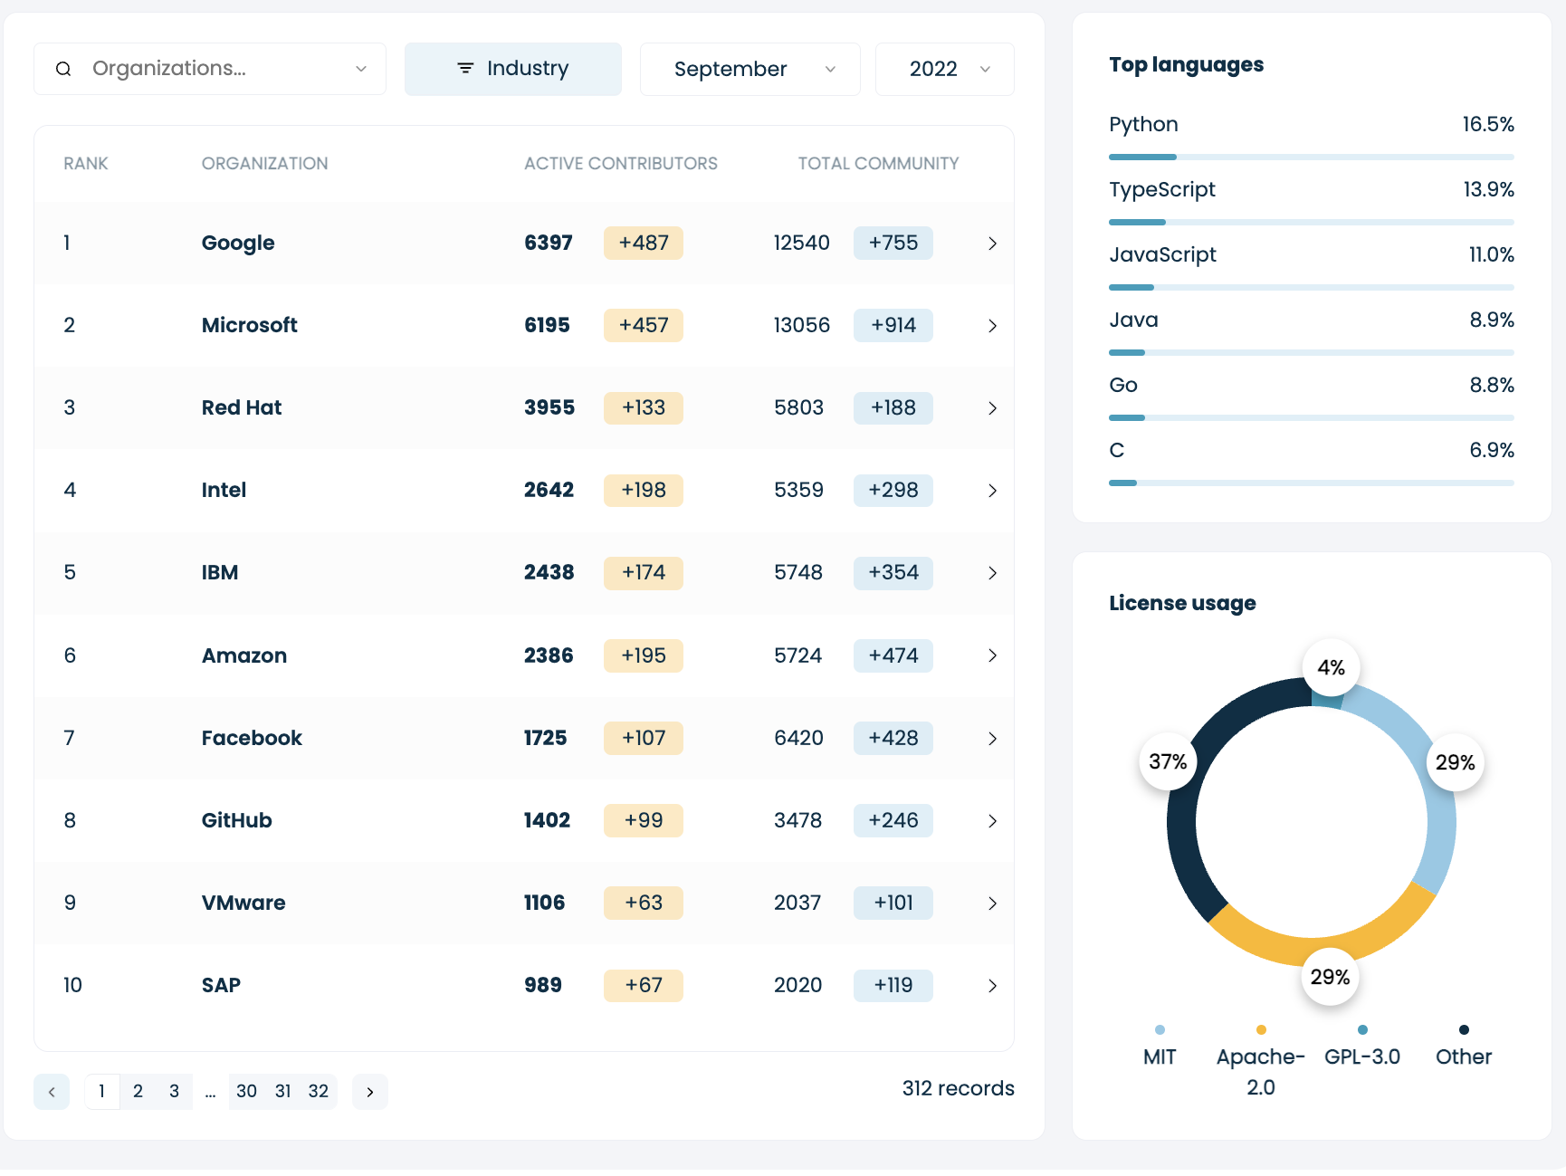

Collaborative Software Development
325M+ Repositories
41M+ Public Repos
58M+ Developers
Sources: https://github.com/ (2022), https://opensourceindex.io/ (2022)
Notes:
Just some numbers to show the scale of collaborative software development; the left are statistics on the number of repos + developers in Github, right side shows statistics on the number of open-source contributions from company employees (at Google, Msft, etc)

Slide 6



Large Open Source Projects
VSCode
1.7k Contributors
102k Commits
7k Open Issues
136k Closed Issues
TensorFlow
3.2k Contributors
137k Commits
2k Open Issues
33k Closed Issues
React Native
2.3k Contributors
25k Commits
2k Open Issues
21k Closed Issues

Slide 7
Open-Source Project Roles
Owner
Maintainers
Contributors
Community Members
Person with administrative ownership over the codebase
Contributors responsible for managing the organizational aspects of the project
Everyone who has contributed something back to the project
People who use the project
Reference: https://opensource.guide/how-to-contribute/

Slide 8
How to Contribute
Issue
Development
Create PR
Await Response
Adding/finding and claiming an issue to work on
Fork the main repo and make changes to the codebase & fix the issue
Submit a pull request to the main repository with your changes
Maintainers may accept, reject, or request changes
Reference: https://opensource.guide/how-to-contribute/

Slide 9
Today’s Activity
Scavenger Hunt!
Find Open Source projects fulfilling the given criteria
Fill in as many squares as possible!
30 Minutes

Slide 10
[Team Name]
Link a Repo to each square
Is sponsored by a large company (i.e. FAANG) | ** Most recent commit (DATE) | Project related to health/wellness | ** Most number of badges (#) | Someone in your group has used this project before
** Largest number of contributors (#) | Repository name contains non-English characters | ** Most number of languages used in repository (#) | Uses bots within workflow (Dependabot, issue bots, etc) | Project related to software development
Find a project that one of your TAs worked on for their HW6 | Project has over 50 current sponsors | Has both development and user documentation | Project related to art | Multiple (3+) CI workflows within Github Actions
** Largest number of open PRs (#) | Project related to education | ** Most recently updated README (DATE) | 1k+ stars but main has broken CI | Project has no code
Project related to gaming | ** Highest forked to starred ratio (X:X) | Repository has a “beginner-friendly” tag for issues | Repository is deprecated | ** Largest number of open issues (#)
** Can only be claimed by one team in the room - you must fulfill what’s described in the square to claim it.

Slide 11
Resources
https://github.com/MunGell/awesome-for-beginners
https://github.com/showcases/great-for-new-contributors
https://up-for-grabs.net
http://www.apache.org/
https://developer.mozilla.org/en-US/docs/MDN/Community/Contributing

Slide 12
Today’s Activity
Reflection
Which attributes make a good open source project? A bad open source project?
Which projects did you find that you would most like to work on? Which would you least like to work on? Why?

