Slide 1
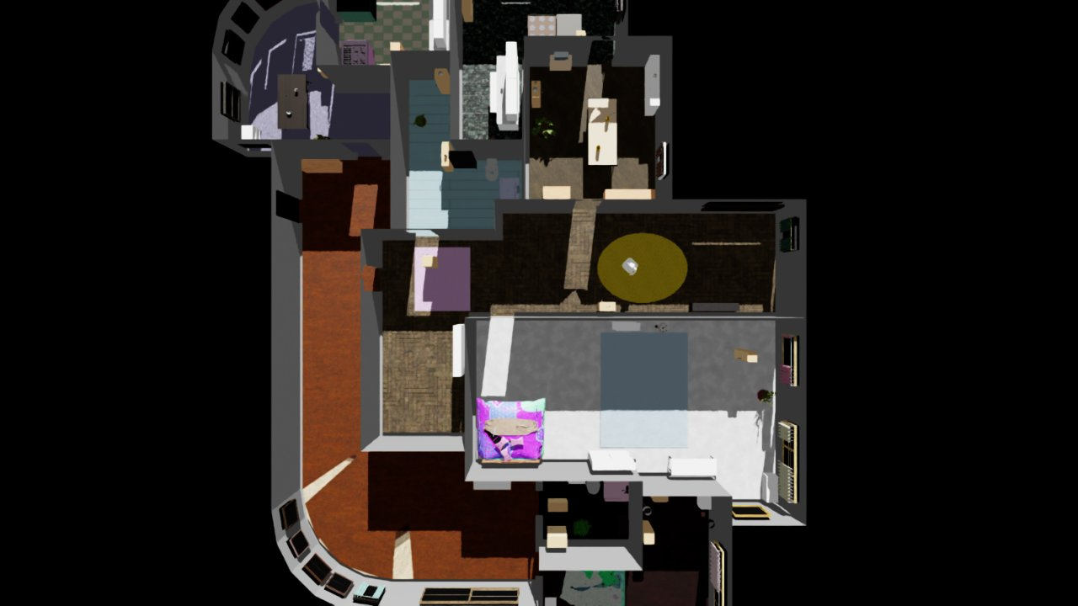
ZenoBench
From generated worlds to household tasks
What we have · What it can do · What comes next
Group meeting | October 2026
github.com/CMU-Agentic-Library/ZenoBench
Notes:
The talk is a high-level overview: upstream EmbodiedGen V2, what ZenoBench contains, task demos, and the proposed upper-level skill-graph interface.

Slide 2
BACKGROUND
EmbodiedGen V2 generates simulation-ready worlds
The upstream system turns language or images into assets, rooms and task layouts.
Assets
Scenes
Task worlds
3D objects with geometry, appearance and physical properties
→
Navigable multi-room environments
→
Objects arranged for interactive robot tasks
ZenoBench uses these generated objects in a reusable house and turns them into runnable, measurable tasks.
Source: HorizonRobotics / EmbodiedGen V2 README
ZenoBench · CMU Agentic Library
02 / 12
Notes:
EmbodiedGen V2 is upstream. It documents text/image-to-3D assets, multi-room scenes and task-driven world composition: https://github.com/HorizonRobotics/EmbodiedGen/blob/master/README.md

Slide 3
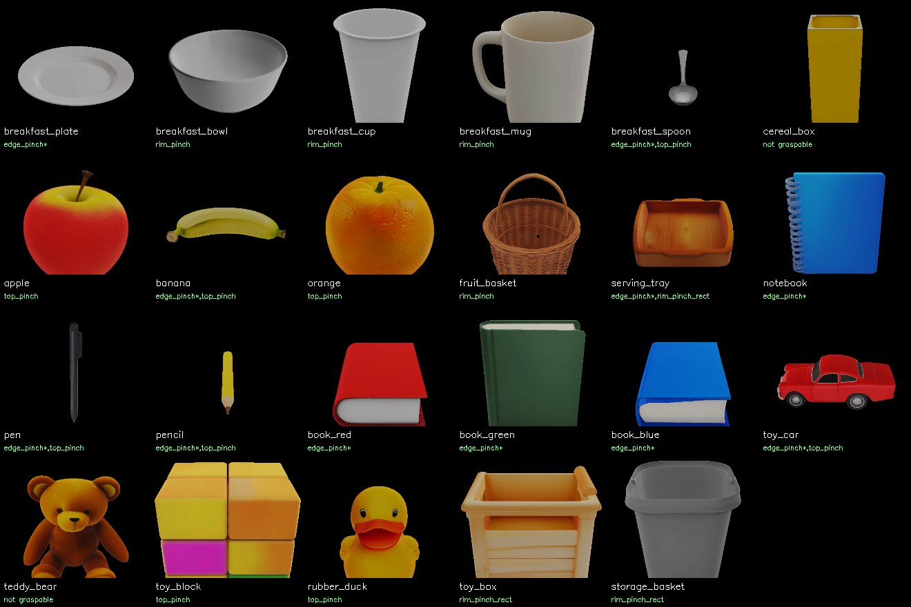
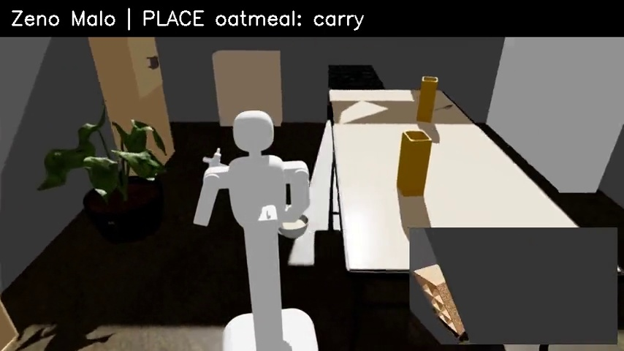
WHAT I BUILT
ZenoBench at a glance
One reusable home, generated task objects, and a suite of executable household goals.
Assets
Rooms
Tasks
EmbodiedGen V2 task objects prepared for physical interaction
10-room Infinigen house with furniture and articulated storage
8 task definitions, each with a scene, goal and evaluation
ZenoBench · CMU Agentic Library
03 / 12
Notes:
The house is an Infinigen layout, and the task objects are EmbodiedGen V2-generated. The repo prepares assets, room interactions, task scenes and scoring. This slide is intentionally a simple inventory, not an implementation pipeline.

Slide 4
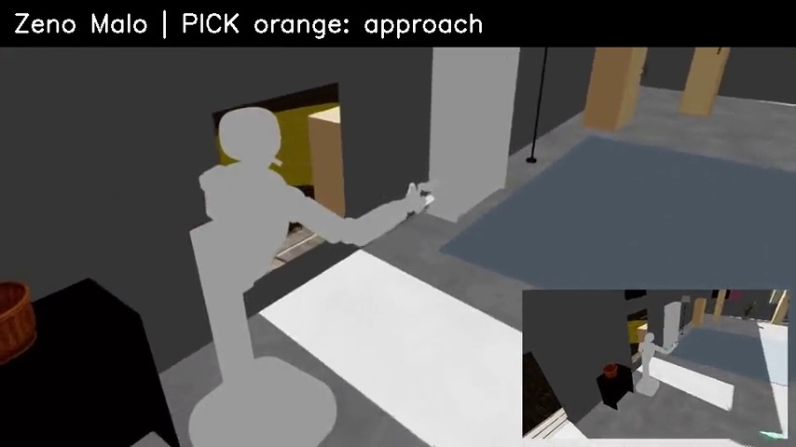
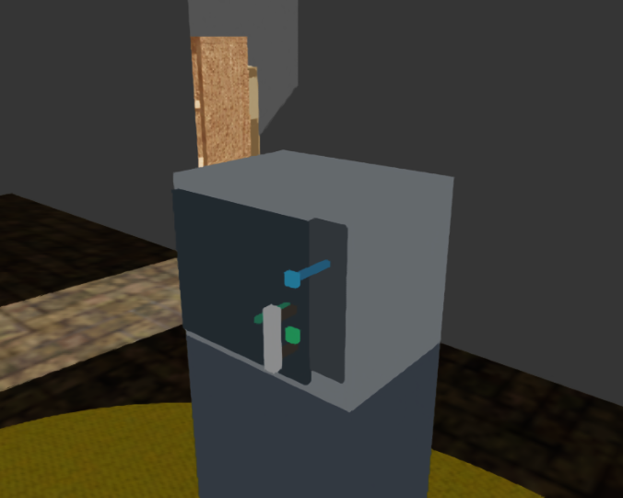
CAPABILITIES
What can the robot do here?
Zeno Malo can execute connected household actions in the same environment.
Move
Handle objects
Travel between rooms and approach workspaces
Pick, carry, place and sort different object shapes
Interact
Complete tasks
Open/close storage and operate appliance controls
Combine actions toward a goal checked from simulator state
ZenoBench · CMU Agentic Library
04 / 12
Notes:
Keep this high-level. These are things the system can demonstrate; do not explain trajectory controllers here. Recorded videos show whole scripted-policy runs and state-based evaluation.

Slide 5
CURRENT CAPABILITIES
Atomic policies: what is callable today
Concrete actions that can be combined under a task or a semantic contract.
Navigate + move
Posture + reach
empty_navigate · carry_navigate
pick_while_moving · place_while_moving
lower_torso · lean_forward
right_tcp_move · gripper open/close
Pick + place
Interact + operate
pick_top · pick_round_rim · pick_edge
place_surface · place_container
open_handle · close_handle · click
microwave_start · place_microwave
60 OOP entries · 54 passed at least one Isaac Sim smoke test · 6 callable but unverified
Unverified: floor-corner pick and five dual-arm / handover routes; verified results are scene-specific.
ZenoBench · CMU Agentic Library
05 / 12
Notes:
Current repo catalog has 60 policy entries, 54 with at least one representative physical smoke run and six callable but unverified. Give examples by category, not the full list. The six unverified include floor-corner picking and five dual-arm or handover routes. An atomic policy is a graph-level action; its controller may include several joint motions.

Slide 6
TASK SUITE
Eight tasks across four household themes
The same house supports different goals rather than a single scripted demonstration.
Collect
Organize
Prepare
Appliances
collect_fruits
tidy_toys
shelve_books
desk_prep
breakfast_setup
heat_breakfast_preloaded
heat_breakfast_combo
heat_breakfast
Gather objects into a shared container
Put floor toys away; place books on shelves
Set up a workspace or a dining table
Operate fridge/microwave and serve food
Representative rollouts and result JSONs are included in the repository.
ZenoBench · CMU Agentic Library
06 / 12
Notes:
All eight names come from task_specs. There are five organization/preparation tasks and three appliance tasks. The README includes representative runs; the task list is not a claim of robust success across all seeds.

Slide 7
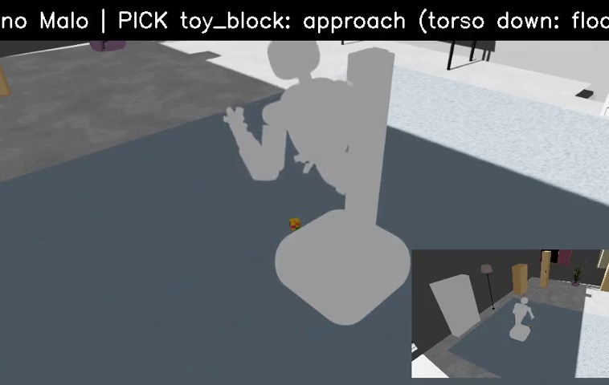
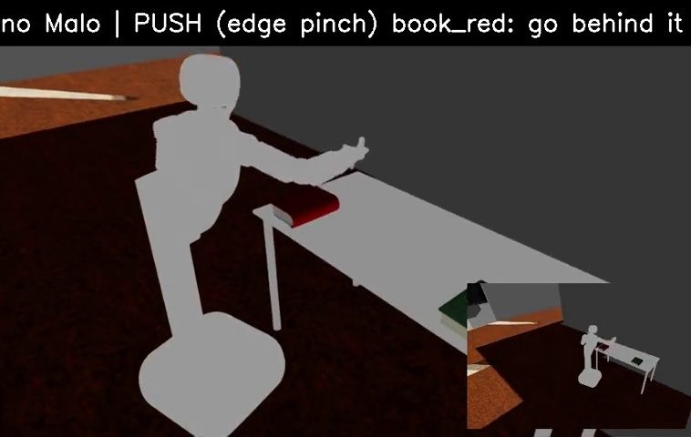
DEMO
Task showcase: three different behaviors
Use the recorded videos to show the system acting in the house.
Collect fruits
Tidy toys
Shelve books
Cross rooms; put two fruits into one container
Pick floor objects and store them
Handle flat books and place them on shelves
ZenoBench · CMU Agentic Library
07 / 12
Notes:
If time is limited, play only one clip. These stills come from the recorded collect_fruits, tidy_toys and shelve_books videos. Video paths are listed in SPEAKER_NOTES.md.

Slide 8
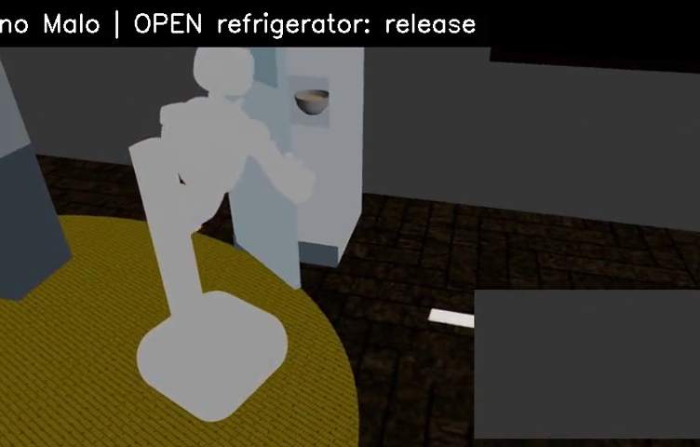
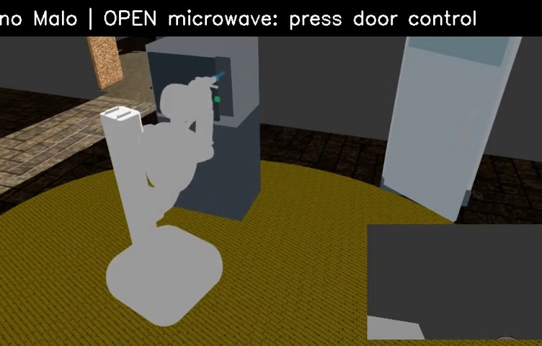
TASK DEMO
One longer example: fridge → microwave → table
A single goal ties together object handling, appliance use and movement through the home.
→
→
Take from fridge
Heat in microwave
Serve at table
Recorded run: all task goals met; oatmeal served warm, doors closed, no object dropped.
One representative rollout; not a multi-seed benchmark result.
ZenoBench · CMU Agentic Library
08 / 12
Notes:
The heat_breakfast seed-0 rollout achieved 100% of its four goals. The repo video shows the full sequence. Heating is modeled at task level, not with PhysX thermal simulation. Avoid quoting this as general success rate.

Slide 9
TASK RESULTS
What whole tasks run today?
Eight task definitions; results shown are representative recorded rollouts.
collect_fruits
SUCCESS
breakfast_setup
67%
Two fruits into one container
Dining table place setting
tidy_toys
SUCCESS
heat_breakfast_preloaded
SUCCESS
Floor toys into toy box / basket
Microwave heating from preloaded food
shelve_books
SUCCESS
heat_breakfast_combo
SUCCESS
Flat books onto a bookcase
Microwave cycle plus chilled milk
desk_prep
SUCCESS
heat_breakfast
SUCCESS
Notebook, pen and mug on desk
Fridge → microwave → dining table
7 successful representative runs; breakfast_setup remains partial after a mug drop.
ZenoBench · CMU Agentic Library
09 / 12
Notes:
These are recorded examples, not a statistical benchmark result. The repo has six successful videos in the main task table, a separate successful preloaded microwave smoke run, and one partial breakfast_setup run at 67% after a mug drop. The full heat_breakfast task has a seed-0 successful rollout.

Slide 10
RESEARCH VALUE
Why this matters for our setting
These tasks give an upper-level planner a meaningful environment to reason, act and recover in.
01
02
03
Plan
Ground
Verify & replan
Choose a sequence of skills for a household goal
Bind each skill to objects, rooms and executable actions
Observe the outcome, detect failure and revise the next step
ZenoBench is the execution and evaluation substrate for the upper-level Skill Graph design.
ZenoBench · CMU Agentic Library
10 / 12
Notes:
This is the transition to the user's two architecture figures. The existing task suite tests the consequences of upper-level decisions. The upper layer will reason over a public skill library and inspect verified outcomes.

Slide 11
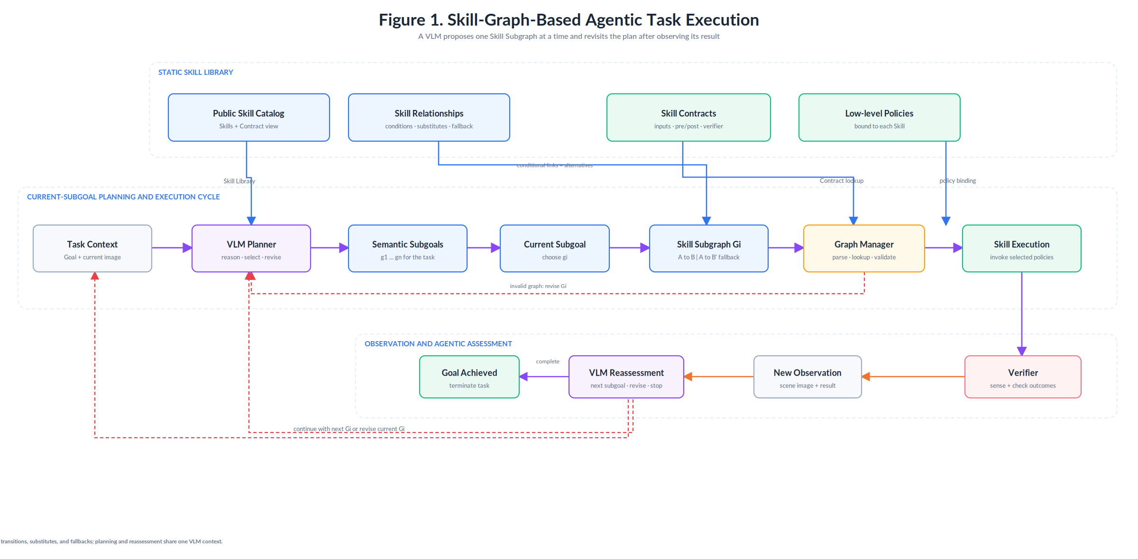
Notes:
Handoff to the upper-layer presenter: Figure 1 shows one Skill Subgraph per subgoal, validation, execution, verification and replanning.

Slide 12
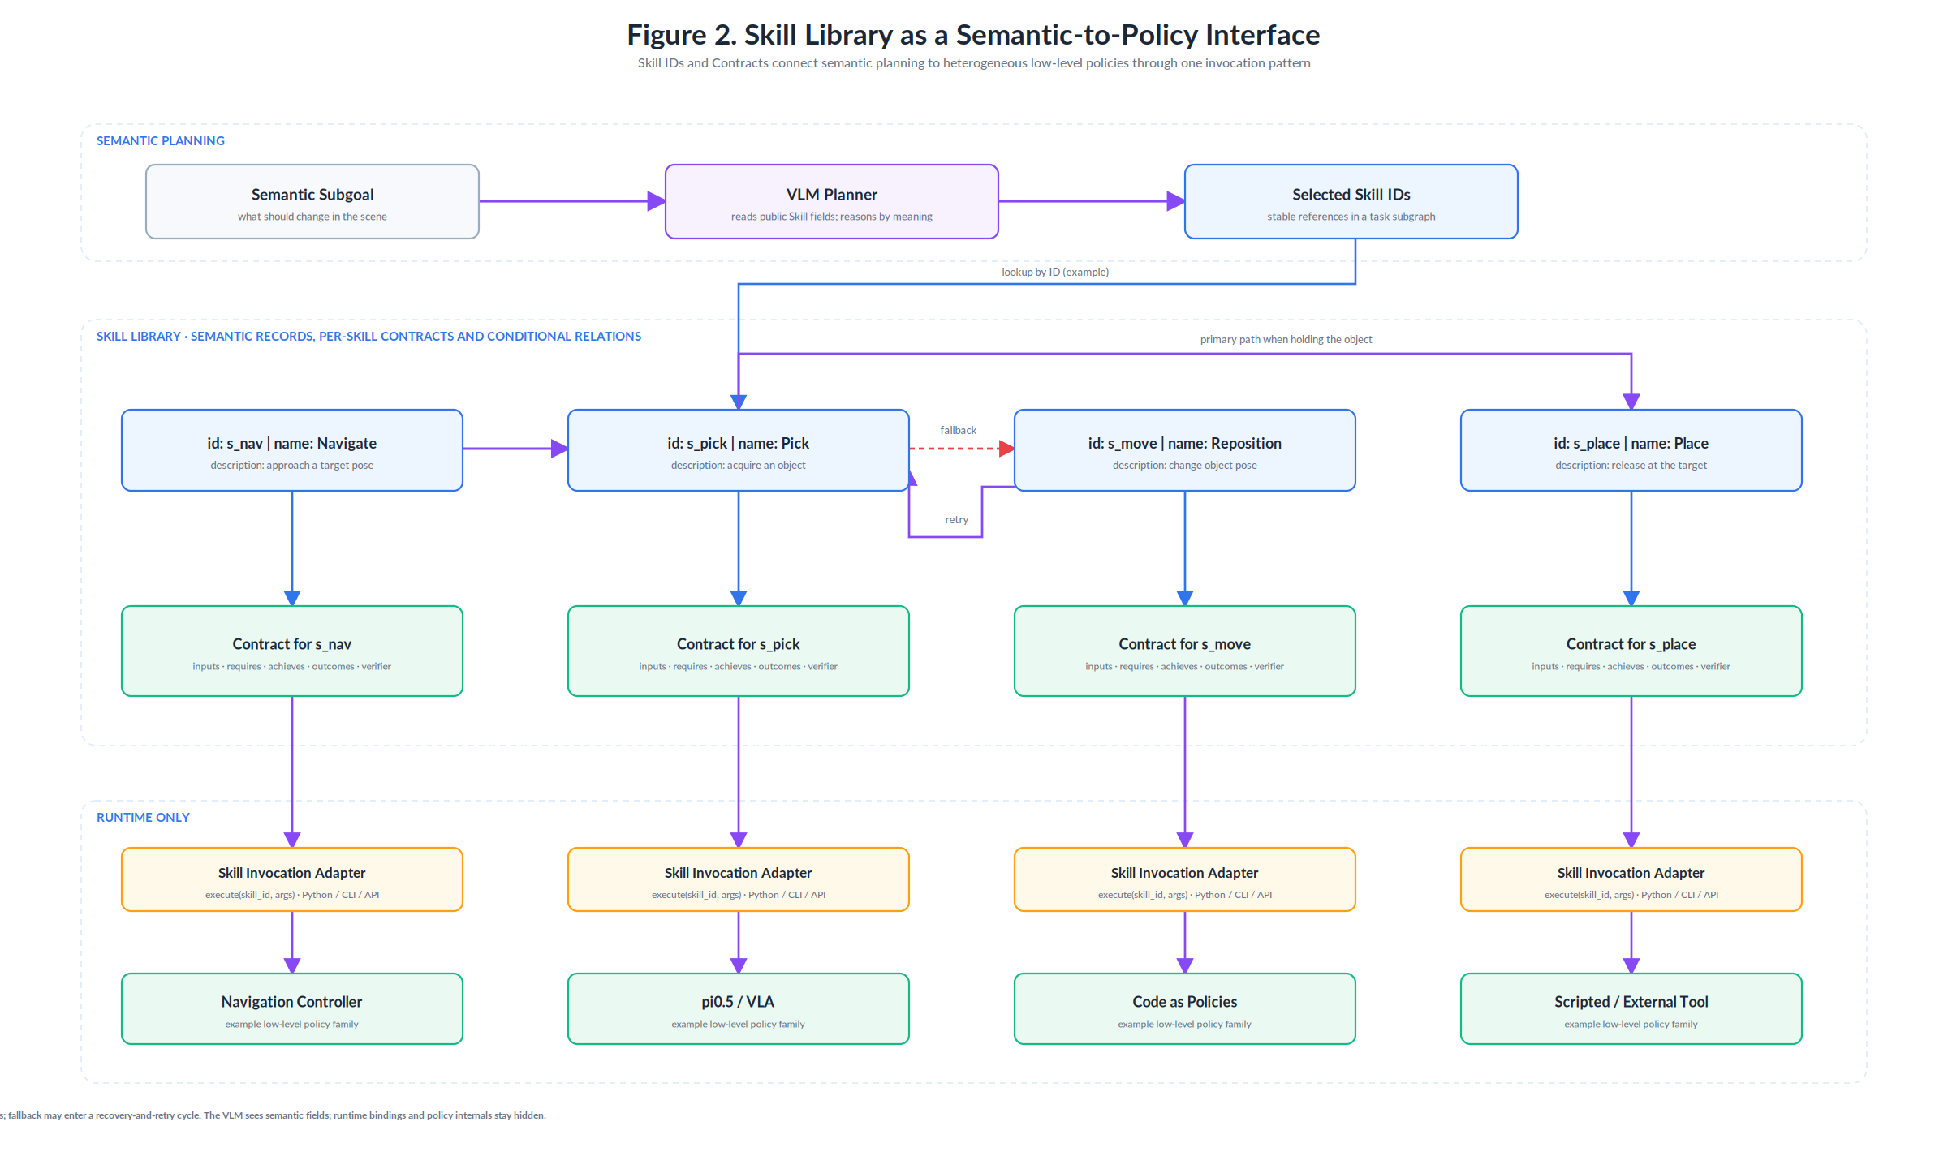
Notes:
Handoff to the upper-layer presenter: Figure 2 shows public SkillNodes, per-skill Contracts, the invocation adapter and heterogeneous low-level policies.

