Slide 1
Modern History of Causal Inference
Peter Spirtes
Notes:
add: GFT & new results. Strong claims…
In this talk I will try to answer the following questions.
- What is causality?
- Why do we care about causality?
- How can we find causal relations?
- What problems do you have to use causality to solve?
In this talk, I will show that actually causal modeling and machine learning could benefit each other.
Relation between causal models and probalisitic models...
go beyond distributions...
bridge between different distributions...
nonstationarity...
WHy human care about causality...
As you can see from the title, the talk is concerned with two tasks. One is causal discovery, that is, how to discovery causal information from purely observational data by machine learning or data analysis. We can also think the other way round, and we will see how causal knowledge can help us understand and solve some machine learning problems.

Slide 2
Aristotle on Causes
“Aiton” has no exact translation into English
“Aiton” is often translated as “cause”; could also be translated as “explanation” or “makes”
Causes are answers to “why” questions

Slide 3
Aristotle on Causes
Material cause: “that from which, <as a constituent> present in it, a thing comes to be … e.g., the bronze and silver, and their genera, are causes of the statue and the bowl.”
Formal cause: “the form, i.e., the pattern … the form is the account of the essence … and the parts of the account.”

Slide 4
Aristotle on Causes
Efficient cause: “the source of the primary principle of change or stability,” e.g., the man who gives advice, the father (of the child). “The producer is a cause of the product, and the initiator of the change is a cause of what is changed.”
Final cause: “something’s end (telos)—i.e., what it is for—is its cause, as health is <the cause> of walking.”

Slide 5
The Scientific Revolution
Advances in physics, celestial dynamics, optics, chemistry
Applied mathematics: analytic geometry, calculus, combinatorics
Mechanistic, atomistic qualitative explanations
The idea that the mechanisms and “hidden springs” of nature can be discovered by experimental manipulations.
Search for a method of search—a method, or methods, of scientific discovery

Slide 6
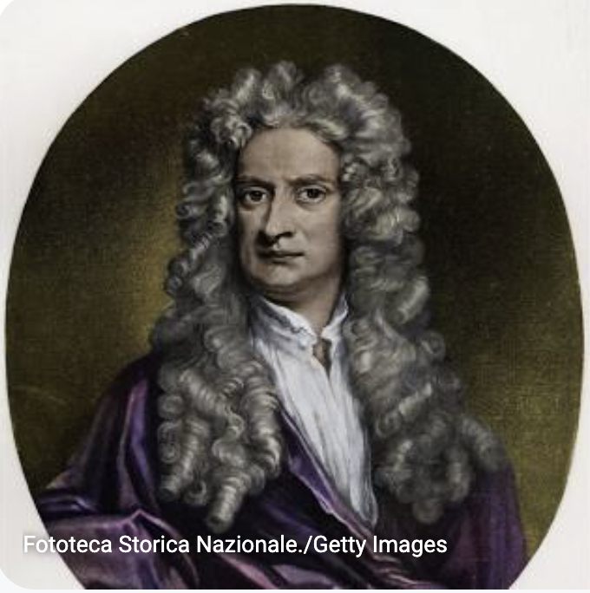
Newton’s Rules of Reasoning
No more causes of natural things should be admitted than are both true and sufficient to explain their phenomena.
Therefore the causes assigned to natural effects of the same kind must be, so far as possible, the same.
Those qualities of bodies that cannot be intended and remitted [i.e. qualities that cannot be increased and diminished] and that belong to all bodies on which experiments can be made should be taken as qualities of all bodies universally.
In experimental philosophy, propositions gathered from phenomena by induction should be considered either exactly or very nearly true notwithstanding any contrary hypotheses, until yet other phenomena make such propositions either more exact or liable to exceptions.

Slide 7
State of Causal Research in 1980’s – 1990’s
Causality
Causal models
Manipulations
Assumptions
Inference of Effects
Search

Slide 8
Causality?

Slide 9
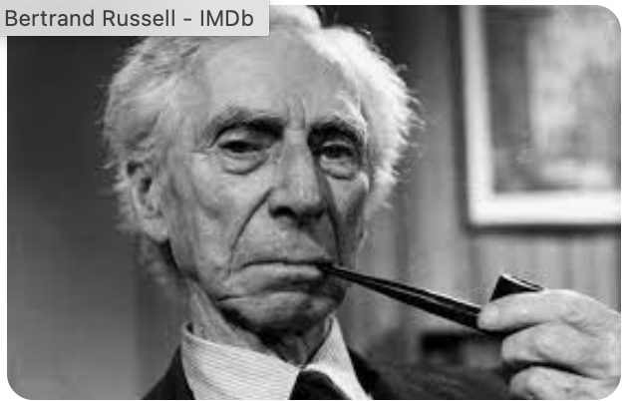
Causality?
Do causes even exist?
...the reason why physics has ceased to look for causes is that, in fact, there are no such things... Bertrand Russell
No satisfactory definition of cause
...I wish, first, to maintain that " cause " is so inextricably bound up with misleading notions as to make its complete extrusion from the philosophical vocabulary desirable... Bertrand Russell
Notes:
Lack of definition would mean introducing causality would introduce vagueness.
But of course people differered about the meaning of probability. Nevertheless, could introduce axioms about probabliity and reason rigorously.

Slide 10
Causality?
Shipley – “The Phenomenalist school of Pearson disliked Wright’s notion that one should distinguish "causes" from correlations. The Realist school of Fisher disliked Wright’s notion that one could study causes by looking at correlations. Professional statisticians therefore ignored it.”
Geweke – “Many econometricians are apt to be uncomfortable when thinking about the concept "causality" (in part, because they usually do so under some duress). On the one hand, the concept is a primitive notion which is indispensable when thinking about economic phenomena, econometric models, and the relationbetween the two. On the other, the idea is notoriously difficult to formalize, as casual reading in the philosophy of science will attest.”

Slide 11
Causal Models

Slide 12
Causal Models
Structural equation models
Graphical Models
Potential outcomes
Granger Causality
Some regression models (regression coefficient = causal coefficient if regress on correct set of variables)
Notes:
.

Slide 13
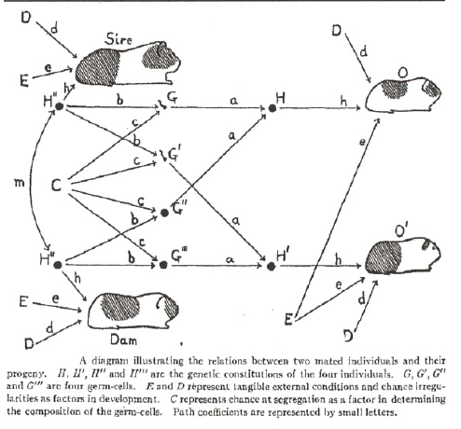
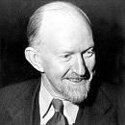
Structural equation models
G = b * H’’ + c * C
G’’’ = b * H’’’ + c * C
Sewell Wright

Slide 14
Probabilistic Interpretation of Directed Acyclic Graphs (DAGs)
A DAG represents a distribution P when each variable is independent of its non-descendants conditional on its parents in the DAG.
CP SEX| PE,SES,IQ)
SEX SES
SEX IQ
SES
SES
SEX
PE
CP
IQ
4/7/22
Notes:
Pearl and colleagues: d-separation, updating algorithms, not causal in full-blooded sense

Slide 15
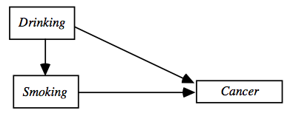
Causal Interpretation of DAGs
A directed graph represents a causal structure
Directed edge from A to B means A is a direct cause of B relative to the given variable set V
(adapted from “Causation, Prediction, and Search” by SGS, 1995)
Notes:
SGS

Slide 16
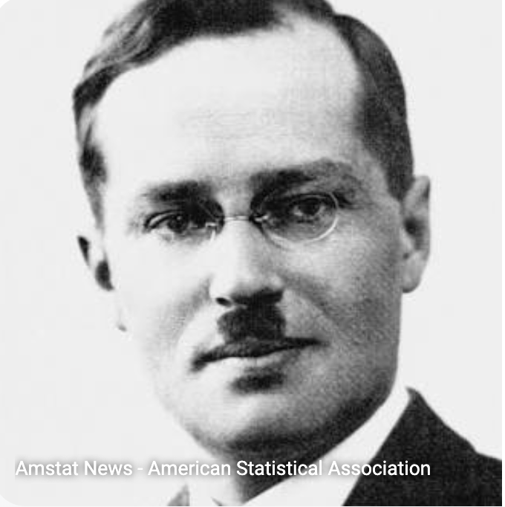
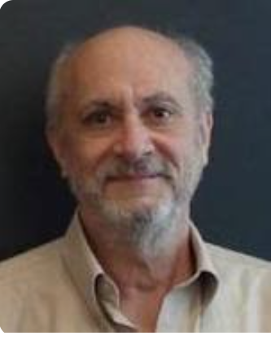
Potential Outcomes
Neyman/Rubin model
Introduction of notation for interventions versus conditioning: Y_{t}(u) is the value that unit u would have if u had been assigned treatment; Y_{c}(u) is the value that unit u would have if u had been assigned control
This was extended from experimental contexts to general contexts

Slide 17
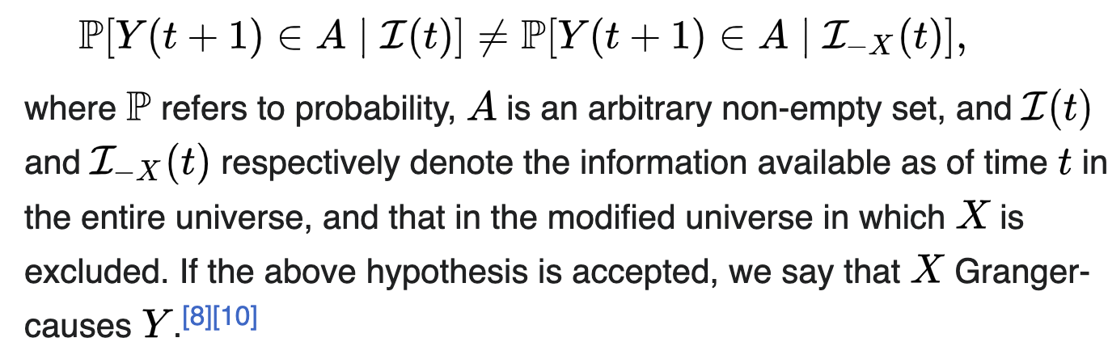
Granger Causality
The cause happens prior to its effect.
The cause has unique information about the future values of its effect.
This is more of a test for causality in the graphical sense under a set of assumptions than it is a separate causal model.

Slide 18
Relationships Between Causal Models
A structural equation model whose functions are represented by a DAG and whose error terms are independent is a special case of a DAG graphical model
Structural equation models allow for correlated errors and cycles
Potential outcome models can be represented in modified DAG models (Robins and Richardson??)

Slide 19
Manipulations

Slide 20
Causal DAGs – Manipulation (Hard)
A hard manipulation of a causal DAG breaks all edges into the variable beinig manipulated
Smoking Drinking
(adapted from “Causation, Prediction, and Search” by SGS, 1995)
Notes:
First, give an example... DAG... representations...
Specifically, 30% of your grade is from assignements or homework.

Slide 21
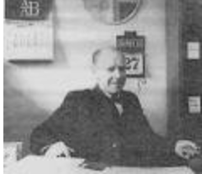
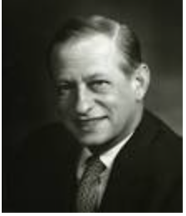
Structural Equation Models - Interventions
Intervention on G’’’
G = b * H’’ + c * C
G’’’ = b * H’’’ + c * C
Strotz and Wold - 1960
Notes:
However, this seems to have been little known in the 1980’s.

Slide 22
Potential Outcomes - Manipulations
Y_{t}(u) is the value that unit u would have if u had been assigned treatment; Y_{c}(u) is the value that unit u would have if u had been assigned control
Neyman, Jerzy. Sur les applications de la theorie des probabilites aux experiences agricoles: Essai des principes. Master's Thesis (1923). Excerpts reprinted in English, Statistical Science, Vol. 5, pp. 463–472. )
This was extended from experimental contexts to general contexts.
Rubin, D. B. (1974), "Estimating Causal Effects of Treatments in Random ized and Nonrandomized Studies," Journal of Educational Psychology, 66, 688-701
Notes:
But not widely know or used outside of certain fields such as epidemiology.

Slide 23
Causal Sufficiency
A set of variables is causally sufficient if every cause of two variables in the set is also in the set.
{PE,CP,SES,IQ} is causally sufficient
{IQ,CP,SES} is not causally sufficient.
SES
SEX
PE
CP
IQ

Slide 24
Frequently Made Assumptions
Each structural equation represnts a manipulable mechanism (or each potential outcome is well defined).
The causal structure is represented by a directed acyclic graph.
Stable Unit Treatment Value Assumption - potential outcomes for a given observation respond only to its own treatment status; potential outcomes are invariant to random assignment of others
Notes:
But not widely know or used outside of certain fields such as epidemiology.

Slide 25
Frequently Made Assumptions
Causal Markov Assumption –If a set of variables is causally sufficient, each variable is independent of its non-effects conditional on its immediate causes)
Simplicity Assumption
Notes:
But not widely know or used outside of certain fields such as epidemiology.

Slide 26

Simplicity Assumption
Causal Markov condition: in causally sufficient system, each variable ind. of its non-descendants (non-effects) conditional on its parents (direct causes) in the causal DAG.
causal structure
(causal graph)
Y → X → Z
Statistical independence(s)
Y Z | X
Y -- X -- Z ?
Faithfulness: all observed (conditional) independencies are entailed by Markov condition in the causal graph
Notes:
At the time, the distinction between satisfying the Markov condition for a graph as opposed to the causal graph were not carefully distinguished. Some version of the faithfulness condition was used (e.g. in variable selection), but not explicitly stated.
In causal discovery from non-experimental data, a crucial step is how to relate the causal structure to the statistical properties of the variables.
Causal Markov condition and the faithfulness assumption provide such a bridge.
faithfulness: all the conditional independence relationships holding in the population can be seen from the causal structure.
Roughly speaking, causal Markov condition means the causal structure implies conditional independences. While faithfulness assumption states that the conditional independences imply the causal structure.
More specifically, causal Markov condition states that in the causal graph,.... Faithfulness means that all ... That is, we do not have more independence relationships, other than those one can see from the causal graph by the Markov condition.
so what causal structure can we derive from this conditional independence relationship? Can we recover the original structure? We will come back to this question very soon.

Slide 27
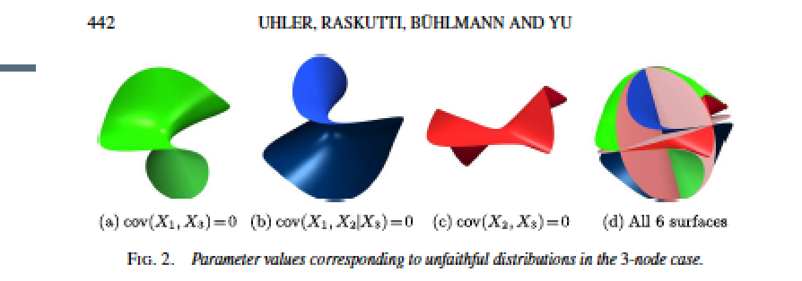
Surfaces of Unfaithfulness in Parameter Space
Why does ”consistency” matter if we cannot know the point at which an estimator has converged?
Surfaces of unfaithfulness in parameter space are Lebesgue measure 0. (pointwise consistency)
But being “close to unfaithful” can have large Lebesgue measure (no uniform consistency).
4/7/22

Slide 28
Three Faces of Faithfulness
Identifiability
If A is independent of B then prefer A → C ← B to A → C → B
Computational Efficiency
If A – C – B and A is independent of B then don’t need to check if A is independent of B conditional on C.
Statistical Efficiency
The Markov equivalence class can be found without testing independence conditional on a set with more than maximum degree of any variable in the true causal graph.
4/7/22

Slide 29
More Often Unmentioned Assumptions – None of the Following
Too many variables
Inadequate sample size
Selection Bias
Measurement error
Missing data
Multiple Data Sets from different contexts
Aggregation of Values
Non-Gaussianity
Non-linearity
Non-stationarity
Mixtures of distributions
Mixtures of structures
Non-causal relationships
Problems of randomized controlled experimentd
4/7/22

Slide 30
Inferences of Effects
Rules equivalent to do-calculus with possible latents: SGS, 1993
Pearl: do-calculus, 1995
4/7/22

Slide 31
Search

Slide 32
Causal Structure Learning and Causal Representation Learning
Inputs
Data (observational or experimental or combination)
Optional Domain Knowledge
Temporal order
Known causes
Known non-causes
etc.
Assumptions
Causal Markov Assumption
Simplicity Assumption
Outputs
Set of causal graphs, or
Probability distribution over causal graphs, or
...

Slide 33
Two Kinds of Search
Causal structure learning – Predict the effects of interventions among variables that have been measured.
Causal Representation Learning – Find causal relations between variables that have not been directly measured: e.g. personality traits.

Slide 34
Causal structure learning

Slide 35
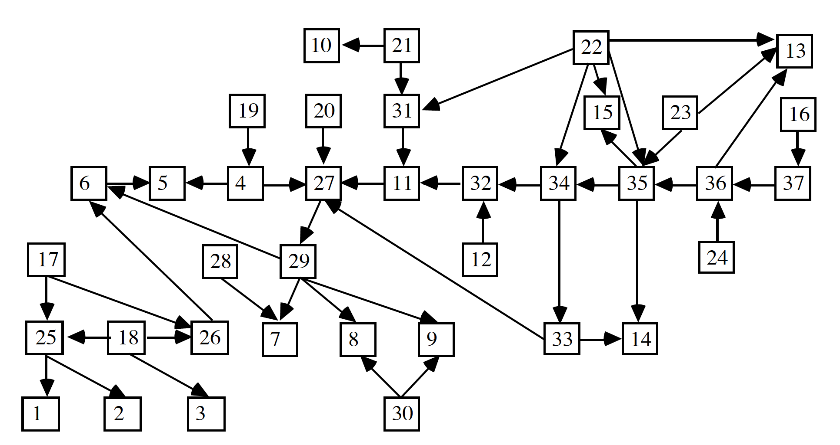
The Alarm Network
Notes:
Actual causal model of intensive care. Data is simulated.

Slide 36
The Alarm Network
Causal graph of intensive care alarms
Simulated data
Number of variables – 37 between 2 and 4 values
Number of edges – 46
Notes:
Fienberg, author of one of the main textbooks on discrete models, thought that there it was impossible to find a model that generated that data.
The original IBM PC in 1981 had a max of 256 kb ram, 2 5.25’’ floppy drive storing 320 kb

Slide 37
The Alarm Network - Search Problems
Suppose that we have data better than any real data set – no measurement error, no missing values, etc. and a large sample (10,000)
State space size -1.73329e+16
Number of DAG models 3.008648e+237
Non-identiability: There are multiple DAGs that represent the exact same set of distributions.
Notes:
Fienberg, author of one of the main textbooks on discrete models, thought that there it was impossible to find a model that generated that data.
The original IBM PC in 1981 had a max of 256 kb ram, 2 5.25’’ floppy drive storing 320 kb

Slide 38
Bradford Hill Criteria for Causation (1965)
strength of association
consistency
specificity
temporality
biological gradient
plausibility
coherence
experiment
analogy

Slide 39
Searches People Used
Factor Analysis
Interpretation 1 – compact representation of distribution
Interpretation II – causal
But assumed no causal relations among measured
Rotations meant causal relations among latents underdetermined

Slide 40
Searches People Used
Regression
Assumed regression coefficient was causal coefficient if regressed on right variables
Advice was to regress on as many variables prior to the regressor as possible
But this did not take care of unmeasured confounders
Also regressing on too many variables can make estimates of structural coefficients worse when there are latent confounders
L1 L2
X Y Z
If regress Z on X then regression coefficient = structural coefficient , but if regress Z on X and Y, then regression coefficient ≠ structural coefficient

Slide 41
Searches People Used
A variety of heuristic searches.
LISREL “modification indices”. These started from a given model, and then modified the model to improve it. These did not work well in practice. The further the original model was from the truth, the worse it performed.
Granger causality – assumed linearity, no latent confounders, no “instantaneous” causality.
Various kinds of stepwise regression for selecting variables.
(P. Spirtes, R. Scheines, and C. Glymour) "Simulation Studies of the Reliability of Computer Aided Specification Using the TETRAD II, EQS, and LISREL VI Programs", Sociological Methods and Research, vol. 18, no. 1, August, 1990, pp. 3-66.
Notes:
tClive Granger argued that causality in economics could be tested for by measuring the ability to predict the future values of a time series using prior values of another time series. Since the question of "true causality" is deeply philosophical, and because of the post hoc ergo propter hoc fallacy of assuming that one thing preceding another can be used as a proof of causation, econometricians assert that the Granger test finds only "predictive causality”
A time series X is said to Granger-cause Y if it can be shown, usually through a series of t-tests and F-tests on lagged values of X (and with lagged values of Y also included), that those X values provide statistically significant information about future values of Y.

Slide 42
Arguments Against Automated Search
Are there causes?
Shipley – “The Phenomenalist school of Pearson disliked Wright’s notion that one should distinguish "causes" from correlations. The Realist school of Fisher disliked Wright’s notion that one could study causes by looking at correlations. Professional statisticians therefore ignored it”
Notes:
Everybody who actually faced making policies knew that they needed to get the causal story right in order to do the right intervention.

Slide 43
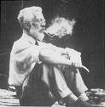
Fisher: No Experiment => No Probability Distribution => No Causal Inference
Early Lung Cancer
Lung irritation
Lung Cancer
Smoking
Does Smoking cause Lung Cancer?

Slide 44
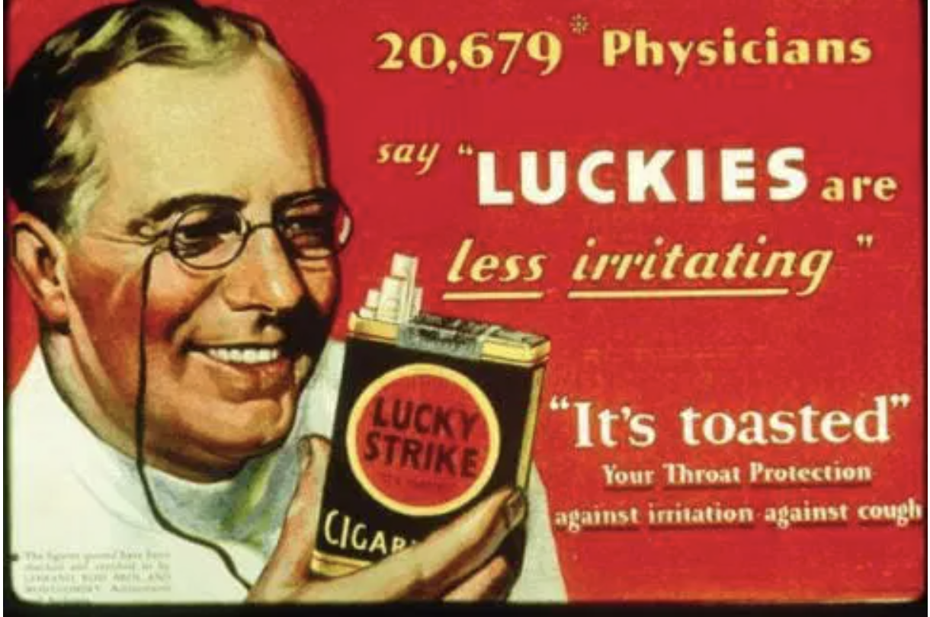

Slide 45
Arguments Against Automated Search
We don’t have any formal model of causality.
Geweke – “Many econometricians are apt to be uncomfortable when thinking about the concept "causality" (in part, because they usually do so under some duress). On the one hand, the concept is a primitive notion which is indispensable when thinking about economic phenomena, econometric models, and the relation between the two. On the other, the idea is notoriously difficult to formalize, as casual reading in the philosophy of science will attest
Notes:
We did not have a definition. But we did have axioms – Markov and Faithfulness. So we could be precise about when things would succeed in the limit. How can you have axioms without a definition? All formal theories have some primitive terms. There are serious disagreements about what probabilities are, but there are still shared axioms. And we had defined intervention. So we could calculate the effects of interventions – see SGS which gave rules for calculating the effects of interventions, and Pearl do-calculus).

Slide 46
Arguments Against Automated Search
We don’t have any automated searches that work.
This is not an argument that there aren’t any that work.

Slide 47
Arguments Against Automated Search
(Younger, 1978; Rawlings, 1988): "relationship"--that is, some statistical dependency--between sample values of variables X and Y may be observed
(i) when X causes Y,
(ii) when Y causes X,
(iii) when each causes the other,
(iv) when some third variable causes both,
(v) when the sample is not representative, or
(vi) when the values of X and Y form time series
} direction unknown
feedback
confounding
non-i.i.d.
Notes:
This depends upon which assumptions are made, and which variables are measured, and which distributions are considered.

Slide 48
Arguments Against Automated Search
In the worst case, it is impossible to distinguish causal directions from each or from confounding using just associations.
“Correlation is not causation”.
This is a worst case argument – it depends upon what assumptions are made, which distributions exist, which variables are measured, and which causal graphs are true.
But the worst case is not every case – what can we distinguish?
You don’t have to just use associations – there is more information in probability distributions than just associations.

Slide 49



Skepticism, 1980-
Terry Speed: There may be better search methods than regression, but only regression should be used.
Donald Rubin: Causal models should contain counterfactual variables. Effects depend counterfactually on causes, not vice-versa. So you cannot even know the appropriate variables unless you already know a lot about the causal relations. So search is impossible.
Judea Pearl: Any associations could be due to unrecorded, unknown causes, so directed graphs cannot be used to estimate causal relations.

Slide 50
More Problems
Number of models
Inadequate sample size
Selection Bias
Measurement error
Missing data
Multiple Data Sets from different contexts
Aggregation of Values
Non-linearity
Non-stationarity
Causal interactions among units
Mixtures of distributions
Mixtures of structures
Violations of SUTVA
Non-causal relationships
.
.
.
4/7/22

Slide 51
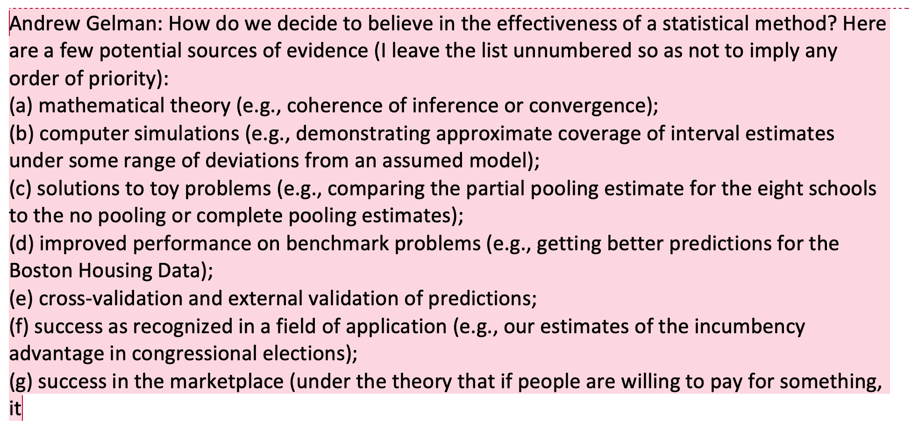
Why Should We Trust the Output of A Search Procedure? What was Lacking in 1990

Slide 52
Possible Responses to non-identifiability
*Strengthen assumptions. Add simplicity assumption (Causal Faithfulness Assumption).
*Weaken sense of success. (Identify Markov equivalence class, not DAG).
Strengthen input. (Add experimental data as well)
Give up.
4/7/22
Notes:
Constraint-based algorithm.

Slide 53
Causality and Modular Changes
Causal system has “irrelevant” modules (Pearl, 2000; Spirtes et al., 1993)
Independent & minimal changes
Changes in values of measured variables or hidden variables
A “minimal change” representation explains the distributiond with a minimal number of changing conditional distributions (Ghassami et al., 2018; Huang et al., 2020)
Causal representation learning: find modular & minimal changes from observational data with identifiability guarantees
Huang, Zhang, Zhang, Ramsey, Sanchez-Romero, Glymour, Schölkopf, "Causal Discovery from Heterogeneous/Nonstationary Data," JMLR, 2020
Ghassami, Huang, Kiyavash, Zhang, “Multi-Domain Causal Structure Learning in Linear Systems,” NeurIPS 2018
Notes:
In order to recover causal model or causal representation from data, we have to figure out two things. One is what properties of footprint the causal process leaves in the data that can be used to recover the information of the causal process. The other is whether such properties are strong enough to establish the identifiability of the causal relations or hidden causal variables . If they are identifiable, we successfully recover the information of the underlying causal process of interest.

Slide 54
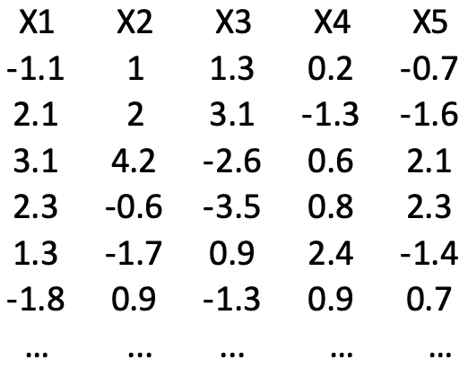
(Typical) Constraint-Based Causal Discovery
Conditional independence constraints between each variable pair
Illustration: the PC algorithm
Extensions: the FCI algorithm…
X1⫫X5 | X3
X2⫫X4 | X1
X2⫫X5 | X3
X4⫫X5 | X3
X1⫫X3 |{X2, X4}
X1
X2
X4
X3
X5
- Spirtes, Glymour, and Scheines. Causation, Prediction, and Search. 1993.

Slide 55
Constraint-Based Causal Discovery
PC provides asymptotically correct results if there doesn’t exist latent confounders (Spirtes et al., 1993)
FCI gives asymptotically correct results even if there are latent confounders (Spirtes et al., 1993)
Rely on causal Markov condition + faithfulness assumption
Outputs equivalence class; might not be informative enough
Faithfulness implies edge minimality: Minimal ways to change the conditional distribution to produce the data dependence
- Spirtes, Glymour, and Scheines. Causation, Prediction, and Search. 1993.
Notes:
Even as adults, we question the “why” of many things not in our control. For children, “why” questions help them make sense of the world around them that they are just beginning to learn about. These “why” questions also help spur and accelerate learning. Our adult responses are crucial and pivotal. So, the bigger question is: What is your response to the “why” questions?

Slide 56
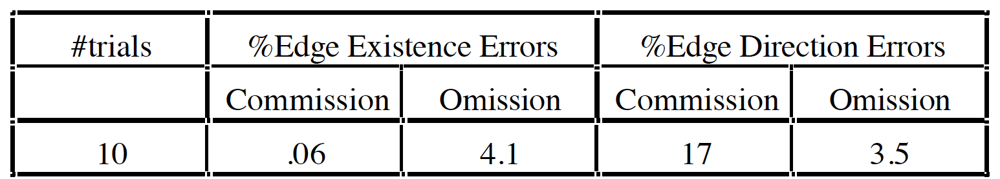
Alarm Network
PC algorithm results

Slide 57

I know There Is No Confounder: Example
Obtained 45 samples of Spartina grass up and down the estuary, and measured 13 variables in the samples, including concentrations of various minerals, acidity (pH), salinity, and the outcome variable, the biomass of each sample
The PC algorithm found that among the measured variables the only direct cause of biomass was pH.
Y-structure: no confounder!
Later verified by intervention-based analysis
…
PH
Biomass
Notes:
In the 1970s, the Edison Electric Company in North Carolina was concerned about the effects on plant growth of acid rain produced by emissions from its electric generators. The company arranged with a biologist and a statistician to investigate whether acidity of waters was affecting plant growth in the region. The investigators chose samples from the Cape Fear estuary, where the Cape Fear River flows into the Atlantic Ocean.
If salinity was controlled for statistically, pH still influenced biomass, but if pH was controlled statistically, variations in salinity did not produce variations in biomass.
But should the results of the search algorithm be trusted to have found the right answers even about Spartina growth in Cape Fear estuary, given such a small sample? Fortunately, we know the answer. A graduate student in biology did the experiment and reported the result in his doctoral thesis. He obtained new samples of Spartina grass and grew them in a green house, varying acidity and the concentration of salt by a standard randomized design, keeping other factors constant.

Slide 58
Possible Confounders
Notes:
In the 1970s, the Edison Electric Company in North Carolina was concerned about the effects on plant growth of acid rain produced by emissions from its electric generators. The company arranged with a biologist and a statistician to investigate whether acidity of waters was affecting plant growth in the region. The investigators chose samples from the Cape Fear estuary, where the Cape Fear River flows into the Atlantic Ocean.
If salinity was controlled for statistically, pH still influenced biomass, but if pH was controlled statistically, variations in salinity did not produce variations in biomass.
But should the results of the search algorithm be trusted to have found the right answers even about Spartina growth in Cape Fear estuary, given such a small sample? Fortunately, we know the answer. A graduate student in biology did the experiment and reported the result in his doctoral thesis. He obtained new samples of Spartina grass and grew them in a green house, varying acidity and the concentration of salt by a standard randomized design, keeping other factors constant.

Slide 59
Suppose X7 Not Measured
X₁ X₄ X₆
X₂ X₃ X₅
X₇
FGES Output - X₇ Measured
X₁ X₄ X₆
X₂ X₃ X₅
FGES Output - X₇ Not Measured
X₁ X₄ X₆
X₂ X₃ X₅
Notes:
Edges in red are either wrong, or have discarded information

Slide 60
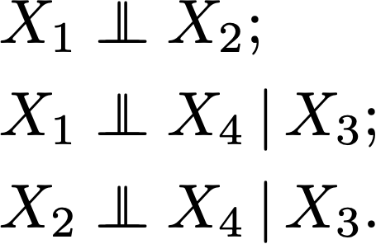
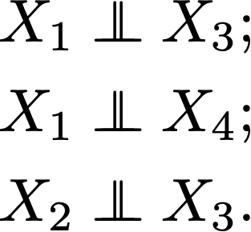
Dealing with Confounders?
Example I
X1
X2
Possible to have confounders behind X3 and X4?
X3
C
:-)
X4
E.g., X1: Raining; X3: wet ground; X4: slippery.
Example II
L
Are there confounders behind X2 and X4?
X1 → X2 X4←X3
E.g., X1: I am not sick; X2: I am in this lecture room; X4: you are in this lecture room; X3: you are not sick.
(See the FCI algorithm)

Slide 61
Partial Ancestral Graph
Each edge has two endpoints: e.g. X₄ o→ X₃ has a circle (“o”) at the X₄ end, and an arrowhead (“>”) at the X₃ end.
X₁ X₄ X₆
X₂ X₃ X₅
Tail (“-”) means “is an ancestor of” in all members of the equivalence class.
Head (“>”) means “is not an ancestor of” in all members of the equivalence class.
Circle (“o”) means “is an ancestor of in some but not all members of the equivalence class.
o
o
o
o

Slide 62
Causal Representation Learning
Notes:
Let me start with the independent noise condition for estimating linear, non-Gaussian causal networks without latent confounders. We say variable set Z and variable Y satisfy the independent noise condition if and only if the residual of regressing Y on Z is statistically independent from Z.
Let Z and Y be variables in a linear, non-Gaussian acyclic causal model (LiNGAM), in which there is no latent confounder. With the IN condition, we can determine the causal orders of the variables and then find the causal model without latent confounders.

Slide 63
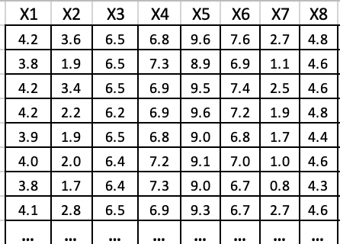
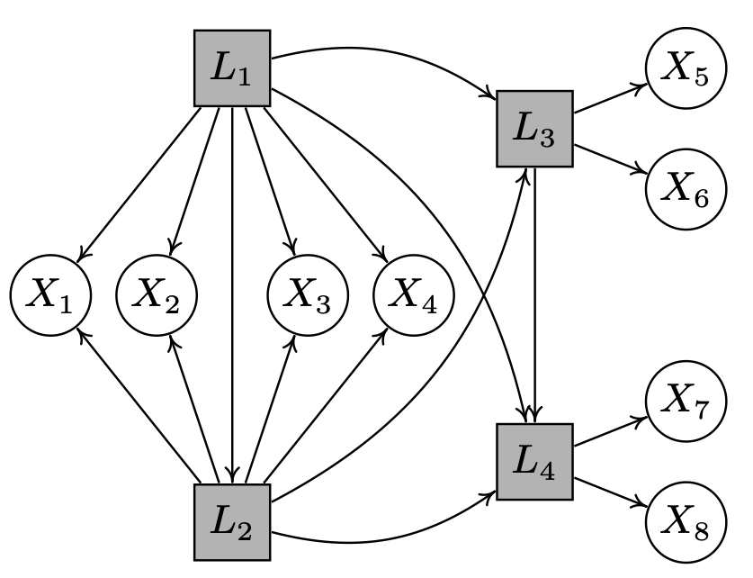

Hidden Causal Representation Learning: Starting Point
Measured variables (e.g., answer scores in psychometric questionnaires) were generated by causally related latent variables
Latent variables & their causal structure
Find latent variables Li and their causal relations from measured variables Xi ?
Silva, Glymour, Scheines, Spirtes, Learning the structure of latent linear structure models, JMLR, 2006.
Spirtes, Calculation of Entailed Rank Constraints in Partially Non-Linear and Cyclic Models, UAI 2013
Kummerfeld, Ramsey, Yang, Spirtes, Scheines, Causal Clustering for 2-Factor Measurement Models, ECML PKDD 2014.
Xie, Cai, Huang, Glymour, Hao, Zhang, "Generalized Independent Noise Condition for Estimating Linear Non-Gaussian Latent Variable Causal Graphs," NeurIPS 2020
Notes:
Let me start with the independent noise condition for estimating linear, non-Gaussian causal networks without latent confounders. We say variable set Z and variable Y satisfy the independent noise condition if and only if the residual of regressing Y on Z is statistically independent from Z.
Let Z and Y be variables in a linear, non-Gaussian acyclic causal model (LiNGAM), in which there is no latent confounder. With the IN condition, we can determine the causal orders of the variables and then find the causal model without latent confounders.

Slide 64
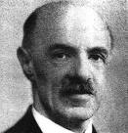
Spearman
L
a b c d
X₁ X₂ X₃ X₄
X₁ = a L + ε_{X1}
X₂ = b L + ε_{X2}
X₃ = c L + ε_{X3}
X₄ = d L + ε_{X4}
Spearman (1927) showed that a necessary condition for a single factor to (linearly) cause 4 measured variables is that the following three “tetrad differences” vanish:
r₁₂ * r₃₄ – r₁₃ * r₂₄ = a b c d – a c b d = 0
r₁₃ * r₂₄ – r₁₄ * r₂₃ = a c b d – a d b c = 0
r₁₂ * r₃₄ – r₁₄ * r₂₃ = a c b d – a d b c = 0
Alternative model:
X₁ X₂ X₃ X₄
Notes:
R12 is the correlation between x1 and x2

Slide 65
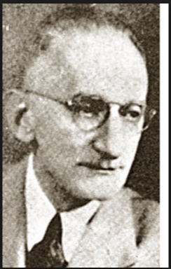
Thurstone(1935) – Factor Analysis
Identify a small number of factors (latent variables) that explain the correlation matrix among the observed.
F₁ F₂
L₁₁ L₁₄ L₂₅ L₂₈
X₁ X₂ X₃ X₄ X₅ X₆ X₇ X₈
X₁ = L₁₁ * F₁ + ε₁
The primary goal is to attain "scientific parsimony or economy of description” (Harman, 1960, p. 4).
Notes:
The primary goal is to attain "scientific parsimony or economy of description” (Harman, 1960, p. 4).
Definition of simple structure based on five principles (e.g. minimize negative loadings and maximize zero loadings) to facilitate interpretation and ensure that loadings were invariant to the inclusion of other items.
Problem of rotation
Problem of causation between measured variables

Slide 66
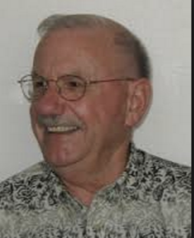
Herbert Costner
L M
X1 X2 X3 X4
?
ρ₁₃ρ₂₄ = ρ₁₄ρ₂₃

Slide 67
Further Linear Constraints
Pentad constraints – Kelley, 1935, Essential Traits of Mental Life
Tetrad Representation Theorem – general relationship between tetrad constraints and linear graphical models – Discovering Causal Structure, 1987

Slide 68
Why Should We Trust the Output of A Search Procedure? Current Status
✅
✅
✅
❓
✅
❓
❓
❌

Slide 69
Obstacles to Research
Need for experimental confirmation or known causal relations.
Ideally, would like to generate models and immediately experimentally test the causal conclusions – robotic experiments?
The applications that are of most interest to the domain are not necessarily the ones that are the best for the development of the field.
Benchmark data sets with gold standard answers and observational data desperately needed.
4/7/22

Slide 70
Obstacles to Research
Need for better simulations.
How sensitive are the results to the many parameters that go into generating graphs and distributions?
Notears example – when the order of the variance of the variables is the same as the causal order can identify DAG rather than the Markov equivalence class
Need for simulations that test the sensitivity of algorithms to deviations from the assumptions.
Need for more research on weakening assumptions rather than improving algorithms on current assumptions.
4/7/22

Slide 71
Obstacles to Use
Number of models
Inadequate sample size
Selection Bias
Measurement error
Missing data
Multiple Data Sets from different contexts
Aggregation of Values
Non-linearity
Non-stationarity
Causal interactions among units
Mixtures of distributions
Mixtures of structures
Violations of SUTVA
Non-causal relationships
Unmeasured Confounders
There have been significant advances in search on all of these problems. But not for when they all occur together, as they plausibly do in complex systems such as biology.

Slide 72
Obstacles to Use
There has been an explosion in the number of different algorithms, which make different assumptions. Which ones should be used in which circumstances? What should the search parameters be? How well do they perform on real data?

Slide 73
Obstacles to Use
For many algorithms, lack of uniform (as opposed to pointwise) consistency proofs under realistic assumptions.
Need for education about the principles behind causal search, and what causal search algorithms can and cannot do.
Need for user friendly software with guidance about how to use it

Slide 74
Bibliography
Bishop, Y, Fienberf, S, and Holland P. (1976) Discrete Multivariate Analysis, MIT Press, Cambridge Mass.
Blalock, H. (1961). Causal Inferences in Nonexperimental Research. University of North Carolina Press, Chapel Hill, NC.
Cooper, G.F., Herskovits, E. A Bayesian method for the induction of probabilistic networks from data. Mach Learn 9, 309–347 (1992)
Costner, H. (1971). Theory, deduction and rules of correspondence. Causal Models in the Social Sciences, Blalock, H. (ed.). Aldine, Chicago.
Fisher, R. A. (1936). "The Use of Multiple Measurements in Taxonomic Problems"(PDF). Annals of Eugenics. 7 (2): 179–188.

Slide 75
Bibliography
Glymour, C., Scheines, R., Spirtes, P., & Kelly, K. (1987). Discovering Causal Structure: Artificial Intelligence, Philosophy of Science, and Statistical Modeling. Academic Press.
Huang, Y., & Valtorta, M. (2006). Pearl’s Calculus of Intervention is Complete. Proceedings from Proceedings of the 22nd Annual Conference on Uncertainty in Artificial Intelligence, Arlington, VA.
Kelley, T. (1928). Crossroads in the Mind of Man. Stanford University Press, Stanford.
Kiiveri, H. and Speed, T. (1982). Structural analysis of multivariate data: A review.Sociological Methodology, Leinhardt, S. (ed.). Jossey-Bass, San Francisco.’
Lauritzen, S. L., & Richardson, T. S. (2002). Chain graph models and their causal interpretations. Journal of the Royal Statistical Society B.
Mason, Samuel J. (July 1956). "Feedback Theory - Further Properties of Signal Flow Graphs" (PDF). Proceedings of the IRE. 44 (7): 920–926.

Slide 76
Bibliography
Neyman, J. (1935) Statistical problems with agricultural experimentation. J. Roy. Stat. Soc. Suppl. 2, 107-180.
Pearl, J. (1988). Probabilistic Reasoning in Intelligent Systems. Morgan and Kaufman, San Mateo.
Pearl, J. (1995). Causal diagrams for empirical research. Biometrika, 82(4), 669-688.
Pearl, J. (2000. Causality: Models, Reasoning, and Inference. Cambridge University Press.
Richardson, T. S. (1996). A discovery algorithm for directed cyclic graphs. Proceedings from Twelfth Conference on Uncertainty in Artificial Intelligence, Portland, OR.
Rubin, D. (1974). Estimating causal effects of treatments in randomized and nonrandomized studies. Journal of Educational Psychology 66, 688-701.
Rubin, D. (1977). Assignment to treatment group on the basis of a covariate. Journal of Educational Statistics 2, 1-26.

Slide 77
Bibliography
Robins, J. (1986) A new approach to causal inference in mortality studies with a sustained exposure period—application to control of the healthy worker survivor effect, Mathematical Modelling VVolume 7, Issues 9–12, 1986, Pages 1393-1512.
Robins, J. M., Scheines, R., Spirtes, P., & Wasserman, L. (2003). Uniform consistency in causal inference. Biometrika, 90(3), 491-515.
Shpitser, I, and Pearl, J (2008) Complete Identification Methods for the Causal Hierarchy Journal of Machine Learning Research 9 1941-1979
Spirtes, P., & Glymour, C. (1991). An Algorithm for Fast Recovery of Sparse Causal Graphs. Social Science Computer Review, 9(1), 67-72.
Spirtes, P., Glymour, C., & Scheines, R. (1993). Causation, Prediction, and Search. Spring-Verlag Lectures in Statistics.
Spirtes, P. (1995). Directed cyclic graphical representations of feedback models. Proceedings from Eleventh Conference on Uncertainty in Artificial Intelligence, Montreal, Canada.
Spirtes, P., Glymour, C., & Scheines, R. (2001). Causation, Prediction, and Search, Second Edition (Adaptive Computation and Machine Learning). The MIT Press.

Slide 78
Bibliography
Simon, H. (1954).Spurious correlation: a causal interpretation. JASA. 49, 467-479.
Spearman, C. (1904). General intelligence objectively determined and measured. American Journal of Psychology 15, 201-293.
Sullivant, S., Talaska, K., & Draisma, J. (2010). Trek Separation for Gaussian Graphical Models. Ann Stat, 38(3), 1665-1685.
Thurstone, L. (1935). The Vectors of Mind. Univ. of Chicago Press, Chicago.
Wold, H., and Strotz, R. (1960) Recursive vs. Nonrecursive Systems: An Attempt at Synthesis (Part I of a Triptych on Causal Chain Systems). ECONOMETRICA: APR 1960, VOLUME 28, ISSUE 2
Wright, S. (1920). The relative importance of heredity and environment in determining the piebald pattern of guinea-pigs. Proceedings of the National Academy of Sciences, 6 , 320-332.
Wright, S. (1934). The method of path coefficients. Ann. Math. Stat. 5, 161-215.

