Slide 1
Lecture 6 Unmeasured Confounders, Selection Bias, Missing Values Peter Spirtes

Slide 2
Causal Sufficiency
A set of random variables V is causally sufficient if V contains every direct cause (with respect to V) of any pair of variables in V
V = {X,Y,Z}: causally sufficient
V = {X,Y}: causally insufficient
Methods exist in causally insufficient cases, e.g., FCI (Chapter 6 of the SGS book)
Z
X
Y
SGS Book, Chapter 5 (for causally sufficient structures); Chapter 6 (without causal sufficiency)
(P. Spirtes, C. Meek, and T. Richardson) “An Algorithm for Causal Inference in the Presence of Latent Variables and Selection Bias”, Computation, Causality, and Discovery, ed. by C. Glymour and G. Cooper, AAAI/MIT Press, 1999, pp. 211-252.
Notes:
Usually the results by constraint-based methods are not unique. The results are in the Markov equivalence class, which is represented by the pattern. In this example, the pattern is this one.
In special cases, the result may be unique. A typical example is the v structure. Suppose we find that Y and Z are independent but they are not independent conditional on X, this is the only possibility.

Slide 3
Unmeasured Confounders

Slide 4
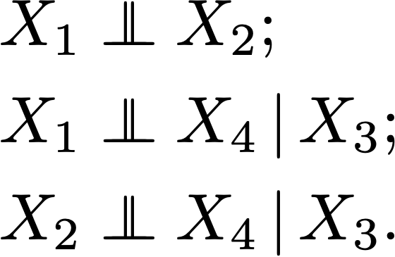
Dealing with Confounders
Example I
X1
X2
Possible to have confounders behind X3 and X4?
X3
X4
E.g., X1: Raining; X3: wet ground; X4: slippery.
X1
X2
X1
X2
o
o
X3
X3
No latent confounder – not true for every directed edges in output, but can tell when it is true
X4
X4
PC output FCI output

Slide 5
Dealing with Confounders
Example II
X1
X2
Possible to have confounders behind X3 and X4?
X3
C
X4
E.g., X1: Raining; X3: wet ground; X4: slippery.
X1
X2
X1
X2
o
o
X3
X3
o
X4
X4
PC output FCI output

Slide 6

I know There Is No Confounder: Example
In the 1970s, the Edison Electric Company in North Carolina was concerned about the effects on plant growth of acid rain produced by emissions from its electric generators.
The investigators chose samples from the Cape Fear estuary, where the Cape Fear River flows into the Atlantic Ocean.
obtained 45 samples of Spartina grass up and down the estuary, and measured 13 variables in the samples, including concentrations of various minerals, acidity (pH), salinity, and the outcome variable, the biomass of each sample
The PC algorithm found that among the measured variables the only direct cause of biomass was pH.
Y-structure: no confounder!
Later verified by intervention-based analysis
Notes:
In the 1970s, the Edison Electric Company in North Carolina was concerned about the effects on plant growth of acid rain produced by emissions from its electric generators. The company arranged with a biologist and a statistician to investigate whether acidity of waters was affecting plant growth in the region. The investigators chose samples from the Cape Fear estuary, where the Cape Fear River flows into the Atlantic Ocean.
If salinity was controlled for statistically, pH still influenced biomass, but if pH was controlled statistically, variations in salinity did not produce variations in biomass.
But should the results of the search algorithm be trusted to have found the right answers even about Spartina growth in Cape Fear estuary, given such a small sample? Fortunately, we know the answer. A graduate student in biology did the experiment and reported the result in his doctoral thesis. He obtained new samples of Spartina grass and grew them in a green house, varying acidity and the concentration of salt by a standard randomized design, keeping other factors constant.

Slide 7
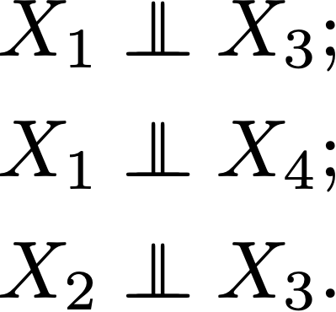
Dealing with Confounders
Example III
Are there confounders behind X2 and X4?
L
X1 → X2 X4←X3
E.g., X1: I am not sick; X2: I am in this lecture room; X4: you are in this lecture room; X3: you are not sick.
No DAG withhout latent confounders has this set of d-separations.
X1
X2
X4
X3
X1
X2
X4
X3
PC output FCI output

Slide 8
Motivation
X Y
Z W
L
DAG G
If L is measured, what is a good DAG selection method?
If L is not measured, why are these not good DAG selection methods?

Slide 9
Motivation
X Y
Z W
L
X Y
Z W
X Y
Z W
In the limit, these two would get the highest BIC score.
The marginal distribution is not faithful to either of them.

Slide 10
Motivation
X Y
Z W
L
X Y
Z W
X Y
Z W
They are not Markov equivalent.
They both make incorrect qualitative predictions about manipulations.
They both make incorrect quantitative predictions about manipulations.

Slide 11
Score-Based Search Over Latent Models
Structural EM interleaves estimation of parameters with structural search
Can also search over latent variable models by calculating posteriors
But there are substantial computational and statistical problems with latent variable models

Slide 12
Alternative Selection Methods
X Y
Z W
L
X Y
Z W
X Y
Z W
Include latent variables explicitly?

Slide 13
DAG Models w/o Latent Variables
Facilitates construction of causal models
Provides a finite search space
‘Nice’ statistical properties:
Always identified
Correspond to a set of distributions characterized by independence relations
Have a well-defined dimension
Asymptotic existence of ML estimates

Slide 14
DAG Models with Latent Variables
Facilitates construction of causal models
Provides a finite search space
‘Nice’ statistical properties:
Always identified
Correspond to a set of distributions characterized by independence relations
Have a well-defined dimension
Asymptotic existence of ML estimates

Slide 15
Solution
Embed each latent variable model in a ‘larger’ model without latent variables that is easier to characterize.
Latent variable
model
Model imposing
only independence
constraints
on observed variables
Sets of distributions

Slide 16
Marginalization
X Y
Z W
X Y
Z W
L
X {Y,W}
Y {Z,X}
Z W | L
{X,Y} L
Graph
Marginalize Graph
Marginalize Independence Model
X {Y,W}
Y {Z,X}
Z W | L
{X,Y} L
Independence Model

Slide 17
Marginalization of DAGs
If X is an ancestral set included in V, and P(V) satisfies the local directed Markov condition for G, then P(X) satisfies the local Markov condition for G_{X}.
This is not true of an arbitrary set X.

Slide 18
Marginalizing
If DAG G represents a set T of conditional independence relations among V, and X ⊆ V, then there is not always a DAG G’ containing just the vertices in X such that G’ represents the subset of T containing variables in X.

Slide 19
Directed Acyclic Graphs
T X₁ X₃
X₂
X₁ X₂ X₃ X₄
X₄
G₁ G₂
T

Slide 20
Independence Model
T
X₁ X₂ X₃ X₄
Each vertex is independent of its non-descendants given its parents.
I(G₁)
<{X₁},{X₂,X₃, X₄ }|{T}> <{X₃},{X₁,X₂, X₄}|{T}> <{X₂},{X₁,X₂, X₃ }|{T}> <{X₄},{X₁,X₂, X₃}|{T}>

Slide 21
Probability Model
T
X₁ X₂ X₃ X₄
X₁ = a ∙ T + ε₁ X₃ = c ∙ T + ε₃
X₂ = b ∙ T + ε₂ X₄ = d ∙ T + ε₄
T = ε_{T}
<a,b,c,d,var(ε_{T}),var(ε₁),var(ε₂),var(ε₃),var(ε₄)>
N(G₁)

Slide 22
Probability Model
cov(X₁,X₂) * cov(X₃,X₄) =
cov(X₁,X₃) * cov(X₂,X₄) =
cov(X₁,X₄) * cov(X₂,X₃)
T
X₁ X₂ X₃ X₄
Fix means of all error terms at 0
X₁ = 3 ∙ T + ε₁ X₃ = 4 ∙ T + ε₃
X₂ = -2 ∙ T + ε₂ X₄ = 8 ∙ T + ε₄
variances of all error terms = 1 T = ε_{T}

Slide 23
Manipulation Model
T
X₁ X₂ X₃ X₄
X₁ = 3 ∙ T + ε₁ X₃ = 4 ∙ T + ε₃
X₂ = -2 ∙ T + ε₂ X₄ = 8 ∙ T + ε₄
T = ε_{T}

Slide 24
Manipulation Model
T
Mean(X₂) = 0
X₁ X₂ X₃ X₄
X₁ = 3 X₃ = 4 ∙ T + ε₃
X₂ = -2 ∙ T + ε₂ X₄ = 8 ∙ T + ε₄
T = ε_{T}

Slide 25
Manipulation Model
T cov(X₁,X₂) * cov(X₃,X₄) =
cov(X₁,X₃) * cov(X₂,X₄) =
cov(X₁,X₄) * cov(X₂,X₃)
X₁ X₂ X₃ X₄
X₁ = ε₁ X₃ = 4 ∙ T + ε₃
X₂ = -2 ∙ T + ε₂ X₄ = 8 ∙ T + ε₄
T = .3 ∙ X₁ + ε_{T} var(ε_{T} ) = .1 var(ε₁ ) = 10

Slide 26
Manipulation Model
T
Mean(X₂) ≠ 0
X₁ X₂ X₃ X₄
X₁ = 3 X₃ = 4 ∙ T + ε₃
X₂ = -2 ∙ T + ε₂ X₄ = 8 ∙ T + ε₄
T = .3 ∙ X₁ + ε_{T} var(ε_{T} ) = .1 var(ε₁ ) = 10

Slide 27
Marginalization – Independence Model
T
X₁ X₂ X₃ X₄
Each vertex is independent of its non-descendants given its parents.
I(G₁)
<{X₁},{X₂,X₃, X₄ }|{T}> <{X₃},{X₁,X₂, X₄}|{T}> <{X₂},{X₁,X₂, X₃ }|{T}> <{X₄},{X₁,X₂, X₃}|{T}>
[_{L}

Slide 28
Independence Model - Marginalization
<{X₁},{X₃}|∅>
<{X₄},{X₁}|{T,X₂}>
<{X₄},{X₃}|{X₁,X₂}>
G₂
X₁ X₃
X₂
X₄
T

Slide 29
Maximal Ancestral Graph Models (Richardson and Spirtes)
G[_{L} represents a subset of the graphs in I-Equivalence(G)[_{L} that share certain ancestor relations
G[_{L} represents does not represent the set of marginal Gaussian distributions of DAGs that are Markov to G (because there are non-conditional independence constaints imposed on the marginals of latent Gaussian models)
The parameterization of G[_{L} is simply that of a particular kind of structural equation model
Every parameter is identifiable
Maximal ancestral graphs are closed under marginalization.

Slide 30
Mixed Ancestral Models
Can score and evaluate in the usual ways
Not every parameter is directly interpreted as a structural coefficient
Not every part of marginal manipulated model can be predicted from mixed ancestral graph
Mixed ancestral models are closed under marginalization and conditionalizataion

Slide 31
Graphical Models – Marginalization
T X₁ X₃
X₂
X₁ X₂ X₃ X₄
X₄
G₁[_{L}
T₂

Slide 32
Mixed Ancestral Graph of DAG
There is an edge between A and B if and only if for every <{A},{B}|C>, there is a latent variable in C.
If A and B are adjacent, then A → B if and only if A is an ancestor of B.
If A and B are adjacent, then A ↔ B if and only if A is not an ancestor of B and B is not an ancestor of A.

Slide 33
m-connection
A path between vertices α and β in an ancestral graph G is said to be m-connecting given a set Z (possibly empty), with α,β ∉ Z, if:
(i) every noncollider on the path is not in Z, and
(ii) every collider on the path is in ant_{G}(Z).

Slide 34
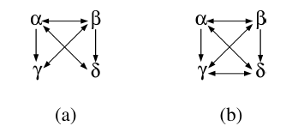
Maximal mixed ancestral graph
an ancestral graph G is said to be maximal if for every pair of vertices α, β if α and β are not adjacent in G then there is a set Z (α,β ∉ Z), such that <{α}, {β} | Z> ∈ Im(G).

Slide 35
Mixed Ancestral Graph

Slide 36
Multiple DAGs Have Same Marginal Graph
T
X Y
G1 MAG
X Y
G2
Parameter is identifiable, but tells only about the probabilitydistribution, not the size of the effect
X Y
Alternative Represenations?

Slide 37
Acyclic Directed Marginal Model
T
X Y
G1 MAG
X Y ADMG
G2
X Y
More informative, but not identifiable from data
X Y

Slide 38
Manipulation model only partially determined for MAGs
T
X Y
G1 MAG
X Y
G2
X Y
Not all of the parameters have a causal interpretation

Slide 39
Manipulation Model for MAGs
A MAG can be used to calculate the results of manipulations for which every DAG represented by the MAG gives the same answer.
What are two different DAGs with the shown marginal that predict different total effects of A on D?
When C is manipulated all of the DAGs represented by the MAG predict the same effects on A, B, and D. How do we know this? Why doesn’t the alternative where there is a common cause of C and D matter? How do we know there is not a latent common cause of C and D?
A B
C
D

Slide 40
Equivalent Mixed Ancestral Graphs
X₁ X₂
X₃
X₄
X₁ X₂
X₃
X₄
X₁ X₂
X₃
X₄
X₁ X₂
X₃
X₄
X₁ X₂
X₃
X₄
X₁ X₃
X₂
X₄
o
o
o
o
o
o
o
o
o
PAG
o
o
o

Slide 41
Partial Ancestral Graph represents Markov-Equivalent DAG Models
A is adjacent to B iff A and B are not d-separated conditional on any subset of the observed variable in any DAG in the Markov-equivalence class.
A → B iff A is an ancestor of B in every DAG in the Markov-equivalence class.
A ↔ B iff A and B are not ancestors of each other in every DAG in the Markov-equivalence class.
A o→ B iff B is not an ancestor of A in every DAG in the Markov-equivalence class.
A o⎯o B places no restriction on ancestor relations

Slide 42
College Plans
Sewell and Shah (1968) studied five variables from a sample of 10,318 Wisconsin high school seniors.
SEX [male = 0, female = 1]
IQ = Intelligence Quotient, [lowest = 0, highest = 3]
CP = college plans [yes = 0, no = 1]
PE = parental encouragement [low = 0, high = 1]
SES = socioeconomic status [lowest = 0, highest = 3]

Slide 43
Mixed Ancestral Graph
Mixed ancestral models are closed under marginalization.
In the linear normal case, the parameterization of a MAG is just a special case of the parameterization of a linear structural equation model.
There is a maximum liklihood estimator of the parameters (Drton).
The BIC score is easy to calculate.

Slide 44
Some Markov Equivalent Mixed Ancestral Graphs
SEX PE CP
IQ
SEX PE CP
IQ
SEX PE CP
IQ
SEX PE CP
IQ
These different MAGs all have the same d-separation relations.

Slide 45
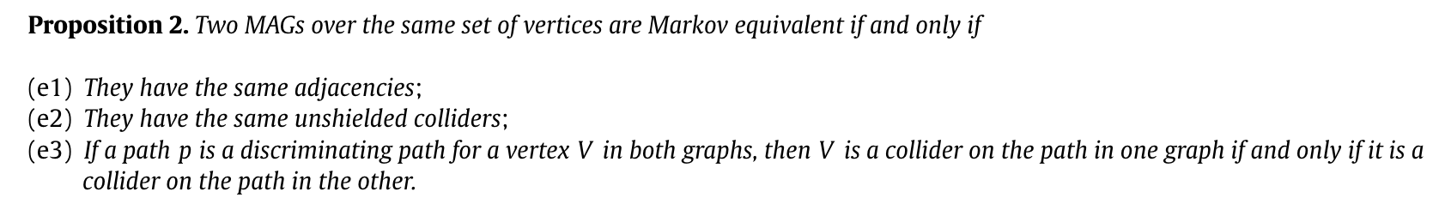
Markov Equivalence of MAGs

Slide 46
Partial Ancestral Graphs
X₁ X₃
X₂
X₄
X₁ X₃
X₂
X₄
X₁ X₃
X₂
X₄
X₁ X₃
X₂
X₄
X₁ X₃
X₂
X₄
o
o
PAG(G₂)

Slide 47
Partial Ancestral Graph
Partial Ancestral Graph represents
Ancestor features common to I-equivalence(G)[_{L}
Marginal independence model
Can be parameterized by turning it into a mixed ancestral graph
Can be scored and evaulated in usual ways

Slide 48
Partial Ancestral Graphs
SEX PE CP
IQ
SEX PE CP
IQ
SEX PE CP
IQ
o
o
o
o
SEX PE CP
IQ
SEX PE CP
IQ
o
o
Partial Ancestral Graph

Slide 49
Partial Ancestral Graph represents I-Equivalent DAG Models
A is adjacent to B iff A and B are not d-separated conditional on any subset of the observed variable in any DAG in the I-equivalence class.
A → B iff A is an ancestor of B in every DAG in the I-equivalence class.
A ↔ B iff A and B are not ancestors of each other in every DAG in the I-equivalence class.
A o→ B iff B is not an ancestor of A in every DAG in the I-equivalence class.
A o⎯o B places no restriction on ancestor relations

Slide 50
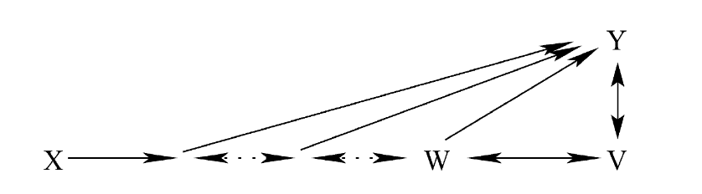
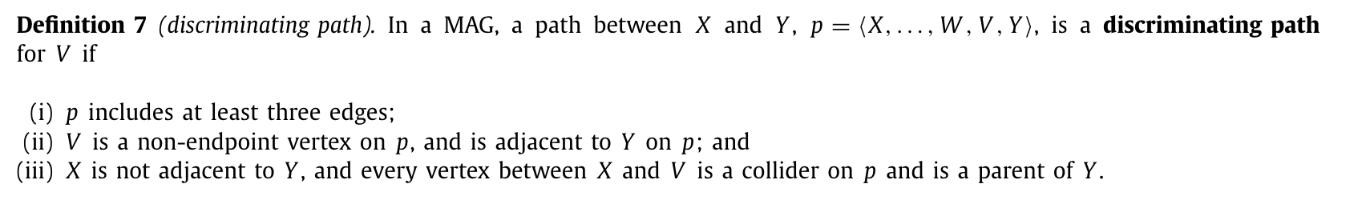
Non-local Orientation Rules

Slide 51
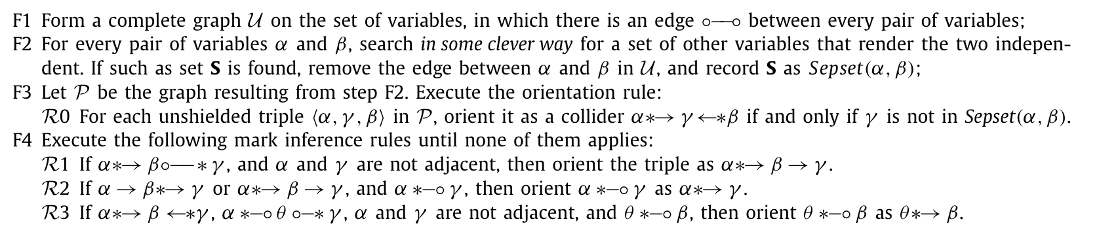
FCI

Slide 52

FCI Algorithm
In the large sample limit, with probability 1, the output is a PAG that represents the true graph over O
If the algorithm needs to test high order conditional independence relations then
Time consuming - worst case number of conditional independence tests (complete PAG)
Unreliable (low power of tests)
Modified versions can halt at any given order of conditional independence test, at the cost of more “Can’t tell” answers.
Not useful information when each pair of variables have common hidden cause.
There is a provably correct score-based search, but it outputs “can’t tell” in most cases

Slide 53
Properties of FCI
FCI provides asymptotically correct results even if there are latent confounders and selection bias and missing values (Spirtes et al., 1993)
Output is an (infinite) Markov equivlence class of DAGs that may contain latent variables – less informative than PC.
Relies on causal Markov condition + faithfulness assumption
Removal of adjacencies and orientations are no longer completely local – slower than PC.

Slide 54
Output for College Plans
SES
SEX PE CP
IQ
SES
SEX PE CP
IQ
o
o
o
o
o
o
Output of FCI Algorithm PAG Corresponding to Output of PC Algorithm
These are different because no DAG can represent the d-separations in the output of the FCI algorithm.

Slide 55
Manipulation Model for PAGs
Same strategies as for Patterns
Complete Calculation of Effects of Identifiable Manipulations
Causal Identification under Markov Equivalence: Completeness Results, Amin Jaber, Jiji Zhang, Elias Bareinboim, Proceedings of the 36th International Conference on Machine Learning, PMLR 97:2981-2989, 2019.

Slide 56
Manipulation Model for PAGs
Same strategies as for Patterns
Complete calculation of effects of identifiable manipulations when possible
Causal Identification under Markov Equivalence: Completeness Results, Amin Jaber, Jiji Zhang, Elias Bareinboim, Proceedings of the 36th International Conference on Machine Learning, PMLR 97:2981-2989, 2019.
Latent variable IDA
Malinsky D, Spirtes P. Estimating Causal Effects with Ancestral Graph Markov Models. JMLR Workshop Conf Proc. 2016 Aug;52:299-309.

Slide 57
Good News – Bad News
In the large sample limit, there is an algorithm (FCI) whose output is arbitrarily close to correct (or output “can’t tell”) with probability 1 (pointwise consistency).
At every finite sample size, every method will be arbitrarily far from truth with high probability for some values of the truth (no uniform consistency.)

Slide 58
Other Constraints
The disadvantage of using MAGs or FCI is they only use conditional independence information
In the case of latent variable models, there are constraints implied on the observed margin that are not conditional independence relations, regardless of the family of distributions
Even if the joint distribution is Gaussian.
These can be used to choose between two different latent variable models that have the same d-separation relations over the observed variables
In addition, there are constraints implied on the observed margin that are particular to a family of distributions

Slide 59
Selection Bias

Slide 60
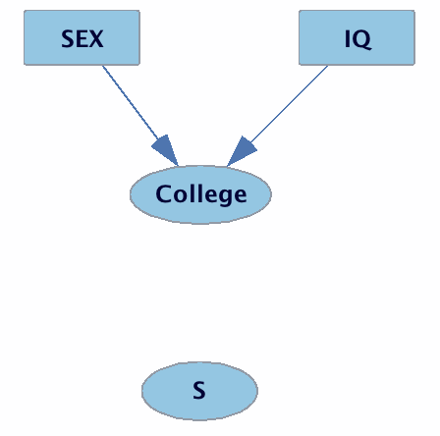
Selection – Always Condition on Membership in Sample (S=1)
Selection P(Sex, IQ|S = 1)
Sex IQ|S
FCI Output: Sex IQ

Slide 61
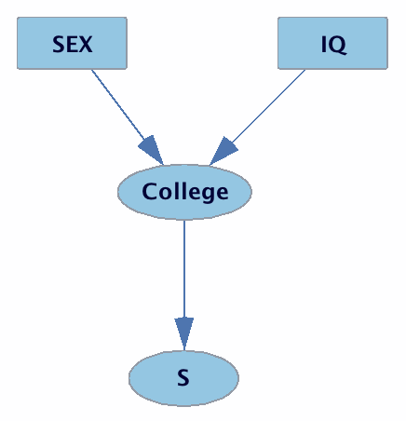
Selection Bias
Selection P(Sex, IQ, College|S = 1)
Sex IQ|S
FCI Output: Sex o-o IQ
Either Sex causes IQ, IQ causes Sex, there is a latent confounder of Sex and IQ or there is selection bias between SEX and IQ

Slide 62
Conditioning
X1
S1 S4
X2 X4
S2 S3
X3
S = {S1,S2,S3,S4}

Slide 63
Conditioning
What conditional independencies hold?
X1 is independent of X3 conditional on {X2, X4, S}
X2 is independent of X4 conditional on {X1, X3, S}

Slide 64
Conditioning
X1
X2 X4
X3
X1 is independent of X3 conditional on {X2, X4}
X2 is independent of X4 conditional on {X1, X3}

Slide 65
Reinterpret Partial Ancestral Graph for Selection Bias
A is adjacent to B iff A and B are not d-separated conditional on any subset of the observed variable in any DAG in the I-equivalence class.
A → B iff A is an ancestor of B or of a selection variable in every DAG in the I-equivalence class.
A ↔ B iff A and B are not ancestors of each other or of a selection variable in every DAG in the I-equivalence class.
A o→ B iff B is not an ancestor of A or of a selection variable in every DAG in the I-equivalence class.
A o⎯o B places no restriction on ancestor relations
A – B iff A and B are both ancestors of a selection variable.

Slide 66
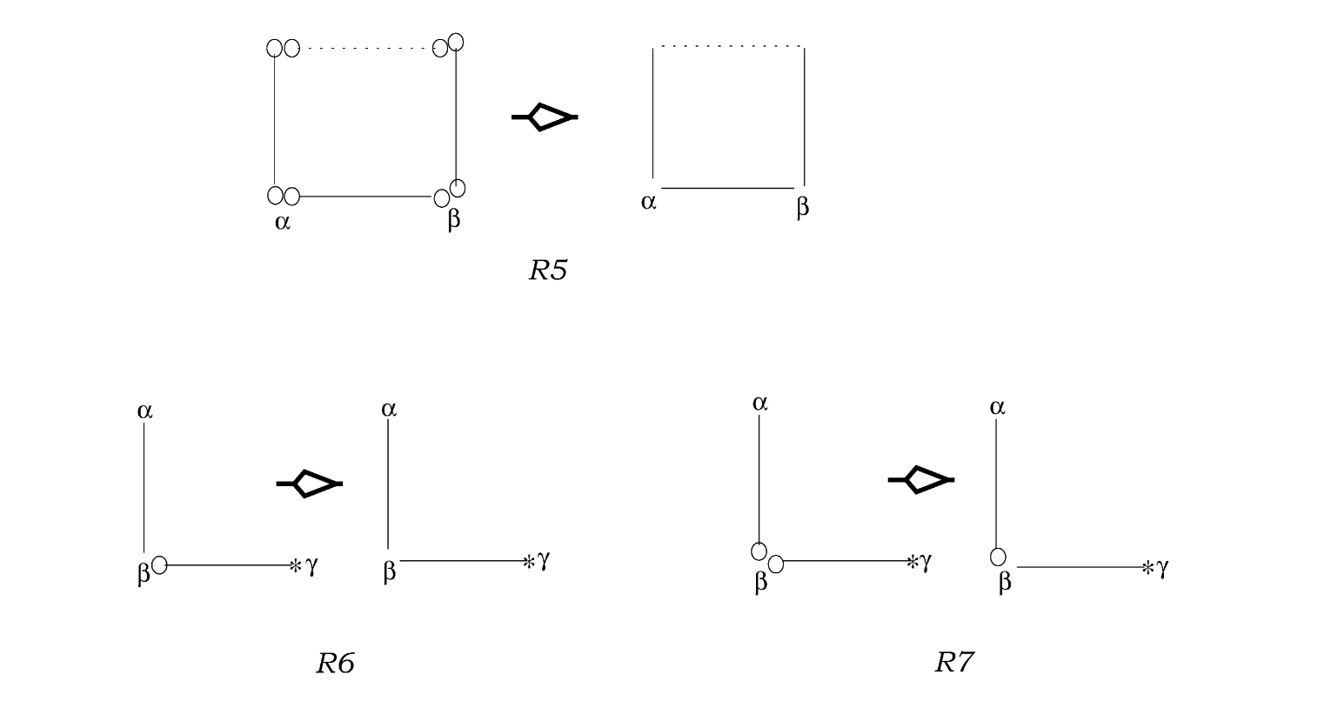
Extra Orientation Rules

Slide 67
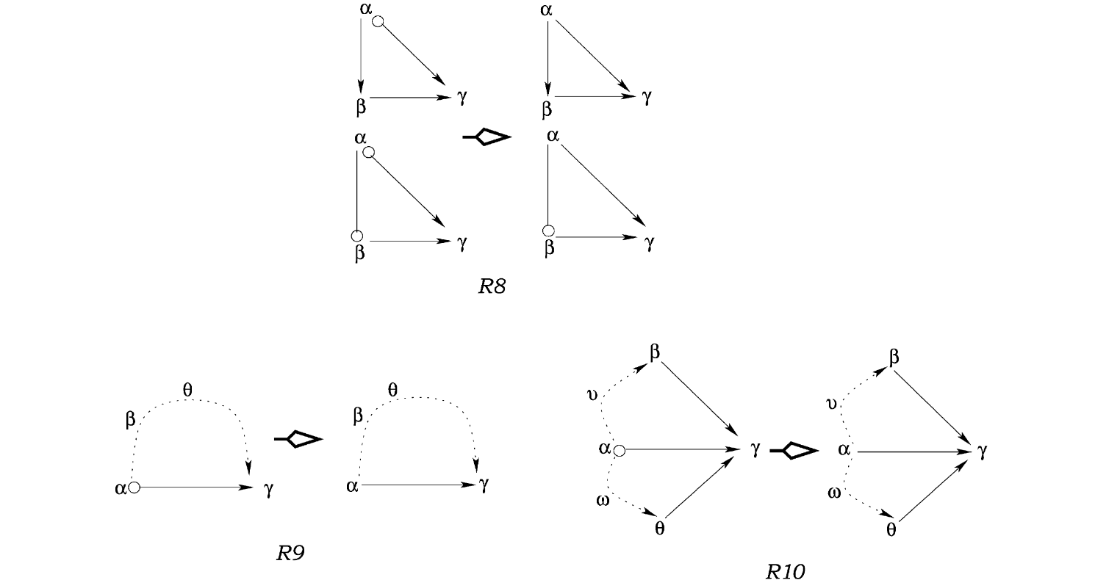
Extra Orientation Rules

Slide 68
Other extensions
Can speed up FCI at cost of informativeness by limiting size of conditioning sets.
Can deal with missing values by performing tests only on subset of units that have no missing values.
Can deal with missing values by performing tests on units that have all values for variables in conditional independence test under mild restrictions on structure.

